Slide 1
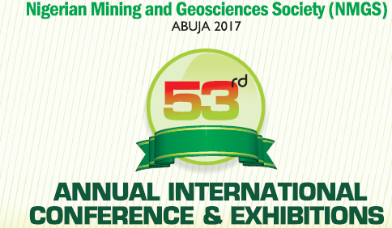


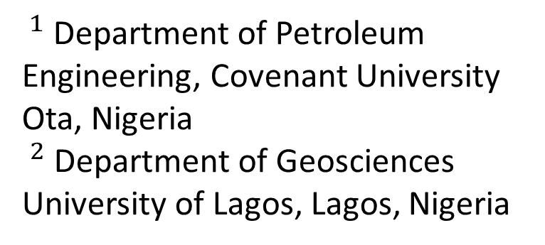
2-D Electrical Resistivity Tomography and Seasonal Variation Assessment of Groundwater around the Olushosun Dumpsite, South-West, Nigeria
Ameloko A. $A^{1}$ and Ayolabi E. $A^{2}$
$^{1}$ Department of Petroleum Engineering, Covenant University Ota, Nigeria
$^{2}$ Department of Geosciences
University of Lagos, Lagos, Nigeria

Slide 2
Presentation Outline
Introduction
  Background to the study
  Aim and Objectives of the study
  Literature review
  Geology of the study Area
Materials and method
Results and Discussion
Conclusions
References

Slide 3
1.0 Background to the study
Dumping are the most used methods of municipal solid waste disposal in Nigeria.
Nigeria generates an average of 0.58 kg solid waste per person daily (Adewumi et al., 2005). With a population of over 170 million people, this huge figure if unabated would lead to serious environmental problems.
Landfill report on LAWMA website (www.lawma.gov.ng) indicates that in the month of February 2012 alone, about 79,946.98 metric tons of waste was deposited on Olushosun dumpsite.

Slide 4
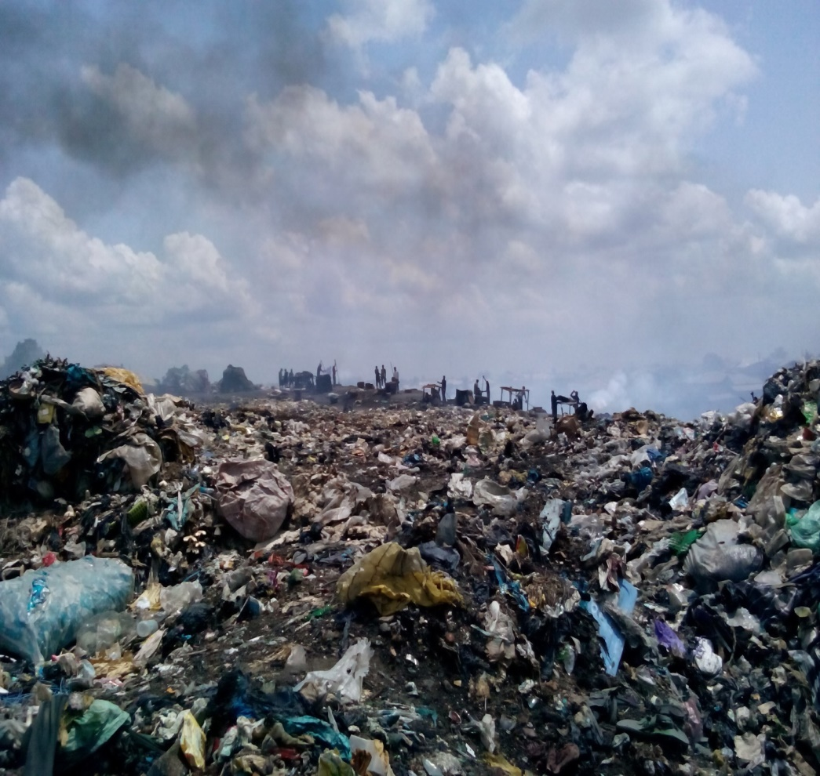
1.0 Background to the study cont’d
Fig 1.0: Pictorial view of the Olushosun dumpsite

Slide 5
1.1 Aim and objectives of the study
The aim of the this research work is to assess the impact of leachates from the dumpsite on the soil and groundwater around the study area.
The specific objectives are to:
investigate the vertical extent of contaminants migration around the dumpsite
analyze the physical properties of water samples from existing hand dug wells and boreholes near the sites.
Examine time-lapse effect of contaminants migration on the subsurface environment from VES data

Slide 6
2.0 Literature review
Most previous time-lapse ERT studies have been aimed at understanding subsurface solute transport by using time-varying electrical responses related to known injections of saline tracers into aquifers or known injections of water into the vadose zone (e.g., Slater et al., 2000; Singha and Gorelick, 2005; Slater and Binley, 2006; Müller et al., 2010; Wilkinson et al., 2010b).
A few studies have taken advantage of pre-existing electrical contrasts between the properties of subsurface fluids, such as those related to movements of contaminant plumes or those related to salt water - fresh water contacts within coastal aquifers (e.g., Acworth and Dasey, 2003; de Franco et al., 2009; Maurer et al., 2009; Ogilvy et al., 2009).

Slide 7
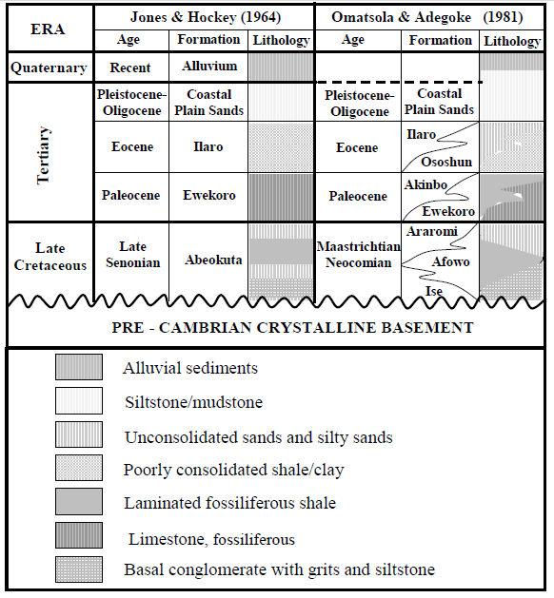
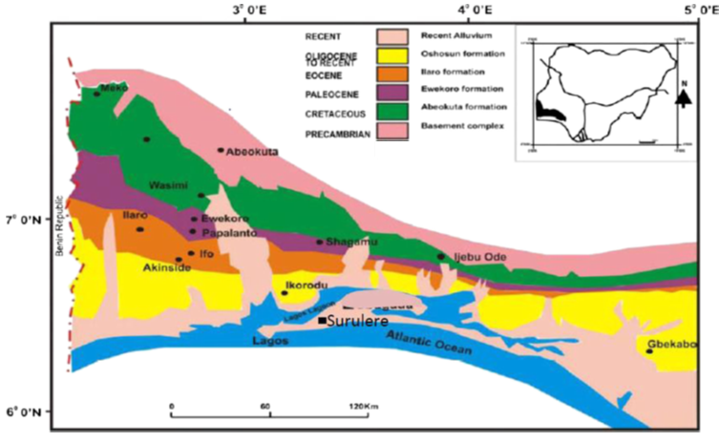
2.1 Geology of the study area
Table 1.0: Stratigraphy of eastern Dahomey basin
Figure 2.0: Geological map of eastern Dahomey Basin (modified after Billman 1992)

Slide 8
3.0 Materials and Method
3.1 Data acquisition
3.1.1 2D resistivity survey
The ERT surveys were carried out with the aid of a digital readout Super Sting R8 Earth Resistivity/IP metre. It is a multi-electrode system that uses 84 electrodes.
The 2D resistivity data were collected along all the traverses using Dipole-Dipole and Pole-Dipole arrays with spacing of electrodes dependent on the level of accessibility on and around the sites
Available time-lapse VES data obtained on the site in 2001, 2002 and 2006 were obtained and analyzed

Slide 9
3.0 Materials and methods cont’d
3.1.2 Water sample analysis
Assessment of physical properties of water
A portable EC/TDS meter was used insitu for this analysis
Borehole and hand dug well water samples within and around the selected dumpsites were analyzed for the content of their total dissolved solid (TDS), pH values, temperature and electrical conductivity (EC)
Measured parameters were later compared with the World Health Organization (WHO, 2004) and Standard Organization of Nigeria (SON, 2007) standards

Slide 10
3.0 Materials and methods cont’d
3.2 Data processing
3.2.1 2d resistivity data
The 2D resistivity data were processed and inverted using the EarthImager inversion software.
interpretation of the VES data was done using curve matching technique to generate the initial resistivity and depth models. These served as input data for computer iteration using WINRESIST software.
3.2.3 Physicochemical data
Data obtained were also plotted as histograms on the Microsoft excel software and compared with WHO and SON standard

Slide 11
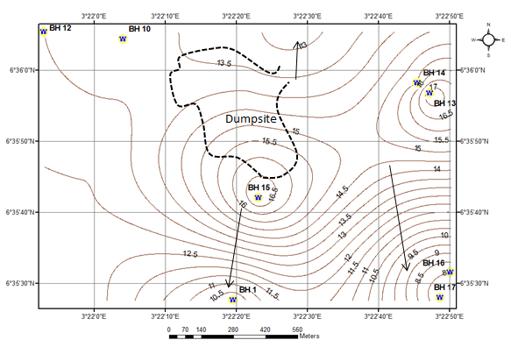
3.0 Materials and methods cont’d
Figure 3.0: Contour Map of Olushosun dumpsite showing Groundwater flow direction

Slide 12
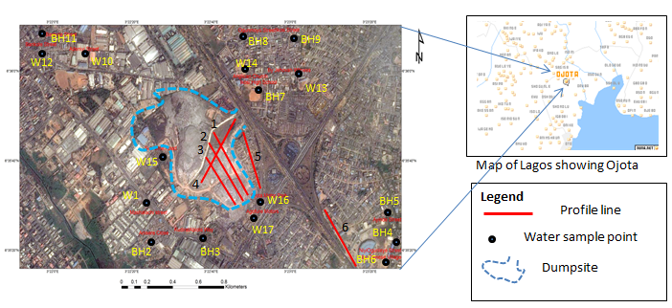
3.0 Materials and methods cont’d
Figure 3.1: Satellite image of Olushosun dumpsite and surrounding areas showing ERT lines and water sampling points

Slide 13
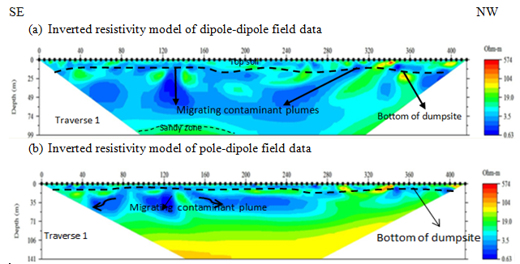
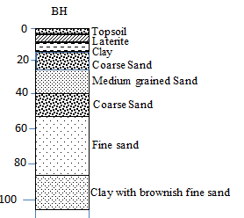
4.0 Results and discussion
Figure 4.0: 2D resistivity inversion models on Olushosun Landfill (Traverses 1)

Slide 14
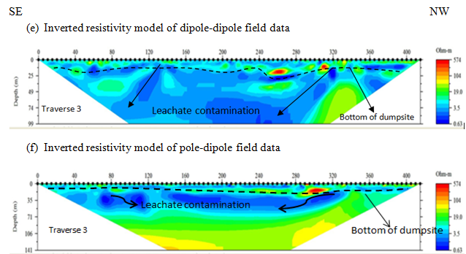
4.0 Results and discussion cont’d
Figure 4.1: 2D resistivity inversion models on Olushosun Landfill (Traverse 3)

Slide 15
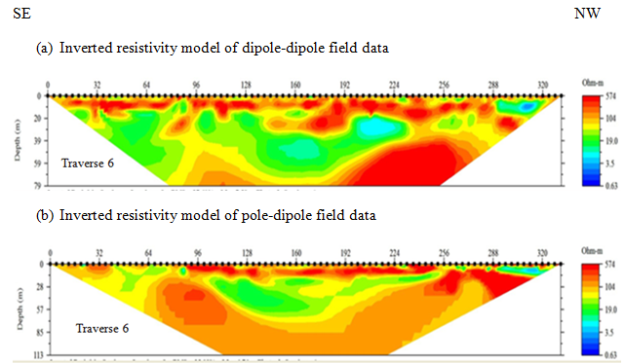
4.0 Results and discussion cont’d
Figure 4.2: Surface 2D resistivity for Olushosun Landfill (Control Traverse)

Slide 16
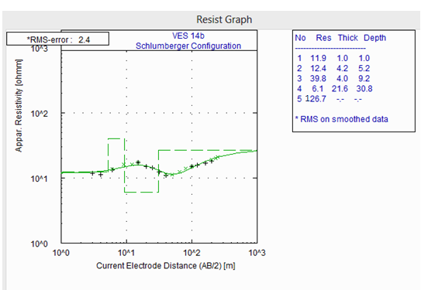
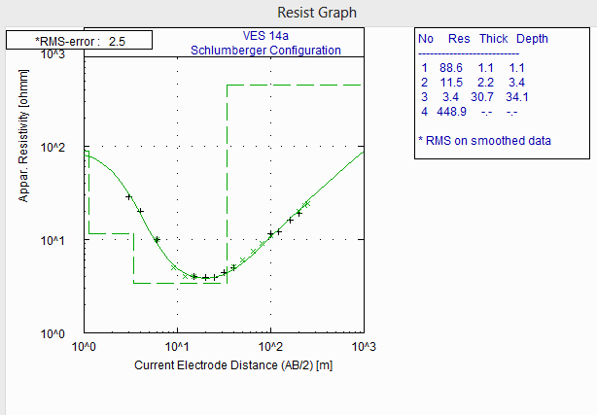
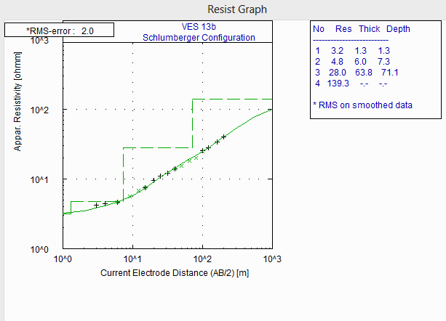
4.0 Results and discussion cont’d
Figure 4.3: VES sounding curves obtained along traverse 1 on the dumpsite in 2001, 2002 and 2006

Slide 17
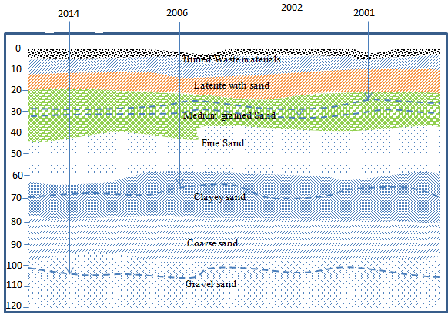
4.0 Results and discussion cont’d
Figure 4.4: Geologic section along traverse 1 showing increase in the depth of migration of leachate with time

Slide 18
4.0 Results and discussion Cont’d
Table 4.1: Seasonal Paired Samples Statistics of groundwater hydrophysical parameters around Olushosun landfill

Slide 19
4.0 Results and discussion Cont’d
Table 4.1: Seasonal Paired Samples Statistics of groundwater hydrophysical parameters around Olushosun landfill Cont’d

Slide 20
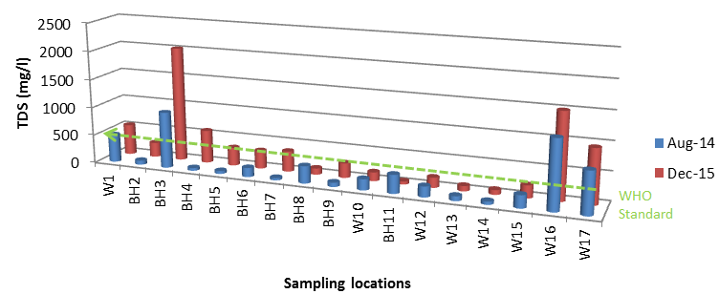
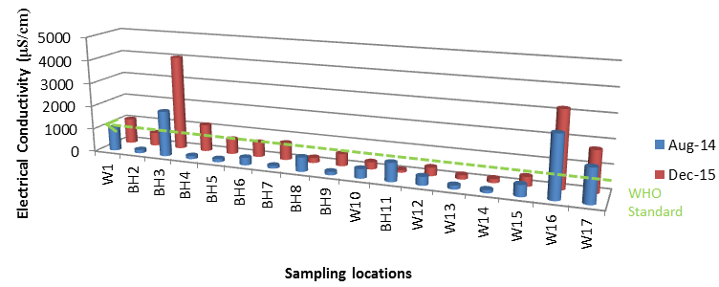
4.0 Results and discussion Cont’d
Figure 4.5: Seasonal variations in TDS and EC concentration of water sample versus WHO standard around the Olushosun dumpsite

Slide 21
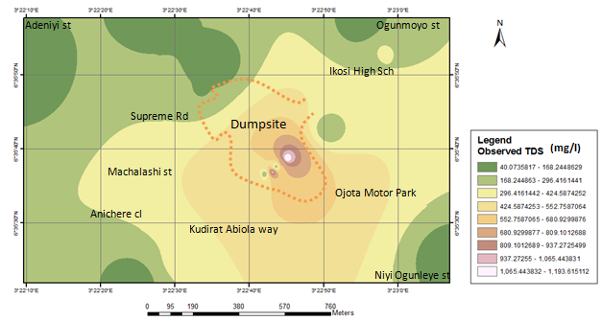
4.0 Results and discussion Cont’d
Figure 4.6: Spatial distribution of total dissolved solid within the study area

Slide 22
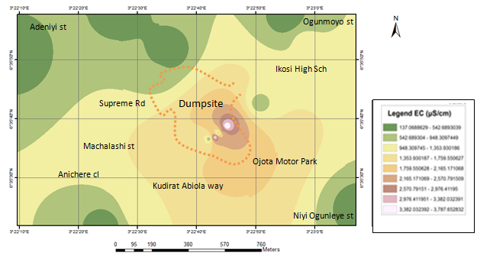
4.0 Results and discussion Cont’d
Figure 4.7: Spatial distribution of Electrical conductivity within the study area

Slide 23
5.0 Conclusion
The results of the 2D resistivity study was able to revealed the depth of 106m of contamination around the Olushosun dumpsite.
The time-lapse geophysical survey and physical property analysis of groundwater was crucial in establishing temporal variation in groundwater quality, and the progressive lateral and vertical spread of contaminants around the selected dumpsites with time .

Slide 24
5.0 Conclusion
This information will facilitate decisions on improving protection of water resources and decreasing the impact of the pollutants on the subsurface environment.

Slide 25
References
Abu-Zeid, N., G. Bianchini, G., Santarato, and C. Vaccaro, 2004. Geochemical characterisation and geophysical mapping of landfill leachates: The Marozzo Canal case study NE Italy: Environmental Geology, 45, 439–447.
Ademola, J. A., 2008. Exposure to high background radiation level in the tin minning area of Jos Plateau, Nigeria. J. Radiol. Prot, 28: 93-99.
AGI, 2003. Earth Imager 2D Resistivity Inversion Software, version1.5.10. Advanced Geosciences, Inc. Austin, TX
Adeoti, L.., Oladele, S., Ogunlana, F. O., 2011. Geo-electrical investigation of leachate impact on groundwater: A case study of Ile-Epo Dumpsite, Lagos, Nigeria, Journal of Applied Sciences and Environmental Management, 15(2), pp 361-364.
Adewumi I. K, Ogedengbe M. O., Adepetu JA, Fabiyi Y. L 2005. Planning organic fertilizer industries for municipal solid wastes management. J Appl Sci Res 1(3):285–291
Akinloye, M. K. and Olomo J. B., 2005. The radioactivity in some grasses in the environment of nuclear research facilities located within the OAU, Ile-Ife, Nigeria. Nig. J. Phys., 17S: 219-225.
Akoteyon I. S., Mbata U. A., Olalude G. A., 2011. Investigation of Heavy Metal Contamination in Groundwater around Land-fill Site in a Typical Sub-Urban Settlement in Alimosho, Lagos State. “J. App. Sci. in Environ. Sanitation 6(2) 155-163.

Slide 26
References cont’d
Aldecy de Almeida, S., and Shozo, S., 2008. valuation on surface water quality of the influence area of the sanitary landfill. Engenharia Ambiental : Pesquisa e Tecnologia 5(2): 139-151.
Ayolabi, E. A., 2005. Geoelectric evaluation of Olushosun landfill site, southwest Nigeria and its implications on groundwater. J Geol Soc India 66:318–322
Ayolabi, Elijah A., Ebenezer, Epelle S., Oluwatosin, Lucas B., and Adedayo Ojo, 2014a. "Geophysical and geochemical site investigation of eastern part of Lagos metropolis, southwestern Nigeria", Arabian Journal of Geosciences. DOI 10.1007/s12517-014-1688-0 8:7445–7453
Ayolabi, Elijah A., Lucas, Oluwatosin B., and Chidinma, Ifekwuna D., 2014b. "Integrated geophysical and physicochemical assessment of Olushosun sanitary landfill site, southwest Nigeria", Arabian Journal of Geosciences. DOI 10.1007/s12517-014-1486-8
Baedecker, M. J., Back, W., 1979. Hydrogeological processes and chemical reactions at a landfill: Ground Wat., 17, 429-437.
Bagchi, A., 1989. Design, construction and monitoring of sanitary landfill. John Wiley & Sons, New York.
Ball, J. M., and Stove, J. G., 2002. Pollution plume migration: Coastal Park landfill. Proc. WasteCon-2002. International water management biennial, Durban, South Africa.

Slide 27
Thank you for listening!!!

