Slide 1
Aqueous Alafia barteri leaf extract did not alter Inflammatory mediator TNF-α and RF in Adjuvant-induced Arthritic Rats by
Adefisan I.O, Ebuehi OAT and Odesanmi O.S.
7th Annual General Meeting and Scientific Conference at
College of Medicine, University of Lagos
10th-12th October,2018

Slide 2
Introduction
Rheumatoid arthritis (RA) is a systemic, chronic and autoimmune inflammatory disease that leads to joint destruction, caused partly by the migration of inflammatory cells into the synovial tissue.
It affects approximately 1% of the adult population globally each year (Wei et al, 2014).
The common indications of RA are pain, stiffness, fatigue, sleep disturbances and fever.

Slide 3
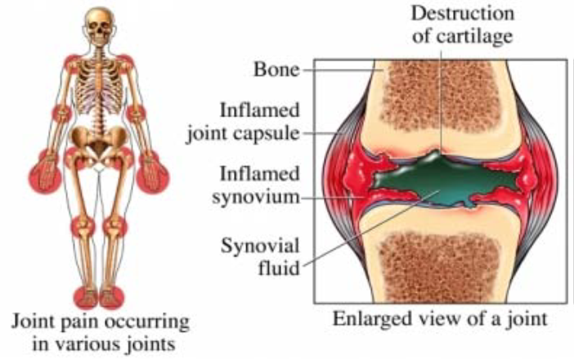

Slide 4
Progression of RA is associated with release of proinflammatory cytokines such as tumour necrosis factor (TNF)-a, interleukin (IL)-1b and IL-6 from monocytes, synovial fibroblasts and macrophages.
This abundance of TNF- in arthritic joint provides evidence of its involvement in the disease pathology which is supported by studies demonstrating that neutralization of TNF- leads to decreased production of other inflammatory cytokines.

Slide 5
Currently, the development of natural anti-inflammatory drugs for prevention or treatment of inflammatory diseases is receiving increasing attention.
Medicinal plants are the main sources of chemical substances with potential therapeutic effects and many of compounds from plants have already been characterized.

Slide 6
The aim of this study was to determine the effect of aqueous leaf extract of Alafia barteri plant on inflammatory responses in adjuvant-induced arthritic (AA) Wistar rats.

Slide 7
Materials and Methods
Twenty-five healthy young Wistar Albino male rats weighing between 100-167g were divided into five groups after acclimatization
The experimental rats were randomly divided as follows
  Group I: Normal control
  Group II: Arthritic control; 0.1 ml Complete Freund’s Adjuvant (CFA)
  Groups III: Oral treatment, 200mg/kg/day Alafia barteri with CFA induction.
  Groups IV: oral treatment, 400mg/kg/day of Alafia barteri with CFA induction.
  Group V: Standard drug, Celecoxib with CFA induction

Slide 8
Body weights and paw measurement was taken periodically and the effect of the extract (200mg/kgbwt and 400mg/kgbwt) on body weight, paw diameter and serum TNF- α as well as Rheumatoid factor were assessed.
The serum samples were assessed for levels of TNF alpha and Rheumatoid Factor.TNF and RF was estimated using ELISA kit from RayBiotech and Generic Assays respectively.
The values obtained are expressed as mean ± SEM. The data were analysed by one-way ANOVA, followed by Dunnett’s post-test using Prism 5.0 (GraphPad Software, Inc., CA).
p-Values less than0.05 (p<0.05) were considered as significant.

Slide 9
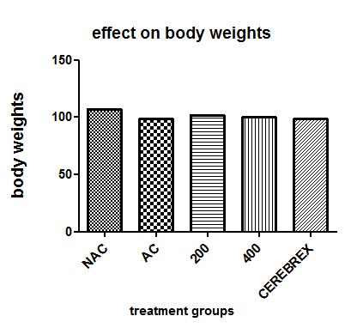
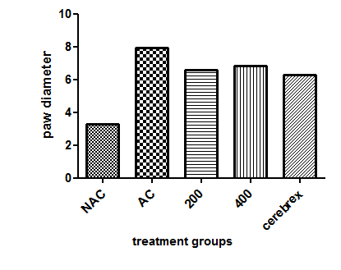
Fig 1: Body weights of CFA induced rats administered with Alafia barteri aqueous
Fig 2: Paw diameter of CFA induced rats administered with Alafia barteri aqueous leaf extract

Slide 10
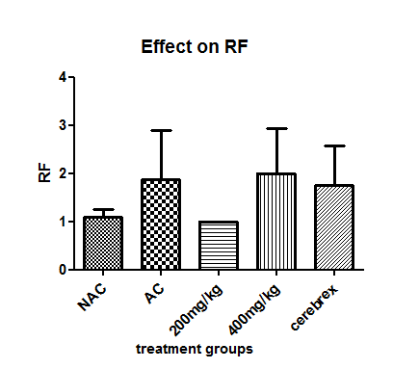
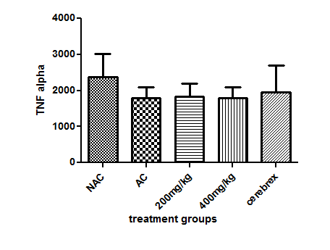
Fig 3: Serum TNF alpha in CFA induced rats administered with Alafia barteri aqueous leaf extract
Fig 4: Serum rheumatoid factor in CFA induced rats administered with of Alafia barteri aqueous leaf extract

Slide 11
Discussion
The aqueous extract of Alafia barteri leaves were found to show no significant difference (p>0.05) in body weights, serum TNF alpha and rheumatoid factor.
However, a significant difference(p<0.05) was seen between the paw diameter of the arthritic control and other groups.
Paw swelling is one of the major factors in assessing the degree of inflammation .It is an index of measuring the anti-arthritic activity of various drugs.
Conclusion: The results of the present study have revealed that the aqueous leaf extract had no significant effect on TNF alpha and RF in adjuvant induced arthritic rats but was found to inhibits inflammation through reduction of paw swelling.

Slide 12
References:
Samira Kargutkar & S. Brijesh (2016); Anti-rheumatic activity of Ananas comosus fruit peel extract in a complete Freund’s adjuvant rat model, Pharmaceutical Biology, 54:11, 2616-2622
Jurandir Fernando Comar^{a, ,} ,Anacharis Babeto de Sá-Nakanishiª, Andrea Luiza de Oliveiraª, Mariana Marques Nogueira Wendtª, Ciomar Aparecida Bersani Amado^{b}, Emy Luiza Ishii Iwamotoª, Rosane Marina Peraltaª, Adelar Brachtª Volume 58(2013),;Oxidative state of the liver of rats with adjuvant-induced arthritis;Free Radical Biology and Medicine;144–153.
A poster presented during the 2018 FBMS annual scientific conference held at College of Medicine, UNILAG.

