Slide 1
PHYLUM CHORDATA
(Chordates)

Slide 2
Class Amphibia
The word Amphibian means vertebrates that live two lives, leaving partly on land and partly on fresh water.
Amphi – dual;
Bio – life
The present day representatives of the class are: Toads, Frogs, Salamanders and limbless tropical caecilians
They consist of 2000 species comprising of 250 genera

Slide 3
Characteristics of Amphibians
They are coldblooded, (poikilothermic or ectothermic)
The skin lacks scales, the skin are smooth or rough and kept moist by glands for cutaneous respiration
They respire by lungs, skin or the mouth lining or
gills in the developmental stage
The skull is provided with two occipital condyles.
Heart is 3 chambered (2 atria and one ventricle)

Slide 4
Characteristics of Amphibians
They possess 4 pentadactyl limbs which are supported by girdles and are adapted for locomotion both on land and water as well.
May produce distinctive sounds.
Fertilization external
  Most are oviparous
  Egg with some yolk and enclosed in gelatinous covering usually laid in water
  Development is always indirect as larva is formed during life cycle which is generally known as Tadpole.

Slide 5
Classification of Amphibians
PRO ANURANS - Extinct forms
  Example: Eryops
ANURANS - Frogs and Toads
  Example – Bufo
URODELA - Newts and Salamanders
  Example: Salamandra, Amphiuma, Triton
APODA - Caecilians
  Example: Icthyophis, Uraeotyphlus, Siphonops

Slide 6
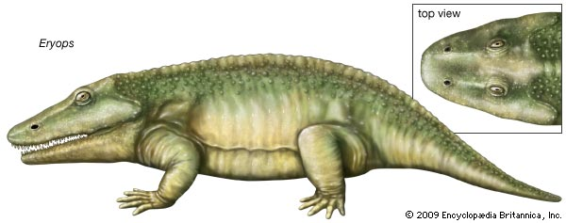
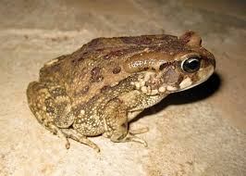
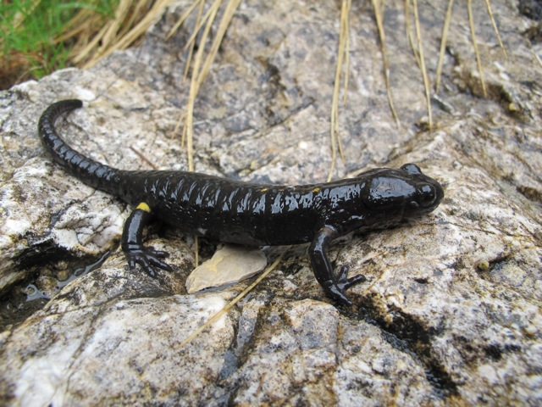
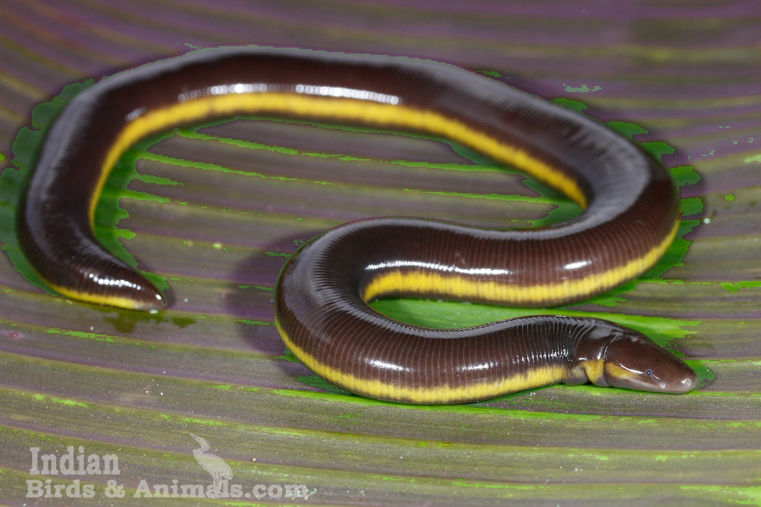
Eryops
Bufo
Salamandra
Icthyophis

Slide 7
Class Reptilia
They are coldblooded terrestrial or aquatic animals
5000 known species
They originated from amphibians
They are regarded as the first true land vertebrates’.
Whereas the amphibians are imperfectly adapted for life on land, the reptiles are perfectly adapted to living on dry land. They have become totally emancipated from water.

Slide 8
Characteristics of Reptiles
A).Characteristics that have made them truly successful on land.
The body is covered by horny scales or scutes without epidermal glands (Some have bony dermal plates). The skin is relatively water proof. The scales are dead structures produced from epidermis by hardening or keratinization.
They developed an intromittent organ in form of a penis which allowed for internal fertilization.

Slide 9
Characteristics of Reptiles
A).Characteristics that have made them truly successful on land.
They developed a cledoic egg. The cledoic egg is a large yolky egg covered in most cases by a shell of calcium carbonate. The shell functions to protect the egg from desiccation and also to protect the embryo.
  Parts of the cledoic egg are:
    Amnion – forms a pond around the embryo
    Chorion – serves for protection and respiration
    Allantois – serves for storage of waste products for respiration
    Yolksac – digest the yolk and pass product to embryo

Slide 10
Characteristics of Reptiles
Characteristics that have made them truly successful on land.
Reptiles developed a true neck.
Endoskeleton more completely bony than in amphibians.
  The vertebral column is differentiated into regions
  Limbs are pentadactyl ending in claws
  Skull has one single median occipital condyle.
Lung is better developed than in amphibians, since it is the only respiratory surface.

Slide 11
Classification of Reptilia
They have been divided into 4 subclasses:
ANAPSIDA - Extinct
  Example: Seymouria, Chelone, Chrysimis, Trionyx
PARAPSIDA
  Example : Icthyosaurus, Protosaurus
DIAPSIDA
  Example: Sphenodon, Gecko, Chamelion, Iguana, Varanus, Crocodile, Alligator
SYNAPSIDA
  Example: Dimetrodon, Cynognathus

Slide 12
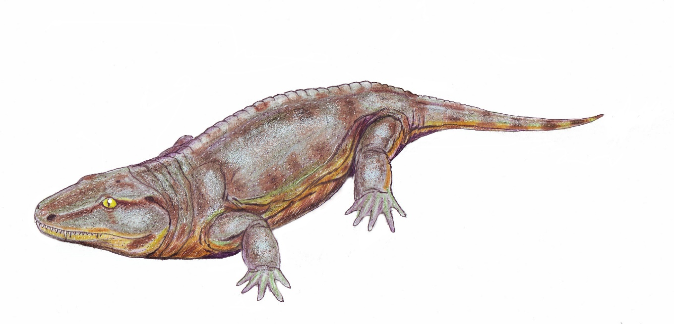
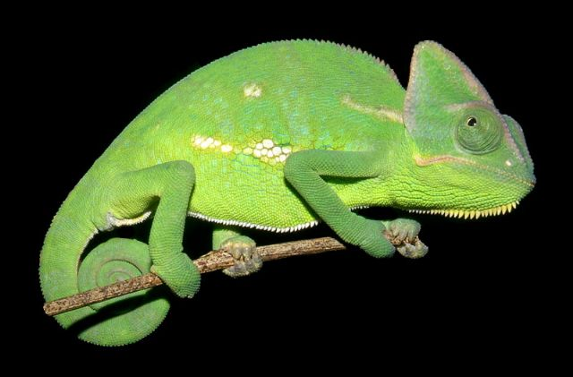
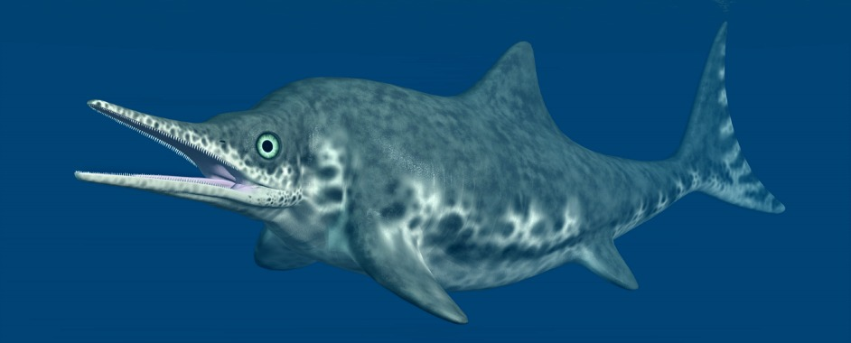
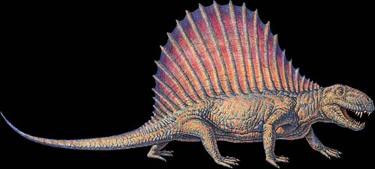
Seymouria
Chamelion
Icthyosaurus
Dimetrodon

Slide 13
Class Aves
Number 8950 species.
They are aerial, terrestrial and aquatic.
They have many characters resembling those of reptiles.
The Reptilia and Aves are placed together as SAUROPSIDA because of similarities
Achaeopteryx shows characteristics of both reptiles & birds.

Slide 14
Modifications for flight
Birds have become highly modified due to aerial life.
Morphological adaptations:
Body form fusiform or spindle shaped.
Body covered with feathers.
Contour feathers make body streamlined and reduce friction to the minimum.
Feathers make body light.
Feathers hold considerable blanket of enveloping air around the body and add much to its buoyancy.

Slide 15
Characters of Aves
Warm blooded vertebrates.
  Endothermal craniates.
  Body temperature, high & constant in correlation with their energy.
Possess exoskeleton of epidermal feathers on the greater parts of the body.
Skin devoid of glands except an oil gland on the tail and the tail is much reduced.
Fore limbs are modified to form wings each bearing 3 clawless digits & provided with feathers
Hind limbs articulate far forward to support the body weight in standing (bipedal).
Hind limbs are adapted for walking, perching swimming and bear 4 toes,
Never more than four digits and they are clawed.

Slide 16
Characters of Aves
Alimentary canal:
Modern birds have no teeth, a horny beak is present.
Beak & claws have horny sheath and feet are covered with scale.
Stomach divided into a glandular proventriculus and a muscular gizzard.
Excretory system:
They have 3 lobed Meta nephric kidneys; however a urinary bladder is absent.
Blood system:
Heart is 4 chambered and only the right aortic arch is present.
Red blood cells are oval, nucleated & biconvex.

Slide 17
Characters of Aves
Reproductive system:
Sexes separate & sexual dimorphism is well marked.
Left ovary alone is present
Oviparous with large yolky eggs enclosed in shell membrane and a hard shell (The embryo has amnion, allantois & yolk sac).
The young may be precocial or altricial when hatched.
  Precocial – able to fend for themselves.
  Altricial - naked and dependent on parents for food for some time, in which case, they receive much parental care.
Fertilization is internal.

Slide 18
Classification of Aves
Subclass Archaeornithes - Extinct birds
  Example: Archaeopteryx archaeonis
Subclass NEORNITHES (22 orders) - Living as well as extinct birds.
  Extinct– Hesperornis, Ichthyornis
  Living – Ostrich – Struthio camelus
  Kiwi - Apteryx
  Penguin - Apetnodytes

Slide 19
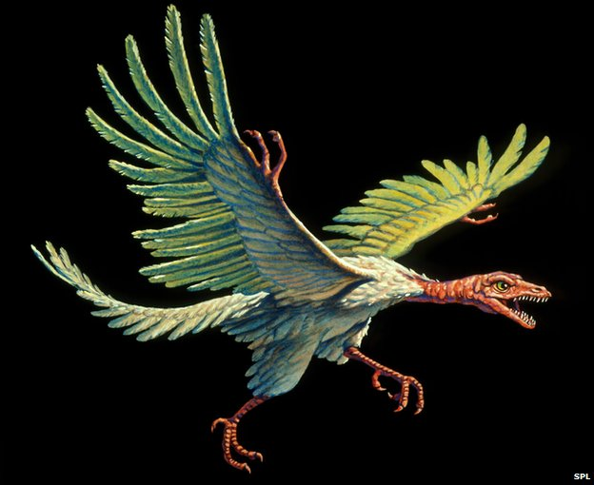
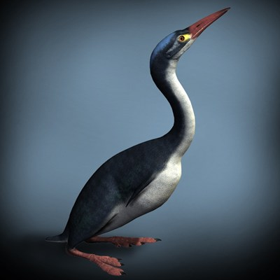
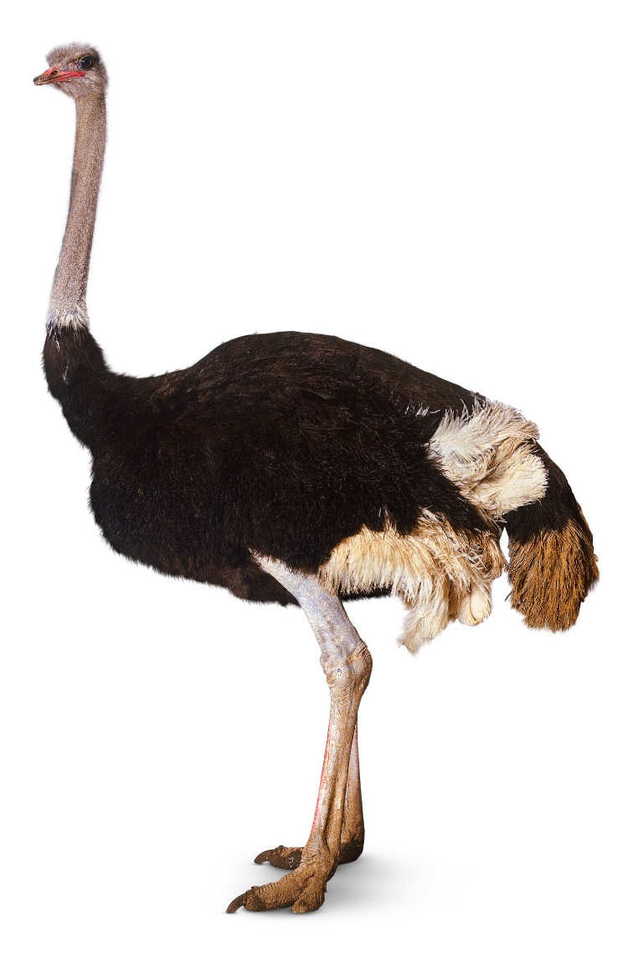
Archaeopteryx
Hesperornis
Ostrich

Slide 20
Class Mammalia
Greek word- Mammae –meaning mammary glands.
Top of the animal kingdom
Believed (undoubtedly) to have been derived from the reptilian subclass Synapsida. Most probably from a mammal like reptile the THERAPSIDS
Tertiary period is known as the age of mammals.
Since this period, mammals have radiated, adapted, and colonized almost all parts of the globe in different ecological conditions.

Slide 21
Class Mammalia
Characteristics of Mammals
The body is usually covered with hairs which are epidermal in origin (hairs are not found in the cetacae).
They are warm blooded or ectothermal or homiothermal animals.
The skin is provided with sebaceous, sweat, scent and milk glands.
  Milk glands produce milk to nourish the young for sometimes after birth. The possession of milk glands (mammae) is where the name mammalia has been derived.
  Sudoriporous(Sweats).
  Sebaceous (oil glands).
Skull is provided with two occipital condyles (That is Dicondylic skull).

Slide 22
Characteristics of Mammals
Two pairs of pentadactyl limbs present (digits in fore & hind limb never more than five) which are adapted variously for walking, running, climbing, burrowing, swimming or flying.
  Limbs are plantigrade, digitgrade or unguligrade.
Toes is usually provided with horny claws, nails, hoofs or fleshy pads in aquatic forms.
Nasal passage, usually long and mobile
  Both jaws are provided with teeth embedded in sockets

Slide 23
Characteristics of Mammals
External ear or pinna with external auditory meatus present
The teeth are thecodont, diphyodont and heterodont.
Thecodont means both jaws are provided with teeth embedded in sockets (Embedded in the alveolar pocket of jaws).
Diphyodont means two sets of teeth are recognized during the life time; decidous or milk teeth (replacable) and permanent teeth.
Heterodont: that is the teeth are differentiated into 4 types, depending on feeding habits: Incisor, canine, molars. Teeth are rarely absent.
Tongue usually mobile.

Slide 24
Characteristics of Mammals
Eyes is provided with mobile lids.
Heart 4 chambered
Respiration occurs only by lungs
Erythrocytes is more spherical and non-nucleated (except in camel).
A muscular transverse partition, the diaphragm, separates the body cavity into an anterior thoracic cavity and a posterior abdominal cavity.

Slide 25
Characteristics of Mammals
Males are with a copulatory organ (penis)
  They are usually viviparous.
  Fertilization is internal.
Development of embryo occurs in uterus of mother where a placenta is formed
Placenta helps the embryo in the physiological exchange of materials from the maternal blood and thus it brings about nutrition, excretion and respiration of the embryo in the womb.

Slide 26
Classification of Mammals
1. Subclass Prototheria – found in Australia, Tasmania, New Guinea. They have only one Order Monotremata
  Examples of Monotremata: Echidna sp, Ornithorhynchus sp
2. Subclass Theria - This inludes the Marsupials and placenta animals
a). Infra class Metatheria
i). Order Marsupiala - Marsupium or brood pouch are present in the females. Placenta usually absent.
  Examples: Opossum – Didelphis
  Tigercat – Dasyurus
  Marsupial mole - Caenolestes and Notoryctes
  Bandicoot – Parameles
  Kangaroo – Marcopus

Slide 27
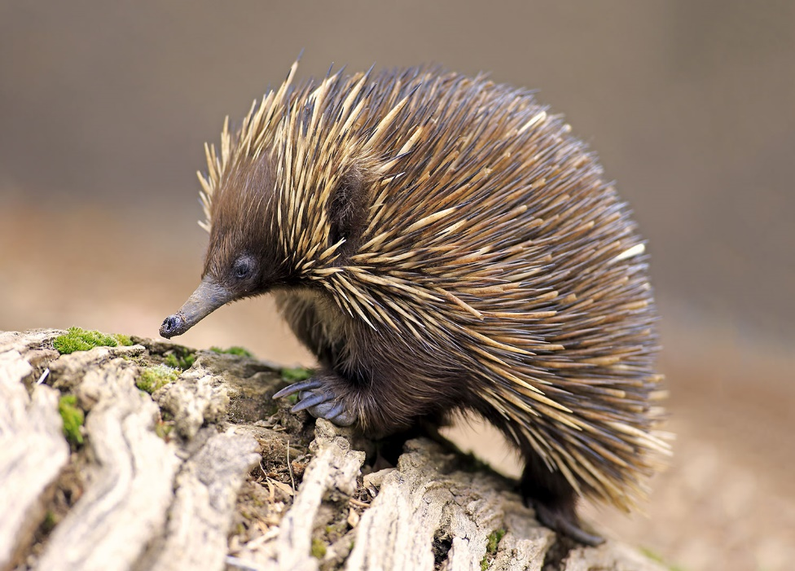
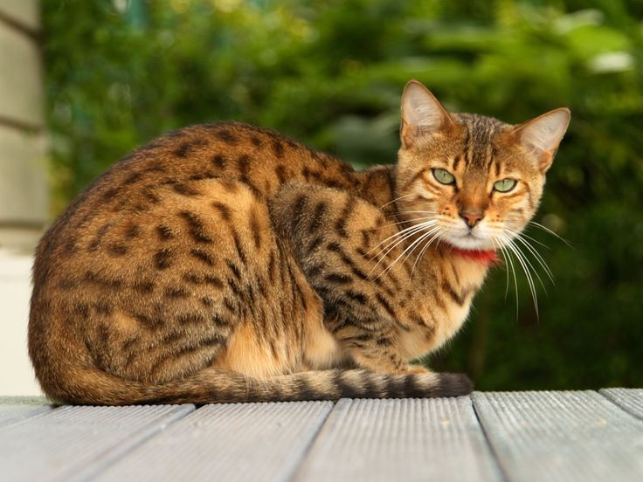
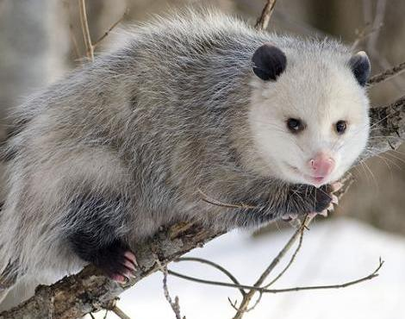
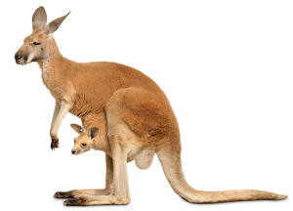
Echidna
Tiger cat
Kangaroo
Didelphis

Slide 28
Classification of Mammals
b). Infra class Eutheria - Young always nourished for a considerable time in the uterus by means of allantoic placenta and born in a relatively advanced state.
i). Order Insectivora - Snout usually long & tapering.
  Examples: Hedgehog – Erinaceus
  Paraechinus
  Mole - Scapanus
  Talpa
  Shrew – Sorex
  Echinosorex

Slide 29
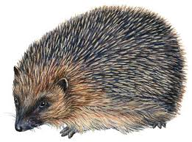
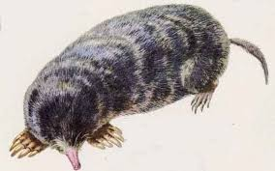
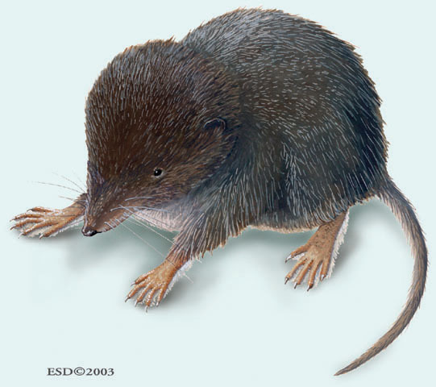
Scapanus
Erinaceus
Sorex

Slide 30
Classification of Mammals
ii). Order Dermoptera - Commonly known as flying lemurs
  Example - Galeopithecus
iii). Order Chiroptera - Commonly known as true flying lemurs
  Examples: Fruit eating bats:(Sub order Megachiroptera): Pteropus
Xanthorpyia
Cynopterus
Brown Bat :( Suborder Microchiroptera): Magaderma
Rhinolophus
Desmodus
Eptesicus

Slide 31
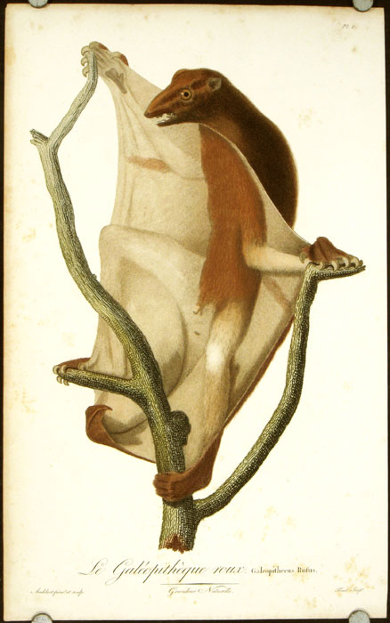
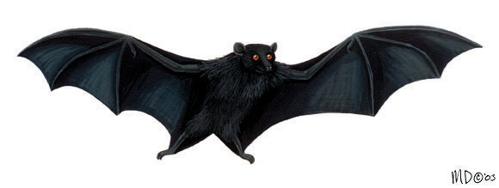
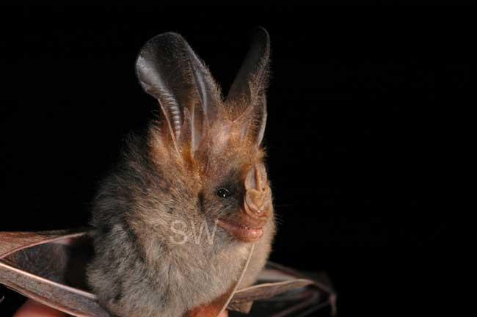
  Pteropus
  Galeopithecus
Magaderma

Slide 32
Classification of Mammals
iv). Order primates - Completely hairy and generally arboreal mammals.
  Examples: Suborder I Lemuroidea: Lemur
  Indris
  Chirogale
  Chiromys
  Loris
  Sub order II Tarsioidea: Torsius
  Spectrum
  Suborder III Anthropoideo: Monkeys
  Apes
  Man

Slide 33
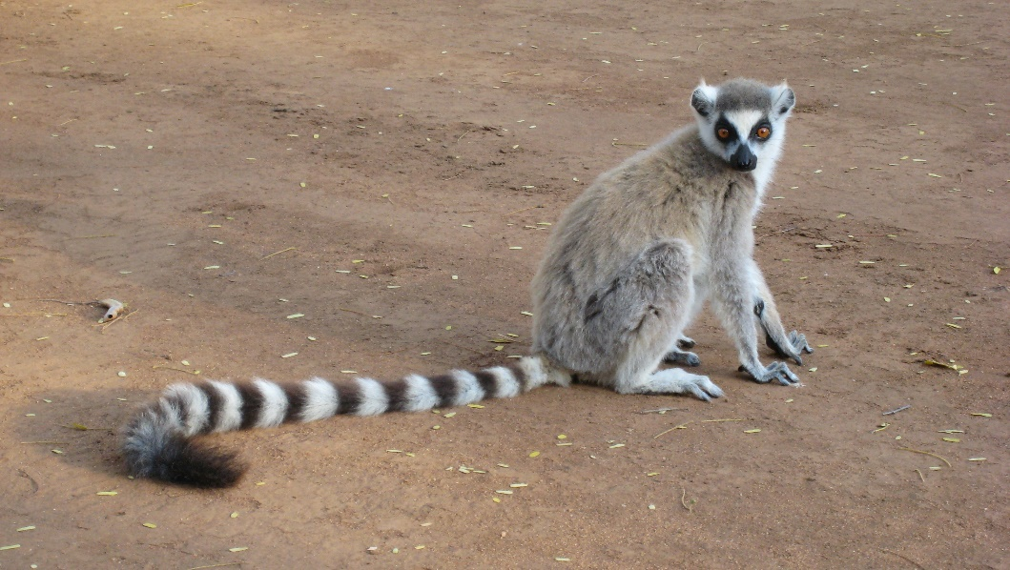
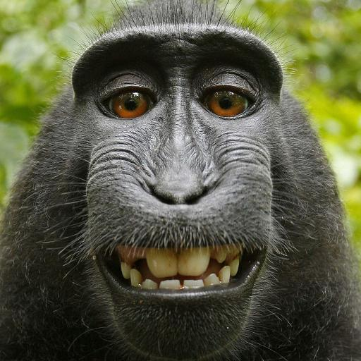
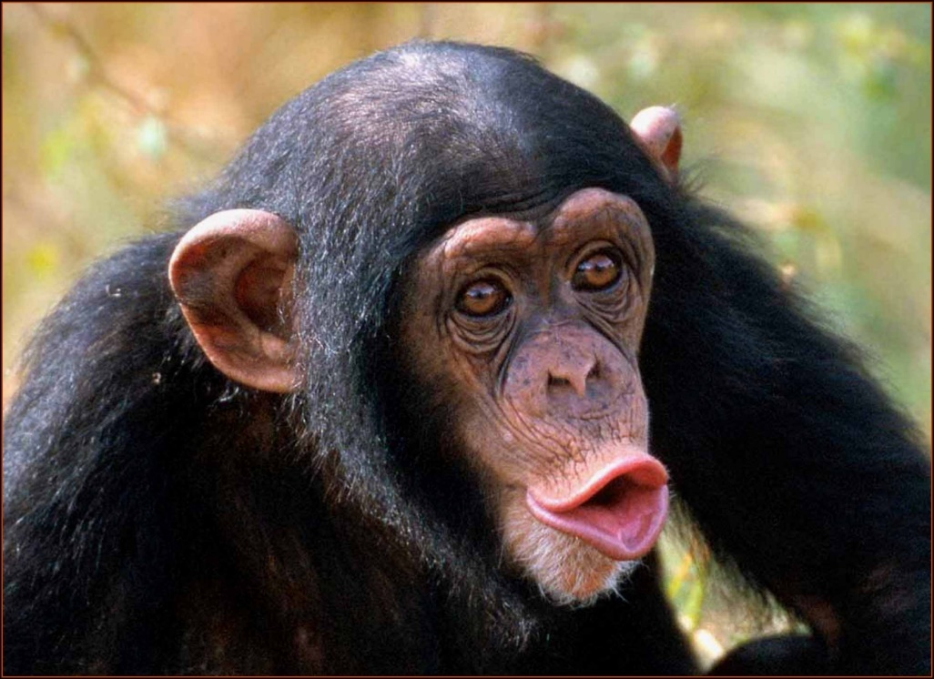
Lemur
Torsius
Monkey

Slide 34
Classification of Mammals
v). Order Edentata
  Examples: Sloth, Armadillos, American ant eater.
vi). Order Pholidata
  Example: Manis (pangolin or scaly anteater)
vii). Order Lagomorpha
  Example: Rabbits & Hares.
viii). Order Rodentia
  Example: Squirrel – Funambulus
Houserat – Rattus rattus
Porcupine – Hustrix
Guinea pig

Slide 35
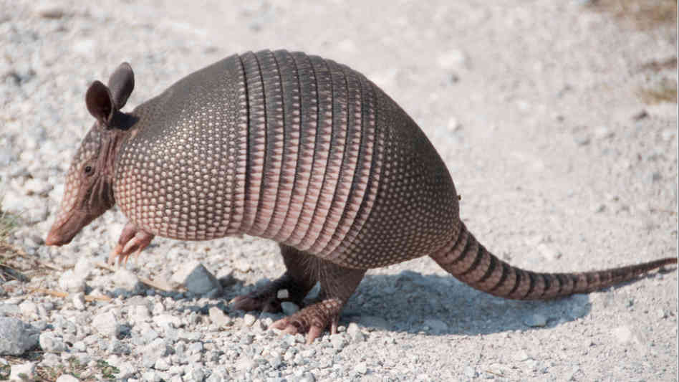
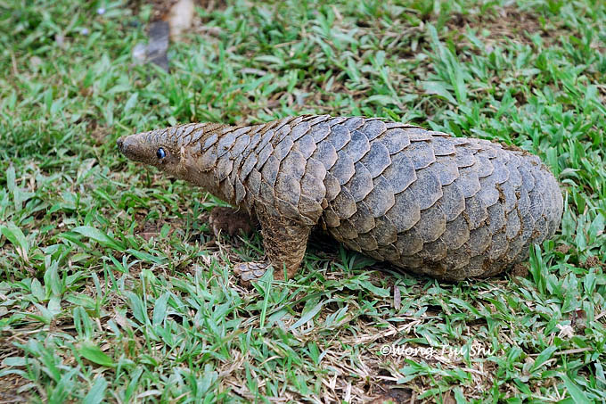
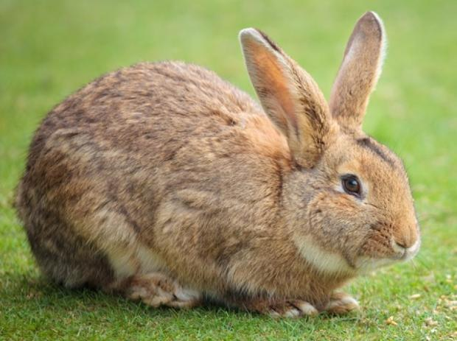
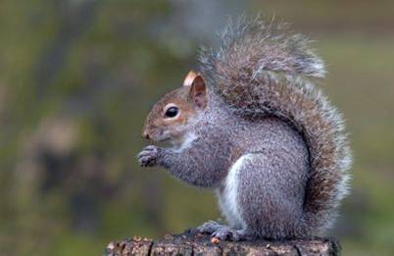
Armadillo
Manis
Squirrel
Rabbit

Slide 36
Classification of Mammals
ix). Order Cetace
  Examples: Whales, Dolphin
x). Order Canivora
  Examples: Sub order I Fissipedia – Lion – Panthera leo
  Tiger – Panthera tigris
  Leopard
  Civet cat
  Wolf
  Fox
  Sub order II Pinnipedia – Sea lion – Otario jubata
  Walrus - Trichecus
  Seal - Phoca

Slide 37
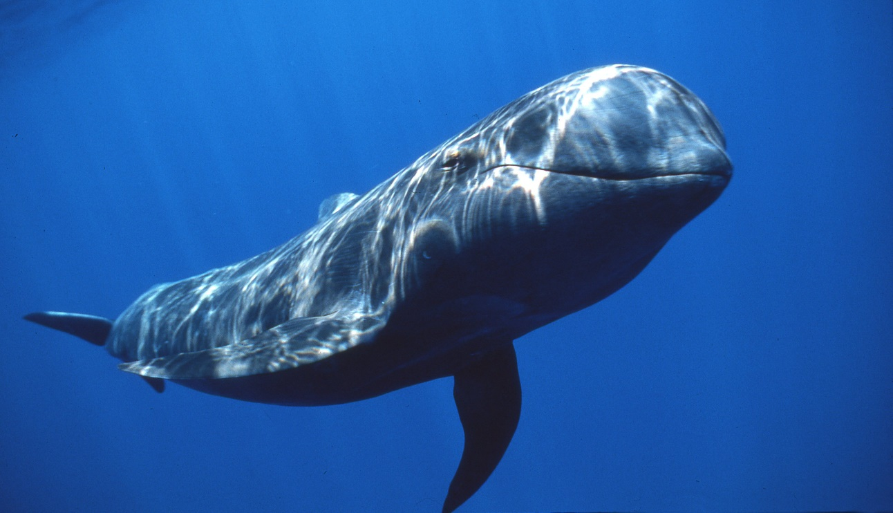
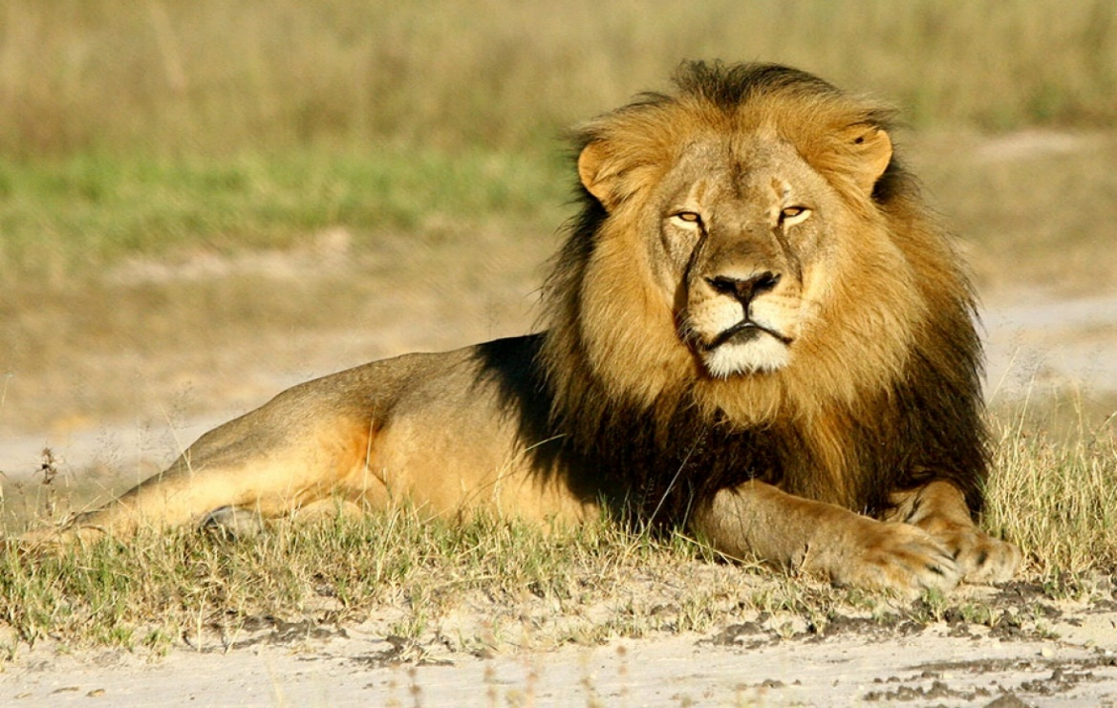
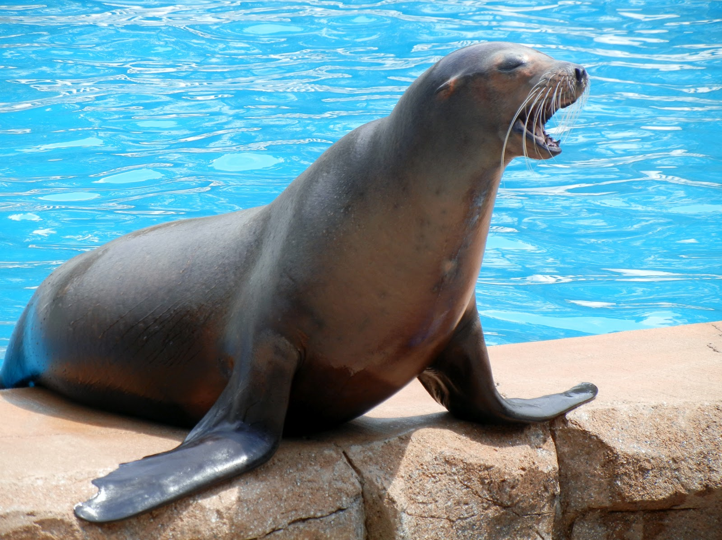
Whale
Lion
Sea Lion

Slide 38
Classification of Mammals
xi). Order Tubulidentata
  Example: Aardvark
xii). Order Proboscidea
  Example: Elephant – Elephas
xiii). Order Hyracoidea
  Example: Procavia or Hyrax
xiv). Order Sirenia
  Example: Dugong – Halicore dugong
  Trichecus – Manatees
xv). Order Perissodactyla
  Example: Horse – Equas
  Zebra
  Rhinoceros

Slide 39
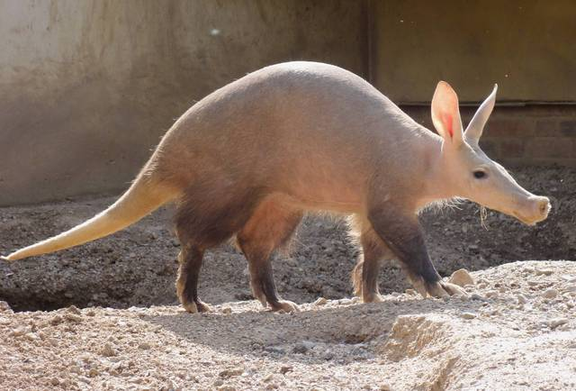
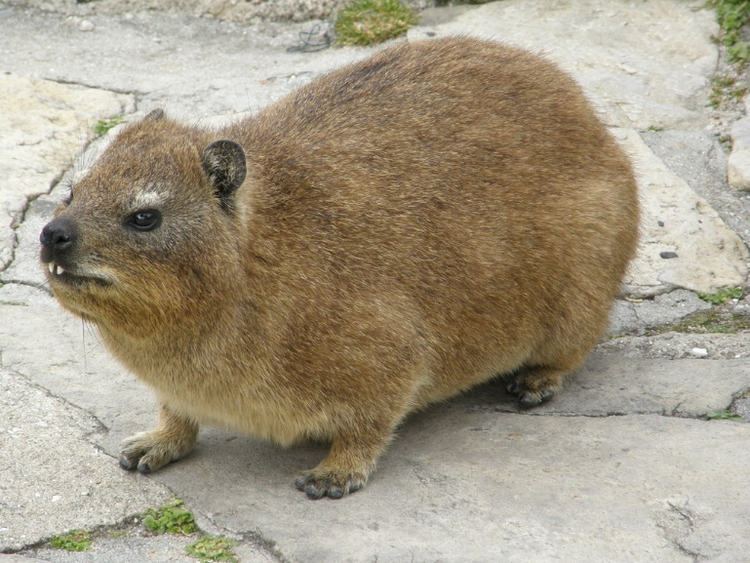
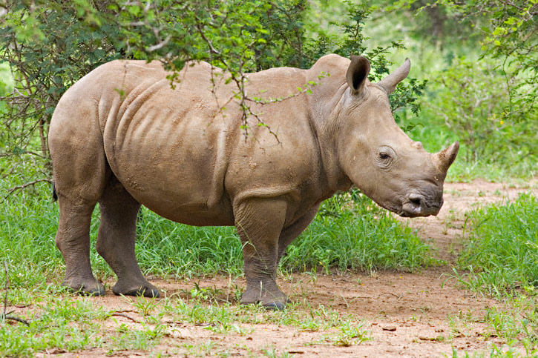
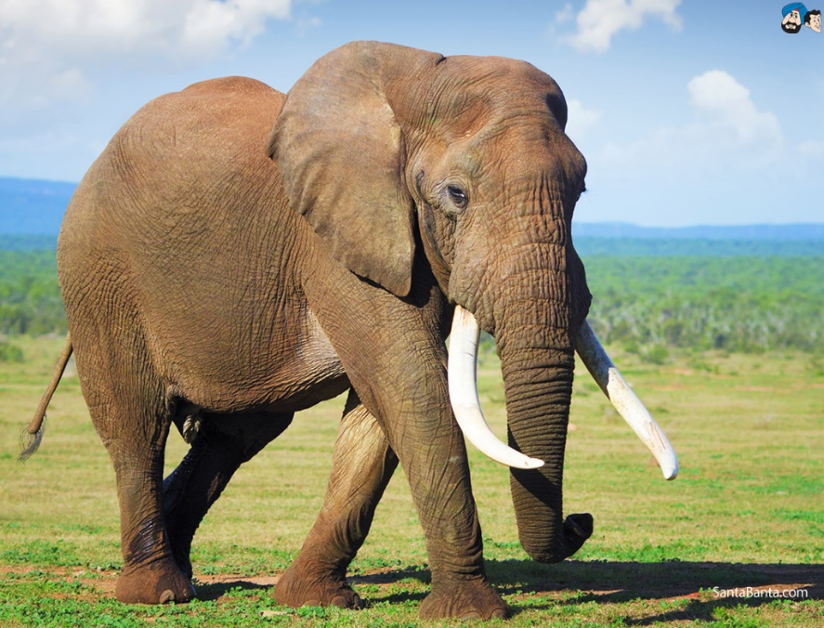
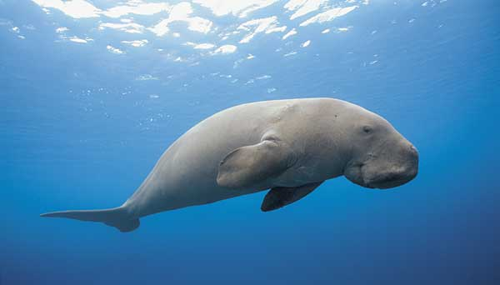
Rhinoceros
Aardvark
Procavia
Elephant
Dugong

Slide 40
Classification of Mammals
xvi). Order Artiodactyla
  Examples: Hippopotamus
  Camel
  Pig
  Deer
  Giraffe
  Antelope
  Cow
  Buffalo
  Sheep
  Goat

Slide 41
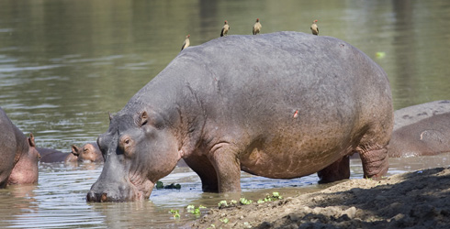
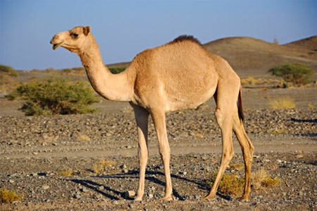
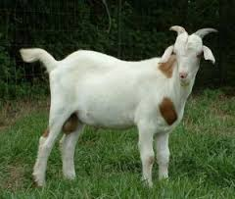
Hippopotamus
Camel
Goat

