Slide 1
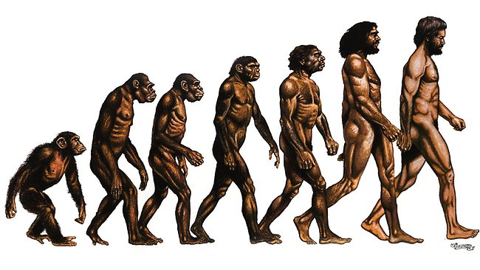
EVOLUTION

Slide 2
The theory of evolution describes how life on earth developed, beginning 3.5 billion years ago. Evolution refers to change in the heritable characteristics of biological populations over successive generations.
These characteristics are the expressions of genes that are passed on from parent to offspring during reproduction. All new species arise from an existing species.
This results in different species sharing a common ancestry, as represented in phylogenetic classification.
Common ancestry can explain the similarities between all living organisms, such as common chemistry (eg all proteins made from the same 20 or so amino acids), physiological pathways (eg anaerobic respiration), cell structure, DNA as the genetic material and a ‘universal’ genetic code.

Slide 3
The individuals of a species share the same genes but (usually) different combinations of alleles of these genes.
An individual inherits alleles from their parent or parents.
A species exists as one or more populations. There is variation in the phenotypes of organisms in a population, due to genetic and environmental factors.
Two forces affect genetic variation in populations: genetic drift and natural selection. Genetic drift can cause changes in allele frequency in small populations.
Natural selection occurs when alleles that enhance the fitness of the individuals that carry them rise in frequency.
A change in the allele frequency of a population is evolution.

Slide 4
If a population becomes isolated from other populations of the same species, there will be no gene flow between the isolated population and the others.
This may lead to the accumulation of genetic differences in the isolated population, compared with the other populations.
These differences may ultimately lead to organisms in the isolated population becoming unable to breed and produce fertile offspring with organisms from the other populations. This reproductive isolation means that a new species has evolved.

Slide 5
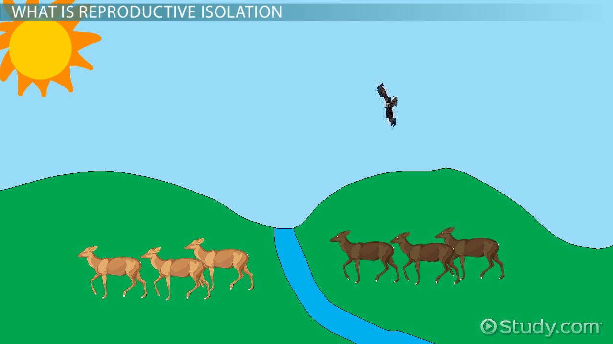

Slide 6
Evolution refers to the gradual development of complex organisms from simpler ancestral types over a long period of time. Evolution begins with the production of new species which gradually differ more and more from each other until new genera, families, classes, have evolved.
Origin of life
The exact origin of life is not known. However some theories have been put forward to show the origin
of life which incevolution
1. Steady state theory: this suggests that life has no origin and it has been in existence.

Slide 7
2. Spontaneous generation: This indicates that life arose from non living matter on numerous occasions.
3. Special creation: this indicates that life was created by a supernatural being at a particular time.
4. Cosmozaon theory: this suggests that life arrived on this planet from elsewhere.
5. Biochemical evolution: Most accepted theory by scientists. It suggests that life arose from according to biochemical and physical laws which lead to formation of certain macromolecules which make up DNA and body cells.

Slide 8
Theories of evolution/mechanism of evolution
Evolution theory explains that the different species of organisms existing today arose from common ancestors which were originally primitive but gradually under went changes along different evolutionary lines in different environments in order to survive in those environments. The trend of evolution there fore, is gradual change from primitive form of life to advanced form of life.
Lamarck’s theory of evolution/Lamarckism: based on acquired characters through use and disuse.
This theory was put forward by a French biologist Jean baptiste Larmarck in 1809. His theory resolves itself into 3 factors namely;
a) influence of the environment
b) Use and disuse

Slide 9
c) Inheritance of acquired characters
A lizard that didn’t use it legs would eventually not have legs and its offspring wouldn’t have legs or a giraffe stretched its neck to reach higher leaves, and this stretched neck would be a trait inherited by its offspring
Based on the above factors, he suggested that; when an organism develops a need for a particular structure in a given environment, this will induce its appearance and therefore the structure will develop to carry out the need in that environment.
This idea was based on the observation that the structures which are subjected to constant use become well developed and those which are not used tend to degenerate hence the theory of use and disuse.

Slide 10
For example;
i) Ancient giraffes were those living today. Lamarck believed that as the number of giraffes increased, there was shortage of food in form of grass, herbs and leaves from very short shrubs. This compelled them to stretch their necks so as to reach for leaves on higher branches of tall trees. The result was elongation of the necks. The offsprings of these giraffes inherited the longer necks, stretched further and the process was repeated until the present long necks were developed.
ii) Exercise and training can lead to the development of muscles of a heavy weight lifter, since he suggested that these beneficial traits acquired in an individual’s life can be passed onto the offsprings, hence evolutionary change can be achieved via transmission of acquired characteristics.

Slide 11
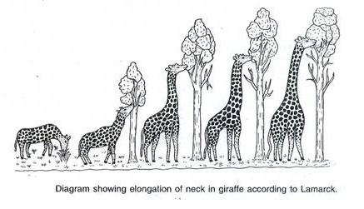
This implies that a heavy weight lifter who has acquired big arm muscles produces children with big arm muscles.
However this was proved totally wrong by genetic evidence that acquired characters can be inherited. This theory therefore is not scientifically accurate.

Slide 12
Darwin’s theory of evolution/ or the theory of natural selection (Darwinism)
Charles Darwin (1809-1882) was a naturalist who observed many species. He is famous for his trips to the Galapagos Islands, his observations of the finches (and other animals) and the book he wrote: “The Origin of Species" :
1. Variation exists among individuals in a species.
2. Individuals of species will compete for resources (food and space)
3. Some competition would lead to the death of some individuals while others would survive
4. Individuals that had advantageous variations are more likely to survive and reproduce.

Slide 13
Darwin’s Finches: Darwin noted that all the finches on the Galapagos island looked about the same except for the shape of their beak.
His observations lead to the conclusion that all the finches were descendants of the same original population.
The shape of the beaks were adaptations for eating a particular type of food (Ex. long beaks were used for eating insects, short for seeds).

Slide 14
The first satisfactory explanation to the mechanism by which evolution takes place was proposed by Darwin and that was the theory of natural selection.
Natural selection is where by the well adapted organisms to changes in the environment are naturally favoured or selected for and survive while the poorly adapted organisms to changes in the environment are naturally selected against and die before reaching sexual maturity or before reproducing.

Slide 15
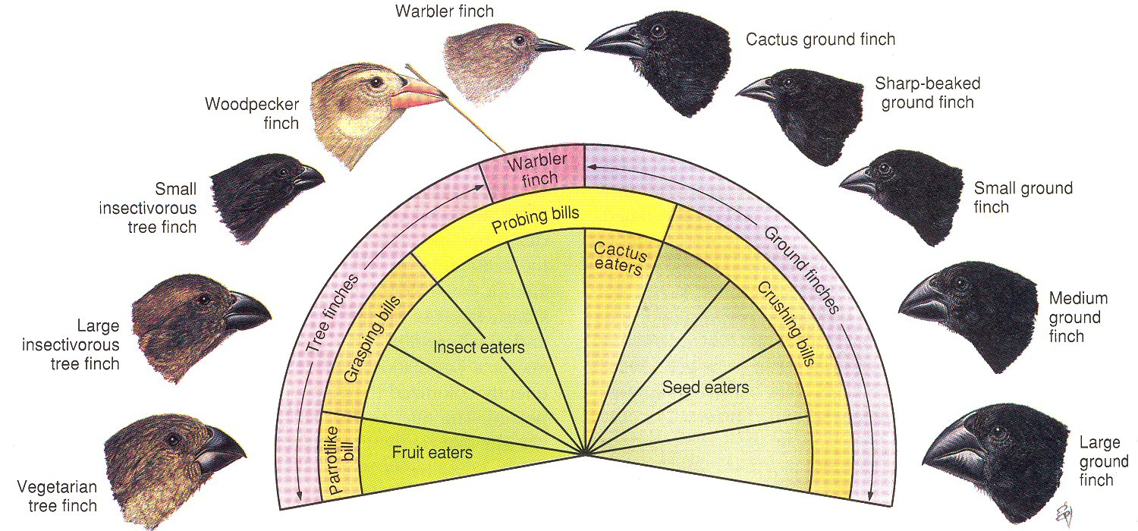
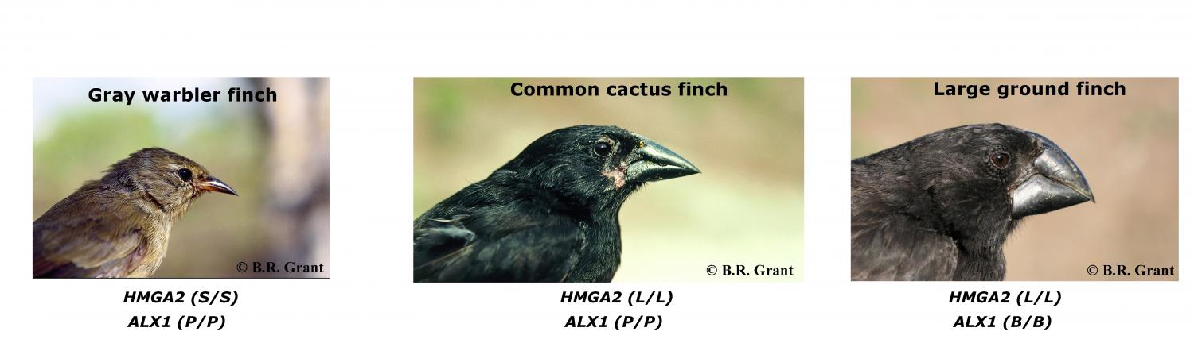

Slide 16
Observations in Support of Evolution
1. Fossil Evidence
If today’s species came from ancient species, then we should be able to find remains of those species that no longer exist.
We have tons of fossils of creatures that no longer exist but bear striking resemblance to creatures that do exist today.
Carbon dating–gives an age of a sample based on the amount of radioactive carbon that is in a sample.
2. Evidence from Living Organism
Evidence of Common Ancestry –Hawaiian Honeycreeper
Homologous Structures–structures that are embryologically similar, but have different functions, the wing of a bird and the forearm of a human.

Slide 17
Vestigial Organs – seemingly functionless parts, snakes have tiny pelvic and limb bones, humans have a tail bone
Biochemistry and DNA
Embryological development – Embryos of different species develop almost identically
Evidence for Evolution
1. Comparative anatomy:
More evidence for evolution is offered by comparative anatomy. As Darwin pointed out, the forelimbs of such animals as humans, porpoises, bats, and other creatures are strikingly similar, even though the forelimbs are used for different purposes (that is, lifting, swimming, and flying, respectively).

Slide 18
Darwin proposed that similar forelimbs have similar origins, and he used this evidence to point to a common ancestor for modern forms. He suggested that various modifications are nothing more than adaptations to the special needs of modern organisms.
Darwin also observed that animals have structures they do not use.
Often these structures degenerate and become undersized compared with similar organs in other organisms. The useless organs or body parts are called vestigial organs.

Slide 19
In humans, they include the appendix, the fused tail vertebrae, the wisdom teeth, and muscles that move the ears and nose.
Darwin maintained that vestigial organs may represent structures that have not quite disappeared.
Perhaps an environmental change made the organ unnecessary for survival, and the organ gradually became nonfunctional and reduced in size.

Slide 20
For example, the appendix in human ancestors may have been an organ for digesting certain foods, and the coccyx at the tip of the vertebral column may be the remnants of a tail possessed by an ancient ancestor.
2. Embryology
Darwin noted the striking similarity among embryos of complex animals such as humans, chickens, frogs, reptiles, and fish. He wrote that the uniformity is evidence for evolution.

Slide 21
The similarities in comparative embryology are also evident in the early stages of development. For example, fish, bird, rabbit, and human embryos are similar in appearance in the early stages. They all have gill slits, a two-chambered heart, and a tail with muscles to move it. Later on, as the embryos grow and develop, they become less and less similar. The branch of biology that focuses on embryos and their development is called embryology.
3. Comparative biochemistry
Although the biochemistry of organisms was not well known in Darwin’s time, modern biochemistry indicates there is a biochemical similarity in all living things. This comparison of biochemical processes with ancient species is called comparative biochemistry.

Slide 22
For example, the same mechanisms for trapping and transforming energy and for building proteins from amino acids are nearly identical in almost all living systems. DNA and RNA are the mechanisms for inheritance and gene activity in all living organisms. The structure of the genetic code is almost identical in all living things. This uniformity in biochemical organization underlies the diversity of living things and points to evolutionary relationships.

