Slide 1
KINGDOM PLANTAE
BY DR. FRANCIS H. IBADIN

Slide 2
KINGDOM PLANTAE
Plants are autotrophic eukaryotes which have become adapted to life on land.
The other autotrophic eukaryotes are algae, which are specialized for life in water.
Autotrophic means that the organism has an inorganic source of carbon (i.e. carbon dioxide).
Nutrition involves acquiring energy as well as carbon and plants are photoautotrophic, meaning that their source of energy is light.
Their method of nutrition is more commonly referred to as photosynthesis.

Slide 3
General Characteristics of kingdom Plantae
Most plants are eukaryotic and chlorophyll containing organisms
Cell walls of plants are composed of cellulose
They have an ability to grow by cell division.
In life cycle of plant cells, the interchanges occur from the embryos and are supported by other tissues and self-produce.
Plants have both organs and organ systems.
They obtain their energy from sun through photosynthesis.
Plants reproduce both by sexual and asexual.
Plants develop a self-defense mechanism to protect them
Organisms within Kingdom Plantae are multicellular, eukaryotic and autotrophic.
They lack motility.

Slide 4
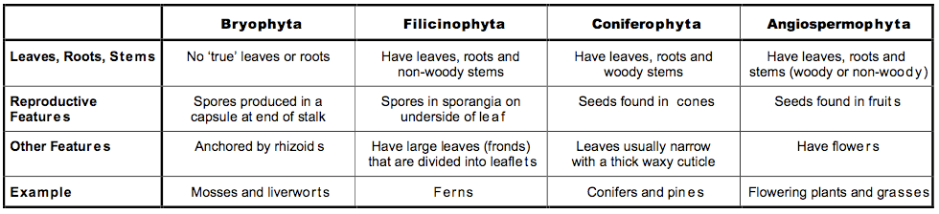

Slide 5
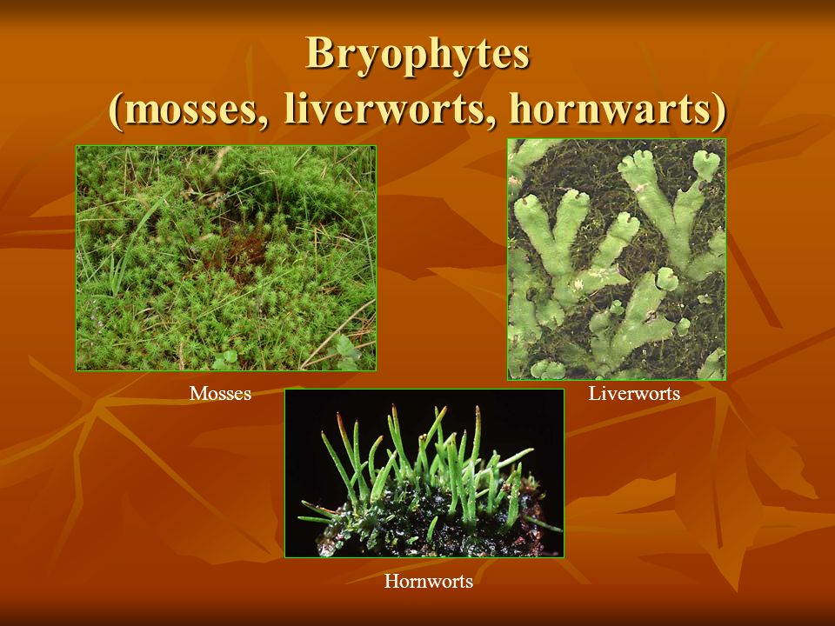
Phylum Bryophyta (liverworts and mosses)

Slide 6
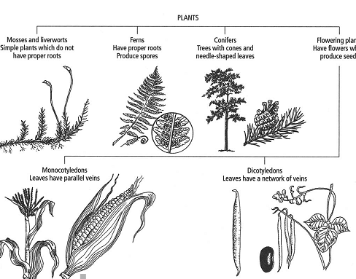

Slide 7
Classification and characteristics of phylum Bryophyta (bryophytes)
General Characteristics
Alternation of generation in which the gametophyte generation is dormant
No vascular tissue, that is no xylem or phloem
Body is a thallus, or differentiated into simple ‘leaves’ and ‘stems’
No true roots, stems or leaves: the gametophyte is anchored by filamentous rhizoids
Sporophyte is attached to, and is dependent upon, the gametophyte for nutrition
Spores are produced by the sporophyte in a spore capsule on the end of a slender stalk above the gametophyte
Live mainly in damp, shady places

Slide 8
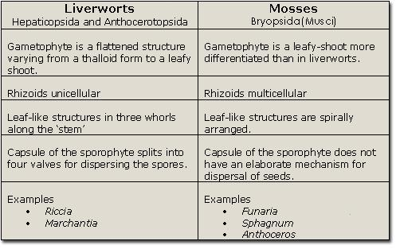

Slide 9
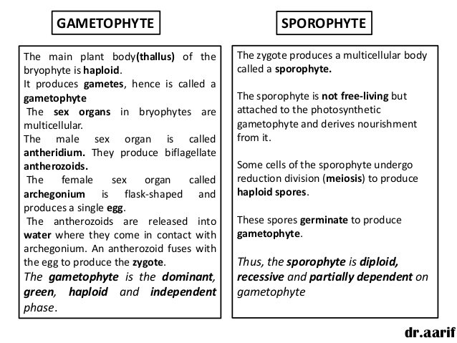

Slide 11
Class Hepaticae – liverworts
They are more simple in structure than mosses and, on the whole, more confined to damp and shady habitats.
They are found in the banks of streams, on damp rocks and in wet vegetation. Most liverworts show regular lobes, or definite ‘stems’ with small, simple ‘leaves’.
The simplest of all though are the thalloid liverworts where the body is a flat thallus with no stem or leave.
An example is the Pellia, a liverwort.
The plant is dull green with flat branches about 1 cm wide.

Slide 12
Class Musci – Mosses
They have a more differentiated structure than liverworts but, like liverworts, are small and found mainly in damp habitats. They often form dense cushions.
Funaria is the common moss in fields, open woodlands and disturbed ground, being one of the easy colonisers of such ground.
It is especially associated with freshly burned areas, for example after health fires.
It is also a common weed in greenhouses, and gardens.

Slide 13
Phylum Filicinophyta (Ferns)
General characteristics of the phylum Filicinophyta (ferns)
Alternation of generation in which the sporophyte is dormant
Gemetophyte is reduced to a small, simple prothallus
Vascular tissue present (xylem and phloem) in sporophyte: sporophyte therefore has true roots, stems and leaves
Leaves relatively large and called fronds
Spores produced in sporangia which are usually in clusters called sori
Examples are Dryopteris filix-mas (male fern), Pteridium (bracken)
They are the simplest plants with the presence of roots, feathery leaves and underground stems.
They have vascular tissues, which helps in the transportation of water, minerals and sugars throughout the plant.

Slide 14
Few ferns are capable of growing in full sunlight, although bracken (Pteridium) is a common exception.
They are common in tropical rain forest where sunlight and humidity are favourable.
They are vascular plants; vascular tissue present (xylem and phloem) in sporophyte.
Xylem carries water and mineral salts round the plant body, while phloem carries mainly organic solutes in solution such as sugars.
Vascular tissue is a major evolutionary advance compound with the simple conducting cells of some bryophytes and algae.
They have spore producing organs, which is present at the bottom of the leaves.
They live in damp shady places.

Slide 15
There are approximately 12,000 varieties of ferns around the globe.
They are large green coloured plants, which prepares their own food.
They reproduce through spores, that sporophyte is dominant.
Vascular tissue is more common in the sporophyte generation, and is one reason why the sporophyte generation becomes conspicuous in all vascular plants.
Alternation of generation in which the sporophyte is dominant
Gametophyte is reduced to a small, simple Prothallus.
Roots penetrate the soil with the results that water and dissolved nutrients can be obtained more easily, and relatively large and called fronds.

Slide 16
Properties of vascular tissue
It forms a transport system, conducting food and water around the multicellular body, thus allowing the development of large, complex bodies.
These bodies can be supported because xylem, apart from being a conducting tissue also contains lignified cells of great strength and rigidity.
Another lignified tissue called Sclerenchyma, also develops in vascular plants and supplements the mechanical role of xylem.

Slide 17
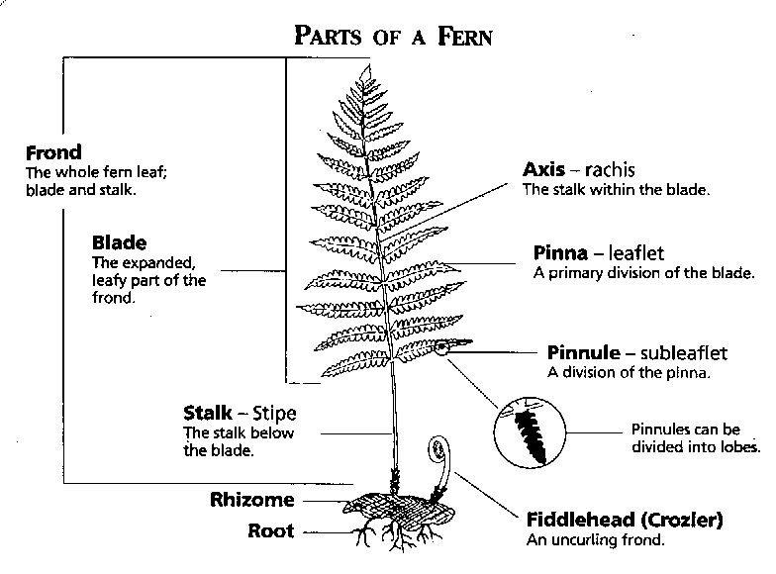
Filicinophyta

Slide 18
Seed-bearing plants
The most successful group of plants have seeds. They probably have their origin among extinct seed-producing members of the ferns and their close relatives.
Features that make seed plants to be adaptable to life on Land
Prevention of water loss: Most fruit leaf and stem are covered with a protective waxy layer called the cuticle. Waxes are biomolecules that do not dissolve in water. The waxy cuticle creates a barrier that helps prevent loss of water in the plant tissues into the air carrying out photosynthesis. The leaf is a plant organ that grows out of the stem and usually where photosynthesis occurs.

Slide 19
Roots: Some plants depend on the soil as their primary source for water and mineral salts or nutrients.
The plants can take in water and nutrients from the soil with their roots.
Roots are plants organs that absorb water and minerals from the soil.
They contain tissues that transport nutrients to the stem. They anchor the plants to the ground.
Some serve as storage organs e.g sweet potatoes.

Slide 20
Movements of water and minerals: Water moves from the root of tree to its leaves and the sugars produced in the leaves moves to the root through the stem.
A stem provides support for growth. It contains tissues for transporting food, water from one part of the plant to another.
They can also serve as organ for food storage. In green cells, some cells contain chorophyll and can carry out photosynthesis.
The stem of most plants contain vascular tissues.
These tissues are made up of tubelike enlongated cells through which water, food and other materials are transported.
Plants that possess vascular tissues are known as vascular plants.

Slide 21
Reproductive Strategy: Some plants reproduce through seed formation.
A seed is a plant organ that contains an embryo along with a food supply and is covered with a protective coat. It prevents embryo from drying and also aid dispersal.
Land plants produce by either spores or seeds.
In non-seed plant which include mosses and ferns, the sperm requires a film of water on the gametophyte plant to reach the egg.
In seed plants which include all flowering plants, sperm reach the egg without using a film of water.

Slide 22
Classification and characteristics of the seed-bearing plants
Seed bearing plants (General characteristics)
Sporophyte is the dominant generation; gametophyte generation is severely reduced
Sporophyte produces two types of spores (in other words, it is heterosporous). The two types are microscopores and megaspores; microspore = pollen grain, megaspore = embryo sac
The embryo sac (megaspore) remains completely enclosed in the ovule (megasporangium); a fertilized ovule is a seed (diagnostic feature)
Water is not needed for sexual reproduction because male gametes do not swim (except in a few primitive members); they are conveyed to the ovum by a pollen tube to effect fertilization (diagnostic feature)
They possess complex vascular tissue in roots, stems and leaves

Slide 23
In conifers, ovules (later seeds) are located on the surfaces of specialized scale leaves called ovuliferious scales. These are arranged in cones. In angiosperms, ovules, and therefore seeds are enclosed, giving more protection.

Slide 24
Phylum Coniferophyta (conifers)
General Characteristics of Phylum Coniferophyta
They account for one – third of the world’s forest distribution
Found mostly at higher altitudes.
Softwood used for timber, resins, turpentine and wood pulp, e.g. pines, spruces, cedars, examples of a typical conifer is Pinus sylvestris (Scots pine).
They are always up to 36m in height.
Grow on sandy / poor mountain soils mostly Pinus sylvestris
Each year a whorl of lateral buds around the stem grows out into a whorl of branches – younger branches to older branches.

Slide 25
The older branches die and drop off as the tree grows.
The main branches and trunk continue to grow from year to year by the activity of an apical bud.
They show unlimited growth
They are covered with a thick waxy cuticle and have sunken stomata, further adaptation for conserving water – Xeromorphic because the xeromorphic features ensure that the tree does not lose too much water from its evergreen leaves during cold seasons, when water may be frozen or difficult to absorb from soil.

Slide 26
Phylum Angiospermophyta (flowering plants)
Angiosperms are better adapted to life on land than any other plants.
One of the most characteristic features of angiosperms, apart from the enclosed seeds is the presence of flowers instead of cones.
This has enabled them to utilize insects, and occasional birds or even bats, as agents of pollination.
In order to attract these animals, flowers are usually brightly coloured, scented and offer pollen or nectar as food.
In some cases, flowers have become indispensable to the insects.

Slide 27
The result is that, in some cases, the evolution of insects and flowering plants has become closely linked and there are many highly specialized, mutually dependent, relationships.
The flower generally becomes adapted to maximise the chances of pollen transfer by the insect and the process is therefore more reliable than wind pollination.
Insect-pollinated plants need not, therefore, produce as much pollen as wind-pollinated plants.
Nevertheless, many flowers are specialized for wind pollination.

Slide 28
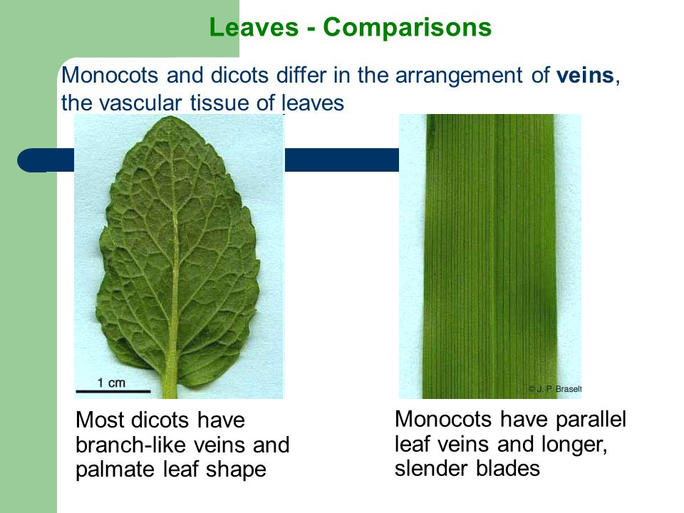
Dicotyledons and monocotyledons
The angisopersms are divided into two major groups that are given the status of classes. The most commonly used names for the two groups are the monocots and dicots.

Slide 30
Angiosperms may be herbaceous (non-woody) or woody. Woody plants become shrubs or trees.
They grow large amounts of secondary xylems (wood) that offers support, as well as being a conducting tissue, and is produced as a result of the activity of the vascular cambium.
This is a layer of cells found between the xylem and phloem in stems and roots. These cells retain the ability to divide. The new xylem produced is called secondary xylem or wood

Slide 31
Many herbaceous plants are annuals, completing their life cycle from germination to seed production in one year.
Some produce organs of perennation such as bulbs, corms and tubers by means of which they survive periods of adverse conditions such as drought.
They may then be biennials, in which case they produce their seeds and die in their second year, or perennials, in which case they survive from year to year.
Shrubs and trees are perennial, and may be evergreen, producing and shedding leaves all year round so that leaves are always present, or deciduous, shedding leaves in seasons of cold or drought.

