Slide 1
PHYLUM CHORDATA
(Chordates)

Slide 2
Definition
The word Chordata is derived from the possession of the notochord
Notochord - This can be divided into two words:
  Noton - Back
  Chorda - Cord
The notochord is a structure possessed by all members of the phylum at one stage of its development.
It may be in the larval or the embryonic stage or it may persist throughout life.

Slide 3
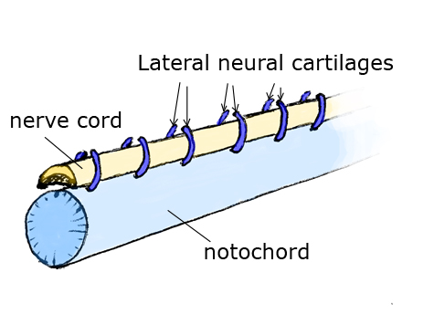

Slide 4
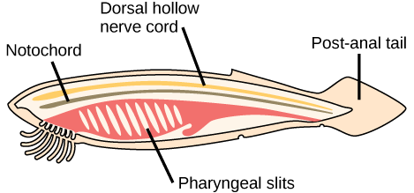
Diagram of a Generalised Chordate

Slide 5
The Main Chordate Characters
These are the distinctive features that set chordates apart from all other phyla.
These characters are always found at some embryonic stage although they may be altered, they may disappear in later stages of the life cycle.
They are:
Possession of Notochord
Possession of hollow dorsal nerve chord
Possession of pharyngeal slit/pouches
Possession of post anal tail
Possession of endostyle

Slide 6
Protochordates
Protos – First Animals indicated as chordate predecessor
Chorda – Cord
Also called the Acraniata (lack the cranium)
Also lack vertebral column and jaw
They are referred to as invertebrate chordates
They are the simplest chordates alive today
They are mostly of small size
They are all marine
Adult or larvae have notochord, dorsal nerve chord, pharyngeal gill slit and post anal tail

Slide 7
Protochordates
Classification
They include the Hemichordates, Urochordates and Cephalochordates.
The hemichordates have been removed and placed in a separate phylum of their own.

Slide 8
Urochordata
Commonly called Tailed Chordates or Tunicates
The name tunicate or tunicata is suggested by the usually tough, nonliving coat called test or tunic that surrounds the body of the animal. The tunic contains cellulose.
They include the sea squirts and the Ascidians
2,200 Urochordates are known

Slide 9
Urochordata (Characters)
They are widely distributed and show a great diversity of structure, habits and habitat.
They are marine animals found in all seas, along the shores and up to a depth of more than 2 miles
They are highly specialized chordates (Specialization for Sedentary living).
They are sessile as adult and the larval forms are free swimming and resemble a microscopic tadpole which bears all the chordates hallmarks.
The chordate affinities are clearly seen in free swimming larvae which have:
i). Pharyngeal gill clefts.
ii).A dorsal tubular central nervous system.
A notochord which is confined only to the tail, that is where they get the name Urochordata (Tailed Chordates).
They are all hermaphrodites

Slide 10
Classification of Urochordates
1. Ascidacea (Little bag)
They are called sea squirts because some species discharge a jet of water from the excurrent siphon when irritated. Examples are Ciona, Ascidia
2. Larvacea (Resemble the larvae stage). Examples are Oikpleura, Appendicularia, Fritallaria
3. Thaliacea. Examples are Salpa, Doliolum.

Slide 11
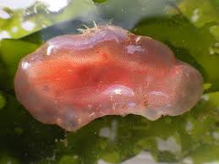
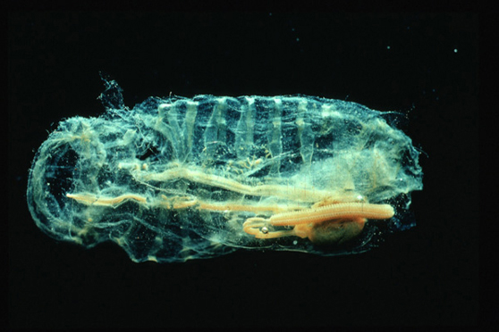
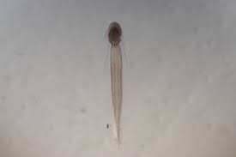
Ascidia (sea squirt)
Salpa
Oikpleura

Slide 12
CEPHALOCHORDATES
They inhabit sandy bottoms of coastal waters (marine)
Nomenclature
They are commonly referred to as Lancelets.
They are also called Amphioxus:
Amphioxus – Amphi (Both ends)
Oxus (Sharp)
The name Amphioxus latter surrendered by priority to Branchiostoma:
Branchiostoma - Branchia (gills).
  Stoma (mouth)

Slide 13
CEPHALOCHORDATES (Characters)
They are translucent animals about 5 – 7cm in length
They are fish like chordates showing the main chordate characters:
Notochord extends the entire length of body and projects beyond the nervous system to the tip of snout (Hence the name cephalochordates).
The cephalochordates have poor development of fins and therefore swim ineffectively
They have no paired fins
The head end present but shows little Specialization.

Slide 14
CEPHALOCHORDATES (Classification)
Comprises a single genus Branchiostoma belonging to Order Branchiostomida
Examples are
Branchiostoma nigeriense (found in Lagos lagoon and pink in color when fresh
B.leonense
B. senegalense
B. gambiense

Slide 15
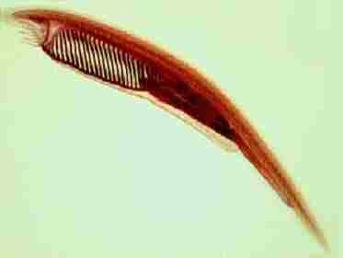
Branchiostoma

Slide 16
THE VERTEBRATA
The vertebrata are made up of two super classes:
a) Agnatha b) Gnathostomata.
Agnatha
Vertebrates without jaws
Mainly fishes
Gnathostomata
Vertebrates with jaws
Consist of fishes and other animals

Slide 17
THE VERTEBRATA
They include the following:
Acanthodians
Placoderms
Chondrichthyes
Osteichthyes
Amphibian
Reptilian
Aves
Mammalia

Slide 18
CONVENIENCE GROUPING
The Vertebrates have been grouped for convenience, on the basis of limbs into :
Pisces : These are fish like vertebrates. The limbs are fins.
They include:
Agnatha
Acanthodians
Placoderms
Chondrichthyes
Osteichthyes
Tetrapod :
This includes:
Amphibia
Reptiles

Slide 19
Agnathans
A / Gnathan – without jaws
Characters
They are the earliest known vertebrates characterized by the absence of jaws.
They are currently regarded as the most primitive living vertebrates because as far as vertebrate features are concerned they haven’t changed from the old basic functions
Many extinct and just few are alive.
Living representatives of the group: Lamprey and Hag fishes
Lamprey - Lampetra fluviatilis – freshwater Petromyzon marinus – marine
Hag fishes - Atlantic hag fish – Myxine glutinosa

Slide 20
Classification of Agnathans
Divided into two:
Ostracodermi – Cephalaspis
They are extinct and are found as fossils.
They have head with heavy armor and bony dermal plates on skin.
Cyclostoma
Petromyzontia (Commonly called LAMPREY)
  Lampetra fluviatilis, (Freshwater), Petromyzon marinus (Marine).
Myxinoidea (Commonly called HAG FISHES).
  Myxine glutinosa, Bdellostoma
The cyclostomata have long rounded and eel like bodies.
They are rounded mouth, from which the name Cyclostomata is derived,
The mouth is also suctorial.

Slide 21
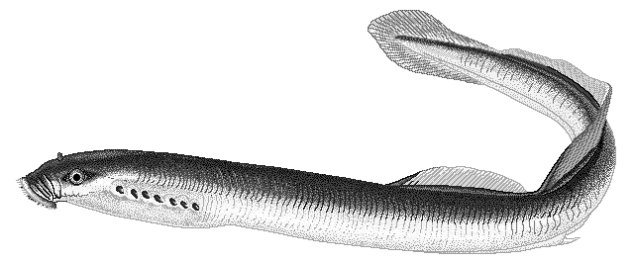
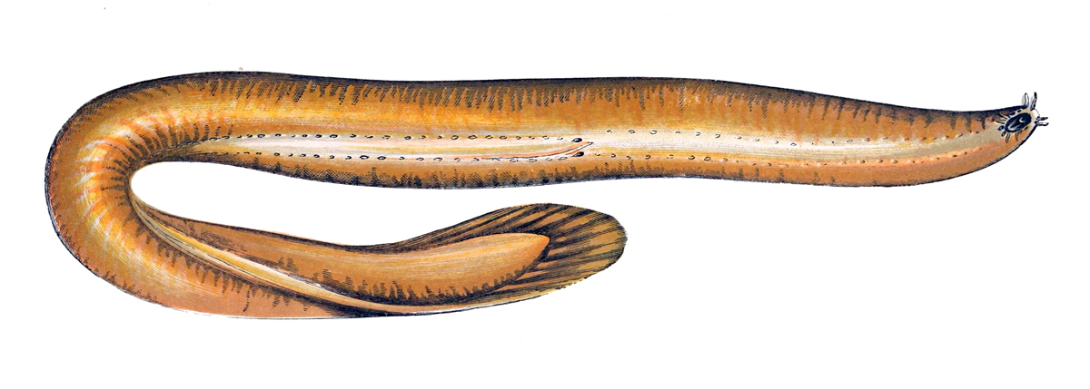
Lampetra fluviatilis
Hagfish

Slide 22
Gnathostomata
Acanthodians
Placoderm.
(The Placoderm and Acanthodian are the extinct forms).
Chondrichthyes.
Osteichthyes.
Amphibia.
Reptilia.
Aves.
Mammalia
(The Chondrichthyes ,Osteichthyes, Amphibia, Reptilia , Aves and Mammalia are the living forms)

Slide 23
Chondrichthyes
All are marine except the river stingray – Potamotrygon garouensis which is found in fresh water
They are cartilaginous fishes. The skeleton is made up entirely of cartilage
The skin is covered with scales. The scales are referred to as placoid scales
The gills are not covered by operculum
Each gill opens separately on the body
Usually 5 pairs on each side of body
The pelvic fin is a sexually dimorphic structure
Pelvic fins modified to form claspers in males
The mouth is located ventrally
Tail fin – usually heterocercal (Asymmetrical)

Slide 24
Classification of Chondrichthyes
Chondricthyes
Elasmobranchi - Selachii (shark), Batoidea (rays & skate)
Bradyodonti/Holocephali
  Elasmobranchi
  Selachii – sharks. Example
                Dogfish – Scyliorhinus canicula
                White shark – Carcharodon carcharias
                Hammerhead shark – Sphyrna couardii
                Saw fish – Pristis pristis
  Batoidea – Rays
    Torpedo torpedo –( Electric ray).
    Dasyatis margarita –( stingray).
    Skate – Raja eglanteria
    Chimaera sp – (rat failed fish / rabbit fish).

Slide 25
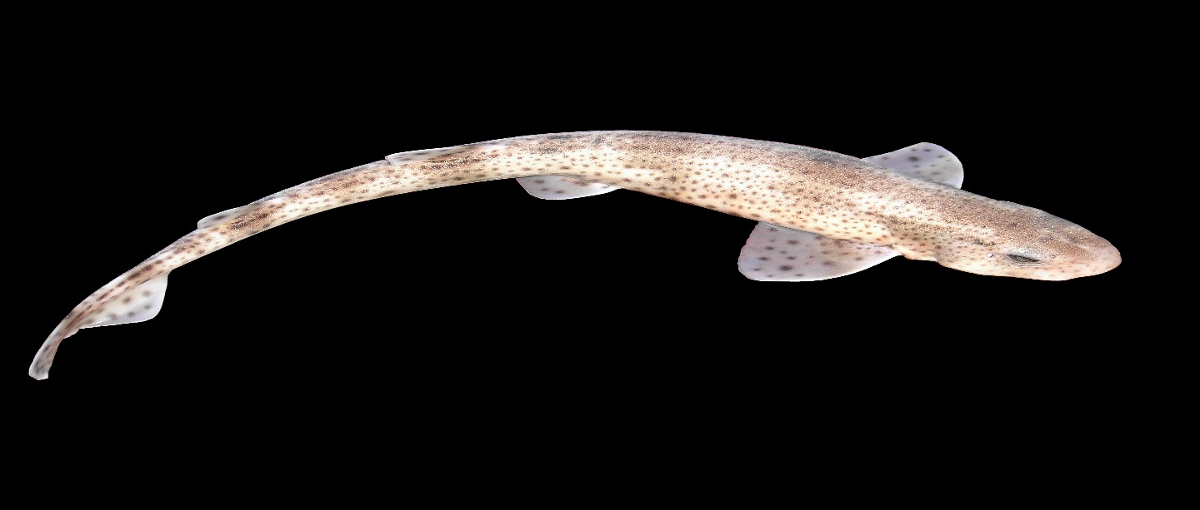
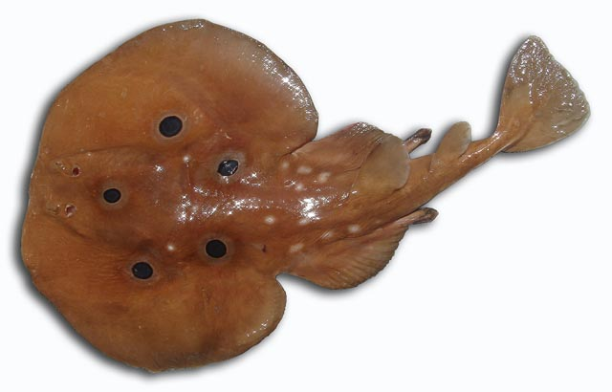
                Scyliorhinus canicula
Torpedo torpedo

Slide 26
Osteichthyes
Inhabit both fresh and marine waters.
Skeleton is made up of bone
Skin covered by cycloid, ctenoid or ganoid scales
Mouth located terminally / sub terminally
Gills are covered by Operculum or gill cover
Presence of bladder in many species
Tail usually homocercal
Pelvic fins not modified to form claspers

Slide 27
Classification of Osteichthyes
Sarcopterygii – flesh finned fishes
  Crossopterygii – lobe fins e.g. Latimeria sp
  Dipnoi – lung fishes e.g. Protopterus
Actinopterygii
  Chondrostei
  Holostei
  Telostei
Examples
Oreochromis niloticus - Tilapia
Clarias gariepinus - Catfish.

Slide 28
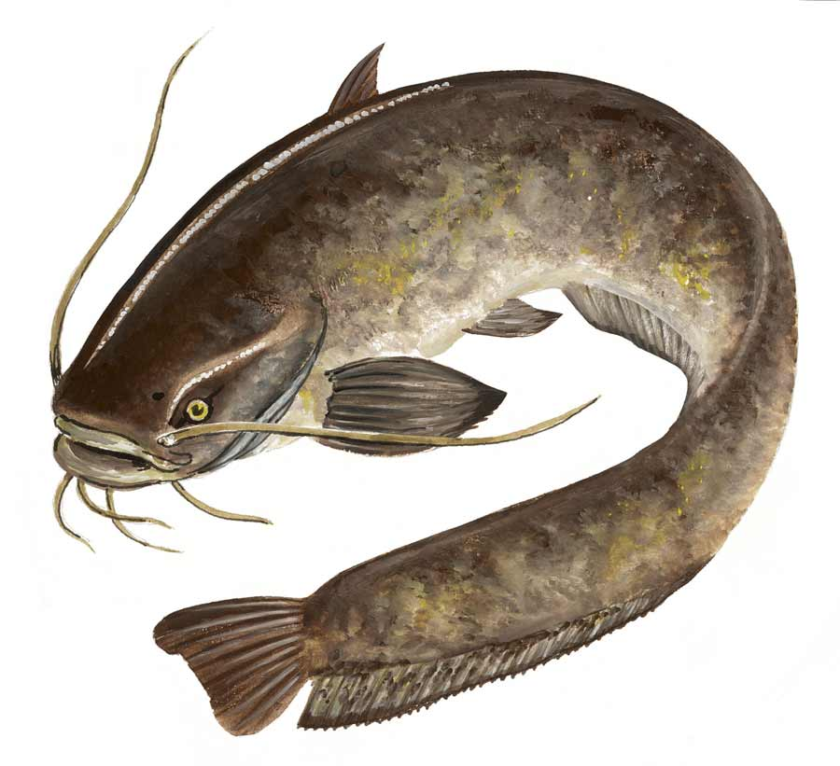
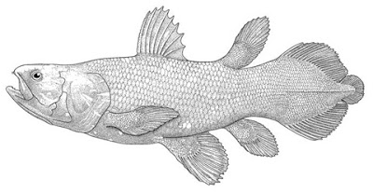
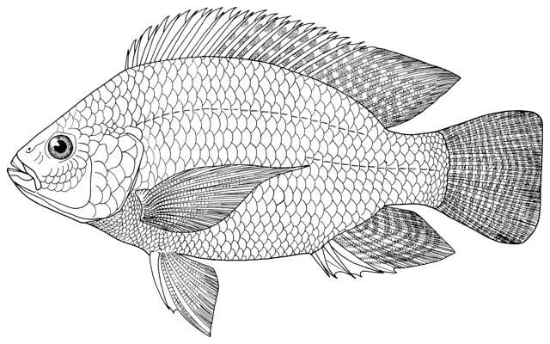

Latimeria sp
Clarias gariepinus
Protopterus
Oreochromis niloticus

