Slide 1
GENETICS
BY DR. FRANCIS H. IBADIN

Slide 2
Introduction to Genetics
Genetics is a field of biology that studies how traits are passed from parents to their offspring. The passing of traits from parents to offspring is known as heredity, therefore, genetics is the study of heredity.
This introduction to genetics takes you through the basic components of genetics such as DNA, genes, chromosomes and genetic inheritance.
Genetics is built around molecules called DNA. DNA molecules hold all the genetic information for an organism. It provides cells with the information they need to perform tasks that allow an organism to grow, survive and reproduce.

Slide 3
A gene is one particular section of a DNA molecule that tells a cell to perform one specific task.
Heredity is what makes children look like their parents. During reproduction, DNA is replicated and passed from a parent to their offspring. This inheritance of genetic material by offspring influences the appearance and behavior of the offspring. The environment that an organism lives in can also influence how genes are expressed.

Slide 4
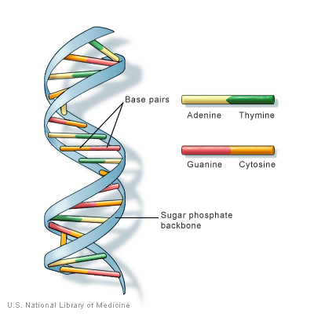
DNA
DNA is the cornerstone of genetics and is the perfect place to start for an introduction to genetics. DNA stands for deoxyribonucleic acid and it is the molecule that holds the genetic
information for a cell and an organism.
DNA - introduction to genetics. A DNA molecule contains a code that can be used by a cell to express certain genes. Specific sections of a DNA molecule provides the information to build specific
proteins which can then be used by a cell to express the desired gene.

Slide 5
A DNA molecule is a nucleic acid, one of the four molecules of life. It comes in the form of a long, linear molecule referred to as a strand. Each strand of DNA is bonded to a second strand of
DNA to form a DNA double helix. In eukaryotic cells, DNA is found in the nucleus as a tightly coiled double helix.
DNA molecules are replicated during cell division. When a cell divides, the two new cells contain all the same DNA that the original cell had.
In sexual reproduction with two parents, half of the DNA of the offspring is provided by each of the parents. The genetic material of a child is made from 50% of their mother’s DNA and 50% their father’s DNA.

Slide 6
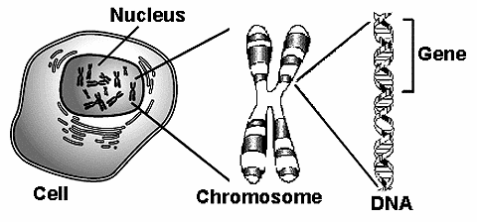
Genes
A gene is a specific segment of a DNA molecule that holds the information for one specific protein. DNA molecules have a unique code for each gene which codes for their specific protein.
Some organisms can have more than 100,000 different genes so they will have 100,000 unique sequences of DNA ‘code’.
Genes are the basic unit of heredity. The genes of an individual are determined by their parent or parents. A bacteria that is born by one parent cell splitting into two cells and has the exact same genes as their one parent cell.

Slide 7
Eye color - introduction to genetics
A human, on the other hand, has two copies of each gene – one set from their mother and a second set from their father. Different forms of the same gene are called alleles.
For each gene, a human can have two different alleles or two of the same alleles – one from each parent.
Physical traits such as eye color or height are often determined by the combination of multiple genes. The environment an individual lives in also impacts how genes are expressed.

Slide 8
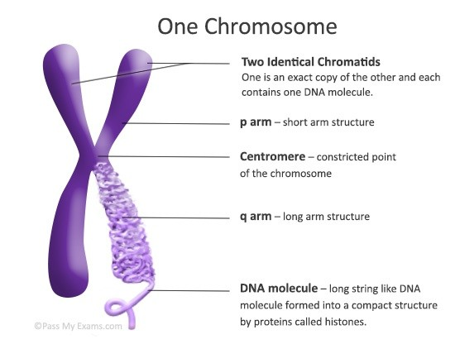
Chromosomes
A chromosome is a structure made from tightly packed strands of DNA and proteins called histones. Strands of DNA are tightly wrapped around the histone proteins and form into long worm-shaped structures called ‘chromatids’. Two chromatids join together to form a chromosome.
Chromosomes are formed in the nucleus of a cell when a cell is dividing. It is possible to see chromosomes under an ordinary light microscope if the cell is in the right stage of cell division.
The number of chromosomes varies between species. Humans have 46 chromosomes. Some species can have many more than 100 chromosomes while others can have as little as two.

Slide 9
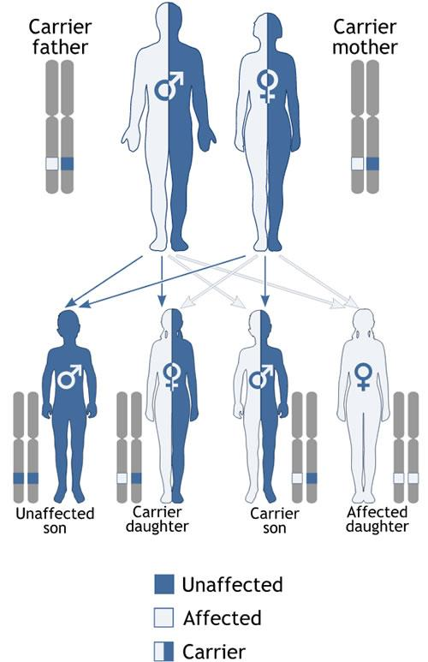
Genetic inheritance
Inheritance is the backbone of genetics and is an important topic to cover in an introduction to genetics. Long before DNA had been discovered and the word ‘genetics’ had been invented, people were studying the inheritance of traits from one generation to the next.
Genetic inheritance occurs both in sexual reproduction and asexual reproduction. In sexual reproduction, two organisms contribute DNA to produce a new organism. In asexual reproduction, one organism provides all the DNA and produces a clone of themselves. In either, genetic material is passed from one generation to the next.
Experiments performed by a monk named Gregor Mendel provided the foundations of our current understanding of how genetic material is passed from parents to their offspring.

Slide 10
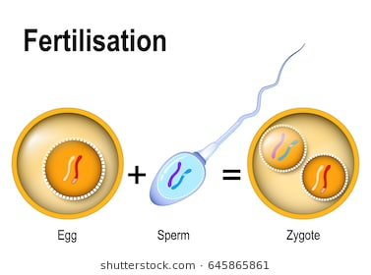
Gametes: this is the matured sex cell which takes part in sexual reproduction
Zygote: This is a single cell formed as a result of the union of a male and female gametes forming diploid cell
Heredity: This is the transmission of traits from parent to offspring.
Variation: This is the similarities and differences experienced in an individual organism
Trait: This is a characteristic that is heritable from one generation to the next.
Allele: This is an alternate form of a single gene or different forms of a gene
Phenotype: This is the physical appearance of a trait; the physical feature resulting from a genotype (e.g. red, white)

Slide 11
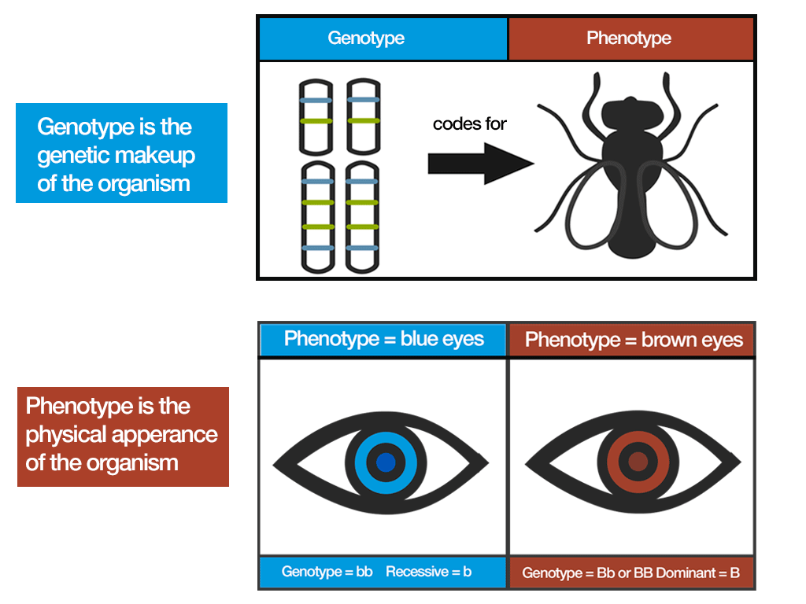
Genotype: This is the letters assigned to a trait; i.e. gene combination for a trait (e.g. RR, Rr, rr). It represents the genetic make-up of an organism.
Hybrids: The offspring of crosses between parents with different traits
Dominant trait: This is a trait or character that is expressed in an offspring when two individuals with contrasting characters or traits are crossed.
Dominant genes: These are the genes that control dominant characters

Slide 12
Recessive trait: This is the character or trait from one parent which is masked or does not produce the effect in the presence of dominant character. It is the trait that does not show through in the first generation
Recessive genes: These are the genes which control recessive characters.
Co-dominant: this is a condition in a heterozygote in which both alleles have equal dominance. More so, the phenotype is a mixture of the opposing characters.
Homozygous: Organisms that have 2 identical alleles for a trait e.g. TT , tt
Heterozygous: organism that have two different alleles for a trait e.g. Tt
True breeding: This occurs when an organism produce offspring identical to themselves if allow to self-pollinate or self-fertilize
Hybridization: This is the crossing of plants with contrasting characters
Mutation: This is a change in the genetic make-up of an organisms resulting in a new characteristics that is inheritable.

Slide 13
Why is Genetics important to society?
The knowledge of genetics is used in Agriculture especially in animal and crop husbandry to produce desirable breeds of animals and varieties of crops such as:
  Improvement in quality of products such as taste, colour, size and nutritive values
  Increase the yield of livestock and plant produce
  Development of early maturing varieties
  Development of disease resistant varieties
  Production of animals and crops that can adapt to climatic conditions
In medicine, the field of genetics has contributed immensely in the treatment of diseases such as:
  The discovery of the cancer causing gene, diagnosis of diseases, gene therapy, genetic screening, etc.
  Determination of the paternity of a child

Slide 14
  Prevention of death through blood transfusion i.e. determining compatible blood groups
  Marriage counseling on hereditary diseases such as haemophilia, sickle cell anaemia etc.
  It also helpful in crime detection through the use of fingerprint and blood group

Slide 15
Forensics and Legal Implication: Human genetic information has been used to either match or rule out a suspect's DNA to biological evidence found at a crime scene, to identify victims and to exonerate convicted individuals using newer genetic methods not available at the time of the initial conviction. Paternity testing is another common legal application of genetic testing.
Human History: Studying human DNA and genetics can help scientists better understand where humans came from as a species. It can help elucidate the connections between different groups of people and give historians and anthropologists a clearer picture of historic human migration patterns

Slide 16
Scientists who have contributed to the history of genetics
Charles Darwin (1809-1882): He developed the idea of natural evolution; Origin of Species and Pangenesis theory
Aristotle (384-322 BC): He contributed in Pangenesis Theory i.e. gemmules (Gemmules were imagined particles of inheritance proposed by Charles Darwin as part of his Pangenesis theory)
Plato (428-348 BC): Plato's idealistic views had a profound effect on biology. To him, the structure and form of organisms could be understood from their function which in turn was designed to achieve ultimate goodness and harmony imposed by an external creator.
Hugo Marie de Vries (1848 –1935): was a Dutch botanist and one of the first geneticists. He is known chiefly for suggesting the concept of genes, rediscovering the laws of heredity in the 1890s. He also introduced the term "mutation", and developed mutation theory of evolution.

Slide 17
Erwin Chargaff (1905 –2002): was an Austro-Hungarian biochemist that immigrated to the United States during the Nazi era and was a professor of biochemistry. His work laid the foundations for Crick and Watson's discoveries. Chargaff discovered two rules that helped lead to the discovery of the double helix structure of DNA. The first rule was that in DNA the number of guanine units is equal to the number of cytosine units, and the number of adenine units is equal to the number of thymine units. This hinted at the base pair makeup of DNA. The second rule was that the relative amounts of guanine, cytosine, adenine and thymine bases vary from one species to another. This hinted that DNA rather than protein could be the genetic material.
Friedrich Miescher – is a Swiss physiological chemist who in 1869 identified what he called "nuclein" inside the nuclei of human white blood cells. This term was later changed to "nucleic acid" and eventually to "deoxyribonucleic acid," or "DNA.

Slide 18
Francis Harry Compton Crick (1916 –2004) was a British molecular biologist, biophysicist, and neuroscientist, most noted for being a co-discoverer of the structure of the DNA molecule in 1953 with James Watson. Crick was an important theoretical molecular biologist and played a crucial role in research related to revealing the helical structure of DNA.
James Dewey Watson (born April 6, 1928) is an American molecular biologist, geneticist and zoologist, best known as one of the co-discoverers of the structure of DNA in 1953 with Francis Crick and Rosalind Franklin.
Francis Crick and James Watson cracked the secret of life when they worked out the double helix structure. They were awarded the Nobel Prize for Physiology or Medicine in 1962.

Slide 19
Gregor Johann Mendel (1822 - 1884): was a scientist, Augustinian friar and abbot of St. Thomas' Abbey in Brno, Margraviate of Moravia. He’s refers to as Father of modern Genetics. Mendel was born in a German-speaking family in the Silesian part of the Austrian Empire known as Czech Republic today. He gained posthumous recognition as the founder of the modern science of genetics. He carried experiment on pea plant between 1856 and 186. He established many of the rules of heredity, now referred to as the laws of Mendelian inheritance.

Slide 20
MENDELIAN INHERITANCE AND POSTULATES
The breeding experiments of Gregor Mendel in the mid-1800s laid the groundwork for the science of genetics. His postulates and laws are still valid till today.
  Brief history of Gregor Mendel
Gregor Johann Mendel (The Father of Genetics) lived between 1822-1884. He was born to a peasant family in Heinzendorf (Czech Republic) in July 22, 1822. He was an Austrian Monk who studied philosophy for several years.
n 1843, he was admitted to the Augustinian Monastery of St. Thomas in Brno where he took the name of Gregor and received important support for his studies and research. He worked at monastery and taught high school. He also tended the monastery garden
In 1849, he was relieved of his pastoral duties and accepted a teaching appointment

Slide 21
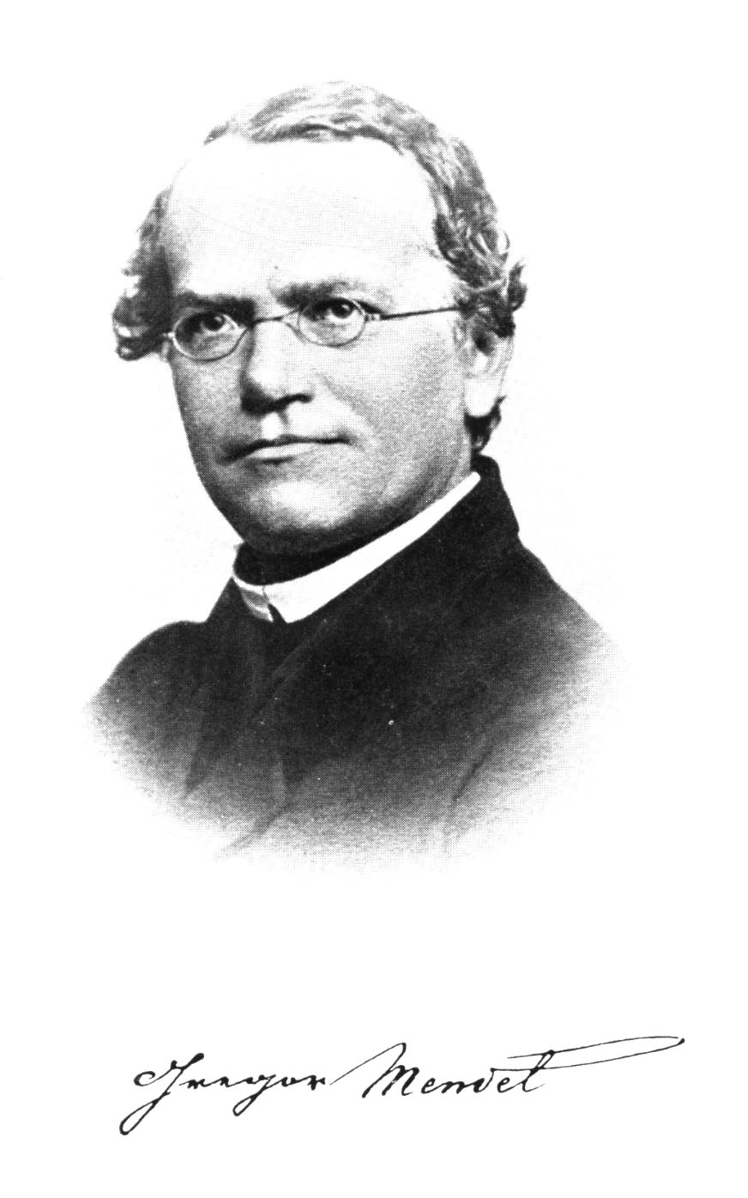
From 1851 – 1853, he attended the University of Vienna to study physics and botany
In 1854, he returned to Brno where he performed his first pea hybridization experiment in 1856
He continued to research until 1864 when he became the abbot of the monastery.

Slide 22
Gregor Johann Mendel Experiment
Mendel conducted his experiments with Pisum sativum known as the garden pea. And between 1856 and 1863, Mendel cultivated and tested some 28,000 pea plants. He grew peas and became interested in the traits that were expressed in different generations of peas.
He wasn’t the first scientist to study the garden pea, but he was one who distinguished himself from others through;
  careful planning and
  adherence to the scientific method
Mendel’s work was not understood or appreciated while he was alive and it wasn’t until the 1900s and even into the 1920s and 30s when people truly understood what he had discovered.

Slide 23
Reasons for the Selection of Garden Pea by Mendel
It was cheap and readily available as seed in a variety of shapes and colors.
Normally self pollinates
It’s easy to cross pollinate
Takes up little space
Have relatively short generation time (single season)
Produces many offspring (1 pod = 6-10 peas)
Selected Characteristics used by Mendel
Flower color: purple or white
Flower position: axil or terminal
Stem length: tall or dwarf
Pod shape: inflated or constricted
Seed shape: round or wrinkled
Seed color: yellow or green
Pod color: yellow or green

Slide 24
Reasons for the success of Mendel’s Experiments
He choose peas (a research organism well-suited to his objectives)
Experiments carefully designed
He restricted his study to a few contrasting traits
He collected large amounts of data
He kept accurate quantitative records
He used mathematical analysis to show that results were consistent with hypotheses
His analysis of the data allowed for certain postulates to be developed which provided the underlying basis for transmission of genes

Slide 25
Inherited and Non-Inherited Traits
Traits are physical characteristics that can be displayed by animals (including human beings) and some plants.
Inherited traits are passed down genetically from one generation to the next, while non-inherited traits are usually associated with a learned behavior.
Inherited Traits
Inherited traits are characteristics acquired through the genetic information each parent contributes to the offspring. Inherited traits can be a physical trait or a behavior.
Examples of physical inherited traits include hair, eye and skin color, facial features, height, dimples, length of toes and muscle structures.
Examples of behavioral traits include a terrier's instinct to chase small animals or a cat puffing out its hair in response to a threat.
Although inherited traits are often associated with things we can see, these traits also play an important role in how the body develops and functions.
For example, inherited traits can increase risks for heart disease, high blood pressure, glaucoma and diabetes.

Slide 26
Non-Inherited Traits
Non-inherited traits are learned traits, and in most cases these traits are learned from close or immediate family members like parents, grandparents and siblings.
Examples of non-inherited traits include table manners, greeting customs (for example, handshake or bow), a preference for certain types of foods, and parenting skills.
These types of traits can also be acquired through actions; for example, a weightlifter developing large muscles, a video game player enhancing fast hand and eye coordination or a yoga student gaining flexibility.
Expression of Traits
While inherited traits are genetically driven, they can also be influenced by non-inherited traits. In many instances, a trait that an individual expresses is due to both inherited and non-inherited causes.
Here are a few examples of how these two traits can influence one another: Height is an inherited trait, but the total height that an individual achieves can be affected by nutrition; and muscle structure is an inherited trait, but muscle development which is expressed is related to diet and physical activities. Hair color is an inherited trait, but if someone grows up in a society where it is popular to dye hair, the expression of this trait may be changed.

Slide 27
Hints for working with genetic traits
Traits are assigned letters
The recessive trait usually provides the letter designate
e.g. Round vs. Wrinkled; W= round, w= wrinkled
Be sure to keep your writing neat enough so that you can read the letters
Capital letters refer to dominant traits while lower case letters refer to recessive traits
Letters usually appear in pairs
e.g. Round = WW vs wrinkled = ww
Remember the genotype will tell you the phenotype.

Slide 28
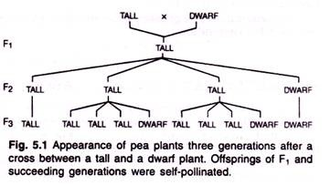
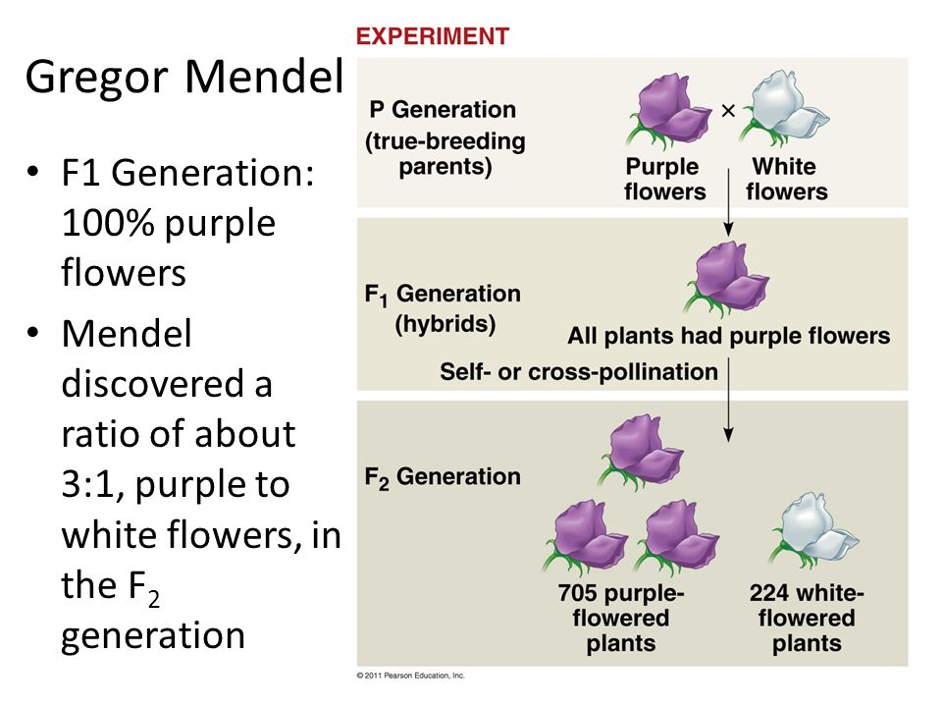
Mendel’s Postulates and Laws of Inheritance
The Mendel’s four postulates and laws of inheritance are:
(1) Principles of Paired Factors
(2) Principle of Dominance
(3) Law of Segregation or Law of Purity of Gametes (Mendel’s First Law of Inheritance)
(4) Law of Independent Assortment (Mendel’s Second Law of Inheritance).
Mendel laid the foundation of the science of genetics through the discovery of basic principles of hereditary. He conducted his experiments with garden pea (Pisum sativum) for over seven years (1856-1864) and advocated four postulates, including two important laws of inheritance.
Appearance of pea plant three generations after a cross between a tall and a dwarf plant

Slide 29
Postulate I. Principles of Paired Factors:
A character is represented in an organism (diploid) [(of a cell or nucleus) containing two complete sets of chromosomes, one from each parent] by at least two factors.
The two factors lie on the two homologous chromosomes at the same locus (Homologous chromosomes are chromosome pairs (one from each parent) that are similar in length, gene position, and centromere location).
They may represent the same (homologous, e.g., TT in case of pure tall pea plants) or alternate expression (heterozygous, e.g., Tt in case of hybrid tall pea plants) of the same character.
Factors representing the alternate or same form of a character are called alleles or allelomorphs.
Postulate II. Principle of Dominance:
“When two homozygous individuals with one or more sets of contrasting characters are crossed, the characters which appear in the hybrids of F1 generation are always the dominant characters and those do not appear in F1 offspring’s are always the recessive characters”.
During the course of investigations of the principles of inheritance, Mendel crossed plants of a variety of Pisum sativum six feet tall with plants of a variety one foot in height on an average, (i.e., parents or P generation). When the seeds from this cross were planted they produced plants not intermediate between the two parents, as might be expected, but all tall, like the six-foot parent (Fig. 5.1) see previous slide

Slide 30
Mendel made crosses to study the inheritance of six other sets of characters (given below) and observed that in every case the hybrid resembled one of the parents with respect to the character.
It follows then that one factor or gene in a pair masks or inhibits the expression of the other. Thus, in the cross described, the tall factor masks, or inhibits the expression of the dwarf factor in the F1 (first filial generation); therefore, the tall factor is called the dominant factor, and the dwarf factor is referred to as the recessive factor, or gene.
Other six sets of characters that Mendel studied and classified as dominant and recessive were as follows:
(1) Round form of seeds dominant over wrinkled.
(2) Yellow colour of cotyledons dominant over green.
(3) Axillary position of flower dominant over terminal position.
(4) Green colour of unripe pod dominant over yellow.
(5) Inflated condition of ripe pod dominant over constricted.
(6) Purple colour of flower dominant over white.

Slide 31
Postulate III. Law of Segregation or Law of Purity of Gametes (Mendel’s First Law of Inheritance):
The two factors (alleles) of a trait which remain together in an individual do not get mixed up but keep their identity distinct, separate at the time of gametogenesis (i.e., gametes formation) or sporogenesis (i.e., spores formation), get randomly distributed to different gametes and then get paired again in different offspring’s as per the principle of probability. Since two alleles remain together in pure form without mixing, affecting or blending each other, the law of segregation is also known as “law of purity of gametes”.
Main features of this law are as follows:
1. When a dominant and a recessive allele of a gene come together in a hybrid after crossing between two plants having contrasting characters, they do not mix or blend together.
2. They separate into different gametes in equal number. Each gamete has only one type of allele (say either A or a).
3. Separation of two alleles of a gene during gamete formation takes place usually due to the separation of homologous chromosomes during meiosis (anaphase I), because alleles are located on the chromosomes.
4. With complete dominance, segregation leads to phenotypic ratio of 3: 1 in F2 generation for characters governed by a single gene, and 9: 3: 3: 1 ratio for characters controlled by two genes.

Slide 32
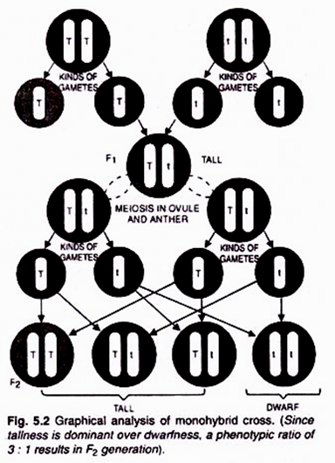
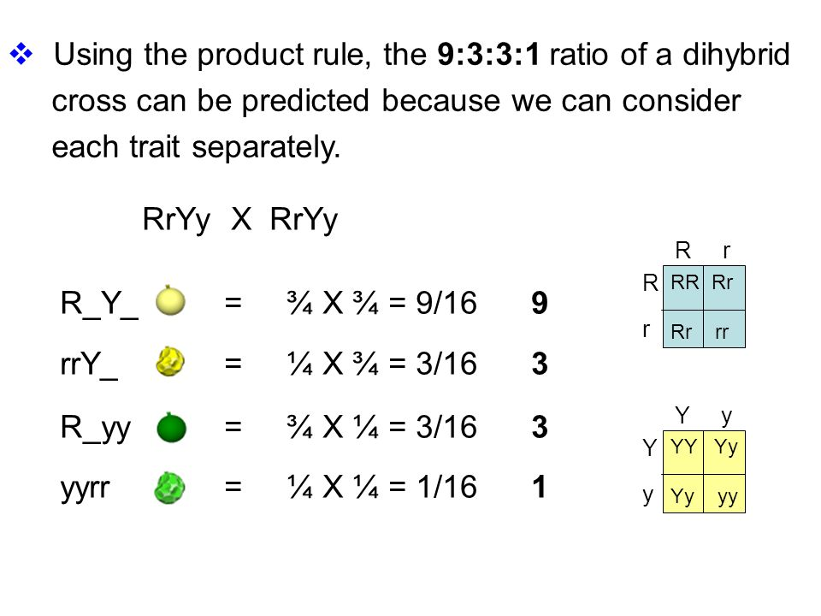
5. If crossing over does not take place, segregation of genes takes place during anaphase I. If crossing over occurs, segregation of genes will take place during anaphase II.
Example:
The principle of the law of segregation can be explained by means of a monohybrid cross.
Analysis of Monohybrid Cross:
A cross in which only a single pair of alleles is considered is called a monohybrid cross. Figure 5.2 is a graphic analysis of the cross between tall and dwarf peas in terms of Mendel’s interpretation.

Slide 33
In this, T is the symbol which stands for the factor or gene controlling tallness, and t is the symbol used to denote the factor or gene controlling dwarfness.
The factors or genes as also postulated by Mendel, always occur in pairs. Both tall and the dwarf plants which are crossed are homozygous (i.e., both the genes in a pair are identical).
These plants are “pure” for tallness and dwarfness respectively, and if self pollinated will always breed true, producing only tall and dwarf plants respectively.
In the present monohybrid cross the tall parent, which is homozygous, is shown as TT, and the dwarf parent is shown as tt.
During the course of sexual reproduction both kinds of plants produce gametes; these gametes contain but one factor of each pair (i.e., either T or t).
The gametes produced by the tall plant contain T gene, while the gametes of dwarf plant possess t gene.

Slide 34
The fusion of a gamete from the tall plant with a gamete from the dwarf plant produces a tall plant in the F1 generation, because the gene for tallness (T) is dominant over that of dwarfness (t).
The new plant in the F, generation is shown in the diagram as Tt.
It is a heterozygous plant because it possess a pair of homologous chromosomes carrying one allele for tallness and one for dwarfness.
The heterozygous plants produce two kinds of gamete or sex cell, male gametes and female gametes.
Half of the male gametes contain T gene and half possess t gene.
Similarly half of the female gametes possess T gene and half contain t gene.
During the process of fertilization which follows these two kinds of gametes (i.e male and female) unite at random and produce F2 (second filial) generation.
As a result of these chance combinations, an approximate phenotypic ratio of 3 tall plants to 1 dwarf plant (i.e., 3: 1 ratio) is normally obtained. All plants with TT and Tt genes will be tall, and the plants possessing tt (both recessive) genes will be dwarf.

Slide 35
Further self breeding of these plants shows that the dwarf plants breed true (tt), i.e., produce only dwarf plants.
Amongst tall plants, 1/3 breed true, that is, yield only tall plants.
The remaining 2/3 of the F2 tall plants or 50% of the total F2 plants behave as hybrid plants and produce both tall and dwarf plants in the ratio 3: 1.
Therefore, the F2 phenotypic ratio of 3: 1 is genotypically 1 pure tall: 2 hybrid tall: 1 dwarf (1: 2: 1 ratio is also called Mendel’s Monohybrid Genotypic Ratio).
Postulate IV. Law of Independent Assortment (Mendel’s Second Law of Inheritance):
After being satisfied with monohybrid crosses, Mendel took into consideration two pairs of contrasting characters and studied their inheritance (i.e., di-hybrid cross).
According to this law “the two factors (genes) of each contrasting character (trait) assort or separate independently of the factors of other characters at the time of gamete formation and get randomly rearranged in the offspring”.

Slide 36
Following are the main features of this law:
1. This law explains simultaneous inheritance of two plant characters.
2. In F₁ when two genes controlling two different characters, come together, each gene exhibits independent dominant behaviour without affecting or modifying the effect of other gene.
3. These gene pairs segregate during gamete formation independently.
4. The alleles of one gene can combine freely with the alleles of another gene. Thus, each allele of a gene has an equal chance to combine with each allele of another gene.
5. Each of the two gene pairs when considered separately, exhibits typical 3: 1 segregation ratio in F₂ generation. This is a typical di-hybrid segregation ratio.
6. Random or free assortment of alleles of two genes leads to formation of new gene combinations.
Example:
The principle or law of independent assortment can be studied by means of di-hybrid cross.
Analysis of Di-hybrid Cross:
In the di-hybrid cross Mendel crossed pure (i.e., homozygous) plants of round seed and yellow cotyledons variety of pea with those having wrinkled seed and green cotyledons.

Slide 37
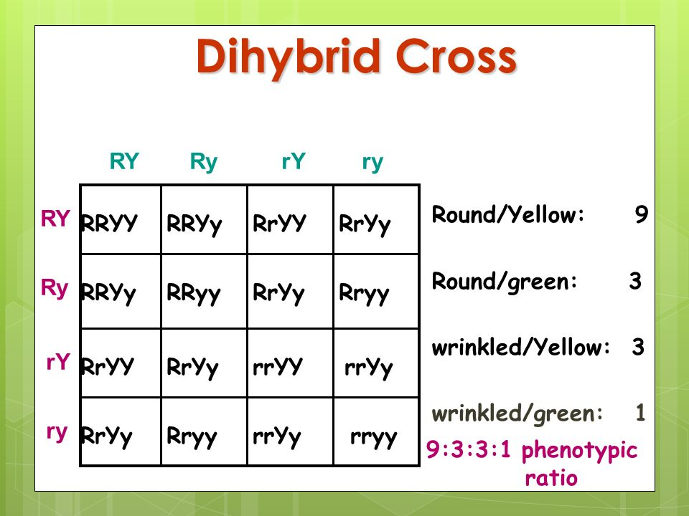
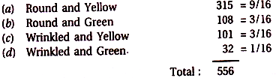
He had already studied these characters and had observed that roundness was dominant over wrinkleless, and yellow colour of the cotyledons was dominant over green colour.
As shown, one homozygous parent is expressed as RRYY (Round seed and yellow cotyledons) and the other is expressed as rryy (wrinkled seed and green cotyledons).
The former, as expected, will produce gametes with YR genes, and the latter will produce gametes with ry genes. The two kinds of gametes fuse to produce F₁ individual with genetic constitution RrYy.
Phenotypically these individuals possess round seeds with yellow cotyledons because roundness is dominant over wrinkleless, and yellow colour is dominant over green. F₁ individuals are thus heterozygous round and heterozygous yellow.
When Mendel self-fertilized the F₁ individuals, in F₂ generation he observed plants of four kinds in the following phenotypic frequencies:

Slide 38
Thus the four categories of plants appeared in approximate phenotypic ratio of 9: 3: 3: 1. (Called Mendel’s Di-hybrid phenotypic Ratio) (Fig. 5.3).
The most noteworthy feature of this di-hybrid cross that struck Mendel was the appearance of two new categories of plants besides the parental-ones i.e., Round Green, and wrinkled yellow. These two new categories were in fact the re-combinations of the parental characters. This led Mendel to postulate the law of independent assortment.
It can also be proved by studying the individual character of seed colour and seed shape separately:
Seed colour:
Yellow (9 + 3 = 12): Green (3 + 1 = 4) or 3: 1
Seed Shape:
Round (9 + 3 = 12): Wrinkled (3 + 1 = 4) or 3: 1
The result of each character is similar to the monohybrid ratio.

Slide 39
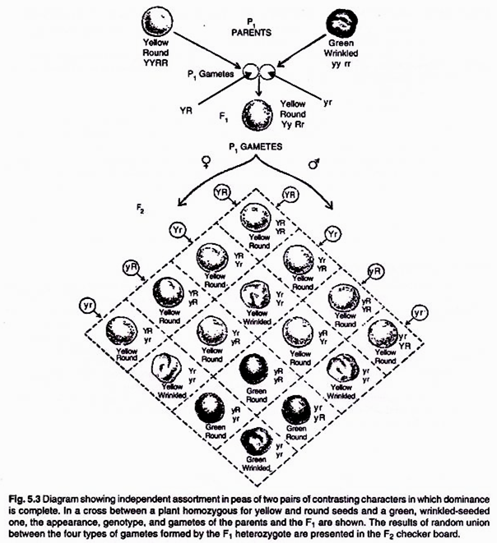

Slide 40
Shortcomings of the Law of Independent Assortment:
The principle or law of independent assortment is applicable to only those factors or genes which occur on different chromosomes.
Actually, a chromosome bears hundreds of genes.
All the genes or factors present on a chromosome are inherited together except when ‘crossing over’ takes place.
The phenomenon of inheritance of a number of genes or factors together due to their occurrence on the same chromosome is called linkage.
Mendel himself found that white-flowered pea plants always produced white seeds, while red-flowered plants always yielded grey seeds.

Slide 41
PROBABILITY IN GENETICS
Probability is a branch of mathematics that deals with calculating the likelihood of a given event's occurrence. Probability is quantified as a number between 0 and 1, where, loosely speaking, 0 indicates impossibility and 1 indicates certainty. Genetics is almost unique among the sciences, in that its fundamental laws were stated as probability laws. Thus the probabilities we compute have a reality as long-run frequencies, and are not just subjective.
TYPES OF PROBABILITY
a. The Empirical Probability – these are the events that can be calculated from real-life observations. The empirical probability of an event is calculated by counting the number of times that event occurs and dividing it by the total number of times that event could have occurred.
b. The Theoretical Probability – these are the events that can be predicted using a set of rules or assumptions. The theoretical probability of an event is calculated based on information about the rules and circumstances that produce the event. It reflects the number of times an event is expected to occur relative to the number of times it could possibly occur.

Slide 42
RULES OF PROBABILITY
The Product Rule of Probability:
It states that the probability of two (or more) independent events occurring together can be calculated by multiplying the individual probabilities of the events.
Example 1:
If you roll a six-sided die once, you have a 1/6 chance of getting a six.
If you roll two dice at once, your chance of getting two sixes is:
= (Probability of a six on die 1) x (Probability of a six on die 2)
= (1/6)⋅(1/6)=1/36
In general;
You can think of the product rule as the “and” rule:
If both event X and event Y must happen in order for a certain outcome to occur, and if X and Y are independent of each other (don’t affect each other’s likelihood), then you can use the product rule to calculate the probability of the outcome by multiplying the probabilities of X and Y

Slide 43
Example 2:
Consider a cross between two heterozygous (Aa) individuals. What are the odds of getting an aa individual in the next generation?
The only way to get an aa individual is if the mother contributes an a gamete and the father contributes an a gamete.
Each parent has a 1/2 chance of making an a gamete.
Thus, the chance of an aa offspring is:
(probability of mother contributing a) x (probability of father contributing a) = (1/2)⋅(1/2)=1/4
2. The Sum Rule of Probability
The sum rule states that the probability that any of several mutually exclusive events will occur is equal to the sum of the events’ individual probabilities.
For example, if you roll a six-sided die, you have a 1/6 chance of getting any given number, but you can only get one number per roll.
You could never get both a one and a six at the same time; these outcomes are mutually exclusive.

Slide 44
Thus, the chances of getting either a one or a six are:
= (probability of getting a 1) + (probability of getting a 6)
= (1/6) + (1/6) = 1/3
You can think of the sum rule as the “or” rule: if an outcome requires that either event X or event Y occur, and if X and Y are mutually exclusive (if only one or the other can occur in a given case), then the probability of the outcome can be calculated by adding the probabilities of X and Y.
Example 3:
Let’s use the sum rule to predict the fraction of offspring from an Aa x Aa cross that will have the dominant phenotype (AA or Aa genotype).
In this cross, there are three events that can lead to a dominant phenotype:
Two A gametes meet (giving AA genotype), or
A gamete from Mom meets a gamete from Dad (giving Aa genotype), or
a gamete from Mom meets A gamete from Dad (giving Aa genotype)
So, the probability of offspring with a dominant phenotype is:
= (probability of A from Mom and A from Dad) + (probability of A from Mom and a from Dad) + (probability of a from Mom and A from Dad)
= (1/4) + (1/4) + (1/4) = ¾

Slide 45
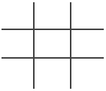
The Punnett Square
The value of studying genetics is in understanding how we can predict the likelihood of inheriting particular traits. This can help plant and animal breeders in developing varieties that have more desirable qualities. It can also help people explain and predict patterns of inheritance in family lines.
One of the easiest ways to calculate the mathematical probability of inheriting a specific trait was invented by an early 20th century English geneticist named Reginald Punnett.
His technique employs what we now call a Punnett square. This is a simple graphical way of discovering all of the potential combinations of genotypes that can occur in children, given the genotypes of their parents. It also shows us the odds of each of the offspring genotypes occurring.
Setting up and using a Punnett square is quite simple once you understand how it works. You begin by drawing a grid of perpendicular lines:
:

Slide 46
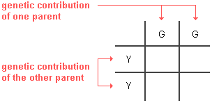
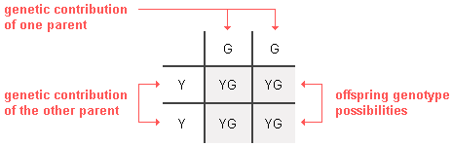
Next, you put the genotype of one parent across the top and that of the other parent down the left side. For example, if parent pea plant genotypes were YY and GG respectively, the setup would be:
Note that only one letter goes in each box for the parents. It does not matter which parent is on the side or the top of the Punnett square.
Next, all you have to do is fill in the boxes by copying the row and column-head letters across or down into the empty squares. This gives us the predicted frequency of all of the potential genotypes among the offspring each time reproduction occurs.

Slide 47
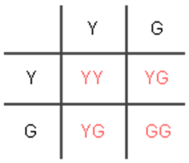
In this example, 100% of the offspring will likely be heterozygous (YG). Since the Y (yellow) allele is dominant over the G (green) allele for pea plants, 100% of the YG offspring will have a yellow phenotype, as Mendel observed in his breeding experiments.
In another example (shown below), if the parent plants both have heterozygous (YG) genotypes, there will be 25% YY, 50% YG, and 25% GG offspring on average. These percentages are determined based on the fact that each of the 4 offspring boxes in a Punnett square is 25% (1 out of 4). As to phenotypes, 75% will be Y and only 25% will be G. These will be the odds every time a new offspring is conceived by parents with YG genotypes.

Slide 48
An offspring's genotype is the result of the combination of genes in the sex cells or gametes (sperm and ova) that came together in its conception.
One sex cell came from each parent. Sex cells normally only have one copy of the gene for each trait (e.g., one copy of the Y or G form of the gene in the example above). Each of the two Punnett square boxes in which the parent genes for a trait are placed (across the top or on the left side) actually represents one of the two possible genotypes for a parent sex cell.
Which of the two parental copies of a gene is inherited depends on which sex cell is inherited - it is a matter of chance.
By placing each of the two copies in its own box has the effect of giving it a 50% chance of being inherited.

Slide 49
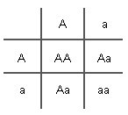

Why?
Why is it important for you to know about Punnett squares? The answer is that they can be used as predictive tools when considering having children. Let us assume, for instance, that both you and your mate are carriers for a particularly unpleasant genetically inherited disease such as cystic fibrosis. Of course, you are worried about whether your children will be healthy and normal. For this example, let us define "A" as being the dominant normal allele and "a" as the recessive abnormal one that is responsible for cystic fibrosis. As carriers, you and your mate are both heterozygous (Aa). This disease only afflicts those who are homozygous recessive (aa). The Punnett square below makes it clear that at each birth, there will be a 25% chance of you having a normal homozygous (AA) child, a 50% chance of a healthy heterozygous (Aa) carrier child like you and your mate, and a 25% chance of a homozygous recessive (aa) child who probably will eventually die from this condition.
 | If both parents are carriers of the recessive allele for a disorder, all of their children will face the following odds of inheriting it: 25% chance of having the recessive disorder 50% chance of being a healthy carrier 25% chance of being healthy and not have the recessive allele at all

Slide 50
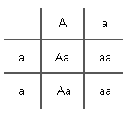

If a carrier (Aa) for such a recessive disease mates with someone who has it (aa), the likelihood of their children also inheriting the condition is far greater (as shown below). On average, half of the children will be heterozygous (Aa) and, therefore, carriers. The remaining half will inherit 2 recessive alleles (aa) and develop the disease.
If one parent is a carrier and the other has a
recessive disorder, their children will have the
following odds of inheriting it:
50% chance of being a healthy carrier
50% chance having the recessive disorder

Slide 51

It is likely that every one of us is a carrier for a large number of recessive alleles. Some of these alleles can cause life-threatening defects if they are inherited from both parents. In addition to cystic fibrosis, albinism, and beta-thalassemia are recessive disorders.
Some disorders are caused by dominant alleles for genes. Inheriting just one copy of such a dominant allele will cause the disorder. This is the case with Huntington disease, achondroplastic dwarfism, and polydactyly. People who are heterozygous (Aa) are not healthy carriers. They have the disorder just like homozygous dominant (AA) individuals.
If only one parent has a single copy of a
dominant allele for a dominant disorder,
their children will have a 50% chance of
inheriting the disorder and 50% chance
of being entirely normal.

Slide 52
Applying probability rules to dihybrid crosses
Example 4:
For instance, let’s imagine that we breed two dogs with the genotype BbCc, where dominant allele B specifies black coat color (versus b, yellow coat color) and dominant allele C specifies straight fur (versus c, curly fur). Assuming that the two genes assort independently and are not sex-linked, how can we predict the number of BbCc puppies among the offspring?
Solution
One approach is to draw a 16-square Punnett square. For a cross involving two genes, a Punnett square is still a good strategy.
Alternatively, we can use a shortcut technique involving four-square Punnett squares and a little application of the product rule.
In this technique, we break the overall question down into two smaller questions, each relating to a different genetic event:
What’s the probability of getting a Bb genotype?
What’s the probability of getting a Cc genotype?

Slide 55
Beta thalassemia is a blood disorder that reduces the production of hemoglobin. Hemoglobin is the iron-containing protein in red blood cells that carries oxygen to cells throughout the body. In people with beta thalassemia, low levels of hemoglobin lead to a lack of oxygen in many parts of the body.
Huntington's disease is an inherited disease that causes the progressive breakdown (degeneration) of nerve cells in the brain. Huntington's disease has a broad impact on a person's functional abilities and usually results in movement, thinking (cognitive) and psychiatric disorders.
Achondroplasia is a bone growth disorder that causes disproportionate dwarfism. Dwarfism is defined as a condition of short stature as an adult. People with achondroplasia are short in stature with a normal sized torso and short limbs. It's the most common type of disproportionate dwarfism
Polydactyly (hexadactyly): The presence of an extra, sixth finger or toe, a very common congenital (of a disease or physical abnormality present from birth) malformation (birth defect).

Slide 56
TESTS OF GOODNESS OF FIT (CHI SQUARE)
A chi-square is a statistical tool that helps us to decide if the observed ratio is close enough to the expected ratio to be acceptable. It is also referred to as “test of goodness of fit”. Chi-square analysis can be used in any area, not just genetics. Chi-square be used to determine if an expected ratio fits an observed ratio.
Chi-square of a monohybrid cross
For instance, Mendel's data from one experiment was ...
P = smooth seeds crossed with wrinkled seeds
F₁ = all smooth seeds (so smooth is dominant and wrinkled is recessive)
F₂ = 5,474 smooth seeds and 1,850 wrinkled seeds
1. What ratio did he observe?
5474 / 1850 = 2.9589189 : 1 = 2.96 : 1

Slide 57
2. What ratio did he expect?
3 : 1
You should understand that the chi-square compares the NUMBER (not ratio) observed to the NUMBER (not ratio) expected.
Calculating the expected number is critical to doing the chi-square
You already know the number observed.
Smooth = 5474
Wrinkled = 1850
3. What is the total number of seeds?
7324
4. What number of wrinkled is expected?
7324 / 4 = 1831
5. What number of smooth is expected?
7324 X 3/4 = 5493
The best (easiest) way to COMPARE two values is to find their DIFFERENCE (by SUBTRACTION).
6. What is the difference between observed and expected smooth?
5474 - 5493 = -19

Slide 58
7. What is the difference between observed and expected wrinkled?
1850 - 1831 = 19
For "statistical magnification" we INCREASE those differences by squaring them.
8. What is the square of the difference between the observed and expected smooth?
19² = 361 or -19 X -19 = 361
9. What is the square of the difference between the observed and expected wrinkled?
19² = 361 or 19 X 19 = 361
These "square of the differences" are too large and must be "Normalised" by dividing each by the number Expected (NOT the number observed). This could be called the "squared differences per expected".
10. What is the square of the difference between the observed and expected smooth, divided by the expected number of smooth?
361 / 5493 = 0.06572 = 0.066
11. What is the square of the difference between the observed and expected wrinkled, divided by the expected number of wrinkled?
361 / 1831 = 0.19716 = 0.197
Lastly, we add together these "squared differences per expected" to give us the TOTAL "squared differences per expected“

Slide 59
12. What is the sum of the "squared differences per expected"?
0.066 + 0.197 = 0.263
Therefore the chi square calculated =0.263
There are two "features" to consider.
A. Significance Level….
We (scientists) like to use the level of 5% as our significant "cut-off". Any chi-square larger than the value from the 5% Table indicates an experiment in which the ratios observed are so far off the ratios expected that we have to conclude that the ratios expected are wrong!
B. Degrees of Freedom…
The more "classes" (categories) the more likely that a statistical "blip" will increase the acceptable limits of the chi-square. The "degrees of freedom" are one less than the number of classes.
i.e. d.f = n-1 (where n stands for number of classes)

Slide 60
13. Name all the different classes in the experiment (earlier)…..
Smooth and Wrinkled
14. How many degrees of freedom were in that experiment?
2 - 1 = 1 (One degree of freedom).
Here's a portion of the Chi Square Significance Table.
Degrees of Freedom | 95 % Significance Levels
1 | 3.84
2 | 5.99
3 | 7.81
4 | 9.49
15. Is the chi-square you calculated within the boundary of "the possible"?
Yes! We calculated a CHI SQUARE = 0.263.
With one degree of freedom we could have a chi-square up to 3.84

Slide 61
  1. CHI-SQUARE OF A MONOHYBRID CROSS AS A QUICK TABLE
Consider these results among the F₂S
4,400 yellow seeds
1,624 green seeds
STEP 1: First, set up a table like the one below
Phenotypes | O | E | O-E | (O-E)² | (O-E)² E
Yellow
Green
Total

Slide 62
STEP 2: Enter the observe data
Phenotypes | O | E | O-E | (O-E)² | (O-E)² E
Yellow | 4400
Green | 1624
Total | 6024

Slide 63
STEP 3: Determine the Expected by multiplying the Total phenotype by the Mendelian ratios for each of the trait.
Phenotypes | O | E | O-E | (O-E)² | (O-E)² E
Yellow | 4400 | 6024 X 3/4 = 4518
Green | 1624 | 6024 X 1/4 = 1506
Total | 6024 | 6024

Slide 64
STEP 4: Subtract Expected from Observe and square the outcome. Divide the result by the Expected
Phenotypes | O | E | O-E | (O-E)² | (O-E)² E
Yellow | 4400 | 6024 X 3/4 = 4518 | 4400 - 4518 = -118 | -118² = 13,924 | 13924 / 4518 = 3.08
Green | 1624 | 6024 X 1/4 = 1506 | 1624 -1506 = 118 | 118² = 13,924 | 13924 /1506 =9.24
Total | 6024 | 6024 |  |  | =12.32

Slide 65
STEP 5: Write out the conclusion whether to accept or reject the analysis. For this experiment, the degree of freedom is n-1 = 2-1, where n=2
Therefore, Chi square tabulated = 3.84
Since the Chi square calculated (12.32) is greater than Chi square tabulated (3.84), it means the observed data does not obey Mendelian principle, as such, it should be rejected.

