Slide 1
BIO 204 BIOLOGICAL TECHNIQUES
COLLECTION OF BIOLOGICAL SPECIMEN
DR. FRANCIS H. IBADIN

Slide 2
Collection of Specimens
In the collection of field samples, you may need tins or empty clean bottles to put in your specimen. Specimens that can be found readily in our immediate environment include rats, leaves, seeds, fruits, flowers, flies, fish, scorpion, ants, worms, etc. Collection of these different specimens naturally vary with the type of organism and in which state you want to have it and the kind of study you intend to do. If you want to study how a frog or toad breaths; you will have to device means of collecting it without killing it. If on the other hand you wish to collect a fragile flying insect like the butterfly in order to study the difference in their designs and colours, you will have to device or use an instrument to reach them as they fly.

Slide 3
The methods used in the collection of specimens depends on the type of study, the type of organism, their habitats and how they live.
Collection of live animals
Live animals are generally collected from aquatic and land areas. For collection visit a nearby aquatic body (e.g. pond) and land area (e.g. Park/Field).
8.4 Collection of Aquatic Invertebrates
Sources
The sources can be ponds, lakes, rivers for fresh water animals and ocean/sea coasts for marine animals.

Slide 4
However, in this section, as an example we will study the collection of animals from ponds.
Materials Required
Nylon nets (Fine weave for small animals and coarse weave for large animals), large clean jars or buckets, shallow white pans or papers
Method
1. Take a clean bucket or a jar and fill it up to about half with the pond water from which you are going to collect the samples.
2. With a trowel, scoop a little amount of mud from the wet edge of the pond and put it in the bucket or jar having pond water.
3. Also put one or two small submerged branches of aquatic plants in the bucket or jar.

Slide 5
4. Take the suitable net and sweep through the water in the pond. You have to sweep more than once.
5. Take out the net. You will see the specimens trapped in the net. Transfer the specimen into the bucket or the jar.
6. Take some extra pond mud, submerged branches or aquatic plants along with some pond water and carry to the laboratory for subsequent use, if needed.
7. In the lab, transfer the live specimens into shallow white pans or place them on a large sheet of paper and spread them out for study.

Slide 6
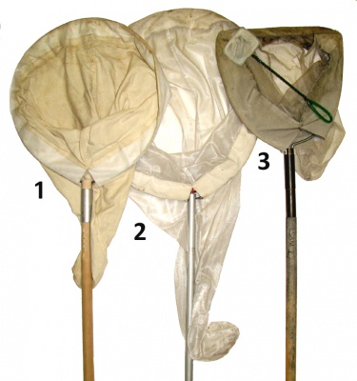
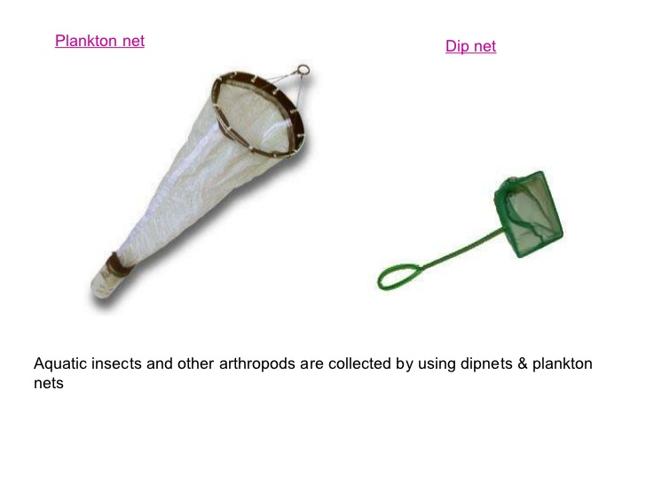
Insect Nets (Sweep nets)

Slide 7
Collection of Insects
Sources: Terrestrial insects are found in gardens especially during flowering seasons, in the fields and indoors. Aquatic insects can be collected from water bodies like ponds, lakes etc.
There are several methods of collecting insects but in this section you will collect terrestrial insects by three methods using: a net, light trap and aspiration.

Slide 8
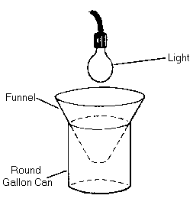
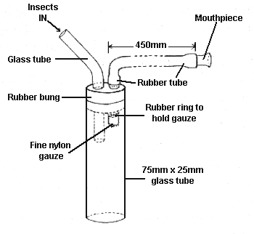
Methods
(a) Sweep Net Method:
This method is suitable for collecting many insects.
Materials Required: Insect-collecting net and killing jar
Light Trap
Aspirator

Slide 9
Steps:
1. Go to the garden/field and identify the insects to be collected.
2. Approach the specimen(s) very quietly. You should try to avoid chasing the insects overtly as it would alert the insects and make them fly/run away.
3. Sweep the net through the herbage over the specimen(s). You might have to sweep more than once.
4. When the insect(s) is trapped in the net, twist the net or your wrist so that net is closed and the specimen is not able to escape.
5. Transfer the collected insects into the killing jar.

Slide 10
(b) Light Trap Method
In this method the collector is not required to be present. It is mainly used for nocturnal insects like moths, midges, some beetles and winged termites.
Materials Required: Light sources such as an electric bulb (200 W) or a lantern lamp, a large shallow container such as a basin sauce pan, white paper sheet and Killing jar.
Steps
1. Select an area where insects are abundance

Slide 11
2. Hang the light source with the help of a hook.
3. Put the white paper as lining in the shallow container and set the container below the light sources so that electric lamp is shining in the middle of the container.
(In the absence of an electric light keep a lantern lamp in the middle of the container)
4. Soon the insects will be attracted by the light and fall into the container.

Slide 12
(In case the shallow basin saucepan is not available you can keep a collecting jar fitted with a cone made of white sheet under the light source. The most efficient light source for insect-trapping is a mercury vapour lamp)
5. Transfer the collected insects into the killing jar.
Collection of Lower Plants
Care is to be taken when collecting plant samples, and this is particularly done with the use of a vasculum, polythene bags or in bottles. You will need a pair of secateurs for cutting hard material, a sharp knife for cutting soft parts, pick for digging out underground parts like roots and rhizomes, scalpel and forceps for separating those plants which grow attached to the barks of trees and rocks.

Slide 13
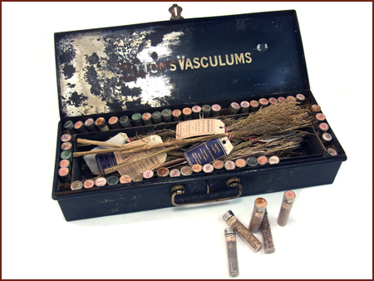
The stems and roots are cut into pieces of size about 3 cm long with the aid of sharp razor or knife. Bryophytes are made free from soil particles and debris before storing in some preservative. The smaller leaves can be preserved as such and larger ones can be cut in pieces, and then preserved.
A Vasculum

Slide 14
Collection of Algae
Sources: Algae occur widely on the soil surface and below it, on the bark of trees, in fresh water, sea water, and a variety of other habitats.
Collection from Bark:
i) In case of bark algae pick up the algae patches from the tree trunk with the help of iron spatula.
ii) Sterilize spatula by swirling it in spirit and then flaming it.
iii) Store various samples collected in separate sterilized bottles after fixing and labeling in their respective shelves.

Slide 15
Preparing Specimens for Laboratory Studies
Upon collection or procurement of your specimens, it is necessary to bring them into the laboratory so that they could be well studied. It is often important for the specimens to be kept for a considerable length of time for sufficient studies to be made. For this reason, it is necessary to know how best to keep them preserved. The same methods may not apply to all types of specimens. For example, bones will not be stored the same way as worms. It is however important for you to know that some storage and preservation may be necessary.

Slide 16
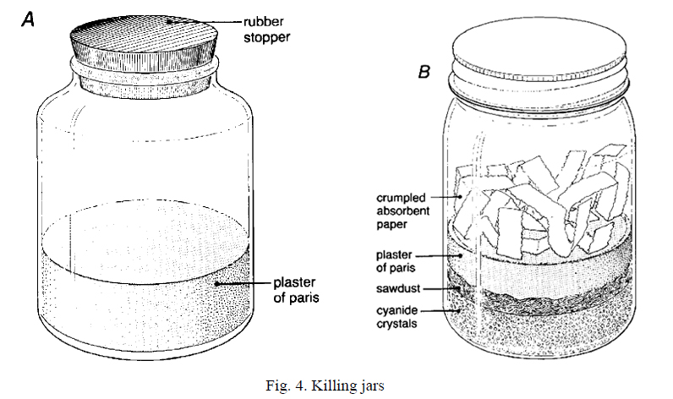
Killing, mounting and display of insect specimens
The incest to be killed is transferred to a bottle contain the killing agent, such as ethyl acetate, chloroform, ether, tetrachloroethane etc. However, the safe and most efficient agent is ethyl acetate.

Slide 17
Materials required include an empty glass bottle with an air-tight lid (you can take a jam or Horlicks bottle), ethyl acetate, cotton, blotting paper and forceps.
Steps:
i) Soak a wad of cotton in ethyl acetate. You must hold this cotton wad with forceps and not with hands.
ii) Place the soaked cotton at the bottom of the bottle and cover it with a piece of blotting paper. Blotting paper is used to avoid the direct contact of the specimens with the chemical because it will wet the specimens and spoil them.

Slide 18
iii) Transfer the insects into the bottle and close tightly. The insects should be taken out within 20 mins to prevent them from being decolourised and get unduly hardened. The bottle should not be over crowded, and different bottles should be used for different types of insects.
iv) The bottles should be labelled ‘poison’ and kept out of reach. Bottles that are no longer in use should be buried.
Mounting of the insects
After being killed the insects are pinned with the help of entomological pins on the pinning board. You can also prepare entomological pins with sewing needles and coloured beads. Take thin sewing needles, heat the eye of needle on a spirit lamp flame and insert the heated end into a coloured bead, which forms the needle head.

Slide 19
Direct mounting:
Mounting should be done immediately the insect is dead:
i) The entomological pin is pushed through the thorax region of the insect. However, the exact point in the body of the insect through which the pin should pass differs in the different groups of insects.
ii) Insert the pin vertically through the body or sloping in such a way that the front part of the body is raised very slightly.
iii) Push the specimen up in the pin until it’s back slightly away from the top so that it does not have any contact with the back of the insect body.
iv) Mount the pinned insects on the board or on a pinning block. Take care to mount the insects uniformly so that specimens can be examined and compared easily.

Slide 20
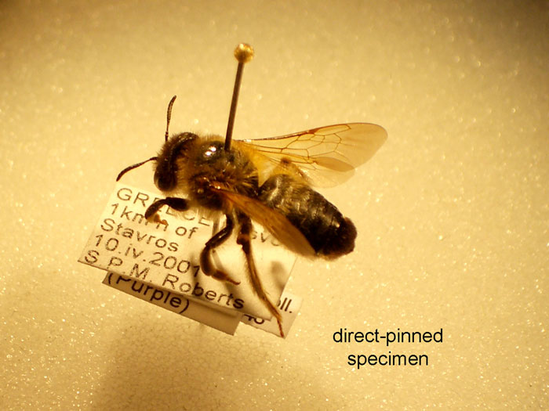
Displaying
Once the specimens are collected and spread, they should be given permanent labels. These labels should be small and made of white card. The following information should be there on the label of each specimen:
1. Name of the insect.
2. Host plant, crop or the area from where it is found.
3. Locality from where it is found.
4. Date.
5. Collector's name
The ink used for writing should be permanent and not spoiled when in contact with any type of liquid.

Slide 21
Preservation of Animal Material
For preserving taxonomic material such as laboratory and museum study specimens, different preservation methods can be considered. In the field, there may be limited access to materials and equipment necessary, so preliminary preservation with more simple methods may be necessary before final preparation as a permanent collection specimen.
Examples: procedures for preliminary preservation of a whole animal

Slide 22
Short-term storage without preservation (of freshly dead animals needed for mounting)
Small animals in a cold to moderate climate may be stored without refrigeration in the shade for 4 -5 hrs. After this period, in warmer climate sooner, the viscera will begin to decompose.
Preparing Specimens for Laboratory Studies
Upon collection or procurement of your specimens, it is necessary to bring them into the laboratory so that they could be well studied. It is often important for the specimens to be kept for a considerable length of time for sufficient studies to be made. For this reason, it is necessary to know how best to preserve them. The same methods may not apply to all types of specimens. For example, bones will not be stored the same way as worms. It is however important for you to know that some storage and preservation may be necessary.

Slide 23
Preservation and Storage
Apart from preservation and storage, you might also need to prepare the specimen for the kind of study that is desired. For example, if you want to study the structure of a section through the root of a plant, you need a microscope to view the details of the sections. Besides, you need to make a slide.
Specimen preservation means a long term preservation of organisms either plant or animal in the best possible condition, so that it can be accessed in future as reference collection for scientific purposes. For reference collections, mammals can be prepared as a variety of specimens.

Slide 24
The condition of the specimen may determine possible ways to preserve it; if for instance decomposition of the skin has loosened the hair of a carcass so much that it can easily be pulled out or removed by rubbing, it will be very difficult or impossible to produce a study skin or mounted specimen.
The some of the most usual types of specimens are:
1) Entire fluid-preserved animals (for studying anatomy and histology; fluid preservation may change the fur colour)
2) Study of skins with accompanying skulls / partial skeletons (some bones remain in the skin), for studying pelage colour, hair quality and moulting patterns,
3) Mounted skins with accompanying partial or entire skeleton (some bones may remain in the skin, dependent on the method of preservation) or freeze-dried specimens

Slide 25
4) Entire skeletons, for instance for studying anatomy, geographic variation or for age determination (entire skeletons are poorly represented in collections, so it is recommended that preparation of at least one male and one female skeleton per species.
Many chemical methods are used to preserve both vertebrate and invertebrate specimens.
Why specimens are preserved?
a) Taxonomic reasons
b) For detailed examination.
c) For morphological study of particular animals as each and every animal can't be in researcher’s vicinity.
d) For zoological museum collection

Slide 26
Steps for Specimen Preservation
1. Killing and relaxing of alcohol,
2. Fixation (stops cellular respiration, kills bacteria within the organism, a good penetrating ability)
3. Storage in bottles, jar vials, trays etc.
Types of Specimen
1) Entire fluid-preserved animals
Purpose: (for studying anatomy and histology; fluid preservation may change the fur colour)
2) Study skins with skulls / partial skeletons (some bones in skin)
Purpose: for studying colour, hair quality and moulting patterns.

Slide 27
3) Mounted skins with partial or entire skeleton (some bones may remain in the skin, dependent on the method of preservation) or freeze-dried specimens.
4) Entire skeletons, for instance for studying anatomy, geographic variation or for age determination.
Preservatives and Their Usage
1) Formalin (Fixative mostly)
Formalin is the commercial name of a solution of formaldehyde gas (CH₂O) in water. Formalin must be diluted with water before it is used as a preservative. A strength of 10% formalin is best for most purposes. If the original strength is 40%, it should be mixed at a ratio of nine parts water to one part formalin

Slide 28
Usage:
It is used for vertebrates only.
It is avoided for long-term storage since it is acidic and difficult to handle.
Mostly formalin is used where colour is important since alcohol dissolves most colours almost immediately.
It penetrates more rapidly, and internal organs remain in better condition.
Procedure:
Dilution
Conc. formalin (100%) = Water saturated with 40% formaldehyde.

Slide 29
10% formalin = 4% formaldehyde (Used for preservation)
2% formalin with seawater for small specimen
ii. Mix one part concentrated formalin to nine parts water.
iii. Fill about two-thirds the bottle's volume with 10% formalin.
As formalin is acidic, it should be buffered by adding a pinch or two of sodium bicarbonate.
Precaution:
Inhalation of formalin fumes is harmful and causes extreme discomfort to nose and eyes.
Contact with fluid causes severe irritation to the skin

Slide 30
Contact with sore or raw spots results in extreme pain.
It is carcinogen.
Hand should be rinsed after usage.
Storage:
It should be kept in safe, water-tight, spill-proof bottles, e.g. pep-bottles
It should always be clearly labelled.
2) Industrial Alcohol (for both fixing and storage)
Usage:
Alcohol is usually not used for killing and fixing vertebrates. But of course used for long-term storage.
Colour of specimen is lost immediately.

Slide 31
A teaspoonful of glycerin in a quart of alcohol helps to preserve natural colours and to keep integuments flexible.
Alcohol usually comes in the 95% concentrated form.
For long-term preservation, 70-75% strength is used.
Warning:
Alcohol is usually safe to handle, it can however cause irritation to the skin in cases of prolonged contact. Always rinse hands with water after working with alcohol. Industrial alcohol is toxic and should never be drunk. Alcohol is highly flammable. Never work with this fluid in the vicinity of open flames.
It is rapidly evaporated, and receptacles holding it should be securely covered at all times, and not be opened unnecessarily.

Slide 32
Vertebrates Specimen Preservation
1) Fishes
After capture Fishes are placed in 10% formalin for quick killing (painful). It is not needed to relax fish. Fishes dies with its finnature well spread-out, and the body straight and well-stretched.
Examination and counting of fin rays and scales is quite easy on such well-preserved material. For 30cm fish, the following is used
i. Formalin - 1 week (fix soft tissue)
ii. Water - 1 day (leach out the formalin)

Slide 33
iii. Alcohol - long term storage
The length of time for each step may have to be increased with increasing size of specimens.
Invertebrate Specimen Preservation
The easiest way to preserve these animals is to use alcohol.
One should be aware of which kind of alcohol they are using as each animal requires a different concentration for preservation. Most invertebrates, however, will be kept in bottles, and sets of tubes or jars for preservation
Arthropods
They are easy to process, as they are killed immediately and stored in alcohol.
Crabs and prawns may also be killed in formalin, but this renders their

Slide 34
joints hard and brittle
The larger arthropods (especially those with hard exoskeletons) sometimes need to be injected with 10% formalin to prevent them from rotting.
Industrial alcohol is used for most arthropods. Insects, crustaceans and arachnids can be simply dropped into alcohol for immediate preservation.
Liquid hand sanitizer can be used for insects. Hand sanitizer is gelled alcohol, hence the usage. Specimen will float inside the vials and do not sink or move despite any amount of handling. It is best to kill the insects in an alcohol solution then transfer them to the hand sanitizer for preservation. The gel will break down over time and become liquid, so it should be replaced occasionally.

Slide 35
Precautionary Measures
a.) Do not crowd living animals in small containers - this will result in damage to their appendages.
b.) Features important in the taxonomic study of fish, for example, are easily damaged with contact even after preservation.
c.). Live crabs before preservation should be kept individually as some species will damage each other and other animals which will distort their morphological features.

Slide 36
A reasonable number (about 95%) of the museums of the world use ethanol (drinking or grain alcohol) for long term preservation.
Over 4.9% use isopropyl (rubbing alcohol), while 0.001 percent use methanol, or wood alcohol.

Slide 37
HERBARIUM TECHNIQUES
What is an Herbarium?
A herbarium is a collection of preserved plants stored, catalogued, and arranged systematically for scientific study by professionals and amateurs. Herbaria are a vital reference library to aid in current plant identification and future taxonomy.
A Herbarium may include some or all of the collections.
• Herbarium sheets
• Cryptogams on sheets

Slide 38
• Packets – cryptogams
• Lichens, fungi, fruits, seeds and related economic material (boxes of bulky specimens)
• Materia medica (jars containing dried specimens)
• Diatoms (mounted in mica on herbarium sheets or slides) and in ethanol?
• Algae (floated onto mount paper)
• Pith
• Timber (hand sections, planks, tree sections, microscopic sections)
• Pressed and bound collections

Slide 39
• Palm leaf materials
• Mounted slide collections
• Pollen
Methods of preparation of herbarium specimens
The preparation of a herbarium involves
(i) Field visit
(ii) Collection of specimens
(iii) Drying
(iv) Mounting on a herbarium sheet,
(v) Preservation
(vi) Labelling and

Slide 40
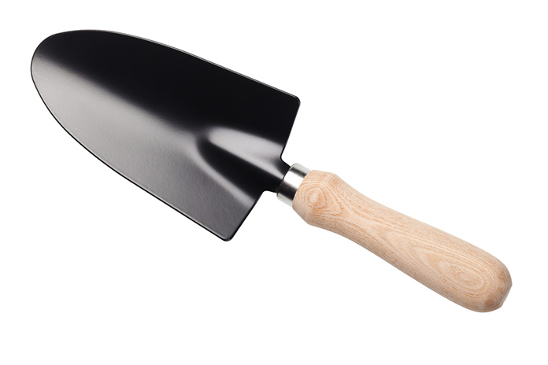
(vii) Proper storage
(a) Field visits and specimen collection
A complete specimen possesses all parts including root system, flowers and fruits. Therefore, regular field visits are necessary to obtain information at every stage of growth and reproduction of a plant species. In the fields, the tools required are mainly trowel (digger) for digging roots, scissors and knife for cutting twigs, a stick with a hook for collection of parts of tall trees, a field note book, polythene bag, old newspaper and magazines.
A trowel

Slide 41
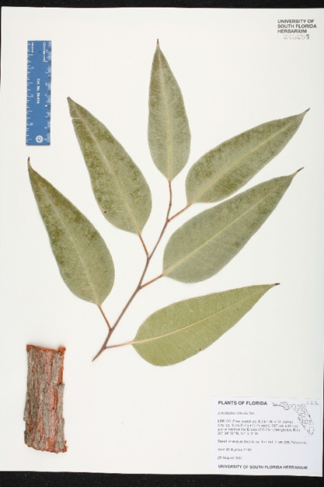
The specimens selected should be vigorous, typical specimens. Insect-damaged plants should be avoided. Specimens should be representative of the population, but should include the range of variation of the plants. In collecting large herbs, shrubs and trees, different types of foliage, flowers and fruits should be collected from the same plant. Collect sufficient material to fill an herbarium sheet (450 x 300 mm) and still leave enough room for the label. Plants too large for a single sheet may be divided and pressed as a series of sheets.
A Herbarium sheet

Slide 42
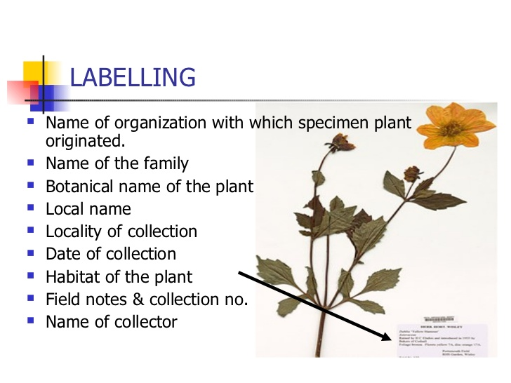
Bark and wood samples are often desirable additions when collecting woody plants. There are special requirements for the identification of some plants. A Eucalyptus specimen, where possible, should include mature leaves, juvenile leaves, buds, fruits, and bark.
Other general hints for collecting are:
1) Bulky plants or parts can often be halved or sliced before pressing. Odd fragments - bark, fruits or seeds - should be kept in numbered or labelled envelopes or packets with the main specimen.
2) Very bushy twigs should be pruned to make a flatter specimen, in such a way that it is obvious where pieces have been broken off.
3) Spiny plants may first be placed under a board and stood on before pressing to prevent tearing the paper.

Slide 43
4) Succulent plants need to be killed first by soaking in methylated spirits for 15-20 minutes. Bulbs should also be killed, or may sprout on herbarium sheet.
5) Water plants must be floated out in a dish of water and lifted out on a sheet of stiff white paper slipped under them in the water; dry excess water, then press the plant in the usual way leaving it on the white paper on which it can remain permanently stuck. A piece of waxed paper over the top of the plant will prevent it adhering to the drying paper.

Slide 44
6) Tall rosette plants and grasses may be pressed complete by bending them once or more into the shape of a "V", "N" or "M".
7) Dioecious plants should be represented by both sexes.
8) Palms - several herbarium sheets are necessary to show the various portions of the leaf, inflorescence and fruit of these species. Photographs of the tree and of each part are essential.
9) Cones of some gymnosperms and Pandanaceae may need to be enclosed in a wire mesh to prevent them falling apart.

Slide 45
b) Pressing and Care of Specimens (drying)
Specimens should be pressed as quickly as possible after collection. If this is not possible, specimens may be stored in plastic bags preferably wrapped in damp (but not wet) papers. Bags should not be packed tightly, and should be kept cool and moist. Make sure that each bag is correctly labelled for locality.
Place each specimen, with numbered tie-on tag attached, in a fold of several sheets of newspaper, and place in the press. If necessary, occasionally add a sheet of corrugated cardboard to act as a ventilator.

Slide 46
As you fill the press, try to keep it level to allow even distribution of pressure. This may mean the use of alternate corners of the fold for bulky roots and other parts, or packing around a bulky specimen with foam. Close the press and exert pressure with the straps.
The plants in the press should be dried fairly quickly, in a warm place if possible. The specimens must not be left in damp papers or they will go moldy. It is therefore necessary to go through the press daily during the first few days and change the plants into dry newspapers.

Slide 47
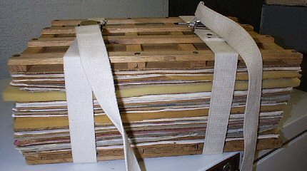
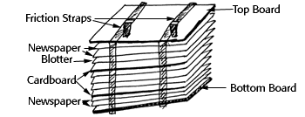
Then continue to inspect press daily and change newspapers as necessary until the plants are dry.
Delicate plants and petals may be lost in changing and should be kept in tissue-paper (or toilet-paper) folders throughout changes. A properly dried plant specimen is brittle.

Slide 48
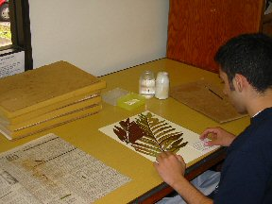
(c) Mounting:
The dried specimens are mounted on herbarium sheets of standard size (41 x 29 cm). Mounting is done with the help of glue, adhesive or cello-tape. The bulky plant parts like dry fruits seeds, cones etc. are dried without pressing and are put in small envelops called fragment packets. Succulent plants are not mounted on herbarium sheets but are collected in 4% formalin or FAA (Formalin Acetic Alcohol).

Slide 49
(d) Preservation
The mounted specimens are sprayed with fungicides like 2% solution of mercuric chloride.
(e) Labelling
A label is pasted or printed on the lower right hand corner. The label should indicate the information about the locality, altitude, habit, date and lime of collection, name of collector, common name, complete scientific name etc.

Slide 50
The collection is also recorded in the field notebook together with information about that collection. As much as possible of the following data should be included:
Exact locality - a good plain language description, and latitude and longitude.
Altitude.
Nature of the habitat - type of soil, topography, slope, aspect.
Associated species, vegetation type.

Slide 51
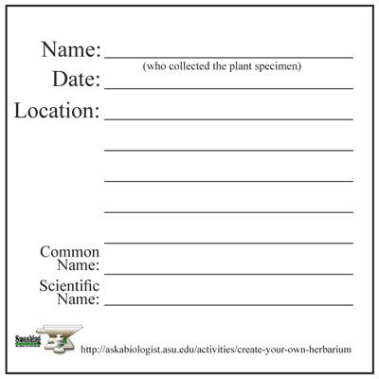
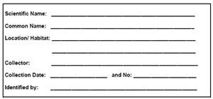
The plant proper - record features which will not be evident from the pressed specimen e.g. whether it is a tree or shrub, height, branching, notes on root system, odour, etc., as well as those features which may be lost on drying e.g. flower colour and odour.
Date of collection

Slide 52
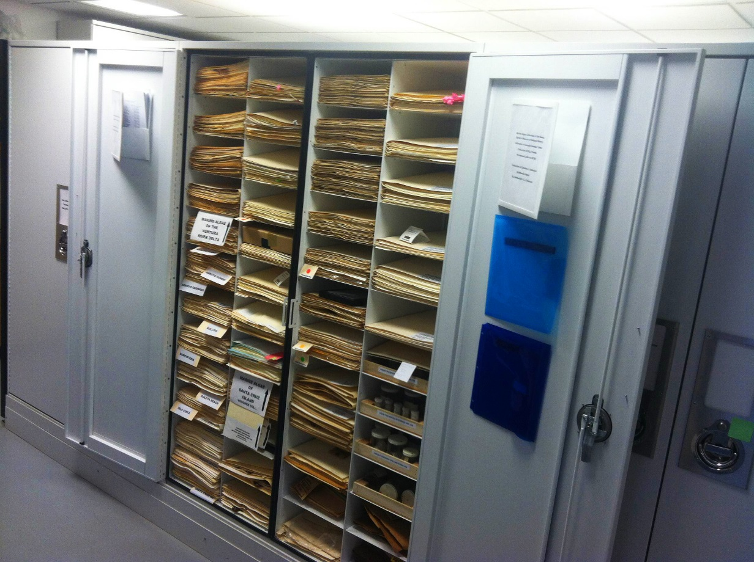
f) Storage
Properly dried, pressed and identified plant specimens are placed in thin paper folds (specimen covers) which are kept together in thicker paper folders genus overs), and finally they are incorporated into the herbarium cupboards in their proper position according to a well known system of classification.
Herbarium cupboard

