Slide 1
BIO 206: SEEDLESS PLANT

Slide 2
COURSE OUTLINE
Morphology and reproduction of Algae, Fungi, Bacteria, Fossil, Bryophytes and Pteridophytes
Bryophytes as indicator of atmospheric pollution
Factors affecting the structures and physical properties of Organic Compounds
Factors affecting the availability of electrons
  Stereochemistry
  Methane
  Energy of activation and free radical substitution reaction in alkanes
  Functional group chemistry
  Electrophilic and Nucleophilic substitution reaction rom
  Aromacity
  Organic reactions e.g Addition free radical and elimination reaction

Slide 3
Morphology and Reproduction in Algae
Algae Introduction
The study of algae known as Phycology.
Algae are simple, Unicellular, non-jacked sex organ and have no embryo development.
Algae are aquatic plants they can be present in marine or fresh water.
All algae are present in Kingdom protista.
Most live in water attached to rocks for free floating.
• Use sunlight for photosynthesis.
• Main food producers in the oceans.
• Important suppliers of oxygen diatoms used in detergents, paint removers, toothpaste Golden algae.

Slide 4
Types of Algae
The five algal phyla are:
  Bacillariophyta (Diatoms)
  Chlorophyta (Green Algae)
  Cyanopyta (Blue-Green Algae)
  Chrysophyta (Yellow-Green Algae)
  Rhodophyta (Red Algae)

Slide 5
GENERAL STRUCTURE
• Thallic (haploid)
Algae structure
  • Unicellular
  • Colonial
  • Filamentous
  • multicellular

Slide 6
Unicells: single cells, motile with flagellate (like Chlamydomonas and Euglena) or nonmotile (like Diatoms).
Colonies: Assemblage of individual cells with variable or constant number of cells that remain constant throughout the colony life in mucilaginous matrix (containing an extracellular matrix made of a gelatinous glycoprotein).
These colonies may be motile (like Volvox and Pandorina) or nonmotile (like Scendesmus and Pediastrum).
Filaments: Daughter cells remain attached after cell division and form a cell chain adjacent cells share cell wall maybe unbranched such as Zygnema and Ulthrix) or branched such as Cladophora.

Slide 7
Reproduction in Algae
Sexual: gametes unite to form a zygote (sperm/egg) Most sexual reproduction is triggered by environmental stress. Sexual Reproduction Meiosis Zoospores Plus and minus gametes Zygospore.
Asexual: No gametes (no union of cells).
Mitosis (unicellular cell may divide into two new cells).
Asexual Reproduction
i. Fragmentation
ii. Spores
iii. Binary fission

Slide 8
Spirogyra reproduce sexually by conjugation
Range in size from microscopic to single celled organisms to large seaweed.
Autotrophic .
Form the reproductive structures – gametangia or gamete chambers.
Aquatic and have flagella at some point in life.
Often contain pyrenoids, organelles that synthesis and store starch.

Slide 9
General Characteristics
Some algal divisions can also be classified as bacteria, protozoa, but most are classified as protista.
Only green algae are true plants in the evolutionary sense.
They are primitive plants No true roots, only attachment structures (Holdfasts).
Produce spores (not seeds).
motile or non-motile.
Most have sexual and asexual reproduction.
Non-vascular, do not possess an internal transport system.

Slide 10
Economic Importance Algae
• Algae is used in biofuel production.
Agar-Agar medium is gotten from algae and it is a dried, jelly like, non-nitrogeneous substance which is used as a base of different culture media in laboratory for culturing microorganisms.
• Its food value and ability to afford good range of temperature for culturing .

Slide 11
• Alginates: • The alginates are used in rubber-tyre industry, Paints, ice-creams, and in presentation of flame-proof fabrics and plastic particles.
Carrageenin
  It is a carbohydrate mucilage algae extracted from Red algae.
  It is used as clearing agent in beer preparation.
  in preparation of tooth-pastes, cosmetics, paints and in pharmaceutical industries iodine.
  The member of brown algae such as luminaria and focus yield iodine.

Slide 12
Diatomite
  It is cell wall material of diatoms.
  It is variously such as food for many aquatic animals .
  Used in filtration process in sugar refining and brewing industry as source of food.
  More than 100 species belonging to green-,brown-,red- algae are used as food by humans because presence of proteins, carbohydrates, minerals and vitamins.

Slide 13
Antibiotics and Medicines
  Some algae yield antibiotics e-g, Chlorellin which is obtained from green alga Chlorella, that inhibits the growth of certain bacteria.
  Brown algae is used in manufacture of various goiter medicines.

Slide 14
Harmful Aspects of algae
They cause water blooms which leads to:
  Death of living organisms.
  Diseases in human beings parasitic activities.

Slide 15
MORPHOLOGY OF FUNGI
• Fungi are eukaryotic organisms.
The vegetative body of a fungus is called thallus which is either unicellular ( e.g yeast) or multicellular (e.g molds).
• The fungal cell wall is made up of chitin.
• The plasmalemma covers the cytoplasm and all cell organelles.
• Nucleus is usually small and mitochondria, endoplasmic reticulum and vacuoles are present.
• Fungi contain filaments called the hyphae (singular: Hypha).
The hyphae have internal cross walls called the septum (singular: Septa).
Fungi may be septate or aseptate.

Slide 16
The septa of many species have pores, allowing cytoplasm to flow freely from one cell to the next.
• Cytoplasmic movement within the hypha provides a means to transport of materials.
The hyphae may be branched.
• A mass of hyphae that is not a reproductive structure is called a mycelium.
Vegetative mycelium- hyphae that penetrate the supporting medium and absorb nutrients.
Aerial mycelium- hyphae that projects above the medium and produce reproductive structures called conidia.

Slide 17
Yeasts as unicellular form of fungi
• Yeasts occur in the form of oval or round bodies that reproduce by asexual process called budding. e.g Saccharomyces cereviseae.
They grow partly as yeast and partly as elongated cells resembling hyphae. e.g Candida albicans
Filamentous fungi
• It consists of Mycelium.
They reproduce by the formation of spores. e.g Aspergillus, Penicillium
Dimorphic fungi
• It exhibits yeast form in the host tissue in vitro at 37° C and mycelial form in vitro at 25° C. e.g Histoplasma capsulatum

Slide 18
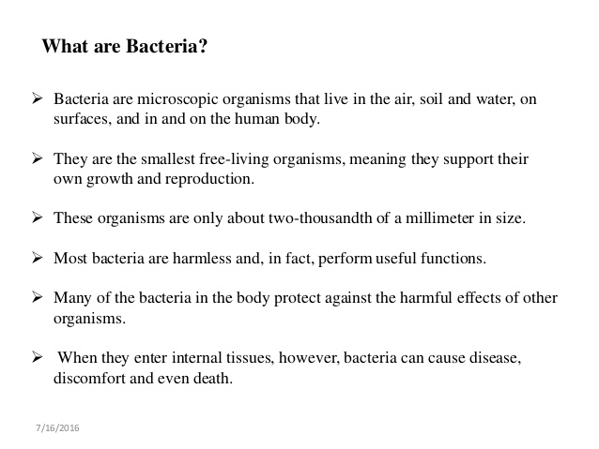

Slide 19
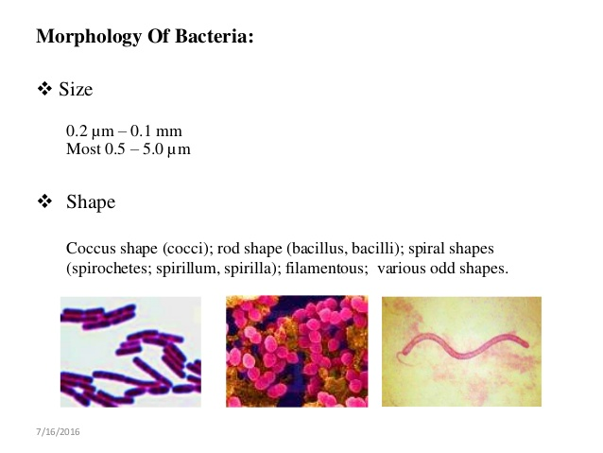

Slide 20
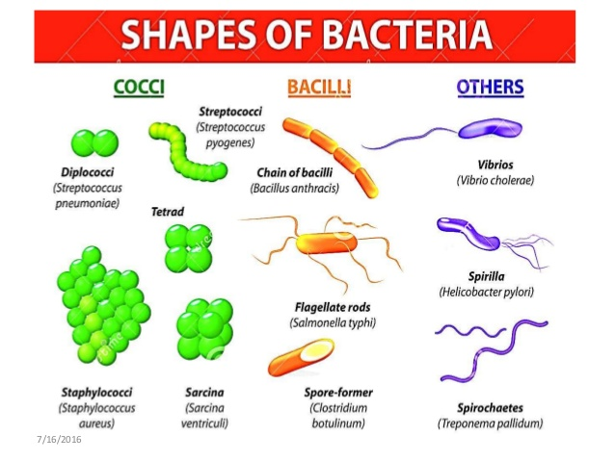

Slide 21
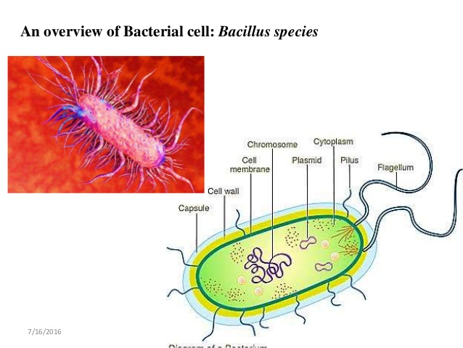

Slide 22
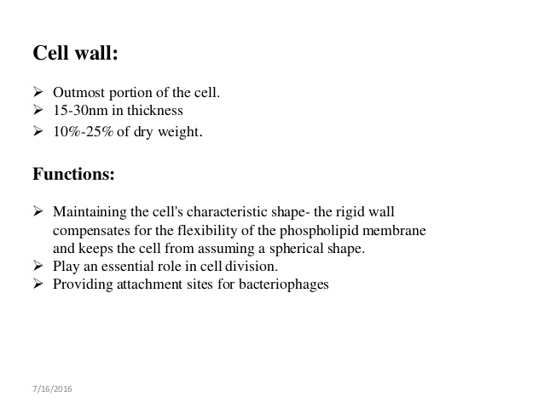

Slide 23
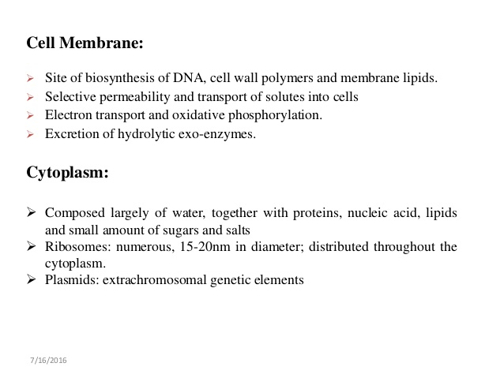

Slide 24
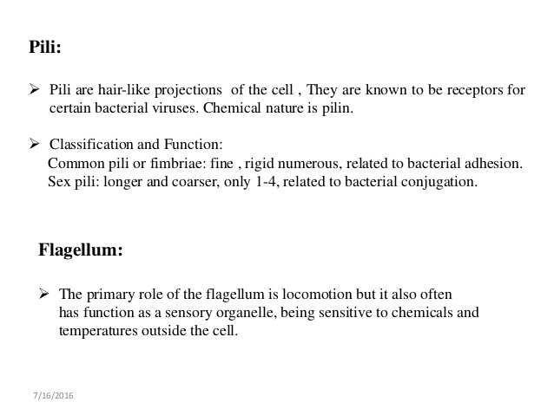

Slide 25
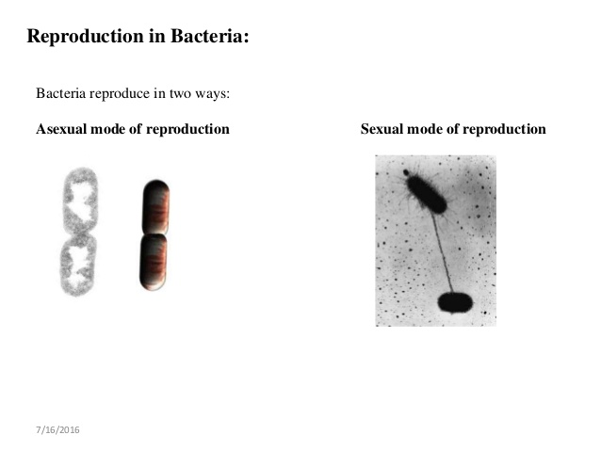

Slide 26
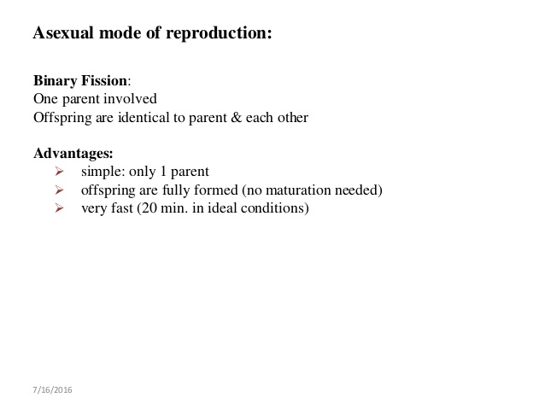

Slide 27
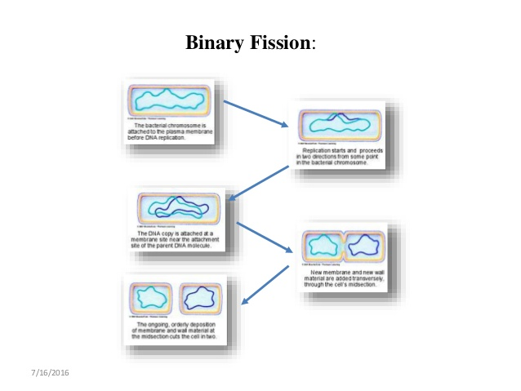

Slide 28
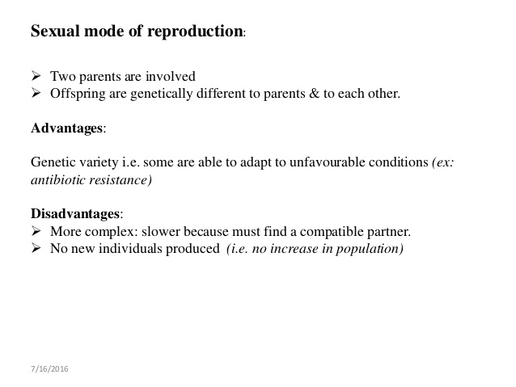

Slide 29
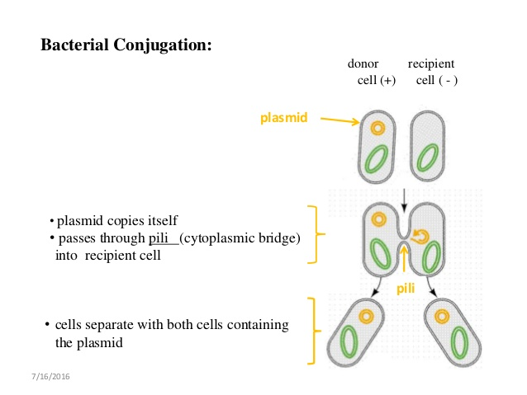

Slide 30
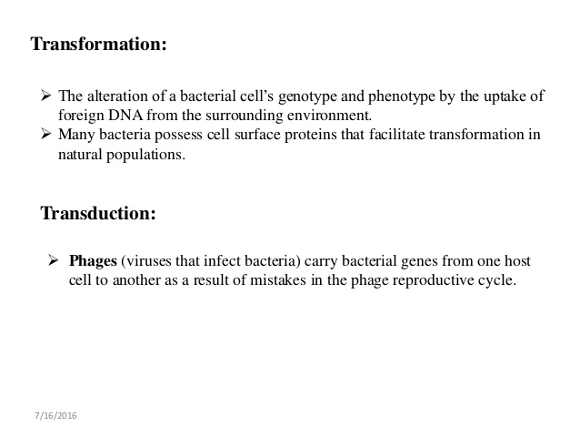

Slide 31
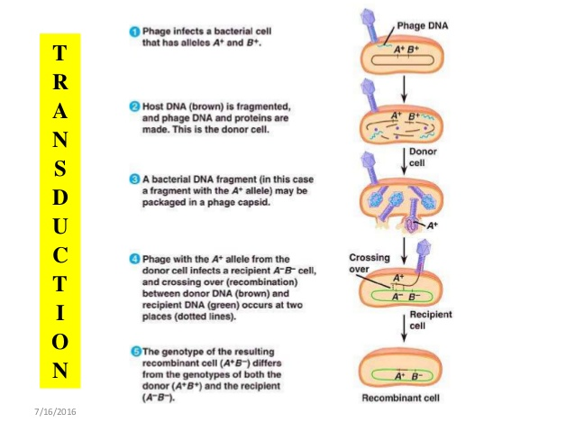

Slide 32
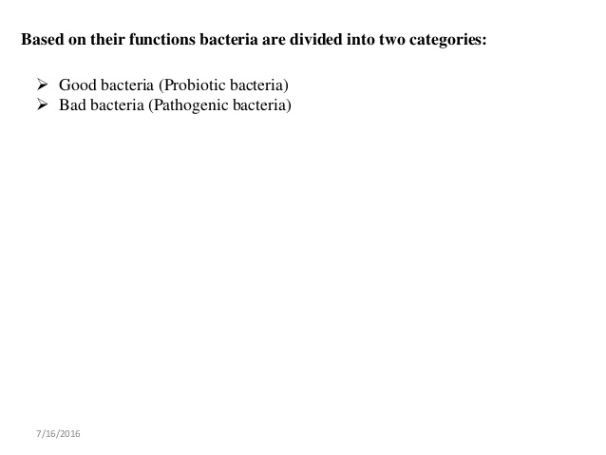

Slide 33
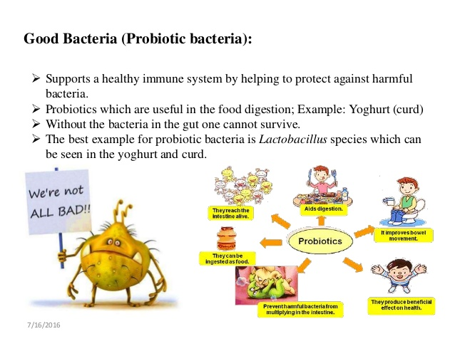

Slide 34
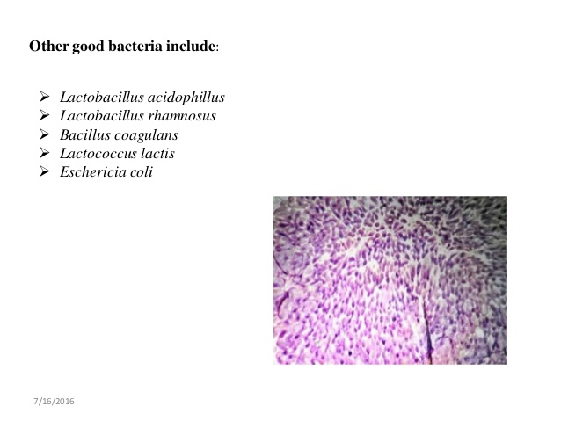

Slide 35
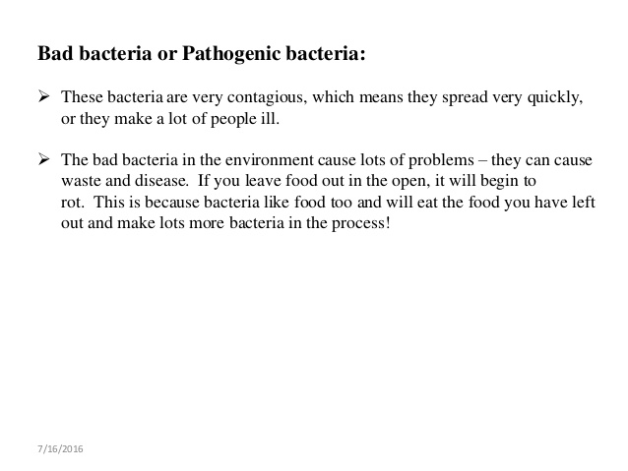

Slide 36
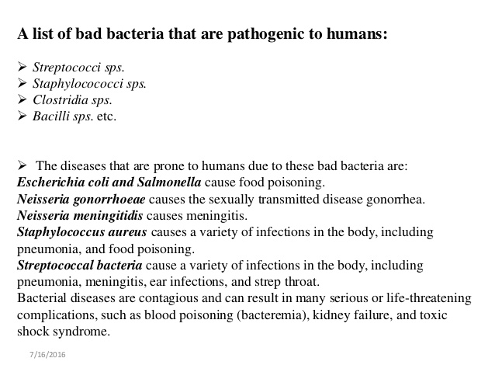

Slide 38
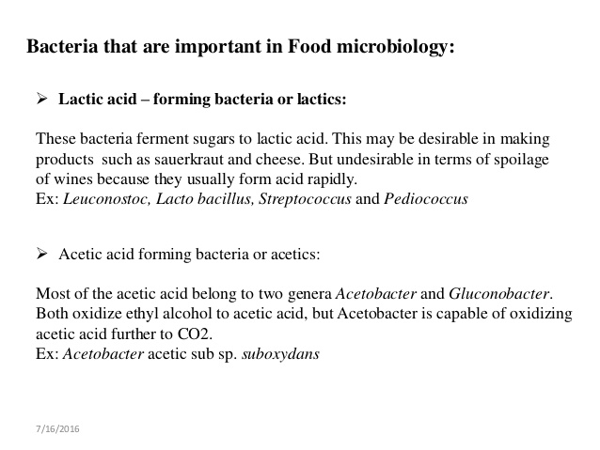

Slide 39
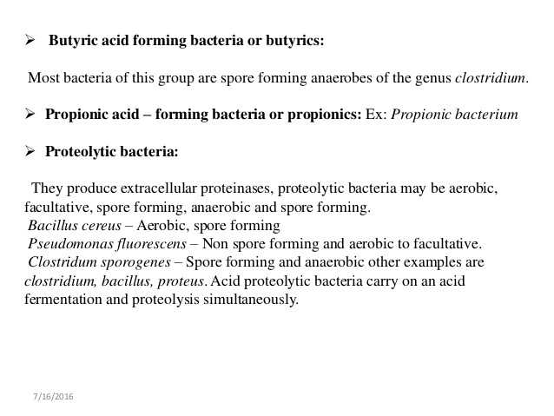

Slide 40
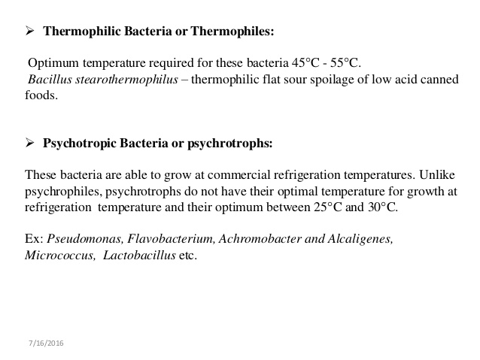

Slide 41
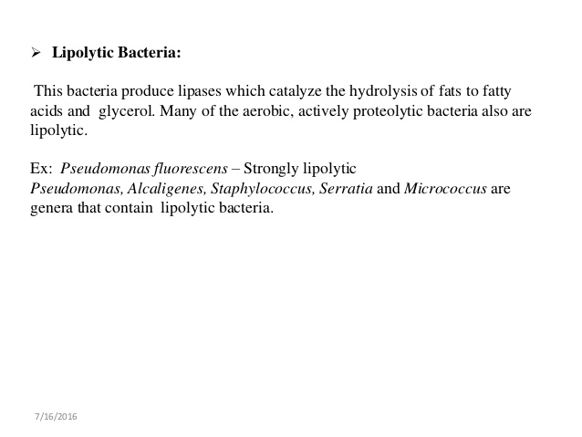

Slide 42
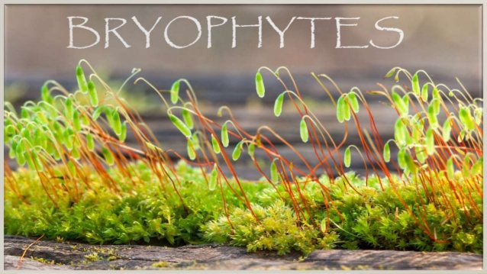

Slide 43
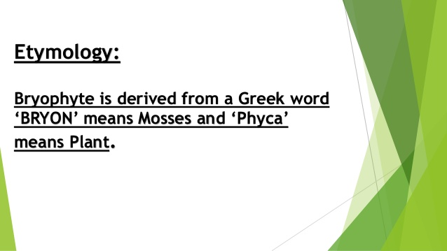

Slide 44
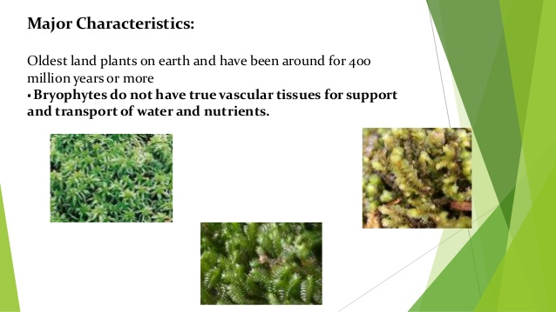

Slide 45
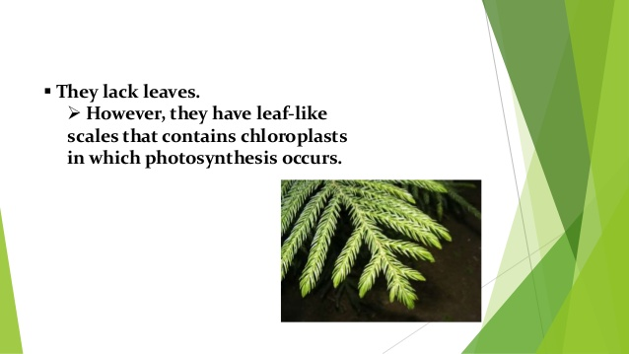

Slide 46
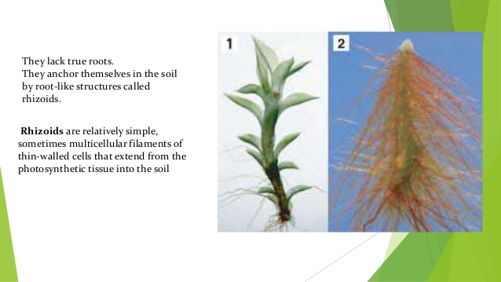

Slide 47
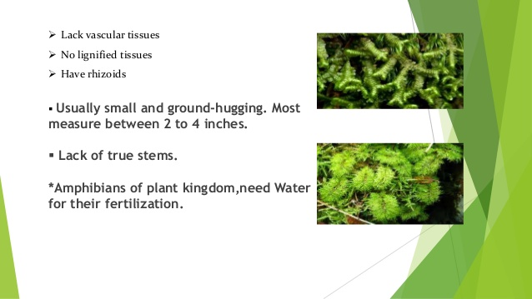

Slide 48
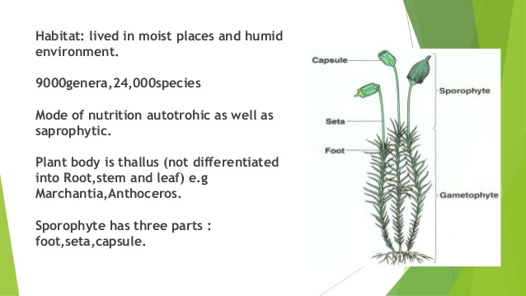

Slide 49
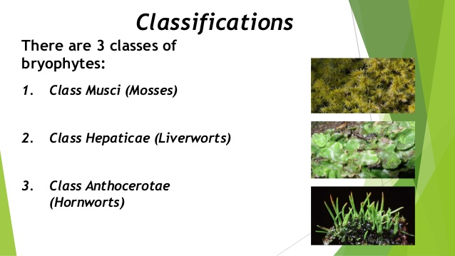

Slide 50
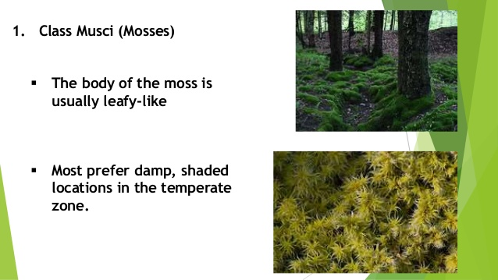

Slide 51
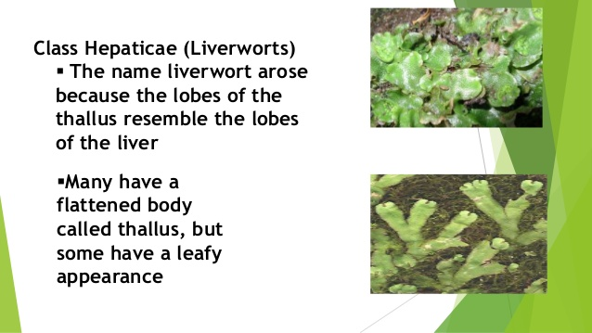

Slide 52
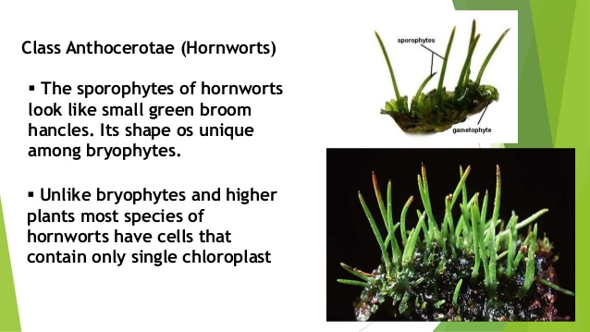

Slide 53
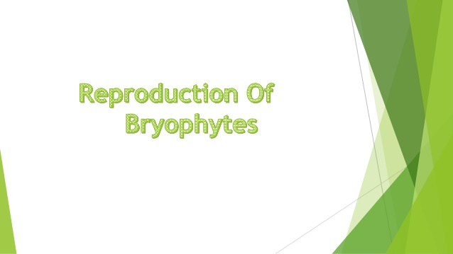

Slide 54
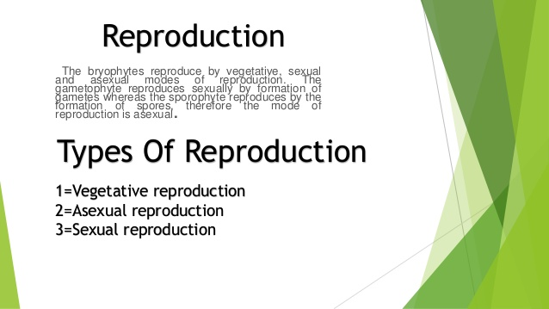

Slide 55
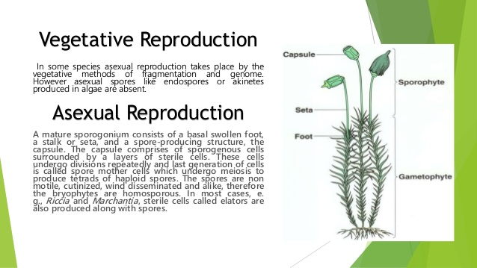

Slide 56
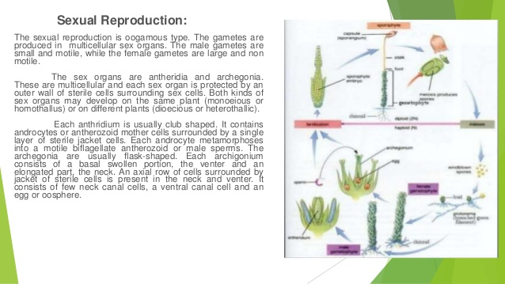

Slide 57
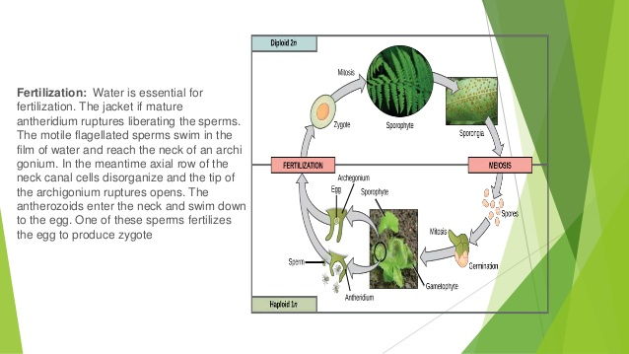

Slide 58
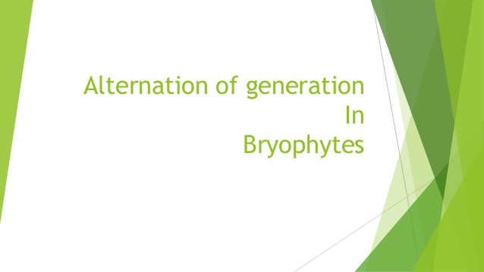

Slide 59
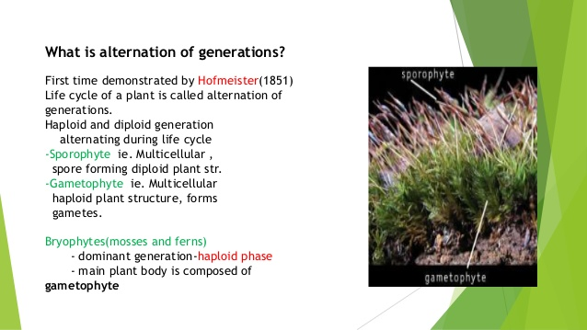

Slide 60
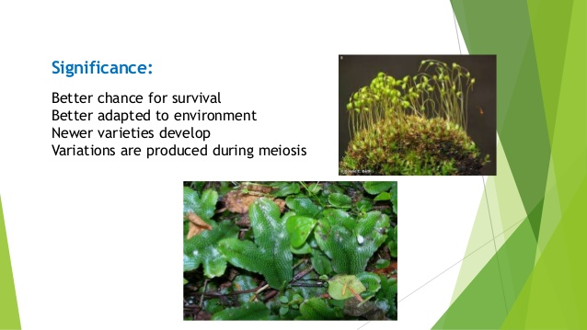

Slide 61
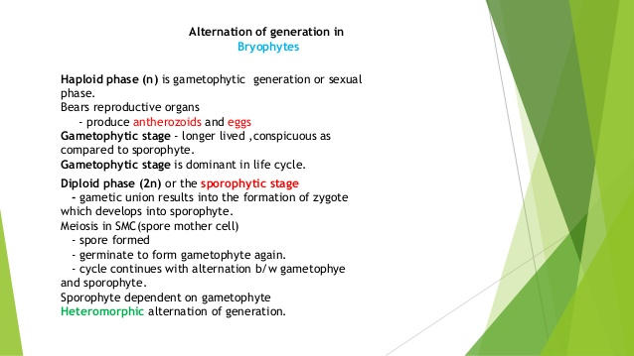

Slide 62
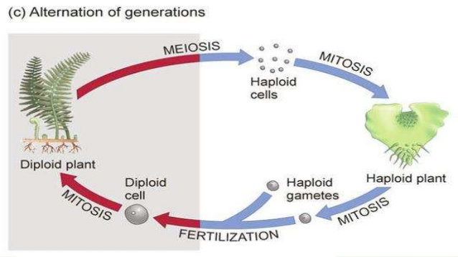

Slide 63
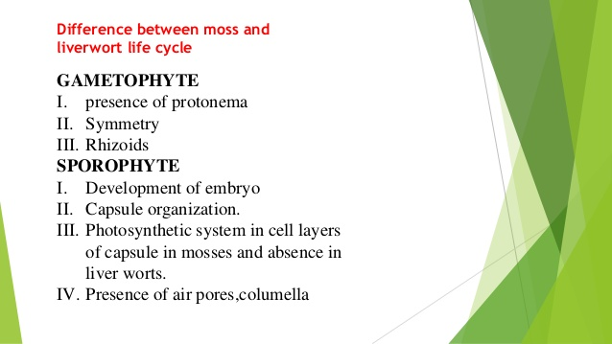

Slide 64
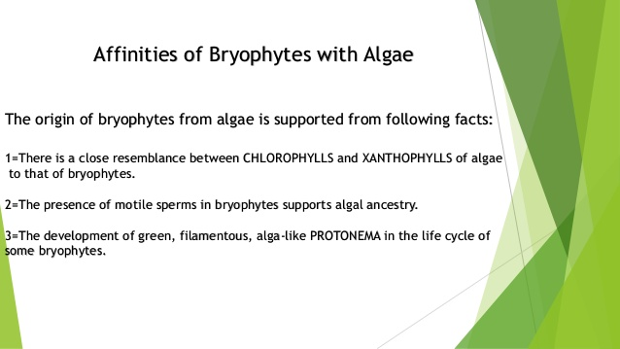

Slide 65


Slide 66
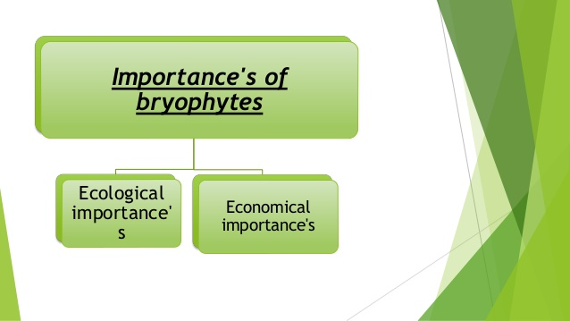

Slide 67
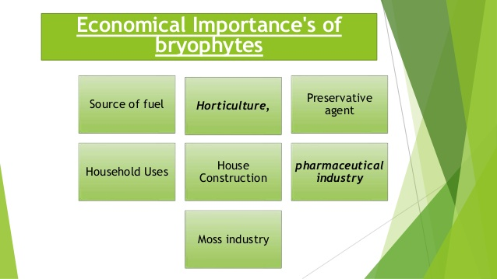

Slide 68
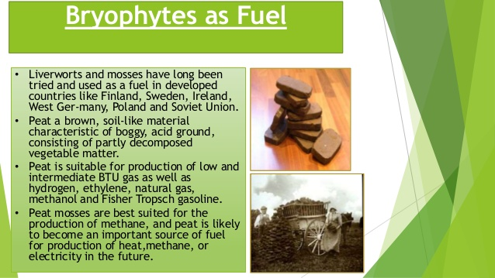

Slide 69
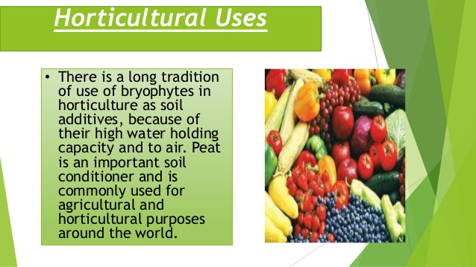

Slide 70


Slide 71


Slide 72


Slide 73


Slide 74


Slide 75


Slide 76


Slide 77


Slide 78


Slide 79


Slide 80


Slide 81


Slide 82


Slide 83


