Slide 1
BIOCHEMISTRY OF NUCLEIC ACIDS
(Metabolism of Pyrimidine Nucleotides)
(BCH 305)
BY
ADEFISAN I.O(Mrs)

Slide 2
Nucleotides are important intracellular molecules of low molecular weight which participate in a wide variety of biochemical processes.
The best known role of the purine and pyrimidine nucleotides is to serve as precursors of DNA and RNA.
However, the purine nucleotides serve also in biologic systems as high energy source: ATP as reguatory signals(CAMP and CGMP) in different tissues and organisms, and as components of the widely used coenzymes FAD,NAD and NADP.
The pyrimidine nucleotides in addition to providing precursors for nucleic acids also serve as high energy intermediates like UDP-glucose and UDP-galactose in carbohydrate metabolism.
The3 major pyrimidine bases found in the nucleotides of prokaryotes and eukaryotes are: cytosine, uracil and thymine.

Slide 3
Naturally occurring purine and pyrimidine bases and their corresponding nucleosides and nucleotides.
Base | Nucleoside(base + sugar) | Nucleotide(base + sugar +phosphoric acid)
Purines Adenine(6-amin purine) | Adenosine Deoxyadenosine | Adenylate Deoxyadenylate
Guanine(2-amino-6-oxypurine) | Guanosine Deoxyguanosine | Guanylate Deoxyguanylate
Hypoxanthine(6-oxypurine) | Inosine Deoxyinosine | Inosinate Deoxyinosinate
Xanthine(2,6-dioxypurine) | Xanthosine | Xanthynilate

Slide 4
Base | Nucleoside(base + sugar) | Nucleotide(base + sugar +phosphoric acid)
Pyrimidines Cytosine(2-oxy-4-amino pyrimidine) | Cytidine Deoxycytidine | Cytidylate Deoxycytidylate
Thymine(2,4-dioxy-5-methyl-pyrimidine) | Thymidine(thymine deoxyriboside) | Thymidylate
Uracil(2,4-dioxypyrimidine) | Uridine | Uridylate

Slide 5
Pyrimidine Synthesis occurs in both the body and through organic synthesis and their degradation products are more water soluble than that of the purines.
Though purines and pyrimidines are nucleic acid components, they are synthesized differently. In pyrimidine synthesis, the ring is synthesized first before combining with PRPP.
Although pyrimidine nucleus is simpler with a briefer synthetic pathway, the two share common precursors: PRPP, glutamine CO2 and Aspartate.
The striking difference between the synthesis of both is that the synthesis of purines start with ribose phosphate as an earlier precurssor molecule while attachment of ribose phosphate comes later in the pathway after the formation of the pryrimidine ring.

Slide 6
De-novo Pathway for pyrimidine Synthesis
Can be explained using these steps.
Synthesis of Carbamoyl Phosphate
Synthesis of Carbamoyl Aspartate
Ring Closure to form dihydro orotate
Oxidation of Dihydro Orotate
Addition of ribose Phosphate moiety
De Carboxylation to form UMP

Slide 7
Ring synthesis starts with the formation of carbamoyl aspartate from ATP, glutamine and CO2 in a reaction catalyzed by carbamoyl phosphate sythetase found in the cytosol.
1. Glutamine + CO₂ + 2 ATP ----> Carbamoyl phosphate + Glutamate + 2 ADP + P_{i}
Enzyme =carbamoyl phosphate sythetase

Slide 8
Note that:
Carbamoyl Phosphate Synthetase II (CPS-II) differs in several ways from its isoform (CPS-I), the enzyme which provides carbamoyl phosphate for the Urea cycle.
  1. CPS-II is located in the cytoplasm, CPS-I mitochondria
  Glutamine not Ammonia is the Nitrogen source
  CPS-I is found only in Liver and Kidney, CPS-II in most tissues

Slide 9
2. Carbamoyl phosphate + Aspartate ---> Carbamoyl aspartate + P_{i}
Enzyme=Aspartate Carbamoyl Transferase(ACT) or Aspartate transcarbamoylase(ATC)
3. Ring closure involves water loss.
Carbamoyl aspartate ----> dihydroorotate
Enzyme=dihydroorotase
4. Dehydrogenation/Oxidation of dihydroorotate
Dihydroorotate + NAD⁺ ----> Orotate + NADH + H⁺
Enzyme=Dihydroorotate dehydrogenase using NAD as a cofactor.
5. Orotate + PRPP ----> OMP + PP_{i}
Enzyme=Orotate Phosphoribosyltransferase
Involves the addition of a ribose moiety(from PRPP)

Slide 10
6. OMP ----> UMP + CO₂
Enzyme: OMP Decarboxylase
OMP is the first pyrimidine formed and is immediately decarboxylated to produce UMP.
Nucleotides are then formed subsequently from UTP via CTP Synthetase.
Similar to purine nucleotides, pyrimidine nucleoside monophospahtes are converted to their diphosphate and triphosphate derivatives.
UTP is aminated to CTP(a reaction where glutamine provides the amino group and which requires ATP)

Slide 11
The reduction of the pyrimidine nucleoside diphosphates to their resepective 2’ deoxynucleoside diphosphate also occurs as in the case of purines with the help of the enzyme –ribonucleotide reductase
UDP ----> dUDP ---->dUMP
dUMP is methylated by an enzyme: thymidylate synthetase which uses N⁵,N¹⁰-methylene-tetrahydrofolate as the methyl donor to form TMP
i.e. dUMP----> TMP

Slide 12
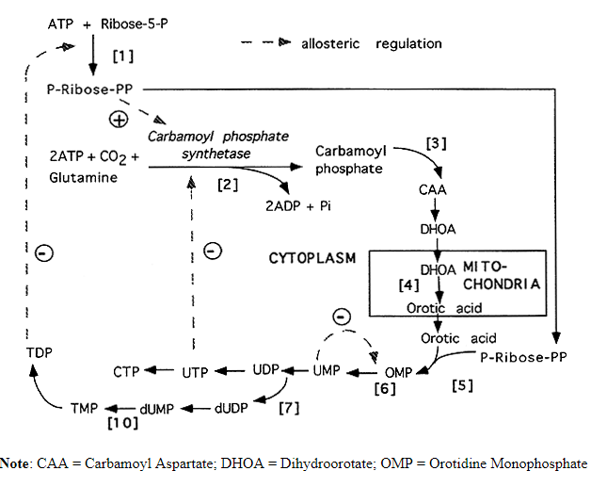

Slide 13
SALVAGE PATHWAY FOR PYRIMIDINE SYNTHESIS
Just like the purines, pyrimidine bases can also be recovered from DNA or RNA degradation.
This recovery is catalyzed by pyrimidine phosphoribosyl transferase which uses PRPP as source of ribose 1 phosphate.
This pathway is important because most tissues cant produce nucleotides through the de-novo pathway.
Basically, it involves the reactions of free bases with ribose 1 phosphate(with PRPP as the source) uridine phosphorylase uridine kinase
Free base + ribose 1 phosphate----------uridine----------UMP
thymidine kinase
Thymine + ribose 1 phosphate-----------thymidine----------TMP

Slide 14
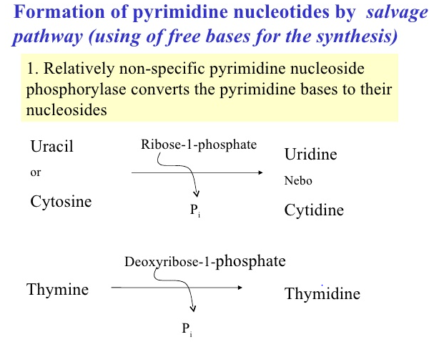

Slide 15
Regulation of Pyrimidine Synthesis
The primary site of regulation is Carbamoyl Phosphate Synthetase II which is allosterically inhibited by UTP.
Elevated PRPP increases the CPS-II activity to help control PRPP levels.
Feedback inhibition (control) is provided by TDP inhibition of PRPP synthesis and UMP inhibition of OMP Decarboxylase.

Slide 16
The regulation of pyrimidine synthesis occurs mainly at the first step.
The ATCase activity of the enzyme is inhibited by CTP and activated by ATP.
CPS-II is activated by ATP and inhibited by UDP, UTP, dUTP, and CTP.
ATP levels also regulate pyrimidine nucleotide biosynthesis at the level of PRPP formation. An increase in the level of PRPP results in an activation of pyrimidine synthesis.
The decarboxylase activity domain is competitively inhibited by UMP and, to a lesser degree, by CMP. Finally, CTP synthase is feedback-inhibited by CTP and activated by GTP.

Slide 17
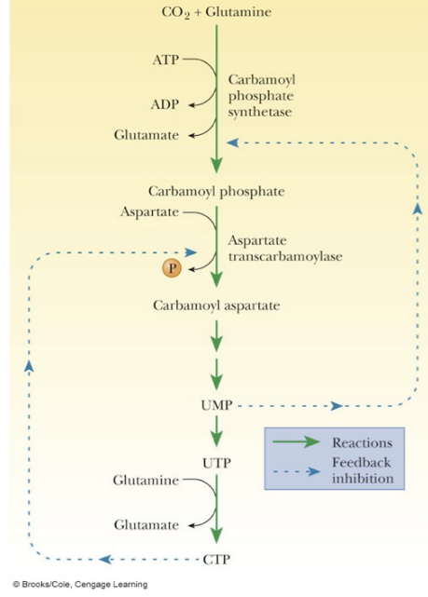

Slide 18
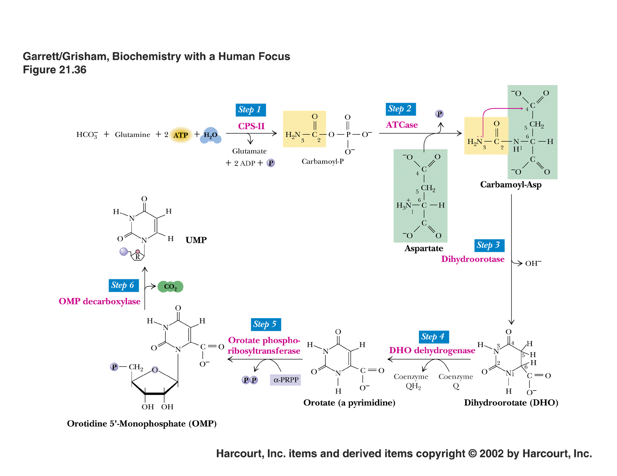

Slide 19
Catabolism of pyrimidine Nucleotides
Degradation occurs mainly in the liver where series of highly soluble end products are formed in contrast to the sparingly soluble end products of purine metabolism(uric acid and sodium urate)
After Pyrimidine biosynthesis, the newly synthesized molecules undergoes degradation after certain period. Animal cells degrade pyrimidine nucleotides to their component bases.

Slide 20
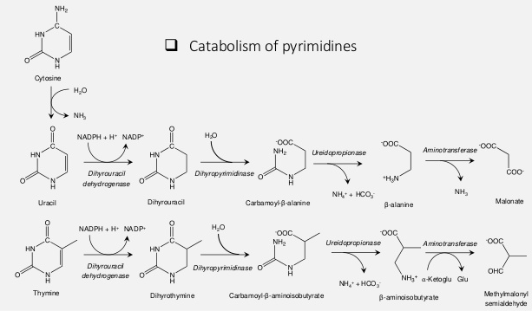

Slide 21
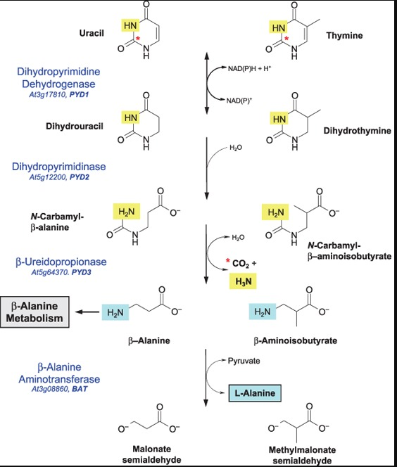
Pyrimidine Catabolism

Slide 22
The major end products of cytosine, uracil and thymine catabolism are beta-alanine and beta aminoisobutyric acid.

