Slide 1
Course Code: MCB 208
Course Title: Biodeterioration
Course Unit: 2 Units (L 30: P 15)
Course Lecturers: Dr. Francis Ibadin
Course Content:
Impact of Processing on Biodeterioration,
Impact of New Technologies on Biodeterioration & Biodeterioration Controls

Slide 2
Almost all food is processed in some way before it is eaten. Commercially, the main reasons to process food are to eliminate micro-organisms (which may cause disease) and to extend shelf life. Simply cooking or combining a food with other foodstuffs to create a recipe is also considered a form of food processing. Whatever the case, the nutrient value of any food is often altered by the processing.

Slide 3
Impacts of processing and storage of food
Some vitamins are more stable (less affected by processing) than others. Water-soluble vitamins
(B-group and C) are more unstable than fat-soluble vitamins (K, A, D and E) during food processing and storage.

Slide 4
The most unstable vitamins include:
• Folate
• Thiamine
• Vitamin C.
More stable vitamins include:
• Niacin (vitamin B3)
• Vitamin K
• Vitamin D
• Biotin (vitamin B7)
• Bantothenic acid (vitamin B5).

Slide 5
Processes affecting food nutrient content
A variety of things can happen during the growing, harvesting, storage and preparing of food that can affect its nutritional content. Processes that expose foods to high levels of heat, light or oxygen cause the greatest nutrient loss. The processes are as follows:

Slide 6
Fertilizers
Most plant crops are produced with the aid of fertilized soils. High use of nitrogen fertilizers tends to reduce the vitamin C content in many fruit and vegetable crops. It does not seem to make any difference to the plant’s nutrient value whether the fertilizer is organic or not.

Slide 7
Milling
Cereals such as wheat can be ground to remove the fibrous husks. The husks contain most of the plant’s dietary fibre, B-group vitamins, phytochemicals and some minerals. That is why products such as white bread are less nutritious than whole meal varieties, even if they have been artificially fortified with some of the nutrients that were lost after milling.

Slide 8
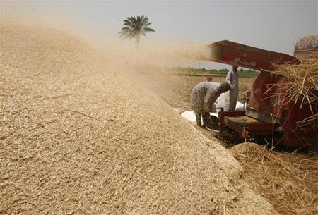
It is impossible to add back everything that is taken out, especially the phytochemicals. The ‘fibre’ that is added back to some products is often in the form of resistant starch, which may not be as beneficial as the fibre removed.

Slide 9
Blanching
Before a food is canned or frozen, it is usually heated very quickly with steam or water. The water-soluble vitamins, including vitamin C and B-complex, are sensitive and easily destroyed by blanching.

Slide 10
Canning
Food is heated inside the can to kill any dangerous micro-organisms and extend the food’s shelf life. Some types of micro-organisms require severe heat treatment and this may affect the taste and texture of the food, making it less appealing. Preservatives are generally not needed or used in canned foods. Water-soluble vitamins are particularly sensitive to high temperatures.

Slide 11

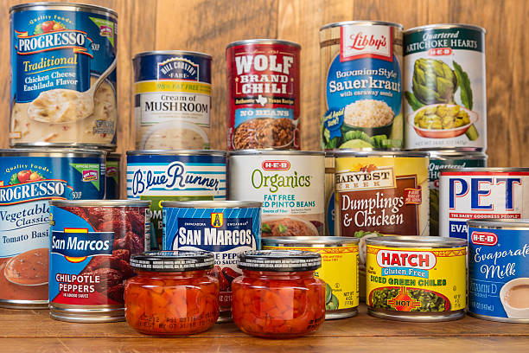
Many people believe that canned foods are not as nutritious as their fresh counterparts, but this is not always the case, as fresh food often deteriorates more rapidly than canned foods.

Slide 12
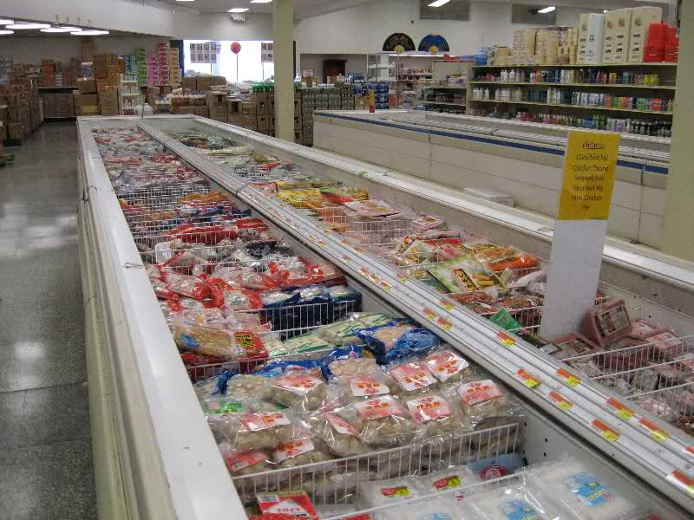
Freezing
The nutrient value of a food is retained when it is frozen. Any nutrient losses are due to the processing prior to freezing and the cooking once the frozen food is thawed.

Slide 13
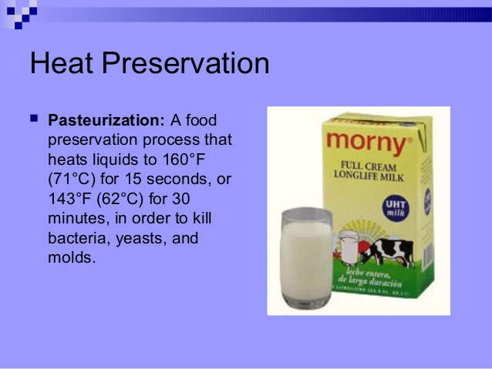
Pasteurization
Pasteurization involves heating liquid foods such as milk and fruit juices to specific temperatures to destroy micro-organisms. The nutrient value of milk is generally unaffected. In the case of pasteurized fruit juices, some losses of vitamin C can occur.

Slide 14
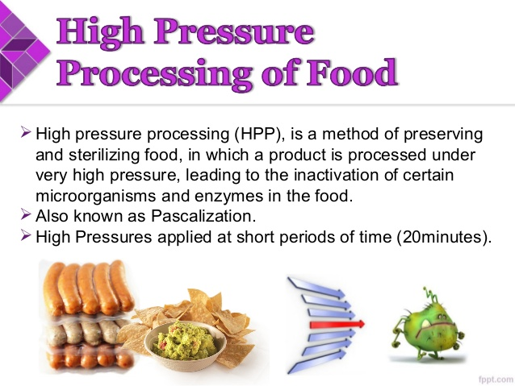
High pressure processing
This alternative preservation method subjects a food to elevated pressures, with or without the use of heat to kill micro-organisms. This method has been used in foods such as fruit juices. As heat is not required, this process impacts less on the vitamin content, flavour and colour of foods.

Slide 15
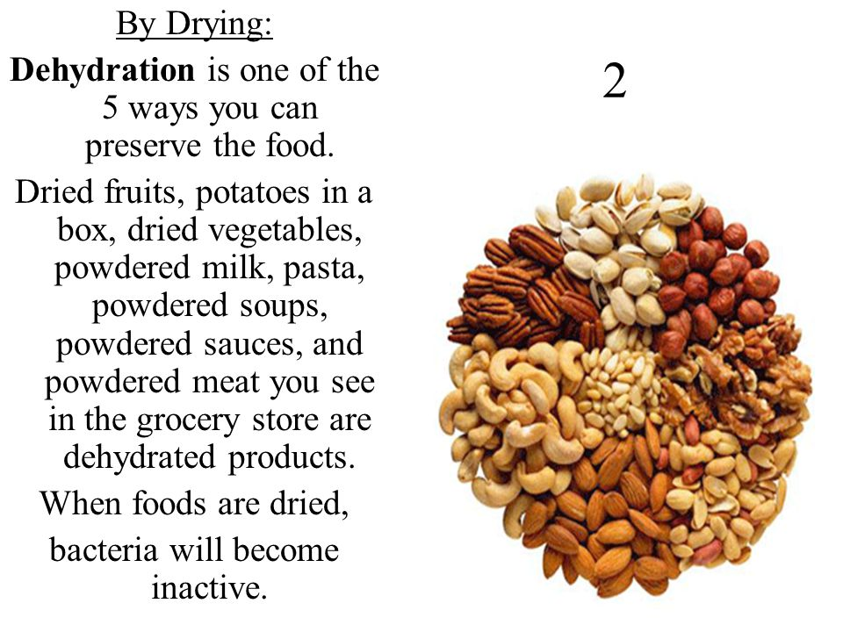
Dehydrating
Drying out foods such as fruits can reduce the amount of vitamin C they retain, but it can also concentrate other nutrients, particularly fibre in plant foods. Dehydrating food also makes food products more energy dense, which may contribute to weight gain. If a dehydrated food is reconstituted and cooked with water, further nutrients are leached out of the food and lost in the cooking water.

Slide 16

Preparation of vegetables
Most vegetables are peeled or trimmed before cooking to remove the tough skin or outer leaves. But most nutrients, such as vitamins, tend to lie close to the skin surface, so excessive trimming can mean a huge reduction in a vegetable’s nutrient value.

Slide 17
Losing nutrients through cooking
Some vitamins dissolve in water, so you lose your vitamins to the cooking water if you prefer to boil your vegetables. For example, boiling a potato can cause much of the potato’s B and C vitamins to migrate into the boiling water. It is still possible to benefit from these nutrients if you consume the liquid, for example, by turning the potato and the liquid into a soup. Alternative cooking methods such as grilling, roasting, steaming, stir-frying or microwaving generally preserve a greater amount of vitamins and other nutrients.

Slide 18
Benefits of cooking food
It would be inaccurate to say that cooking food always lessens the nutrient value. Cooking can be advantageous in many ways, including:
• making the food tastier
• breaking down parts of vegetables that would otherwise be indigestible
• destroying bacteria or other harmful micro-organisms
• making phytochemicals more available, for instance, phytochemicals are more available in cooked tomatoes than in raw tomatoes. (Phytochemicals are chemicals produced by plants).

Slide 19
Preserving the nutrient value of vegetables
Some suggestions to retain the maximum nutrition in the foods you cook include:
• Store foods properly, such as keeping cold foods cold and sealing some foods in airtight containers.
• Keep vegetables in the crisper section of the refrigerator.
• Try washing or scrubbing vegetables rather than peeling them.
• Use the outer leaves of vegetables like cabbage or lettuce unless they are wilted or unpalatable.
• Microwave, steam, roast or grill vegetables rather than boiling them.
• If you boil your vegetables, save the nutrient-laden water for soup stock.
• Use fresh ingredients whenever possible.
• Cook foods quickly.

Slide 20
Things to remember
• The nutrient value of food is almost always altered by the kind of processing it undergoes.
• The water-soluble vitamins are the most vulnerable to processing and cooking.
• Careful cooking and storage will help retain the nutrients in your food.

Slide 21
IMPACT OF NEW TECHNOLOGIES ON BIODETERIORATION
In recent years there has been both industrial ‘push’ and consumer ‘pull’ for minimally processed foods that are closer in nature to, for example, freshly prepared meals. There are many new and emerging technologies attracting research interest for food preservation.

Slide 22
Ohmic Heating
Ohmic heating works on the principle that all food materials have an inherent resistance to the flow of electricity. When an alternating electrical current (AC) is passed through a food product, the electrical resistance of that food causes it to heat up. Other names for this technology include resistance heating, direct resistance heating, Joule heating and Electroheating.

Slide 23
Since ohmic heating technology relies on the electrical resistance of the food to generate heat, if the electrical resistances of all components of the product are constant then the product heats uniformly. Particulate products can be heated uniformly, and since the process does not rely exclusively on heat transfer from the carrier fluid to the particulate, this can overcome some of the limitations of heat transfer found in conventional high-temperature/short-time (HTST) systems such as plate, tubular or scraped surface heat exchangers. Products such as fruit juices and concentrates, shelf-stable milk, puddings, soups and liquid egg products can all be heated rapidly, uniformly, and with a reduced impact on the organoleptic properties of the product.

Slide 24
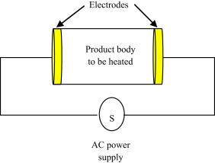
The advantages of ohmic heating over conventional heat exchangers can be summarized as follows:
● Rapid and uniform heating
● Higher particulate temperatures are attainable
● Enhanced product quality owing to rapid heating
● Reduced fouling of certain products
● Greater energy efficiency
● Instant switch-on/switch-off
● Reduced maintenance
● Quiet (dependent on type of pumps, etc.)
● Environmentally friendly. Schematic diagram illustrate the principle of ohmic heating

Slide 25
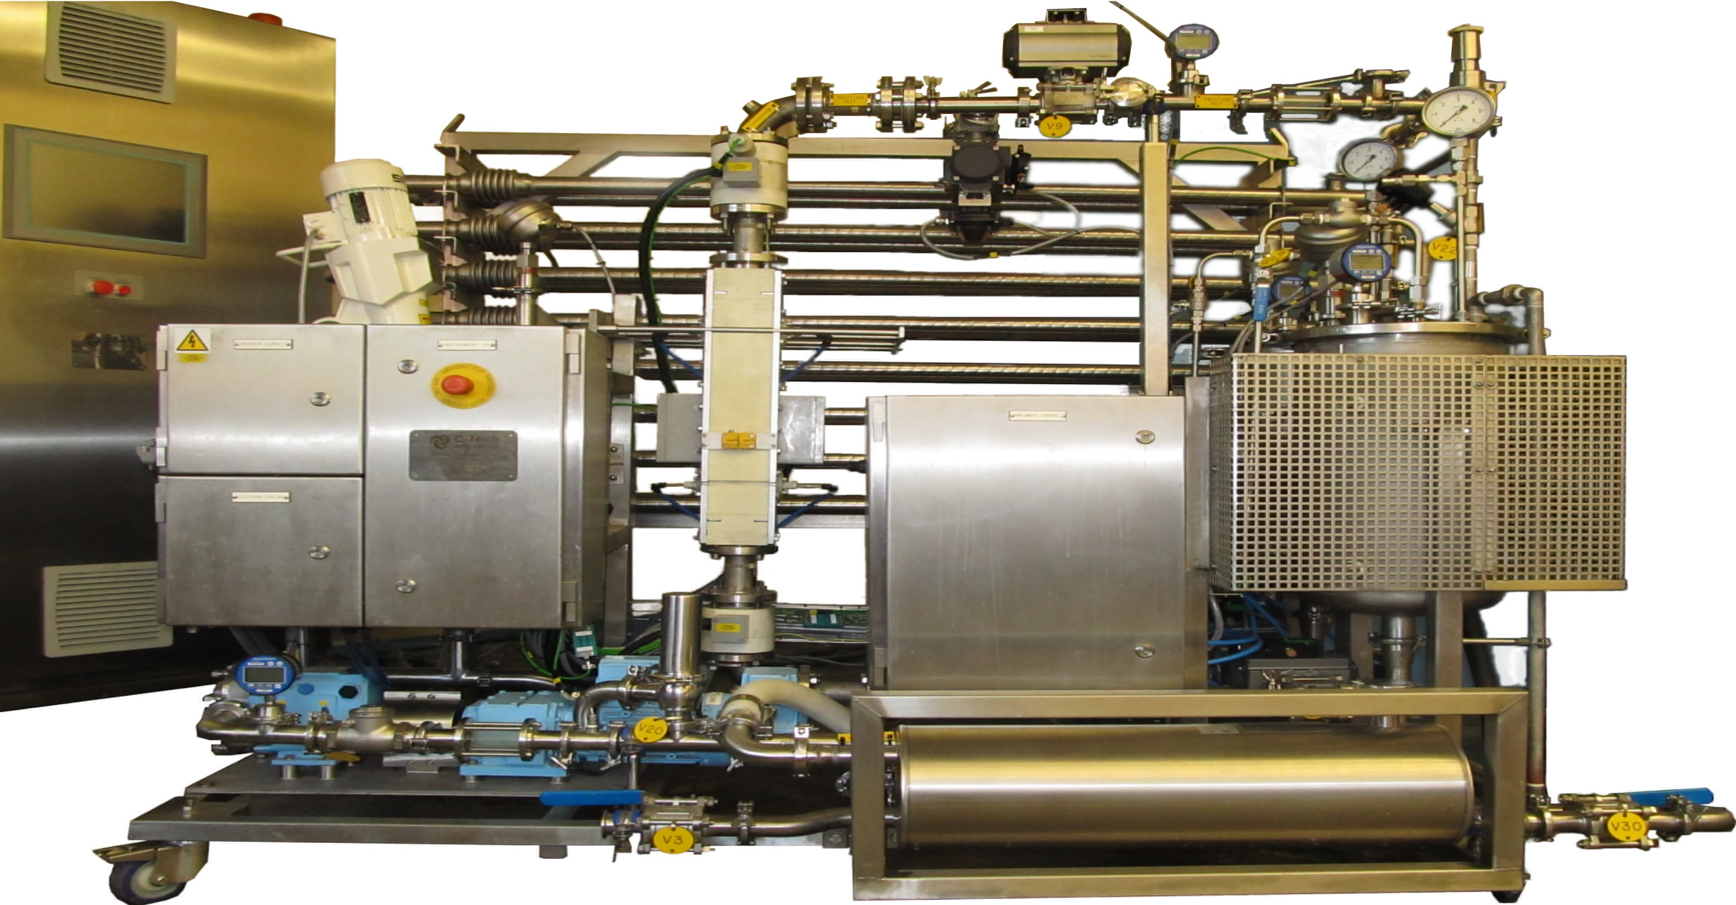
A pilot-scale ohmic heater for pasteurisation of fruit

Slide 26
Pressure Processing
High-pressure processing (HPP) is a non-thermal pasteurization process in which a food is subjected to pressures in the region of 300 to 600 MPa (3000 to 6000 bar) and held at pressure for a time, generally under 10 minutes. The applied pressure is usually transmitted via water in commercial systems but alternative materials such as propylene glycol or oil-in-water emulsions are employed in laboratory systems. A small temperature rise is observed during pressurization. This rise is typically around 3–4°C per 100 MPa of applied pressure for predominantly aqueous materials, but varies depending on the composition of the product.

Slide 27
The extremely high pressures employed in HPP inactivate vegetative micro-organisms, and because the process does not involve heating, the sensory and nutritional qualities of HPP products can be remarkably similar to those of their unprocessed counterparts. Bacterial spores are very resistant to commercially achievable pressures and, as a result, products that are currently on the market are chilled, and many are high acid or contain additional preservation hurdles such as the presence of antimicrobial compounds.

Slide 28
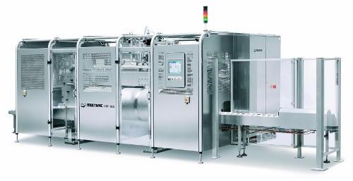
A horizontal batch high-pressure processing vessel

Slide 29
Microwave and Radio-Frequency Heating
Microwave and radio-frequency (RF) heating are well established thermal processing technologies that have found application in many process sectors. Commercial installations are common in the plastics, textiles, paper and board, wood and food processing industries. Food applications for the prevention of biodeterioration are not, however, in widespread use. Microwave and RF heating are similar in that, as is the case for ohmic heating, heat is generated volumetrically throughout a product rather than having to rely on the slow conduction or convection of heat from the product surface to the core. Microwave and RF heating refers to the use of electromagnetic waves at particular frequency to generate heat in a food material.

Slide 30
The major advantage of microwave/RF heating is, as for ohmic heating, the rapid and volumetric temperature rise that can be achieved in foods. In food processing, the advantages of the rapid heating effects are amplified by the fact that both microwave and RF radiation can penetrate the food to a depth of several cm (microwave) or tens of cm (RF), promoting a volumetric heating effect throughout the food. This can have huge advantages over slower conventional heating processes, as the high-temperature/short-time process can achieve bacterial reduction, while thermal degradation of desired components is reduced.

Slide 31
The major difference between microwave and RF heating relates to the electrical field. In RF heating, the electrical field is generated in a directional manner between a pair of electrode plates; the food material to be heated is placed between the two plates to achieve the desired effect.
In microwave heating, the electrical component of the microwave field approaches the food product from all directions; microwave heating usually takes place in an enclosed cavity, or in close vicinity to a waveguide applicator.

Slide 32
The volumetric nature of both microwave and RF heating leads to a number of significant advantages over traditional surface heating techniques. Among the most important advantages are:
● Improved food quality
● Increased product throughput
● Improved energy efficiency
● Improved control of the heating process.
It should, however, be recognized that there is something of a trade-off to realize these key advantages.
There are several disadvantages associated with both microwave and RF process operations, the major drawbacks being:
● Difficulties in validating the heat treatment
● High equipment and operating costs.

Slide 33
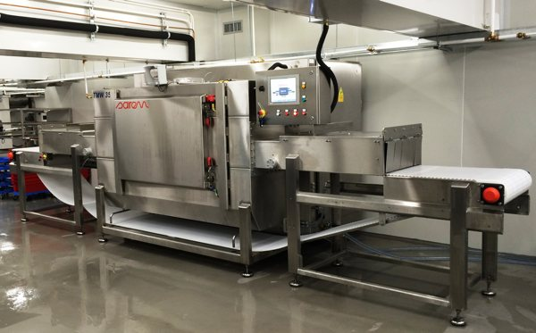
Microwave cooking process in food industry

Slide 34
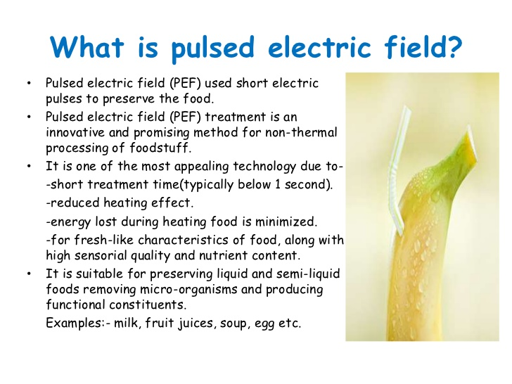
Pulsed Electric Field Processing
Pulsed electric field (PEF) processing is a technique in which a food is placed between two electrodes and exposed to a pulsed high-voltage field (typically 20–80 kV/cm). Treatment times are of the order of less than 1 second for preservation applications. This process reduces levels of micro-organisms while minimizing undesirable changes in the sensory properties of the food.

Slide 35
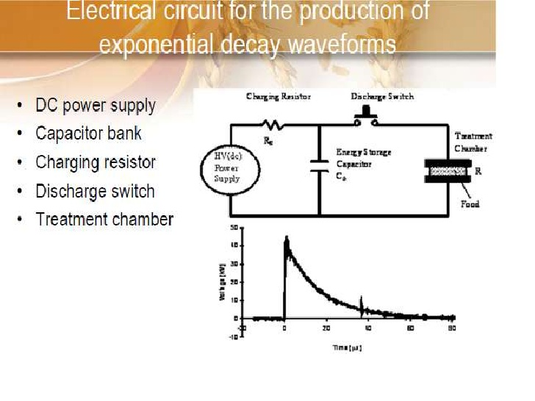
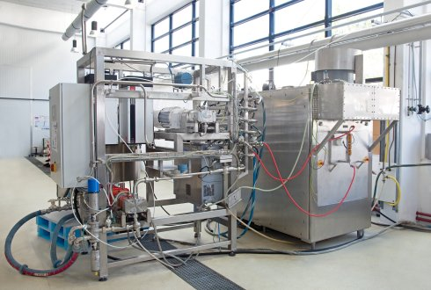
Pulsed electric field processing

Slide 36
Irradiation
The use of ionizing radiation to destroy micro-organisms or insects, or to improve the shelf life of perishable materials is well established, but it is a technology that remains highly controversial. X-rays and radioactivity were discovered at the end of the nineteenth century, and in the early years of the twentieth century the possible application of these modalities to the preservation of food was already being investigated. Gamma rays have very short wavelengths beyond the ultraviolet end of the electromagnetic spectrum. They penetrate deeply into food, making them very useful for food irradiation. The most widely used source of gamma rays is the radioactive isotope cobalt-60 (60Co).

Slide 37
In general, Gram-negative micro-organisms such as the common spoilage bacteria Pseudomonas and important pathogens such as Salmonella and Escherichia coli are more sensitive to ionizing radiation than Grampositive bacteria, but exceptions do occur. Different strains of the same organism can differ in their ability to survive irradiation. Pathogens such as E. coli, Salmonella spp., Listeria monocytogenes and Campylobacter species are all relatively sensitive to irradiation. Food-borne pathogens capable of growth at low temperatures, e.g. Listeria and Aeromonas species, are also sensitive to irradiation and will be eliminated by similar doses to those for Salmonella.

Slide 38
Most food spoilage bacteria are sensitive to radiation, although strains of the Acinetobacter moraxella have some resistance to radiation and may form a large proportion of the bacterial survivors on food irradiated with moderate doses. In experiments carried out on red meat and poultry, certain strains of this genus were shown to be even more resistant to radiation than spores, although their presence in such food is not significant from either a public health or a sensory perspective.

Slide 39
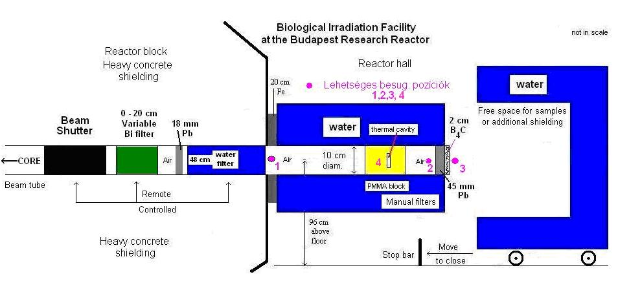
Schematic view of the Biological Irradiation Facility

Slide 40
BIODETERIORATION CONTROL
The main effort in the field of biodeterioration has been to develop, either empirically or by design, methods for preventing the biodeterioration of materials and thus preserve their value and usefulness for as long as possible. The first use of preventative methods was to enable the storage of foodstuffs after harvest or hunting, and these involved physical/mechanical techniques such as heat, cold, drying, osmotic pressure, and the use of mechanical barriers. Chemical methods were first introduced as fumigants (sulfur) and then as salts of mercury, copper, and zinc in the eighteenth and nineteenth centuries for preserving timber and other natural products in storage.

Slide 41
PHYSICAL METHODS
A knowledge of the physiology of the biodeteriogen is useful in determining the strategy of physical methods, from the gnawing and vertical jumping capabilities of rodents, to the tolerance of certain fungi to low water activities. Refrigeration down to −20 ◦C is often necessary to retard growth over a long period, although slow-growing moulds have been reported in large cold stores. It is usually accepted that growth is inhibited at the temperature at which the cell contents freeze. The ability of some organisms to produce their own intracellular ‘antifreeze’ may account for continued growth in extreme cold. It is not uncommon for fungal growth to occur on foods stored in domestic refrigerators where the temperature may be between 4 and 6 ◦C.

Slide 42
At the other end of the temperature spectrum, temperatures in excess of 40 ◦C will reduce the activity of a number of organisms, although temperatures above boiling point will be necessary for severe reductions in the viability of organisms which produce spores.
The partial removal of water from a product or the maintenance of that product in an atmosphere low in moisture is commonly used in a variety of familiar situations. Desiccants are often placed inside the packaging of goods to absorb atmospheric water and reduce the humidity in the package, which in turn reduces the likelihood of microbial growth. The level of moisture in the air, often given as the RH, depends on the temperature, and both these parameters influence the expected lifetime of an object.

Slide 43
The water activity (A_{w}) of a material is a measure of the availability of the water, in this context, to the microorganism and the atmosphere in which it grows. It is expressed as the ratio of the vapour pressure of water over the material to the vapour pressure over pure water at the same temperature. The water activity of pure water is thus 1.0, and this decreases as solutes are added. Although the water activity of a material or substance is an intrinsic feature, preservation methods often rely on altering the ERH (equilibrium relative humidity) of a product by the addition of chemicals which change the water relations within that product.
Propylene glycol and sorbitol are used in tobaccos and domestic animal food to impart a feeling of moisture or plasticizing effect on the product. These glycols also reduce the water activity sufficiently to retard the growth of moulds.

Slide 44
Radiations such as gamma rays, UV rays, and microwaves have all been employed to a limited extent as sterilizing agents, often where there has been a large-scale spoilage problem in, for example, a liquid product, and there is a possibility that the product may be reclaimed or reworked. Gamma irradiation has been used to treat books from a library after flooding resulted in widespread fungal growth. The ability of the radiation to adequately penetrate the material to be sterilized is paramount. Thus UV systems have found a niche in the treatment of both potable and recirculating water used in industry, in which relatively thin films can be made to flow through the source of radiation.

Slide 45
Filters are also extensively used as barriers to microorganisms in aqueous recirculation systems. Membrane filters with pore sizes of either 0.45 or 0.22μm are routinely used to trap fungi and bacteria.
Larger-pore filters can be employed for filamentous growths to reduce blockage problems. The use of physical barriers for the exclusion of larger organisms is a matter of common sense and knowledge of the habits of particular troublesome groups.

Slide 46
The nature of the surface of a material affects the initial colonization by microorganisms. Smooth hydrophobic surfaces such as epoxy paint films are less likely to encourage colonization than textured surfaces (external renderings or stucco plasters), which can harbour organic debris and water and provide crevices for microorganisms. This approach has been used to prevent external fouling on off-shore structures. It involves coating the vulnerable parts of the structure with a silicone rubber material (polydimethyl siloxanes) which contains a hydrophobic fluid. The fluid slowly and continuously exudes from the surface, preventing settlement of marine organisms.

Slide 47
CHEMICAL METHODS
The chemicals used in controlling biodeterioration in materials come in the form of gases (fumigants), dispersible powders, and liquids. Gaseous sterilization or fumigation is used to decontaminate materials which have already been infested with insects or microorganisms and which are not amenable to other forms of sterilization such as heat, radiation, or the addition of toxic chemicals in solution or suspension. Low oxygen atmospheres (less than 0.03%) have been used to treat infestations of woodborers and termites in museum artefacts.

Slide 48
Chemical preservatives are variously referred to as biocides, bactericides, fungicides, fungi stats, antifouling compounds, and material protectants. The term preservative is probably the most accurate descriptive term for general use, because it infers that he protected material maintains its integrity and performance characteristics during storage and use. The termbiocide is more commonly used to describe the range of chemicals used to combat biodeterioration in industrial products, although we still talk of wood preservatives and antifouling compounds in the building and boat industries, respectively.

Slide 49
To be effective, the ideal biocide (which does not, of course, exist!) should have the following characteristics:
Toxic to the target deteriogens
Non-toxic to human and non-target animal and plant life
It must be compatible with the product and not impart any
unwanted colour or alter the properties of the material
It must partition into the phase where its activity is
required
It should be stable in both the concentrate and the diluted
form
It should have a low cost: performance ratio

Slide 50
Major Chemical Actives
Oxidizing Agents
The biocide with the longest history in water disinfection, and still one of the most popular antimicrobials because of its low cost, is chlorine. It is used in industrial and domestic applications. However, it has a limited pH range, being less effective at alkaline levels, and is inactivated by reaction with proteins, as well as with ammonia-containing compounds.
Other oxidizing biocides include hydrogen peroxide, ozone, and, of course, other halogens. Ozone is being increasingly used in place of chlorine in the treatment of domestic and industrial water supplies.

Slide 51
Aldehydes
Formaldehyde and glutaraldehyde are broad-spectrum biocides, with good sporicidal activity. They have good water solubility, but their main feature is that they easily vaporize, and this is put to good effect in situations in which there is poor hygiene in the factory where the product is made. If added (usually in combination with another active) early on in the manufacturing process, they provide protection throughout the plant and then continue to release formaldehyde during storage of the finished product. They continue also to be used in combination with isothiazolinones as in-can biocides for paints and adhesives and in combination with parabens preparations.

Slide 52
Alcohols
The aliphatic alcohols, such as ethanol and isopropanol, tend to be used as disinfectants in antibacterial hand washes because of their speed of action in the destruction of bacteria and viruses. Because of their evaporation rate they cannot be used as biocides.
However, benzyl alcohol and phenoxyethanol are used in cosmetic preservation as bactericides at concentrations up to 1%, often in combination with complementary actives.

Slide 53
Phenolics
Phenolic compounds, derived from coal tar, were the early effective disinfectants.
Phenol itself is a potent carcinogen, but a range of chlorinated phenols is still available for both disinfection and preservation.
They tend to be bactericides, but orthophenyl phenol has fungicidal activity, and its potassium salt is often used in combination with a quaternary ammonium compound to provide a broad-spectrum biocidal wash for the treatment of masonry before repainting.

Slide 54
Organic Acids and their Esters
Acetic, propionic, lactic, sorbic, and benzoic acids and their salts are traditionally used for preservation of acidic foodstuffs. They are weak acids which are active only in their undissociated states, thus limiting their effectiveness to the pH range 4–6. At this range they are employed to control yeast and mould growth in fruit juices and fermented milk products. The esters of hydoxybenzoic acid, known collectively as the parabens, are very widely used in the food and cosmetic industries as preservatives to inhibit moulds and yeasts.

Slide 55
Quaternary Ammonium/Phosphonium Compounds
They are rapid-acting antimicrobials and thus find application as disinfectants.
However, because of their stability to pH and heat, they can be successful as longer-term biocides, providing they are not used in combination with anionic surfactants or high levels of protein and salts, which will severely reduce their efficacy.
They have broad-spectrum activity towards bacteria and will control algal growth.

Slide 56
Isothiazolinones
This is a group of actives which might be termed ‘modern technology’ in the biocide field.
They are characterized by the five membered isothiazolinone ring, which has a number of different substituents which give the resulting molecule varying biocidal properties, including, generally, good activity against microorganisms in biofilms.
The main derivatives in commercial use are methyl, methylchloro, benzyl, octyl, and dichloro-octyl.

Slide 57
Other Organohalogen-Containing Biocides
The other major preservative used for in-can preservation is bromonitropropane diol (trade name, Bronopol). Bronopol shares the same deactivating characteristics as the isothiazolinones, but it is more effective as a bactericide than a fungicide. It is often used in combination with the water-soluble isothiazolinones to provide an extremely broad-spectrum preservative. Other important biocides are worth a mention include bromonitropropane diol, carbendazim, octylisothiazolinone, iodopropynyl butylcarbamate (IPBC), dichlorophenyl dimethylurea, carbendazim and octylisothiazolinone.

Slide 58
BIOLOGICAL METHODS
The use of one biological agent to suppress another is a strategy which receives periodic attention, particularly when it fails to achieve the desired result and the balance of nature is disturbed. One example in the control of wood decay is the use of immunizing commensals. Studies have shown that the fungus Scytalidium lignicola is antagonistic to Lentinus lepideus, a wood-decaying fungus; Trichoderma viride has also been used commercially.

Slide 59
It may be introduced as a slug (spores of the fungus mixed in a dehydrated nutrient matrix and pressed into a pill) into the trunk of a standing tree; in a similar situation, the technique has also been suggested for protecting electricity transmission and telegraph poles.
As biotechnological research develops as a discipline, the search for microbially produced chemical agents with highly specific antagonistic properties may see a resurgence, particularly in the control of contamination of fermentation processes.

