Slide 1


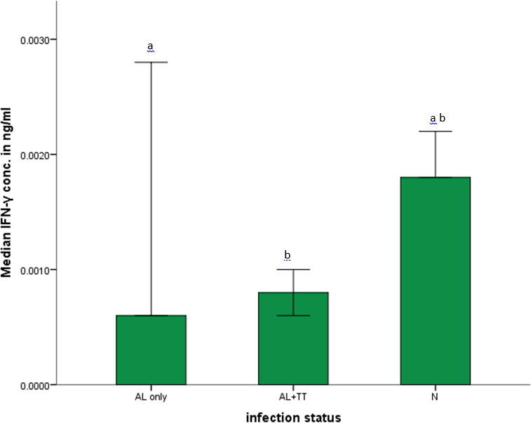
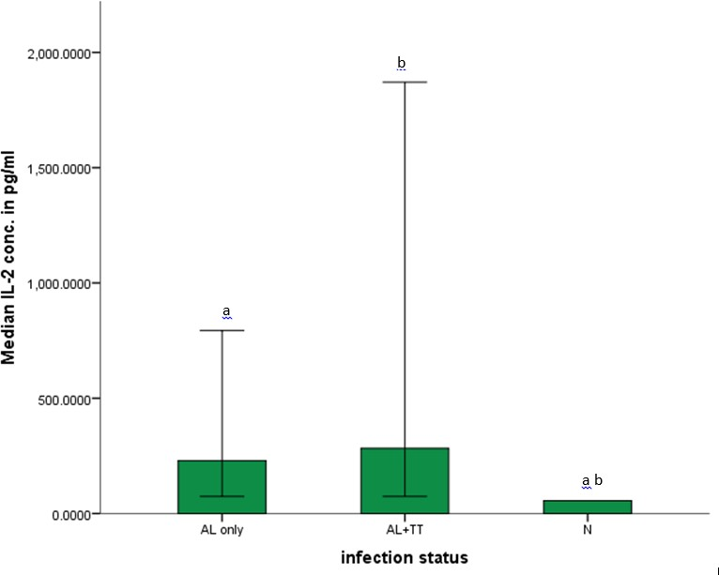
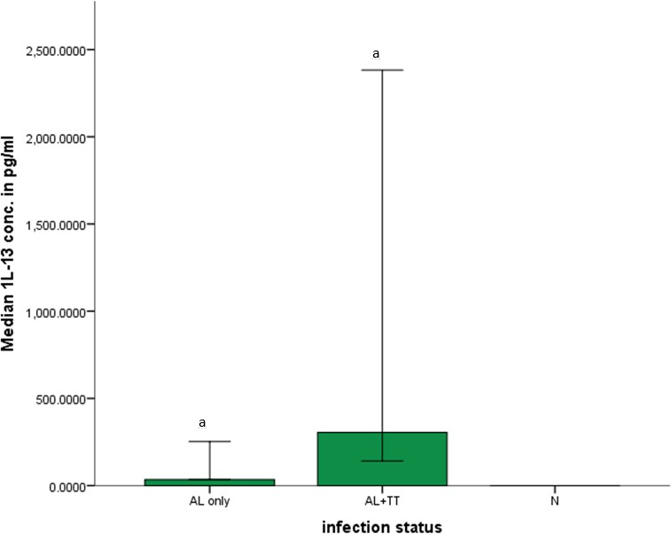

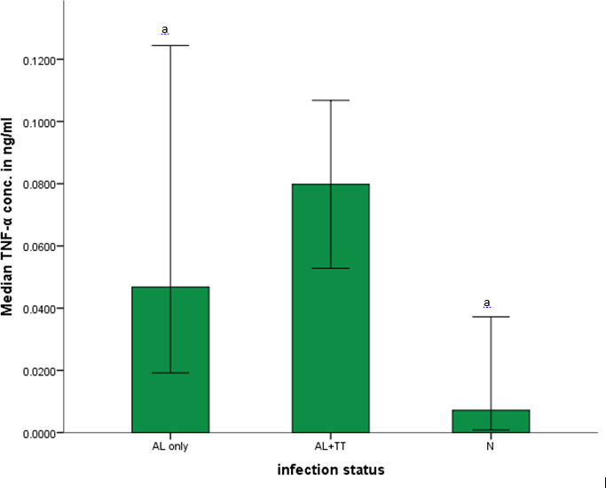
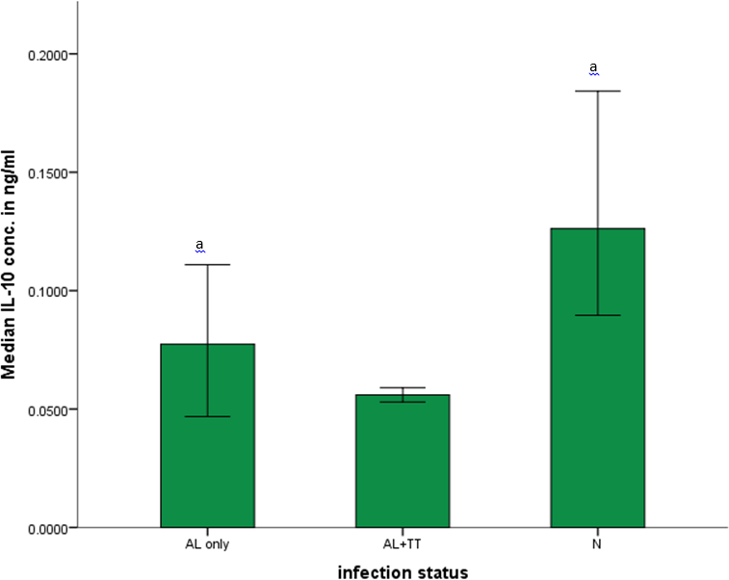
CHANGES IN CYTOKINE PROFILE OF PREGNANT WOMEN INFECTED WITH SINGLE AND MULTIPLE SPECIES OF INTESTINAL HELMINTHES
OR Rabiu^{1,2,7}, AM Kosoko^{1,3}, H Dada-Adegbola⁴, CO Falade^{1,5}, OG Arinola⁶, OG Ademowo^{1,5*}
¹Institute for Advanced Medical Research & Training, ²Department of Zoology, ³Department of Biochemistry, ⁴Department of Microbiology & Parasitology, ⁵Department of Pharmacology & Therapeutics, ⁶Immunology Unit, Department of Chemical Pathology, University of Ibadan, ⁷Mountain Top University, Nigeria.
Background
Helminthiasis is a common occurrence in sub-Saharan Africa with increased prevalence among the vulnerable groups of children and pregnant women. Epidemiological studies have shown co-existence of multiple helminth species. The impact of intestinal helminth species specific changes in the cytokine profile of pregnant women was evaluated.
Methodology
Pregnant women aged between 18-45 years were recruited from antenatal clinics of healthcare facilities while those infected with HIV were recruited from the HIV clinic.
Thick blood films were prepared and stained for viewing under light microscope to check for malaria parasites. Stool samples were also collected and processed for microscopic examination of helminthes using wet preparation and Kato-Katz methods.
Serum samples were assayed for TNF-α, IFN-γ, IL-1α,
IL-2, IL-4, IL-6, IL-10, IL-12 (p70), IL-13 and IL-17 using
ELISA kits purchased from Assaypro, USA and GenWay Biotech Inc., USA. Assays were performed according to manufacturer’s instructions.
From the large pool of data, those infected with helminthes only and those without infections were used for the analysis. Data analysis was done using SPSS software version 22.
Frequencies were analysed using descriptive statistics. Mann-Whitney U test was used to determine significant differences in median values.
Figure 1: Median concentrations of IFN-γ among the infected and uninfected groups Key: AL – A. lumbicoides, TT – T. trichiura, N – Uninfected
Error bars indicate confidence interval (CI)
Symbols on error bars indicate significant differences between groups.
Figure 2: Median concentrations of IL-2 among the infected and uninfected groups Key: AL – A. lumbicoides, TT – T. trichiura, N – Uninfected
Error bars indicate confidence interval (CI)
Symbols on error bars indicate significant differences between groups.
Results
From the larger cohort of recruited women, serum samples from 199 women were used for determination of cytokine profile, of which 30 were infected with helminthes only; 24(12.1 ) had Ascaris lumbricoides (AL) only, 5(2.5 ) had co-infection of Ascaris and Trichuris trichiura (AL+TT) while 1(0.5 ) had hookworms only. Relative to the uninfected group, AL+TT caused significant increases in IFN-γ (Fig. 1) and IL-2 (Fig. 2). IL-13 (Fig. 3) was below detectable limit in the uninfected group. Increases in TNF-α (Fig. 4), IFN-γ (Fig. 1) and IL-2 (Fig. 2) and a corresponding decrease in IL-10 (Fig.5) was observed in those infected with AL only compared with the uninfected group. There were no significant differences in the concentrations of IL-1α, IL-4, IL-6, IL- 12(p70) and IL-17 among the groups. Comparison of the two groups infected with helminthes showed that AL+TT further increased the concentrations of TNF-α, IFN-γ and IL-2 with decrease in IL-10 but these were not significant (p>0.05). Only IL-13 significantly increased in those infected with AL+TT relative to those infected with AL only.
Figure 3: Median concentrations of IL-13 among the infected and uninfected groups Key: AL – A. lumbicoides, TT – T. trichiura, N – Uninfected
Error bars indicate confidence interval (CI)
Symbols on error bars indicate significant differences between groups.
Conclusion
IL-13 protects against nematodes and it is justifiable to increase in response to multiple species. Beyond this, there appears not to be a major alteration in the cytokine profile of single and multiple intestinal helminth infections. Hence, species specific immune response of intestinal helminths may not be a major challenge in vaccine development and test for efficacy.
Figure 4: Median concentrations of TNF-α among the infected and uninfected groups Key: AL – A. lumbicoides, TT – T. trichiura, N – Uninfected
Error bars indicate confidence interval (CI)
Symbols on error bars indicate significant differences between groups.
Figure 5: Median concentrations of IL-10 among the infected and uninfected groups Key: AL – A. lumbicoides, TT – T. trichiura, N – Uninfected
Error bars indicate confidence interval (CI)
Symbols on error bars indicate significant differences between groups.
Acknowledgement
The project was partly funded by European FP7 grant (IDEA). The project was also supported by a scholarship and
grant from the West African Institute of Infectious Diseases of Poverty (IIDP) from 2013 to 2016 awarded to ORR

