Slide 1

CHM 102
Organic Chemistry
HOMOLOGOUS SERIES AND FUNCTIONAL GROUPS
Dr. (Mrs.) NDUKWE, Nelly Acha
CHM 102
Organic Chemistry HOMOLOGOUS SERIES AND FUNCTIONAL GROUPS by Dr. (Mrs.) NDUKWE, Nelly Acha is licensed under a Creative Commons Attribution-NonCommercial 4.0 International License.

Slide 2
HOMOLOGOUS SERIES
A homologous series represent a group of compounds with the same functional group.
Members of the same homologous series are known as homologs and the general characteristics of homologs include:
They are represented by the same general formula
Each member differs from the next member by a –CH2 unit.
The physical properties change gradually with increasing molar mass.
They have similar chemical properties.
And can be prepared by the same method.

Slide 3
Homologous (family) Series
Each series has a general formula.
All members possess the same functional group. It is the functional group that gives the series its characteristic reactions.
There is a gradual change in physical properties from one member to the next. The most common example of this is the increasing melting and boiling points as we go up a series. The reason for this is that the molecules get larger and therefore harder to break.
Members of the same homologous series have similar chemical properties.

Slide 4
Characteristics of a homologous series
All members of the series can be represented by the same general formula
Each member of the series differs from the members before or after it by a – CH₂- functional group
All members of the series possess similar chemical properties
All members of the series show a gradual change in their physical properties as their molecular mass increases. In general, as molar mass increases, melting point, boiling point and density increase

Slide 5
Homologous Series
A homologous series is a series of compounds that have the same functional group, and each member differs from the next member by a – CH₂ – unit in their formulae.
CH₄ C₂H₆ C₃H₈ C₄H₁₀
CH₂ CH₂ CH₂

Slide 6

Homologous Series of Hydrocarbons
Hydrocarbons are compounds that only have Carbon and Hydrogen...
There are several types of homologous series of hydrocarbons that are based on the number of bonds and the arrangement the atoms in that compound. They include:
Alkanes, Alkenes, Alkynes, & Benzene

Slide 7
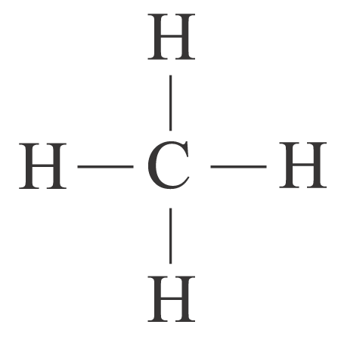
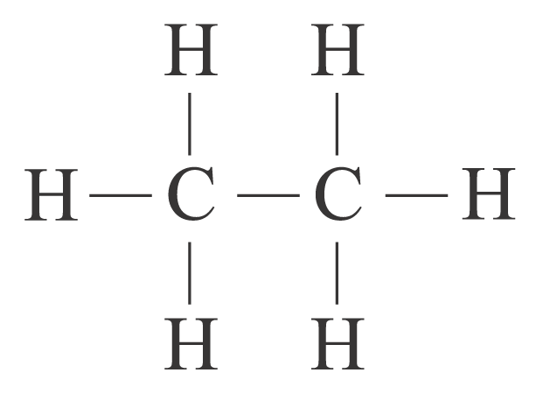
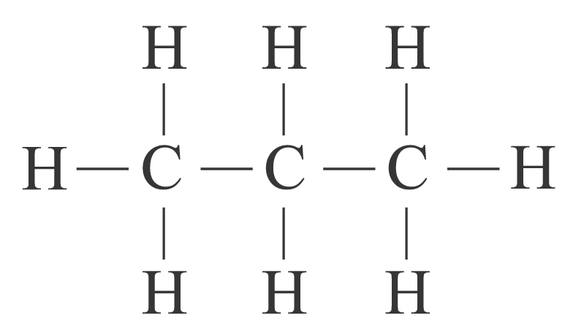
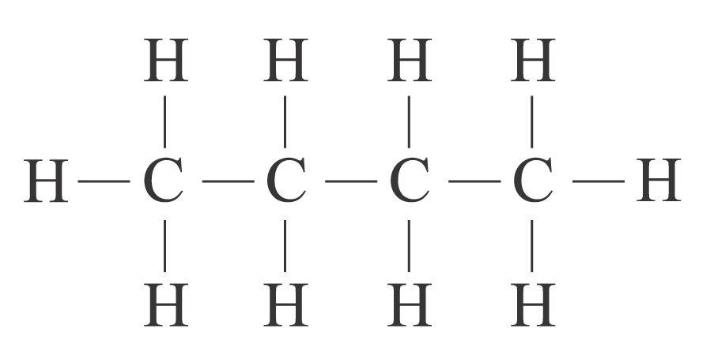
The first four members of straight-chain alkanes
Number of carbon atom(s) | IUPAC name | Molecular formula | Condensed structural formula | Structural formula
1 | Methane | CH₄ | CH₄
2 | Ethane | C₂H₆ | CH₃CH₃
3 | Propane | C₃H₈ | CH₃CH₂CH₃
4 | Butane | C₄H₁₀ | CH₃CH₂CH₂CH₃

Slide 8
Homologous Series
The physical properties change gradually along the homologous series
e.g. the longer the carbon chain in the molecule ( or the greater the molecular mass)
➔ the greater the attractive force between molecules
➔ the higher the melting point,
boiling point and density

Slide 9
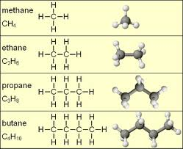
Homologous Series
A homologous series is a group of compounds which all possess the same functional group. Members of homologous series all have the same general formula.
Example Alkanes : CnH2n+2

Slide 10
Names of some Alkenes (Homologs)
Number of carbons | Molecular Formula | Name
2 | C₂H₄ | ethene
3 | C₃H₆ | propene
4 | C₄H₈ | butene
5 | C₅H₁₀ | pentene
6 | C₆H₁₂ | hexene
7 | C₇H₁₄ | heptene
8 | C₈H₁₆ | octene
9 | C₉H₁₈ | nonene
10 | C₁₀H₂₀ | decene

Slide 11
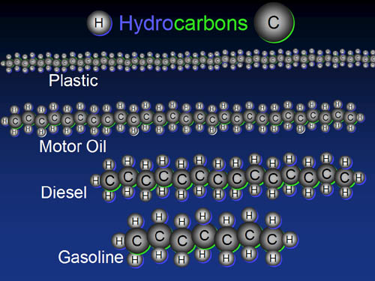
What are hydrocarbons?
All organic compounds contain carbon. Those that contain only carbon and hydrogen are called hydrocarbons.

Slide 12

Benzene
The final homologous hydrocarbon that is very stable.
They are often called aromatic compounds.
They are distinguished by alternating double and single bonds throughout a molecule.
A Benzene molecule is illustrated by the following formula:
C_{n}H_{2n - 6}

Slide 13

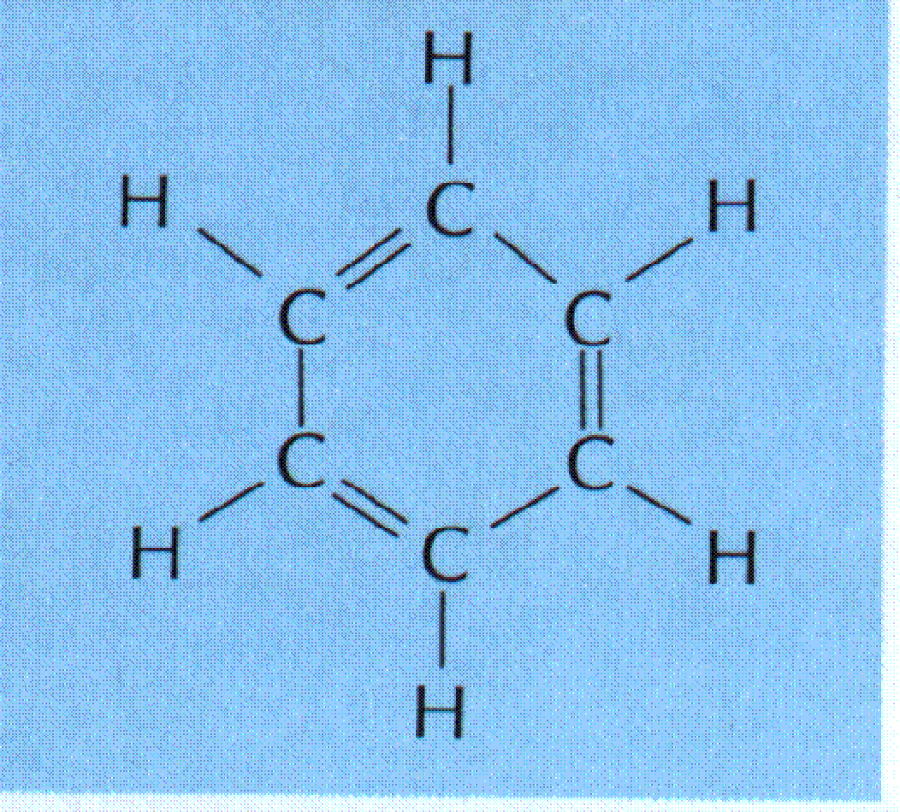
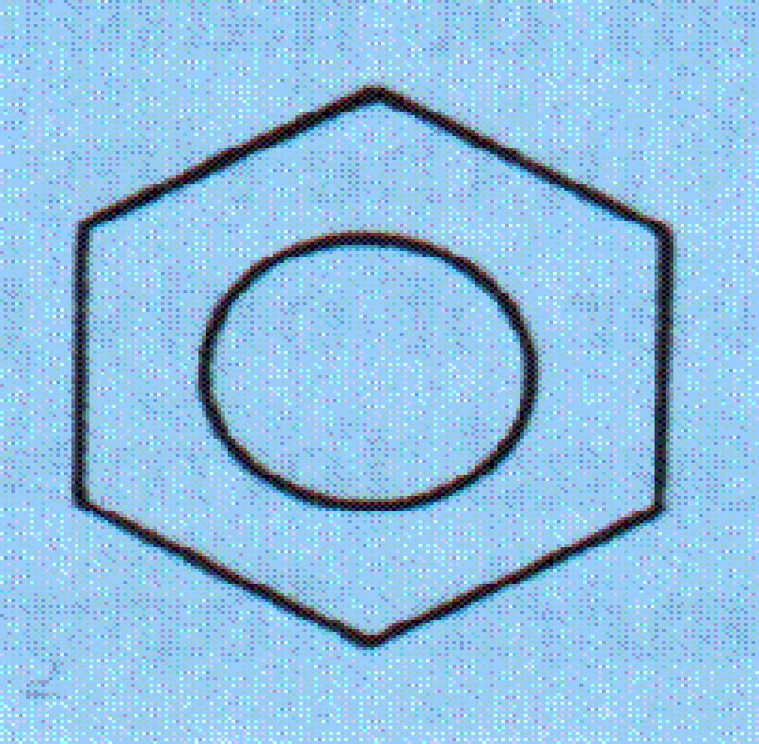
Benzene
They can be written as…..
or

Slide 14
Benzene
CH₃
Methyl Benzene or Toluene

Slide 15
Alkyl halides ( A class of Organic Compound)
The alkyl halides are also known as halo alkanes
These are important compounds in organic synthesis reactions. For the purposes of nomenclature the halogens F, Cl,Br, I are treated as fluoro (not flouro), chloro, bromo and iodo side groups.

Slide 16
Halogen Substituents
When a halogen is connected to a parent chain of a hydrocarbons it is given the following prefixes:
Cl = Chloro
Br = Bromo
F = Fluoro
I = Iodo

Slide 17
Halogen Substituents (Alkyl Halides)
Cl
CH₃–CH₂–C–CH₃
Cl
2,2 dichlorobutane

Slide 18
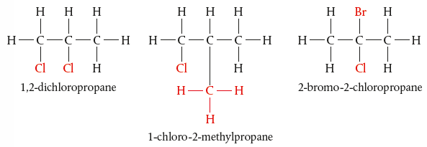
Halo-Alkanes

Slide 19
Functional Groups
Organic compounds are classified by the presence of characteristic functional groups
A functional group is defined as an atom or a group of atoms that effectively determines the chemical properties of an organic compound.
A functional Group is a particular arrangement of a few atoms on a hydrocarbon that results in specific chemical and physical properties for that type or class of organic molecules

Slide 20
Functional Groups
Organic compounds are classified into groups based on the functional group which they contain.
A functional group contains a particular bond between two carbon atoms, e.g. a double bond, or is a particular atom or a particular group of atoms.
All members of a group contain the same functional group which determines the properties of that group. The group is known as a homologous series.

Slide 21
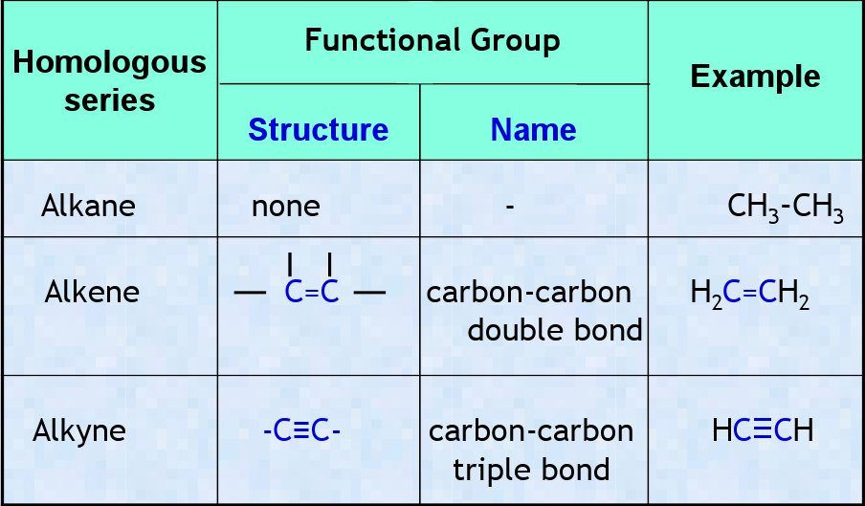
Functional Groups

Slide 22
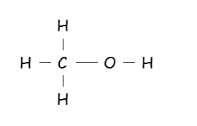
Alcohols
The names of all alcohols end in ‘-ol’
The functional group of the alcohols is –OH (hydroxyl group)
Formula of the first member of the homologous series ……CH₃OH
Alcohols are substituted alkanes (as an -H has been replaced
with an –OH)
Alcohols are made via hydration of alkenes and fermentation.
The structural formula of first member of the alkanols is-----
Alcohols are useful industrial and pharmaceutical solvents.
First member of homologous series is called …methanol
All alcohols follow the general formula;
C
H
O
H
n
2n +1

Slide 23
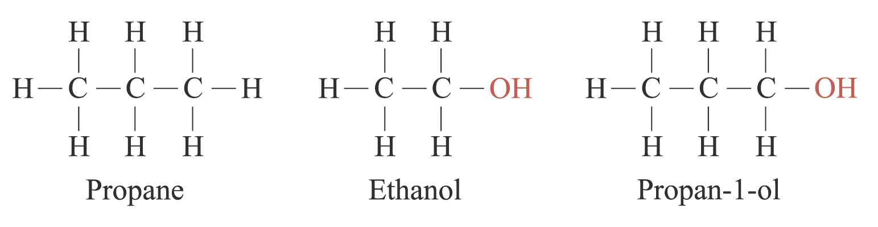
Alcohols
and
have similar chemical properties
➔ they contain the same functional group –OH
➔ they are classified into the same homologous series — alcohols

Slide 24
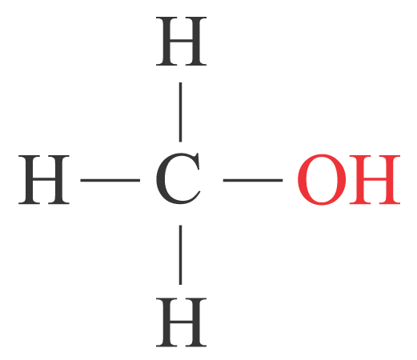
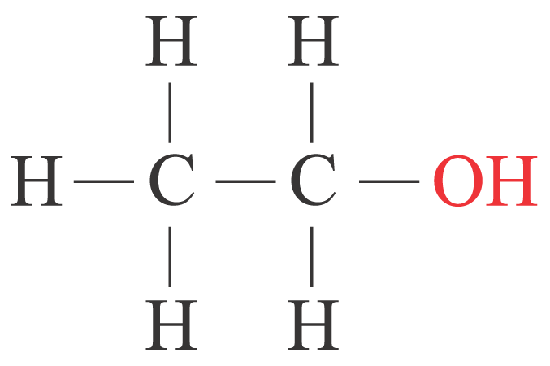
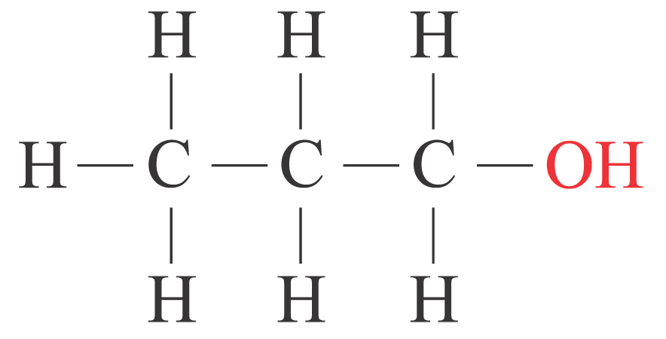
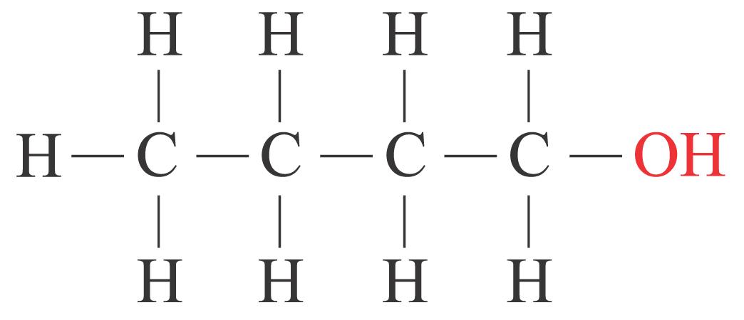
The first four members of straight-chain alcohols
Number of carbon atom(s) | IUPAC name | Molecular formula | Condensed structural formula | Structural formula
1 | Methanol | CH₃OH | CH₃OH
2 | Ethanol | C₂H₅OH | CH₃CH₂OH
3 | Propan-1-ol | C₃H₇OH | CH₃CH₂CH₂OH
4 | Butan-1-ol | C₄H₉OH | CH₃CH₂CH₂CH₂OH

Slide 25
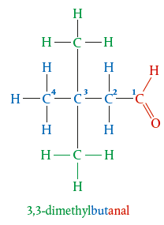
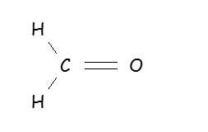
Functional Groups
Members in the same series can be represented by a general formula.
e.g. alkanols: C_{n}H_{2n+1}OH
alkanals: C_{n}H_{2n+1}CHO
alkanoic acids: C_{n}H_{2n+1}COOH
The structural formula of first member of the alkanals is----

Slide 26
Functional Groups: Carboxylic Acids
The names of all carboxylic acids end in ‘-oic acid’
The functional group of the carboxylic acids is -COOH
(carboxyl group)
This carboxyl group is always attached to the end
carbon.
Carboxylic acids react like other acids
General Formula;
C_{n} H_{2n+1} COOH

Slide 27
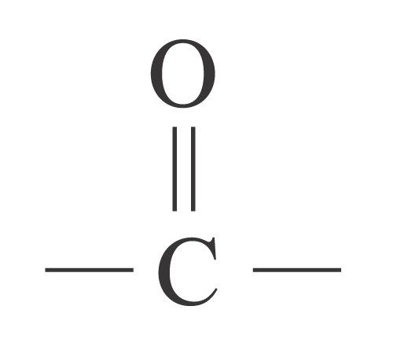
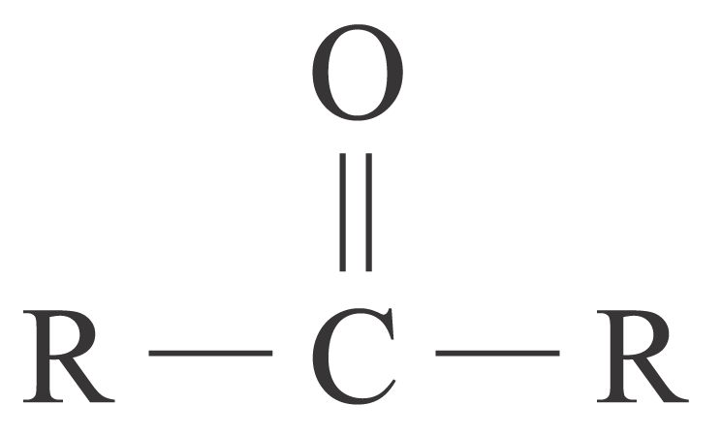
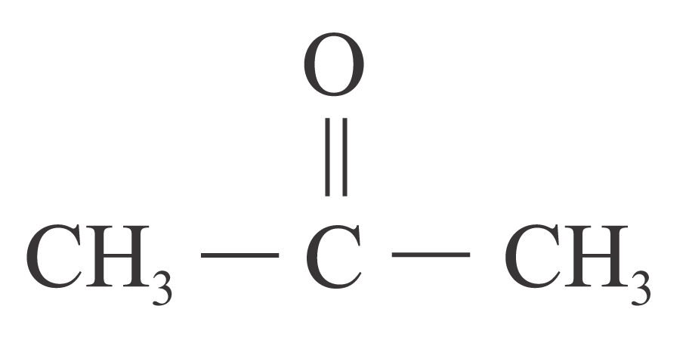
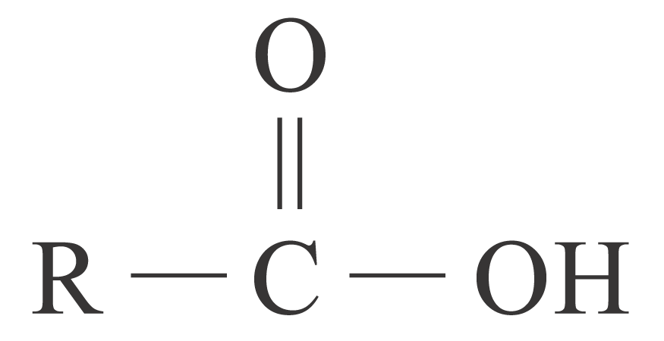
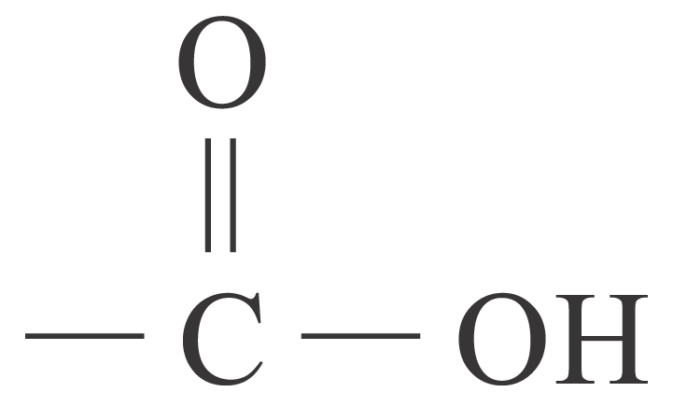
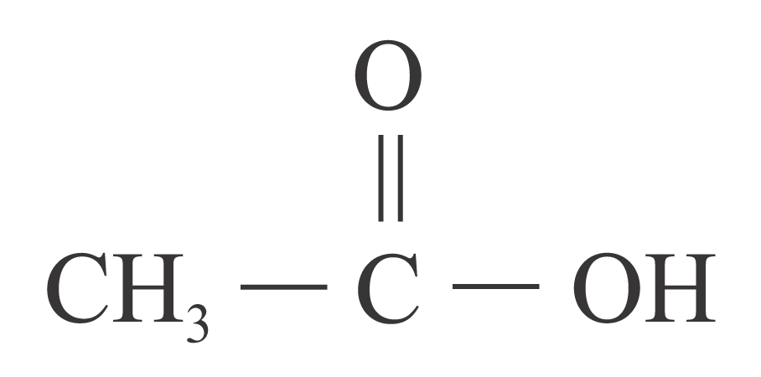
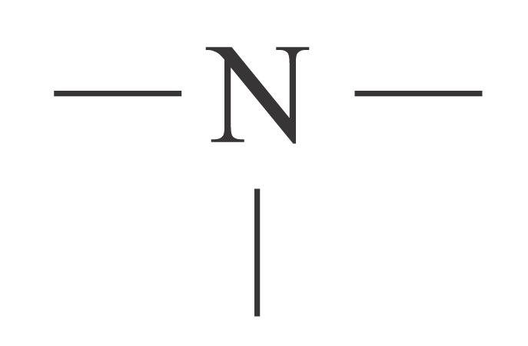
Functional Groups
Family | General formula | Functional group | Example
 |  |  | Formula | IUPAC name
Ketone |  | carbonyl group |  | Propanone
Carboxylic acid |  | carboxyl group |  | Ethanoic acid
Amine | RNH₂ R₂NH R₃N | amino group | CH₃NH₂ | Methylamine
Nitrile | RC≡N | ⎯ C ≡ N nitrile group | CH₃CN | Ethanenitrile
R = C_{n}H_{2n+1} –

Slide 28
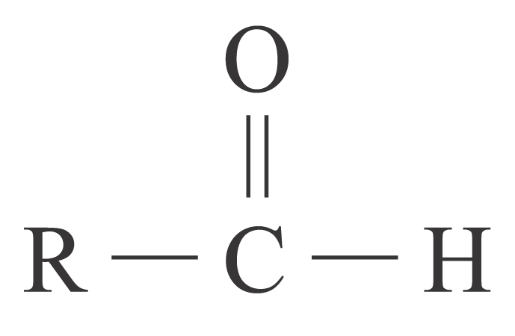
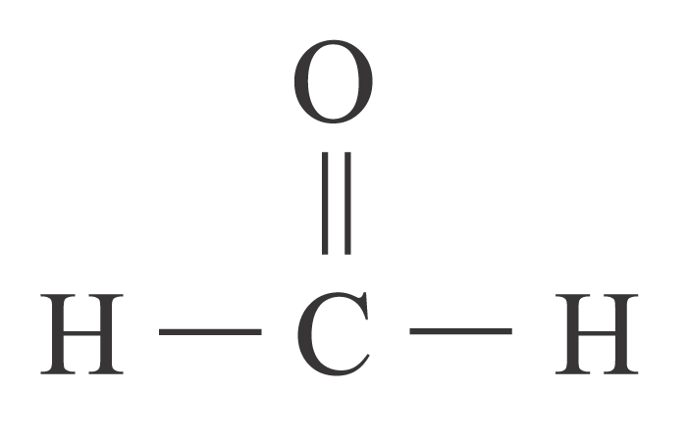
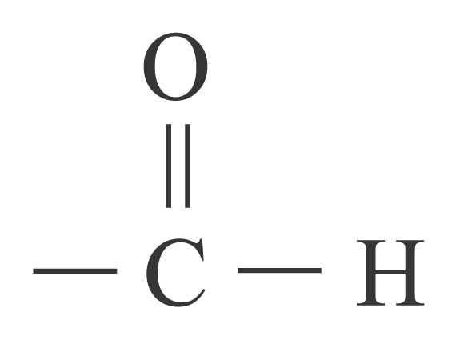
Functional Groups
Family | General formula | Functional group | Example
 |  |  | Formula | IUPAC name
Haloalkane | RX | X halo group | CH₃Cl | Chloromethane
Alcohol | ROH | ⎯ OH hydroxyl group | CH₃OH | Methanol
Ether | R⎯O ⎯ R | ⎯ O ⎯ oxy group | CH₃ ⎯ O ⎯ CH₃ | Methoxymethane
Aldehyde |  | carbonyl group |  | Methanal
R = C_{n}H_{2n+1} –

Slide 29
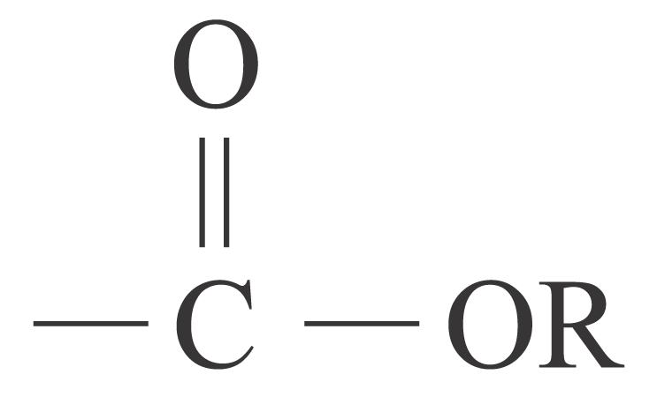
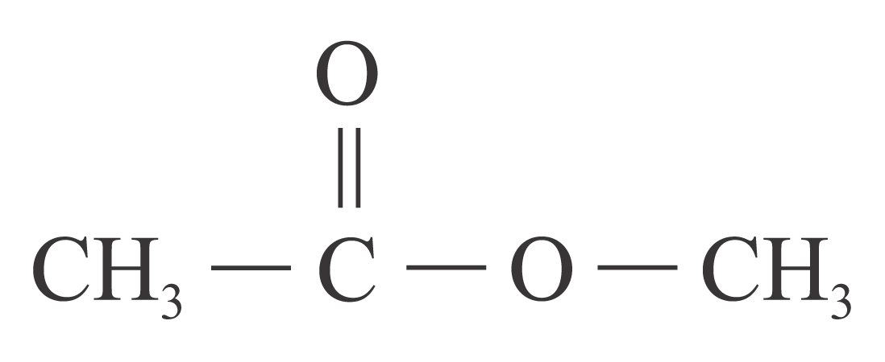
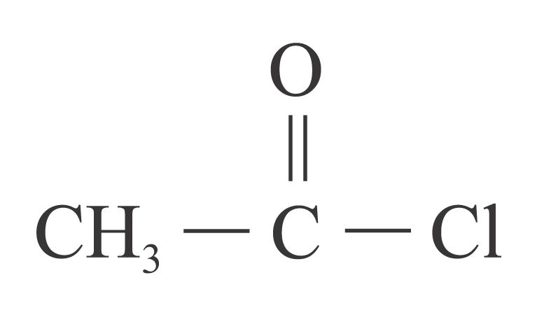
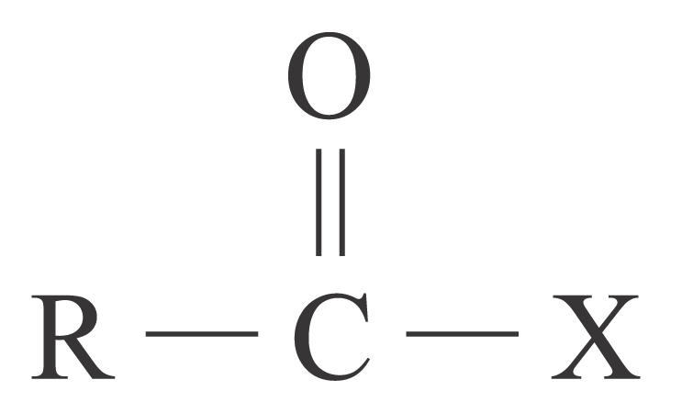
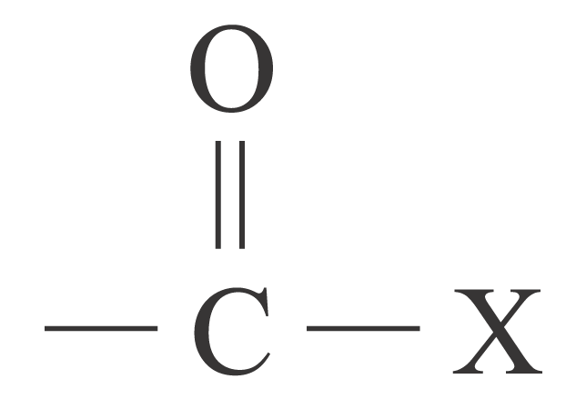
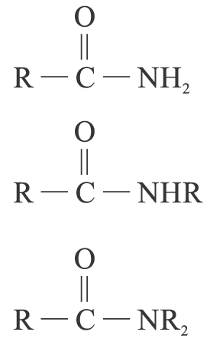
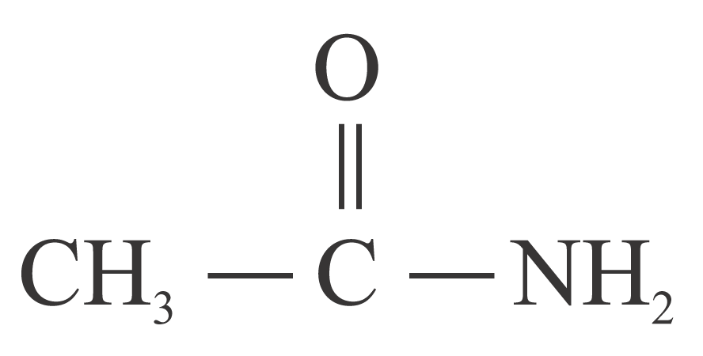
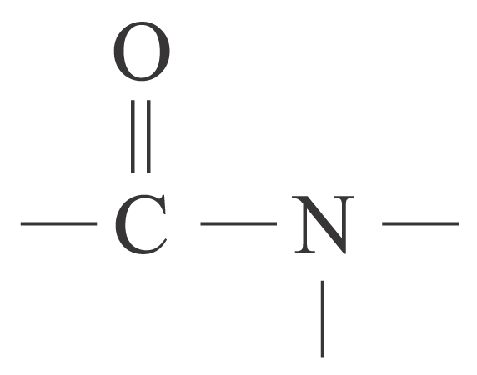
Functional Groups
Family | General formula | Functional group | Example
 |  |  | Formula | IUPAC name
Ester |  | ester group |  | Methyl ethanoate
Acyl halide |  | acyl halide group |  | Ethanoyl chloride
Amide |  | amide group |  | Ethanamide
R = C_{n}H_{2n+1} –

Slide 30
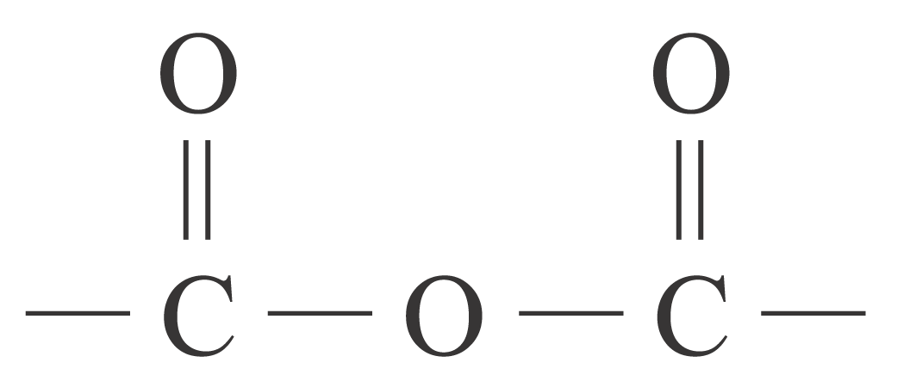
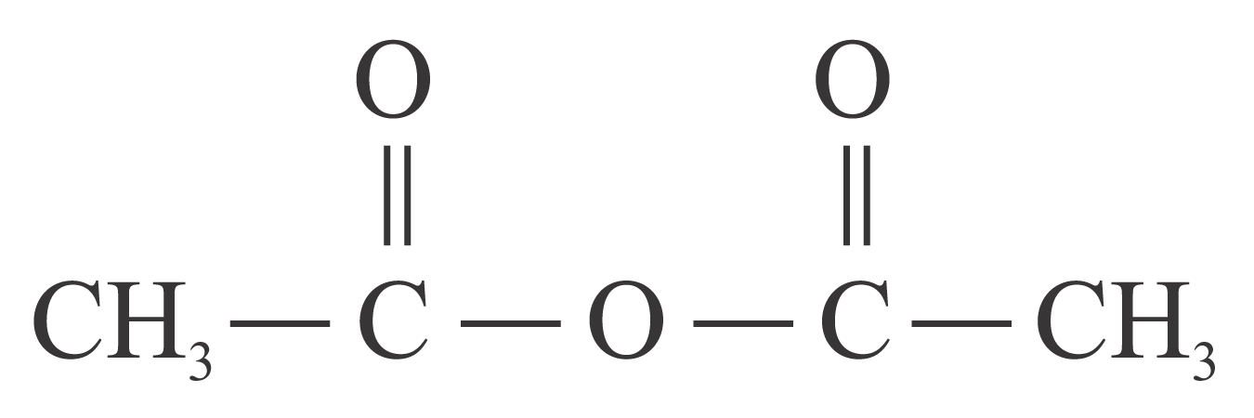
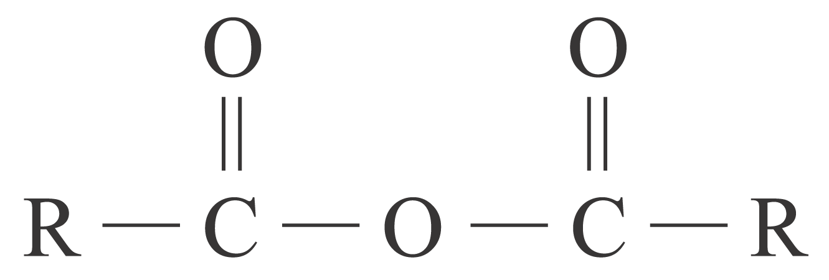
Functional Groups
Family | General formula | Functional group | Example
 |  |  | Formula | IUPAC name
Acid anhydride |  | acid anhydride group |  | Ethanoic anhydride
R = C_{n}H_{2n+1} –

Slide 31
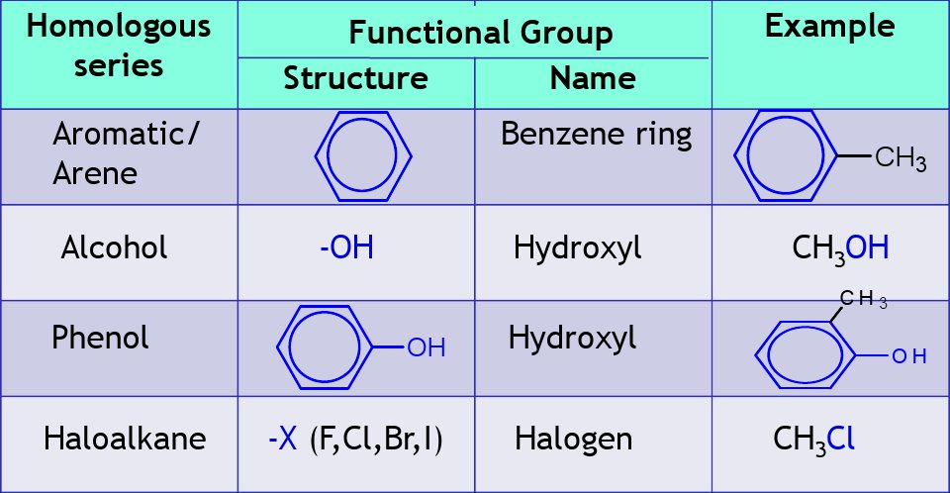
Functional Groups

Slide 32
Aromatic Hydrocarbon
CHM 102
Organic Chemistry HOMOLOGOUS SERIES AND FUNCTIONAL GROUPS by Dr. (Mrs.) NDUKWE, Nelly Acha is licensed under a Creative Commons Attribution-NonCommercial 4.0 International License.

