Slide 1
CHM 402: Group Theory and Symmetry
Dr. E.A. Ofudje eaofudje@mtu.edu.ng
Representation of symmetry operations using matrices.
Reducible and non-reducible group representations.
Applications. General symmetry applications.

Slide 2
Applications of matrices to Symmetry point group
z
y
x
σ_{v}(xz)
σ_{v}(yz)
ι

Slide 3
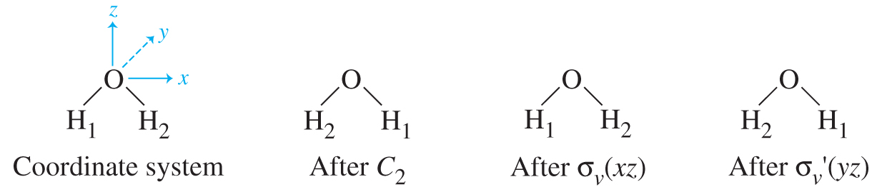
Representations of Point Groups
  Matrix Representations of C_{2v}
    Choose set of x,y,z axes
      z is usually the C_{n} axis
      xz plane is usually the plane of the molecule
    Examine what happens after the molecule undergoes each symmetry operation in the point group (E, C₂, 2σ)

Slide 4
    Transformation Matrix = matrix expressing the effect of a symmetry operation on the x,y,z axes to give x’,y’,z’
    E Transformation Matrix
      x,y,z → x,y,z
      What matrix times x,y,z doesn’t change anything?
transformation
matrix
z
y
x
E Transformation Matrix

Slide 5
C₂
    C₂ Transformation Matrix
      x,y,z → -x, -y, z
      Correct matrix is:
    σ_{v}(xz) Transformation Matrix
      x,y,z → x,-y,z
      Correct matrix is:
    σ_{v}(yz) Transformation Matrix
      x,y,z → -x,y,z
      Correct matrix is:
z
y
x
σ_{v}
z
y
x
σ_{d}
z
y
x

Slide 6
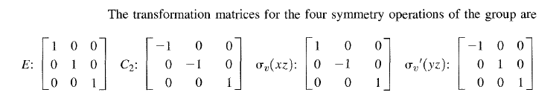
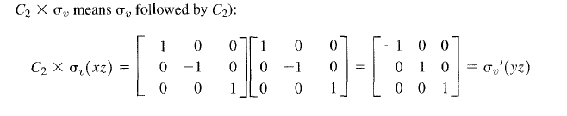
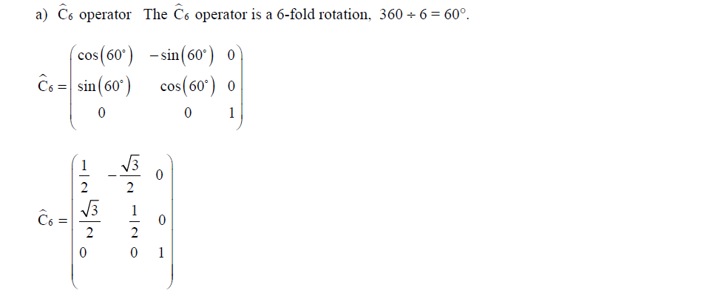
Generate a 3 × 3 matrix for the following

Slide 7

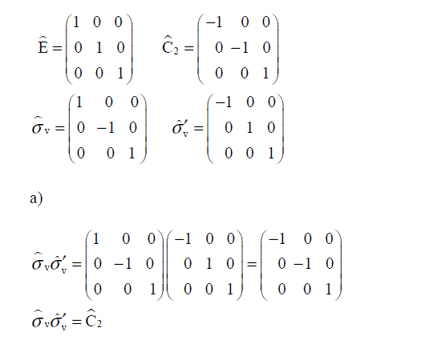
Use the 3 × 3 matrices for the C2v group to verify the group multiplication table for the following successive operations:
Solutions

Slide 8
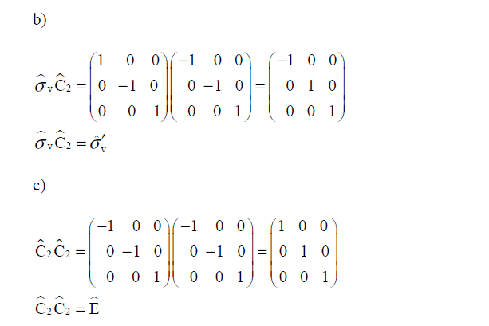

Use the 3 × 3 matrices for the C_{2v} group to verify the associative property for the following successive operations:

Slide 9
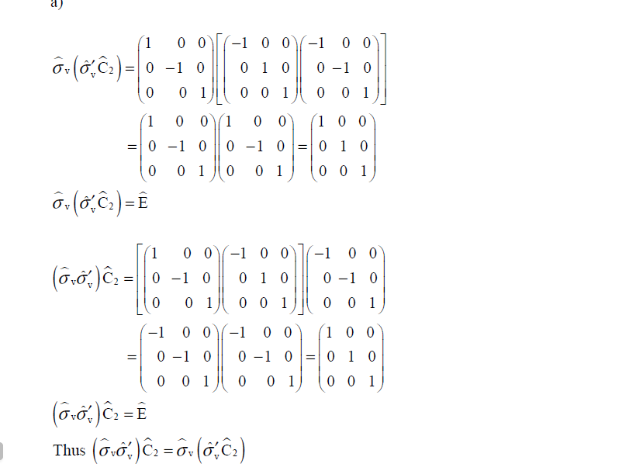
solutions

Slide 10
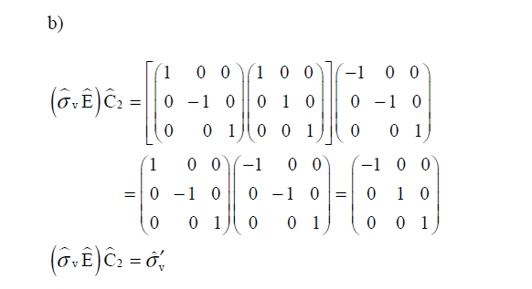
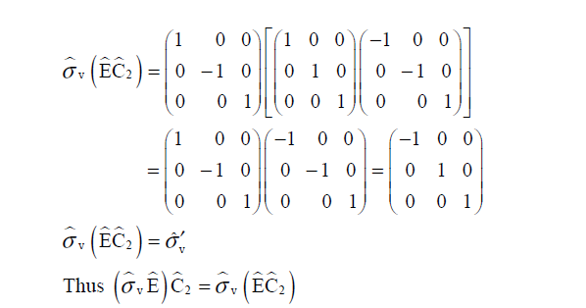

Slide 11
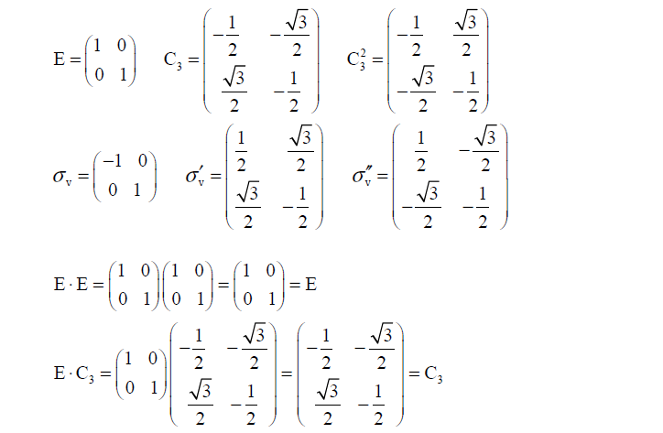
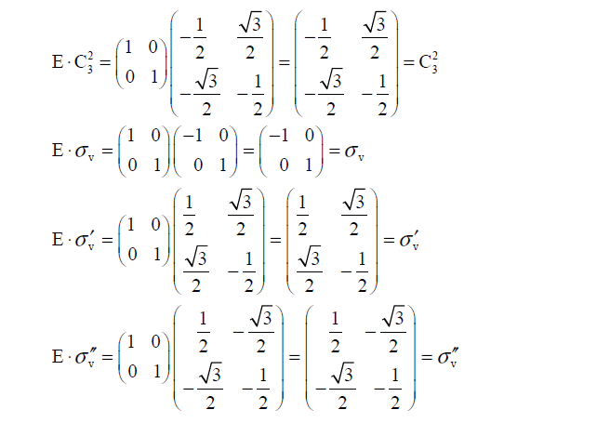
Use the 2 × 2 matrices to derive the multiplication table for the C_{3v} group.

Slide 12
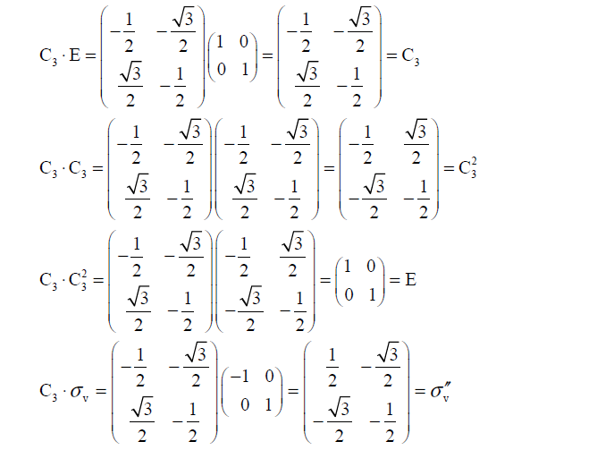

Slide 13
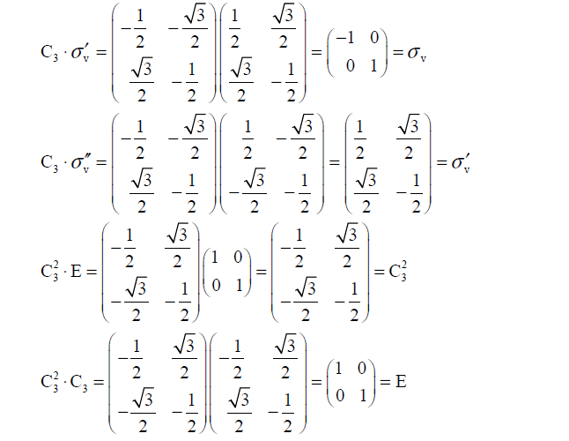

Slide 14
    These 4 matrices are the “Matrix Representation” of the C_{2v} point group
      All point group properties transfer to the matrices as well
      Example: Eσ_{v}(xz) = σ_{v}(xz)
  REDUCIBLE AND IRREDUCIBLE REPRESENTATIONS
A representation of higher dimension which can be reduced into representation of lower dimension is called reducible representation.
    Character = sum of diagonal from upper left to lower right (only defined for square matrices)
      The set of characters = a reducible representation (Γ) or shorthand version of the matrix representation

Slide 15
    Reducible and Irreducible Representations
      Each matrix in the C_{2v} matrix representation can be block diagonalized
      To block diagonalize, make each nonzero element into a 1x1 matrix
      When you do this, the x,y, and z axes can be treated independently
        Positions 1,1 always describe x-axis
        Positions 2,2 always describe y-axis
        Positions 3,3 always describe z-axis
      Generate a partial character table from this treatment
E
C₂
σ_{v}(xz)
σ_{v}(yz)
Axis used | E | C₂ | σ_{v}(xz) | σ_{v}(yz)
x | 1 | -1 | 1 | -1
y | 1 | -1 | -1 | 1
z | 1 | 1 | 1 | 1
Γ | 3 | -1 | 1 | 1
Irreducible
Representations
Reducible Repr.

Slide 16
Character Tables
  The C_{2v} Character Table
    We have found three of the irreducible representations of the character table through matrix math
    One more (A₂) irreducible representation is derived from the first three due to the properties of character tables (below)
    R_{x}, R_{y}, R_{z} stand for rotation al mode about the x, y, z axes respectively
    x’s are p and d orbitals, x, y, z stands for traslational mode, while x², y², z² are used to determine the IR and Raman activeness
C_{2v} | E | C₂ | σ_{v}(xz) | σ_{v}(yz)
A₁ | 1 | 1 | 1 | 1 | z | x², y², z²
A₂ | 1 | 1 | -1 | -1 | R_{z} | xy
B₁ | 1 | -1 | 1 | -1 | x, R_{y} | xz
B₂ | 1 | -1 | -1 | 1 | y, R_{x} | yz

Slide 17
Contributed of character per unshifted atom for a C_{2v}
Symmetry operation | Contribution of character per unshifted atom
E (Identity) | 3
I (Inversion) | -3
Cn (rotation along z-axis) | 2cosθ+1
Sn (improper rotation) | 2cosθ-1
σ (relection) | 1

Slide 18
Reducible representation for C_{2V} point group
C_{2V} | E | C₂ | σ_{v}(xz) | σ!_{v}(yz)
Unshifted atom | 3 | 1 | 3 | 1
Contribution per atom | 3 | -1 | 1 | 1
Г_{red} | 9 | -1 | 3 | 1
To get the unshifted atom, you need to perform all the necessary symmetry operation with a C_{2v} point group.
z
y
x
To get the contribution per atom, you make use of the table of Contributed of character per unshifted atom for a C_{2v}

Slide 19
To get reducible representation, you need to multiply unshifted atom by contribution per atom
reducible : N =
, where n is the number of particle, h is the number of symmetry operation, X_{r} is the reducible representation, x_{i} are values of irreducible representation from character table and n is the coefficient of the symmetry operation.
Г_{A1} =
Г_{A1} =
Г_{A2} =
Г_{A2} =
Г_{B1} =
Г_{B1} =

Slide 20
Г_{B2} =
Г_{B2} =
Г_{irreducible} = 3A₁ + A₂ + 3B₁ + 2B₂ which is the irreversible representation
of the point group for C_{2V}
To obtain translational, vibrational and rotational modes, you need to go back to the character Table and compare with you values for reducible.
Г_{traslational} = A₁ + B₁ + B₂
Г_{rotational} = A₂ + B₁ + B₂
Г_{vibrational} = Г_{irreducible} –( Г_{trans} + Г_{rota} )
3A₁ + A₂ + 3B₁ + 2B₂ –( A₁ + B₁ + B₂+ A₂ + B₁ + B₂)
Г_{vibrational} = 2A1 + B1

Slide 21
To check whether the vibrational modes are IR or Raman active,
i.) Since there is x, y ,z in the representation of the vibrational mode, it is IR active.
ii). Since there is quadratic functions (i.e. x², y², z₂, xz), it is also Raman active.
Therefore, Г_{vibrational} is both IR and Raman active

Slide 22
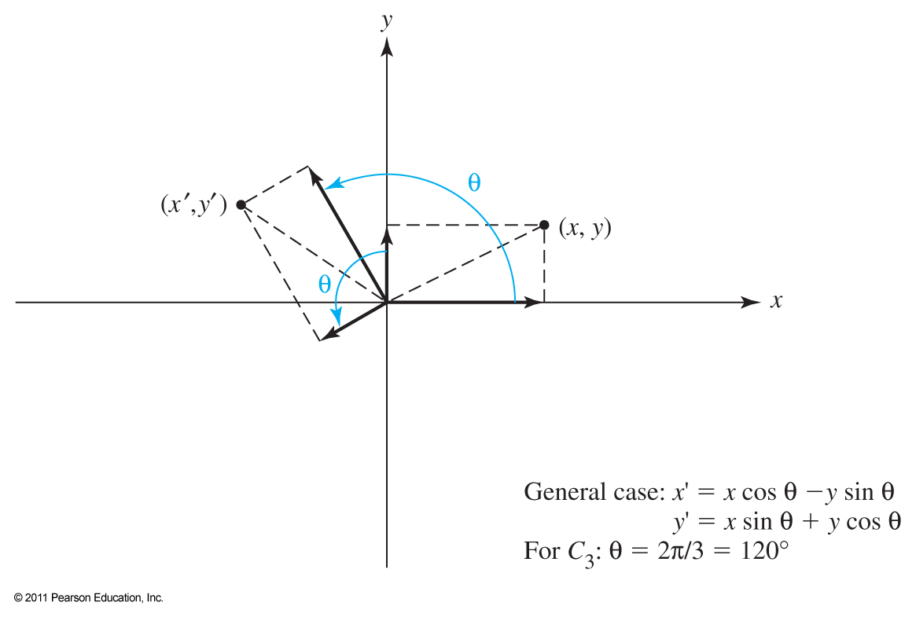
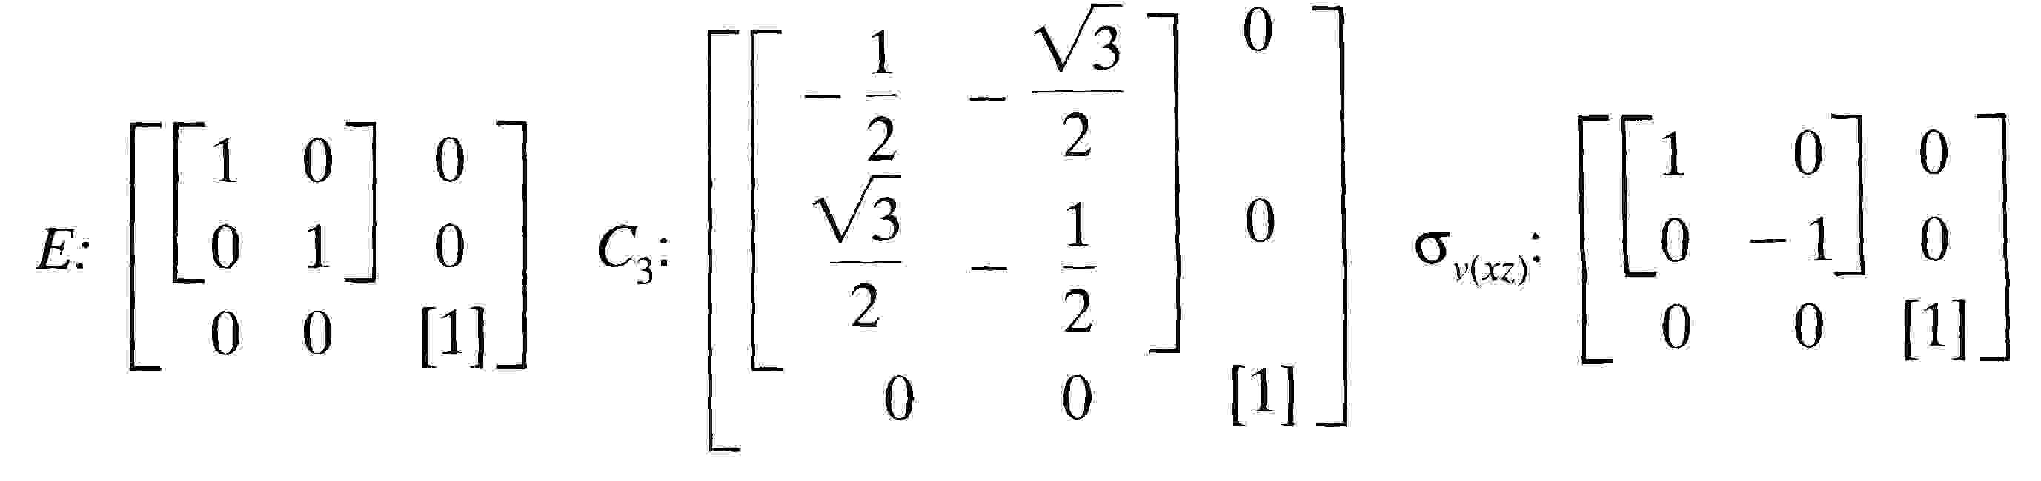
  The C_{3v} Character Table for NH₃
    1) The threefold symmetry of NH₃ makes for complex transformation matrices

Slide 23
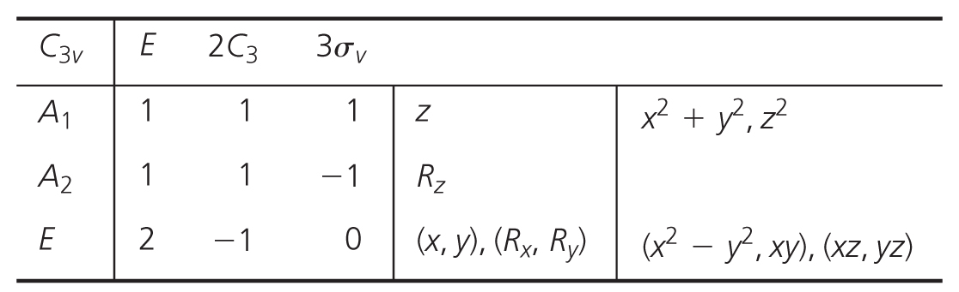
    Though more complex, the C_{3v} Character Table can be generated similarly to that of the C_{2v} group
  Notes on Character Tables
    Multiple operations in the same class are listed together
    Different C₂ axes are listed separately with primes (‘)
      Those through outer atoms are ‘
      Those not through outer atoms are ”
    Symmetry of orbitals are listed except for s orbitals, which are always in the first listed A irreducible representation
    Irreducible Representation Labels
      Degeneracy (dimension) is determined by the character of E operation
        A if E = 1 and χ of C_{n} = 1
        B if E = 1 and χ of C_{n} = -1
        E if E = 2 (doubly degenerate)
        T if E = 3 (triply degenerate)

Slide 24
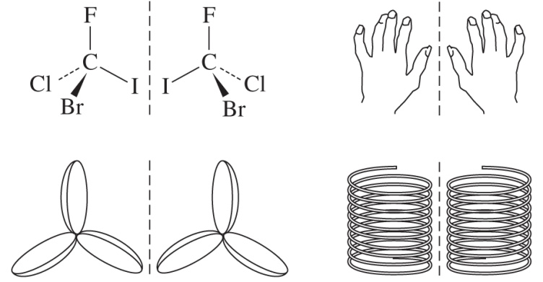
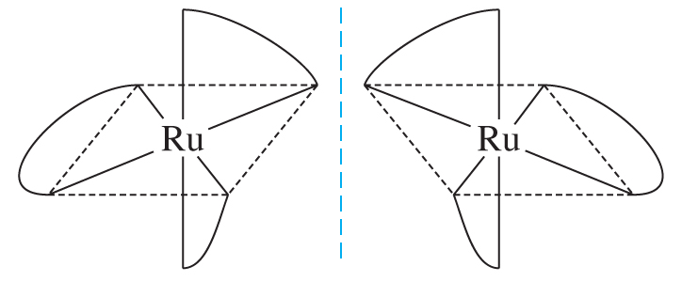
      Subscripts
        1 if symmetric to perpendicular C₂ axis (or σ_{v})
        2 if antisymmetric to perpendicular C₂ axis (or σ_{v})
        g if symmetric to i
        u if antisymmetric to i
      Primes
        ‘ if symmetric to σ_{h}
        “ if antisymmetric to σ_{h}
Applications of Symmetry
  It is used in the determination of Chiral Molecules
    Molecules not superimposable with their mirror images are called chiral or dissymetric
    They may still have some symmetry operations: E, C_{n}
    Chiral molecules cannot have i, σ, or S_{n} symmetry operations

Slide 25
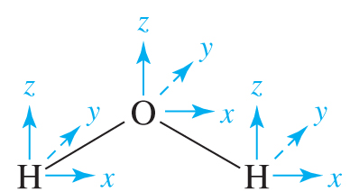
  It is use to determine molecular Vibrations
    To use symmetry, we must assign axes
    to each atom of the molecule
      The z-axis is usually the C_{n} axis
      The x-axis is in the molecular plane
      The y-axis is perpendicular to the molecular plane
    Degrees of Freedom = possible atomic movements in the molecule
      3N degrees of freedom for a molecule of N atoms
      Nonlinear molecules
        3 translations (along x, y, z)
        3 rotations (around x, y, z)
        3N – 6 vibrations
      c. Linear molecules
        Only 2 rotations change the molecule
        3N – 5 vibrations
    3. We will use group theory to determine the symmetry of all nine motions and then assign them to translation, rotation, and vibration

Slide 26
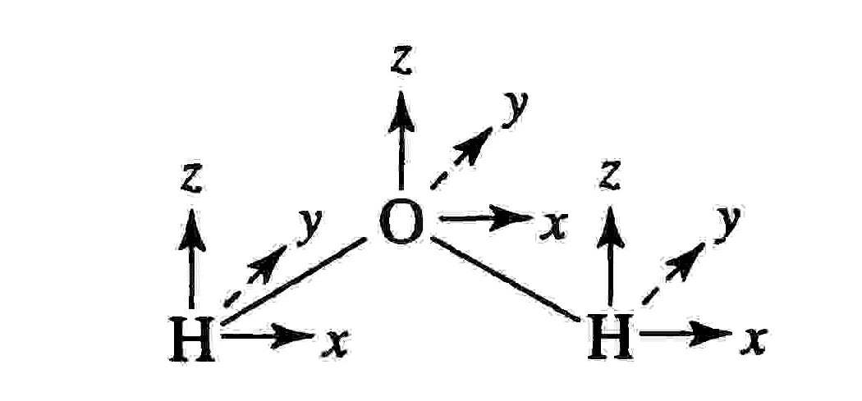
      Look at the C_{2v} character table
      Add up how many vectors stay the same after an operation
        If the atom moves, none of its vectors stay the same = 0
        If the atom stays and the vector is unchanged = +1
        If the atom stays and the vector is reversed = -1
      Reduce the reducible representation to its irreducible components
C_{2v} | E | C₂ | σ_{v}(xz) | σ_{v}(yz)
A₁ | 1 | 1 | 1 | 1 | z | x², y², z²
A₂ | 1 | 1 | -1 | -1 | R_{z} | xy
B₁ | 1 | -1 | 1 | -1 | x, R_{y} | xz
B₂ | 1 | -1 | -1 | 1 | y, R_{x} | yz
C_{2v} | E | C₂ | σ_{v}(xz) | σ_{v}(yz)
Γ | 9 | -1 | 3 | 1

Slide 27
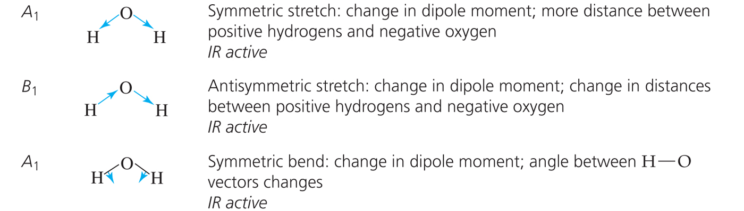
        n_{A1} = ¼[(1x9x1)+(1x-1x1)+(1x3x1)+(1x1x1)] = 3 A₁
        n_{A2} = ¼[(1x9x1)+(1x-1x1)+(1x3x-1)+(1x1x-1)] = 1 A₂
        n_{A1} = ¼[(1x9x1)+(1x-1x-1)+(1x3x1)+(1x-1x1)] = 3 B₁
        n_{A1} = ¼[(1x9x1)+(1x-1x-1)+(1x3x-1)+(1x1x1)] = 2 B₂
      All motions of water match 3A₁ + A₂ + 3B₁ + 2B₂
      Use the character table to remove translations
        x, y, z = A₁ + B₁ + B₂
      Use the character table to remove rotations
        R_{x}, R_{y}, R_{z} = A₂ + B₁ + B₂
      The motions remaining are the vibrations = 2A₁ + B₁
        A₁ = totally symmetric
        B₁ = antisymmetric to C₂ and to reflection in yz plane

Slide 28
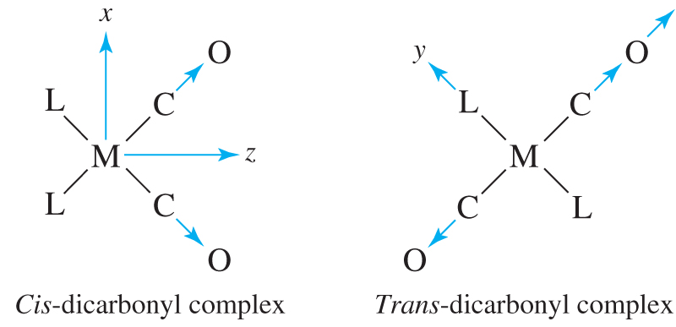
    Symmetry and IR
      IR only “sees” a vibration if the vibration changes the molecule’s dipole
      Motion along the x, y, z axes creates a changed dipole
        Infrared Active vibrations match up with x, y, z on character table
        Infrared Inactive vibrations don’t
      For water, all three vibrations are infrared active
  To determine molecular Vibrations of ML₂(CO)₂ complexes
    The symmetry of cis- ML₂(CO)₂ complexes is C_{2v}
      The C≡O stretch has only one possible direction of motion
      Instead of using xyz vectors at each atom, we can use a single vector

Slide 29
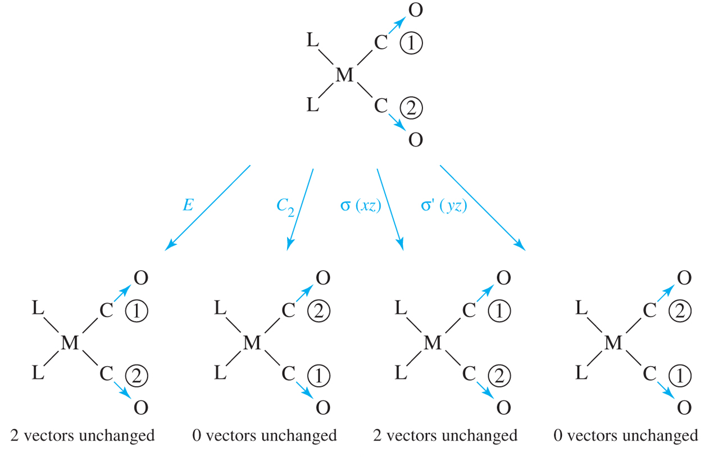
      c) Reducible representation from the 2 vectors
      d) 2 possible vibrations from reduction formula: A₁ + B₁ (see both)
C_{2v} | E | C₂ | σ_{v}(xz) | σ_{v}(yz)
Γ | 2 | 0 | 2 | 0

Slide 30
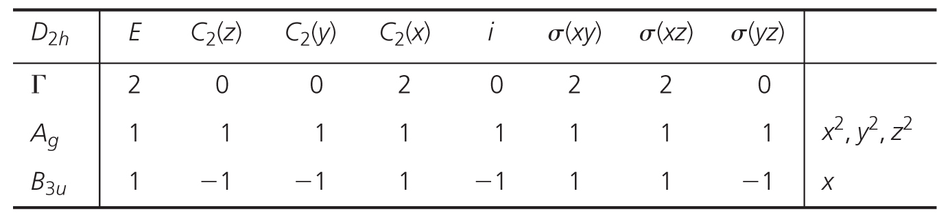
    The symmetry of trans- ML₂(CO)₂ complexes is D_{2h}
      Symmetry operations on the vectors generate a reducible representation
      Reduction formula give 2 irreducible representations
      Only the B_{3u} representation is IR Active
      We can tell cis from trans by the number of C=O IR bands

