Slide 1
CHM 402: Group Theory and Symmetry
Dr. E.A. Ofudje
Review of molecular symmetry operations.
Definition of groups.
Molecular symmetry groups.
Introduction to the mathematical structure of groups.
Group representations.
Detailed study of groups Cn, Dn, and full rotation group.
Applications. General symmetry applications.

Slide 2
What is symmetry?
The term symmetry is derived from the Greek word “symmetria” which means “measured together”.
An object is symmetric if one part (e.g. one side) of it is the same as all of the other parts.
It is the movement in manipulation of an object or molecular structure from an initial position to a final position such that the initial position and the final positions are indistinguishable both geometrically and physically even though the two positions are not identical.

Slide 3
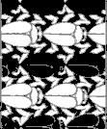


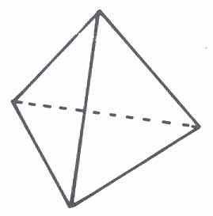


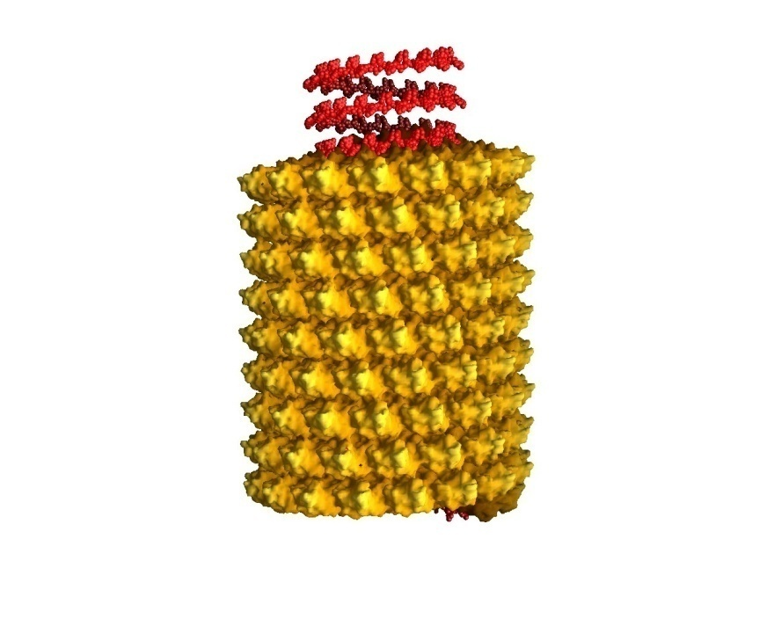



Symmetry and Introduction to Group Theory
Symmetry is all around us and is a fundamental property of nature.

Slide 4
We need to be able to specify the symmetry of molecules clearly.
No symmetry – CHFClBr
Some symmetry – CHFCl₂
More symmetry – CH₂Cl₂
More symmetry ? – CHCl₃
What about ?
Point groups provide us with a way to indicate the symmetry unambiguously.

Slide 5
In Chemistry, a group consists of a set of symmetry elements (and associated symmetry operations) that completely describe the symmetry of an object.
A group is a tool that is used to determine symmetry operation
Symmetry Element and Point Groups
Symmetry element – a geometric entity with respect to which a symmetry operation is performed.
Symmetry operation – a rearrangement of a body after which it appears unchanged. A symmetry operation is the action that produces an object identical to the initial object.

Slide 6
Symmetry Elements
Examples of symmetry elements are mirror planes, axis of rotation, centers of inversion, etc.
A molecule has a given symmetry element if the operation leaves the molecule appearing as if nothing has changed (even though atoms and bonds may have been moved.)
A symmetry element is unique with a particular molecule.

Slide 7
Symmetry Elements
Element | Operation
Rotation axis, C_{n} | n-fold rotation
Improper rotation axis, S_{n} | n-fold improper rotation
Plane of symmetry, σ | Reflection
Center of symmetry, i | Inversion
 | Identity, E

Slide 8
1. Identity, E
All molecules have Identity.
This operation leaves the entire molecule unchanged.
The molecule does not move and all atoms of the molecule stay at the same place when we apply an identity operation,
It is a highly asymmetric molecule such as a tetrahedral carbon with 4 different groups attached has only identity, and no other symmetry elements.

Slide 9
2. Rotation operation or proper rotation (C_{n})
This is the rotation through 360°/n about a rotation axis. C_{n} generates n operations, whose symbols are C_{n}, C_{n}², C_{n}³, C_{n}⁴,…, E (=C_{n}^{n}).
Table 1 shows the way we write the 6 operations generated by proper rotation C₆. From this table, we can see that the symbols of the 6 rotations generated by C₆ are C₆, C₃, C₂, C₃², C₆⁵
Notes about rotation operations:
Rotations are considered positive in the counter-clockwise direction.
Each possible rotation operation is assigned using a superscript integer m of the form C_{n}^{m}.
The rotation C_{n}^{n} is equivalent to the identity operation (nothing is moved).

Slide 10
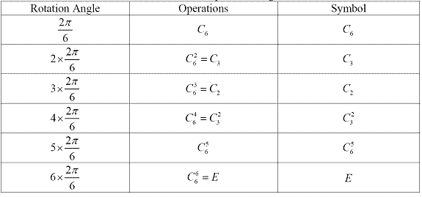
Table 1: C₆ axis and operations it generates
Where n is the order of rotation and m is the degree of rotation

Slide 11
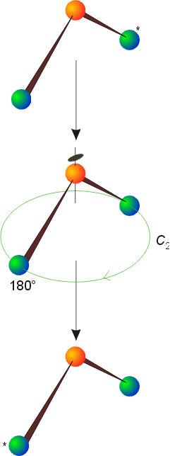
n-fold rotation - a rotation of 360°/n about the C_{n} axis (n = 1 to ∞)
180°
In water there is a C₂ axis so we can perform a 2-fold (180°) rotation to get the identical arrangement of atoms.
120°
120°
In ammonia there is a C₃ axis so we can perform 3-fold (120°) rotations to get identical arrangement of atoms.

Slide 12
Rotation of water molecule through 120 ͦC is not a symmetry operation but rotation of BF₃ through 120 ͦC is a symmetry operation

Slide 13
Notes about rotation operations:
Rotations are considered positive in the counter-clockwise direction.
Each possible rotation operation is assigned using a superscript integer m of the form C_{n}^{m}.
The rotation C_{n}^{n} is equivalent to the identity operation (nothing is moved).
C₃¹
C₃²
C₃³ = E

Slide 14
Notes about rotation operations, C_{n}^{m}:
If n/m is an integer, then that rotation operation is equivalent to an n/m - fold rotation.
e.g. C₄² = C₂¹, C₆² = C₃¹, C₆³ = C₂¹, etc. (identical to simplifying fractions)
C₄¹
C₄² = C₂¹
C₄³

Slide 15
Notes about rotation operations, C_{n}^{m}:
Linear molecules have an infinite number of rotation axes C∞ because any rotation on the molecular axis will give the same arrangement.

Slide 16
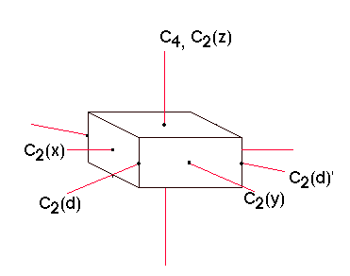
The Principal axis in an object is the highest order rotation axis. It is usually easy to identify the principle axis and this is typically assigned to the z-axis if we are using Cartesian coordinates.
Ethane, C₂H₆
Benzene, C₆H₆
The principal axis is the three-fold axis containing the C-C bond.
The principal axis is the six-fold axis through the center of the ring.
The principal axis in a tetrahedron is a three-fold axis going through one vertex and the center of the object.

Slide 17
3. Reflection operation (σ)
Reflection operation (σ) contains a mirror plane.
  CH₃Cl contains multiple mirror planes that contain the principal axis. These mirror planes are σ_{v} or σ_{d}.
    If applicable, the σ_{v} plane usually intersects several atoms while σ_{d} goes between them.
  C₄H₄ and C₆H₆ also contain a horizontal plane perpendicular to the principal axis of rotation. This plane is called σ_{h}.

Slide 18
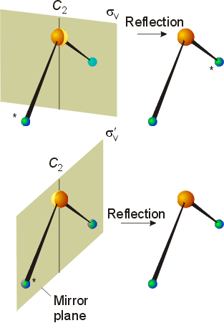
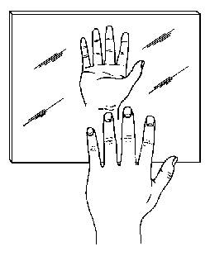
Reflection across a plane of symmetry, σ (mirror plane)
σ_{v}
These mirror planes are called “vertical” mirror planes, σ_{v}, because they contain the principal axis. The reflection illustrated in the top diagram is through a mirror plane perpendicular to the plane of the water molecule. The plane shown on the bottom is in the same plane as the water molecule.
σ_{v}
Handedness is changed by reflection!

Slide 19
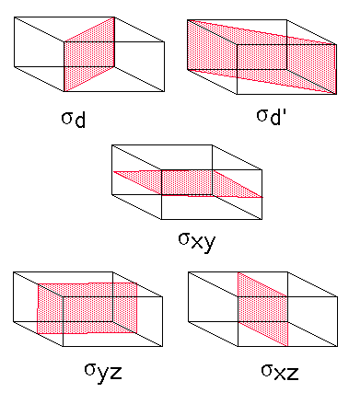
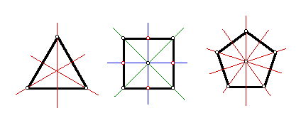
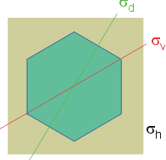
Notes about reflection operations:
A reflection operation exchanges one half of the object with the reflection of the other half.
Reflection planes may be vertical, horizontal or dihedral (more on σ_{d} later).
Two successive reflections are equivalent to the identity operation (nothing is moved).
σ_{h}
A “horizontal” mirror plane, σ_{h}, is perpendicular to the principal axis. This must be the xy-plane if the z-axis is the principal axis.
In benzene, the σ_{h} is in the plane of the molecule – it “reflects” each atom onto itself.
σ_{d}
σ_{d}
σ_{h}
Vertical and dihedral mirror planes of geometric shapes.
σ_{v}
σ_{v}

Slide 20
4. Inversion (i)`
Inversion (i) – each point moves through the center of the molecule to a position opposite the original position and as far from the central point as when it started. The environment at the new point is the same as the environment at the old point.
  Invert the molecule. If the inversion creates a molecule that appears identical, the molecule possesses a center of inversion.
  CH₃Cl, C₄H₄, and CH₄ – Determine if the molecules have inversion symmetry.

Slide 21
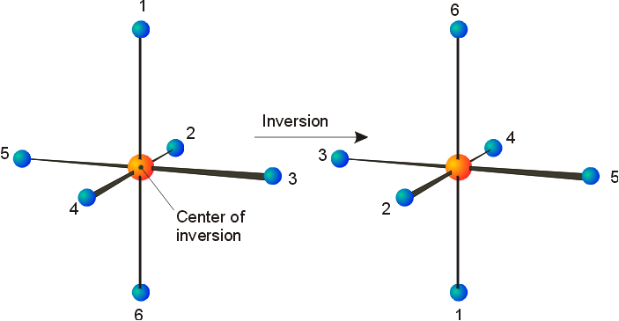
Inversion and centers of symmetry, i (inversion centers)
In this operation, every part of the object is reflected through the inversion center, which must be at the center of mass of the object.
1
2
2
1
2
i
1
1
2
2
1
1
2
1
2
2
1
i
[x, y, z]
[-x, -y, -z]
We will not consider the matrix approach to each of the symmetry operations in this course but it is particularly helpful for understanding what the inversion operation does. The inversion operation takes a point or object at [x, y, z] to [-x, -y, -z].

Slide 22
5. Improper rotation or rotation-reflection (S_{n})
Improper rotation or rotation-reflection (S_{n}) – requires rotation of 360°/n followed by reflection through a plane perpendicular to the axis of rotation.
  C₄H₄ and H₃C-CH₃ (ethane) Name and identify the S_{n} operations performed on ethane.
  S₂ ≡ i (preferred)
  S₁ ≡ σ (preferred)

Slide 23
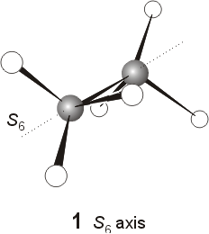
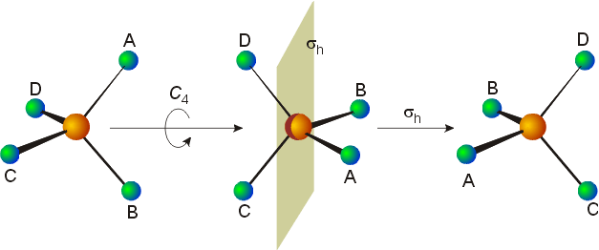
improper rotation, S_{n}^{m} (associated with an improper rotation axis or a rotation-reflection axis) This operation involves a rotation of 360°/n followed by a reflection perpendicular to the axis. It is a single operation and is labeled in the same manner as “proper” rotations.
S₄¹
S₄¹
90°
σ_{h}
C₂¹
S₄²
Note that: S₁ = σ, S₂ = i, and sometimes S_{2n} = C_{n} (e.g. in box) this makes more sense when you examine the matrices that describe the operations.

