Slide 1
CHM 403: Quantum Chemistry
THE POSTULATES OF QUANTUM MECHANICS
BY
DR. E.A. Ofudje
eaofudje@mtu.edu.ng
1

Slide 2
THE POSTULATES OF QUANTUM MECHANICS
Postulate 1:
The state of a quantum mechanical particle is completely described by a wave function (x, t) which must be single value, finite and continuous.
Postulate 2:
For every measurable property of a system such position, momentum, and energy, there exists a corresponding operator in quantum mechanics.
An operator is a mathematical symbol which when operated on another mathematical function, transformed it to another. An operator is a symbol that instructs one to do something.

Slide 3
has no meaning if it stands alone; but
COMMUTATING OPERATOR
If and are two operators, then if then we say
and are commuting operators. E.g. let = k and =
and f(x) = sin x, show that:
Then:
Also;
Therefore, i.e they are commuting operators.

Slide 4
Example 2:
Supposing we have ; and that , does this operator commute?
Solution
For the operator to commute, then;
Since , therefore the operators do not commute.

Slide 5
LINEAR OPERATOR
If an operator is acting on sum of two functions i.e
i.e
If it is equal to the sum of operations on two functions separately, then it is called linear operator e.g
Let show that is a linear operator
Solution
Therefore, is a linear operator.

Slide 6
POSTULATE 3:
The measurement of a physical observable will give a result that is one of the eigen value of the corresponding operator.
EIGEN FUNCTION AND EIGEN VALUE
If an operator acts on a well behaved function and generates some function, multiplied by constant, then this constant is called eigen value and this function is called eigen function.
, where is operator, is Eigen function and is Eigen value
Note that for eigen function, the operation must returns the original function multiplied by a constant.

Slide 7
Example 1: , find the Eigen value and Eigen function.
Solution
Where -m² is Eigen value and is Eigen function.
Example 2:
Which of the following functions is an eigen function of the operator ?
(a) (b) (c) (d) (d)
Solution
(a)
is not an eigen function

Slide 8
(b) ; is not an eigen function
(c)
is an eigen function with eigen value of k
(d) , it is an eigen function
Example 3:
Suppose the differential operator acts on the function , then
Where and m are the eigen function and eigen value of the operator

Slide 9
Example 4: if the function then;
and this is not an eigen value equation.
Example 5: but for the example above,
Thus, is the eigen function of with eigen value of
–m²
POSTULATE 4:
To every observable in classical mechanics, there correspond a linear Hermitan operator in quantum mechanics.

Slide 10
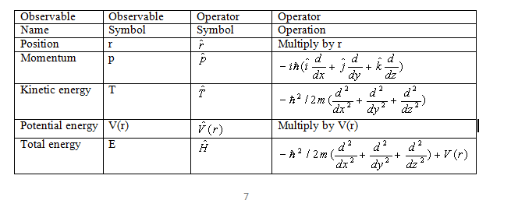
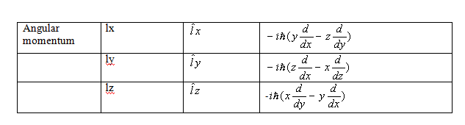

Slide 11
POSTULATE 5:
The wave function or state function of a system evolves in time according to the time –depent Schrodinger equation i.e
Where is Hermitian operator
HERMITIAN OPERATOR
An operator which satisfy the condition:
is said to be a hermitian operator.
e.g. prove that is a hermitian
operator.
Solution
To be a hermitian operator, then

Slide 12
Also,
Thus, is a hermitian operator.
Normalization of wave function
Normalization of wave function means multiplying a wave function with a constant (called normalization constant) to ensure that the sum of the probability for finding the particle equals unity (1).
i.e
where is normalized wave function.

Slide 13
If = wave function and N = normalization constant, then N
=normalized wave function
Example 1:
Normalize between 0 to 2.
Solution
Introduce a normalization constant (N) and solve;
The normalized form will be:

Slide 14
Example 2:
Normalize the function between 0 and
Solution
Let N be the normalization constant
The normalization function is

Slide 15
Example 3:
Normalize between 0 and
Solution
Let N be the normalization constant
The normalized form will be

Slide 16
Example 4:
The wave function of a particle confined to an infinitely deep
potential energy well is
Determine the value of C, knowing that the particle must be
somewhere in all space
SOLUTION
If the probability density is
The probability of finding the particle in width dx is
The probability of finding the particle in all space is
Because we are sure to find the particle somewhere in all space, the
probability equals the unit:
Normalization condition:

Slide 17
For a particle confined to an infinitely deep potential energy well:
Recall that:
Recall that Ka = 0
Thus;
Therefore,
Normalization condition:

Slide 18
Example 5:
Normalize between
Solution
Recall that:
Therefore,

Slide 19
Example 6: determine the normalization factor ‘A’ for the wave function: between
Example 7: Assuming that the three real functions and are normal and orthogonal. Normalize the following functions
(ii) (iii)
(iv) (v)
Solution
(i) By using;
Introduce a normalization constant (N) and solve;

Slide 20
i.e since they are both real numbers; the conjugate of
is
Recall that: and that:
The normalization wave function is:

Slide 21
Assignment
Solve example 6 and 7(ii to v) and submit in the next 48 hours

