Slide 1
CHM 405: STATISTICAL MECHANICS
CONFIGURATION AND A MICROSTATE
BY
DR. E.A. Ofudje
eaofudje@mtu.edu.ng
1

Slide 2
CONFIGURATION AND A MICROSTATE?
A configuration is a general arrangement of total energy available to the system.
A microstate is a specific arrangement of energy in which the energy content of specific oscillators is described.
How is this number used to describe energy
distributions?
The occupation number represents the number of units occupying a given energy level. It can be use to describe the distribution of energy over a collection of units which specify the number of units occupying a given energy level.

Slide 3
Let’s consider a very simple ensemble of three localized oscillator which shows three quanta of energy. In how many ways can the three energy quanta be distributed among three distinguishable oscillators?
Solution
1st condition
3
*
3
*
*
3
2
2
2
1
1
*
*
1
*
*
*
*
a
b
c
a
b
c
c
a
b
300
Fig 1
003
Fig 3
030
Fig 2

Slide 4
2nd Condition
3
3
3
*
*
2
2
*
2
*
1
*
1
*
1
*
*
*
a
b
c
a
b
c
a
b
c
210
Fig 4
201
Fig 5
120
Fig 6
3
3
3
*
2
*
2
*
2
*
1
*
1
*
1
*
*
*
a
b
c
a
b
c
a
b
c
012
Fig 7
021
Fig 8
102
Fig 9

Slide 5
3rd Condition
3
2
1
*
*
*
a
b
c
111
Fig 10
Figure 1-10 represents three identical harmonic oscillators sharing three quanta of energy. The oscillators constitute a, b and c. Figure 1-3 constitutes 300 configuration, while Fig. 4-9 constitute another configuration where the oscillator share the quanta in configuration 201, while figure 10 constitutes another configuration where the oscillator share 111 configuration.
Thus, there are three different configurations known as macrostates; each of the figures are called macrostates with a total number of 10 microstates.

Slide 6

Using the equation
Configuration 1 (Fig. 1-3)
For 300 macrostate
Configuration 2 (Fig. 4-9)
For 210 macrostate
Configuration 3 (Fig. 10)
For 111 macrostate
Example 2: Distribute 5 quanta of energy among 5 oscillator and use this information to answer the following question.

Slide 7
Find the number of microstates in each macrostate.
How many macrostates are possible in the distribution?
What is the total microstate present in the distribution.
What is the probability of the most probable distribution.
Which macrostate gives the highest microstates?
Sketch the figures showing the configurations where each oscillator takes all the 5 quanta.
Solution
(a) Configuration 1;
microstates
(b) Configuration 2;
microstates

Slide 8
(c) Configuration 3;
microstates
(d) Configuration 4;
microstates
(e) Configuration 5;
microstates
(f) Configuration 6;
microstates
(g) Configuration 7;
microstate
(ii) There are seven possible macrostates
(iii). There are 126 microstates in the distribution
(iv). The probability of the most probable distribution is 60/126
(v) The macrostate 31100 and 22100 gave the highest microstate

Slide 9
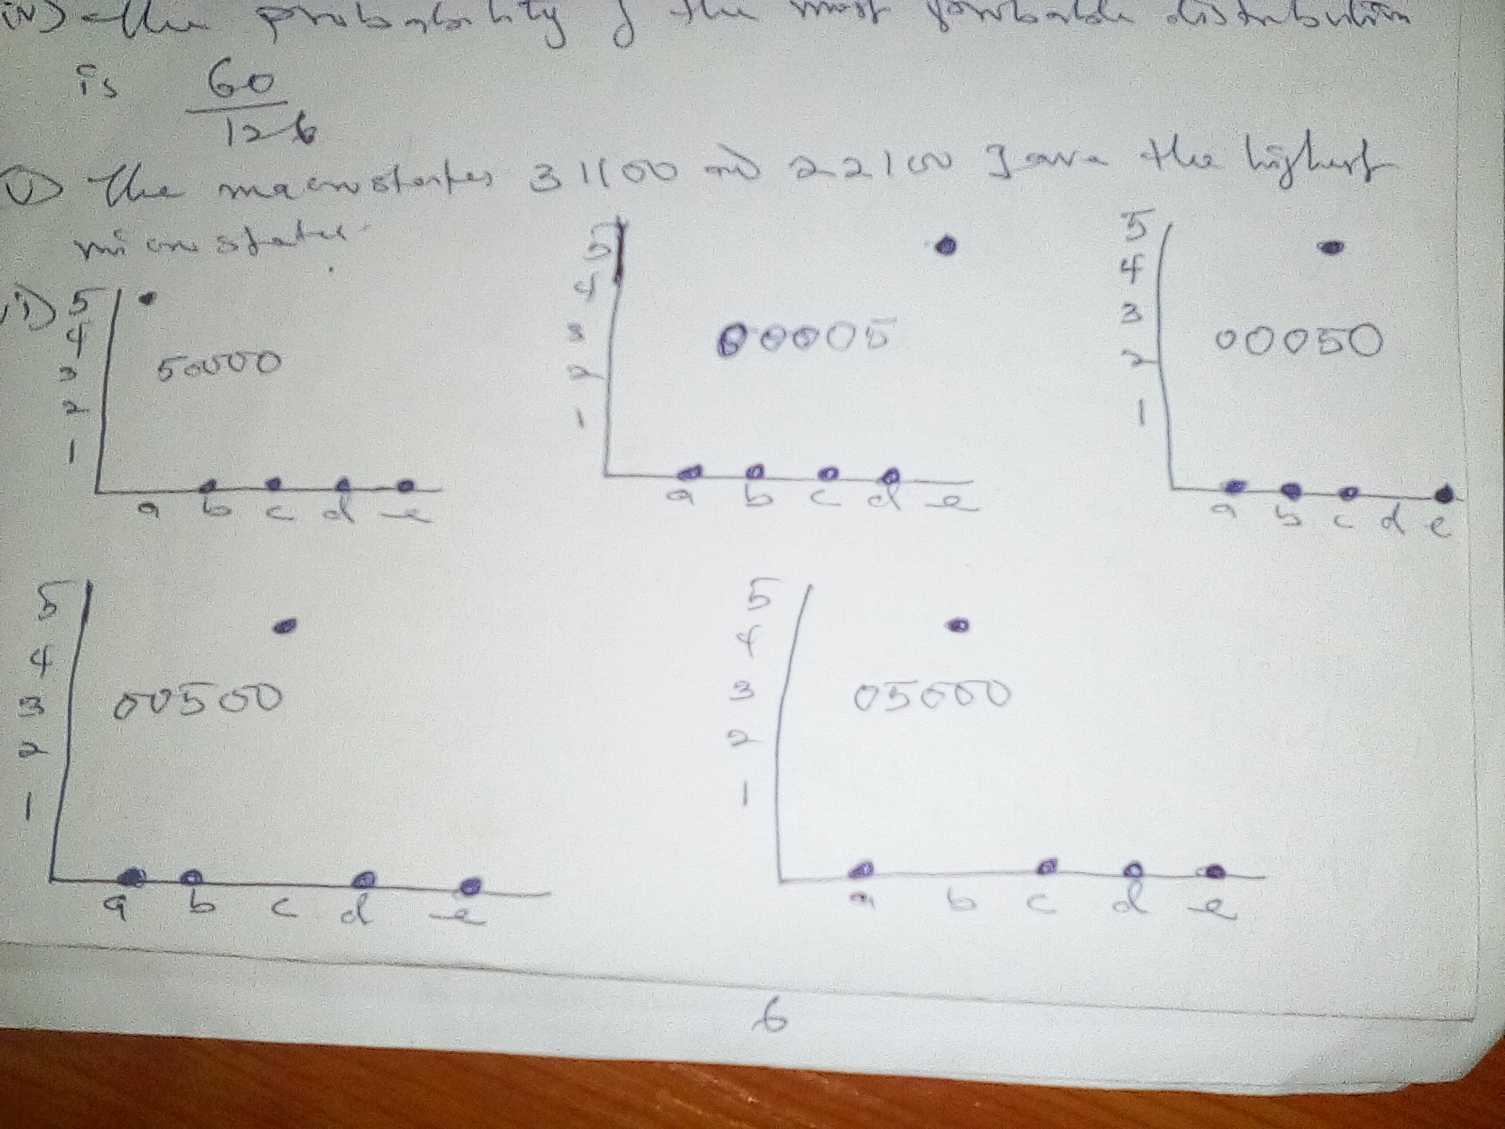
(vi)
Assignment
Distribute 5 quanta among 10 oscillators

