Slide 1

Computational studies of halogenated carbon based nanomaterials as multifunctional catalysts
CBAS Monthly Seminar, March Edition
College of Basic and Applied Sciences Seminar
Computational studies of halogenated carbon based materials as multifunctional catalysts
Department of Chemical Sciences
Presenter: Dr. Olajire S. Olanrele
11th March, 2021

Slide 2

Outline
▷ Part 1 『Background』
▷ Part 2 『Computational methods』
▷ Part 3 『Research contents』
Contents
Halogenation of graphene triggered by heteroatom doping
Halogenated graphene as cathodes for high-performance Li-S batteries
▷ Part 4 『Conclusion』
2

Slide 3
▷ Part 1 『Background』
▷ Part 2 『Computational methods』
▷ Part 3 『Research contents』
Halogenation of graphene triggered by heteroatom doping
Halogenated graphene as cathodes for high-performance Li-S batteries
▷ Part 4 『Conclusion』
3

Slide 4
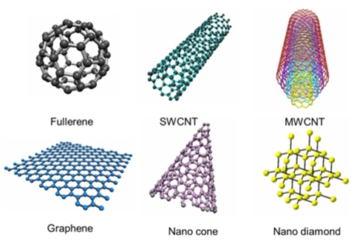
Background
NCMs have interesting chemical, physical, electronic, and materials properties
Support
(Heterogeneous Catalysis))
Chemical inertness
Large surface area
Thermal stability
Mechanical resistance
Stability in acidic and basic media
Easy recovery of precious metal
Chem. Rev. 2013, 8, 5782
4

Slide 5
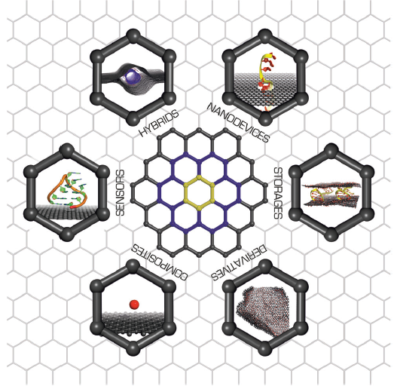
Background
Pure NCMs are inert in nature
Challenges
Deposition of chemically active phase due to lack of anchoring sites
Chemical modification can be used to tune the properties of NCMs for desired applications
The prominent strategies to functionalize NCM is byby adsorption of halogens, heteroatoms doping and creation of defects
Areas where NCM and its derivatives may have valuable applications
5
6
5

Slide 6
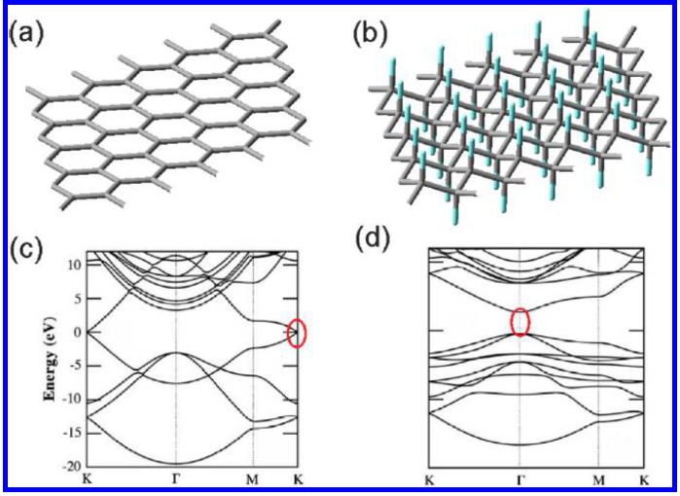


Background
Halogenation of NCMs by holagen elements (F,Cl,Br, I)
Fully Halogenated Graphene
Partially Halogenated Graphene
a
1.99
3.76
b
2.04
2.97
Halogenation in NCMs
Increase the surface reactivity
Modify the electronic property and geometric structure
Change in sp² hybrid state of NCM to sp³ state and modulate band gap level
Conductivity and charge carrier mobility are enhanced
Other intrinsic properties of NCMs (mechanical strength, etc) are further improved
5
7
6

Slide 7
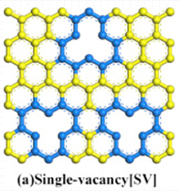
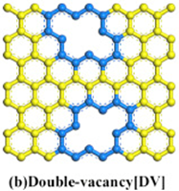
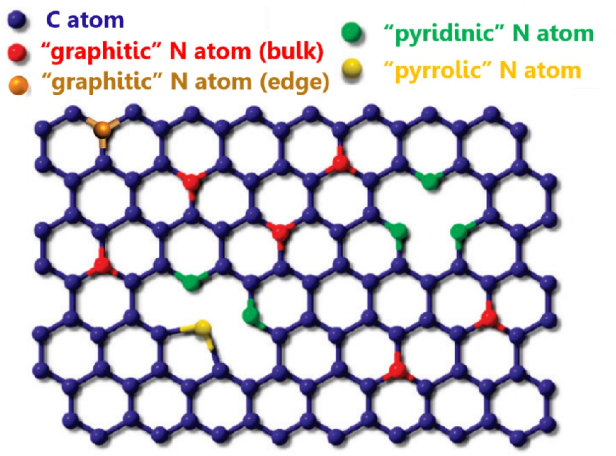
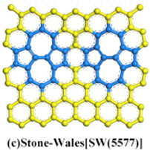
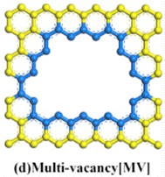
Background
Heteroatom doping of NCMs (B &N)
Creation of defects in NCMs
Doping in NCMs
Modify the electronic structure
Increase surface reactivity
Enhance stability of TM atoms
Improve the catalytic properties
Defects in NCMs
Modify the electronic structure
Increase surface reactivity
Enhance stability of TM atoms
Improve the catalytic properties
5
7
7

Slide 8
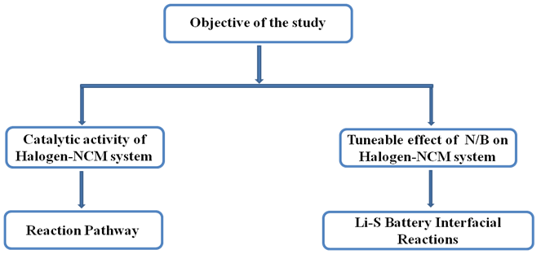
Objective of the study
5
8

Slide 9
▷ Part 1 『Background』
▷ Part 2 『Computational methods』
▷ Part 3 『Research contents』
Halogenation of graphene triggered by heteroatom doping
Halogenated graphene as cathodes for high-performance Li-S batteries
▷ Part 4 『Conclusion』
9

Slide 10
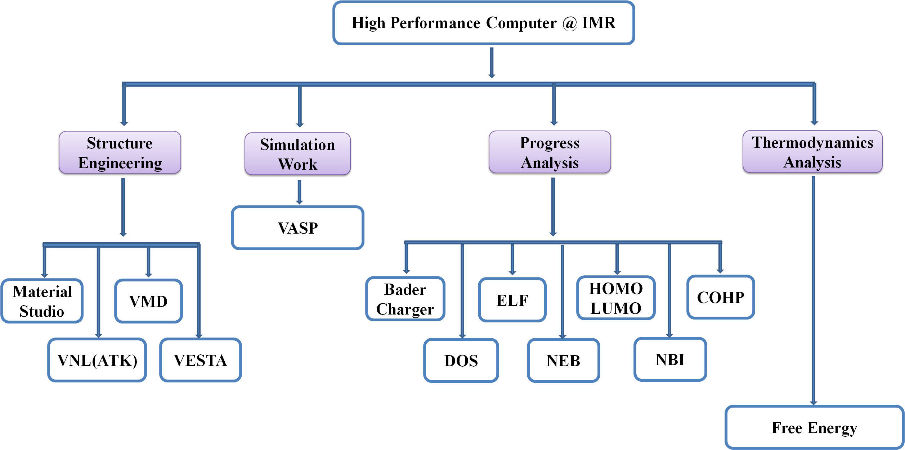
Computational methods
10

Slide 11
▷ Part 1 『Background』
▷ Part 2 『Computational methods』
▷ Part 3 『Research contents』
Halogenation of graphene triggered by heteroatom doping
Halogenated graphene as cathodes for high-performance Li-S batteries
▷ Part 4 『Conclusion』
11

Slide 12
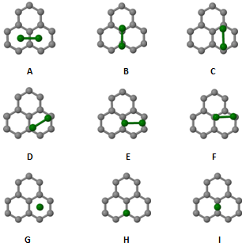
Catalytic activity of halogen molecules adsorbed on graphene layers
3.1
Graphene Functionalization using halogen molecules
Graphene is a band gapless material with inert surface
Limitation
For graphene based catalyst to function, its surface morphology must be tuned and adjusted
Strategy to be used
Adsorption of halogen molecules on the surface of graphene layer
Change in hybridization of carbons from sp² to sp³ state
Graphene intrinsic properties (e.g electrical conductivity, mechanical strength, carrier mobility) are significantly modified
C, X=(F, Cl, Br, I)
Key configurations for the diatomic halogens adsorbed on pristinic graphene. Sites A−F are denoted as parallel orientations while sites G−H are perpendicular orientations.
12

Slide 13
Binding Energy (eV) for pristine graphene-halogen systems
3.1
Interactions between halogen diatomic molecules (Cl2, Br2, I2) and pristine graphene is weak
physisorption.
The adsorption of F2 molecule is much stronger than the other halogens due to its strong
electronegativity.
5
9
13

Slide 14
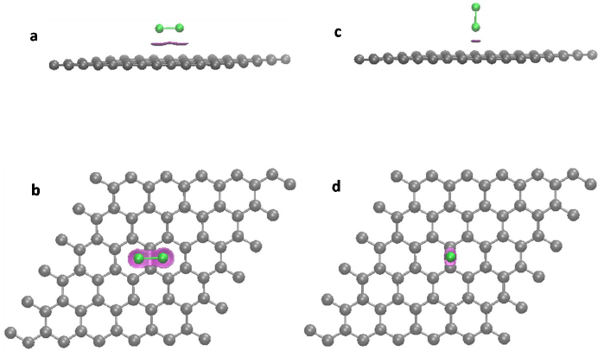
Nature of interactions between pristine graphene-halogen systems
3.1
There exist non-covalent interactions which mainly resides in between fluorine molecule and graphene
Obviously, the weak interaction does not really helpful to bind halogen molecules and subsequently undermine formation of halogenated graphene derivatives.
C, F, = Intermolecular bonding force
Non-covalent bonding analysis plot of fluorine-graphene system (a) Side view @ adsorption site A (b) Front view @ adsorption site A (c) Side view @ adsorption site I (d) Front view @ adsorption site I.
5
14

Slide 15
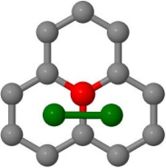
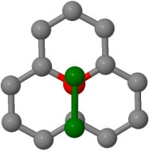
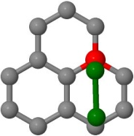
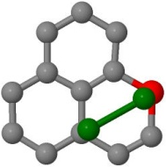
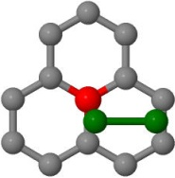
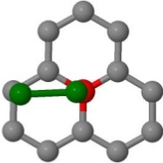
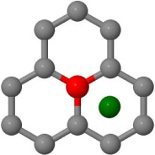
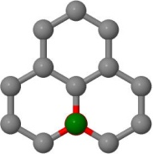
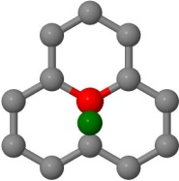
Catalytic activity of halogen molecules adsorbed on doped-graphene layers
3.1
Functionalization of graphene by doping and
adsorption of halogen molecules
Doping is an effective strategy to adjust the interactions between graphene and halogens for the development of novel halogenated graphene
A
B
C
Boron and nitrogen are two most often used dopants
D
E
F
Due to their close atomic radius with that of carbon which potentially make them to enter carbon matrix.
G
H
I
C, B/N, X=(F, Cl, Br, I)
1. Sajjad, A et al., J. Mater. Chem. A, 2017, 5, 1665
2. TianFu, L. et al., J. Mater. Chem. A, 2017, 5, 21596
Key configurations for the diatomic halogens adsorbed on doped graphene. Sites A−F are denoted as parallel orientations while sites G−H are perpendicular orientations.
3. Zheng,Y et al., Angew. Chem. Int. Ed. 2013, 52, 3110 –3116.
5
9
15

Slide 16
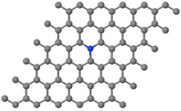
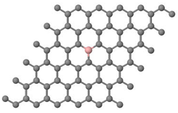
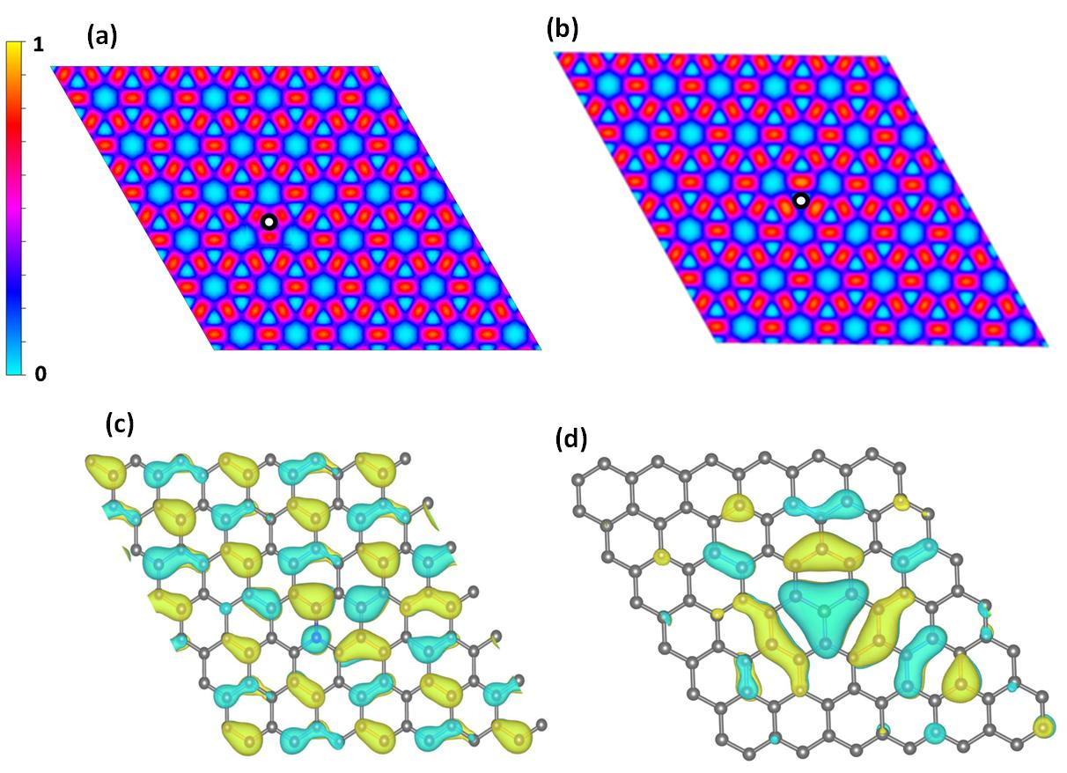
Tunable effect of B and N dopants on graphene layer
3.1
a
b
Optimized structure of (a) nitrogenn doped-graphene and (b) boron doped-graphene system
Nitrogen doping
N becomes negatively charged by 1.33e
Charges are transferred to N from 3C around N
Electron depletions around N
lone pair lobe are located on N
Boron doping
B becomes positively charged by 1.84e
Charges are transferred from B to the surrounding Cs
Electron accumulation around B
delocalized orbital are formed with 3 neighbouring Cs
The perturbed electronic structure from doping will have a direct influence on the binding energies of halogen diatomic molecules
ELF analysis (a) nitrogen doping (b) boron doping. The symbol indicates dopant position. HOMO orbital plot (c) nitrogen doping (d) boron doping
5
16

Slide 17
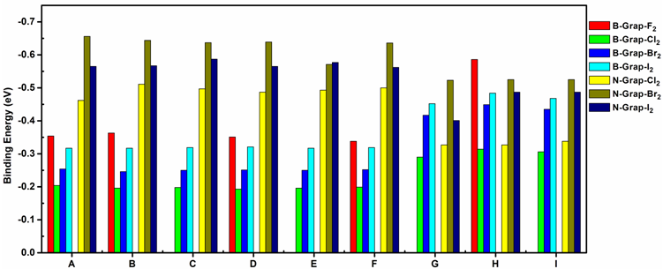
Binding Energy (eV) for B- and N-doped graphene−halogen systems
3.1
For B-doped graphene
Different trends in (Cl2, Br2, I2 ), no too much changes
in the BE of (A-F).
However, the (G-I) is witnessed a significant increase
in BE particularly for Br2 and I2 .
For N-doped graphene
The discussion is restricted to Cl2, Br2, I2 .
High BE is due to increased charge density and polarization of orbital induced by nitrogen doping.
17

Slide 18
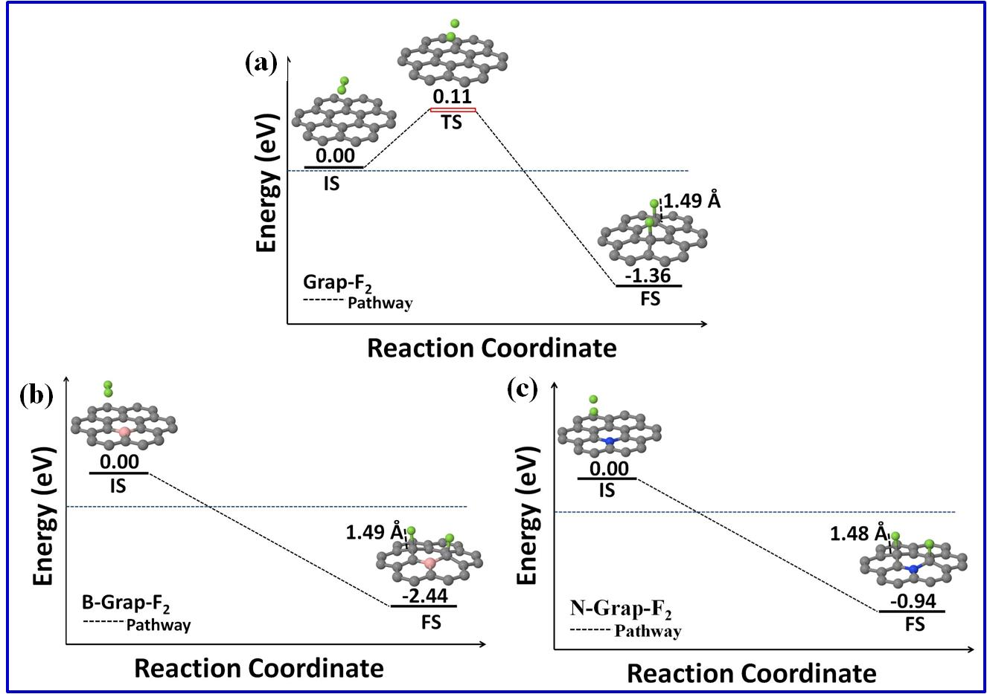
Dissociation of F₂ on pristine, B- and N-doped graphene
3.1
The dissociation of F2 on pristine graphene barrier of 0.11eV.
The dissociation of F2 on B- and N-doped graphene is a barrierless processes.
The bond distance being 1.49 Å and 1.48 Å for B- and N-doped graphene is a pure indication that
covalent bonding is formed between dissociated fluorine atom and carbon atom on graphene.
5
9
18

Slide 19
Summary
3.1
Boron and nitrogen dopants induce the significant changes on the electronic structure of graphene.
Nitrogen and boron doping significantly increase the binding strength of halogen molecules (Cl2, Br2, I2 ).
Nitrogen and boron doping also triggered the spontaneous dissociation of F2 molecule.
5
9
19
Notes:
Distrupt the regular pi-e pattern & create spin density and orbital polarization

Slide 20
▷ Part 1 『Background』
▷ Part 2 『Computational methods』
▷ Part 3 『Research contents』
Halogenation of graphene triggered by heteroatom doping
Halogenated graphene as cathodes for high-performance Li-S batteries
▷ Part 4 『Conclusion』
20

Slide 21
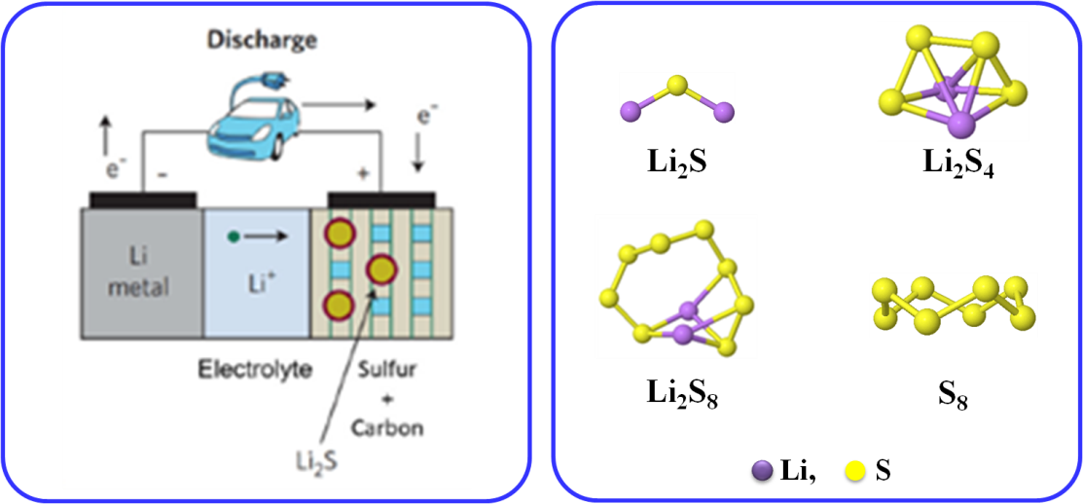
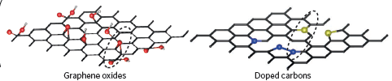
Li-S Battery Technology
3.2
Scientific approaches to tackle shuttle effect
N, B, P, S,O often used
Advantages of Li-S batteries
High theoretical specific capacity of 1675 mAh kg⁻¹
& energy density of 2600 Wh kg⁻¹
Availability, low cost & eco-friendliness of sulfur
A hybrid of chemically modified heteroatom-doped CNMs in S cathode can be used to restrain and trap polysulfide molecules
Setbacks of Li-S batteries
Insulating nature of S cathode
Volumetric expansion (80%) & severe capacity decay
of S during charge/discharge process
Shuttle phenomenon i.e. diffusion of highly soluble
(Li2Sn, 3 ≤ n ≤ 8) in Li and S electrode, which causes
decrease of Columbic efficiency
Of great importance is halogenation of carbon by halogen elements (F, Cl, Br and I).
5
21

Slide 22
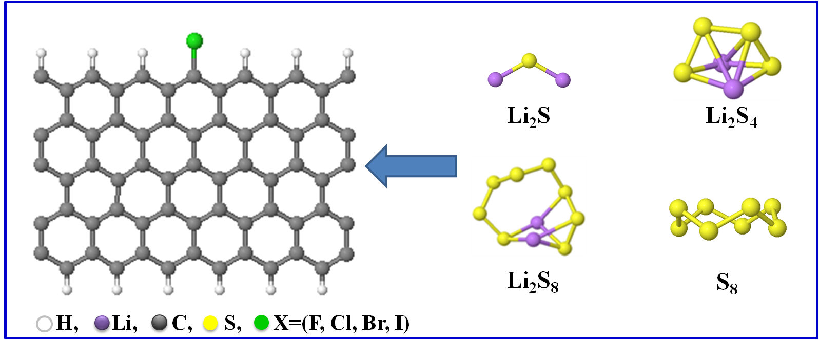
Halogen doping in CNR
3.2
Halogen doping in carbon cathode
Tune the catalytic properties of carbon host
Induce strong dipole moment for trapping solube
lithium sulfide due to its high electronegativities
Why zigzag geometry of carbon host?
Dopants enjoy high stability at the zigzag edge
Superior intrinsic catalytic reactivity of the site
5
9
22

Slide 23
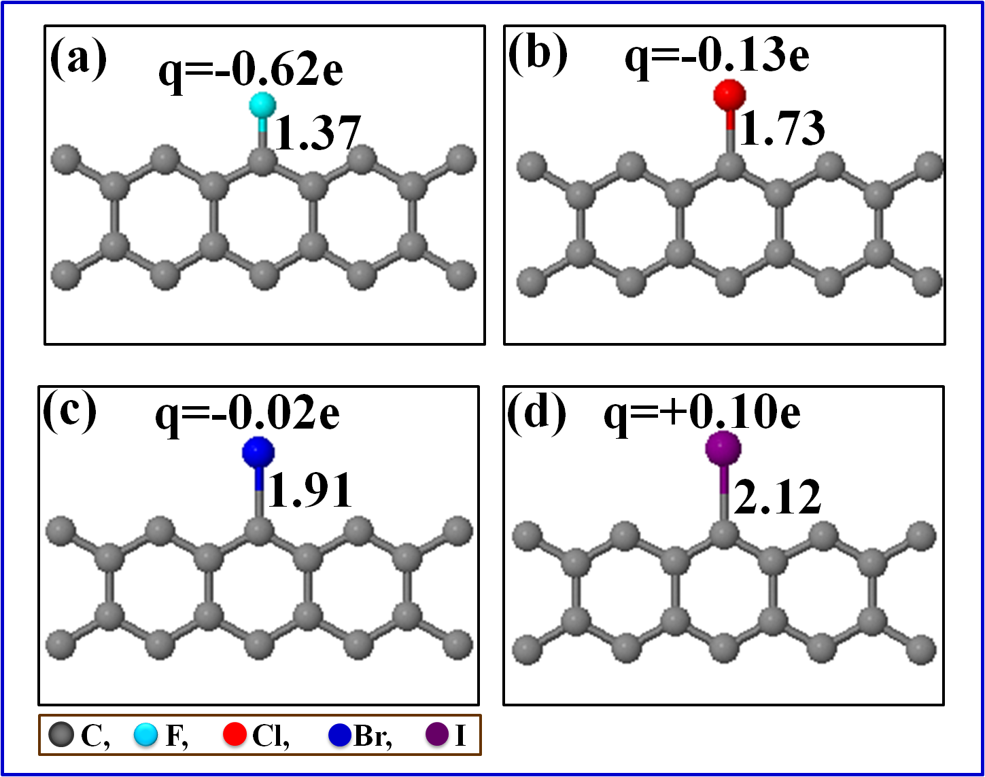
Charge analysis in halogen-doped CNR
3.2
Charge transfer from carbon to halogens with exceptions to iodine, due to
its bigger electronegativity
F, Cl , Br, negatively charged
Much bigger charge is observe on F, while I is positively charged
5
9
23

Slide 24
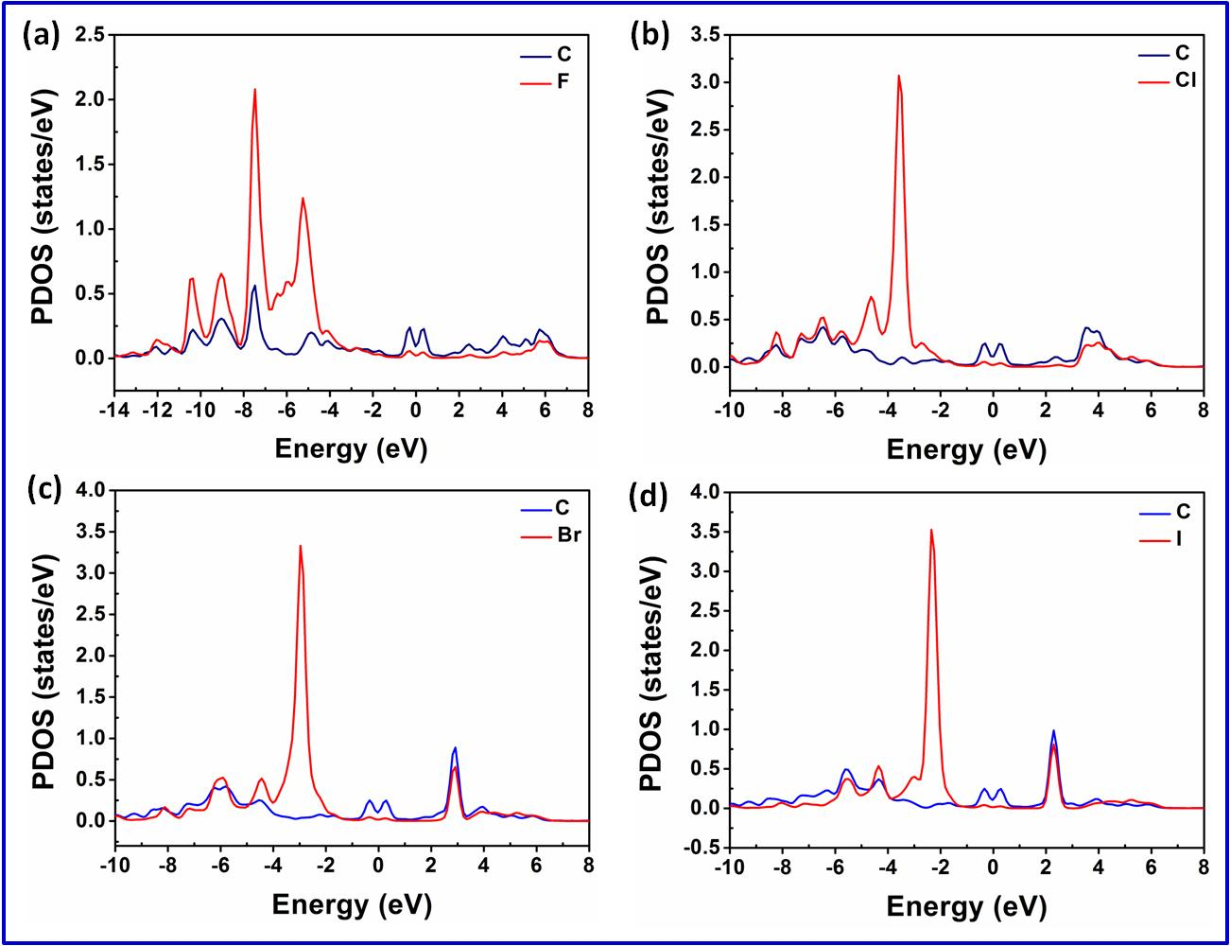
PDOS in halogen-doped CNR
3.2
Overlap of halogen and carbon orbitals distributed around the Fermi level
Spike peak for all halogen under Fermi level
5
24

Slide 25
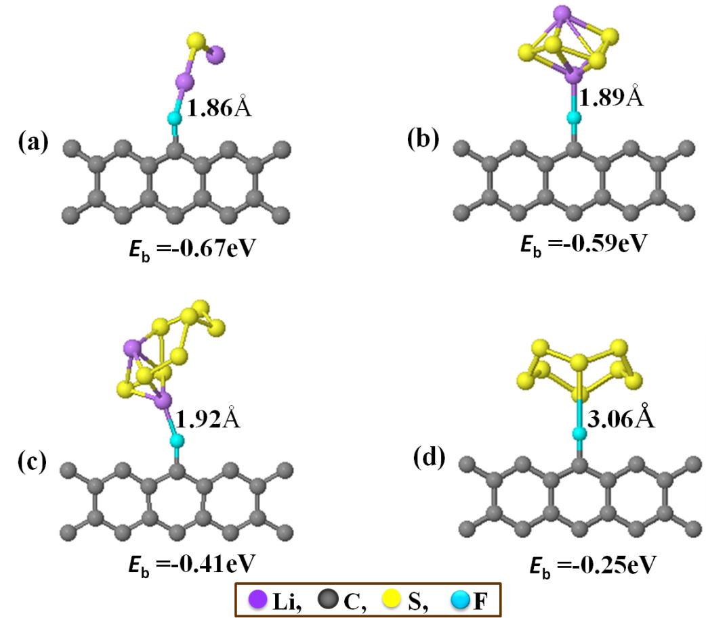
Halogen doped graphene with sulfur containing clusters
3.2
The charge transfer between X-ZZCNR and the LiPs
X-ZZCNR-LiPs
LiPs | F-ZZCNR | Cl-ZZCNR | Br-ZZCNR | I-ZZCNR
Li₂S | -0.648 | -0.355 | -0.217 | -0.057
Li₂S₄ | -0.671 | -0.295 | -0.148 | +0.031
Li₂S₈ | -0.650 | -0.298 | -0.073 | +0.104
S₈ | -0.686 | -0.231 | -0.015 | +0.147
Charge Q (e)
Optimized structures of the most stable geometry for the binding of (a) Li2S (b) Li2S4 (c) Li2S8 and S8 to F-ZZCNR
Halogenated carbon acquires charges from lithium polysulfides upon adsorption due to high electron inductive effect of halogens
Except for unlithiated S8 cluster, the interactions between adsorbed molecule and graphene edge are between Li and halogen for all investigated configurations
5
25

Slide 26
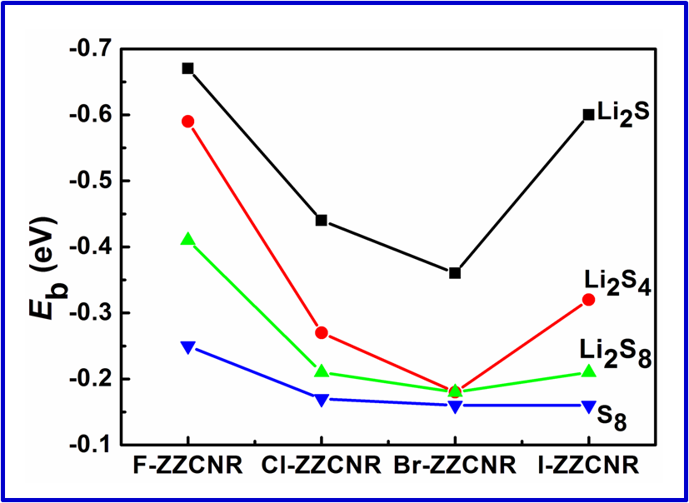
Adsorption of polysulfides (Li₂S_{n} (n= 1, 4 and 8)) towards X-ZZCNR
3.2
S8 has lowest Eb and smallest polarizability.
For Li2S, Li2S4, Li2S8, the Eb increased with the decreased in Li2Sn chain size for all
halogenated edge.
Concave curve like trend for the Eb of LiPs with monotonous decrease F, Cl, Br which related
to their reduced electronegativities and I does not obey this trend due to it different charge state.
5
9
26

Slide 27
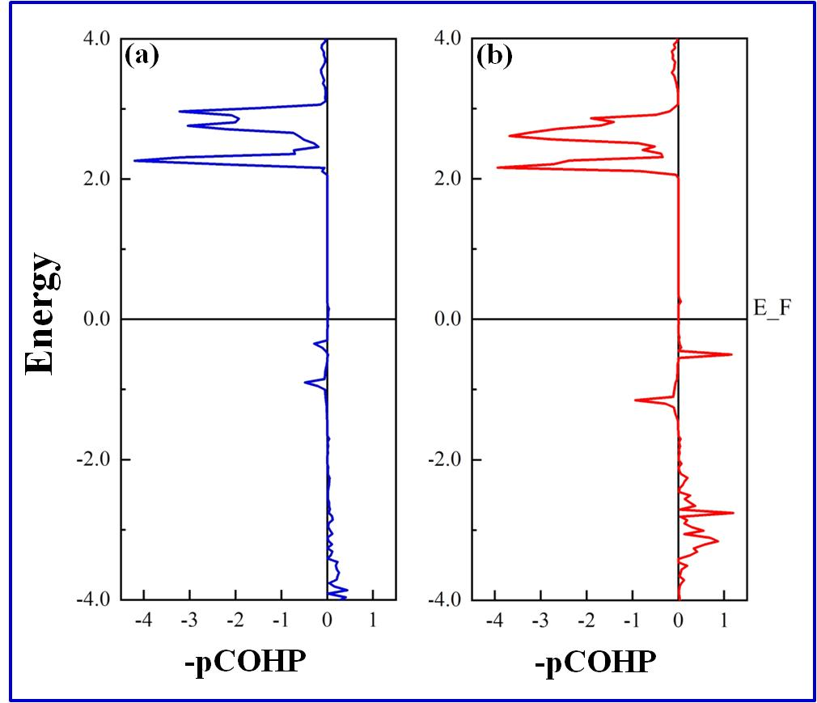
COHP analysis for Li₂S adsorbed on Br and I decorated edges of ZZCNR
3.2
More bonding states are found immediately under Fermi level for I than Br case which explained why stronger binding strength are found in iodine doped edge.
5
9
27

Slide 28
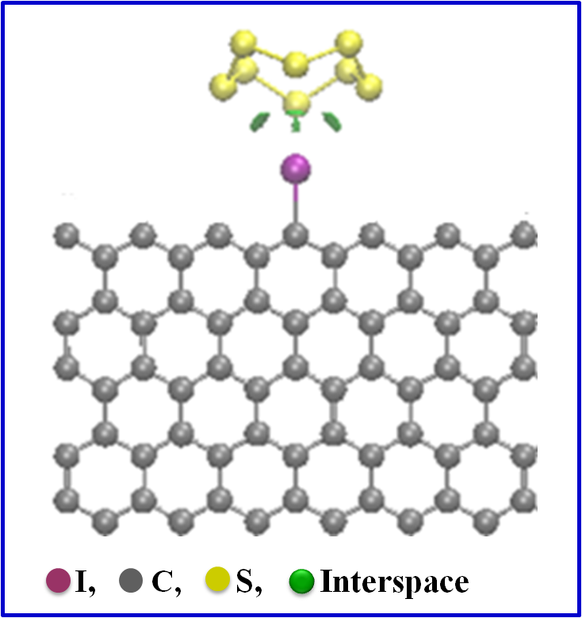
Nature of interaction between polysulfides and halogenated carbon
3.2
Non-covalent interaction (NCI) plot reveals intermolecular interactions which exactly resides in the
interspace between S₈ and halogenated carbon
5
9
28

Slide 29
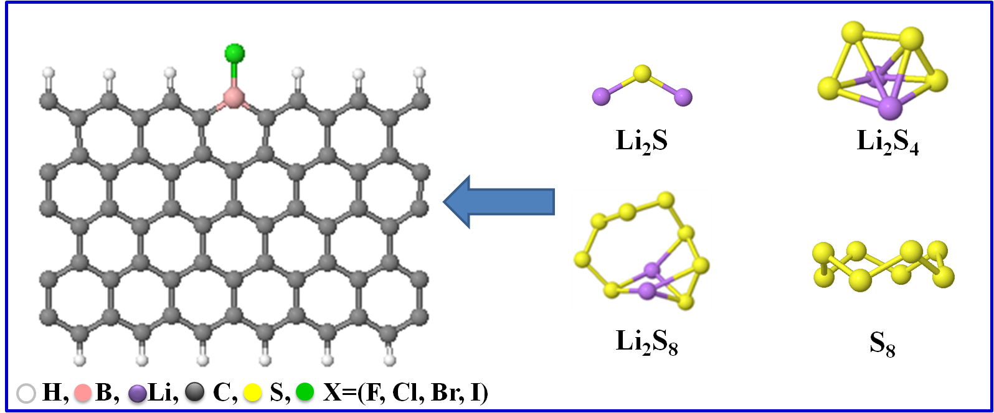
Halogen-Boron dual doping in CNR
3.2
Halogen-boron dual doping in carbon cathode
Exert control on the properties of halogenated carbon
Further tune the catalytic properties of halogenated carbon host
Further induce strong dipole moment for trapping soluble lithium
sulfide due to synergistic coupling effect between B and X
5
29

Slide 30
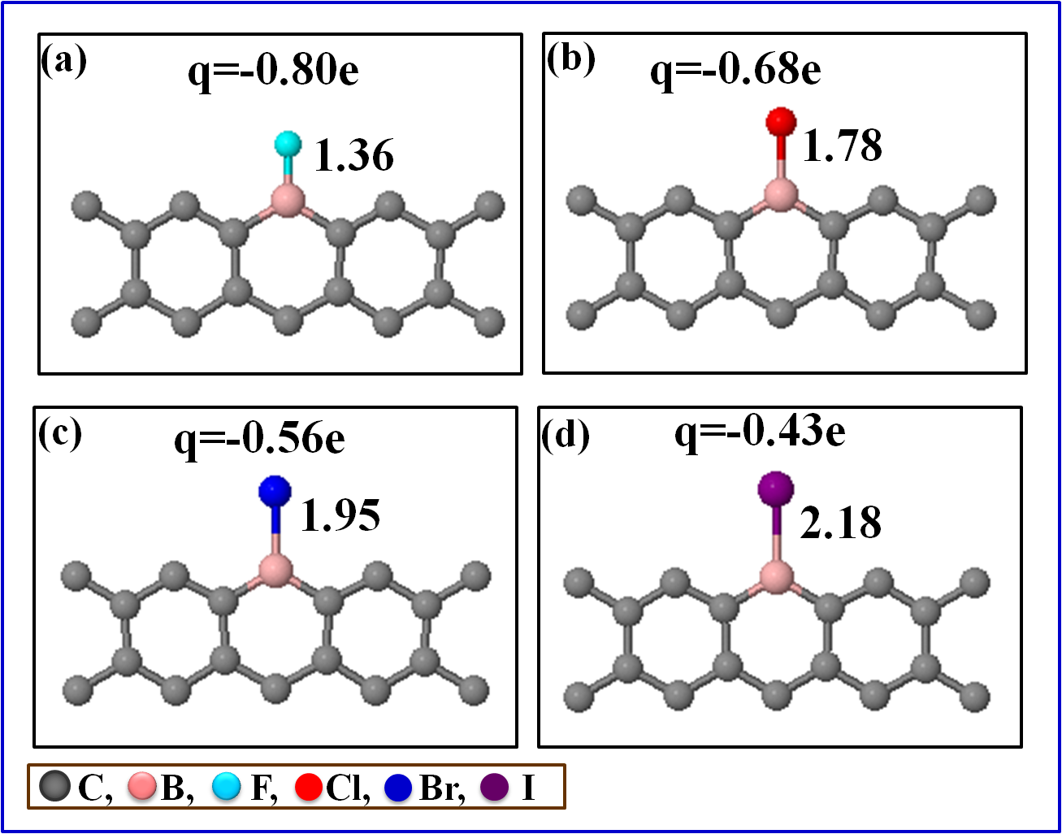
Charge analysis in halogen-boron dual doped CNR
3.2
The charges of halogen is increased after boron doping
Charge state of iodine becomes negative charged after boron doping
5
9
30

Slide 31
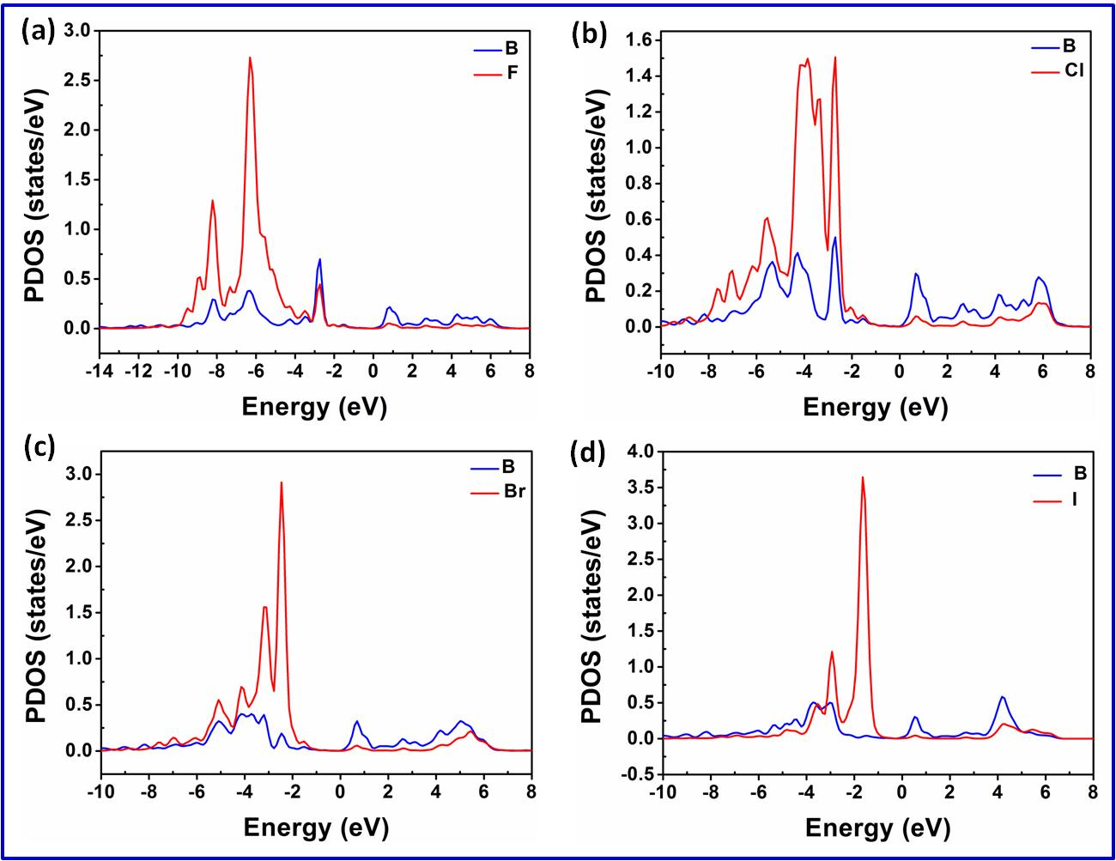
PDOS in halogen-boron dual doped CNR
3.2
The charge accumulations on halogens consequently influence the electronic structure.
The valence band of halogen is push upward toward Fermi level with the increased charges.
5
9
31

Slide 32
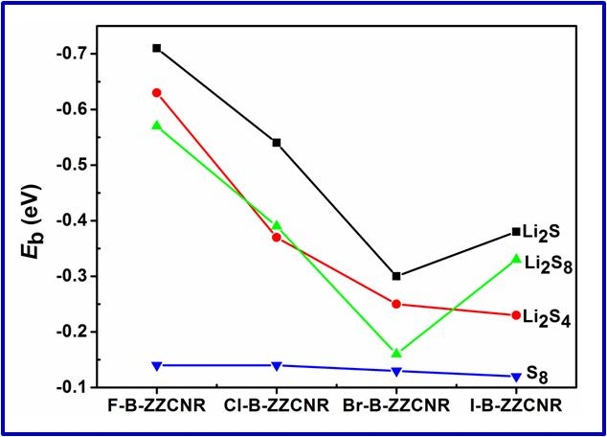
Adsorption of polysulfides (Li₂S_{n} (n= 1, 4 and 8)) towards X-B-ZZCNR
3.2
The charge transfer between X-B-ZZCNR and the LiPs
X-B-ZZCNR-LiPs
LiPs | F-B-ZZCNR | Cl-B-ZZCNR | Br-B-ZZCNR | I-B-ZZCNR
Li₂S | -0.821 | -0.731 | -0.703 | -0.492
Li₂S₄ | -0.820 | -0.721 | -0.663 | -0.434
Li₂S₈ | -0.814 | -0.728 | -0.635 | -0.396
S₈ | -0.792 | -0.668 | -0.599 | -0.338
Charge Q (e)
Concave curve is also observed for Eb of LiPs
towards halogen-boron dual dopants .
For F, Cl, Br, the Eb is generally increased from
halogen-boron dual dopants compared with single
halogen case.
The synergy effects between two dopants are
responsible for the enhanced adsorption energy.
Boron induces charge accumulation on halogens
which consequently create a strong dipole.
The induced strong dipole enhances adsorption
of lithium polysulfides.
5
9
32

Slide 33
Summary
3.2
The halogen dopants significantly enhanced the binding strength of polysulfide adsorbed on halogenated graphene edge.
Iodine presents different feature from the other halogen elements due to its modified electronic structure.
Introduction of boron as a second dopant synergize the halogenated graphene/lithium polysulfide’s interactions.
5
9
33

Slide 34
▷ Part 1 『Background』
▷ Part 2 『Computational methods』
▷ Part 3 『Research contents』
Halogenation of graphene triggered by heteroatom doping
Halogenated graphene as cathodes for high-performance Li-S batteries
▷ Part 4 『Conclusion』
34

Slide 35
Conclusions
4.0
In this research, the catalytic performance of halogenated-NCM and B/N synergized halogenated-NCM metal free catalyst for interfacial polysulfide reaction were studied under the framework of first principles density functional theory (DFT) calculations. Based on the analysis of the obtained results, the following main conclusions were drawn:
Halogenation of NCMs exert control on properties of NCMs and heteroatom doping further strengthens the halogen-NCM interactions.
Halogenation of carbon host regulates the adsorption of lithium polysulfide and enhances the reaction kinetics of the Li-S battery system.
Halogen and boron dual doped carbon catalyst shows better catalytic performance towards polysulfide reaction than halogen doped cases.
5
9
35

Slide 36
Future Work
Further analysis on halogenated nanostructured carbon materials for Li-S Batteries.
Effect of electrolyte on mobilization/immobilization of soluble polysulfide's on zigzag and armchair geometries of halogenated carbon cathodes.
The lithiophilicity chemistry and accelerated polysulfide redox kinetics of heteroatom-doped carbon for high-performance lithium sulfur batteries.
5
9
36

Slide 37
Research Outputs
O. S. Olanrele, et. al., (2020) . Heteroatom doping triggers halogenation. RSC Advances, 9:37507-37511. (Published).
(2) O. S. Olanrele, et. al., (2020) . Tuning of interaction between cathode and lithium polysulfide in Li-S battery by rational halogenations. Journal of Energy Chemistry, 49: 147-155. (Published).
(3) O. S. Olanrele. Functionalization of zigzag edge geometry of carbon nanoribbion to achieve strong anchoring and stabilization of polysulfides for lithium–sulfur batteries (Completed).
O. S. Olanrele. A novel halogen-doped Fe embedded carbon nanotube bifunctional electrocatalyst for oxygen reduction and oxygen evolution reactions (Completed).
O. S. Olanrele. Halogen-doped carbon nanotube supported iron single atom catalysts for small molecules adsorptions and environmental monitoring of poisonous gases. (Completed).
(6) O. S. Olanrele. Catalytic effect of 3d transition metal on halogenated SWNT for oxygen adsorption reaction. (In- progress).
5
9
37

Slide 38
References
E. Xu, C. Brown, et. al.,(2015). Electronic properties of halogen-adsorbed graphene. The
Journal of Physical Chemistry C.119:17271−17277.
N. Rudenko, et. al., (2010) .Adsorption of diatomic halogen molecules on graphene:
A van der Waals density functional study. Phys. Rev. B. 82:035427.
D. Tristant, et. al.,( (2015) Theoretical study of graphene doping mechanism by iodine
molecules. The Journal of Physical Chemistry C.119: 12071−12078.
(4) O. S. Olanrele, et. al., (2020) . Heteroatom doping triggers halogenation. RSC Advances, 9:
37507-37511.
A. Manthiram, et. al., (2015) . Lithium-Sulfur Batteries: Progress and Prospects. Adv. Mater.
27 (12):1980−2006.
R. Fang, et. al., (2017). More reliable lithium-sulfur batteries: status, solutions and prospects
Adv. Mater.. 29:1606823.
Q, Pang, et. al., (2016). Advances in lithium–sulfur batteries based on multifunctional
cathodes and electrolytes. Nat. Energy , 1:16132.
(8) Y. Cai, et. al., (2016). Encapsulation of cathode in lithium-sulfur batteries with a novel two-
dimensional carbon allotrope: DHP-graphene .Scientific Reports,7: 14948.
J. X. Song, et. al., (2015). Strong lithium polysulfide chemisorption on electroactive sites of
nitrogen‐doped carbon composites for high‐performance lithium–sulfur battery cathodes.
Angew. Chem. Int. Ed.54 :4325.
(10) O. S. Olanrele, et. al., (2020) . Tuning of interaction between cathode and lithium polysulfide
in Li-S battery by rational halogenations. Journal of Energy Chemistry, 49: 147-155.
5
9

Slide 39

thanks for listening
5
9

