Slide 1
CSC 307
COMPUTER ARCHITECTURE AND ORGANISATION
(DR KASALI F. A.)
CSC 307 – Computer Architecture and Organization by Kasali, F.A. is licensed under a Creative Commons Attribution-NonCommercial 4.0 International License.

Slide 2
Objectives of this Lesson
At the end of this class, students should be able to:
Understand the characteristics of memory systems
Explain the memory hierarchy and different Data Access methods
Distinguish between Internal and External memory
Illustrate the different memory addressing techniques
Describe the roles/functions of Operating Systems
Notes:
Computer memory exhibits perhaps the widest range of type, technology, organization, performance, and cost of any feature
of a computer system. No single technology is optimal in satisfying the memory
requirements for a computer system. As a consequence, the typical computer
system is equipped with a hierarchy of memory subsystems, some internal to the
system (directly accessible by the processor) and some external (accessible by the
processor via an I/O module).

Slide 3
Computer Memory
A memory is just like a human brain. It is used to store data and instructions. Computer memory is the storage space in the computer, where data is to be processed and instructions required for processing are stored.
The memory is divided into large number of small parts called cells. Each location or cell has a unique address, which varies from zero to memory size minus one.
For example, if the computer has 64k words, then this memory unit has 64 * 1024 = 65536 memory locations. The address of these locations varies from 0 to 65535.

Slide 4
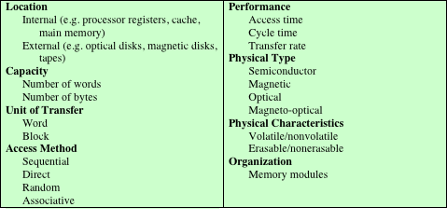
Key Characteristics of Computer Memory Systems
Notes:
The term location in Table 4.1 refers to whether memory is internal and external to the computer. Internal memory is often equated with main memory. But there
are other forms of internal memory. The processor requires its own local memory, in
112 CHAPTER 4 / CACHE MEMORY
the form of registers (e.g., see Figure 2.3). Further, as we shall see, the control unit
portion of the processor may also require its own internal memory.We will defer discussion of these latter two types of internal memory to later chapters. Cache is
another form of internal memory. External memory consists of peripheral storage
devices, such as disk and tape, that are accessible to the processor via I/O controllers.
An obvious characteristic of memory is its capacity. For internal memory, this
is typically expressed in terms of bytes (1 byte 8 bits) or words. Common word
lengths are 8, 16, and 32 bits. External memory capacity is typically expressed in
terms of bytes.
A related concept is the unit of transfer. For internal memory, the unit of
transfer is equal to the number of electrical lines into and out of the memory
module. This may be equal to the word length, but is often larger, such as 64, 128, or
256 bits.

Slide 5
Memory Units
Memory unit is the amount of data that can be stored in the storage unit. This storage capacity is expressed in terms of Bytes.
Main Memory Storage Units
Binary Digit (Bit): A binary digit is logical 0 and 1 representing a passive or an active state of a component in an electric circuit.
Nibble: A group of 4 bits is called nibble.
Byte: A group of 8 bits is called byte. A byte is the smallest unit, which can represent a data item or a character.
Word: You often hear about 32-bit or 64-bit computer architectures. A word is basically the number of bits a particular computer's CPU can deal with in one go. It varies depending on the computer architecture you're using. It is the fundamental unit of organization in memory.
Block: This is a contiguous set of bits or bytes that forms an identifiable unit of data.
Notes:
With 8 bits you can store any number between 0 and 255, since there are 256 different combinations of 1 and 0 to choose from. A "memory block" is a contiguous chunk of memory. For external memory, data are often transferred in much
larger units than a word, and these are referred to as blocks

Slide 6
Methods of Accessing Units of Data
Sequential access
Memory is organized into units of data called records
Access must be made in a specific linear sequence
Access time is variable
Direct access
Involves a shared read-write mechanism
Individual blocks or records have a unique address based on physical location
Access time is variable
Random access
Each addressable location in memory has a unique, physically wired-in addressing mechanism
The time to access a given location is independent of the sequence of prior accesses and is constant
Any location can be selected at random and directly addressed and accessed
Main memory and some cache systems are random access
Associative
A word is retrieved based on a portion of its contents rather than its address
Each location has its own addressing mechanism and retrieval time is constant independent of location or prior access patterns
Cache memories may employ associative access
Notes:
Another distinction among memory types is the method of accessing units of
data. These include the following:
• Sequential access: Memory is organized into units of data, called records.
Access must be made in a specific linear sequence. Stored addressing information
is used to separate records and assist in the retrieval process. A shared
read–write mechanism is used, and this must be moved from its current location
to the desired location, passing and rejecting each intermediate record.
Thus, the time to access an arbitrary record is highly variable. Tape units, discussed
in Chapter 6, are sequential access.
Direct access: As with sequential access, direct access involves a shared
read–write mechanism. However, individual blocks or records have a unique
address based on physical location. Access is accomplished by direct access
to reach a general vicinity plus sequential searching, counting, or waiting to
reach the final location. Again, access time is variable. Disk units, discussed in
Chapter 6, are direct access.
• Random access: Each addressable location in memory has a unique, physically
wired-in addressing mechanism. The time to access a given location is independent
of the sequence of prior accesses and is constant. Thus, any location
can be selected at random and directly addressed and accessed. Main memory
and some cache systems are random access.
• Associative: This is a random access type of memory that enables one to make
a comparison of desired bit locations within a word for a specified match, and
to do this for all words simultaneously. Thus, a word is retrieved based on a
portion of its contents rather than its address. As with ordinary random-access
memory, each location has its own addressing mechanism, and retrieval time
is constant independent of location or prior access patterns. Cache memories
may employ associative access.

Slide 7
Memory Capacity and Performance
These two are the most important characteristics of memory
In terms of performance, we have;
Access time (latency): For RAM, this is the time it takes to perform a read or write operation, that is, the time from the instant that an address is presented to the memory to the instant that data have been stored or made available for use. For non-random-access memory, access time is the time it takes to position the read–write mechanism at the desired location.
Memory cycle time: This concept is primarily applied to RAM and consists of the access time plus any additional time required before a second access can commence.
Transfer rate: This is the rate at which data can be transferred into or out of a memory unit. For RAM, it is equal to 1/(cycle time).

Slide 8
Forms of Memory
  The most common forms are:
  Semiconductor memory
  Magnetic surface memory
  Optical
  Magneto-optical
  Several physical characteristics of data storage are important:
  Volatile memory: Information decays naturally or is lost when electrical power is switched off
  Nonvolatile memory
    Once recorded, information remains without deterioration until deliberately changed
    No electrical power is needed to retain information
  Magnetic-surface memories: Non volatile
  Semiconductor memory: Volatile or non Volatile
  Nonerasable memory
    Cannot be altered, except by destroying the storage unit
    Semiconductor memory of this type is known as read-only memory (ROM)
  For random-access memory the organization is a key design issue
Notes:
Organization refers to the physical arrangement of bits to form words

Slide 9
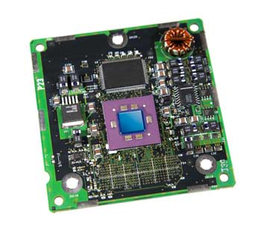
Cache Memory
Cache memory is a very high speed semiconductor memory which can speed up the CPU.
It acts as a buffer between the CPU and the main memory.
It is used to hold those parts of data and program which are most frequently used by the CPU.
The parts of data and programs are transferred from the disk to cache memory by the operating system, from where the CPU can access them.
Advantages
The advantages of cache memory are as follows −
Cache memory is faster than main memory.
It consumes less access time as compared to main memory.
It stores the program that can be executed within a short period of time.
It stores data for temporary use.
Disadvantages
The disadvantages of cache memory are as follows −
Cache memory has limited capacity.
It is very expensive.

Slide 10
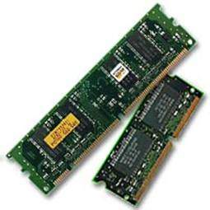
Primary Memory (Main Memory)
Primary memory holds only those data and instructions on which the computer is currently working.
It has a limited capacity and data is lost when power is switched off.
It is generally made up of semiconductor device.
These memories are not as fast as registers.
The data and instruction required to be processed resides in the main memory.
It is divided into two subcategories RAM and ROM.
Characteristics of Main Memory
These are semiconductor memories.
It is known as the main memory.
Usually volatile memory.
Data is lost in case power is switched off.
It is the working memory of the computer.
Faster than secondary memories.
A computer cannot run without the primary memory.

Slide 11
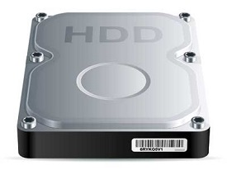
Secondary Memory
This type of memory is also known as external memory or non-volatile. It is slower than the main memory.
These are used for storing data/information permanently.
CPU directly does not access these memories, instead they are accessed via input-output routines.
The contents of secondary memories are first transferred to the main memory, and then the CPU can access it. For example, disk, CD-ROM, DVD, etc.
Characteristics of Secondary Memory
These are magnetic and optical memories.
It is known as the backup memory.
It is a non-volatile memory.
Data is permanently stored even if power is switched off.
It is used for storage of data in a computer.
Computer may run without the secondary memory.
Slower than primary memories.

Slide 12
Assignment 3
Highlight the similarities and differences between SRAM and DRAM
Briefly discuss the distinguishing features between the following types of ROM
PROM, EPROM, EEPROM and Flash Memory.

Slide 13
Random Access Memory (RAM)
RAM is the internal memory of the CPU for storing data, program, and program result. It is a read/write memory which stores data until the machine is working. As soon as the machine is switched off, data is erased.
Data in the RAM can be accessed randomly but it is very expensive. RAM is small, both in terms of its physical size and in the amount of data it can hold.
RAM is of two types −
Static RAM (SRAM)
Dynamic RAM (DRAM)
Notes:
RAM is volatile, i.e. data stored in it is lost when we switch off the computer or if there is a power failure. Hence, a backup Uninterruptible Power System (UPS) is often used with computers.

Slide 14
Static RAM (SRAM)
The word static indicates that the memory retains its contents as long as power is being supplied. However, data is lost when the power gets down due to volatile nature. SRAM chips use a matrix of 6-transistors and no capacitors. Transistors do not require power to prevent leakage, so SRAM need not be refreshed on a regular basis.
SRAM uses more chips than DRAM for the same amount of storage space, making the manufacturing costs higher. SRAM is thus used as cache memory and has very fast access.
Characteristic of Static RAM
Long life
No need to refresh
Faster
Used as cache memory
Large size
Expensive
High power consumption
Notes:
Bits stored as on/off switches
No charges to leak
No refreshing needed when powered
More complex construction
Larger per bit
More expensive
Does not need refresh circuits
Faster
Cache
Digital
Uses flip-flops

Slide 15
Dynamic RAM (DRAM)
DRAM, unlike SRAM, must be continually refreshed in order to maintain the data. DRAM is used for most system memory as it is cheap and small. All DRAMs are made up of memory cells, which are composed of one capacitor and one transistor.
Characteristics of Dynamic RAM
Short data lifetime
Needs to be refreshed continuously
Slower as compared to SRAM
Used as RAM
Smaller in size
Less expensive
Less power consumption
Notes:
Bits stored as capacitors, Charges leak
Need refreshing even when powered
Simpler construction
Smaller per bit
Less expensive
Need refresh circuits
Slower
Main memory
Essentially analogue
Level of charge determines value

Slide 16
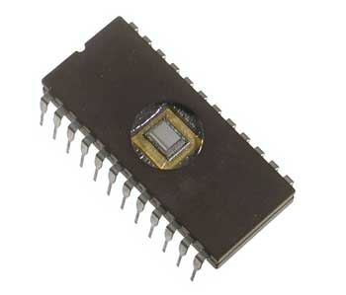
Read Only Memory (ROM)
This is the memory from which we can only read but cannot write on it. This type of memory is non-volatile. The information is stored permanently in such memories during manufacture. A ROM stores such instructions that are required to start a computer. This operation is referred to as bootstrap.
The advantages of ROM are as follows −
Non-volatile in nature
Cannot be accidentally changed
Cheaper than RAMs
Easy to test
More reliable than RAMs
Static and do not require refreshing
Contents are always known and can be verified
Notes:
ROM chips are not only used in the computer but also in other electronic items like washing machine and microwave oven. An important application of ROMs is microprogramming, discussed in Part Four. Other potential applications include
• Library subroutines for frequently wanted functions
• System programs
• Function tables

Slide 17
Types of ROM
MROM (Masked ROM)
The very first ROMs were hard-wired devices that contained a pre-programmed set of data or instructions. These kind of ROMs are known as masked ROMs, which are inexpensive.
PROM (Programmable Read Only Memory)
PROM is read-only memory that can be modified only once by a user. The user buys a blank PROM and enters the desired contents using a PROM program. Inside the PROM chip, there are small fuses which are burnt open during programming. It can be programmed only once and is not erasable.
EPROM (Erasable and Programmable Read Only Memory)
EPROM can be erased by exposing it to ultra-violet light for a duration of up to 40 minutes. Usually, an EPROM eraser achieves this function. During programming, an electrical charge is trapped in an insulated gate region. The charge is retained for more than 10 years because the charge has no leakage path. For erasing this charge, ultra-violet light is passed through a quartz crystal window (lid). This exposure to ultra-violet light dissipates the charge. During normal use, the quartz lid is sealed with a sticker.
EEPROM (Electrically Erasable and Programmable Read Only Memory)
EEPROM is programmed and erased electrically. It can be erased and reprogrammed about ten thousand times. Both erasing and programming take about 4 to 10 ms (millisecond). In EEPROM, any location can be selectively erased and programmed. EEPROMs can be erased one byte at a time, rather than erasing the entire chip. Hence, the process of reprogramming is flexible but slow.

Slide 18
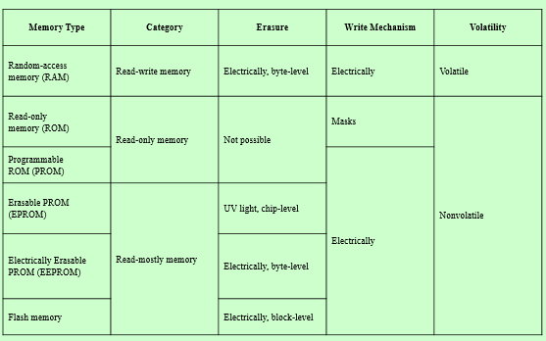
Semi conductor Memory Types

Slide 19
Errors in Semiconductors
A semiconductor memory system is subject to errors. These can be categorized as hard failures and soft errors.
A hard failure is a permanent physical defect so that the memory cell or cells affected cannot reliably store data but become stuck at 0 or 1 or switch erratically between 0 and 1. Hard errors can be caused by harsh environmental abuse, manufacturing defects, and wear.
A soft error is a random, nondestructive event that alters the contents of one or more memory cells without damaging the memory. Soft errors can be caused by power supply problems or alpha particles. These particles result from radioactive decay and are distressingly common because radioactive nuclei are found in small quantities in nearly all materials.
Both hard and soft errors are clearly undesirable, and most modern main memory systems include logic for both detecting and correcting errors.
The simplest of the error-correcting codes is the Hamming code devised by Richard Hamming at Bell Laboratories

Slide 20
Memory Hierarchy
Design constraints on a computer’s memory can be summed up by three questions:
  How much, how fast, how expensive
There is a trade-off among capacity, access time, and cost
  Faster access time, greater cost per bit
  Greater capacity, smaller cost per bit
  Greater capacity, slower access time
The way out of the memory dilemma is not to rely on a single memory component or technology, but to employ a memory hierarchy
Notes:
The question of how much is somewhat open ended. If the capacity is there,
applications will likely be developed to use it. The question of how fast is, in a sense,
easier to answer. To achieve greatest performance, the memory must be able to
keep up with the processor. That is, as the processor is executing instructions, we
would not want it to have to pause waiting for instructions or operands. The final
question must also be considered. For a practical system, the cost of memory must
be reasonable in relationship to other components.
As might be expected, there is a trade-off among the three key characteristics
of memory: capacity, access time, and cost. A variety of technologies are used to
implement memory systems, and across this spectrum of technologies, the following
relationships hold:
• Faster access time, greater cost per bit
• Greater capacity, smaller cost per bit
• Greater capacity, slower access time
The dilemma facing the designer is clear. The designer would like to use memory
technologies that provide for large-capacity memory, both because the capacity
is needed and because the cost per bit is low. However, to meet performance
requirements, the designer needs to use expensive, relatively lower-capacity memories
with short access times.
The way out of this dilemma is not to rely on a single memory component or
technology, but to employ a memory hierarchy.

Slide 21
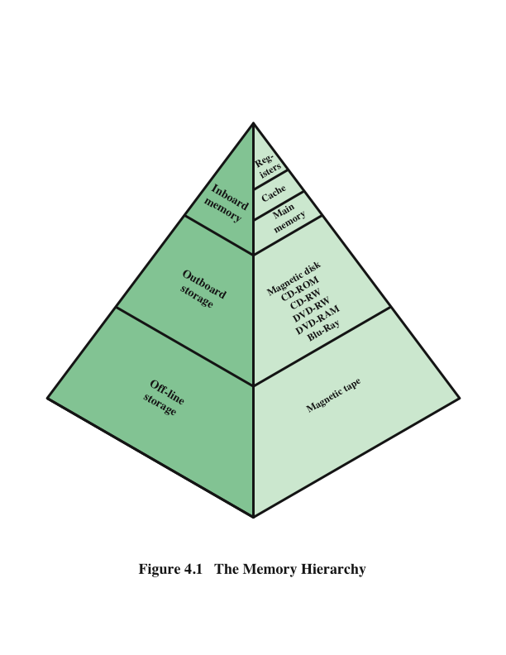
Memory Hierarchy Diagram
The memory with the fastest access is the costliest one. Larger storage devices offer slow speed and they are less expensive, however they can store huge volumes of data as compared to CPU registers or cache memory
Notes:
A typical hierarchy is illustrated in Figure 4.1. As one goes down the hierarchy, the following occur:
a. Decreasing cost per bit
b. Increasing capacity
c. Increasing access time
d. Decreasing frequency of access of the memory by the processor
Thus, smaller, more expensive, faster memories are supplemented by larger,
cheaper, slower memories. The key to the success of this organization is item (d)
:decreasing frequency of access. We examine this concept in greater detail when we
discuss the cache, later in this chapter, and virtual memory in Chapter 8. A brief
explanation is provided at this point.
The use of two levels of memory to reduce average access time works in principle,
but only if conditions (a) through (d) apply. By employing a variety of technologies,
a spectrum of memory systems exists that satisfies conditions (a) through
(c). Fortunately, condition (d) is also generally valid.
The basis for the validity of condition (d) is a principle known as locality of
reference [DENN68]. During the course of execution of a program, memory references
by the processor, for both instructions and data, tend to cluster. Programs
typically contain a number of iterative loops and subroutines. Once a loop or subroutine
is entered, there are repeated references to a small set of instructions.
Similarly, operations on tables and arrays involve access to a clustered set of data
words. Over a long period of time, the clusters in use change, but over a short period
of time, the processor is primarily working with fixed clusters of memory references.
Accordingly, it is possible to organize data across the hierarchy such that the
percentage of accesses to each successively lower level is substantially less than that
of the level above. Consider the two-level example already presented. Let level 2
memory contains all program instructions and data. The current clusters can be
temporarily placed in level 1. From time to time, one of the clusters in level 1 will
have to be swapped back to level 2 to make room for a new cluster coming in to
level 1. On average, however, most references will be to instructions and data contained
in level 1.
This principle can be applied across more than two levels of memory, as suggested
by the hierarchy shown in Figure 4.1. The fastest, smallest, and most expensive
type of memory consists of the registers internal to the processor. Typically, a
processor will contain a few dozen such registers, although some machines contain
hundreds of registers. Main memory is the principal internal memory system of
the computer. Each location in main memory has a unique address. Main memory
is usually extended with a higher-speed, smaller cache. The cache is not usually
visible to the programmer or, indeed, to the processor. It is a device for staging
the movement of data between main memory and processor registers to improve
performance.

Slide 22
Review Questions
What are the key properties of semiconductor memory?
What are two senses in which the term random-access memory is used?
What is the difference between DRAM and SRAM in terms of application?
What is the difference between DRAM and SRAM in terms of characteristics such as speed, size, and cost?
Explain why one type of RAM is considered to be analog and the other digital.
What are some applications for ROM?
What are the differences among EPROM, EEPROM, and flash memory?
Notes:
Solution: They exhibit two stable (or semistable) states, which can be used to represent binary
1 and 0; they are capable of being written into (at least once), to set the state; they
are capable of being read to sense the state.
5.2 (1) A memory in which individual words of memory are directly accessed through
wired-in addressing logic. (2) Semiconductor main memory in which it is possible
both to read data from the memory and to write new data into the memory easily
and rapidly.
5.3 SRAM is used for cache memory (both on and off chip), and DRAM is used for
main memory.
5.4 SRAMs generally have faster access times than DRAMs. DRAMS are less expensive
and smaller than SRAMs.
5.5 A DRAM cell is essentially an analog device using a capacitor; the capacitor can
store any charge value within a range; a threshold value determines whether the
charge is interpreted as 1 or 0. A SRAM cell is a digital device, in which binary
values are stored using traditional flip-flop logic-gate configurations.
5.6 Microprogrammed control unit memory; library subroutines for frequently wanted
functions; system programs; function tables

Slide 23
External Memory
Magnetic disks remain the most important component of external memory. Both removable and fixed, or hard, disks are used in systems ranging from personal computers to mainframes and supercomputers.
To achieve greater performance and higher availability, servers and larger systems use RAID disk technology. RAID is a family of techniques for using multiple disks as a parallel array of data storage devices, with redundancy built in to compensate for disk failure.
Optical storage technology has become increasingly important in all types of computer systems. While CD-ROM has been widely used for many years, more recent technologies, such as writable CD and DVD, are becoming increasingly important.

Slide 24
Magnetic Disks
Hard disk drives are the most common secondary storage devices in present computer systems. These are called magnetic disks because they use the concept of magnetization to store information.
Hard disks consist of metal disks coated with magnetizable material. These disks are placed vertically on a spindle.
A read/write head moves in between the disks and is used to magnetize or de-magnetize the spot under it. A magnetized spot can be recognized as 0 (zero) or 1 (one).
Hard disks are formatted in a well-defined order to store data efficiently.
A hard disk plate has many concentric circles on it, called tracks. Every track is further divided into sectors. A sector on a hard disk typically stores 512 bytes of data.

Slide 25
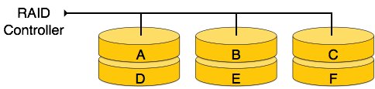
Redundant Array of Independent Disks (RAID)
RAID is a technology to connect multiple secondary storage devices and use them as a single storage media.
RAID consists of an array of disks in which multiple disks are connected together to achieve different goals. RAID levels define the use of disk arrays.
RAID 0
In this level, a striped array of disks is implemented. The data is broken down into blocks and the blocks are distributed among disks. Each disk receives a block of data to write/read in parallel. It enhances the speed and performance of the storage device. There is no parity and backup in Level 0.

Slide 26
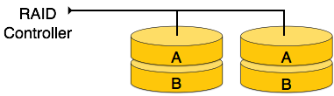
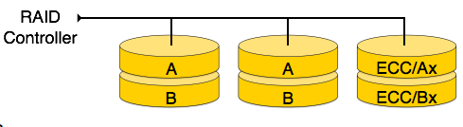
RAID 1
RAID 1 uses mirroring techniques. When data is sent to a RAID controller, it sends a copy of data to all the disks in the array. RAID level 1 is also called mirroring and provides 100% redundancy in case of a failure.
RAID 2
RAID 2 records Error Correction Code using Hamming distance for its data, striped on different disks. Like level 0, each data bit in a word is recorded on a separate disk and ECC codes of the data words are stored on a different set disks. Due to its complex structure and high cost, RAID 2 is not commercially available.

Slide 27
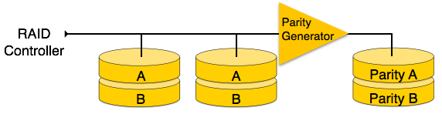
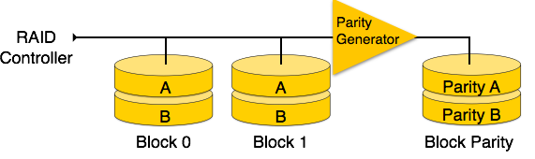
RAID 3
RAID 3 stripes the data onto multiple disks. The parity bit generated for data word is stored on a different disk. This technique makes it to overcome single disk failures.
RAID 4
In this level, an entire block of data is written onto data disks and then the parity is generated and stored on a different disk. Note that level 3 uses byte-level striping, whereas level 4 uses block-level striping. Both level 3 and level 4 require at least three disks to implement RAID.

Slide 28
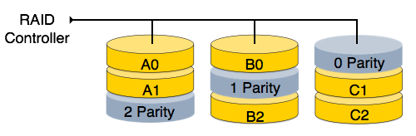
RAID 5
RAID 5 writes whole data blocks onto different disks, but the parity bits generated for data block stripe are distributed among all the data disks rather than storing them on a different dedicated disk.
RAID 6
RAID 6 is an extension of level 5. In this level, two independent parities are generated and stored in distributed fashion among multiple disks. Two parities provide additional fault tolerance. This level requires at least four disk drives to implement RAID.

Slide 29
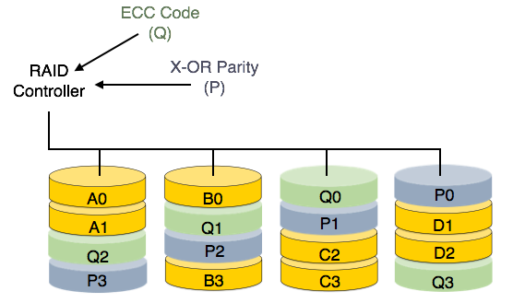

Slide 30
Optical Memory
In 1983, one of the most successful consumer products of all time was introduced:
The compact disk (CD) digital audio system.
The CD is a non-erasable disk that can store more than 60 minutes of audio information on one side.
The huge commercial success of the CD enabled the development of low-cost optical-disk storage technology that has revolutionized computer data storage.
A variety of optical-disk systems have been introduced

Slide 31
CD: Compact Disk. A nonerasable disk that stores digitized audio information. The standard system uses
12-cm disks and can record more than 60 minutes of uninterrupted playing time.
CD-ROM: Compact Disk Read-Only Memory. A nonerasable disk used for storing computer data. The standard
system uses 12-cm disks and can hold more than 650 Mbytes.
CD-R: CD Recordable. Similar to a CD-ROM. The user can write to the disk only once.
CD-RW: CD Rewritable. Similar to a CD-ROM. The user can erase and rewrite to the disk multiple times.
DVD: Digital Versatile Disk. A technology for producing digitized, compressed representation of video information, as well as large volumes of other digital data. Both 8 and 12 cm diameters are used, with a
double-sided capacity of up to 17 Gbytes. The basic DVD is read-only (DVD-ROM).
DVD-R: DVD Recordable. Similar to a DVD-ROM. The user can write to the disk only once. Only one-sided disks can be used.
DVD-RW: DVD Rewritable. Similar to a DVD-ROM. The user can erase and rewrite to the disk multiple times. Only one-sided disks can be used.
Blu-Ray DVD: High definition video disk. Provides considerably greater data storage density than DVD, using a 405-nm (blue-violet) laser. A single layer on a single side can store 25 Gbytes.

Slide 32
Virtual Memory
Virtual memory is a memory management capability of an OS that uses hardware and software to allow a computer to compensate for physical memory shortages by temporarily transferring data from RAM to disk storage. Virtual address space is increased using active memory in RAM and inactive memory in hard disk drives (HDDs) to form contiguous addresses that hold both the application and its data
Benefits
It can handle twice as many addresses as main memory
It frees applications from managing shared memory and saves users from adding more memory modules when RAM space runs out
Disadvantage
The use of virtual memory has its tradeoffs, particularly with speed. It's generally better to have as much physical memory as possible so programs work directly from RAM or physical memory. The use of virtual memory slows a computer because data must be mapped between virtual and physical memory, which requires extra hardware support for address translations.
Notes:
Computers have a finite amount of RAM so memory can run out, especially when multiple programs run at the same time. A system using virtual memory can load larger programs or multiple programs running at the same time, allowing each one to operate as if it has infinite memory and without having to purchase more RAM.
As part of the process of copying virtual memory into physical memory, the OS divides memory into pagefiles or swap files that contain a fixed number of addresses. Each page is stored on a disk and when the page is needed, the OS copies it from the disk to main memory and translates the virtual addresses into real addresses

Slide 33
Memory Addressing Techniques
Immediate
Direct
Indirect
Register
Register Indirect
Displacement
Stack
Notes:
a memory address is a reference to a specific memory location used at various levels by software and hardware. The address field or fields in a typical instruction format are relatively small. We
would like to be able to reference a large range of locations in main memory or, for
some systems, virtual memory. To achieve this objective, a variety of addressing
techniques has been employed.

Slide 34
Note the following notations
A = contents of an address field in the instruction
R = contents of an address field in the instruction that refers to a register
EA = actual (effective) address of the location containing the referenced operand
(X) = contents of memory location X or register X
Notes:
Before beginning this discussion, two comments need to be made. First, virtually all computer architectures provide more than one of these addressing modes.
The question arises as to how the processor can determine which address mode is
being used in a particular instruction. Several approaches are taken. Often, different
opcodes will use different addressing modes. Also, one or more bits in the instruction format can be used as a mode field. The value of the mode field determines
which addressing mode is to be used.
The second comment concerns the interpretation of the effective address
(EA). In a system without virtual memory, the effective address will be either a
main memory address or a register. In a virtual memory system, the effective
address is a virtual address or a register. The actual mapping to a physical address is a function of the memory management unit (MMU) and is invisible to
the programmer.

Slide 35
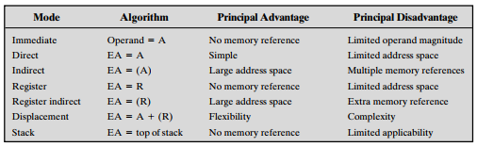
Basic Addressing Modes

Slide 36
Immediate Addressing
Operand is part of instruction
Operand = address field
e.g. ADD 5
  Add 5 to contents of accumulator
  5 is operand
No memory reference to fetch data
Fast
Limited range

Slide 37
Direct Addressing
Address field contains address of operand
Effective address (EA) = address field (A)
e.g. ADD A
  Add contents of cell A to accumulator
  Look in memory at address A for operand
Single memory reference to access data
No additional calculations to work out effective address
Limited address space

Slide 38
Indirect Addressing
Memory cell pointed to by address field contains the address of (pointer to) the operand
EA = (A)
  Look in A, find address (A) and look there for operand
e.g. ADD (A)
  Add contents of cell pointed to by contents of A to accumulator
Large address space
2^{n} where n = word length
Multiple memory accesses to find operand
Hence slower

Slide 39
Register Addressing
Operand is held in register named in address filed
EA = R
Limited number of registers
Very small address field needed
  Shorter instructions
  Faster instruction fetch
No memory access
Very fast execution
Very limited address space
Multiple registers helps performance
  Requires good assembly programming or compiler writing
c.f. Direct addressing

Slide 40
Register Indirect Addressing
C.f. indirect addressing
EA = (R)
Operand is in memory cell pointed to by contents of register R
Large address space (2^{n})
One fewer memory access than indirect addressing
Displacement Addressing
EA = A + (R)
Address field hold two values
  A = base value
  R = register that holds displacement
  or vice versa

Slide 41
Stack Addressing
Operand is (implicitly) on top of stack
e.g.
  ADD Pop top two items from stack and add

Slide 42
Review Questions (Illustration with diagrams attracts more marks)
Briefly define immediate addressing.
Briefly define direct addressing.
Briefly define indirect addressing.
Briefly define register addressing.
Briefly define register indirect addressing.
Briefly define displacement addressing.
Briefly define stack addressing.
Differentiate between all the 6 addressing modes using their algorithms, principal benefit and limitation as point of reference
Computer Architecture and Organisation by Dr. Kasali, F. A. is licensed under a Creative Commons Attribution-NonCommercial 4.0 International License.

Slide 43
THANK YOU FOR LISTENING
Computer Architecture and Organisation by Dr. Kasali, F. A. is licensed under a Creative Commons Attribution-NonCommercial 4.0 International License.

