Slide 1
CSC 307
COMPUTER ARCHITECTURE AND ORGANISATION
(DR KASALI F. A.)
Notes:
Architecture: the design, structure, and behavior of a computer including the characteristics of individual components and how they interact.
Organization: the coordinating of separate components into a unit or structure. Computer Architecture refers to those attributes of a system visible to a programmer or, put another way, those attributes that have a direct impact on the logical execution of a program.
Computer Organization refers to the operational units and their interconnections that realize the architectural specifications.

Slide 2
Course Outline
CSC 307 : Computer Architecture and Organization (3 Units) (L45: P0)
Fundamental building blocks, logic expressive immunization, sum of product forms.
Register transfer notation, Physical considerations. Data representation, and number bases, Fixed and Floating point systems representation
Memory systems organization and architecture.
Memory system, general; characteristics of memory operation. (Technology-magnetic recording semi-conductor memory, coupled devices, magnetic bubble). Memory addressing, memory hierarchy, virtual memory control systems. Hardware control, micro programmed control, Asynchronous control, i/c control. Introduction to the methodology of faulty tolerant computing.

Slide 3
GRADING POLICY
CLASS ATTENDANCE 5%
CLASS PARTICIPATION/QUIZ 5%
ASSIGNMENTS 10%
MID SEMESTER EXAMINATION 10%
FINAL EXAMINATION 70%

Slide 4
LATE POLICY, ATTENDANCE AND MAKE UP
Attendance will be taken at the beginning of each lecture
Official / medical excuses must be presented within one week
Late attendance is counted as half presence
Two late attendances are counted as one absence
No makeup exam will be given for missing exam or quiz without cogent reason(s)
Notes:
Cogent: forceful and convincing to the intellect

Slide 5
Why Study Computer Architecture and Organization?
You want to be called “Computer Engineer or Scientist”
You want to become an “expert” on computer hardware
You want to become a “computer system designer”
You want to become a “software designer” and need to understand how to improve code performance
Technology is improving rapidly, new opportunities, has never been more exciting!
Because Institute of Electrical Engineering Electronics/Association of Computing Machinery mandated it for all Computer Science/Computer Engineering to study it.
Notes:
The computer lies at the heart of computing. Without it most of
the computing disciplines today would be a branch of theoretical
mathematics. To be a professional in any field of computing today,
one should not regard the computer as just a black box that executes programs by magic.All students of computing should acquire
some understanding and appreciation of a computer system’s functional components, their characteristics, their performance, and
their interactions. There are practical implications as well. Students
need to understand computer architecture in order to structure a
program so that it runs more efficiently on a real machine. In selecting a system to use, they should be able to understand the
tradeoff among various components, such as CPU clock speed vs.
memory size

Slide 6
Aims of this course
At the end of this course, students should be able to:
Understand the structure and function of a Computer
Compare the history of computers from first generation to the present
Explain the roles of registers, memory (internal and external), memory addressing, Instruction cycle and control systems
Solve some problems in Number Systems
Understand the concept of Boolean Algebra
Implement Boolean functions
Discuss the concept of Fault Tolerant Computing

Slide 7
Text
Stallings, W. (Eds.). (2010). Computer Organization and Architecture (8th ed.) Upper Saddle River, New Jersey: Prentice Hall.
Related Online Sources

Slide 8
Objectives of this Lesson
At the end of this class, students should be able to:
Perform basic arithmetic operations on binary, decimal and hexadecimal numbers.
Understand some basic concepts of digital logic
Differentiate between computer Organization and Architecture
Differentiate between computer Structure and Function
Draw the structure of a computer
Explain the components of a computer
Trace the historical development of computers from first generation till present

Slide 9
Practice Questions
1 Convert the following binary numbers to their decimal equivalents:
a. 001100 b. 000011 c. 011100 d. 111100 e. 101010
2 Convert the following binary numbers to their decimal equivalents:
a. 11100.011 b. 110011.10011 c. 1010101010.1
3 Convert the following decimal numbers to their binary equivalents:
a. 64 b. 100 c. 111 d. 145 e. 255
4 Convert the following decimal numbers to their binary equivalents:
a. 34.75 b. 25.25 c. 27.1875
5 Express the following octal numbers in hexadecimal notation:
a. 12 b. 5655 c. 2550276 d. 76545336 e. 3726755

Slide 10
6 Convert the following hexadecimal numbers to their decimal equivalents:
a. C b. 9F c. D52 d. 67E e. ABCD
7 Convert the following hexadecimal numbers to their decimal equivalents:
a. F.4 b. D3.E c. 1111.1 d. 888.8 e. EBA.C
8 Convert the following decimal numbers to their hexadecimal equivalents:
a. 16 b. 80 c. 2560 d. 3000 e. 62,500
9 Convert the following decimal numbers to their hexadecimal equivalents:
a. 204.125 b. 255.875 c. 631.25 d. 10000.00390625
10 Convert the following hexadecimal numbers to their binary equivalents:
a. E b. 1C c. A64 d. 1F.C e. 239.4
Notes:
Check archi notes

Slide 11
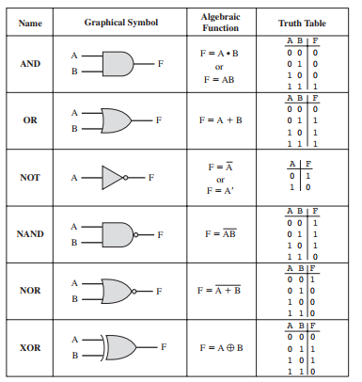
Basic Logic Gates

Slide 12
Computer Architecture and Organization
Computer Architecture refers to those attributes of a system visible to a programmer or, put another way, those attributes that have a direct impact on the logical execution of a program.
Computer Organization refers to the operational units and their interconnections that realize the architectural specifications.
Examples of architectural attributes include the instruction set, the number of bits used to represent various data types (e.g., numbers, characters), I/O mechanisms, and techniques for addressing memory.
Organizational attributes include those hardware details transparent to the programmer, such as control signals; interfaces between the computer and peripherals; and the memory technology used.
Notes:
A computer is a complex system; contemporary computers contain millions of elementary electronic components.
How,then,can one clearly describe them?The key is to recognize the hierarchical nature of most complex systems,
including the computer.A hierarchical system is a set of interrelated subsystems, each of the latter, in
turn,hierarchical in structure until we reach some lowest level of elementary subsystem.
The hierarchical nature of complex systems is essential to both their design and
their description. The designer need only deal with a particular level of the system at
a time. At each level, the system consists of a set of components and their interrelationships
.The behavior at each level depends only on a simplified, abstracted characterization of the system at the next lower level. At each level, the designer is
concerned with structure and function:

Slide 13
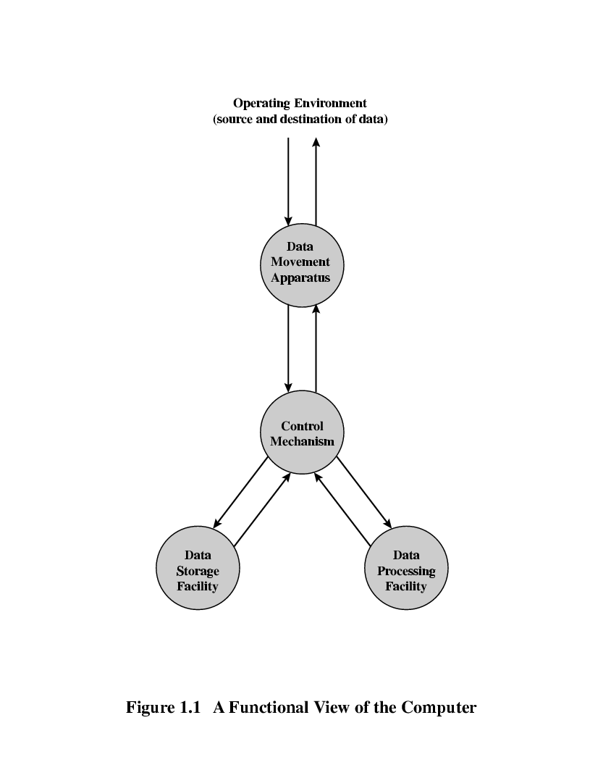
Structure and Function of a Computer
Structure: The way in which the components are
interrelated
Function: The operation of each individual component
as part of the structure
Fig 1: A Functional View of the Computer

Slide 14
Generally, there are only four functions of the computer
Data Processing
Data Movement
Data Storage
Control
The computer must be able to process data. The data may take a wide variety of forms, and the range of processing requirements is broad.
It is also essential that a computer store data. Even if the computer is processing data on the fly, the computer must temporarily store at least those pieces of data that are being worked on at any given moment. Thus, there is at least a short-term data storage function. Equally important, the computer performs a long-term data storage function. Files of data are stored on the computer for subsequent retrieval and update.
The computer must be able to move data between itself and the outside world. The computer’s operating environment consists of devices that serve as either sources or destinations of data
Notes:
(i.e., data come in and get processed, and the results go out immediately),

Slide 15
When data are received from or delivered to a device that is directly connected to the computer, the process is known as input–output (I/O), and the device is referred to as a peripheral.
When data are moved over longer distances, to or from a remote device, the process is known as data communications.
Finally, there must be control of these three functions. Ultimately, this control is exercised by the individual(s) who provides the computer with instructions. Within the computer, a control unit manages the computer’s resources and orchestrates the performance of its functional parts in response to those instructions

Slide 16
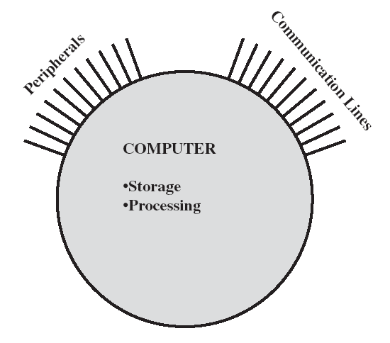
Structure of a computer
The Computer
  CPU
    Controls the operation of the computer and performs its data processing functions.
  Main memory
    Stores data
  I/O
    Moves data between the computer and its
    external environment
  System interconnection
    Provides for communication among CPU,
    main memory, and I/O
Notes:
The computer interacts in some fashion with its external environment. In general, all of its linkages to the external environment is grouped into peripheral devices or communication lines.

Slide 17
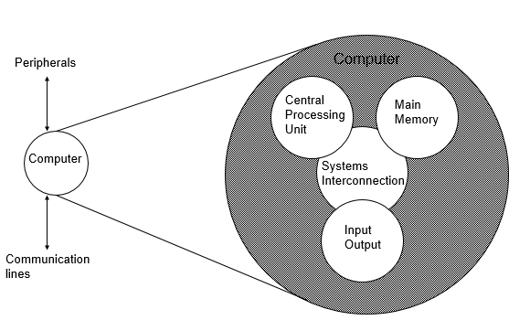
Top Level Structure of the Computer

Slide 18
Central Processing Unit(CPU)
This is the most complex component of a computer
Its major structural components are as follows:
• Control unit: Controls the operation of the CPU and hence the computer
• Arithmetic and logic unit (ALU): Performs the computer’s data processing
functions
• Registers: Provides storage internal to the CPU
• CPU interconnection: Some mechanism that provides for communication
among the control unit, ALU, and registers

Slide 19
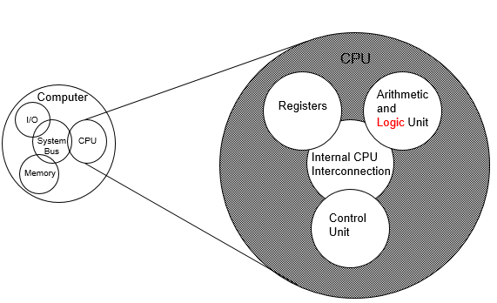
The CPU

Slide 20
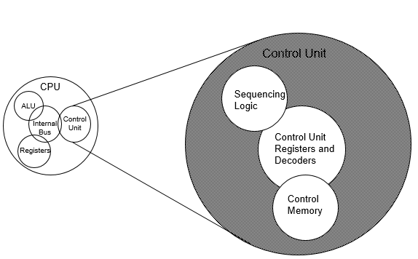
The Control Unit
Notes:
There are several approaches to the implementation of the control unit; one common approach is a microprogrammed implementation. In essence,
a microprogrammed control unit operates by executing microinstructions that define
the functionality of the control unit.

Slide 21
Review Questions/QUIZ
What, in general terms, is the distinction between computer organization and computer architecture?
What, in general terms, is the distinction between computer structure and computer function?
What are the four main functions of a computer?
List and briefly define the main structural components of a computer.
List and briefly define the main structural components of a processor.

Slide 22
ASSIGNMENT ONE
Discuss briefly the history of computers
What is the implication of Moore’s law in the present generation of computers
Differentiate between Vacuum tubes, Transistors and Integrated Circuits

Slide 23
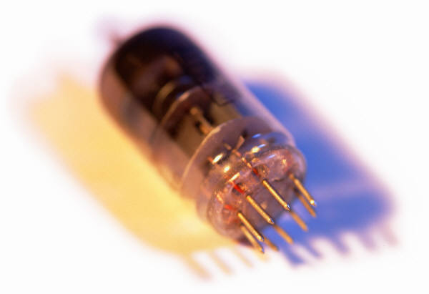
History of Computers
First Generation: Vacuum Tubes
ENIAC
  Electronic Numerical Integrator And Computer
Designed and constructed at the University of Pennsylvania
  Started in 1943 – completed in 1946
  By John Mauchly and John Eckert
World’s first general purpose electronic digital computer
  Army’s Ballistics Research Laboratory (BRL) needed a way to supply trajectory tables for new weapons accurately and within a reasonable time frame
  Was not finished in time to be used in the war effort
  Its first task was to perform a series of calculations that were used to help determine the feasibility of the hydrogen bomb
  Continued to operate under BRL management until 1955 when it was disassembled
Notes:
John Mauchly, a professor of electrical engineering at the University of
Pennsylvania, and John Eckert, one of his graduate students, proposed to build a
general-purpose computer using vacuum tubes for the BRL’s application. In 1943,
the Army accepted this proposal, and work began on the ENIAC.
The ENIAC , designed and constructed at the University of Pennsylvania, was the world’s first general purpose
electronic digital computer. The project was a response to U.S. needs
during World War II. The Army’s Ballistics Research Laboratory (BRL), an agency
responsible for developing range and trajectory tables for new weapons, was having
difficulty supplying these tables accurately and within a reasonable time frame.
Without these firing tables, the new weapons and artillery were useless to gunners.
The BRL employed more than 200 people who, using desktop calculators, solved
the necessary ballistics equations. Preparation of the tables for a single weapon
would take one person many hours, even days.

Slide 24
ENIAC was enormous, weighed 30 tons, occupied 1500 square feet of floor
space, and contained more than 18,000 vacuum tubes.
When operating, it consumed 140 kilowatts of power. It was also substantially faster than any electromechanical computer, capable of 5000 additions per second.
The ENIAC was a decimal rather than a binary machine. Its memory consisted of 20 “accumulators,” each capable of holding a 10-digit decimal number. A ring of 10 vacuum tubes represented each digit. At any time, only one vacuum tube was in the ON state, representing one of the 10 digits.
The major drawback of the ENIAC was that it had to be programmed manually by setting switches and plugging and unplugging cables.
The ENIAC was completed in 1946, too late to be used in the war effort. Instead, its first task was to perform a series of complex calculations that were used to help determine the feasibility of the hydrogen bomb. The use of the ENIAC for a purpose other than that for which it was built demonstrated its general-purpose
nature.
The ENIAC continued to operate under BRL management until 1955, when
it was disassembled.
Notes:
That is, numbers were represented in decimal form, and arithmetic was performed in the decimal system.

Slide 25
John von Neumann
Electronic Discrete Variable Computer (EDVAC)
First publication of the idea was in 1945
Stored program concept
  Attributed to ENIAC designers, most notably the mathematician John von Neumann
  Program represented in a form suitable for storing in memory alongside the data
  IAS computer
  Princeton Institute for Advanced Studies
  Prototype of all subsequent general-purpose computers
  Completed in 1952
  The memory of the IAS consists of 1000 storage locations, called words, of
  40 binary digits (bits) each. Both data and instructions are stored there. Numbers
  are represented in binary form, and each instruction is a binary code.
Notes:
The task of entering and altering programs for the ENIAC was extremely tedious.
But suppose a program could be represented in a form suitable for storing in memory
alongside the data. Then, a computer could get its instructions by reading them from
memory, and a program could be set or altered by setting the values of a portion of memory.
This idea, known as the stored-program concept, is usually attributed to the
ENIAC designers, most notably the mathematician John von Neumann, who was
a consultant on the ENIAC project. Alan Turing developed the idea at about the
same time. The first publication of the idea was in a 1945 proposal by von Neumann
for a new computer, the EDVAC (Electronic Discrete Variable Computer).
In 1946, von Neumann and his colleagues began the design of a new stored program
computer, referred to as the IAS computer, at the Princeton Institute for
Advanced Studies.

Slide 26
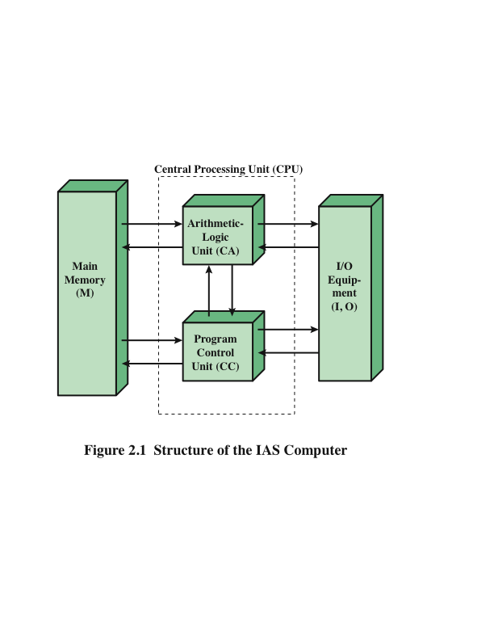
Structure of von Neumann Machine
Notes:
Figure 2.1 shows the general structure of the IAS computer (compare to middle
portion of Figure 1.4). It consists of
• A main memory, which stores both data and instructions
• An arithmetic and logic unit (ALU) capable of operating on binary data
• A control unit, which interprets the instructions in memory and causes them
to be executed
• Input/output (I/O) equipment operated by the control unit

Slide 27
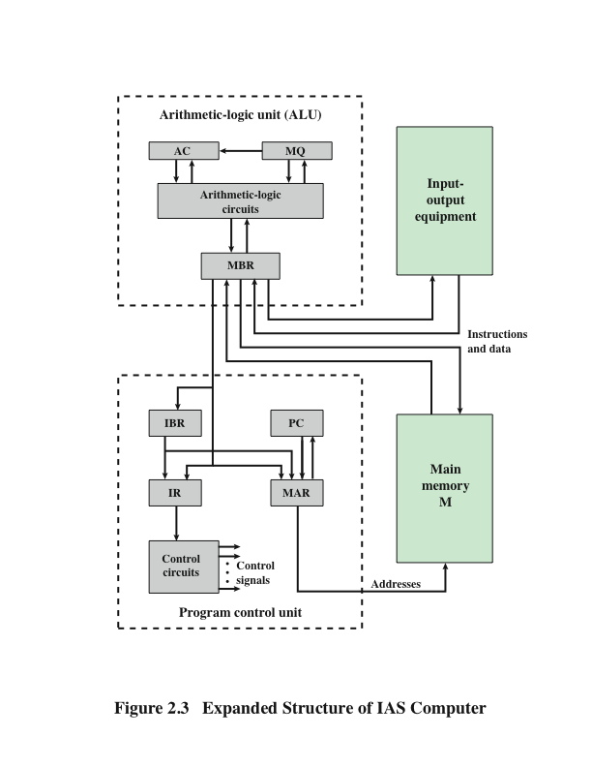
Structure of IAS Computer
Notes:
The control unit operates the IAS by fetching instructions from memory and
executing them one at a time. To explain this, a more detailed structure diagram is
needed, as indicated in Figure 2.3. This figure reveals that both the control unit and
the ALU contain storage locations, called registers.

Slide 28
Registers
Memory buffer register (MBR): Contains a word to be stored in memory or sent to the I/O unit, or is used to receive a word from memory or from the I/O unit.
Memory address register (MAR): Specifies the address in memory of the word to be written from or read into the MBR.
Instruction register (IR ): Contains the 8-bit opcode instruction being executed.
Instruction buffer register (IBR): Employed to hold temporarily the right-hand
instruction from a word in memory.
Program counter (PC): Contains the address of the next instruction pair to be fetched from memory.
Accumulator (AC) and multiplier quotient (MQ): Employed to hold temporarily operands and results of ALU operations. For example, the result of multiplying two 40-bit numbers is an 80-bit number; the most significant 40 bits are stored in the AC and the least significant in the MQ.

Slide 29
Commercial Computers
UNIVAC
1947 – Eckert and Mauchly formed the Eckert-Mauchly Computer Corporation to manufacture computers commercially
UNIVAC I (Universal Automatic Computer)
  First successful commercial computer
  Was intended for both scientific and commercial applications
  Commissioned by the US Bureau of Census for 1950 calculations
  The first paper describing the
  It could solve matrix algebraic computations, statistical problems, premium billings for a life insurance company, and logistical problems
The Eckert-Mauchly Computer Corporation became part of the UNIVAC division of the Sperry-Rand Corporation
UNIVAC II – delivered in the late 1950’s
  Had greater memory capacity and higher performance
  Backward compatible
Notes:
First, advances in technology
allow companies to continue to build larger, more powerful computers. Second,
each company tries to make its new machines backward compatible with the older
machines. This means that the programs written for the older machines can be
executed on the new machine. This strategy is adopted in the hopes of retaining the
customer base; that is, when a customer decides to buy a newer machine, he or she is
likely to get it from the same company to avoid losing the investment in programs.

Slide 30
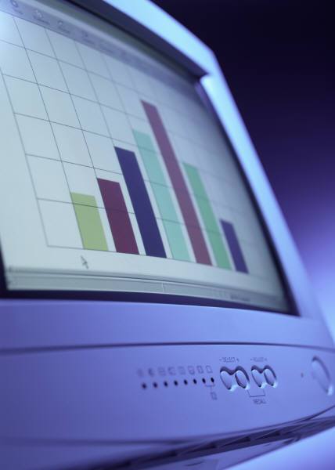

IBM
Was the major manufacturer of punched-card processing equipment
Delivered its first electronic stored-program computer (701) in 1953
  Intended primarily for scientific applications
  Introduced 702 product in 1955
  Hardware features made it suitable to business applications
  Series of 700/7000 computers established IBM as the overwhelmingly dominant computer manufacturer

Slide 31
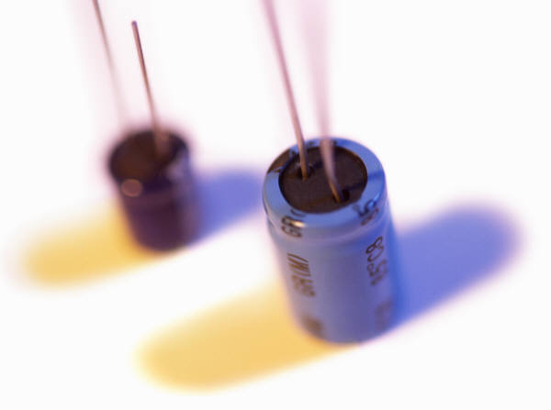
Second Generation
Transistors
  Smaller
  Cheaper
  Dissipates less heat than a vacuum tube
  Is a solid state device made from silicon
  Was invented at Bell Labs in 1947
  It was not until the late 1950’s that fully transistorized computers were commercially available

Slide 32
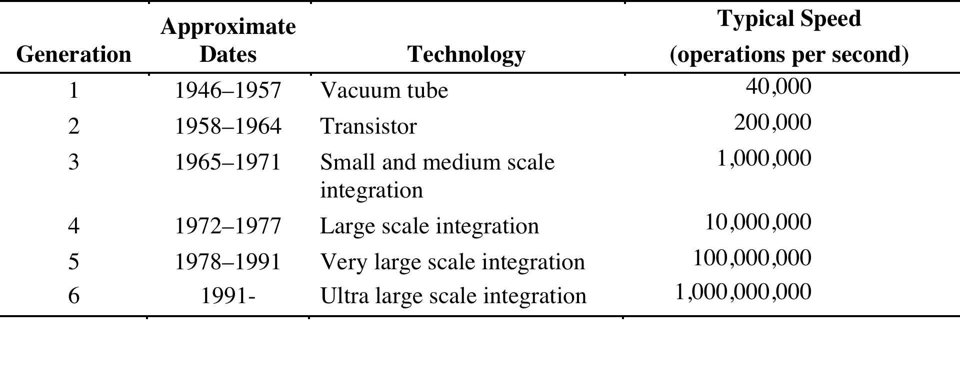
Table 1: Generation of Computers
Notes:
It has become widely accepted to classify computers into generations based on the fundamental
hardware technology employed (Table 2.2). Each new generation is characterized
by greater processing performance, larger memory capacity, and smaller
size than the previous one.

Slide 33
Second Generation Computers
Introduced:
  More complex arithmetic and logic units and control units
  The use of high-level programming languages
  Provision of system software which provided the ability to:
    load programs
    move data to peripherals and libraries
    perform common computations
Appearance of the Digital Equipment Corporation (DEC) in 1957
PDP-1 was DEC’s first computer
This began the mini-computer phenomenon that would become so prominent in the third generation
Notes:
In broad terms, system software provided the ability to load programs,
move data to peripherals, and libraries to perform common computations, similar
to what modern OSes like Windows and Linux do.

Slide 34
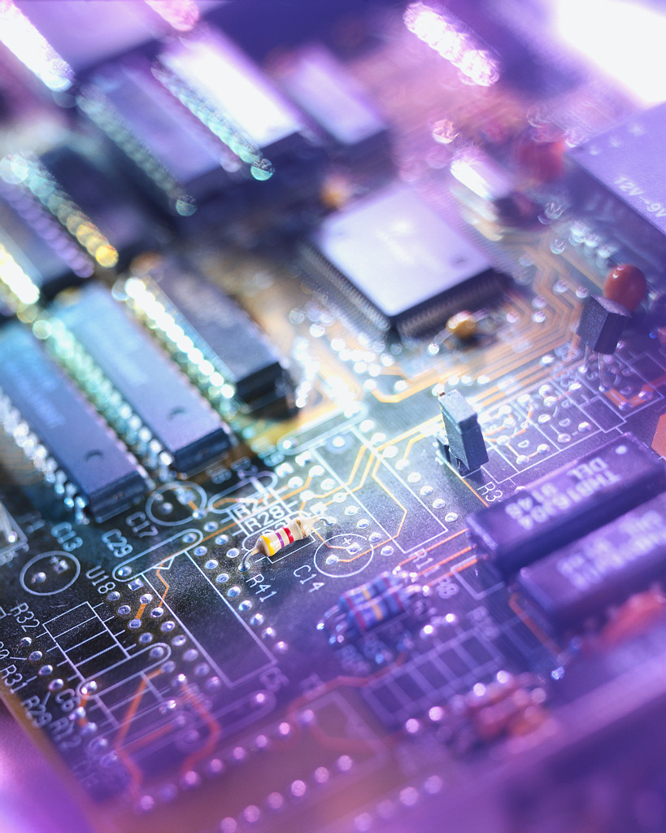
Third Generation: Integrated Circuits
1958 – the invention of the integrated circuit
Discrete component
  Single, self-contained transistor
  Manufactured separately, packaged in their own containers, and soldered or wired together onto Masonite-like circuit boards
  Manufacturing process was expensive and cumbersome
  This era started the world of microelectronics
  The two most important members of the third generation were the IBM System/360 and the DEC PDP-8
Notes:
A single, self-contained transistor is called a discrete component. Throughout the
1950s and early 1960s, electronic equipment was composed largely of discrete components—
transistors, resistors, capacitors, and so on. Discrete components were
manufactured separately, packaged in their own containers, and soldered or wired
together onto masonite-like circuit boards, which were then installed in computers,
oscilloscopes, and other electronic equipment. Whenever an electronic device called
for a transistor, a little tube of metal containing a pinhead-sized piece of silicon
had to be soldered to a circuit board. The entire manufacturing process, from transistor
to circuit board, was expensive and cumbersome.
These facts of life were beginning to create problems in the computer industry.
Early second-generation computers contained about 10,000 transistors. This
figure grew to the hundreds of thousands, making the manufacture of newer, more
powerful machines increasingly difficult.
In 1958 came the achievement that revolutionized electronics and started the
era of microelectronics: the invention of the integrated circuit. It is the integrated
circuit that defines the third generation of computers. In this section, we provide a
brief introduction to the technology of integrated circuits. Then we look at perhaps
the two most important members of the third generation, both of which were introduced
at the beginning of that era: the IBM System/360 and the DEC PDP-8.

Slide 35
Microelectronics
This means “small electronics.” Since the beginnings of digital electronics and the computer industry, there has been a persistent and consistent trend toward the reduction in size of digital electronic circuits.
The basic elements of a digital computer, must perform storage, movement, processing, and control functions.
Only two fundamental types of components are required : gates and memory cells.
A gate is a device that implements a simple Boolean or logical function, such as IF A AND B ARE TRUE THEN C IS TRUE (AND gate). Such devices are called gates because they control data flow in much the same way that canal gates do.
The memory cell is a device that can store one bit of data; that is, the device can be in one of two stable states at any time. By interconnecting large numbers of these fundamental devices, we can construct a computer. We can relate this to our four basic functions as follows:

Slide 36
Data storage: Provided by memory cells.
Data processing: Provided by gates.
Data movement: The paths among components are used to move data from
memory to memory and from memory through gates to memory.
Control: The paths among components can carry control signals. For example, a gate will have one or two data inputs plus a control signal input that activates the gate.
When the control signal is ON, the gate performs its function on the data inputs and produces a data output. Similarly, the memory cell will store the bit that is on its input lead when the WRITE control signal is ON and will place the bit that is in the cell on its output lead when the READ control signal is ON.

Slide 37
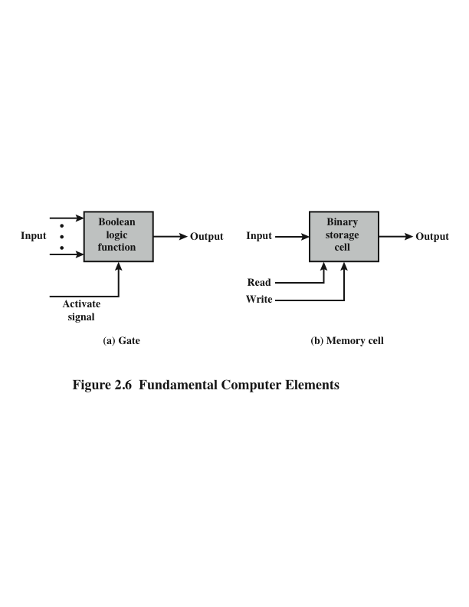
A computer consists of gates, memory cells, and interconnections among these elements
The gates and memory cells are constructed of simple digital electronic components
Exploits the fact that such components as transistors, resistors, and conductors can be fabricated from a semiconductor such as silicon
Many transistors can be produced at the same time on a single wafer of silicon Transistors can be connected with a processor metallization to form circuits

Slide 38
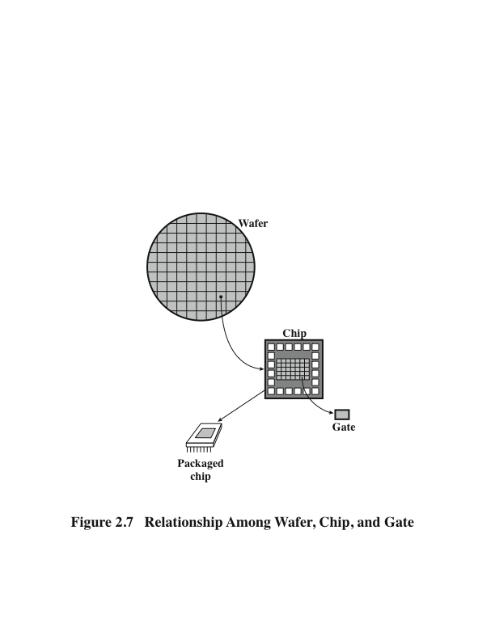
Wafer, Chip and Gate Relationship (The key concepts in an integrated circuit)
Notes:
A thin wafer of
silicon is divided into a matrix of small areas, each a few millimeters square. The
identical circuit pattern is fabricated in each area, and the wafer is broken up into
chips. Each chip consists of many gates and/or memory cells plus a number of input
and output attachment points. This chip is then packaged in housing that protects
it and provides pins for attachment to devices beyond the chip. A number of these
packages can then be interconnected on a printed circuit board to produce larger
and more complex circuits.

Slide 39
Moore’s Law
Initially, only a few gates or memory cells could be reliably manufactured and packaged together. These early integrated circuits are referred to as small-scale integration (SSI).
As time went on, it became possible to pack more and more components on the same chip. it is one of the most remarkable technological trends ever recorded.
This figure reflects the famous Moore’s law, which was propounded by Gordon Moore, cofounder of Intel, in 1965.
Moore observed that the number of transistors that could be put on a single chip was doubling every year and correctly predicted that this pace would continue into the near future. To the surprise of many, including Moore, the pace continued year after year and decade after decade. The pace slowed to a doubling every 18 months in the 1970s but has sustained that rate ever since.

Slide 40
Later Generations: Semi-conductor Memory Microprocessors
Beyond the third generation there is less general agreement on defining generations of computers.
With the introduction of large-scale integration (LSI), more than 1000 components can be placed on a single integrated circuit chip.
Very-large-scale integration (VLSI) achieved more than 10,000 components per chip, while current ultra-large-scale integration (ULSI) chips can contain more than one billion components.
With the rapid pace of technology, the high rate of introduction of new products, and the importance of software and communications as well as hardware, the classification by generation becomes less clear and less meaningful. sults.
Notes:
It could be said that the commercial application of new developments resulted in a major change in
the early 1970s and that the results of these changes are still being worked out. In
this section, we mention two of the most important of these re

Slide 41
Semiconductor Memory
In 1970 Fairchild produced the first relatively capacious semiconductor memory
Chip was about the size of a single core
Could hold 256 bits of memory
Non-destructive
Much faster than core
In 1974 the price per bit of semiconductor memory dropped below the price per bit of core memory
There has been a continuing and rapid decline in memory cost accompanied by a corresponding increase in physical memory density
Developments in memory and processor technologies changed the nature of computers in less than a decade
Since 1970 semiconductor memory has been through 13 generations
Each generation has provided four times the storage density of the previous generation, accompanied by declining cost per bit and declining access time
Notes:
Since 1970, semiconductor memory has been through 13 generations: 1K, 4K,
16K, 64K, 256K, 1M, 4M, 16M, 64M, 256M, 1G, 4G, and, as of this writing, 16 Gbits
on a single chip (1K = 2¹⁰, 1M = 2²⁰, 1G = 2³⁰). Each generation has provided four
times the storage density of the previous generation, accompanied by declining cost
per bit and declining access time.

Slide 42
Microprocessors
The density of elements on processor chips continued to rise
  More and more elements were placed on each chip so that fewer and fewer chips were needed to construct a single computer processor
1971 Intel developed 4004
  First chip to contain all of the components of a CPU on a single chip
  Birth of microprocessor
1972 Intel developed 8008
  First 8-bit microprocessor
1974 Intel developed 8080
  First general purpose microprocessor
  Faster, has a richer instruction set, has a large addressing capability

Slide 43
Concept of Family in the world of Computers
The concept of a family of compatible computers was both novel and extremely successful. The characteristics of a family are as follows:
Similar or identical instruction set: In many cases, the exact same set of machine instructions is supported on all members of the family. Thus, a program that executes on one machine will also execute on any other.
Similar or identical operating system: The same basic operating system is available for all family members. In some cases, additional features are added to the higher-end members.
Increasing speed: The rate of instruction execution increases in going from lower to higher family members.
Increasing number of I/O ports: The number of I/O ports increases in going from lower to higher family members.
Increasing memory size: The size of main memory increases in going from lower to higher family members.
Increasing cost: At a given point in time, the cost of a system increases in going from lower to higher family members.
Notes:
A customer with modest requirements and a budget to match could start with the relatively inexpensive Model 30. Later, if the customer’s needs grew, it was possible to upgrade to a faster machine with more memory without sacrificing the investment in already-developed software.

Slide 44
Review Questions/Quiz
What is a stored program computer?
What are the four main components of any general-purpose computer?
At the integrated circuit level, what are the three principal constituents of a computer system?
Explain Moore’s law.
List and explain the key characteristics of a computer family.

Slide 45
THANK YOU FOR LISTENING

