Slide 1
COST ACCOUNTING
(ACC 203)
LECTURE NOTE
By
DR. O. J. AKINYOMI

Slide 2
Accounting for Overhead Costs

Slide 3
Overhead
Overhead cost is ‘expenditure on labour, materials or services that cannot be economically identified with a specific saleable cost unit’
Overhead cost as defined by CIMA Official Terminology

Slide 4
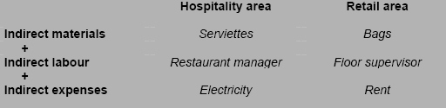
Overhead cost – key points
  The total of all indirect costs
  Costs incurred that cannot be traced directly to a specific cost unit
  A ‘shared’ cost

Slide 5
Why is overhead cost important?
Management need to be aware of the level of expenditure on overheads. If left uncontrolled, the amount spent can increase year in year out, eroding significant proportions of gross profit and reducing competitiveness. Managers need to know:
  Overhead expenditure per cost centre or department.
  Overhead costs per unit.

Slide 6
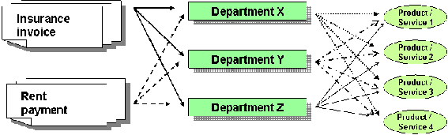
Dealing with overhead cost

Slide 7
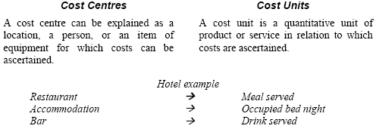
Cost centres and cost units

Slide 8
Overhead allotment
When an overhead cost can be identified with a particular cost centre, the whole cost is allotted to that cost centre

Slide 9
Overhead apportionment
The process by which overheads are divided between several cost centres in a 'fair' proportion is referred to as cost apportionment.
Each overhead type is examined and a suitable base for sharing out the cost is established.

Slide 10
Illustration – Apportioning overhead
The overhead cost in relation to rent is N10,000 and floor space was chosen as the most suitable basis for sharing or apportioning this cost. The total floor space available is 500 square metres (300 for department A and 200 for department B). You are required to compute the overhead apportioned to department A and department B.
Solution:
Dept A 300 m² Dept B 200 m² Total 500 m²
60% x 10,000 40% x 10,000 100% x 10,000
N6,000 N4,000 N10,000

Slide 11
Basis for apportioning overhead
  Examples of suitable basis could include:
  Number of employees (used for supervision, employee benefits, canteen costs).
  Floor space (used for rent, rates, electricity).
  Book value of assets (used for depreciation of assets or contents insurance).
  Value of material issues (used for costs relating to material movements or stores and warehousing).
  Number of material requisitions (used for costs relating to material movements or stores and warehousing).

Slide 12
Example 3.1: Apportioning overhead cost
ABC Ltd sells clothing from Lagos. Management has identified 4 departments.
The following cost information is available. Other information:
 | Men’s Clothing | Women’s Clothing | Children Clothing | Footwear | Total
 | N | N | N | N | N
Direct materials | 390,000 | 295,000 | 270,000 | 135,000 | 1090,000
Direct labour | 120,000 | 96,000 | 195,000 | 69,000 | 480,000
Indirect labour | 16,750 | 12,250 | 12,050 | 7,450 | 48,500
Electricity |  |  |  |  | 50,000
Rent and rates |  |  |  |  | 70,000
Personnel costs |  |  |  |  | 35,000
Depreciation of assets |  |  |  |  | 18,000
Insurance of assets |  |  |  |  | 45,000

Slide 13
Example 3.1: Apportioning overhead cost
Other information:
 | Men’s Clothing | Women’s Clothing | Children Clothing | Footwear | Total
Floor area (m²) | 600 | 1,500 | 600 | 300 | 3,000
Number of staff | 11 | 9 | 7 | 8 | 35
Fixed asset value | N1.5m | N3.5m | N0.9m | N0.1m | N6m
Prepare an overhead statement apportioning the overhead costs to each department.

Slide 14
Example 3.1: Apportioning overhead cost
 | Basis | Men’s Clothing | Women’s Clothing | Children Clothing | Footwear | Total
 |  | N | N | N | N | N
Indirect labour | Provided | 16,750 | 12,250 | 12,050 | 7,450 | 48,500
Electricity | Area | 10,000 | 25,000 | 10,000 | 5,000 | 50,000
Rent and rates | Area | 14,000 | 35,000 | 14,000 | 7,000 | 70,000
Personnel costs | Staff | 11,000 | 9,000 | 7,000 | 8,000 | 35,000
Depreciation of assets | Value | 4,500 | 10,500 | 2,700 | 300 | 18,000
Insurance of assets | Value | 11,250 | 26,250 | 6,750 | 750 | 45,00
Total overhead |  | 67,500 | 118,000 | 52,500 | 28,500 | 266,500

Slide 15
Absorption Costing

Slide 16
Absorption costing
  Absorption costing (overhead recovery) can be explained as the process whereby the overheads of the various cost centres are added to cost units or jobs.
  Absorption costing is the traditional approach to charging overhead costs to cost units.
  Absorption costing can be explained as a process for sharing out the overhead costs of each cost centre to each product or service that is provided by that cost centre.

Slide 17
Absorption costing steps
Apportion all overheads to cost centres.
Identify the support or service cost centres, and re-apportion the costs of these to the cost centres involved in producing the products or services.
Calculate the overhead absorption rate (OAR) for each cost centre involved in producing products or services, using the most appropriate base.
Use the OAR to establish the overhead cost per unit.

Slide 18
Step 1 – Apportion overhead to each cost centre
The first step involves the allocation and apportionment of overhead costs to each cost centre that has been identified.
(see example 3.1)

Slide 19
Step 2 – Re-apportion support or service centre costs
  Organisations may have service departments (canteen, maintenance and administration) which cannot be related to any income producing activity.
  To find the full cost of a cost unit this department’s costs should also be absorbed into the unit cost.
  Therefore service departments must be apportioned to the various departments producing the products or services.

Slide 20
Example 3.2: Re-apportioning service centre costs
XYZ Ltd operates a busy complex providing ten pin bowling, snooker and an outdoor adventure maze. Cost centres have been established for each of the key activities provided. In addition to the three cost centres there are two support centres for administration and maintenance. Overhead cost has been apportioned to each of the cost
Centres as follows:

Slide 21
Example3.2: Example 3.2 (Cont.)
 | Bowling | Snooker | Maze | Admin | Maintenance | Total
Total overhead | N362,000 | N187,000 | N245,000 | N96,000 | N78,000 | N968,000
It is policy to re-apportion the cost of maintenance using maintenance hours, and administration using revenue earned. The following is available for the period.
 | Bowling | Snooker | Maze | Total
Maintenance time | 2,600 hours | 1,000 hours | 1,400 hours | 5,000 hours
Revenue earned | N450,000 | N230,000 | N320,000 | N1,000,000
You are required to re-apportion the costs of the two service centres.

Slide 22
Example 3.2: Re-apportioning service centre costs
Overhead Re-apportionment
 | Bowling | Snooker | Maze | Admin | Maint. | Total
Total OH | N362,000 | N187,000 | N245,000 | N96,000 | N78,000 | N968,000
Admin | N43,200 | N22,080 | N30,720 | N(N96,000) |  | N0
Maint. | N40,560 | N15,600 | N21,840 |  | (N78,000) | N0
Total OH | N445,760 | N224,680 | N297,560 | N0 | N0 | N968,000
Workings for re-apportionment of admin costs:
450,000/1,000,000 x 96,000 =N43,200
230,000/1,000,000 x 96,000 = N22,080
320,000/1,000,000 x 96,000 = N30,720

Slide 23
Example 3.2: Re-apportioning service centre costs
Overhead Re-apportionment (Cont.)
Workings for re-apportionment of maintenance costs:
2,600/5,000 x 78,000 =N40,560
1,000,000/5,000 x 78,000 = N15,600
1,400,000/5,000 x 78,000 = N21,840

Slide 24
Step 3 – Establishing an overhead absorption rate
  This step involves the establishment of an overhead absorption rate that allows the overhead cost of a product or service to be calculated.
  The calculation of an overhead absorption rate requires two variables:
    The total overhead attributable to a cost centre.
    The absorption base.

Slide 25
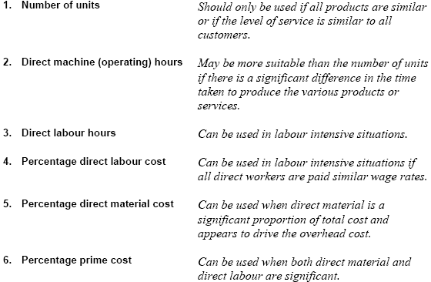
Absorption basis

Slide 26
Example 3.3: Overhead absorption rates
MNO Ltd is a small retail organization selling protective clothing to builders. The company is currently making a loss and is reviewing accounting procedures. The following information relates to the three products sold by the company:
 | Selling price | Purchase cost | Number sold
Hard hats | N16 | N10 | 12,000
Shoes | N60 | N35 | 10,000
Luminous vests | N5 | N2 | 18,000
 |  |  | 40,000
Total overhead for the period in question amounted to N200,000. The owner considers that both the number of units, and a rate based on the percentage of material cost, are equally suitable as a basis to absorb overheads to the three products and is not sure which is the best to adopt.

Slide 27
Calculate an overhead absorption rate based on number of units.
Calculate an overhead absorption rate based on the percentage of material cost.

Slide 28
Example 3.3: Overhead absorption rates
a) Overhead absorption rate based on the number of units.
Overhead N200,000/40,000 units = N5 per unit
This approach is very simple as total overhead is divided by the total number of units sold.
b) Overhead absorption rate based on a percentage of material cost.
 | Purchase cost | Numbers sold
Hard hats | N10 | 12,000 | N120,000
Shoes | N35 | 10,000 | N350,000
Luminous vests | N2 | 18,000 | N36,000
 |  |  | N506,000
Overhead N200,000/Materials N506,000 = 39.5% of material cost

Slide 29
Step 4 – Establishing the overhead cost per unit
Once the overhead absorption rate is established then the total cost of a product or service can be calculated.
This can be demonstrated by using the data from example 3.3
Total cost and profit using OAR based on the number of units
 | Hats | Shoes | Vests
Material cost | N10.00 | N35.00 | N2.00
Overhead cost | N5.00 | N5.00 | N5.00
Total cost | N15.00 | N40.00 | N7.00
Selling price | N16.00 | N60.00 | N5.00
Profit | N1.00 | N20.00 | (2.00)

Slide 30
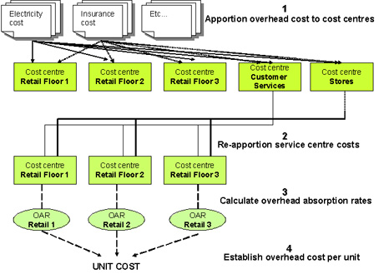
The absorption process

Slide 31
Example 3.4: Absorption Costing
 | Accommodation | Restaurant | Bar | Leisure complex | Admin | Facilities management
Indirect labour | N220,000 | N99,000 | N44,000 | N110,000 | N28,000 | N49,000
Overheads yet to be apportioned:
Electricity and gas N10,000
Building insurance N55,000
Employee benefits N50,000
Asset depreciation N400,000
Other information available for use in apportioning overhead cost:

Slide 32
Example 3.4: Absorption Costing
 | Floor space(m²) | No of employ. | Value of assets | Admin split
Accommodation | 3,000 | 5 | N4.4m | 50%
Restaurant | 600 | 12 | N0.8m | 20%
Bar | 300 | 6 | N0.4m | 5%
Leisure complex | 900 | 7 | N1.6m | 25%
Admin | 200 | 5 | N0.6m | -
Facilities Manag | - | 15 | N0.2m | -
Total | 5,000 | 50 | N8.0m | 100%
Cost unit
Occupied bed per night 23,445 bed night
Meals served 45,348 meals
Drinks purchased 136,280 drinks
Client hours 29,895 leisure hours
a) Calculate overhead absorption rates for the four main cost centres.
b) Establish the overhead cost to be involved in a quotation to a travel agent for a mid-week special that includes:
Three bed nights
Two evening meals
One glass of drink in the bar
Five hours in the leisure centre.

Slide 33
Example 3.4: Absorption Costing
Manor Country Lodge Overhead Statement
 | Basis | Accom | Restaurant | Bar | Leisure | Admin | Facilities | Total
 |  | N | N | N | N | N | N | N
Step 1: Apportion overhead to each cost centre
OH App Given 220,000 |  |  | 99,000 | 44,000 | 110,000 | 28,000 49,000 |  | 550,000
Elect | Floor | 6,000 | 1,200 | 600 | 1,800 | 400 0 |  | 10,000
Insur | Floor | 33,000 | 6,600 | 3,300 | 9,900 | 2,200 | 0 | 55,000
Empl | Employ | 5,000 | 12,000 | 6,000 | 7,000 | 5,000 | 15,000 | 50,000
Dep | Value | 220,000 | 40,000 | 20,000 | 80,000 | 30,000 | 10,000 | 400,000
Total |  | 484,000 | 158,800 | 73,900 | 208,700 | 65,600 | 74,000 | 1,065,000

Slide 34
Example 3.4: Absorption Costing
Step 2: Re-apportion support service centre cost:
 | Basis | Accom | Restaurant | Bar | Leisure | Admin | Facilities | Total
Facilities Mgt | Floor | 44,400 | 8,880 | 4,440 | 13,320 | 2,960 | (74,000) | 0
 |  |  |  |  |  | 68,560
Admin | Percent | 34,280 | 13,712 | 3,428 | 17,140 | (68,560) | 0 | 0
Total |  | 562,680 | 181,392 | 81,768 | 239,160 | 0 | 0 | 1,065,000
Note: As the admin department provides services to facilities management, the overhead for facilities management is apportioned between the various departments including admin before the admin overheads are apportioned

Slide 35
Example 3.4: Absorption Costing
Step 3: Establish an overhead absorption rate
Calculating an overhead absorption rate requires the total overhead for each cost centre and an appropriate base for each cost centre. The total overhead for each cost centre was calculated in step 2 above. The details provided in the Manor Country Lodge example itemised the number of cost units produced by each cost centre. This can be used to calculate the overhead absorption rates for each area.
 | Accommodation | Restaurant | Bar | Leisure complex
Cost centre OH | N562,680 | N181,392 | N81,786 | N239,160
No of units | 23,445 nights | 45,348 meals | 136,280 drinks | 29,895 leisure hours
 | = N24 per night | =N4 per meal | =N0.60/ per drink | =N8 per leisure hr

Slide 36
Example 3.4: Absorption Costing
Part b of example 3.4) Overhead cost for travel agents quotation.
 |  | N
Three bed nights | 3 x N24 | 72.00
Two evening meals | 2 x N4 | 8.00
One glass of drink in the bar | 1 x N0.60 | 0.60
Five hours in the leisure centre | 5 x N8 | 40.00
Total overhead |  | 120.60
Note: The N120.60 established above only covers overhead cost. Direct costs must be included in the quotations. Direct costs would include those associated with the room (cleaning and laundry), meals and the drink.

Slide 37
Predetermined overhead absorption rates
  A predetermined overhead absorption rate can help management estimate the full cost of a product or service during the year to provide more accurate information for pricing decisions.
  Predetermined overhead absorption rates are based on budgeted figures.
  If a predetermined rate is used, the overhead cost per unit is calculated prior to the accounting period, using budgeted figures for overheads and units of activity.

Slide 38
Example 3.5: Predetermined overhead absorption rates
City Guide Ltd is a successful business which provides professional tour guides to the tourist industry. Budgets for the coming year indicate that overhead will amount to N100,000. As the service is labour intensive, direct labour hours is considered to be the most appropriate absorption base and it is forecast that direct labour hours will total 20,000 in the year.
Calculate the predetermined overhead absorption rate.
The predetermined overhead absorption rate would be calculated as follows:
Budgeted overhead/Budgeted labour hours N100,000/20,000
= N5 per labour hour.
This means that in addition to direct costs, N5 per labour hour will be charged to each client.

Slide 39
Under / over absorption
  Because the overhead cost per unit is based on estimates, it is almost inevitable that at the end of the accounting year there will have been an under-absorption (recovery) or over-absorption (recovery) of the overhead actually incurred.
  The estimates for both overhead and activity level are unlikely to be the same as what actually occurred.
  In an absorption costing system where the predetermined cost per unit is charged in the accounting records, it is necessary to check the amount under- or over-absorbed (charged) and make an adjustment in the accounts.

Slide 40
Under / over absorption
N
Actual overhead cost for the period XX
Compared to
Overhead charged for the period
(actual hours or units x predetermined rate) XX
Difference is the under- or over- recovery XX

Slide 41
Example 3.6: Under- or over-recovery of overhead
Actual overhead for City Guides Ltd amounted to N106,500 and the actual direct labour hours amounted to 21,000 hours. The company was absorbing overhead at a predetermined overhead rate of N5 per direct labour hour (3.5 above).
Calculate the amount of under- or over- recovery of overhead that occurred
Solution:
The amount of under- or over-absorbed is found by taking the absorbed overhead (the actual labour hours worked by the predetermined overhead rate) from the actual overhead cost.
Actual overhead cost N106,500
Absorbed overhead (21,000 hours x N5) N105,000
Under-absorbed (recovered) N1,500
Both the actual overhead and actual activity level were higher than the estimates resulting in a lower charge against profit for overhead than what was required. An adjustment for the under-recovered amount of N1,500 should be charged in the profit statement, reducing the profit figure. The opposite would apply with over-absorbed overhead.

Slide 42
Arguments for absorption costing
  Absorption costing recognises that selling price must cover all costs incurred. If absorption costing is used, then organisations should ensure that all costs are included when setting selling prices.
  Production cannot be achieved without incurring overheads, therefore all such costs, should be included in stock valuations. This is in accordance with the requirements of the international accounting standard which requires that production cost should include all costs incurred (including fixed overhead) in bringing the product to its current condition and location.
  Absorption costing recognises the importance of working at full capacity. The under- and over-absorption (recovery) explained above can focus attention on the cost effect of actual activity being different from the budget or capacity levels established prior to the period. If an organisation fails to work to full capacity, then the overhead cost per unit may be higher than necessary. This is because overhead cost is charged out to fewer units.

Slide 43
Arguments against absorption costing
  Absorption costing involves the apportionment of overhead, which can be subjective. The resulting information can be misleading for management decision-making.
  Profits can be manipulated in a manufacturing organisation by simply increasing production without actually selling the additional items. Because fixed overhead is included in stock valuation, increasing production without increasing sales will result in a higher closing stock figure and hence a lower cost of sales and a higher profit figure. Fixed overhead is transferred from the current period’s cost (reducing costs in the profit statements) to a future period. Although this approach complies with accounting concepts, it may encourage management to build excessive stock levels to achieve a short-term profit increase.

Slide 44
Blanket or single overhead absorption rate
A company can take the simplistic view of choosing a single overhead absorption base for the entire organisation, one which is most reflective of the organisations activity. This is known as using a blanket overhead absorption rate or a single factory-wide rate. This is a simplistic approach and not very accurate.

Slide 45
Activity Based Costing (ABC)

Slide 46
Activity based costing
An alternative method to absorption costing, called Activity Based Costing (ABC) has emerged.
It was developed in the Late 1980’s to address the requirements of a more modern manufacturing environment.

Slide 47
The changing environment
Cost €
1960s
2000+

Slide 48
The changing environment

Slide 49
Key points on ABC
  Traditional overhead recovery basis (direct labour/cost particularly) may have little relevance to overhead and the complexity of the modern business environment.
  ABC is based on the concept that it is the activities involved in providing a product or service that incur cost.
  It is therefore more accurate to charge overhead cost based on the amount of activity consumed when the product or service is provided.
  The ABC approach is more reflective and accurate, as it identifies each activity that occurs in an organisation and charges overhead to each product on the basis of its consumption, or use, of each activity.

Slide 50
The objective of ABC
The objective of activity based costing is to arrive at a more accurate product cost. This is achieved by assigning overhead cost to the activities carried out within the organisation and then relating how often these activities occur for each product or service produced.

Slide 51
ABC implementation considerations
  Decision to implement is significant as generally ABC systems are more complex and sophisticated.
  A detailed cost benefit analysis should be carried out before a commitment to the introduction of ABC is given.
  It is important that senior management buy into the system from the onset and encourage its implementation throughout the organisation.
  It is essential that the resources necessary for implementation of the new system are made available.
  The implementation of an ABC approach requires a thorough examination of the organisation to identify every activity that occurs.
  A cost pool should be created for each activity and the most suitable cost driver is established.
  The terms ‘cost pools’ and ‘cost drivers’ are central in explaining the concept.

Slide 52
Cost pools
  Cost pools are similar in principle to cost centres in traditional systems, however, cost pools relate to activities regardless of conventional departmental boundaries.
  A cost pool should be created for each activity identified.
  The costs associated with each activity are pooled together accumulating the total cost of the activity

Slide 53
Cost drivers
  The key idea behind ABC is to focus attention on those factors that cause or drive costs.
  These factors are known as cost drivers.
  A cost driver is the event and factors, which cause an activity to occur and to consume resources.

Slide 54
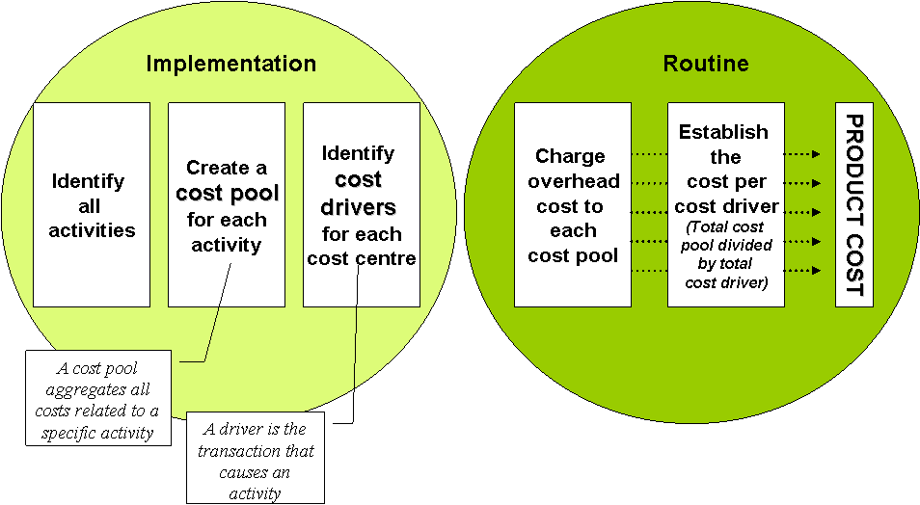

Implementing ABC

Slide 55
ABC steps
Apportion all overheads to cost pools.
Calculate cost driver rates for each cost pool.
Establish the overhead cost per unit.

Slide 56
Example 3.7: ABC cost pools and cost drivers
The management team of Matthew Stores Ltd is investigating the feasibility of implementing ABC. The customer services area has been selected to pilot the approach. The overhead costs have already been apportioned to the cost pools identified. The following cost pools, costs and drivers have been established.

Slide 57
Example 3.7: ABC cost pools and cost drivers
Activity cost pool | Cost | Driver
Phone enquiries | N2,800 | No of calls received = 3,240
Examining returned stock | N4,400 | No of items examined =4,450
Returning stock to shelves | N3,900 | No of items returned to shelves = 4,000
Processing refunds | N2,400 | No of refunds generated = 2,300
Handling exchanges | N1,000 | No of exchanges = 2,150
Investigating other complaints | N6,800 | No of other complaints = 1,200
Total overhead | N21,300
You are required to calculate cost driver rates for each cost pool using the drivers identified.

Slide 58
Example 3.8: ABC to establish unit cost
Ultimate Experience Ltd operates a chain of five star health farms offering a complete range of alternative health and relaxation experiences. The management accountant has used the massage room as a pilot for the development of a new ABC system. Each activity carried out in the area has been identified and a cost pool has been created for each. Suitable cost drivers have been identified. Overhead has been apportioned and the following rates established.

Slide 59
Example 3.8: ABC to establish unit cost
Processing bookings | 35% per booking
Taking client details and consent | 75% form
Preparing room | N1.20 per session
Applying detox materials | N2.30 per session
Massage | 30% per minute
Remove detox material | N1.80 per session
Demonstrate how the system can be used to calculate the total overhead costs associated with offering a client three massage sessions. The actual massage time chosen by the client is 30 minutes for each session. The client details and consent are taken once during the stay and kept on file. Assume three separate bookings are made.

Slide 60
Example 3.8: ABC to establish unit cost
The client requires three sessions, so each activity is multiplied by three, except for taking client details. The cost of the massage is driven by the minutes of massage time.
Massage cost
Processing bookings | 3 x N0.35 | N1.05
Taking client details and consent | 1 x N0.75 | N0.75
Prepare room | 3 x N1.20 | N3.60
Apply detox material | 3 x N2.30 | N6.90
Massage | 3 x 30 minutes x N0.30 | N27.00
Remove detox material | 3 x N1.80 | N5.40
Total |  | N44.70

Slide 61
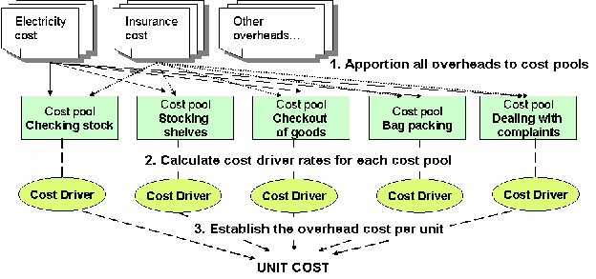
The ABC process

Slide 62
Example 3.9: The ABC approach
Quality Pictures Ltd operates a successful retail outlet providing framed, high quality reproductions of original paintings by leading artists. The customers chooses from a range of pictures and has a choice of three frame sizes. An activity based costing system is in operation.
The apportionment of overhead costs to each cost pool has already been carried out producing the following costs:
Activity cost pools N
Order processing 22,500
Material movement 34,200
Set-up time 33,000
Printing 28,512
Framing 60,000
Quality checks 10,325
88,537
The following cost driver details have been accumulated for the period under review:
Total
No of pictures ordered 2,500
Direct material cost N57,000
No of set-ups 6,000
Printing time (minutes) 35,640
No of frames 2,500
Quality checking time (minutes) 7,375

Slide 63
Example 3.9: The ABC approach
The following details have been established for each frame size:
 | Size 1 | Size 2 | Size 3
Sales price | N80,000 | N130,000 | N180,000
Number of orders per picture | 1 | 1 | 1
Direct material cost per picture | N15 | N24 | N30
Number of set-ups per picture | 1 | 3 | 3
Printing time (minutes) | 10 | 15 | 18
Number of frames | 1 | 1 | 1
Minutes spent checking quality | 2 | 3 | 4

Slide 64
Example 3.9: The ABC approach
Step 1: Apportion overhead cost to cost pools.
This has been completed and given in the example, so it is necessary to start at the second step.
Step 2: Calculate the cost driver rates for each cost pool.
The total cost of each cost pool is divided by the total for each driver.
Order processing | N22,500 / 2,500 = N9 per order
Material movement | N34,200 / N57,000 = N0.60 per N
Set-up time | N33,000 / 6,000 = N5.50 per set-up
Printing | N28,512 / 35,640 = N0.80 per minute
Framing | N60,000 / 2,500 = N24 per frame
Quality testing | N10,325 / 7,375 = N1.40 per minute

Slide 65
Example 3.9: The ABC approach
Step 3: Establish the overhead cost per unit.
This is achieved by multiplying the unit data for each frame by the cost driver rates established in step 2 above.
Overhead cost details
 |  | N | N | N
Order processing | (N9 per order) | 9.00 | 9.00 | 9.00
Material movement | (N0.60 per N material cost) | 9.00 | 14.40 | 18.00
Set-up time | (N5.50 per set-up) | 5.50 | 16.50 | 16.50
Printing | (N0.80 per minute) | 8.00 | 12.00 | 14.40
Framing | (N24 per frame) | 24.00 | 24.00 | 24.00
Quality testing | N1.40 per minute) | 2.80 | 4.20 | 5.60
Total overhead cost |  | 58.30 | 80.10 | 87.50

Slide 66
Example 3.9: The ABC approach
 | Size 1 | Size 2 | Size 3
 | N | N | N
Sales price | 80.00 | 130.00 | 180.00
Direct material cost | 15.00 | 24.00 | 30.00
Overhead cost | 58.30 | 80.10 | 87.50
Profit | 6.70 | 25.90 | 62.50
Profit margin | 8.4% | 19.9% | 34.7%

Slide 67
More than a product costing system
  ABC provides a revolutionary approach to cost control by analysing costs based on activities rather than traditional departmental boundaries.
  Management attention focuses now on the activities required and their cost.
  Unnecessary activities can be eliminated and costly activities examined with a view to significantly reducing costs.
  While ABC was initially popular in manufacturing due to its provision of superior product costs and stock valuations, the cost control aspect has resulted in many service organisations also implementing ABC systems.

Slide 68
Advantages of ABC
  Product costs produced by an ABC system should be more accurate than those produced by an absorption costing system.
  ABC is approved as a method of valuing stock in accordance with accounting standards.
  ABC systems produce useful information for decision-making.
  As ABC systems focus on identifying activities in an organisation, unnecessary activities or activities that do not add value can be identified, adjusted, or eliminated.
  The ABC approach provides a new emphasis on cost control by focusing attention on the cost of each activity.
  The ABC approach is useful in cost reduction programmes.

Slide 69
Criticisms of ABC
  ABC systems are generally complex, difficult and expensive to implement.
  ABC systems can be time consuming and expensive to administer.
  An ABC system should not be introduced unless it can provide additional information which management can use.
  Where an organisation deals in similar products or provides a similar service level to all clients, ABC will provide little benefit as a costing system, because it produces similar costs to other simpler approaches.
  Some argue the merits of implementing ABC, questioning if it actually contributes to company profit or merely moves overhead costs from one product to another. They argue that total overhead is unlikely to change in the short-term.
  It does not solve the problem of allocating all overhead. Overhead costs like electricity, insurance and rent still need to be apportioned. The process of sharing overhead costs to cost pools can be subjective.
  Complex situations may have multiple cost drivers. When establishing what drives the cost of an activity there may be more than one cost driver. If the approach is not applied properly it can result in a costly exercise with no significant benefits achieved.
  Developing appropriate cost pools and cost drivers can be difficult. If the design is flawed or the gathering of necessary data inaccurate, the outputs (product costs) will be misleading.

Slide 70
ABC
While ABC provides a more accurate and reflective product cost, it should be remembered that it does not provide the ‘true’ cost of a product or service. This is because overheads are shared costs that require apportionment. Apportioning this overhead is always a subjective process no matter how sophisticated the system. ABC provides a more accurate reflection of total cost compared to absorption costing. However, like absorption costing, the cost provided includes a significant proportion of fixed cost which will remain, despite a decision to discontinue a specific product or service. Management should fully consider this when making such decisions.

