Slide 1

CSC 404: HUMAN COMPUTER INTERACTION (HCI)
Dr. Kasali, F. A
fkasali@mtu.edu.ng, kasalifunmilayo@gmail.com
+234 706 256 2000
CSC 404 – Human Computer Interaction by Kasali, F.A. is licensed under a Creative Commons Attribution-NonCommercial 4.0 International License.

Slide 2
Outline
Introduction
What is HCI?
  The HCI Challenge
  HCI is Not about
  HCI is about
The goals of HCI
What is Usability?
Why is usability important?
  Why HCI is Important in the Context of WWW?
  It is not Simple to Make Good User Interfaces
Examples of good and bad design

Slide 3
Grading
Attendance: 5%
Midterm: (Assign + mid-test) 25%
Final Exam: 70%

Slide 4
Textbook
Alan D., Janet, F., Gregory, D. A., & Russell, B. (2004). Human–computer Interaction (3rd Edition)

Slide 5
Introduction
Interacting with technology has become an essential part of everyday life for the majority of people.
The average user of a computer system is now less likely to understand the technology. Since, there are different types of technology they have to use.
People are busy and may spend little or no time actually learning a new system.

Slide 6
Introduction..(cont.)
Therefore, computer systems should be easy to use, easy to learn, and with no errors.
To design and develop of such a system is a major concern of HCI

Slide 7
Introduction..(cont.)
Since human-computer interaction studies a human and a machine in conjunction, it draws supporting knowledge from both the human and the machine side.
On the human side, communication theory, graphic and industrial design disciplines, linguistics, social sciences, cognitive psychology, and human performance are relevant.
On the machine side, techniques in computer graphics, operating systems, programming languages, Engineering, Design methods and development environments are relevant.
The multidisciplinary nature of HCI enables people with different backgrounds contribute to its success.
HCI is also sometimes referred to as man—machine interaction (MMI) or computer—human interaction (CHI).

Slide 8
What is HCI?
Human-computer interaction (HCI): “is a discipline concerned with the design, evaluation and implementation of interactive systems for human use and with study of major phenomena surrounding them.”
(ACM SIGCHI, 1992, p. 6)

Slide 9
What is HCI?
HCI (human-computer interaction) is the study of interaction between people (users) and computers.
Interaction between users and computers occurs at the user interface
The golden principle in HCI is that “people should come first”.

Slide 10
What ..(cont.)
HCI consists of three parts:
Human: could be an individual user or a group of users.
Computer: could be any technology ranging from the general desktop computer to a large scale computer system.
Interaction: any direct or indirect communication between a human and computer.

Slide 11
What ..(cont.)
HCI concentrates on the study of human factors
The study of human factors started during the Second World War by US army.
Usability was born because of badly designed arms that caused “friendly fire” during war.

Slide 12
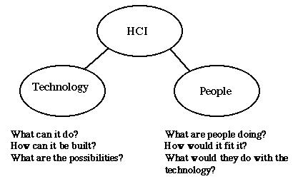
The HCI Challenge

Slide 13
HCI is Not about
Making the interface look pretty
Only about desktop computers (and that goes for computing as well!)
Something that would be nice to do but usually there’s no time for it

Slide 14
HCI is about
Understanding the users
Understanding users tasks
Understanding the surrounding environment
GUI requirements gathering and analysis
Design prototype
Evaluation of the system

Slide 15
The goals of HCI
The goal of HCI “is to develop or improve the safety, utility, effectiveness, efficiency and usability of system that include computers.”
(Interacting with computers, 1989, p3)

Slide 16
The goals of HCI
The goals of HCI are to produce usable and safe systems, as well as functional systems. In order to fulfill that, developers must attempt to:
  Understand how people use technology
  Building suitable systems
  Achieve efficient, effective, and safe interaction
  Put people first
  People needs, capabilities and preferences should come first. People should not have to change the way that they use a system. Instead, the system should be designed to match their requirements

Slide 17
Generally
The basic goal of HCI study is to improve the interactions between users and computers by making computers more usable and receptive to the user's needs in the following ways:
Methodologies and processes for designing interfaces in their related styles (i.e. given a task and a class of users, designing the best possible interface within given constraints, optimizing for a desired property such as learnability or efficiency of use)
Methods or techniques for implementing interfaces (e.g. software toolkits and libraries; efficient algorithms to use)

Slide 18
Generally
Techniques for evaluating and comparing interfaces
Developing new interfaces and interaction techniques
Developing descriptive and predictive models and theories of interaction
Designing systems that minimize the barrier between the human's cognitive model of what they want to accomplish and the computer's understanding of the user's task.

Slide 19
What is Usability?
A usable system is:
  easy to use
  easy to learn
  easy to remember how to use
  effective to use
  efficient to use
  safe to use
  enjoyable to use

Slide 20
Why is usability important?
A Good user-interface can:
1. Earn a company billions.
2. Increase users loyalty.
3. Increase users trust.
4. Makes users happy : )

Slide 21
Why ..(cont.)
A Bad user-interface can:
1. be annoying, embarrassing, frustrating, and even deadly.
2. Increase mistakes in data entry and system operation.
3. Makes functions become completely inaccessible.
4. System failure because of user rejection.

Slide 22
Why HCI is Important in the Context of WWW?
• Competition is very close (just another link…)
• Comparison is easily possible (example – Online-Shop)
• Users who can’t find the product in the shop can not buy it
• Users who are not able to fill in correctly the order form are not going to buy

Slide 23
It is not to Make Good User Interfaces
Basic misconceptions:
• If I (the developer) can use it, everyone can use it
• If our non-technical staff can use it, everyone can
• Good user interfaces are applied common sense
• A system is usable if all style guidelines are met

Slide 24
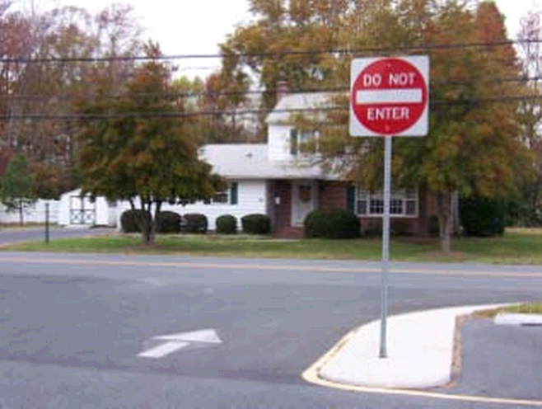
Examples of good and bad design

Slide 25
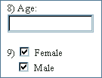
Examples ..(cont.)

Slide 26
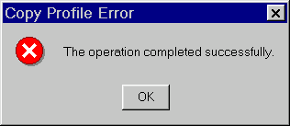
Examples ..(cont.)

Slide 27
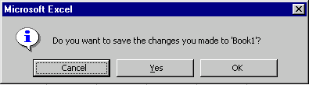
Examples ..(cont.)

Slide 28
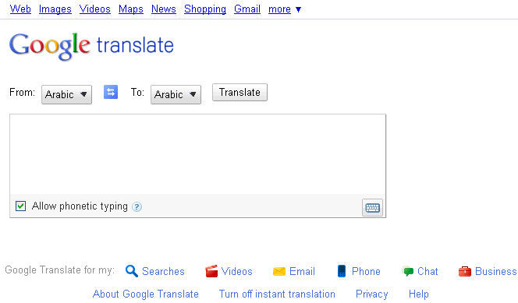
Examples ..(cont.)

Slide 29
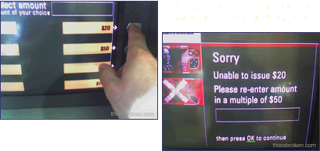
Examples ..(cont.)

Slide 30
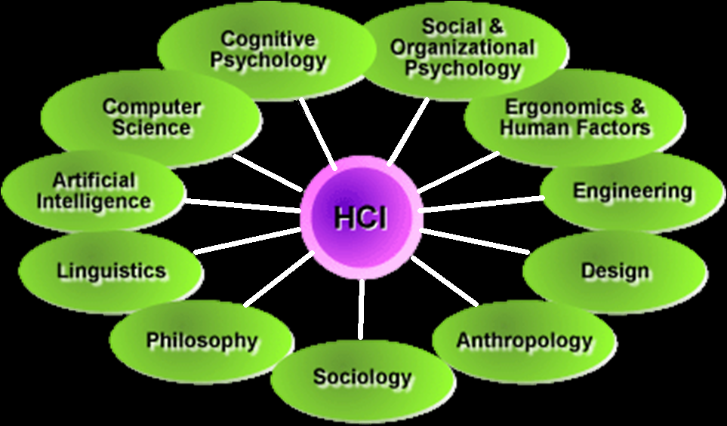
Disciplines Contributing to Human-Computer Interaction

Slide 31

Is HCI really Important?

Slide 32
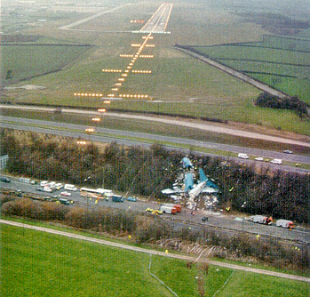
A real life example
Example about: Health and safety concerns
If the video doesn’t record a TV
program because we pressed
the wrong button, we are likely
to feel angry.
A real example: Ethiopian Airlines 737 MAX 8 Flight 302 taking off from Addis Ababa crashed minutes after take-off on Sunday March 10, 2019, killing all 157 people on board

Slide 33
A real ..(cont.)
Example about: direct correlation between HCI and sales
NYNEX: a telecommunicationon company in Italy
  Purpose: to increase the performance of helpdesk office
  Decided to improve the usability of the helpdesk operator interface
  Reduced the process time 1 second per call
Result: $ 3,000,000 benefit / year

Slide 34
The importance of HCI
Can Preventing accidents
Health and safety concerns
Can reduce the cost of customer training and support
Direct correlation between HCI and sales
HCI can provide you a job.

Slide 35
Time to Think!
What is the percentage of software development projects that fails?
A. 20%
B. 35%
C. 55%
D. 85%

Slide 36
Fact
- Fletcher Buckley “: 85% of Software projects are either late or delivered without satisfying the specification.”
But WHY?

Slide 37
Reasons for Failures
Projects in general fail for various reasons:
lack of senior management commitment
lack of user involvement
lack of user requirements specifications
poor project planning and team problems

Slide 38
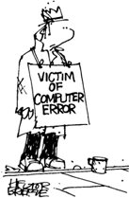
Traditional approaches to system development
Is concerned with producing software, software specification, maintainability, and testing
Generally considers the interface to be just another software component.

Slide 39
Example of traditional approach
Requirements
specification
Analysis
Design
Implementation
The waterfall model
Testing
Operation and
maintenance

Slide 40
Introduction to User Centered approach
This approach normally involves a number of key activities throughout the development of the software including:
Involving users
Obtaining their feedback on the design
Providing prototypes for system evaluation and re-design in light of user feedback and comments.

Slide 41
User Centered approach
Real users involved at each step of the process
Find out about the users before requirement specification
Design and implementation
Review (usability test) with the users

Slide 42

The life cycle for interactive systems
cannot assume a linear
sequence of activities
as in the waterfall model
lots of feedback!
user needs
Requirements
specification
Analysis
Design
Implementation
Testing
Operation and
maintenance
Notes:
lots of feedback are expected

Slide 43
User Centered Development
Data Collection
Data Analysis
Prototyping
Design
Evaluation

Slide 44
1. Data Collection
Data recording
  Using media
Interviews
  Stakeholder interviews
  Subject Matter Expert interviews
  User and customer interviews
Questionnaires
  Surveys, product reviews
Literature review
  Studying existing systems

Slide 45
2. Data Analysis
Requirement analysis
  Formal specifications of the system
User analysis
  Identifying and understanding the user
Task analysis
  Steps user take to accomplish this task
Functional analysis
  Functions that system perform to help the users carry out their task

Slide 46
3. Prototyping
Advantages of Prototyping:
Users are actively involved in the development
It provides a better system to users
The users get a better understanding of the system being developed.
Errors can be detected much earlier
Quicker user feedback is available leading to better solutions

Slide 47
4. Design
Goals
  Achieving goals
Users and systems
  Understanding the raw materials: computer and human
Limitations
  Accepting limitations of humans and of design

Slide 48
5. Evaluation
Testing the usability, functionality and acceptability of an interactive system
Expert evaluation
  Evaluation by Subject Matter Experts
User evaluation
  Evaluation by user or customer

Slide 49

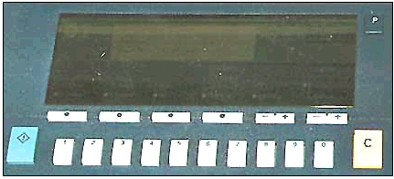
Designer vs. Users
Making a photocopy
Why this photocopier does not work? What do you think!

Slide 50

Designer vs. Users
Designer meant by ‘C’ = Clear People thought that ‘C’ = Copy

Slide 51

Examples ..(cont.)

Slide 52
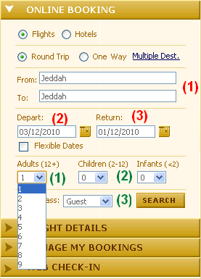
Examples ..(cont.)

Slide 53
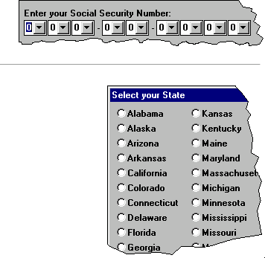
Examples ..(cont.)

Slide 54
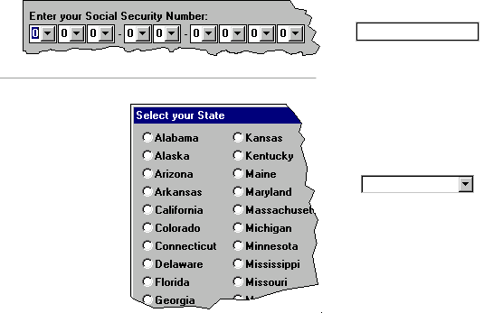
Examples ..(cont.)

Slide 55
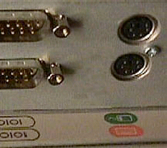
Examples ..(cont.)

Slide 56
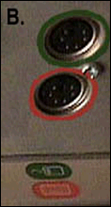
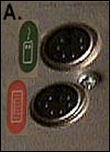
Examples ..(cont.)

Slide 57
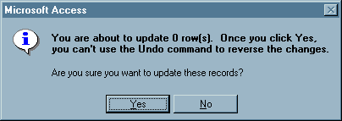
Examples ..(cont.)

Slide 58

Examples ..(cont.)

Slide 59
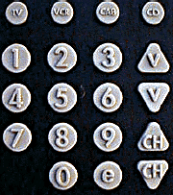
Examples ..(cont.)

Slide 60
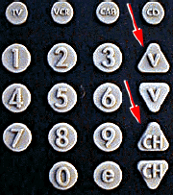
Examples ..(cont.)

Slide 61
Thank you

