Slide 1
EFFECT OF EXTRUSION ON PROTEIN QUALITY, ANTI-NUTRITIONAL FACTORS AND DIGESTIBILITY OF COMPLEMENTARY DIET FROM QUALITY PROTEIN MAIZE AND SOYBEAN PROTEIN CONCENTRATE
BY
OMOSEBI M.O., OSUNDAHUNSI O.F. and FAGBEMI T.N.
International Conference (Humboldt-Kolleg)
Federal University of Technology AKURE
APRIL 2017
EFFECT OF EXTRUSION ON PROTEIN QUALITY, ANTI-NUTRITIONAL FACTORS AND DIGESTIBILITY OF COMPLEMENTARY DIET FROM QUALITY PROTEIN MAIZE AND SOYBEAN PROTEIN CONCENTRATEby OMOSEBI M.O., OSUNDAHUNSI O.F. and FAGBEMI T.N. is licensed under a Creative Commons Attribution-NonCommercial 4.0 International License

Slide 2
INTRODUCTION
Many children in developing countries survive on a nutritionally inadequate diet (Nestel et al., 2003).
Children become stunted not only as a result of insufficient calorie intakes, but also because of poor quality diets (Victora et al., 2012)
Complementary foods being introduced should augment micro and macro nutrient intake (Yeung, 1998).

Slide 3
In developing countries like Nigeria, complementary foods are mainly based on starch tubers like cocoyam, sweet potato or on cereals like maize, millet and sorghum.
Children are normally given these staples in the form of gruels that is either mixed with boiled water or boiled with water (Igyor et al., 2011).
Zarkadas et al. (2000) observed that QPM genotypes contained high levels of lysine and trytophan compared to normal maize.
Soybean Protein Concentrate (SPC) is 65-67% crude protein. The extraction process removes the anti-nutritional factors (ANF’s) in regular soybean meal (USSEC, 2008).

Slide 4
Food with balanced amino acid profile can be obtained by mixing legumes and cereal grains.
The retention of these essential nutrients would be enhanced through the application of extrusion cooking processes (Iwe, 2003).
The anti nutritional factors present in legumes are reduced to the barest minimum in the protein concentrates (Endres, 2001).

Slide 5
OBJECTIVES
Assess the nutritional quality of the diet using the in-vitro digestibility
Assess the effect of extrusion cooking on the nutritional quality of the formulated meal

Slide 6


Slide 7
MATERIALS
Consumer friendly varieties of Cassava roots (TMS 4(2) 1425) was purchased from International Institute for Tropical Agriculture (IITA), Ibadan
The product was extruded in the Crop Utilization unit, IITA Ibadan
Soybeans (TGx1987-10F) was purchased from International Institute for Tropical Agriculture (IITA)
Quality protein maize (ART/98/SUWN/SR) was purchased from Institute of Agricultural Research and Technology (IAR&T), Ibadan

Slide 8
The cassava starch was processed using the method described by Osundahunsi et al., (2011) as shown in Fig. 1
The protein concentrate was processed using the method described by (Adebowale et al., 2003) as shown in Fig. 2.
The quality protein maize was cleaned and milled to give a fine meal.
The maize meal, cassava starch and soybean protein concentrates were mixed in proportions to reach the target protein content of at least 18% using regression analysis (Altan et al., 2009).
The moisture content of the mixture was adjusted, extruded, cooled, milled and packaged for analysis.

Slide 9
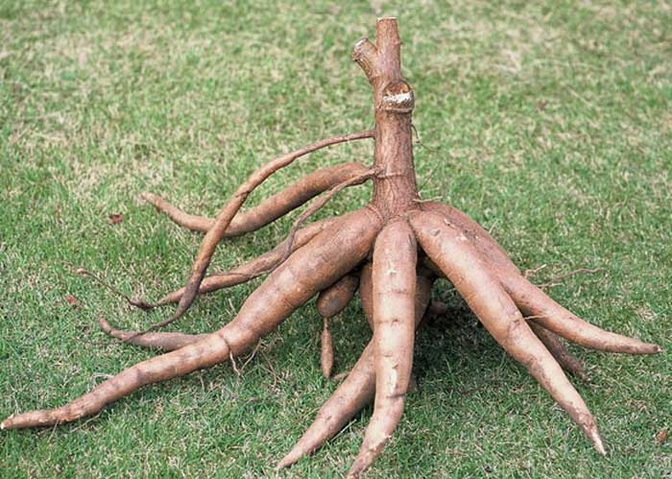
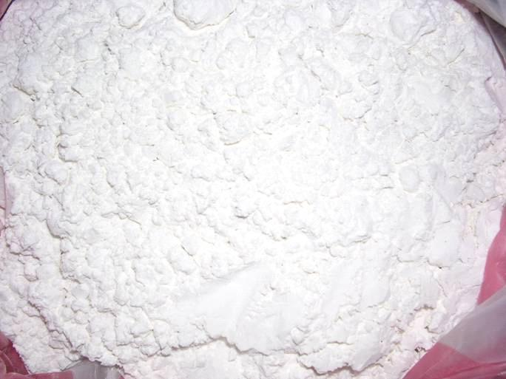
Cassava roots
Peeling
Washing
Grating
Mixing with water
Filteration
Settling
Starch Washing
Settling and dewatering
Drying (35±2ºC)
Milling
Native Cassava starch
Fig 1. Production of Cassava Starch (Osundahunsi et al., 2011)

Slide 10
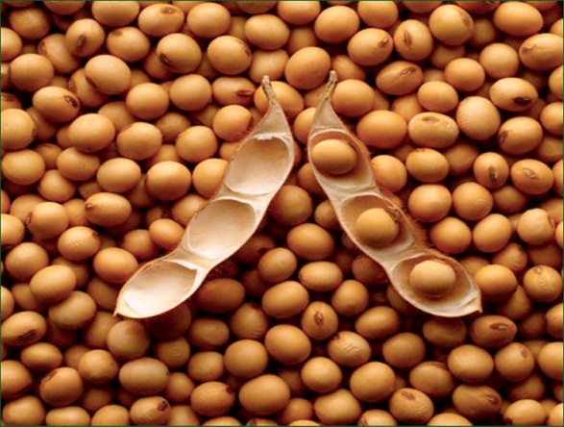
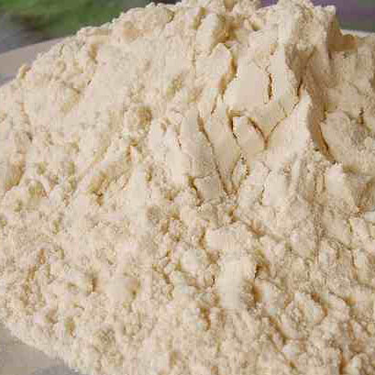
Full-Fat Soy Flour
Defatting
Defatted Soy Flour
Alkaline solubilization
(flour:water (1:10) at pH 8.0-8.5. stir for 4-5 hours)
Centrifugation Sediment
(at 5000rpm for 10 mins)
Acid precipitation
(adjust supernatant to pH 4.0 with 0.1M HCl)
Centrifugation Supernatant
(at 5000rpm for 7 mins)
Freeze Drying
Soy Protein Concentrate
Fig 2--- Production of Soybean Protein Concentrate (Adebowale et al., 2003

Slide 11
COMPOSITION OF THE MEAL
Quality Protein Maize (72%)
Cassava Starch (9.06%)
Soy Protein Concentrate (18.94%)

Slide 12
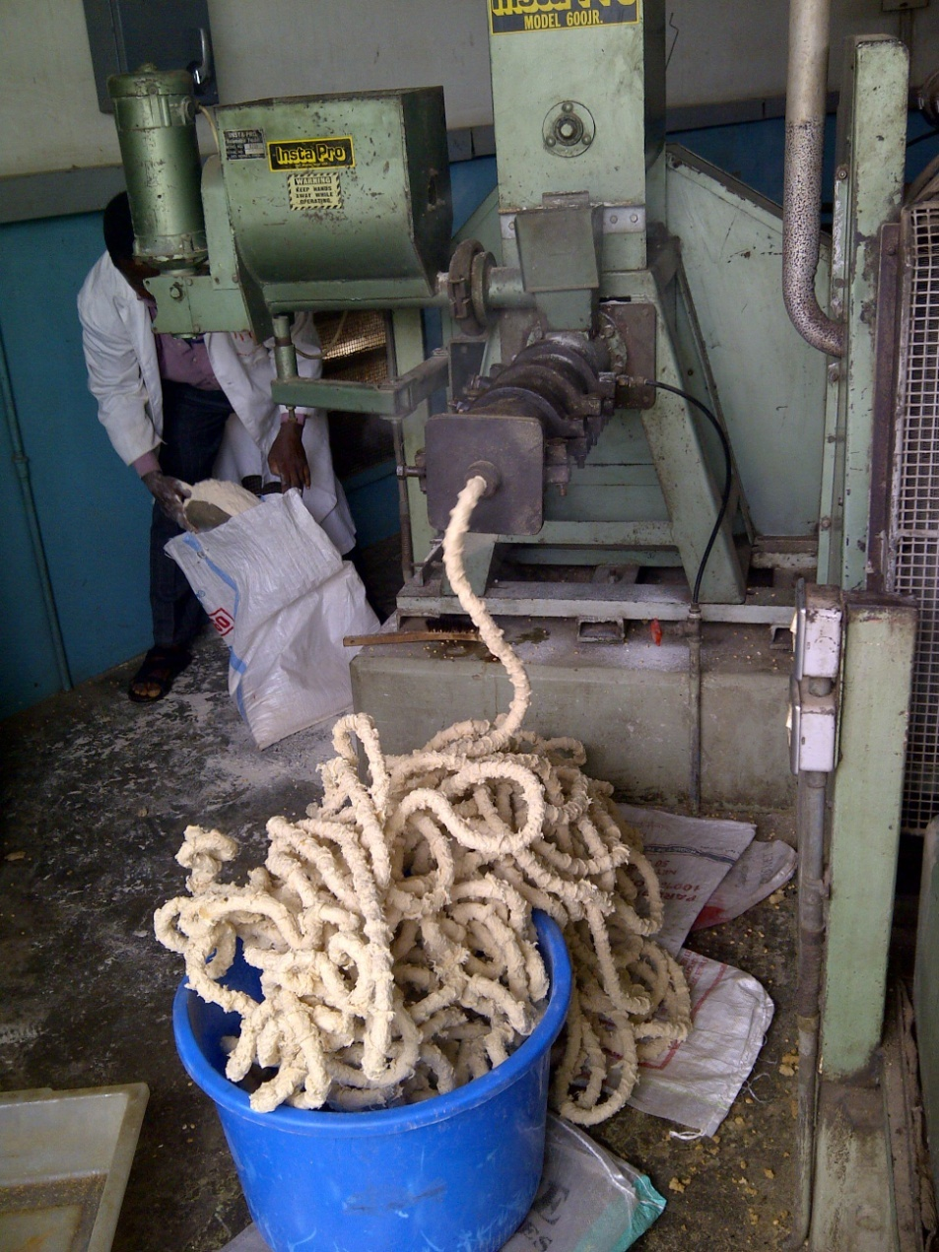
EXTRUDER

Slide 13
Table 1: Extrusion conditions
Product | Extrusion Temperature (ºC) | Feed moisture content (%) | Screw Speed (rpm)
A | 180 | 20 | 230
B | 170 | 20 | 200
C | 180 | 18 | 200
D | - | - | -
D: Unextruded meal

Slide 14
Amino acid content/ profile was determined using the method of Bidlingmeyer et al., (1984)
The Anti-nutritional factors (trypsin inhibitor, phytic acid, tannins, and cyanide) were determined (Kakade et al., (1974); Wheeler and Ferrel (1971); Joslyn, (1970); Padmaja, (1989); Poonam et al., (1984); Bokanga, (2001).

Slide 15
In-vitro Digestibility
In-vitro protein digestibility (IVPD) was evaluated using the multienzyme method(3.1mg chymotrypsin, 1.6mg trypsin, 1.3mg peptidase /ml) method described by Gupta and Singh (2005).
In-vitro starch digestibility was carried out using the method described by Singh et al., (1982). The IVSD was calculated from the constructed maltose standard curve.

Slide 16
Table 2. Amino acid composition (g/100g protein), essential amino acid (EAA) score, total EAA (TEAA)
Amino Acid | A |  | B |  | C |  | D |  | Requirement (infant under 2 yrs)
 | g/100g protein | EAA Score | g/100g protein | EAA Score | g/100g protein | EAA Score | g/100g protein | EAA Score
Lysine | 5.427 | 104.4 | 5.360 | 103.1 | 5.301 | 101.9 | 5.275 | 101.4 | 5.2
Histidine | 3.088 | 118.8 | 3.205 | 123.3 | 3.267 | 125.7 | 3.160 | 121.5 | 2.6
Threonine | 3.441 | 78.2 | 3.509 | 79.8 | 3.514 | 79.9 | 3.406 | 77.4 | 4.4
Cysteine | 1.888 | 120.0 | 1.744 | 107.5 | 1.440 | 110.9 | 1.640 | 105.1 | 2.9
Methionine | 1.591 |  | 1.374 |  | 1.775 |  | 1.407
Valine | 4.599 | 115.0 | 4.315 | 108.6 | 4.450 | 111.25 | 4.334 | 108.35 | 4.0
Isoleucine | 3.992 | 114.1 | 3.661 | 104.6 | 3.685 | 105.3 | 3.837 | 109.6 | 3.5
Leucine | 8.751 | 109.4 | 8.777 | 109.7 | 9.197 | 115.0 | 8.715 | 108.9 | 8.0
Tyrosine | 3.196 | 133.7 | 3.164 | 132.1 | 3.226 | 133.11 | 3.164 | 134.1 | 6.3
Phenylalanine | 5.225 |  | 5.157 |  | 5.160 |  | 5.283
Tryptophan | 0.960 | 87.3 | 0.974 | 88.5 | 0.876 | 79.6 | 0.945 | 85.9 | 0.74
Total | 42.16 |  | 41.24 |  | 41.89 |  | 41.17 |  | 37.64

Slide 17
Table 3. Limiting amino acid (LAA) of extruded and uncooked samples and Non Essential amino acids (g/100g)
Amino acid | A | B | C | D
Limiting amino acids | Threonine & Tryptophan | Threonine & Tryptophan | Threonine & Tryptophan | Threonine & Tryptophan
Non Essential amino acids
Arginine | 7.061 | 7.008 | 6.958 | 7.109
Aspartic acid | 10.695 | 10.821 | 10.160 | 10.890
Serine | 5.470 | 5.705 | 5.624 | 5.646
Glutamic acid | 19.967 | 20.587 | 20.103 | 20.827
Proline | 7.753 | 8.052 | 8.415 | 7.990
Glycine | 3.869 | 3.920 | 3.867 | 3.889
Alanine | 4.674 | 4.837 | 5.142 | 4.597
A: (T₁₈₀º_{C}, MC_{20%}, SS_{230rpm}); B: (T₁₇₀º_{C}, MC_{20%}, SS_{200rpm}); C: (T₁₈₀º_{C}, MC_{18%}, SS_{200rpm}); D: (uncooked meal)

Slide 18
Table 4. Nutritional quality of the extruded and unextruded meals of QPM, soybean concentrate and cassava starch.
 | A | B | C | D
TEAA/TAA% | 41.5 | 40.4 | 41.0 | 40.3
TNEAA/TAA% | 58.5 | 59.6 | 59.0 | 59.7
TSAA(Meth+Cys) | 3.479 | 3.118 | 3.215 | 3.047
ArEAA(Phe + Tyr) | 8.421 | 8.321 | 8.386 | 8.447
TEAA/TNEAA | 0.71 | 0.68 | 0.69 | 0.68
EAAI (%) | 98.07 | 95.94 | 96.06 | 95.66
BV (%) | 95.20 | 92.87 | 93.01 | 92.57
A: (T₁₈₀º_{C}, MC_{20%}, SS_{230rpm}); B: (T₁₇₀º_{C}, MC_{20%}, SS_{200rpm}); C: (T₁₈₀º_{C}, MC_{18%}, SS_{200rpm}); D: (unextruded meal)
Total essential amino acids (TEAA). Total amino acids (TAA), Total non-essential amino acids (TNEAA), Total sulphur amino acids (TSAA), Aromatic essential amino acids (ArEAA), Protein efficiency ratio (PER), Essential amino acid index (EAAI), Biological value (BV).

Slide 19
Table 5: Anti nutritional Factors
Sample ID | Trypsin inhibitor (mg/g sample) | % Phytic acid | Tannin (mg/g) | Cyanide (mg/100g)
A | 1.76±0.02 | 0.83±0 | 0.04±0.01 | 0.11±0.02
B | 1.80±0.01 | 0.83±0.04 | 0.03±0 | 0.13±0.02
C | 2.08±0.01 | 0.84±0.01 | 0.04±0.01 | 0.11±0.01
D | 8.32±0.02 | 1.01±0.02 | 0.05±0 | 0.20±0.01
A: (T₁₈₀º_{C}, MC_{20%}, SS_{230rpm}); B: (T₁₇₀º_{C}, MC_{20%}, SS_{200rpm}); C: (T₁₈₀º_{C}, MC_{18%}, SS_{200rpm}); D: (uncooked meal)

Slide 20
Table 6: In vitro Starch Digestibility
Sample ID | IVSD (mg maltose/g sample) | IVSD (%)
A | 602.52 | 60.25ª±0.03
B | 598.54 | 59.85ª±0.01
C | 601.93 | 60.19ª±0.01
D | 402.40 | 40.24^{b}±0.02
Fig 6: Maltose standard curve
A: (T₁₈₀º_{C}, MC_{20%}, SS_{230rpm}); B: (T₁₇₀º_{C}, MC_{20%}, SS_{200rpm}); C: (T₁₈₀º_{C}, MC_{18%}, SS_{200rpm}); D: (uncooked meal)

Slide 21
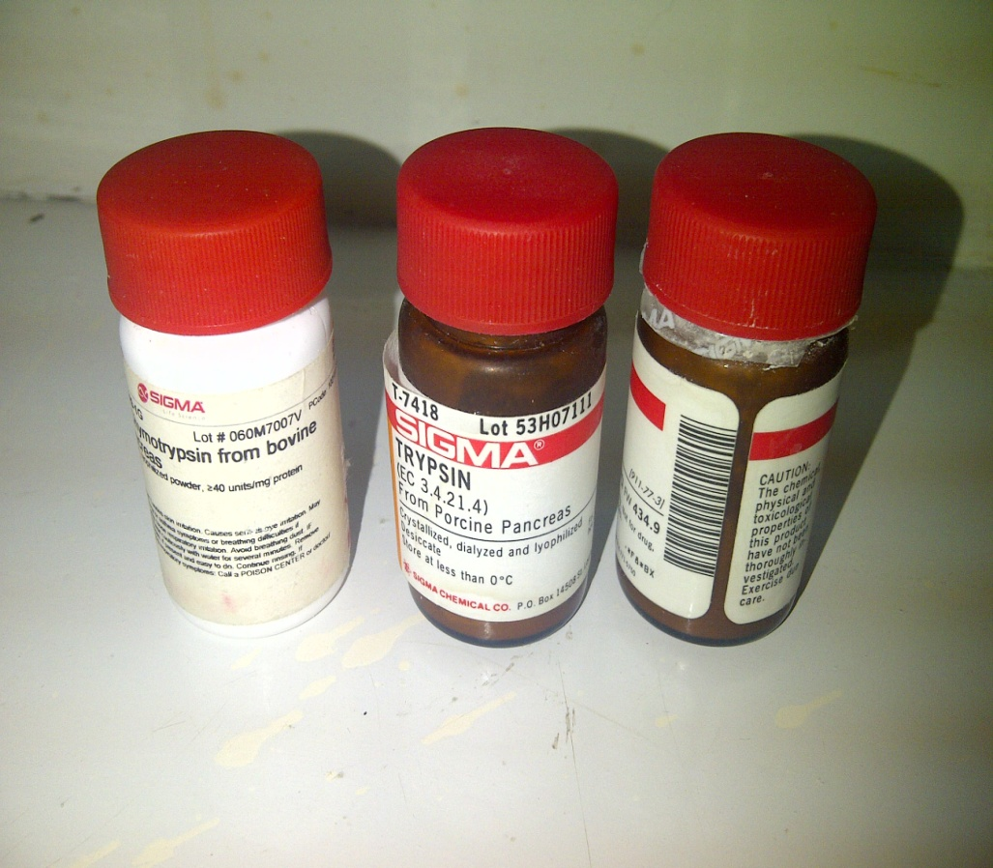
Table 7: In vitro Protein Digestibility
Sample ID | IVPD (%)
A | 92.98ª±0.05
B | 90.44^{b}±0.02
C | 89.90^{b}±0.01
D | 84.80^{c}±0.02
A: (T₁₈₀º_{C}, MC_{20%}, SS_{230rpm}); B: (T₁₇₀º_{C}, MC_{20%}, SS_{200rpm}); C: (T₁₈₀º_{C}, MC_{18%}, SS_{200rpm}); D: (uncooked meal)

Slide 22
CONCLUSION
Extrusion cooking improved the protein and starch digestibilities of the samples.
Extrusion significantly reduced the anti-nutritional factors.
Extrusion cooking had no significant effect on the amino acid content of the products.

Slide 23
THANK YOU
EFFECT OF EXTRUSION ON PROTEIN QUALITY, ANTI-NUTRITIONAL FACTORS AND DIGESTIBILITY OF COMPLEMENTARY DIET FROM QUALITY PROTEIN MAIZE AND SOYBEAN PROTEIN CONCENTRATEby OMOSEBI M.O., OSUNDAHUNSI O.F. and FAGBEMI T.N. is licensed under a Creative Commons Attribution-NonCommercial 4.0 International License

