Slide 1
Presented
By
FAYEMI, OLANREWAJU EMMANUEL (Ph.D)
(Technical Oral presentation)
at
Annual conference of International Association for Food Protection (July 25th-28th, 2015). Portland Oregon, U.S.A

Slide 2
Effect of Probiotic on the Survival of Non-O157 Shiga Toxin-producing
E. Coli (STEC) Strains in Traditional African Fermented Weaning Food Products
- FAYEMI, O. E (Ph.D)

Slide 3






www.googleimages.com

Slide 4
Introduction Objectives Experimental Results Conclusions
Introduction
Significance of cereal based weaning foods in African
Traditional African fermented maize gruel – ogi
Motoho, a traditional non-alcoholic fermented sorghum beverage
Safety challenges associated with the fermentation and preparation of tradition African fermented foods
Prevalence of diarrhoea and infant mortality in Africa
Locally sourced probiotics, potential intervention for Africa

Slide 5


Introduction Objectives Experimental Results Conclusions
Uji
Kenya
Arraw Senegal
Motoho
&
Maheu
Swaziland
Motoho
&
Maheu
South Africa
Motoho
&
Maheu
Mozambique
Motoho
&
Maheu
Lesotho
Motoho
&
Maheu
Botswana
Motoho
&
Maheu
Zimbabwe
Baca
Cote D’Ivoire
Ogi
Nigeria
Koko
Ghana
Mawe
Benin & Togo
Bouillie
Cameroon
Country of production and consumption of:
Fermented maize gruel
Non-alcoholic sorghum beverage
Map of Africa showing countries where fermented maize gruel and non-alcoholic fermented sorghum beverage are mostly consumed as adult meals and weaning foods

Slide 6
Introduction Objectives Experimental Results Conclusions
Objectives
Determination of the probiotic potential of the LAB associated with ogi spontaneous fermentation
Evaluation of the ability of probiotic bacteria to inhibit acid tolerant non-O157 STEC strains from environmental sources in ogi and sorghum motoho.

Slide 7
Probiotic characterisation of the LAB strains from traditional African fermented maize gruel (ogi)

Slide 8
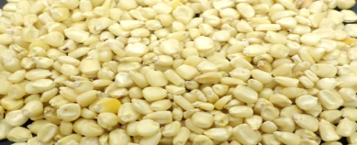
Experimental
Introduction Objectives Experimental Results Conclusions
Maize grains
Isolation and identification of LAB strains in ogi
(MALDI-TOF MS)
24 h interval
Sorting and Cleaning and steeping in potable tap water for 72 h
Determination of probiotic potential of the LAB strains in ogi & L. plantarum (CSIR, SA)
Acid and bile tolerance
Hydrophobicity (MATH)
Coaggregation
Autoaggregation
Antimicrobial activity
Adhesion to erythrocyte-like Caco-2 cells
Wet milling, sieving and souring for 48 h

Slide 9
Introduction Objectives Experimental Results Conclusions
Acid and bile tolerance of the LAB strains
Fifteen LAB strains ( 9 Lactobacillus plantarum and 6 Pediococcus pentosaceus) were examined for acid and bile tolerance
pH 4.5
pH 2.5
(2 h)
0.3 % bile salt at pH 6.5
(5 h)
Six L. plantarum and three P. pentosaceus strains showed acid and bile tolerance of ˃ 6 log₁₀ cfu/mL after 2 h exposure to pH 2.5 and subsequent 5 h exposure to bile salt

Slide 10
Introduction Objectives Experimental Results Conclusions
Strains with hydrophobic cell surface

Slide 11
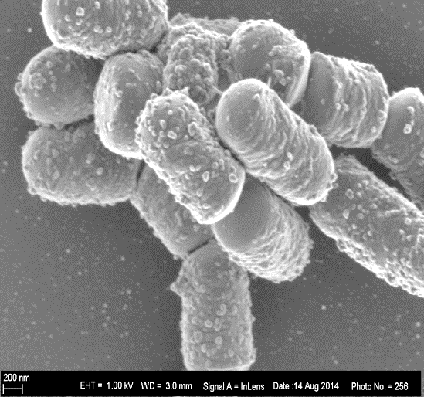
Introduction Objectives Experimental Results Conclusions
Autoaggregation of the LAB strains
LAB strains | Autoaggregation (%)
 | PBS | MRS broth
Lactobacillus plantarum B411 | 62.0^{b} (3.0) * | 93.0^{b} (4.0)
Lactobacillus plantarum FS2 | 54.5^{ab} (4.0) | 85.0^{ab} (4.0)
Pediococcus pentosaceus D39 | 43.0ª (2.0) | 76.5ª (4.0)
* Means and standard deviation (n = 3). Values in the same column followed by different letters
are significantly different at p < 0.05

Slide 12
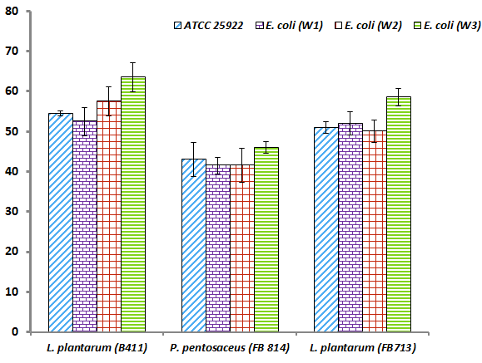
Introduction Objectives Experimental Results Conclusions
Coaggregation (%)
Coaggregation of the LAB strains with pathogenic E. coli strains in phosphate buffered saline (PBS) after incubation for 5 h at 37 ºC.
Same bar graph pattern with different superscript are significantly different at p ˂ 0.05.

Slide 13
Introduction Objective Experimental Results Conclusions
Antimicrobial activity of the LAB strains against pathogenic E. coli indicator strains
E. Coli indication Strain | Inhibition zone (mm)
 | Lactobacillus Plantarum B411 | Lactobacillus plantarum FS2 | Pediococcus pentosaceus D39
E. coli (W1) | 26.0^{b} (2.0) * | 27.5^{c} (2.0) | 21.0^{b} (2.0)
E. coli (W2) | 28.0^{b} (3.0) | 19.0^{b} (2.0) | 21.5^{b} (2.0)
E. coli (W3) | 28.0^{b} (2.0) | 20.0^{b} (3.0) | 25.5^{c} (2.0)
ATCC 25922 | 17.0ª (2.0) | 13.0ª (2.0) | 15.0ª (1.0)
*Means and standard deviation (n = 3). Values in the same column with different superscript are significantly different at p < 0.05

Slide 14
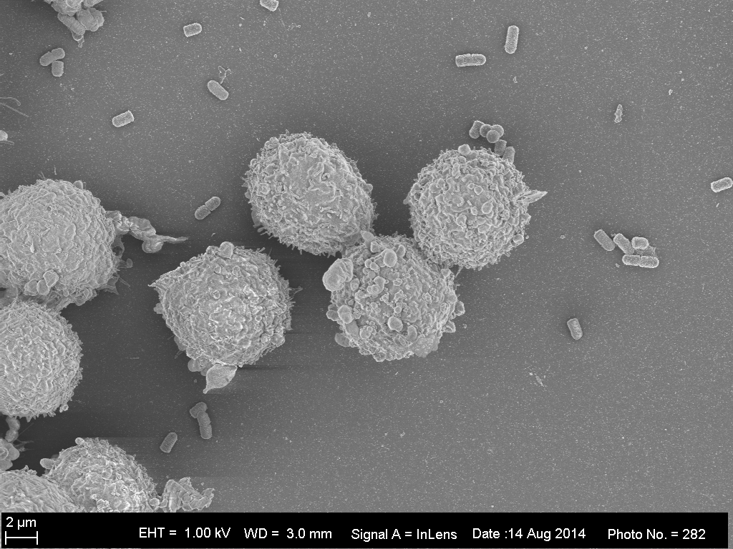
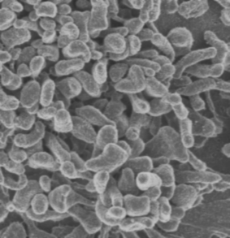
Introduction Objectives Experimental Results Conclusions
Bacterial adhesion to Caco-2 cells
b
c
c
a
2 µm
2 µm
d
e
2 µm
2 µm
2 µm
SEM showing (a) Caco-2 cell, adherence of (b & c) L. plantarum B411 and (d & e) P. pentosaceus D39 to Caco-2 cells.

Slide 15
Introduction Objectives Experimental Results Conclusions
Adhesion of L. plantarum B411, P. pentosaceus D39 and L. plantarum FS2 to Caco-2 cells. Each adhesion assay was expressed as mean ± standard deviation (n = 3). Bar graphs with different superscript are significantly different at p ˂ 0.05

Slide 16
The survival of non-O157 STEC strains in probiotic fermented ogi and sorghum motoho

Slide 17
Experimental
Introduction Objectives Experimental Results Conclusions
Maize grains
Sorghum flour
Isolation and identification of LAB strains in ogi
Sorting and Cleaning and steeping in potable tap water for 72 h
Sorting and Cleaning
Reconstitution in water and cooking for 30 mins
Determination of probiotic potential of the LAB strains in ogi & L. plantarum (CSIR, SA)
Acid and bile tolerance
Hydrophobicity (MATH)
Coaggregation
Autoaggregation
Antimicrobial activity
Adhesion to erythrocyte-like Caco-2 cells
Wet milling, sieving and souring for 48 h
Stepping in portable tap water
Cooling to 30 oC
Selected Probiotic strains
Inoculation with probiotic bacteria and acid adapted and non-acid adapted non-O157 STEC strains
Fermentation for 72 h
Fermentation for
24 h
Enumeration on selective agar
24 h interval
Wet milling, sieving and souring for 48 h

Slide 18
Introduction Objectives Experimental Results Conclusions
Acid adaptation of the non-O157 STEC strains
Eight non-O157 STEC strains from environmental sources were evaluated for acid adaptation and acid tolerance
Three strains which exhibited acid tolerance potential were selected for the survival studies in ogi and sorghum motoho

Slide 19
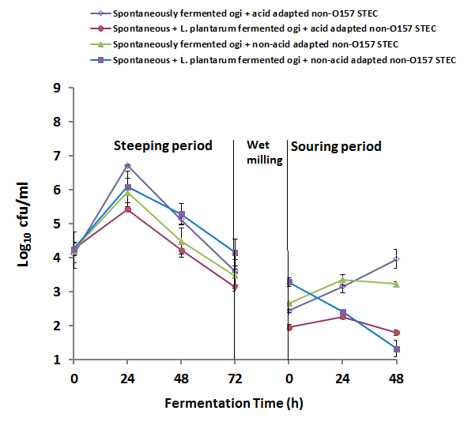
Introduction Objectives Experimental Results Conclusions
0.3 & 1.0 log reductions
2.5 & 3.0 log reductions
Effects of spontaneous fermentation and in combination with probiotic L. plantarum on the survival of acid adapted or non-acid adapted non-O157 STEC during the production of ogi.
Results are means ± standard deviation (n = 3).

Slide 20
Introduction Objectives Experimental Results Conclusions
Effects of fermenting sorghum spontaneously and with probiotic bacteria (Lactobacillus plantarum FS2 and Pediococcus pentosaceus D39) on the survival of acid adapted (AA) and non-acid adapted (NAA) non-O157 Shiga toxin producing E. coli (STEC) in the motoho product
Stage of motoho processing | Inoculated non-O157 STEC | Spontaneously fermented sorghum motoho | Lactobacillus plantarum FS2 fermented sorghum motoho (Log₁₀ cfu/mL) | Pediococcus pentosaceus D39 fermented sorghum motoho (Log₁₀ cfu/mL) | Lactobacillus plantarum FS2 and Pediococcus pentosaceus D39 fermented sorghum motoho (Log₁₀ cfu/mL)
After cooking and inoculation with probiotic bacteria and non-O157 STEC | AA | 4.52^{g} ± 0.02 | 4.42^{g} ± 0.06 | 4.49^{g} ± 0.02 | 4.58^{g} ± 0.02
 | NAA | 4.48^{g} ± 0.04 | 4.40^{g} ± 0.07 | 4.46^{g} ± 0.01 | 4.57^{g} ± 0.05
After 24 h incubation | AA | 2.70^{d} ± 0.01 | 2.16^{b} ± 0.09 | 2.43^{c} ± 0.26 | 1.67ª ± 0.39
 | NAA | 3.78^{f} ± 0.04 | 3.95^{f} ± 0.02 | 3.98^{f} ± 0.02 | 3.22e ± 0.05
2.9 log reductions
Values are the means and standard deviations of three replicate experiments (n =3). Means with different superscript are significantly different at p ≤ 0.05. - not determined

Slide 21
Introduction Objectives Experimental Results Conclusions
Conclusions
Lactic acid bacteria from the ogi fermented gruel possess desirable in vitro probiotic properties and could be considered as potential probiotic strains.
The use of such potential probiotic bacteria could help ensure the safety of traditional African fermented cereal gruel, which is also used as a weaning food by preventing the growth of non-O157 STEC thereby reducing the occurrence of infant diarrhoea caused by non-O157 STEC.

Slide 22

Thank you
Merci
Asanteni
Shukrah
E seun
Dankie
Oh yeh rah don
Ngiyabonga
Kea leboha

