Slide 1


Electrical conductivity and total dissolved solid (TDS) evaluation of groundwater around the Igbenre-Ekotedo dumpsite Ota, South West Nigeria using correlation and regression analysis
Ameloko A.A and Ayolabi E.A
1.Department of Petroleum Engineering, Covenant University Ota, Nigeria
2. Department of Geosciences
University of Lagos, Lagos, Nigeria

Slide 2
Presentation Outline
Introduction
  Background to the study
  Aim and Objectives of the study
  Literature review
  Basic theory
  Geology of the study Area
Materials and method
Results and Discussion
Conclusions
References

Slide 3
1.1 Background to the study
The management of solid waste landfills has been a major problem of our urban centers in Nigeria and other developing economies worldwide.
In these urban centres, wastes are generated daily and disposed indiscriminately in rivers and landfills without recourse to the underground environment, local geology and their proximity to the living quarters (Ehirim et; al, 2009, Adeoti et; al, 2011).

Slide 4

1.1 Background to the study Cont’d
Fig 1.0: Pictorial view of Igbere Eko-tedo dumpsite in Ota

Slide 5
1.2 Aim and objectives of the study
The aim of the this research work is to assess the impact of leachates from the dumpsite on the soil and groundwater system around the study area.
The specific objectives are to:
Carry out Frequency Domain Electromagnetic [FDEM] surveys to determine the vertical and lateral distribution of contaminants around the dumpsite.
Carry out hydrophysical analysis on water samples obtained from boreholes near the sites.
Develop TDS model for TDS prediction around the site

Slide 6
1.3 Literature review
Electrical and electromagnetic geophysical methods are becoming increasingly accepted tools for the initial characterization of contaminant plumes from municipal and hazardous waste landfills (Greenhouse and Harris 1983; Sweeney 1984; Greenhouse and Monier-Williams 1985).
Many other workers have investigated the contamination of groundwater by heavy metal around landfill site [Lee, et al., 1986, Christensen, et al., 1998, Ogundiran, and Afolabi, 2008, Ayolabi and Peters, 2004, Ayolabi and Oyelayo, 2005, Ayolabi et al., 2013]

Slide 7
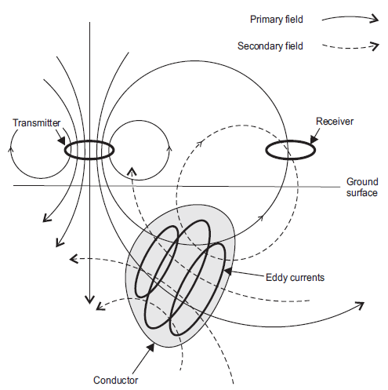
1.4 Basic theory
Figure 1.1: General Principle of Electromagnetic Surveying

Slide 8
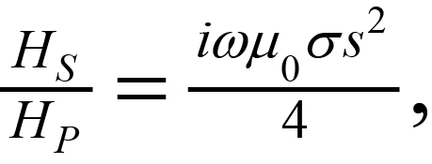
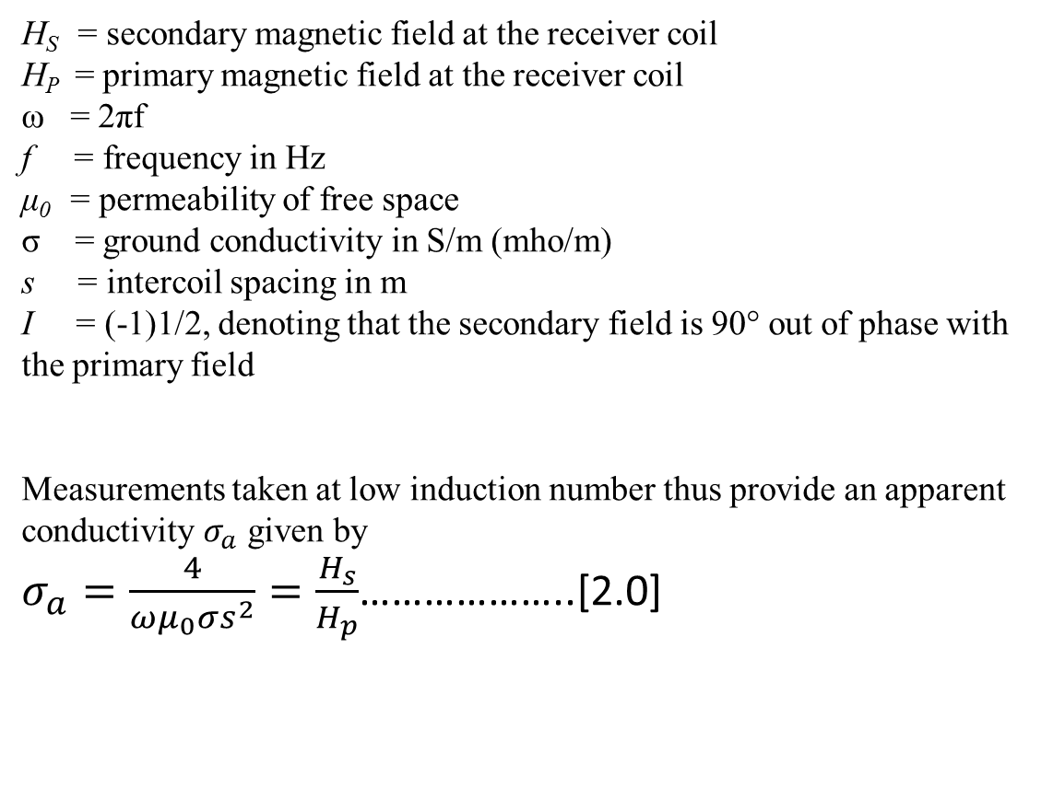
1.4 Basic theory Cont’d
…………………… (1.0)
H_{S} = secondary magnetic field at the receiver coil
H_{P} = primary magnetic field at the receiver coil
ω = 2πf
f = frequency in Hz
μ₀ = permeability of free space
σ = ground conductivity in S/m (mho/m)
s = intercoil spacing in m
I = (-1)1/2, denoting that the secondary field is 90° out of phase with the primary field
Measurements taken at low induction number thus provide an apparent conductivity $σ_{a}$ given by
$σ_{a}=\frac{4}{ωμ_{0}σs^{2}}=\frac{H_{s}}{H_{p}}$………………..[2.0]

Slide 9
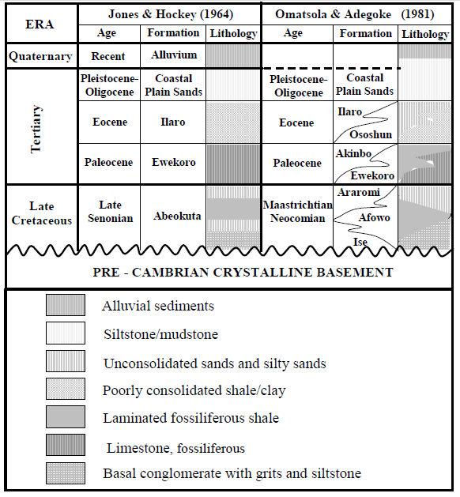
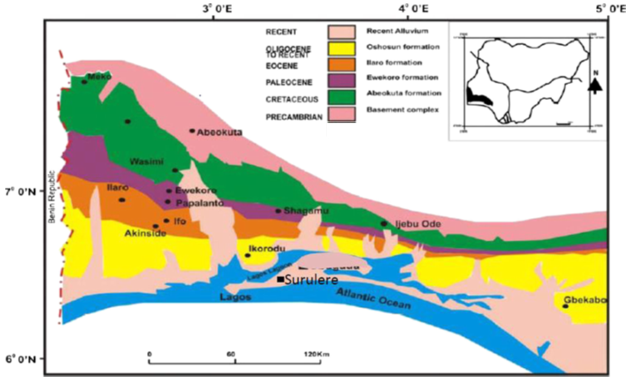
1.5 Geology of the study area
Table 1.0: Stratigraphy of eastern Dahomey basin
Figure 1.2: Geological map of eastern Dahomey Basin (modified after Billman 1992)

Slide 10
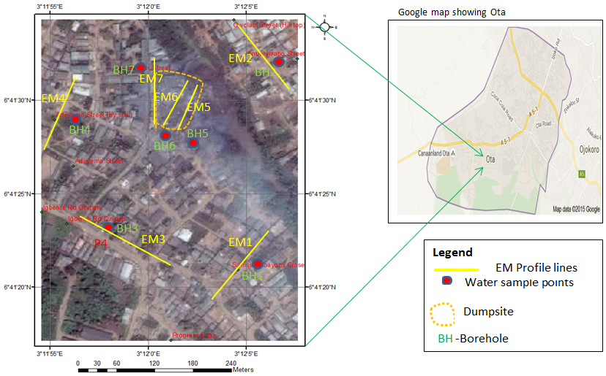
1.6 Location of the study area
Figure 1.3: Data acquisition map showing location of dumpsite

Slide 11
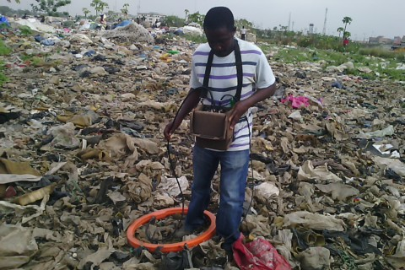
2.0 Materials and Method
2.1 Data Acquisition
EM data
Figure 2.0: EM-34 instrument

Slide 12
2.1 Materials and methods cont’d
Water sample analysis
The physical properties of water tested for are their total dissolved solid (TDS), pH values, temperatures, hardness and electrical conductivity (EC).

Slide 13
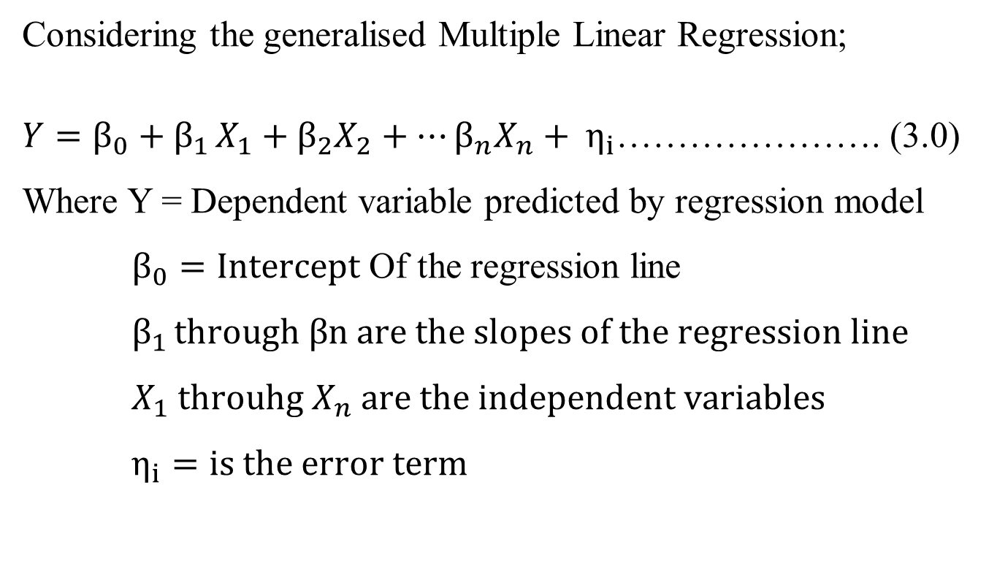
2.2 Materials and methods cont’d
Statistical analysis of data
Considering the generalised Multiple Linear Regression;
$Y=β_{0}+β_{1 }X_{1}+β_{2}X_{2}+…β_{n}X_{n}+ η_{i}$…………………. (3.0)
Where Y = Dependent variable predicted by regression model
$β_{0}=Intercept$ Of the regression line
$β_{1 }through βn are the slopes of the regression line$
$X_{1} throuhg X_{n} are the independent variables$
$η_{i}=is the error term$

Slide 14
3.0 Results and discussion
Table 2.0: Observed mean Terrain Conductivity and TDS Parameters for the Vicinity of Igbenre Ekotedo Dumpsites
EM-34 | Coordinate | HD 10 (mS/m) | HD 20 (mS/m) | HD 40 (mS/m) | VD 10 (mS/m) | VD 20 (mS/m) | VD 40 (mS/m) | TDS (mg/l)
Traverse 1 | 6⁰ 41′ 21.67″N 3⁰ 12′ 03.89″E | 49.59 | 18.44 | 35.35 | 38.82 | 28.50 | 49.80 | 30
Traverse 2 | 6⁰ 41′ 22.27″N 3⁰ 11′ 56.49″E | 29.0 | 19.38 | 45.47 | 20.71 | 48.06 | 47.59 | 32
Traverse 3 | 6⁰ 41′ 33.24″N 3⁰ 12′ 07.49″E | 38.76 | 48.5 | 34.29 | 19.53 | 36.69 | 51.35 | 35
Traverse 4 | 6⁰ 41′ 33.90″N 3⁰ 11′ 55.36″E | 8.40 | 56.18 | 54.06 | 10.39 | 45.59 | 41.22 | 45
Traverse 5 | 6⁰ 41′ 29.64″N 3⁰ 11′ 57.41″E | 125.62 | 250.46 | 37.72 | 56.46 | 159.08 | 42.27 | 136
Traverse 6 | 6⁰ 41′ 29.34″N 3⁰ 11′ 59.89″E | 153.0 | 256.38 | 123.45 | 41.46 | 140.15 | 41 | 275
Traverse 7 | 6⁰ 41′ 28.91″N 3⁰ 12′ 01.97″E | 168.54 | 297.92 | 212.29 | 38.85 | 230.67 | 51.64 | 692

Slide 15
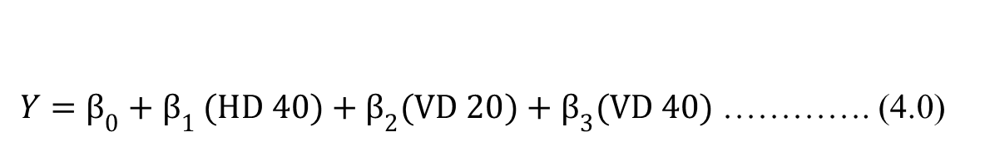
3.0 Results and discussion Cont’d
Table 3.0: Summary statistics for regression model using all data variables
$Y=β_{0}+β_{1 }(HD 40)+β_{2}(VD 20)+β_{3}(VD 40)$ …………. (4.0)
$TDS=−452.78+2.27\left(HD40\right)+1.22\left(VD20\right)+7.19 \left(VD40\right)………….$(5.0)

Slide 16
3.0 Results and discussion Cont’d
Table 4.0: Record of the Observed and Predicted TDS
S/n | Observed TDS (mg/l) | Predicted TDS (mg/l)
1 | 30 | 20.86210389
2 | 32 | 51.90192424
3 | 35 | 39.64219057
4 | 45 | 22.54071447
5 | 136 | 131.9938489
6 | 275 | 294.4011364
7 | 692 | 683.6580815

Slide 17
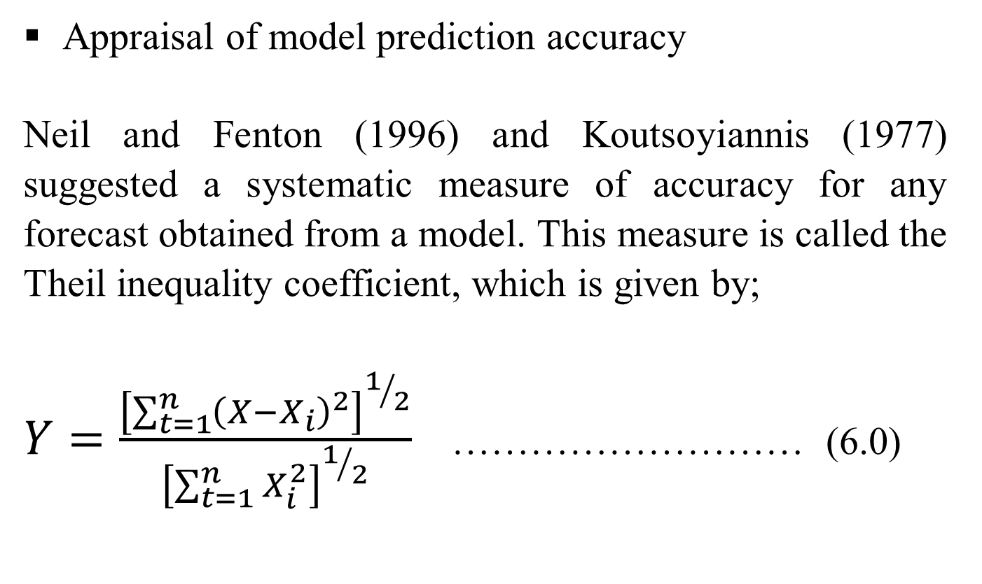
3.0 Results and discussion Cont’d
Appraisal of model prediction accuracy
Neil and Fenton (1996) and Koutsoyiannis (1977) suggested a systematic measure of accuracy for any forecast obtained from a model. This measure is called the Theil inequality coefficient, which is given by;
$Y=\frac{{\left[\sum_{t=1}^{n}{{\left(X−X_{i}\right)}^{2}}\right]}^{1/2}}{{\left[\sum_{t=1}^{n}{X_{i}^{2}}\right]}^{1/2}}$ ……………………… (6.0)

Slide 18
3.0 Results and discussion Cont’d
Where;
Y = Theil inequality coefficient
X_{i} = the observed TDS obtained from groundwater within and around the dumpsites
X = the corresponding predicted TDS from the TDS model.
The determined Theil’s inequality coefficient Y values for the model is 0.014

Slide 19
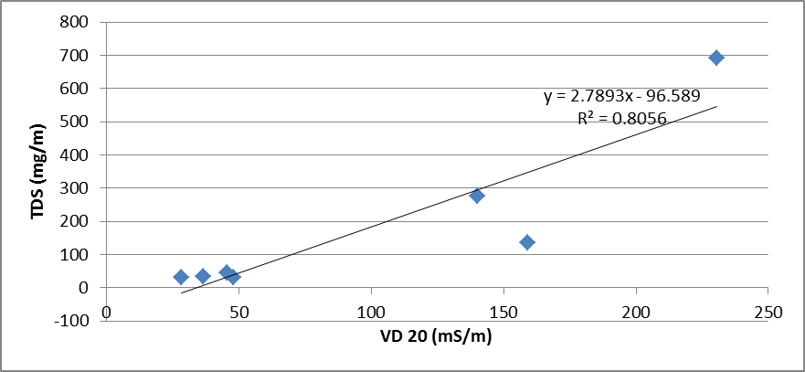
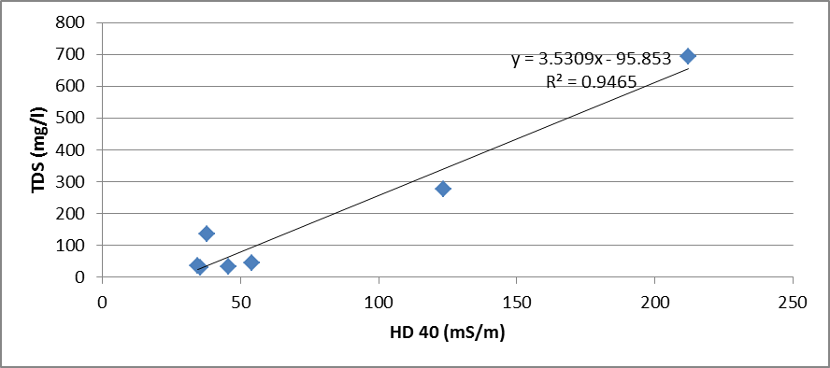
3.0 Results and discussion Cont’d
a
b
Figure 3.0: Linear relationships between TDS and (a) VD 20 (b) HD 40

Slide 20
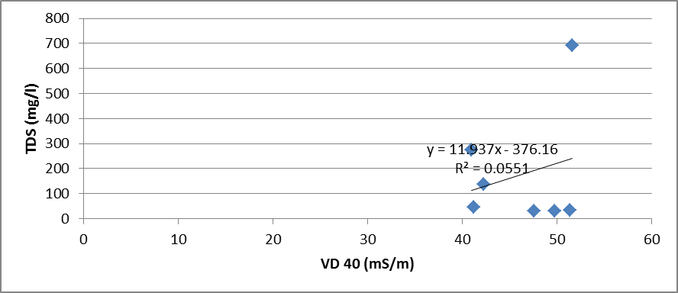
3.0 Results and discussion Cont’d
Figure 3.1: Linear relationships between TDS and VD 40

Slide 21
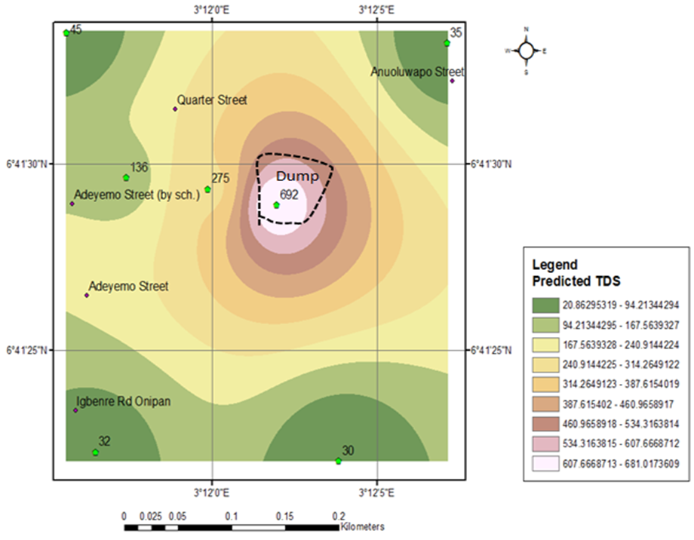
3.0 Results and discussion Cont’d
Figure 3.2: Contour plot of predicted TDS around the study area

Slide 22
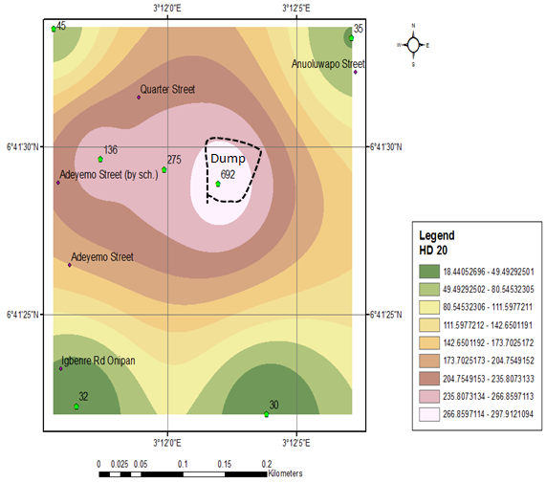
3.0 Results and discussion Cont’d
Figure 3.3: Subsurface Contour plot of apparent soil electrical conductivity measured using EM34 in horizontal dipole mode (HD 20) coil spacing.

Slide 23
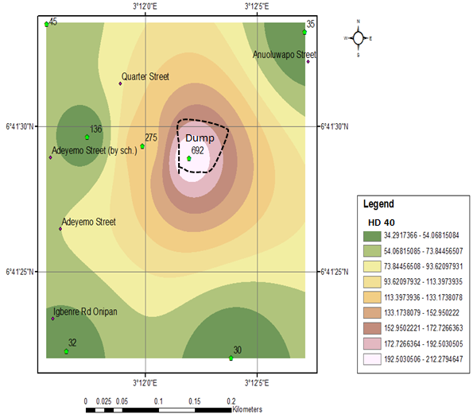
3.0 Results and discussion Cont’d
Figure 3.4: Subsurface Contour plot of apparent soil electrical conductivity measured using EM34 in horizontal dipole mode (HD 40) coil spacing.

Slide 24
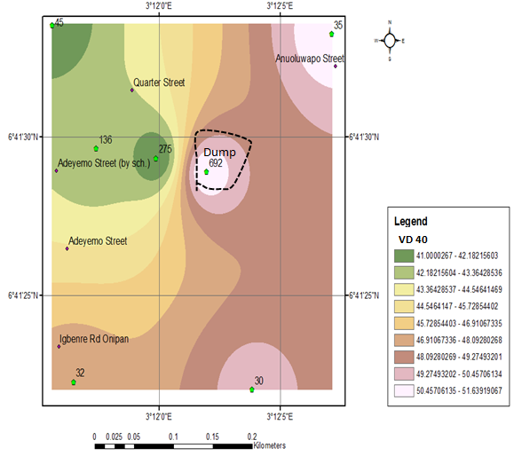
3.0 Results and discussion Cont’d
Figure 3.5: Subsurface Contour plot of apparent soil electrical conductivity measured using EM34 in vertical dipole mode (VD 40) coil spacing.

Slide 25
4.0 Conclusion
Although, the accuracy of the developed TDS model is site specific, it can be reliably deployed for groundwater TDS concentration determination around the study area where there are no boreholes and hand dug wells, but with only terrain conductivity data.
However, where there are borehole and hand dug wells, terrain conductivity data around the area alone can be applied to the model to determine TDS concentration in groundwater, thus reducing the time and cost of determining and monitoring both parameters separately.

Slide 26
4.0 Conclusion Cont’d
The proximity of the dumpsite to living quarters is a potential danger and proactive majors must be put in place by the appropriate authorities to avoid further spread of the contaminants and ultimately the outbreak of epidemic resulting from the consumption of contaminated groundwater around this area.

Slide 27
5.0 References
Acworth, R. I., and G. R. Dasey (2003), Mapping of the hyporheic zone around a tidal creek using a combination of borehole logging, borehole electrical tomography and crosscreek electrical imaging, New South Wales, Australia, Hydrogeology Journal, 11(3), 368-377.
Adeoti, L., Oladele, S Ogunlana, FO., (2011), Geo-electrical investigation of leachate impact on groundwater: A case study of Ile-Epo Dumpsite, Lagos, Nigeria, Journal of Applied Sciences and Environmental Management, 15(2), pp 361-364.
Adepelumi A. A., Ako, B. D., Afolabi O. and Arubayi J. B. 2005. Delineation of Contamination Plume around Oxidation Sewage-ponds in Southwestern Nigeria. Environmental Geology, 48. PP. 1137 – 1146.
Agagu, O.A., 1985. A geology guide to the bituminous sediments in southwestern Nigeria, University of Ibadan Press.
Akoteyon, IS, Mbata, UA and Olalude, GA., (2011), Investigation of heavy metal contamination in groundwater landfill site in a typical sub-urban settlement in Alimosho, Lagos, Nigeria. Journal of applied sciences in environmental sanitation, 6(2), pp 155-163.
Ayolabi EA, Peters, DY., (2005), Hydrochemical and electrical resistivity assessment of the impact of solid waste on the groundwater at Okealfa refuse dumpsite, Lagos, Nigeria, Journal of Science, Engineering and technology, 12(1), pp 5936 – 5946

Slide 28
5.0 References Cont’d
Ball, JM, Stove, JG., (2002), Pollution plume migration, coastal park landfill. Proc. Waste, Conference on international water management biennial, Durban South Africa.
Barker, R.D., 1990. Improving the quality of resistivity sounding data in landfill studies, in Geotechnical and Environmental Geophysics, edited by S.H. Ward, Vol. 1, Society of Exploration Geophysicists, pp. 245–251.
Bartone CR, Bartone J, Bernstein CRJ, Wright F (1990). Investments in Solid Waste Management: Opportunities for Environmental Improvement. Working Paper No. 405. World Bank Policy, Research and External Affairs Department. Washington D.C. p. 123.
Bayode S. M. O. Olorunfemi and J. S. Ojo 2011. Geoelectric Mapping of Some Ancient Dumpsitesand the Associated Pollution Plume in Akure Metropolis, Southwestern Nigeria. International Journal of Physical Science. Vol. 3, No.1, PP. 68 –80.
Beatriz, A. H., Vega, M., Barrado, E., Pardo,R. and Fernandez, L., 1998. A Case of Hydrochemical Characterization of an Alluvial Aquifer Influenced by Human Activities, Water, Air and Soil Pollution, 112, pp. 365-387.

Slide 29
Thank you for listening!!!

