Slide 1
ELEMENTS OF ENVIRONMENTAL STUDIES
BY DR. FRANCIS H. IBADIN

Slide 2
What is Ecology?
Ecology is a branch of science that deals with the interrelationship between organisms and their environment.
LEVELS OF ECOLOGICAL ORGANIZATION
Species: They are organisms that are morphologically similar, and can breed and produce fertile offspring.
Population: It is a group of individuals of the same species occupying a given area; e.g. a population of Agama lizards in MTU campus.
Community: It is an assemblage of all the populations of organisms living and interacting in a particular area. An example is the community of plants and animal in a pond or desert.

Slide 3
Ecosystems: It is composed of a biological community and its physical environment. The environment includes the abiotic factors and the biotic factors.
Biome: A broad regional type of ecosystem characterized by distinctive climate and soil conditions and distinctive kind of biological community adapted to such conditions.
Biosphere: It is the sum of all the biomes established on earth, it is the part of the earth’s crust, water and the atmosphere that supports life.

Slide 4
STRUCTURE OF ECOSYSTEMS
Each ecosystem has two main components:
(1) Abiotic Components:
The nonliving portions or the physical and chemical environment prevailing in an ecosystem form the abiotic components. They include water, soil, sunlight, temperature, humidity etc.
(2) Biotic Components:
They are the living organisms in the environment. They include plants, animals and micro-organisms (Bacteria and Fungi).

Slide 5
A Habitat is a place or set of environmental conditions in which a particular organism lives.
A more functional term, the Ecological Niche is a description of either the role played by a species in a biological community or the total set of environmental factors that determine species distribution.
A Niche describes how a species obtains food, what relationships it has with other species, and the services it provides in its community.

Slide 6
There are three major types of habitats namely; Terrestrial, Freshwater and Marine Habitats, which are all located within the Biosphere.
The Biosphere – is the thin outer layer of the earth capable of supporting life.
The non-living subdivisions of the biosphere include:
Lithosphere – rocky materials of the earth’s outer shell and is the ultimate source of all mineral elements required by living organisms.
Hydrosphere – is the water on or near the earth’s surface and it extends to the lithosphere and the atmosphere.

Slide 7
Atmosphere – gaseous components of the biosphere. It extends to some 3500 km above the surface of the earth, but life is confined to the lowest part called the troposphere.
The main gases present in the atmosphere are by volume - nitrogen, 78%; oxygen, 21%; argon, 0.93%; carbon dioxide, 0.03% and variable amount of water vapour.

Slide 8
THE MAJOR TYPES OF HABITATS
There are three major types of habitats namely;
Terrestrial, Freshwater and Marine Habitats. The Freshwater and Marine habitats are composed mainly of water, unlike the terrestrial habitat.
TERRESTRIAL HABITAT:
The terrestrial habitat are mainly land based biomes which can be greatly influenced by physical conditions like temperature, water, humidity, precipitation, light etc.

Slide 9
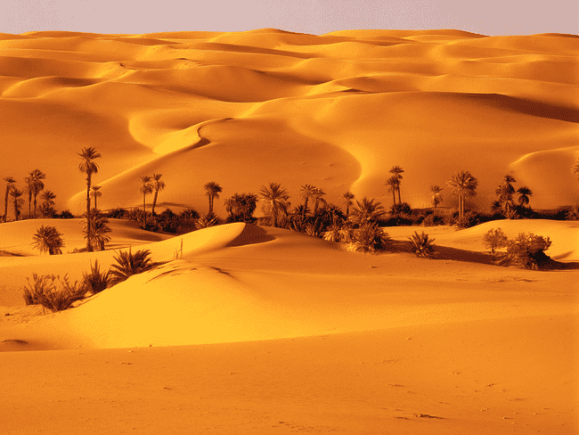
(b) Major Biomes
(i) Deserts

Slide 10
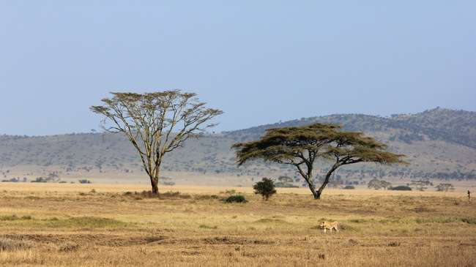
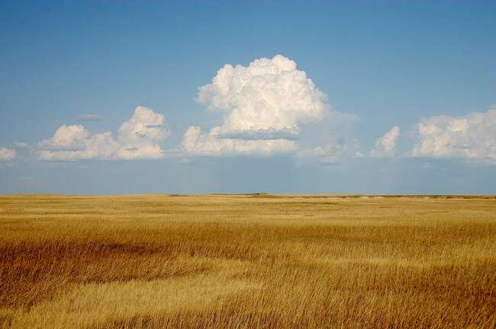
(ii) Grasslands
Tropical grasslands (Savannah) & Temperature grasslands

Slide 11
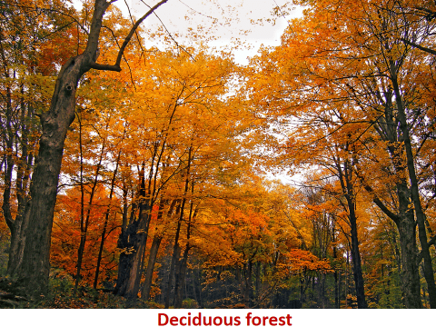
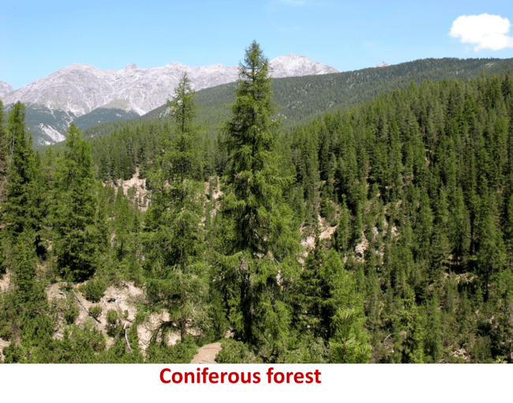
(iii) Forests: Deciduous Forest & Coniferous Forest
The largest tree in the world is the California Redwood.

Slide 12
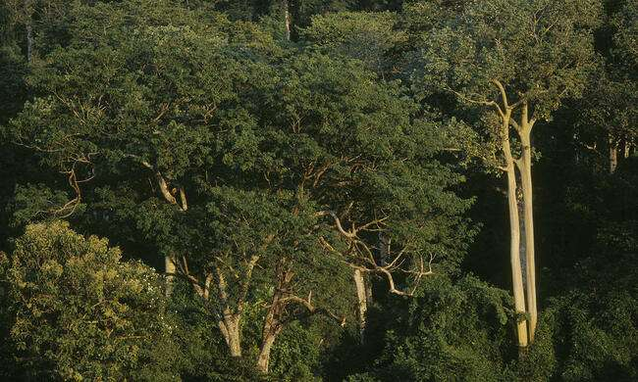
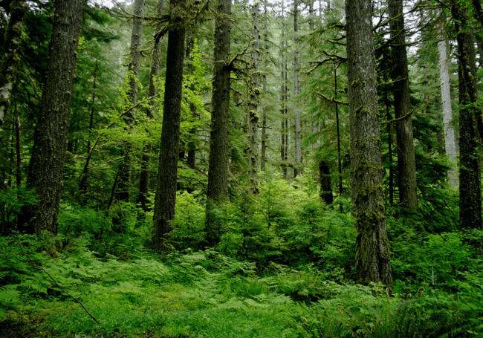
Tropical rainforests and Temperate rainforests
The largest rainforest in the world is the Amazon rain forest.

Slide 13
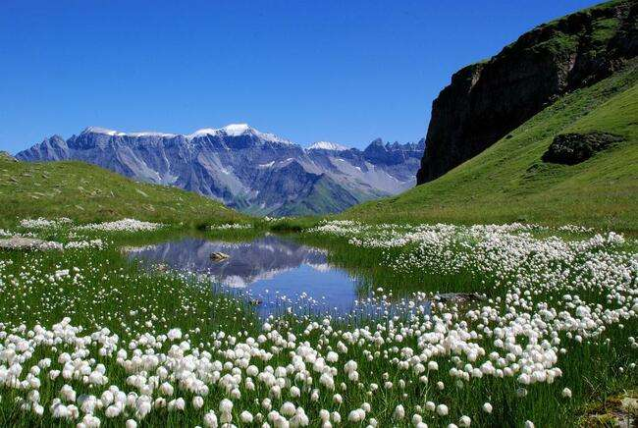
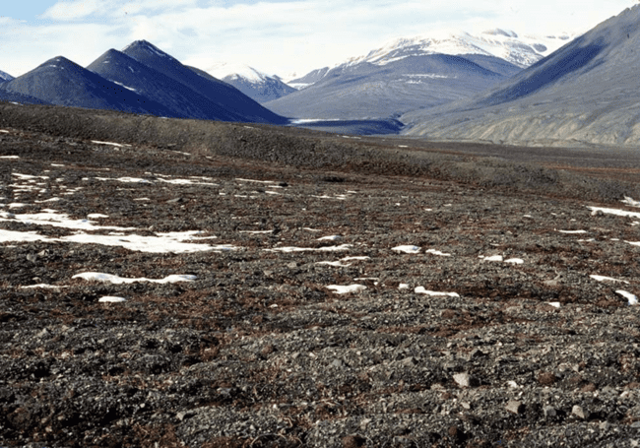
(iv) Tundra (Mountain Ecosystems): Arctic Tundra & Alpine Tundra

Slide 14
THE FRESHWATER HABITAT:
Freshwaters are defined as inland water bodies having a considerably low salt concentration (less than 0.5 parts per thousand). Freshwater can be divided into two main groups, namely the lentic (standing) and the lotic (running) water bodies.
The lentic water bodies are relatively still, although limited movement can occur as a result of wind action e.g. Lakes, Ponds, Pot holes etc. Due to their lower velocity they have lower oxygen concentration.
The lotic water bodies are those in constant flow, some examples are Rivers, Streams, Waterfalls etc. They have high velocity water flow and a high oxygen concentration.

Slide 15

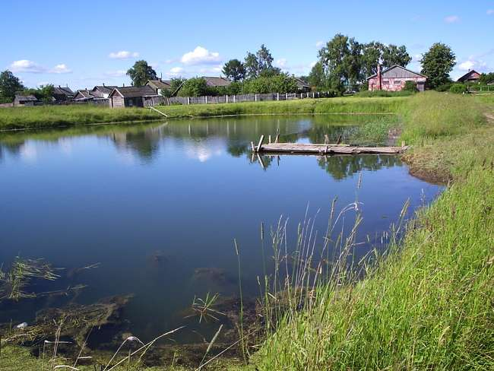
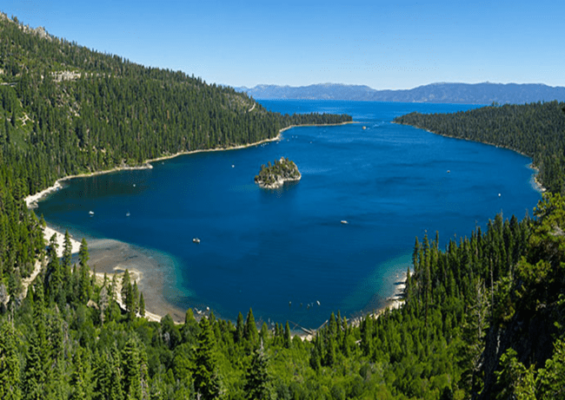
Lake Tangayika (Tanzania-Congo) is regarded as the longest lake in Africa.

Slide 16

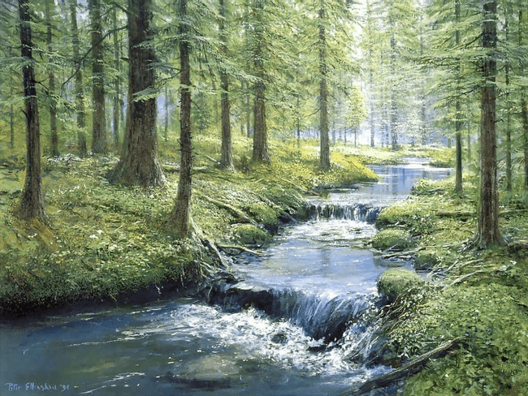
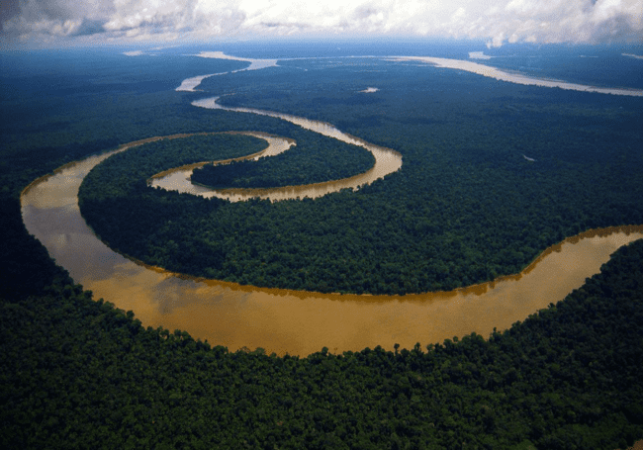
The River Nile is the longest river in the world, while the Amazon River is the largest river in the world. The largest river in Africa is River Congo.

Slide 17
(c) Wetlands
Wetlands are ecosystems of several types in which rooted vegetation is surrounded by standing water during part of the year.
Other terms for wetland include marsh (wetlands without trees), bog, flood plain, prairie pothole and swamp (wetlands with trees).
Mangroves are trees that grow in the coastal intertidal zone (salt water), with low oxygen soil.

Slide 18
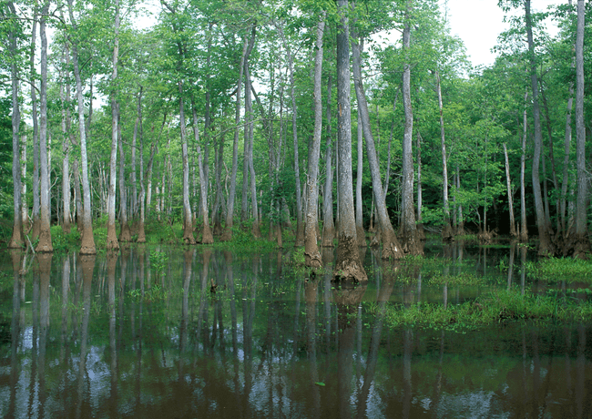
A swamp

Slide 19
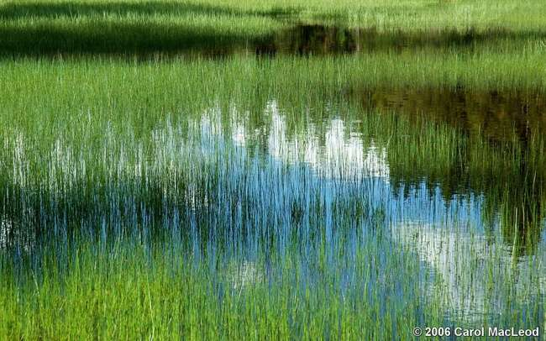
A marsh

Slide 20
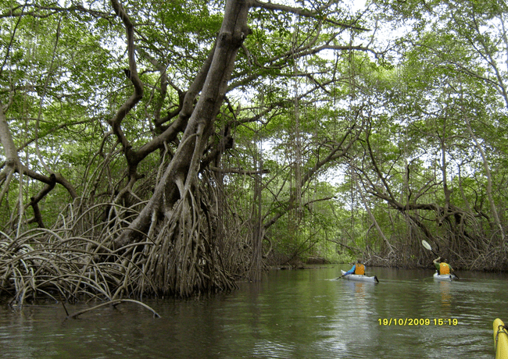
A mangrove forest

Slide 21
4. BRACKISH WATER:
This environment is actually a meeting point between the fresh water and the marine water habitat.
It occurs in places like estuaries, where rivers drain into the ocean, where there is therefore a mixture of fresh and marine water.
The salt content of the water is normally higher than that of fresh water and lower than that of marine water due to mixing of both waters (between 0.5 to 35 parts per thousand).

Slide 22
Impact of population growth on the biosphere
Population growth goes along with growth of towns and cities, which is referred to as urbanization. Urbanization is caused by the presence of social amenities like electricity, good roads, medical facilities, pipe-borne water, availability of industries and high quality goods and employment opportunities.
Consequences of population growth and urbanization
1 Accommodation problem
2 Lack of planned cities resulting in the development of slums
3 Reduction in the number of people farming in rural areas
4 More mouths to fees, therefore more emphasis on large-scale agriculture leading to deforestation, soil erosion, desertification, loss of wild and game animals
5 Epidemics like cholera, influenza
6 Antisocial behavior in human beings
7 High cost of living
8 Environmental pollution

Slide 23
Pollution is the contamination of a medium (air, water, soil) with impurities to a level that is detrimental to organisms or the balance of nature.
To make foul, unclean, dirty; it can also be defined as any physical, chemical, or biological change that adversely affects the health, survival, or activities of living organisms or that alters the environment in undesirable ways.
Pollutants are contaminants that adversely alter the physical, chemical or biological properties of the environment.
The term includes nutrients, sediments, pathogens, toxic metals, carcinogens, oxygen-demanding materials and all other harmful substances.

Slide 24
Two types of pollutants are known; biodegradable and non-biodegradable pollutants.
Biodegradable pollutants are those that can be decomposed by bacteria, hence could easily be removed from the environment e.g. sewage.
Sewage is a water-carried waste, in solution that is intended to be removed from a community e.g. waste water from the kitchen sink and excrement from homes.
Non-biodegradable are chemicals substances which cannot be broken down by bacteria, hence persists and accumulate in the environment e.g. heavy metals from industries, plastic and other man-made synthetic materials.

Slide 25
Burning of fossil fuels (coals, petroleum and natural gas) provide energy for home and industrial use results in the release of carbon oxides (CO & CO2); hydrocarbons methane (CH4) and benzene (C6H6); nitrogen oxides (nitric oxides – NO), nitrogen dioxide (NO2) and nitrous oxide (N2O); sulphur oxides (sulphur dioxide – SO2 & sulphur trioxide – SO3). These cause air pollution.

Slide 26
Waste gases like SO2 and NO react with rain to form H2SO4 and NHO3 in the atmosphere which mix with rain to give rise to acid rain that damages lakes, streams, forests, buildings, statues, etc. CO2 and other gases e.g. methane, nitrous oxide and CFC in the atmosphere deplete the ozone layer and also increase Global Warming (Greenhouse effect)
Depletion of the ozone layer increases the risk of skin cancer.

