Slide 1

Evaluation of the performances of two rapid diagnostic tests (Cyscope®mini and Paracheck-Pf®) in the diagnosis of malaria among febrile children in Southwest Nigeria.
Rabiu OR^{1,4}, Kosoko AM^{2,4}, Falade CO^{3,4}, Ademowo OG^{3,4}
1 Department of Zoology 2 Department of Biochemistry 3 Department of Pharmacology & Therapeutics
4 Institute for Advanced Medical Research and Training,
University of Ibadan, Ibadan, Nigeria.

Slide 2
Background
Malaria is a major cause of morbidity and mortality in endemic areas of which Nigeria is one.
Young children and pregnant women are most at risk.
Malaria diagnosis was presumptive most of the time with attendant problems of over- diagnosis.
WHO now advocates universal parasite-based diagnosis before treatment (WHO, 2010).

Slide 3
Background contd.
Microscopy is the current gold standard has a lot of challenges
  Tedious and time consuming
  Needs functional microscope and electricity supply
  Expertise to read the slides
Rapid Diagnostic Test (RDTs) a viable option.
  Fast (15 -20 minutes)
  No equipment or electricity required
  Minimal training required
Antigens targeted by malaria RDTs
  HRP2, pLDH, Aldolase, MSP and CSP antigens

Slide 4
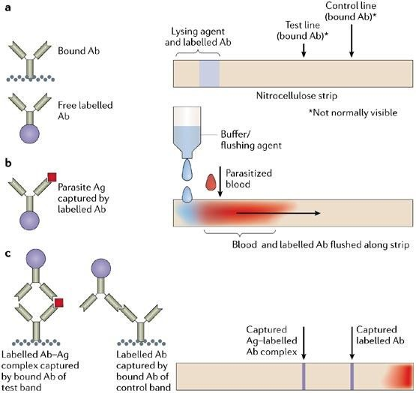
Fig. 1: Mechanism of action of common malaria RDTs (Bell et al. 2006).

Slide 5
Objective
To test the diagnostic performances of
Cyscope®mini (Partec, Germany) and Paracheck-Pf®
(Orchid Biomedical India) among febrile
Systems, Goa,
children using light microscopy as gold standard.

Slide 6
Patients and methods
Ethical approval - from the University of Ibadan/University College Hospital Ethical Review Committee, Ibadan.
Study site - GOP, UCH, Ibadan.
Target population – Febrile children of both sexes aged 6mths – 12 years presenting with fever.
Informed consent from parents/guardians of study volunteers.
Study duration – 6 mths starting Sept. 2010

Slide 7
Patients and methods contd.
Questionnaires administered for age, sex, height, weight, temperature, presenting features & treatment history.
Capillary blood from finger prick for
▫ haematocrit determination (PCV)
▫ thick and thin films
▫ Cyscope®mini slide and
▫ Paracheck-Pf® cassette test.
Data analysis using SPSS version 16.0 statistical software (Chicago, IL).
The overall diagnostic performances were calculated using OpenEpi version 2.3

Slide 8
Formulae for calculation of diagnostic
performance.
Sensitivity =TP/(TP+FN)
Specificity=TN/(TN+FP)
Positive predictive values
PPV=TP/(TP+FP)
Negative predictive values NPV=TN/(TN+FN)
Test accuracy
=(TP+TN)/(total number of
tests)
Overall reliability= [(TPxTN) - (FPxFN)] [(TP+FN) x (TN+FP)]
TP - number of true positives
TN - number of true negatives
FP - number of false positives
FN - number of false negatives
(Wanji et al. 2008)

Slide 9
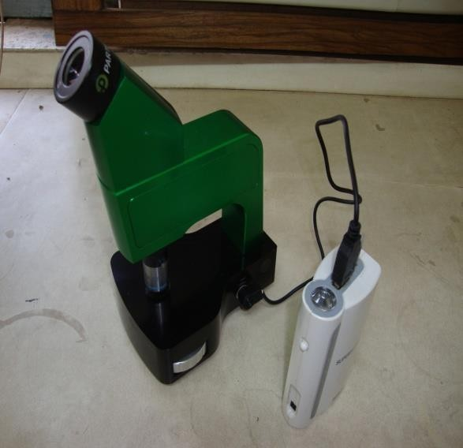
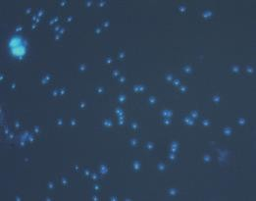
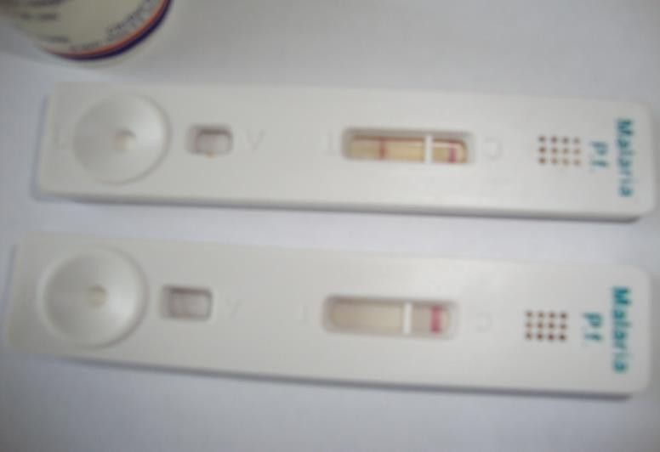
Cyscope®mini
WBC
Parasites
Test band
Control band
Paracheck-Pf®
Fig. 2: Images of the two RDTs

Slide 10
Results – Patients’ parameters
Total no of enrollees - 209 children
  209 – Microscopy & Cyscope®mini
  142 – Microscopy & Paracheck-Pf®
50.7% (106/209) males and 49.3% (103/209)
females.
The average age - 40±30.38months (3 years 4 months)
Mean weight - 13.7 ± 6.1kg.
Mean temperature - 37.4 ±1.1°C
Mean haematocrit was 32 ± 5.5%.

Slide 11
Results - Presenting symptoms
A history of fever or fever at presentation - 90.4% (above 37.4°C – 45.5%).
Cough - 51.2%
Loss of appetite - 49.3%
Catarrh - 37.8%
Headache - 37.8%

Slide 12
Results - Detection of malaria parasite by microscopy
Malaria parasite prevalence of 22.0% (46/209).
Parasite density ranged from 40/µL to 203,883/ µL.
Parasite density was ≤1000/µL in 21.7% (10/46) of the enrollees.
Majority (67.4%) of the children positive for malaria had parasite densities within the range of 1,001- 100,000/µL .

Slide 13
Results - Malaria parasite detection by Cyscope®mini relative to microscopy
Prevalence rate of 85.2% (178/209).
86.4% (19/22) parasite detection at densities
≤10,000/µL.
At parasite densities >10,000/µL, the detection rate was 95.8% (23/24).
Sensitivity - 91.3%
Specificity - 16.56%

Slide 14
Results - Malaria parasite detection by Paracheck-Pf® relative to microscopy
Prevalence rate of 32.1% (45/140).
90.9% (10/11) parasite detection at parasite density ≤10,000/µL.
At parasite densities >10,000/µL, the detection rate was 83.3% (15/18).
Sensitivity – 86.21%
Specificity - 81.98%

Slide 15
Table 1: Analysis of results obtained from RDTs compared to microscopy
RDT | TP grouped by parasite densities |  |  |  | FP | TN | FN | Total
 | <1000 µL | (1001- 10,000) µL | (10,001- 100,000) µL | >100,000 µL
Cyscope®mini | 9 | 10 | 18 | 5 | 136 | 27 | 4 | 209
Paracheck-Pf® | 4 | 6 | 10 | 5 | 20 | 91 | 4 | 140
Key: TP – True positives, FP – False positives, TN – True negatives, FN – False negatives

Slide 16
Table 2: Summary of comparative diagnostic performances of Cyscope®mini and Paracheck-Pf® in patients screened with both RDTs (p<0.05).
 | Cyscope®mini | Paracheck-Pf®
Sensitivity | 100% | 86.21%
Specificity | 13.51% | 81.98%
Positive Predictive Value (PPV) | 23.2% | 55.56%
Negative Predictive Value (NPV) | 100% | 95.79%
Diagnostic Accuracy | 31.43% | 82.86%
Likelihood ratio of a Positive Test | 1.156 | 4.784
Likelihood ratio of a Negative Test | 0.0 | 0.1682
Cohen’s kappa (unweighted) | 0.0608 | 0.5665

Slide 17
Summary of Results
The sensitivities of the two RDTs were quite impressive relative to microscopy.
The sensitivities of Paracheck-Pf® and Cyscope®mini were lower than the WHO standards for RDTs.
Cyscope®mini recorded a high number of false positives.
The diagnostic performance of Paracheck- Pf® was significantly higher than that of Cyscope®mini.

Slide 18
Conclusions and Recommendation
RDTs will be good complements for microscopy
  Requires no expertise
  Suitable in places with poor electricity supply.
High rate of false positives reported in the use of Cyscope®mini should be carefully examined.
More research to improve on Paracheck- Pf® and Cyscope®mini sensitivities and specificities.

Slide 19
Acknowledgements
Guardians of enrollees and the enrollees
Research staff of Drug Research Unit, IAMRAT
Partec Company, Germany

Slide 20
Thank you for Listening

