Slide 1
FINANCIAL INCLUSION, POVERTY AND INCOME INEQUALITY IN NIGERIA
Presented by:
Dr. Ologundudu, Mojeed Muhammed
Associate Professor of Economics,
Ag. HOD, Economics Department,
Ag. Director Academic Planning,
Mountain Top University
Annual International Conference on Research in Management and Social Sciences
Powered by:
Christopher University
Social and Management Scientist Forum
August, 2021

Slide 2
1.0. Introduction
Economics of poverty and inequality has re-occupied a central position on the academic research agenda in the developing countries.
Nigeria is a country that has experienced high incidence of poverty and inequality in the last three and half decades.
Available evidence suggests that the poverty and inequality variables and are on increase (Okojie, 2000 et al)
    35% in 1985
    46.3% in 1990
    52.8% in 2000
    75.5% in 2019

Slide 3
The spatial difference in the incident of poverty and inequality in Nigeria is more worrisome.
Statistically, rural poverty and inequality level shows that:
    1985: 38.4%
    1990: 46.2%
    2000: 79.4%
Zonal distribution also shows that:
    Northern zone: 85%
    Southern zone: 65%
Worst still, the country lack good governance and responsible leadership which is a major ingredient of financial inclusion.

Slide 4
1.1. Statement of the Problem
Financial inclusions is now a typical issue on the global policy agenda for most country now.
Nigeria launched the National Financial Inclusion Strategy (NFIS) in 2012 as a key driver to become on one of the largest economies.
NFIS goal aim at reducing the number of Nigerians without access to financial services from 46.3% to 20% by 2020.
Study on poverty and inequality is not a new area of study in Nigeria.

Slide 5
But study on financial inclusion, poverty and income inequality nexus governance is still in its infancy especially in developing economies.
Though, a few studies have examined the interactions of financial inclusion and governance indicators on welfare of the poor (Kanffinan et al, 2000, Acemoglu et al, 2005)
Others have dealt with financial inclusion and institutional structure both in advanced and emerging economies (Kande & Tomani, 2010).

Slide 6
The study intend to extend the frontier of knowledge and fill the existing gap by considering and providing:
  Conceptual framework and key policy insights in the transmission mechanism of financial inclusion as a panacea to:
    reduce the incidence of poverty in Nigeria;
    Bridge the income inequality through good governance and lens of investment in infrastructure and per capital GDP in Nigeria.

Slide 7
1.3. Conceptual Framework and Literature Review
Financial inclusion is the process that guarantees the ease of accessibility, availability and affordability of financial services for every active economic agent in the economy (Sarma, 2008, Njideke, 2014; Morduch & Sincular, 2002, Adada & Johnson, 2012).
Extant literature revealed that as at 2000 30% of Nigeria adults are financially excluded (Sarma & Pius 2010; Ona Olapo, 2015; Allen et al 2013, Honoham, 2008).
The World Bank (2014) distinguish between voluntary and involuntary financial exclusion.

Slide 8
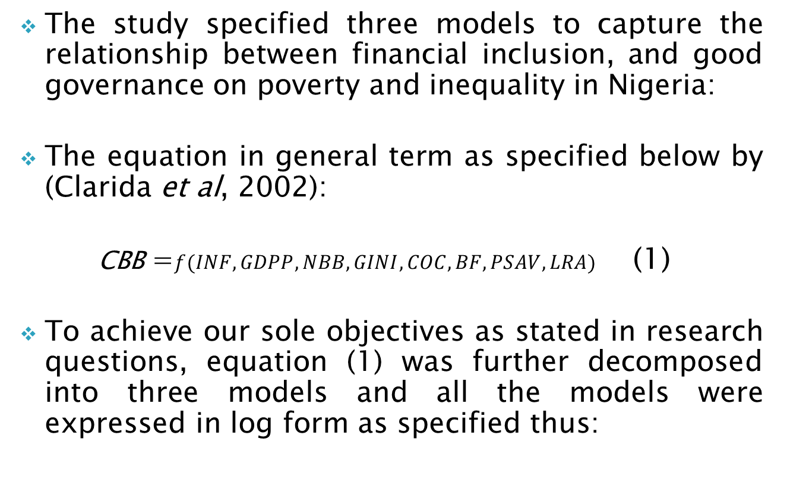
1.4. Estimation Techniques and Model Specification
The study specified three models to capture the relationship between financial inclusion, and good governance on poverty and inequality in Nigeria:
The equation in general term as specified below by (Clarida et al, 2002):
CBB =$f(INF, GDPP, NBB, GINI, COC, BF,PSAV, LRA)$ (1)
To achieve our sole objectives as stated in research questions, equation (1) was further decomposed into three models and all the models were expressed in log form as specified thus:

Slide 9
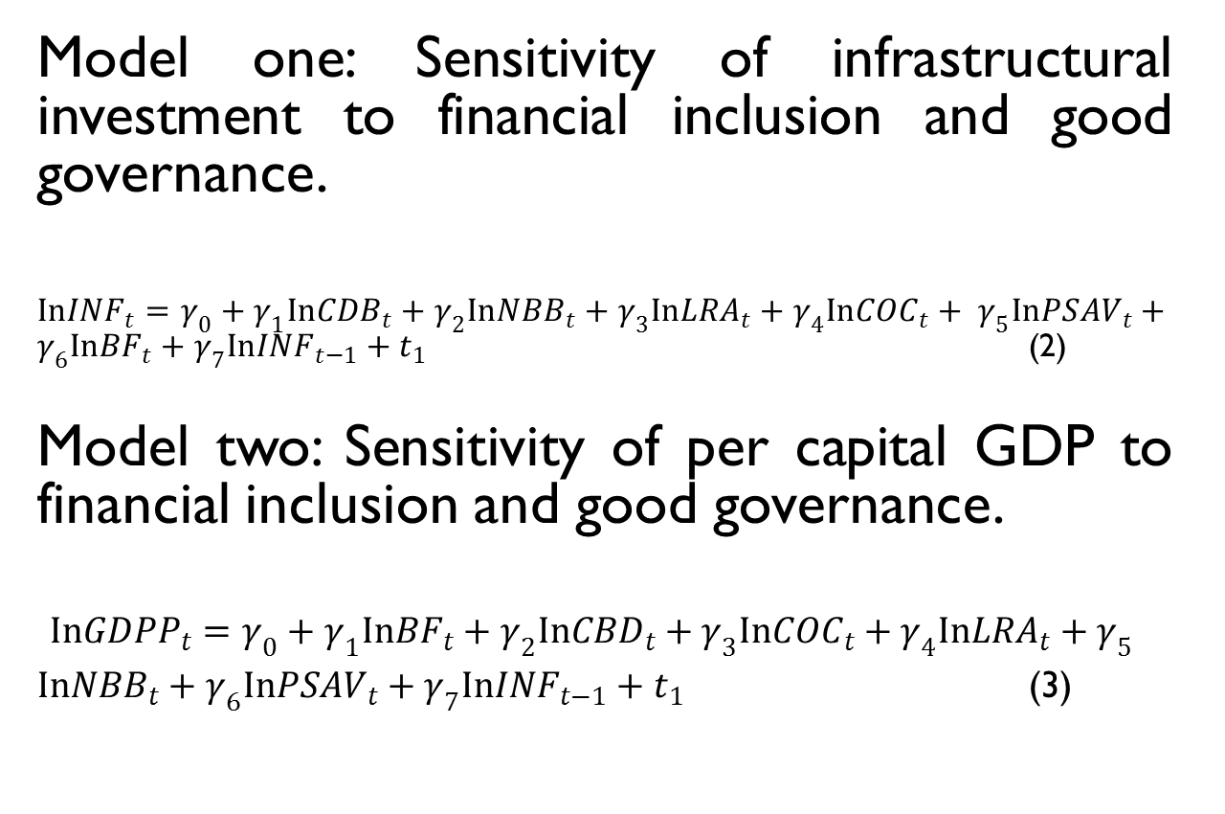
Model one: Sensitivity of infrastructural investment to financial inclusion and good governance.
$InINF_{t}=γ_{0}+γ_{1}{InCDB}_{t}+γ_{2}In{NBB}_{t}+γ_{3}In{LRA}_{t}+γ_{4}In{COC}_{t}+{ γ}_{5}In{PSAV}_{t}+γ_{6}In{BF}_{t}+γ_{7}In{INF}_{t−1}+t_{1}$ (2)
Model two: Sensitivity of per capital GDP to financial inclusion and good governance.
$$In{GDPP}_{t}=γ_{0}+γ_{1}In{BF}_{t}+γ_{2}In{CBD}_{t}+γ_{3}In{COC}_{t}+γ_{4}In{LRA}_{t}+γ_{5}$$
$In{NBB}_{t}+γ_{6}In{PSAV}_{t}+γ_{7}In{INF}_{t−1}+t_{1}$ (3)

Slide 10
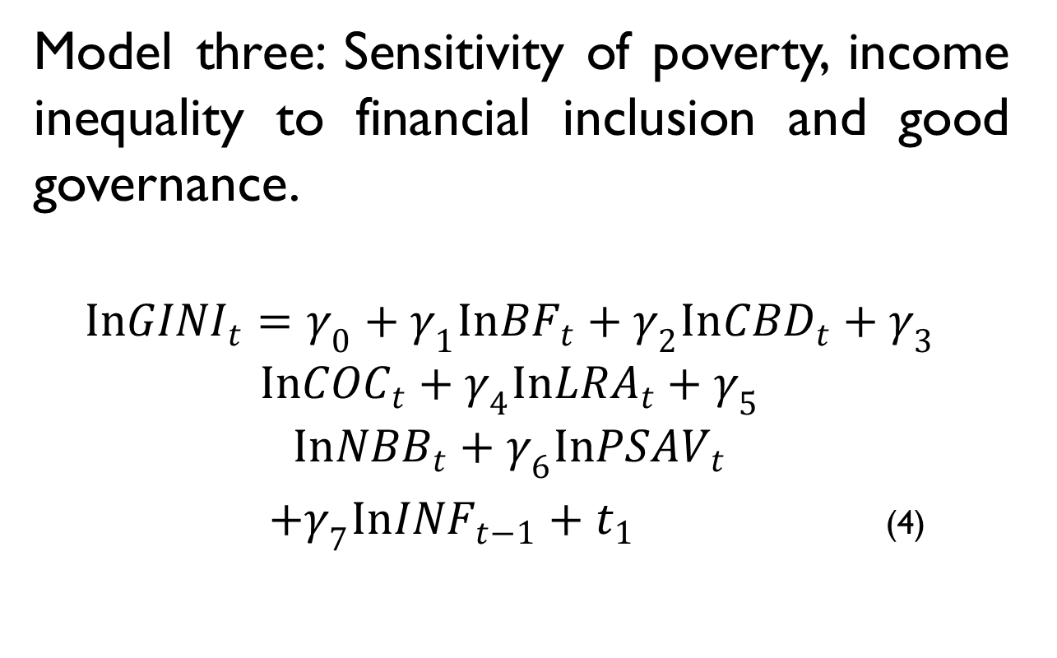
Model three: Sensitivity of poverty, income inequality to financial inclusion and good governance.
$$In{GINI}_{t}=γ_{0}+γ_{1}In{BF}_{t}+γ_{2}In{CBD}_{t}+γ_{3}$$
$$In{COC}_{t}+γ_{4}In{LRA}_{t}+γ_{5}$$
$$In{NBB}_{t}+γ_{6}In{PSAV}_{t}$$
$+γ_{7}In{INF}_{t−1}+t_{1}$ (4)

Slide 11
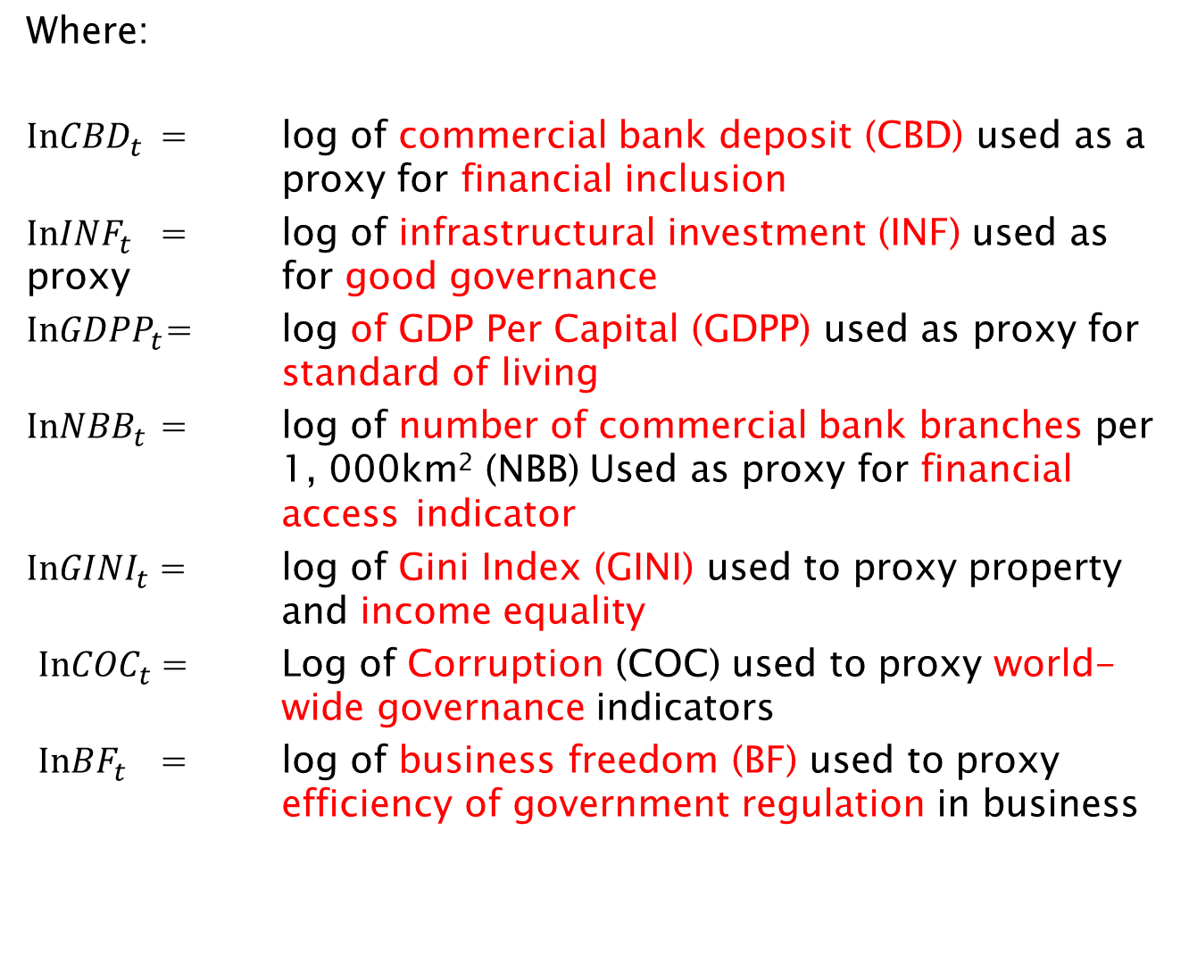
Where:
$In{CBD}_{t}$ = log of commercial bank deposit (CBD) used as a proxy for financial inclusion
$In{INF}_{t}$ = log of infrastructural investment (INF) used as proxy for good governance
$In{GDPP}_{t}$= log of GDP Per Capital (GDPP) used as proxy for standard of living
$In{NBB}_{t}$ = log of number of commercial bank branches per 1, 000km² (NBB) Used as proxy for financial access indicator
$In{GINI}_{t}$= log of Gini Index (GINI) used to proxy property and income equality
$In{COC}_{t}$= Log of Corruption (COC) used to proxy world- wide governance indicators
$In{BF}_{t}$ = log of business freedom (BF) used to proxy efficiency of government regulation in business

Slide 12
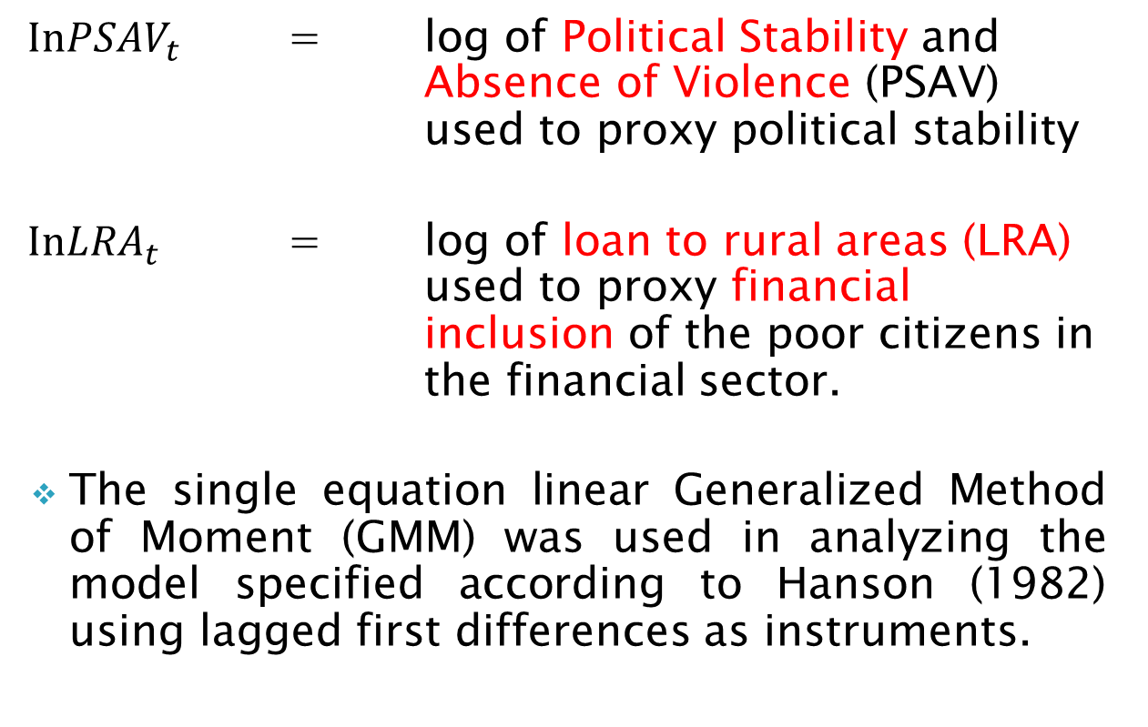
$In{PSAV}_{t}$ = log of Political Stability and Absence of Violence (PSAV) used to proxy political stability
$In{LRA}_{t}$ = log of loan to rural areas (LRA) used to proxy financial inclusion of the poor citizens in the financial sector.
The single equation linear Generalized Method of Moment (GMM) was used in analyzing the model specified according to Hanson (1982) using lagged first differences as instruments.

Slide 13
1.5. Empirical Findings
Unit root test using KPSS was used to examine the time series properties of the data and to determine the order of integration of the variables used in the model.
Cointegration test was also conducted o determine non-stationery time series variable to confirm whether the variables being used have long run relationship or not.
All the variables were stationery at first differences.

Slide 14
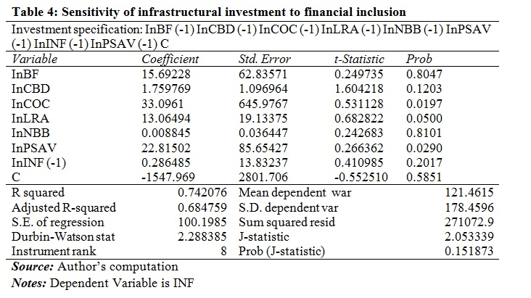

Slide 15
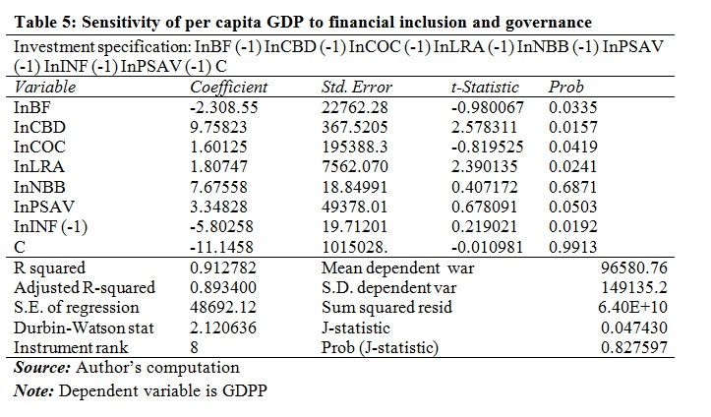

Slide 16
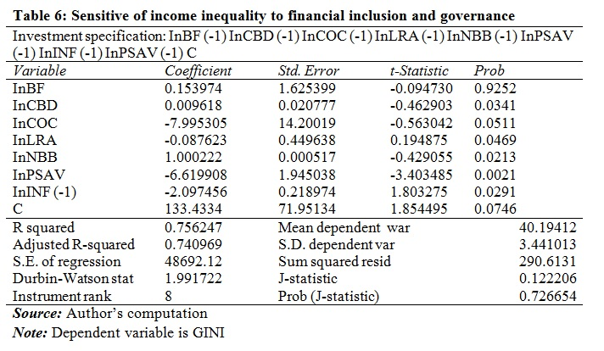

Slide 17
GMM estimation results in table 4, 5 and 6 shows that:
    The impact of financial inclusion and governance variable were positively related to investment in infrastructural facilities in the country.
    The impact of financial inclusion and governance on GDP per capital income were positively correlated.
    The impact of financial inclusion and governance on income inequality were negatively correlated.

Slide 18
1.6. Conclusion and Policy Implications
By intuition when these variables are triggered in Nigeria, they tend to bridge the gap between the rich and the poor and reduce the prevalence of poverty in the economy.
It was found that number of bank branches, loan to rural areas, control of corruption, political stability and absence of violence were statistically and positively related to investment in infrastructure in Nigeria.

Slide 19
By implications, any improvement in these variables will reduce the high incidence of financial exclusion, reduce income inequality, alleviate poverty and increase the welfare of the poor in the country.
Therefore, the policy implications of the results and its impact on the welfare of the poor is centered on the following:

Slide 20
    Adequate financial and political security need to be put in place to encourage financial inclusion of all the economic agent (Honoham, 2008).
    Inclusive and transparent government should be instituted at all time (Onaolapo, 2015).
    The government should put in place programmes that would address growing income inequality and alleviate poverty, as a means of addressing financial exclusion of low-income groups.

Slide 21
THANK YOU FOR LISTENING!

