Slide 1
COURSE TITLE:
MEAT AND FISH TECHNOLOGY
COURSE CODE: FST 506
By
Dr. Dupe Temilade Otolowo,
Department of Food Science and Technology,
Mountain Top University,
Ibafo, Prayer City, Nigeria

Slide 2
LECTURE 1

Slide 3
INTRODUCTION
Meat is the flesh of animals that is consumed for food and it is a major source of animal protein.
In the tropics i.e. this part of the world, the bulk of the meat consumed is derived from some animals including sheep, cattle, goats, pigs, deer, elephant, camel, antelope, rabbits, squirrel, rats, and other animals domesticated or wild;
Poultry such as; chicken, turkey, ducks, guinea fowl, geese, quail and other avian
Reptilian animals include; fish, crayfish, crabs, lobster, and other sea foods while molluscs include; snails, periwinkle, and other molluscs; and edible varieties of insects. However, all these are generally considered separate from the red meats of terrestrial animals.

Slide 4
Meat products and By-products
Meat and meat products are generally understood to include also apart from the skeletal muscles, the glands and organs of these animals (tongue, liver, heart, kidneys, brain etc.).
By-products from animal slaughter include; animal intestine (for sausage casings); fat which is rendered into tallow (use in making candle, soap) and lard (melted pig fat used in cooking); hides (for leather) and wool (in clothing material); bones, blood used in poultry and other feeds; gelatine and enzymes used by the pharmaceutical and food industries.

Slide 5
Carcass: The portions of the body remaining in sheep, cattle and pigs after the head, feet, hides, digestive tract, intestines, bladder, heart, trachea, lings (small, not important parts), kidney, spleen, liver, blood and adhering fatty tissue have been removed is referred to as the carcass.
These portions make up averagely 50, 45 and 25% of live weight of sheep, cattle and pigs, respectively.
Products derived from animals such as milk, cheese, butter, eggs are not called meat products but animal products.

Slide 6
Carcass yield of meat animals
Carcass yield of meat animals is calculated as percentage of live weight as:
Dressing% = Dressed weight x 100
Live weight
It varies with species, breed, age, sex and plane of nutrition.
High dressing percentage is desirable only if the increase is brought about by muscular growth rather than deposition of excess fat.

Slide 7
Grading and Inspection of Meat
Grading: Ensures that consumers get what they pay for. It is based on factors such as contour of the meat, amount of fat, degree of marbling of the fat, texture and firmness of the meat and colour.
The best cuts of meat have more fat well marbled throughout the lean which results in greater tenderness and better flavour. Grading is usually done at the slaughter house.
Inspection: Safeguards the health of consumers by ensuring that a clean, wholesome, disease-free meat that is without adulteration is supplied to the market.
If the animals are diseased, the meat can carry a wide variety of organisms that is pathogenic to man.

Slide 8
LECTURE 2
Chemical Composition of Muscle Tissue
Muscle tissue contains approximately 75% water and 25% solids, of which 19% are proteins. Lipids constitute about 2.5 to 5% of muscle.

Slide 9
Water
Largest component of the muscle tissue about three quarter (75%). Almost 70% of water content in fresh meat is located within the myofibrils as:
Free water/mobilised ii) Intermediate/immobilised water and
iii) Bound water- about 4-5%
pH of meat > isoelectric point (neutral charge) = high water retention of the tissue.
This increased the water holding capacity of the meat which is associated with juiciness and tenderness of cooked meat.

Slide 10
Protein
Muscle proteins have been broadly classified into three categories:
i) Myofibrillar proteins -- soluble in dilute salt solution
ii) Sarcoplasmic proteins -- soluble in water or very dilute salt solution.
iii) Stroma or connective Tissue proteins -- almost insoluble
Myofibrillar proteins:
These proteins constitute contractile part of the muscle and make up about 60% of the total protein in the skeletal muscle.

Slide 11
Lipids
Lipid is a major component of the carcass of a meat animal. It is highly variable and is inversely proportional to the moisture content.
Carbohydrates
Immediately after slaughter, muscle normally contains a very small amount (nearly 1%) of glycogen. However, it gets worked up before the completion of rigor mortis and plays a key role in attaining the ultimate muscle pH. Both the rate and amount of glycolysis influence the colour, tenderness and water holding capacity of meat.

Slide 12
Minerals
About 3.5% of the total body weight is inorganic matter, located in skeletal tissue as: salts of calcium, phosphorus and magnesium. Essential minerals like calcium, phosphorus, sodium, potassium, sulphur, chlorine, magnesium, iron etc. and trace elements like manganese, copper, iodine, zinc, cobalt etc, exists in living meat animal.
Important functions/role:
Conversion of muscle to meat- development of rigor mortis
Alteration of fluid balance a drop in pH and WHC.
Influence the meat colour and tenderization
Several inorganic ions act as catalysts during oxidation of meat fat.

Slide 13
Vitamins
The exudates from cut meat surfaces and drip loss during thawing of frozen meat contain an appreciable amount of B-complex vitamins and amino acids. Most of the vitamins in meat are relatively stable during processing or cooking. However, thiamine or to some extent vitamin B₆ are susceptible to heat treatment.
Factor influencing the vitamin content of meat
The species and age of the animal
The degree of fatness and
Type of feed received by the animal.

Slide 14
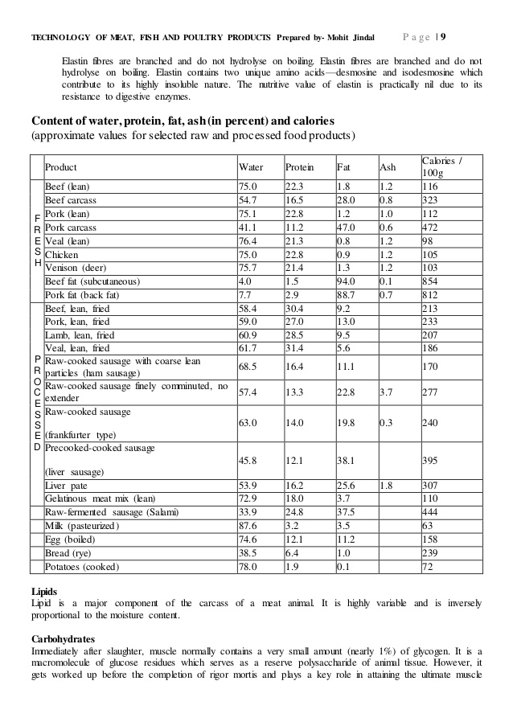
Chemical and Biochemical Composition of Muscle

Slide 15
Table 2: Nutrient composition (per 100g) of lean red meat
Nutrient | Beef | Veal | Lamb | Mutton
Moisture (g) | 73.1 | 74.8 | 72.9 | 73.2
Protein (g) | 23.2 | 24.8 | 21.9 | 21.5
Fat (g) | 2.8 | 1.5 | 4.7 | 4.0
Energy (kJ) | 498 | 477 | 546 | 514
Cholesterol (mg) | 50 | 51 | 66 | 66
Thiamin (mg) | 0.04 | 0.06 | 0.12 | 0.16
Riboflavin (mg) | 0.18 | 0.20 | 0.23 | 0.25
Niacin (mg) | 5.0 | 16.0 | 5.2 | 8.0
Vitamin B6 (mg) | 0.52 | 0.8 | 0.10 | 0.8
Vitamin B12 (μg) | 2.5 | 1.6 | 0.96 | 2.8
Pantothenic acid (mg) | 0.35 | 1.5 | 0.74 | 1.33
Vitamin A (μg) | <5 | <5 | 8.6 | 7.8
Beta-carotene (μg) | 10 | <5 | <5 | <5
Alpha-tocopherol (mg) | 0.63 | 0.50 | 0.44 | 0.20
Sodium (mg) | 51 | 51 | 69 | 71
Potassium (mg) | 363 | 362 | 344 | 365
Calcium (mg) | 4.5 | 6.5 | 7.2 | 6.6
Iron (mg) | 1.8 | 1.1 | 2.0 | 3.3
Zinc (mg) | 4.6 | 4.2 | 4.5 | 3.9
Magnesium (mg) | 25 | 26 | 28 | 28
Phosphorous (mg) | 215 | 260 | 194 | 290
Copper (mg) | 0.12 | 0.08 | 0.12 | 0.22
Selenium (μg) | 17 | <10 | 14 | <10

Slide 16
LECTURE 3
Structure of Animal Muscle
Muscles are highly specialized tissues that are used to provide structural support, create movement and maintain metabolic processes for complete function of the animal.

Slide 17
Types of muscles Fibre
Skeletal Muscles- The skeletal muscle is the principal muscle tissue in meat, although very little of smooth tissue is also present.
Smooth Muscles- are found in the gastro-intestinal tract, blood vessels, organ cells, lymphatic and skin in close association with the connective tissue layers. These are involuntary in nature.
Cardiac Muscles- Specialised muscle found only in the heart; are also involuntary. Their muscle fibres are rounded to irregular in shape.

Slide 18
Skeletal Muscles
The skeletal muscle structure is made up of (a) connective tissues and (b) fibre.
Connective tissue
The main connective tissue types are adipose tissue (fat), bone, and connective tissue proper.
Collagen- connective tissues are composed mainly of collagen which constitutes 20 – 25% of the protein in mammals. Muscles used extensively have higher amounts of collagen and are generally tougher.
Elastin- Elastic, shrinks and toughens on heating. Elastin like collagen becomes more insoluble with increasing age of the animal.

Slide 19
Connective tissue contd
The sheath of connective tissue is referred to as the epimysium which separates the muscle fibres into bundles
The bundles are made up of perimysium; contains the larger blood vessels and nerves
Endomysium- Inward connective tissue from perimysium surrounding each individual muscle fibre
Connective tissue fibres form the bulk of tendons and ligaments. The tendons attach muscle with bone whereas ligaments connect two bones or support organs

Slide 20
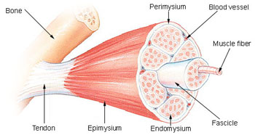
Fig 1: Structure of the Muscle Fibre
Source: Canada Beef Inc (2012)

Slide 21
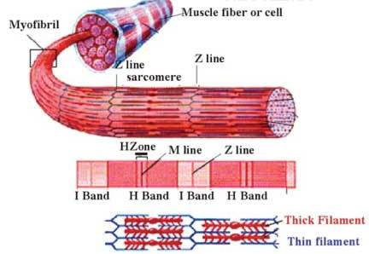
Fig 2: Structure of the Muscle Fibre

Slide 22
General Component of Muscle Fibre/Cells
The component of muscle cells that are specific to muscle tissue are: Myofibrils which is made up of sarcolemma, sarcoplasm, and sarcoplasmic reticulum
Sarcolemma- Plasma membrane sheath covering the muscle fibres
Sarcoplasm- contains very many Mitochondria (energy producing units within the cell) which produces very large amount of ATP
Sarcoplasmic reticulum- Stores Ca²⁺ necessary for bone contraction. The ATPase activity of myosin is stimulated by Ca++ ions.

Slide 23
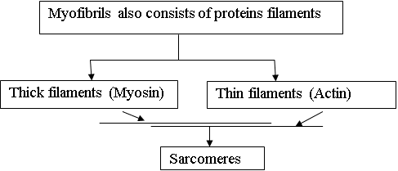

Slide 24
LECTURE 4
Conversion of Muscle to Meat and edible fish
Slaughter of food animal is followed by a series of physical and chemical changes over a period of several hours or even days resulting in the conversion of muscle to meat.

Slide 25
Processes involved in converting muscle to meat
Slaughtering
loss of body heat/declining of temperature
(loss of homeostasis)
Cessation of blood circulation
Loss of oxygen supply to the muscle due to exsanguinations (bleeding)
Inhibition of aerobic pathway for energy production
Stored creatine phosphate (CP) used for rephosphorylation of ADP to
ATP gets exhausted (Creatine phosphate + ADP = ATP + creatine)
Energy metabolism is then shifted to anaerobic pathway
(breakdown of glycogen to lactic acid)
Anaerobic conditions
Actomyosin = onset of rigor mortis
Glycogen lactic acid + 2 ATP
Fig 4: Processes involved in converting muscle to meat

Slide 26
LECTURE 5
Rigormotis
Within the period of the time which must elapse between the death of an animal or fish and its consumption, a large number of biochemical and physicochemical changes must take place. The entire process involved in this conversion is divided into three stages.

Slide 27
Stage 1
The prerigor state in which the muscle tissue is soft and pliable, and is characterized biochemically by a fall in the ATP and creatine and phosphate levels as well as an active glycolysis.

Slide 28
Stage 2
The rigor mortis- stiff and rigid condition of muscle tissue. The onset of rigor may occur at 8-12hours postmortem and may last for a further 15-20hours in mammals, depending on a number of factors. Fish generally exhibit a shorter rigor mortis period starting around 1-7hours following death with many factors also determining the duration.

Slide 29
Stage 3
The postrigor state in which meat and fish gradually tenderize, becoming organ and elastically acceptable as aging progresses. Mammalian meat usually reaches an optimum acceptability on storage at around 2ºC for up 2-3weeks following the dissolution of rigor.

Slide 30
Table 3: Delay Time before Onset of Rigor
Species Hours
Beef 6-12
Lamb 6-12
Pork ¼ -3
Turkey <1
Chicken < ½
Fish <1

Slide 31
FIRST TEST ON MEAT AND FISH TECHNOLOGY
Qn. 1. What did you understand by the word “meat”? Mention four meat animals. 3mks
Qn. 2. Explain the meaning of carcass as used in meat processing. A meat animal’s live and dressed weights are 60 kg and 15 kg respectively. What is the dressing percentage of the carcass? 5 marks
Qn. 3. State the factors responsible for the value obtained in Qn. 2 and suggest the meat animal that is likely to be involved. 3 marks
Qn. 4. As a Food Technologist working in the Grading and Inspection section of a meat industry, what are the importance of your duties to the society? 2 marks
Qn. 5. The component of skeletal muscle responsible for greater percent of muscle protein is called -------- consisting of the ----- and ------ filaments. 3 marks
Qn. 6. Briefly explain rigormotis in the process of converting muscle to meat. 4 marks

Slide 32
Effect of Lactic acid Production on pH and quality of Meat Tissue
Ultimate pH = 5.5-5.7 gradually attained at about 5-6 hr;15-20 hr; aided by high environmental temperature; desirable to check microorganisms’ proliferation during storage.
A sharp decline pH = 5.4/below in less than 5 hr aided by chilling may cause denaturation of muscle proteins. So, the muscles depict pale, soft and exudative (PSE) condition.
A prolong high pH = 6 - > 7; depicts a dark, firm and dry (DFD) condition.
Both the PSE and DFD conditions are undesirable for a quality meat.

Slide 33
Factors Influencing the Rate and Extent of pH Decline
the species of food animal,
various pre-slaughter factors,
environmental temperature etc.

Slide 34
Factors influencing the Physical and Biochemical changes
– Handling
– Environment
– Transportation
– Nutrition/ Growth Promotants
– Genetics
– Immobilization (Stunning)
– Chilling

Slide 35
LECTURE 6
Factors Affecting Post-mortem Changes and Meat Quality
Stress – physiological changes such as heart rate, respiration, body temp, and blood pressure occur during the exposure of the animal to adverse conditions
Blood Splash – Rupture of capillaries, because blood pressure skyrockets. Found in lean or Fat
Nerve damage– causes muscle fibers to die; Connective tissue and fat deposit in damaged area
pH level – Muscle appearance: Low pH- Pale, Soft, Exudative (PSE) or High pH- dark firm and dry (DFD)

Slide 36
Pale, Soft, Exudative (PSE)
Short term stress
• Rapid Lactic acid build-up and sharp pH decline at high muscle temps, resulting in pale colour and soft texture
• Decreased ability to hold water i.e Rapid loss of WHC
Reduced juiciness, increased cooking losses
• Most often found in loin and ham muscles of pork
• Price dock
Solution: Rest animals prior to slaughter to replenish glycogen
reserves and to remove lactic acid from the muscle

Slide 37
Dark, Firm, Dry (DFD)
Long term stress
– Little glycogen and little pH drop
– Increased ability to hold water ie high WHC
– Increased microbial growth
– Dark coloured cutters
– Price dock
Glycogen is depleted, but muscle temp and homeostatic conditions are met.
– Fatigue, exercise, fasting, excitement, fighting before slaughter
– Results in reduced glycogen reserves at slaughter time, and thus less lactic acid is produced
– Dark colour, firm texture, excellent water binding capabilities
– Reduced cooking losses

Slide 38
Water Holding Capacity
• The ability of meat to retain its water during application of forces
• 3 forms water in meat muscle:
– Bound water
• Inner most layer of water
• Associated with a protein
• Remains bound even during mechanical processes
– Immobilised water
• Middle layer, less organized, released depending on the
amount of force exerted
– Free water
• Outer most layer, held by weak capillary forces

Slide 39
Net Charge Effect in Water Holding Capacity of Meat
The influence of pH on WHC is called the Net Charge Effect
– responsible for 1/3 of water loss
• PSE has a low WHC because of its low pH
• DFD has better WHC because of its high pH
• Higher pHs have greater net charges on proteins and a
greater % of bound and immobilized water

Slide 40
LECTURE 7
Technologies to Improve Meat Quality: Aging and Tenderisation
• Cooler aging
– Enzyme activity degrades proteins at Z-line
– Longer aged, more tender the muscle is
– Does not degrade connective tissue
Hot boning
– Occurs before pH drops, so with a high pH has better WHC
– Without skeletal restraint, muscles shortens and become tough if allowed to go through rigor and not ground; e.g. Whole-hog sausage
• Delayed Chilling
– Hold carcasses at room temp for 2 to 4 hours after dressing
– Glycolytic rate is faster at the higher temps, ATP is depleted, and cold shortening is prevented.
– Ageing is accelerated

Slide 41
Technologies to Improve Meat Quality Contd.
Electrical Stimulation (ES)
– Acceleration of pH decline
– Muscle goes into rigor faster
Benefits
• Prevent cold shortening
• Accelerates proteolytic activity
• Physically disrupts muscle fibers
• Makes tough carcasses more tender, but not tender carcasses more tender
• Brightens red muscle – possible improvement in quality grade

Slide 42
Importance of Lactic Acid in the Quality of Meat
Lactic acid is the usual end product of glycogen reactions (anaerobic in nature) in the muscles of animals.
The muscle contains about 1% glycogen which it holds as a preserve form of energy, especially for muscular activity.
When a rested animal is killed, the glycogen in the muscle is broken down and becomes converted to lactic acid, and the meat therefore becomes slightly acidic. This acid exerts a preservative effect on the meat.
Unless meat contains an appropriate amount of lactic acid, it is sticky and flabby and bacteria are liable to multiply in it during storage. This is because a proper degree of acidity restricts bacterial growth.
Meat in well–rested animal has a more open and less sticky structure.

Slide 43
Importance of Lactic Acid in the Quality of Meat Contd.
The glycogen reserve can be used up in some of the muscles by walking, running or fighting and may take some time for the glycogen to be restored.
Seriously affected keeping quality- Animal killed when muscle glycogen is exhausted by been driven on foot to the abattoir or by struggling, the final acidity of the meat is very much less.
Satisfactory keeping quality- killed animal when its muscles contain the maximum concentration of glycogen.
Therefore, the animal should be fully rested before slaughtering.
If they have been driven to the slaughter house on foot, they must be kept quietly in lairage for some length of time.

Slide 44
Importance of Lactic Acid in the Quality of Meat Contd.
The lactic acid reduces bacterial growth, both inside the meat and the surface (such growth leads to the tainting (spoilage) of the meat and slime growth)
The lactic acid improves the structures of the meat, especially when present in high and moderate concentrations.

Slide 45
LECTURE 8
PROCESSING OF MEAT
Pre-slaughter Care, Handling and Transport of Meat Animals
Pre-slaughter care and handling can greatly influence the quality and quantity of meat.
-Ways of loading and unloading,
-means of transportation and
-average distance covered by the animals from the point of production to the point of slaughter.
Excited, stressed, bruised and injured animals are not expected to yield wholesome meat.
The animals should be taken to the nearby slaughter house or abattoir avoiding long journeys.
The underlying principles for pre-slaughter, care, handling and transport of meat animals are:
To avoid unnecessary suffering (stress/fatigue, bruises, injury, etc) of animals during transport
To ensure minimum hygienic standards
3. To prevent spread of diseases.

Slide 46
Effect of Stress and Fatigue on Meat Animals
Stress and fatigue lower the quality of meat in several ruminant species due to depletion of glycogen in the muscle.
Due to low acid production, ultimate pH of the muscle remains high causing a condition called dark cutting meat or dark, firm and dry (DFD) meat. Thus,
-reduced keeping quality/shelf life of meat
-higher water content
-unusually tender after cooking.
In pigs, acute stress or excitement before slaughter causes another abnormal condition wherein low ultimate pH is achieved within 45 minutes due to rapid glycolysis even when the temperature of muscle is quite high. Leading to a condition of pale, soft and exudative (FSE) pork with higher drip and cooking losses.

Slide 47
Ante-mortem Examination of Meat Animals
Examined 12-24 hrs before slaughter by qualified veterinarians.
rested at least for 24 hours
not fed for at least 12 hours before slaughter but they should be provided with plenty of water
Two Stages of Examination Procedure:
General examination: The general behaviour, reflexes, fatigue excitement, gait, posture of the animals are checked during rest and while they are in motion.
Detailed examination: Suspected- Their temperature, pulse rate and respiration rate should be recorded. Animals showing elevated temperature and systematic disturbance should be detailed for further inspection and treatment in the isolation pen before pass for slaughter.

Slide 48
Slaughtering and Dressing of Meat Animals
Slaughtering means putting the food animals to death and thereafter preparing the carcasses for human consumption. The bleeding should be as efficient as possible and the means of slaughtering should be safe for the handlers also.
There are two main types of slaughter methods:
Scientific or Humane slaughter/stunning- Mechanical instruments, Electrical stunning, Chemical Stunning (Carbon dioxide gas (CO₂))
Ritual slaughter

Slide 49
DRESSING TECHNIQUES FOR DIFFERENT ANIMALS
In the abattoir, the carcases is conveyed by gravity or power driven along an overhead rail. Equipment such as brisket saw, hock cutter, hide puller, aitch-bone cutter etc. facilitate the dressing. The typical sequence of operations are as follows:
Meat Cutting and Packaging: Meat cutting refers to the skill of separation of carcass into wholesale primal cuts in order to facilitate requirements of meat trade, cater for the consumer preference, and convenient handling by the butchers.

Slide 50
Basic requisites in meat cutting are:
The carcass has to be essentially chilled for proper meat cutting and trimming job.
Meat cutting room should be maintained at a temperature of 15-20⁰C and relative humidity of 80%.
All meat cutting equipment and machinery such as meat cutting tables, various types of knives, manual as well as electrically operated saws should be made up of stainless steel and be sufficiently sharp.
Meat cutting operation has to be done by adequately trained and experienced butchers.
Approved meat cutting method should be followed step by step as per standard specifications.
In-line operations, in a meat cutting room should be fully synchronized. Different cuts, fat, trimmings etc. should be transferred to their natural destinations.

Slide 51
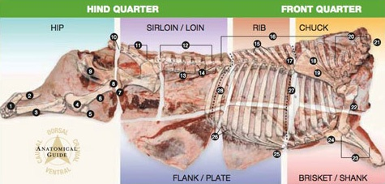
Fig 5: Beef Carcass showing different Cuts
Source: Canada Beef Inc. Corporate Information Copyright 2012

Slide 52
Different Cuts of Beef Carcass
Hock Bones Gambrel Cord (tendon of gastronemius – calcaneal tendon or achilles tendon) Hind Shank (tibia) Stifle Joint Knee Cap (patella) Round Bone (femur) Ball of Femur Protuberance of Femur Pelvic Bone Tail Bones (caudal vertebrae – 2 bones) Sacrum (sacral vertebrae – 5 bones) Loin Bones (lumbar vertebrae – 6 bones) Chine Bones (the split bodies of cervical, thoracic, lumbar and sacral vertebrae) Transverse Process of Lumbar Vertebrae | Feather Bones (split dorsal processes of the thoracic vertebrae) Back Bones (thoracic vertebrae – 13 bones) Blade Bone Cartilage Ridge of Blade Bones (spine of the scapula) Blade Bone (scapula) Neck Bones (cervical vertebrae – 7 bones) Atlas Bone (first cervical vertebrae) Arm Bone (humerus) Fore Shank Bones (ulna, radius) Elbow (olecranon process of the ulna) Breast Bone (sternum) Rib Cartilages (costal cartilages) Chuck/Rib break between rib 5 and 6 Rib/Loin break between rib 12 and 13

Slide 53
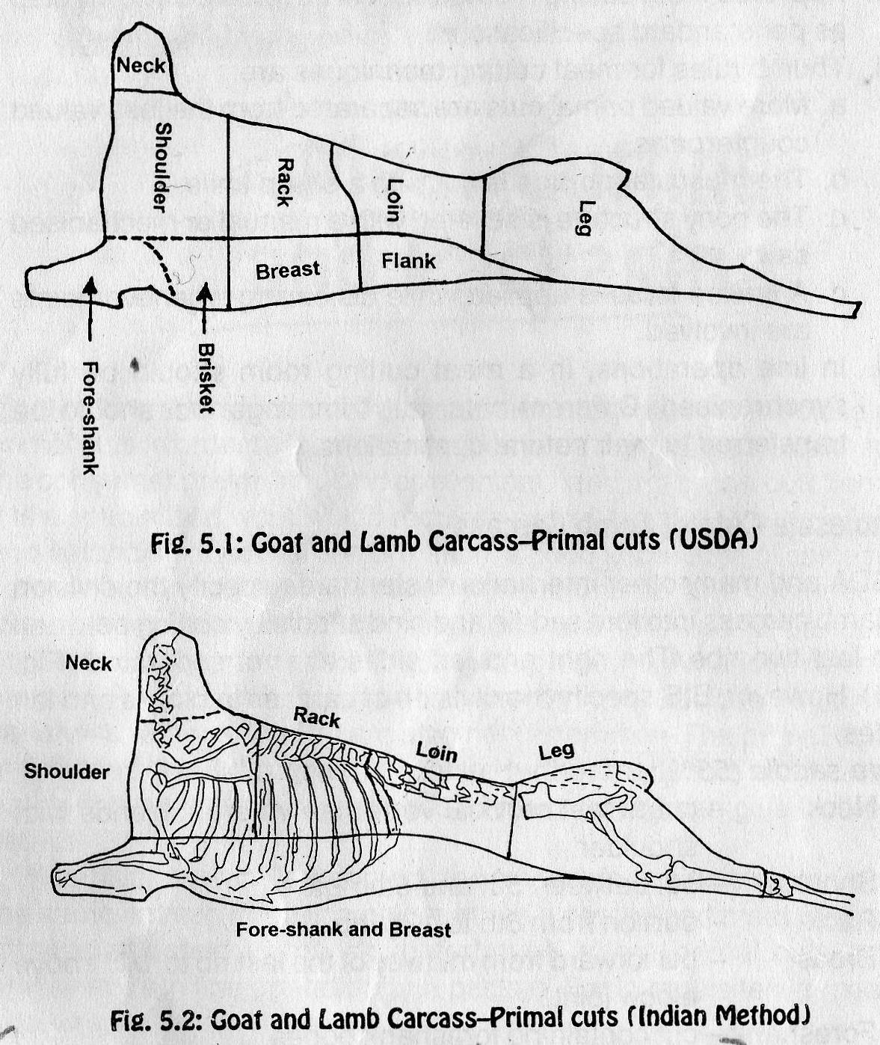
Fig 6: Structure of the Muscle Fibre

Slide 54
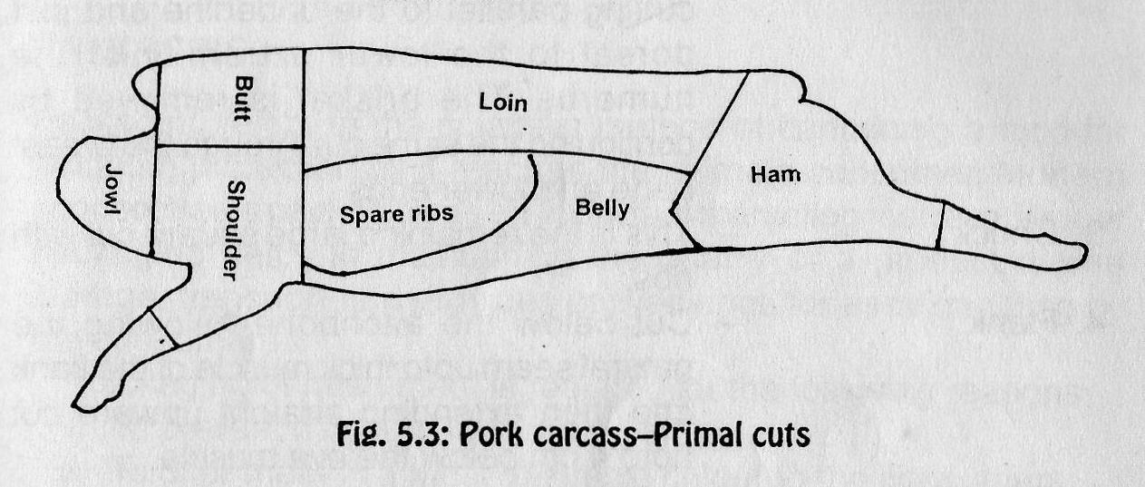
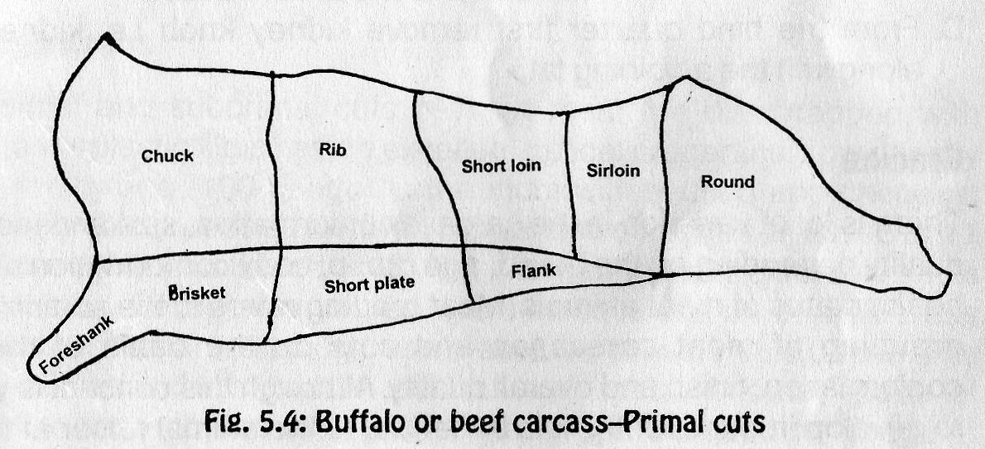
Fig 7: Structure of the Muscle Fibre

Slide 55
LECTURE 9
SPOILAGE OF MEAT AND FISH
The most causative agent in meat and fish spoilage is the presence and activities of bacterial (proliferation)
The pre-handling before slaughter and amount of lactic acid in the meat tissue.

Slide 56
Spoilage of meat
When meat depicts signs of decomposition and putrefaction, it is referred to as spoiled and becomes unfit for human consumption. Besides microorganisms, intrinsic enzymes and insects also contribute to the spoilage of meat. Microbial spoilage of fresh chilled meat is generally on the surface whereas it is within meat at higher temperature. The causative agents and deteriorative changes are quite different in aerobic and anaerobic spoilage. Under aerobic conditions, most significant symptom of meat spoilage by bacteria and yeast is the slime formation on the surface which results due to coalescence of a large number of individual colonies. There may be discolouration of meat due to oxidizing agents produced by bacteria or growth of colonies of coloured organisms. The production of off-odours is also usually encountered.

Slide 57
Spoilage of meat Contd.
Bacterial action causes proteolysis of meat proteins and lipolysis of meat lipids. The end products of proteolysis are simple peptides and amino acids under aerobic conditions whereas sulphur dioxide, ammonia and other obnoxious compounds like amines and ketones under anaerobic conditions. Moulds may grow on semi-dried meats causing surface stickiness and whiskers.
Under anaerobic conditions, meat decomposition is more offensive. There may be putrefaction in the deep tissues such as lymph nodes and bone joints, which is always accompanied by foul odours or taints. Souring may also develop due to accumulation of organic acids.

Slide 58
Identification of Meat Spoilage
Meat spoilage can be detected by any of the following physical and chemical methods:
Physical observations such as discolouration, slime formation, stickiness etc. give a clear indication of spoilage.
At low temperature, there could be formation of many off-flavour compounds originating from free amino acids and related compounds. Chemical determinations for the presence of ammonia, indole, di and tri methylamine can also be carried out to determine extent of microbial spoilage in meats.
The pH value could also be an indicator of spoilage. At the onset of spoilage, ground meat has a pH of 6.5 which may even increase to 8.5 in putrid meats.

Slide 59
Identification of Meat Spoilage Contd
iv. Determination of Extract Release Volume (ERV) can also be an index. It refers to the volume of aqueous extract released by a meat homogenate when it is passed through a filter for a given period of time. As meats undergo microbial spoilage, there is a complete hydrolysis of proteins which significantly decreases the ERV.
v. High thiobarbituric acid and peroxide values indicate chemical spoilage of meat and meat products.

Slide 60
Fish spoilage
Fish cannot be prevented from struggling unlike animals before slaughtering and therefore the level of glycogen becomes depleted.
Thus, fish contains low level of glycogen (which can be converted to lactic acid) at death. Proper degree of acidity restricts bacterial growth.
The collective tissues holding the fish together are weak.
Fish contains between 0.2–2% nitrogenous compound called trimethylamine oxide (TMAO) which is absent in meat.
The (TMAO) is broken down after death of the fish (by bacteria) into monomethylamine and dimethylamine responsible for the offensive odour characteristic of spoilt fish.

Slide 61
Fish spoilage contd.
Fish contains higher level of unsaturated fat when compared with meat which when oxidized leads to rancidity and offensive odour.
Bacteria are in abundance on the surface, gills and gut of the fish because of its habitat thereby gaining entry into the fish once it dies.

Slide 62
LECTURE 10
Ageing of Dressed Carcasses
In the absence of microbial spoilage, the holding of unprocessed meat above freezing point is known as ageing / conditioning and sometimes ripening. During this period of holding at above freezing point (0 to 3⁰C) several changes occur in meat at a subtle rate. Atmospheric oxidation proceeds very slowly in the dark while bacterial action is retarded to a large extent. Proteolytic enzymes (proteases) within muscle fibres remain active and fragment myofibrils in natural course. Cathepsins or autolytic enzymes also play their role. Maillard reaction also proceeds to a varying degree. A combination of these alterations bring about desirable changes in the sensory attributes of meat system especially increase in tenderness, flavour and to some extent in the juiciness. Increase in tenderness is relatively rapid during first 3 to 7 days post-mortem and tenderization rate diminishes after that.

Slide 63
Types of Post-mortem Ageing
Two types of post-mortem ageing procedures are commercially practiced:
(i) dry ageing and (ii) wet ageing.
Dry ageing is the traditional procedure in which entire carcass or wholesale cuts, without any packaging, are hung in the chilling room at 0 to 1⁰C for 3 to 4 weeks at relative humidity of 86% and air velocity of 0.5 meter/sec. These conditions can vary widely at commercial level.
Wet ageing is the predominant commercial practice wherein wholesale or primal cuts are put in vacuum bags and held at 0 to 1⁰C for 7 to 10 days. In such a situation, humidity and air velocity provisions become superfluous.

Slide 64
Significant Changes in the Meat System During Ageing
Protein denaturation: Denaturation refers to physical rearrangement of chemical bonds in the amino acids of protein polypeptide chains without involving any hydrolysis. During post-mortem ageing myofibrillar and sarcoplasmic proteins denature to a varying degree. There is detachment of actin filaments at Z-lines resulting in the fragmentation of myofibrils. It enhances tenderness, although muscle proteins manifest some loss of water holding capacity. However, connective tissue proteins like collagen and elastin do not undergo denaturation.

Slide 65
ii. Proteolysis: Denatured proteins are particularly susceptible to the action of proteolytic enzymes. So, myofibrillar proteins are very prone to these enzymes. During ageing, sarcoplasmic reticulum loses the capacity to retain Ca⁺⁺ ions and their release initiate a water-soluble enzyme called calcium-activated sarcoplasmic factor (CASF). This factor degrades desmin (a Z-line protein), connectin (gap filaments), troponin T (above pH 6) and M line proteins causing tenderization of meat. Proteolysis brings about some improvement in water holding capacity of meat. Some collagen fibres appear to swell during ageing suggesting partial damage to cross links in perimyseal and endomyseal collagen and solubilisation to a limited extent.

Slide 66
Industrial Meat Tenderization
In meat industry, tenderization of meat is brought about not only by ageing and cathepsin initiated proteolysis but by using certain meat tenderising enzymes like papain (papaya), ficin (figs), bromelain (pineapple). They act on the gristle (tough collagen) and hydrolyse it to make the meat much tender.

Slide 67
LECTURE 11
Eating Quality / Palatability Characters of Meat
Three major palatability attributes of meat are: juiciness, flavour and tenderness.
Juiciness: Differences in the juiciness of meat may be attributed to the amount of bound moisture and intramuscular fat concentration. Hence, juiciness is largely determined by water holding capacity and intramuscular lipid.
Meat flavour: This is associated with water soluble myofibrillar proteins.
Tenderness: depends on contractile state of muscle and amount of connective tissue. Tenderness also depends on ante mortem and post-mortem factors and is found to be heritable (45%). The factors responsible for tenderness in meat are genetics, species, age, feeding, muscle type, suspension of carcass, electrical stimulation, chemical activities (salt curing, use of papain etc.), marinating, freezing, thawing, cooking etc.

Slide 68
Meat Colour
Myoglobin constitutes about 80-90% of the total meat pigments. Myoglobin molecule has a protein portion (globin) and a heme (iron containing) ring. In intact meat, iron in the heme ring of myoglobin exists in the reduced form. Upon cutting, grinding or exposure to air, myoglobin is oxygenated to form oxymyoglobin within 30-45 minutes. Oxymyoglobin has a bright red colour (bloom) which is very much desired by the consumers. However, this pigment is comparatively unstable. In conditions of less oxygen, partial vacuum or semipermeable package, myoglobin as well as oxymyoglobin is oxidized to brown coloured metmyoglobin. At the time of meat purchase, brown colour is usually associated, by the consumers with meat that has been stored for long although it is not always true. In order to prevent the formation of brown colour, fresh meat is often packed in films with very good gas (oxygen) transmission rate.

Slide 69
Colour fixing reactions of cured meats can be summarized as follows:
Nitrate > nitrite
Absence of light and air
Nitrite >Nitric oxide (NO)
NO + Mb >Nitric oxide metmyoglobin (NOMMb)
Favourable conditions
NOMMb >Nitirc oxide myoglobin (NOMb) (unstable cured pigment)
NOMb + heat/smoke >Nitroso haemochromogen (stable pink pigment)
Nitrates and nitrites at permitted levels of 500 ppm and 200 ppm respectively act as preservatives by inhibiting the growth of a number of bacteria especially Clostridium botulinum.

Slide 70
LECTURE 12
Methods of Meat Preservation
Meat is a highly perishable commodity due to nearly neutral pH (low acid food), high moisture content and rich nutrients. Various methods employed to prolong the shelf-life of meat are:
1. Chilling /Refrigeration 2. Freezing
3. Curing 4. Smoking
5. Thermal processing 6. Canning
7. Dehydration 8. Irradiation.

Slide 71
Chilling/Refrigeration: This is the most widely used method of preservation for short term storage of meat because chilling or refrigeration slows down the microbial growth and enzymatic as well as chemical reactions. Storage of fresh meat is done at a refrigeration temperature of 2 to 5⁰C. The relative humidity is generally kept 90% in order to check excessive shrinkage due to loss of moisture. Carcasses are first held in chill coolers (15⁰C) to remove their body heat and then passed on to holding coolers (5⁰C). It is important to maintain proper spacing between carcasses so as to allow thorough air circulation. Refrigerated temperatures favour the growth of psychrophilic organisms causing spoilage of meat in due course of time.
Generally, fresh meat is maintained in good condition for a period of 5-7 days at a refrigerated temperature of 4±1⁰C. Processed meat products are also stored under refrigeration till they are finally consumed and their shelf life depends on the processing steps followed in each case.

Slide 72
Freezing
Freezing is a method of choice for the long term preservation of meat. It stops the microbial growth and retards the action of enzymes. It has the advantage of retaining most of the nutritive value of meat during storage, although a very little loss of nutrients does occur in the drip during thawing process.
Various type of freezers are employed to freeze meat and meat products. They include plate freezers, blast freezers etc. A temperature range of –10 to –30⁰C is generally achieved.
To preserved the quality of meat and meat products a storage temperature of –18⁰C is recommended because at this level almost all water in meat is frozen and minor temperature fluctuations can be taken care of. At —18⁰C, storage life of buffalo meat, beef, mutton and chevon is approximately 6 months, while that of pork and poultry is 4months because of associated unsaturated fat, prone to rancidity development. Storage life of cured and salted meat products is still limited (2 months) as salt is a pro-oxidant. However, at –10⁰C, storage life of these meats is reduced by half or even less.

Slide 73
Curing
Preservation of meat by heavy salting is an age old practice. It was applied as a thumb rule because refrigeration facilities were not available. Later, curing by common salt and sodium nitrite resulted in comparatively improved products. These days mild curing of meat products is practiced mainly for specific flavour and colour development and the added preservative effects that curing ingredients offer. The main curing ingredients include sodium chloride, sodium nitrite, sodium nitrate and sugar. Basic functions of sodium chloride as an ingredient include:
It dehydrates and alters the osmotic pressure which results in inhibiting growth of spoilage bacteria.
Chloride ions in the salt directly act on the microorganisms and inhibit their growth and activity.
It slows down the action of proteolytic enzymes in meat.
It interacts with fatty acids to enhance the flavour of the cured products.
It also contributes to the tenderness of the product.
Sodium nitrates and nitrite: Serve to stabilize the attractive cured meat colour and impart characteristic cured meat flavour.

Slide 74
Smoking
Meat smoking was known to man as an aid in preservation for a long time, although its chemical basis was a mystery. It is now well known that smoke contains a large number of wood degradation products such as aldehydes, ketones, organic acids, phenols etc. which exert bacteriostatic effect besides imparting characteristic smoky flavour. Preservation of smoked meat is also due to surface dehydration, lowering of surface pH and antioxidant property of smoke constituents. Curing and smoking of meat are closely interrelated and these days, curing is usually followed by smoking. Besides, smoking and cooking operations are accomplished simultaneously.
Smoke is produced in the specially constructed ‘smoke house’ where saw dust or hardwood and sometimes both are subjected to combustion at a temperature of about 300⁰C. High temperature is desirable to minimize the production of carcinogenic compounds

Slide 75
Thermal Processing / Pasteurisation
Pasteurisation refers to moderate heating in the temperature range of 58ºC to 75ºC whereby most of the microorganisms present including trichinae occasionally found in pork are killed. Incidentally, this is also the cooking temperature range of most processed meats. This heat treatment significantly extends the shelf life of meat, although such products also need to be stored under refrigeration.
Canning
It is a process of preservation achieved by thermal sterilization of a product held in hermetically sealed containers. Canning preserves the sensory attributes such as appearance, flavour and texture of the meat products to a large extent. Besides, canned meat products have a shelf life of at least 2 years at ambient temperature

Slide 76
Dehydration
This is the process of removing water from meat concentrates thereby making them unavailable to the microorganisms. The extent of availability of water to microbial cell is expressed as water activity (a_{w}).
Dehydration lowers the water activity considerably to prevent the growth of spoilage organisms. Sun drying of meat chunks as a means of preservation was practiced even in ancient days but rehydration of such meat chunks used to be limited.
Mechanical drying process involves the passage of hot air with controlled humidity but here also there is difficulty in rehydration.
Freeze drying of meat is a satisfactory process of dehydration and preservation due to better reconstitution properties, nutritive quality and acceptability.

Slide 77
Irradiation
Radiation is the emission and propagation of energy in the material medium. Electromagnetic radiations are in the form of continuous waves. These are capable of ionizing molecules in their path. These radiations can destroy the microorganisms by fragmenting their DNA molecules and causing ionization of inherent water within microorganisms. Since microbial destruction of foods takes place without significantly raising the temperature of food, irradiation is many times referred as cold sterilization. Among radiations, alpha and beta-rays charged particles have limited use in food irradiation while X-rays and Gamma rays are mostly used.
A dose of 50-100K rad (radurisation) of Gamma rays can enhance the shelf-life of fresh meat cuts and poultry products by 19 days whereas a dose of 4-5 Mrad (rad appertisation) can sterilize pork, poultry and fish.

Slide 78
LECTURE 13
PROCESSING OF MEAT AND MEAT PRODUCTS
Basic processing procedures involved in the transformation of meat into useful and edible products include: non-comminuted or comminuted processing. Thus, all processed meats can be classified as either non-comminuted or comminuted products.
Non-comminuted products are generally processed from intact cuts. These products are usually cured, smoked and cooked, e.g. ham and bacon.
Comminution: Comminution refers to subdivision or reduction of raw meat into meat pieces or particles. The degree of comminution or particle size varies with the processing characteristics of products. Such meat particle size reduction helps in the uniform distribution of seasonings and eliminates the toughness associated with meat of old animals and lowers the fuel cost for cooking. Comminution is done with the help of meat mincer for coarse ground products whereas bowl chopper is also employed for making fine meat emulsion.

Slide 79
Emulsification: A mixture of two immiscible liquids where one liquid is dispersed as droplets in another liquid is called emulsion. An emulsion has two phases—a continuous phase and a dispersed or discontinuous phase. The emulsion can be stabilized by reducing the interfacial tension with the help of emulsifying agents or emulsifiers.

Slide 80
Meat emulsion comprises of a dispersed phase of solid or liquid fat droplets and a continuous phase of water containing salt and proteins. Here, continuous phase can also be referred to as a matrix in which fat droplets are dispersed. For practical purposes, meat emulsion is an oil-in-water emulsion where solubilised meat proteins act as emulsifiers. It is very important to maintain low temperature during emulsion formation in order to avoid melting of fat particles, denaturation of soluble proteins and lowering of viscosity. This is done by adding ice flakes instead of chilled water during chopping. For the preparation of a good meat emulsion, lean meat is first chopped with salt to extract salt soluble proteins and then fat and other ingredients are added. Salt soluble proteins have a relatively high emulsifying capacity. Once a good meat emulsion is formed, it has to be protected during cooking or heat treatment.

Slide 81
Meat extension: A lot of non-meat food items can be incorporated in meat products. These are generally termed as extenders, although these may be specifically referred to as fillers, binders, emulsifiers or stabilizers depending on the purpose of their incorporation in the basic meat formulation. In developing countries, soy products, potato starch and flours of wheat, rice, pea, corn etc. are used as fillers to reduce the cost of formulations. Several milk products such as skim milk powder, dried whey, sodium caseinate etc. are frequently used as binders. Some gums like sodium alginate, carrageenan, gum Arabic etc. may be used to stabilize fragile meat emulsions.

Slide 82
Pre-blending: It refers to the mixing of a part or all the curing ingredients (salt, nitrite, nitrate etc) with ground meat in a specified proportion. This process allows better extraction of proteins which in turn helps in the formation of stable emulsion. It permits control of product composition by adjusting the desired fat content.
The processing of meat before the onset of rigor is referred to as hot processing
Hot processing: It refers to the processing of carcass as soon as possible after slaughter (certainly within 1-2 hours) without undergoing any chilling. The term pre-rigor processing is used when muscular meat is processed in a pre-rigor condition.

Slide 83
Advantages of hot processing:
It accelerates the processing steps and entire processing steps and time are reduced to a great extent.
There is improvement in the cooking yield and sensory quality of the product.
There are financial benefits due to reduced chiller space and labour requirement.
Thus, lot of energy is saved if hot processing is adopted at a pilot scale.

Slide 84
Cooking: Meat and meat products are cooked by any one or a combination of three methods—dry heat, moist heat and microwave cooking.
Dry heat cooking is an accepted method for relatively tender cuts of meat such as pork chops, leg and chops of lamb, ground and comminuted meats etc. Dry heat cooking involves either broiling, roasting (in hot-air oven at 115-150⁰C) or frying. Roasting generally gives good browning and improves the flavour of the product. Frying –deep fat or shallow pan is especially suitable for thin cuts of meat such as sliced steaks, mutton chops, chicken meat pieces etc.

Slide 85
Moist heat cooking is recommended for relatively tough cuts of meat. In this method, hot water or steam is continuously kept in contact with meat for cooking, Pressure cooking, stewing, simmering, braising, etc. are popular moisture cooking procedures. Higher cooking temperatures can be achieved in pressure cooking facilitating the tenderization of tough cuts of meat. In stewing, tough meat pieces are first browned in small amount of fat and then covered with water along with curry stuff and allowed to cook at simmering temperature in covered container. The final product becomes tender along with a curry. Simmering involves cooking in hot water at a temperature of 70⁰C for considerable time. Braising utilizes both dry heat as well as moist heat for proper processing of meat products. Several meat cuts like pork chops and steaks, mutton breast and shanks etc. are first fried in a frying pan and then put in a covered container along with water and seasoning for cooking at 80-90⁰C.

Slide 86
LECTURE 14
MEAT PRODUCTS
Meat Products can be grouped as follows:
1. Cured and smoked meats
2. Sausages
3. Intermediate moisture and shelf stable meat products
4. Restructured meat products
5. Other popular meat products
Cured and Smoked Meats
All meat products belonging to this class are cured, whereas only some of them are smoked. The primal cuts of pork especially ham and bacon have been subjected to curing and smoking for a long time. These days, it is a general practice to accomplish cooking also during smoking except for Country ham, which is smoked without cooking.

Slide 87
Sausages
Sausage term was derived in the ancient times from the latin word ‘salsus’ meaning salt. It was literally coined to refer to ground meat which was salted and stuffed in animal casings. Presently, sausage may be defined as a meat product which is prepared from minced and seasoned meat and formed into cylindrical shape by natural or synthetic casings. Though sausages originated in the western world, these products acquired universal popularity due to variety and convenience to the consumers. Sausages are economical also because they are generally prepared from cheaper cuts of meat and by-products of industry.

Slide 88
Classification of Sausage
Sausages are such a large number of varying kinds of products that it is not possible to cover them in any classification system. Some overlapping is always there. Some of the popular classification systems are:
- Based on degree of chopping: (a) Coarse ground sausage (b) Emulsion type sausage
- Based on moisture content: (a) Fresh sausage (b) Smoked uncooked sausage (c) Cooked sausage (dry and semi-dry sausage)
- Based on fermentation : (a) Fermented sausage (b) Non-fermented sausage

Slide 89
Sausage Processing Steps
Grinding or mincing: Lean meat and fat are minced separately in a meat mincer. The choice of mincer plate or sieve depends on the type of meat.
Mixing: Meat and fat to be used for the preparation of coarse ground sausage are mixed uniformly in a mixer. Extender, condiments and spices should also be run in the mixer for even distribution.
Chopping and emulsifying: For emulsion preparation, lean meat is first chopped for few minutes in a bowl chopper with salt to extract myofibrillar proteins. This is followed by addition of fat and running for a few minutes again to get desired emulsion consistency. Now, all other ingredients are added and chopper is run for some time for uniform distribution. The entire operation is conducted at low temperature by addition of ice flakes in place of chilled water.

Slide 90
Stuffing: Sausage emulsion or batter is taken to stuffer for extrusion into casings. The casings are first collected on the stuffing horn or nozzle and released to coincide with the extrusion.
Linking and tying: In small sausages, the encased mass is twisted to produce links either manually or mechanically whereas in large sausages, the encased mass is tied with thread at regular intervals.
Smoking and cooking: Sausage links are hung on the smokehouse trolley and transferred to smoke house. The temperature of smokehouse is usually maintained at 68-70⁰C which is enough for coagulation of sausage emulsion, cooking and requisite drying of sausages.
Chilling: The cooked product is showered with chilled water to an internal temperature of about 4⁰C.
Peeling and packaging: While artificial or synthetic casings are peeled off before the product is packed, small sized natural casings need not be removed. The product is generally unit packed for retail outlets.

Slide 91
Some of the popular classification systems of Sausages are:
i. Based on degree of chopping : a. Coarse ground sausage
b. Emulsion type sausage
ii. Based on moisture content : a. Fresh sausage
b. Smoked uncooked sausage
c. Cooked sausage
d. Dry and semi-dry sausage
iii. Based on fermentation : a. Fermented sausage
b. Non-fermented sausage
Other examples of popular sausages
Bologna: It is an emulsion type sausage prepared from the meat of old animals
Hot dog: It is a fairly spicy sausage in broader casings, usually processed in India.
Mortadella: It is a dry sausage prepared in cattle bladder or artificial broader casings.

Slide 92
Intermediate Moisture and Shelf Stable Meat Products
Intermediate Moisture Meats (IMM) are meat products with 20-50% moisture and had moderate juiciness and texture on rehydration. Such products were resistant to bacteriological spoilage and could be held without refrigeration. The basic reason for the stability of these products lay in the reduced availability of water to the microorganisms, since water activity generally remains in the range of 0.6 to 0.85. These semi-moist meats are of special significance to the developing countries where refrigeration facilities are not always available. Such products can be easily be carried in defence expeditions and stress situations like floods, famines etc. for air drop.
Humectants
Various additives employed for lowering the water activity of foods are known as humectants. Some of the most commonly used humectants are: Glycerol, Propylene glycol, Sodium chloride, Polyhydric alcohols (e.g. sorbitol), Sugars (e.g. sucrose, dextrose, corn syrup etc).

Slide 93
Basic Processing Techniques for IMM
Moist infusion or desorption: it involves soaking and/or cooking of meat chunks or cubes to yield a final product having desired water activity level, e.g. sweet and sour pork, Hungarian goulash etc.
Dry infusion or adsorption: it involves initial dehydration of meat chunks or cubes followed by soaking in an infusion solution containing desired osmotic agents, e.g. ready-to-eat cubes of roast pork, chicken a la king etc.
Component blending: In this process, dry and wet ingredients or components are blended with the meat, cooked and extruded or otherwise mixed to give a final product of desired water activity.

Slide 94
The thumb rules for the preparation of IMM are:
Reduction of water activity by addition of humectants,
Retardation of microbial growth by addition of antimicrobial especially antimycotic agents and Improvement of sensory properties such as flavour and texture through physical and chemical treatments.
Stability of Intermediate Moisture Meats
Intermediate Moisture Food (IMF) products are fairly stable at ambient temperature for several weeks or even months. However, prolonged storage may result in some quality deterioration.

Slide 95
LECTURE 15
CHEMICAL COMPOSITION AND NUTRITIVE VALUE OF POULTRY MEAT
Poultry meat is a good source of protein. It has a balanced lipid content and low calorific value. It is palatable, tender and easily digestible. It is easy to prepare and can be served in a variety of ways.
CHEMICAL COMPOSITION:
Moisture This is the largest component of muscle tissue. It dissolves nutrients and serves as a medium for their transport. Raw chicken meat contains 70-74% moisture. In general, younger birds have a higher moisture to skeletal muscle ratio as compared to older ones.

Slide 96
CHEMICAL COMPOSITION OF POULTRY MEAT CONTD.
Protein: Poultry meat has a higher protein content than most of the red meats. This protein is of very superior quality with respect to biological value and essential amino acid contents. Male birds generally have a higher protein content as compared to their female counterparts.
Fat: Most fat in poultry remains confined underneath the skin in contrast to red meats where it is generally distributed throughout the tissues. Poultry meat contains less cholesterol, a fatty alcohol associated with atherosclerosis, as compared to most other animal based foods.

Slide 97
CHEMICAL COMPOSITION OF POULTRY MEAT CONTD.
Carbohydrate: Poultry meat has very little carbohydrate content, hardly 1-2 per cent of total edible tissue. Inositol, glucose and fructose are the major and mannose and ribose are the minor constituents of carbohydrate.
Vitamins: Poultry meat is a good source of many vitamins. Niacin is present in good quantity whereas thiamine (vitamin B₁), riboflavin (vitamin B₂) and ascorbic acid (vitamin C) are also present in fair quantity. Poultry liver is a rich source of vitamin A, vitamin B complex and vitamin C.
Minerals: Poultry meat contains nearly one per cent desired minerals. Some of the important ones are sodium, potassium, calcium, magnesium, iron, phosphorus, sulphur, chlorine etc.

Slide 98
NUTRITIVE VALUE OF POULTRY MEAT
Poultry meat is a food of high nutritional value. It is higher in protein content as compared to red meats classified under first class category because it contains all the essential amino acids in a balanced proportion. Such high protein diet ensures overall development of the body and plays an important role in tissue repairs.
Chicken meat with low fat content provides the much desired essential fatty acids which form necessary constituents of the cell wall, mitochondria and other cell constituents. Thus, it helps in maintaining the health of the consumers. Due to its low energy value, chicken meat is a good food for weight control diets. It contains more phospholipids and low cholesterol than other meats, which minimizes risks due to diabetes and heart diseases.
Chicken meat is a good source of vitamins and minerals in human diet. It is rich in niacin and moderately rich in thiamine, riboflavin and ascorbic acid. Also a good source of iron and phosphorus.

Slide 99
NUTRITIVE VALUE OF POULTRY MEAT CONTD.
Due to high biological value and easy digestibility, chicken meat is a choice food for aged persons as well as children. It carries a high class image because of its product variety and healthful nature.
In general, poultry meat contains all the essential amino acids, fatty acids and minerals in an appropriate quantity. It has the ability to alleviate the nutritional stress conditions in the human beings. It has a good aesthetic appeal. Poultry meat has no religious inhibition and its many products satisfy the variety quest of the consumer

Slide 100
SLAUGHTERING OF POULTRY
Slaughtering involves stunning and bleeding:
Stunning: To immobilise the birds
Bleeding: To remove the blood
Scalding Scalding refers to immersion of birds in hot water for loosening the feathers. It should be done when all reflexes have ceased. The birds are transferred into the scalding tank. Broiler and young birds are scalded at 55⁰C for 1.5 minutes whereas culled birds and spent hens are scalded at 60⁰C for 2 minutes
Defeathering: The process is carried out to pull off the feathers from the carcass. It can be done mechanically or manually.
Singeing- for 5 to 10 seconds to remove hair like appendages called filo plumes.

Slide 101
Slaughtering of Poultry Contd.
Washing- Spray with clean water to remove dirt and reduce microbial population
Removal of Feet and Oil Gland: The next step involves cutting of feet from tarso-metatarsal joint with a sharp knife and removal of oil gland.
Evisceration: The carcasses are hung by hocks to the shackles for evisceration. By a slit opening from the tip of breast bone, abdominal cavity is opened by means of a transverse cut. After post-mortem inspection, inedible offals, including trachea, lungs, oesophagus, crop, intestines, gall bladder and kidneys are removed whereas giblet consisting of heart, liver and gizzard should be collected, cleaned and packed in a wrapper.
Chilling and Draining: After washing, the dressed birds are chilled in a chilling tank containing slush ice or crushed ice for 30-45 minutes in order to cool the carcasses to an internal temperature of about 4⁰C. The chilled birds are kept on the draining rack for 10 minutes to remove the excess water.

Slide 102
Slaughtering of Poultry Contd.
Washing: Dressed birds are thoroughly washed again with clean spray water preferably maintained at 15±5ºC. Special care should be taken to wash the interior and sides.
Grading: Dressed chickens are graded on the basis of conformation, degree of fleshing, bruises, cuts and other quality attributes.
Packaging: Before packaging, dressed chickens having gizzard without mucosal layer, heart without pericardium and liver without gall bladder are placed in the abdominal cavity of the carcass and packed in polyethylene bags (200 gauge). Shrink packaging may be adopted if dressed chickens are to be stored in a frozen condition.
Storage: Dressed chicken can be stored in a refrigerator at 2ºC for 7 days and deep freezer at -18 to -20ºC for a period of 4-6 months.

Slide 103
PRESERVATION OF POULTRY MEAT
The basic purpose of poultry meat preservation is to retard or prevent microbial spoilage and other physico-chemical changes which cause deterioration in quality. Thus, proper preservation safeguards the sensory quality and nutritive value of poultry meat. Various methods employed for preservation of poultry meat are as follows.
Chilling, Freezing, Curing, Smoking, Dehydration, Canning, and Radiation
Radiation Preservation- For poultry meat, radiation sterilisatin dose of 4.5 Mrad alone and pasteurisation dose of 0.5 Mrad in combination with other preservation methods have been successfully used. Higher does may induce undesirable changes in the quality of poultry.

Slide 104
LECTURE 16
FISH
Fish and fish products are classified as important in human nutrition because they are sources of biologically valuable proteins, fats and fat-soluble vitamins. Fish can be classified in various ways, such as:
Environment where they live: Sea fish (Herring, Cod, Saithe, Tuna, Mackerel, Hake) and Freshwater fish (Pike, Carp, Trout, Catfish, Tilapia) or those which can live in both environments (Eels, Salmon).
By body form: Round (Cod, Saithe) or Flat (Common Sole, Turbot or Plaice).
Fat Distribution: Lean/white fish: The fat is within the liver only;
Fatty Fish: The fat is distributed within the flesh.

Slide 105
(v) Bone structure:
(a) Finfish (vertebrate with fins): Finfish are fleshy fish with a bony skeleton and are covered with scales. They may be lean or fat. For example:
• Lean saltwater fish: cod, flounder, haddock, halibut, red snapper, whiting.
• Lean freshwater fish: brook trout and yellow pike.
• Fat saltwater fish: herring, mackerel, and salmon.
• Fat freshwater fish: catfish, lake trout, and whitefish.
(b) Shellfish (invertebrates): Shellfish are either crustaceans or mollusks; the former with a crustlike shell and segmented bodies, the latter with soft structures in a partial or whole, hard shell. Some examples are as follows:
• Crustacea: crab, crayfish, lobster, and shrimp.
• Mollusks: abalone, clams, mussels, oysters, and scallops.

Slide 106
CHEMICAL COMPOSITION OF FISH
The edible portion of a fish is less than that of warm-blooded animals. The total waste is about 50% with only 10-15% after the head has been removed. Fish meat is readily digestible as it digests faster than terrestrial animals therefore making it have a much lower nutritive saturation value. During cooking, there is about 15% loss in quality of fish and meat shrinkage is less significant than that of beef.
WATER
The main constituent of fish flesh is water, which usually accounts for about 80 % of the weight of a fresh white fish fillet. Whereas the average water content of the flesh of fatty fish is about 70 %, individual specimens of certain species may at times be found with a water content anywhere between the extremes of 30 and 90 %. The water in fresh fish muscle is tightly bound to the proteins in the structure in such a way that it cannot readily be expelled even under high pressure.

Slide 107
PROTEINS
The protein-Nitrogen content of fish muscle is between 2 – 3% though it has a high nutritional value than beef or milk as it contains more amino acids. Fish meat is softer and more tender than mammalian meat. The sarcoplasma protein accounts for 16 – 22% of the muscle tissue total protein. The fish meat proteins has a good digestibility. The heat stability of fish proteins is lower than that of mammals and it can be easily denatured by urea and enzymes.
(iii) CARBOHYDRATES
The principal carbohydrate in fish muscle is collagen. It makes up about 0.3 % of the total muscle which is generally lower than mammalian muscle tissue.

Slide 108
LIPIDS
The fat or oil content of fish is highly variable as it is influenced by the kind of fish, maturity, season, food availability and feeding habit. Fat can be deposited in the muscle tissue (Carp, Herring); in the liver (Cod, Haddock) or in the intestines (Blue pike, pike, Perch). Fish fat is highly characterized by the presence of high content of polyenic acids with 4 – 6 double bonds. The fat is not always uniformly distributed throughout the flesh of a fatty fish.
(vii) VITAMINS AND MINERALS
Fish fat and Liver oil are sources of fat soluble vitamins, A and D. Vitamins E and K are also present. The water soluble vitamins, thiamine, riboflavin and niacin occur in relatively high amounts while others are present only in low amounts. The major minerals in fish tissue are Ca (48 -420 mg/kg), Mg (240 – 310 mg/kg), P (1,730 – 2,170 mg/kg), Fe (5-248 mg/kg), Cu (0.4 – 1.7mg/kg).

Slide 109
EXTRACTIVES
These are substances that can easily be extracted from fish flesh by water or water-based solutions. Unlike the proteins, substances in this group have comparatively small molecules; the most important extractives in fish include sugars, free amino acids, that is free in the sense that they are not bound in the protein structure, and nitrogenous bases, which are substances chemically related to ammonia. While many of these extractives contribute generally to the flavour of fish, some of them, known as volatiles, contribute directly to the flavours and odours characteristic of particular species.

Slide 110
POST-MORTEM CHANGES IN FISH
After death, there is a drop in pH to as low as 6.2 due to the low glycogen content of the fish muscle when compared to mammalian muscle. Rigor mortis is shorter in cold blooded animals than in warm blooded animals.
Fish exhausted by a lengthy struggle in a trawling net (during and after capture) gives meat of low keeping quality. Rigor mortis is short and pH is high. Avoiding fish exhaustion helps to extend rigor. Because of the peculiar structure of fish muscle, the tendency to generate an alkaline pH reaction in muscle and a high probability of microbial infection during fishing and fish dressing, conditions are highly favourable for rapid spoilage of fish. Therefore, bacteriological supervision and control from the market to processing plants and during distribution are of utmost importance.
The pH of fresh fish is 6.0-6.5. The suitability limit for consumption is pH of 6.8 while spoiled fish meat has a pH of 7.0 and above.

Slide 111
LECTURE 17
STORAGE AND PROCESSING OF FISH AND FISH PRODUCTS
Cooling and Freezing
Refrigeration remains the most modern and effective way to retain the wholesomeness and nutritional value of food. This method also enables fisher men to remain on the ocean for months in search of fish.
At temperatures slightly above 0ºC, fish deterioration is rapid. Hence, as soon as fish is caught, they must be packed in ice on board the ship. The ice used may be sprinkled with a bactericidal substance. Whole fish (gutted or ungutted, with or without head removal) or for fish fillets may be frozen. To prevent oxidation, the whole fish is sprinkled with water to form a glaze of ice or it is frozen in an alginate jelly or coated with a latex film.
Domestic thawing of fish is done either at room temperature or under a stream of running tap water. Fish must be consumed shortly after thawing to prevent loss of juices due to dripping and decay.

Slide 112
2. Drying
Fish can be preserved by drying naturally in the sun or in drying installations. Stock fish which is primarily a non-fatty fish (cod, saithe, haddock, ling or tuck) with head removed, split and gutted is spread outdoors to dry in air. Unsalted fish is made by hanging up headless cod in the open air until it is dry and hard. Larger fish is usually split and may be hung in two pieces. Drying takes up to 6 weeks and during this time the water content reduces from about 80 % to 15 %. This final water content is about the minimum at which moulds grow. It has a characteristic flavour and it is extremely tough. Dehydration by use of mechanical dryer can also be employed under controlled drying conditions.

Slide 113
3. Salting
Salt is the oldest and most important preservative for fish. Fish curing involves rubbing or sprinkling fish with salt or immersion in brine (salt solution) and then smoking. In heavily-salted fish, there are at least 20 g of salt in 100 g of tissue, in medium-salted fish, the salt content is 12 – 20 g.
The effectiveness of salting operation for preservation depends on:
uniform salt concentration in the fish flesh.
concentration of salt solution and time taken for salting.
whether or not salting is combined with other methods, such as drying or smoking.
Salting is not used as such as a method of preservation but as preparation for smoking or drying. The use of a light salt solution ensures a decrease in bacterial growth on the surface of the fish during the smoking or drying process.

Slide 114
4. Smoking
Smoking is a method of fish preservation that combines three effects, namely:
Preservative value of smoke: the smoke produced from the burning wood contains a large number of compounds, some of which will kill bacteria e.g. phenols
Drying: the fire which produces the smoke also generates heat that dries the fish
Cooking: at high smoking temperature, the flesh of the fish is cooked and enzymes and bacteria are destroyed (ready-to-eat product).
Two main types of smoking processes are used. They are
Cold Smoking: This involves the use of temperatures between 30 and 40ºC and the product is not cooked. Cold smoking is used for flavour impartation and the end product is similar in keeping quality for fresh fish.
Hot Smoking: This involves temperatures of 80ºC and above and the fish is cooked during the process. This process prevents spoilage and prolongs shelf life.

Slide 115
Smoking Contd
The equipment used during smoking process is referred to as a Kiln which could be either traditional or mechanical. The traditional kiln is simply a chimney in which fish are hung over a fire of smouldering sawdust. This must be accompany with the process stripping the kiln to curtail the problem of smoke burn associated with traditional smoking as a result of uncontrolled smoking conditions. In mechanical kilns, the design involves attempts at overcoming the disadvantages in the traditional kilns. Smoke is obtained from fires laid in special hearths outside the kiln. The smoke is led into the kiln by ducts and mixed with air. Temperature is maintained by using either electric or steam heaters that are thermostatically controlled. The humidity of the smoke can also be controlled by altering the amount of fresh air entering the kiln. The warm smoke is blown by a fan at an even speed over trolleys of fish in a horizontal tunnel.

Slide 116
Smoking Contd
Procedure for Fish Smoking
The processes involved, prior to actual smoking of fish varies with species and type of product required. Pre-smoking operations include gutting, washing, brining, pre-drying, smoking, cooling and packaging. Generally smaller species like Bonga and Sardinella are smoked whole while Sole and Catfish are usually bent into a horseshoe shape and held together in that shape by means of a sharp stick. Tuna and tuna-like species are cut into steaks to increase the surface area for salt and smoke penetration.

Slide 117
5. Fermentation
Fermentation of fish is especially used in situations where drying of fish is not possible because the climate is too wet and where cooling and sterilisation is too expensive. Fermented fish pastes and sauces have a much more important place in the daily diet than salted or dried fish.
During the fermentation of fish, protein is broken down in the presence of a high salt concentration. The fish protein is mainly broken down by enzymes which are from within the fish itself. These enzymes are mainly present in the gut of the fish. In cases where the intestines have been removed, fermentation is slower as there are fewer enzymes present in the flesh.
There are three kinds of fermented fish product:
The fish flesh is converted into liquid which is fish sauce
The fish is converted into paste
The fish, whole or in pieces retains as much as possible its structure.
Assignment: Discuss extensively on Canning as a method of fish preservation.

Slide 118
LECTURE 18
EGGS
STRUCTURE, COMPOSITION AND NUTRITIVE VALUE OF EGGS
Studying the structure, composition and nutritive value of Eggs is necessary to effectively preserve its quality during storage and marketing. There are four main components of hen’s egg:
a. Shell
b. Shell membranes
c. Albumen or white
d. Yolk
The yolk develops in the functional left ovary of the hen as an ovum largely during the final 10 days before release. After ovulation or release, fully developed ovum or yolk is engulfed in the oviduct where a gel of albumin or egg white is secreted to surround the yolk for a few hours. Finally, the shell membranes and the calcareous shell are deposited in the oviduct for nearly 10 hours before the egg is laid.

Slide 119
Fig. 8: Internal
Structure of an Egg

Slide 120
Microbial Spoilage of Eggs
It was widely believed in nineteenth century that contents of fresh eggs were always sterile. Studies conducted afterwards revealed that microorganisms can gain entry into the egg congenitally. However, most of the contaminants of eggs are of extragenital origin and come in contact with egg shell at oviposition from the dust, soil and faecal matter adhered to the nesting material. Since the cuticle and pores of the egg shell are moist at this stage, the possibility of invasion of the shell by some contaminants through a few pores cannot be ruled out. The microorganisms on the shell surface usually belong to a mixed group, but those causing spoilage of egg (generally called rot ) are gram-negative in nature which have very simple nutritional requirements.
The microorganisms have to pass through a series of in-built physic-chemical barriers in the egg—the shell, the shell membranes, and the albumen before reaching the yolk where they could easily multiply causing rot.

Slide 121
The mechanism of microbial spoilage in eggs can be divided into three serial steps:
1. Penetration of microorganisms through the egg shell and shell membranes.
2. Colonisation of microorganisms on the shell membrane.
3. Overpowering of the antibacterial factors present in the albumen.
1. Penetration of Microorganisms through the Egg Shell and Shell Membranes
Egg shell acquires a diverse microflora at the time of oviposition. Under normal conditions of handling and storage, shell gets dried soon and most of these microorganisms fail to survive. An egg shell contains more than 17000 pores. However, only ten to twelve pores allow the microorganisms to pass through. The microorganisms either succeed in when the egg contents contract on cooling or gain entry due to capillary action through pore canals when the shell surface is moist. The role of microorganisms remain passive in both situations. It is due to capillary action that incidence of rotting are comparatively high in washed eggs which have been subjected to dry abrasion. The cuticular plugs on the pore canals are opened during the process of abrasion of eggs.

Slide 122
After gaining entry through the shell pores, microorganisms come across shell membranes. These membranes act as bacterial filters and offer maximum resistance to the offending organisms which have succeeded in penetrating the shell.
Mould may also cause rot in eggs under humid storage conditions. In such case shell is generally covered with mycelium (whisker) and hyphae penetrate the pores to reach shell membranes.
2. Colonisation of Microorganisms on the Shell Membrane
Once the microorganisms have an access to shell membrane, they are able to multiply and form colonies. The pH of egg contents move towards neutrality and yolk comes in contact with inner shell membrane.

Slide 123
3. Overpowering the Antibacterial Factors Present in the Albumen
Egg white or albumen provides an unfavourable medium for microbial growth because of the defensive role played by many of its protein components such as conalbumen. Conalbumen is the principal antimicrobial factor present in the egg and its inhibitory action is more on gram positive as compared to gram negative organisms.

Slide 124
Table 4: A summarized and general type of rots in egg
Type of rot | Changes in egg | Organisms
Green rot | Albumen becomes green | Pseudomonas, Fluorescens
Black rot (Type 1) | Blackening of yolk with “faecal odour” | Proteus sp.
Black rot (Type 2) | Green coloured albumen but yolk is black with “cabbage odour” | Pseudomonas sp.
Red rot | Albumen stained red throughout, Yolk surrounded by custard like material | Serratia sp.
Fungal rot | Pink spots on egg contents Black spots on contents Yellow or green spots on contents | Sporotrichium Cladosporium Penicillium

Slide 125
LECTURE 19
The preservation methods employed to maintain the quality of shell eggs
Eggs should be collected frequently, held initially at low temperature and then a suitable preservation method be employed to maintain its keeping quality for anticipated consumer acceptance. The preservation methods include;
Egg Cleaning
Oil Treatment
Cold Storage
Thermo-stabilization
Immersion in Liquids

Slide 126
Egg Cleaning
Earlier, it was a general practice to dry-clean dirty egg shells by abrasive mounting on a mechanical wheel. This practice has now become obsolete because it weakens the shell. These days washing in warm water containing a detergent sanitizer is an effective way of cleaning the eggs with dirty shells. A temperature difference of 10-15ºC between eggs and wash water is ideal, otherwise there may be problem of crack shells. Besides, eggs should not be immersed in warm water for more than 3-4 minutes. After washing, the eggs should be dried promptly. Wash water should be changed after washing every five to six baskets of eggs. It should be emphasized that only dirty eggs are subjected to washing. It not only reduces the microbial load on the egg shell surface but also improves the appearance and consumer appeal.

Slide 127
2. Oil Treatment
Oil coating spay of eggs has become very popular for short term storage of this commodity. Coating oil forms a thin film on the surface of the shell sealing the pores. It should be done as early as possible, preferably within first few hours after laying of eggs because loss of CO₂ is more during this period and evaporation of moisture is also more during the first few days. Egg coating is done by dipping the eggs in the groundnut oil whereas for oil spray, the eggs are arranged in the filler flats with their broad end up. If the eggs need washing, oil coating should be done after washing. It is important to drain out excess oil before packaging. The temperature of oil should be in range of 15 to 30ºC for ideal results. Oil treatment safeguards the quality of albumen for at least 7 days because it effectively seals the shell pores.

Slide 128
3. Cold Storage
This method of preservation is suitable for long tern storage of clean eggs in the main laying season and abundant availability. The temperature of cold store is maintained at 0ºC (32ºF) and relative humidity between 80 to 85 per cent. An anteroom with intermediate temperature is generally provided to check condensation of water vapour on the eggs during removal. Use of new egg packing trays are advised for cold storage. Like all other animal products, eggs also pick up strong odour, so the same cold store cannot be used for storing onion, garlic or any other commodity with strong odour. The quality of shell eggs can be maintained for about 6 months in a cold storage. Oil coating of eggs prior to cold storage can further enhance their keeping quality. Such eggs could keep well at 14ºC and 90% RH for a period of 8 months.

Slide 129
4. Thermo-stabilization
This preservation method involves stabilization of albumen quality by holding the eggs in an oil bath maintained at 55ºC for 15 minutes or 58ºC for 10 minutes. This process brings about coagulation of thin albumen just below the shell membranes, thereby blocking the passage of air and moisture. In addition, oil coating of shell pores also takes place. Thus keeping quality of eggs is maintained for sometimes and thinning of egg white is retarded. Alternatively, eggs are immersed in hot water at 71ºC for 2 to 3 seconds. In this flash heat treatment, bacteria present on the surface of the shell are destroyed and a thin film of albumen just below the shell membrane is coagulated sealing the egg shell from inside.

Slide 130
5. Immersion in Liquids
Under rural conditions, lime-water or water –glass immersion are most useful. In lime-water treatment, a litre of boiling water is added to 1 kg of quick lime and allowed to cool. Now 5 litres of water and 250g of table salt are added to it. The solution is strained through a fine cloth when the mixture settles down. Eggs are dipped in the clear fluid overnight and then dried at room temperature. In this process, an additional thin film of calcium carbonate is deposited on the egg shell and seals the pores. Such eggs can be stored for a month at ambient temperature. In water-glass treatment, one part of sodium silicate is mixed in 10 parts of water and eggs are dipped overnight. In this process, a thin precipitate of silica is deposited on the egg shell and partially seals the pores.

Slide 131
Fresh Egg collection
Cold storage 4-5ºC
Candling & Inspection at 15ºC
Cleaning with disinfectant/sanitizing (2% sodium hypochlorite solution at 43ºC for 3 min )
Breaking & collection
Churning & filteration
Homogenization for 5 min
Pasteurization (62.5º for 5 min) (To destroy salmonella & other microorganisms)
Desugaring (by adding 0.5% yeast to prevent Maillard reaction)
Fermenting at 30ºC for 11/2
Repasteurization (62.5º for 3-5 min)
Cooling & churning
Drying (drying can be done in 3 ways)
Fig. 9: PREPARATION OF EGG POWDERS

Slide 132
Churned Egg
Freezing (Blast freezer)
Spray drying
Foam mat drying
Drying
In-let temp is 185ºC; Out let temp is 85ºC
(So that mc is 2-4%)
Spreading
Gas packaging
Vacuum packaging
Drying in hot Oven
(60ºC for 24 hr; Mc reduced to 2-4%)
Storage
Storage
Gas packaging
Storage
Fig. 10: Drying Methods in the production of Egg Powder

Slide 133
Deteriorative Changes in Egg powders on storage:
1. Discoloration of egg powder
2. Loss of Nutritive value
3. Off flavour are produced
4. Loss of solubility
5. Non-enzymatic changes

Slide 134
SECOND TEST ON MEAT AND FISH TECHNOLOGY
1. Explain the probable causes of Pale, Soft, Exudative (PSE) and Dark, Firm, Dry (DFD) meats and state their characteristics. 8 marks
Qn. 2. You kept meat and fish separately at the same environmental conditions but you discovered that the fish deteriorated faster than the meat. Discuss the possible cause of your discovery. 8 marks
Qn. 3. Enumerate the importance of lactic acid on meat quality. 4 marks

