Slide 1
NUTRITIONAL EVALUATION OF FOOD PROCESSING
(FST 512)
Lecturer:
Dr. (Mrs.) M. Omolola Omosebi

Slide 2
Nutrient Losses during Food Processing
Vegetables are perishable commodities and postharvest losses are established to be greater than 20–40% in the tropical and subtropical regions.
The main losses occur during harvesting, transportation, storage, and processing.
The harvesting losses can be overcome by adopting appropriate technologies, whereas moisture losses during transportation can be minimized by proper packaging.
Processing of vegetables has the following objectives: (1) improving the shelf life and quality of vegetables, (2) enhancing the palatability and digestibility of vegetables, and (3) inactivation of nutritional inhibitors that increase protein and other nutrients’ availability.

Slide 3
The nutritional losses during processing are of significant importance as cooking is necessary in order to improve the palatability and digestibility of vegetables.
Cooked vegetables are more digestible as compared to raw, with the exception of cucumber, which is usually consumed fresh. A summary of effects of processing on nutrients is given in the following Table .
Thermal processing is the commonly used method in household and industrial food production. However, high processing/cooking temperatures can affect heat labile vitamins and amino acids.
In some cases, excessive heating may cause the generation of toxic metabolites.For example, as a result of various preparations, processing, or cooking steps, peas may lose from 56 to 65% vitamin C.

Slide 4
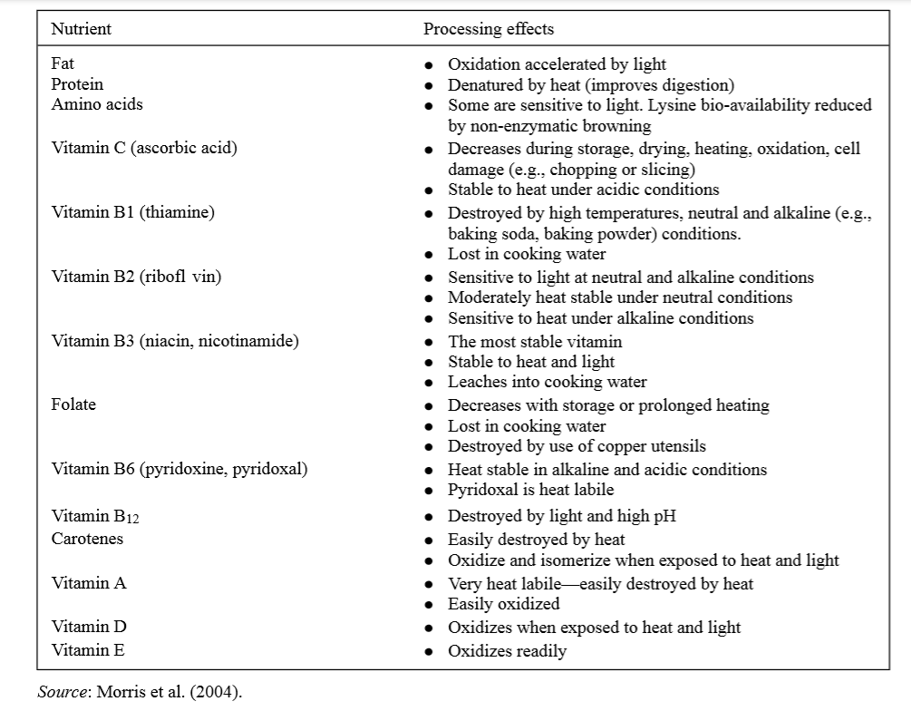
Effects of processing on various nutrients

Slide 5
During canning, chlorophyll is converted to pheophytin due to the high temperatures.
Loss of amino acids during processing and post canning storage may influence the flavour of canned products.
In one such example, heating peas at 120◦C for an hour resulted in 6.9% loss of amino acids. In another study, it is observed that losses in amino acids during blanching are relatively high for spinach as compared to peas.
The antioxidant potential of vegetables is also of significant importance . For example, it has been reported that the canning process resulted in reduced (18% to 35%) antioxidant activities of garlic, peas, broccoli,and Brussels.
The canned products further spoil (fla sour, bacillus spoilage, and hydrogen swell) due to microbes and enzymes.

Slide 6
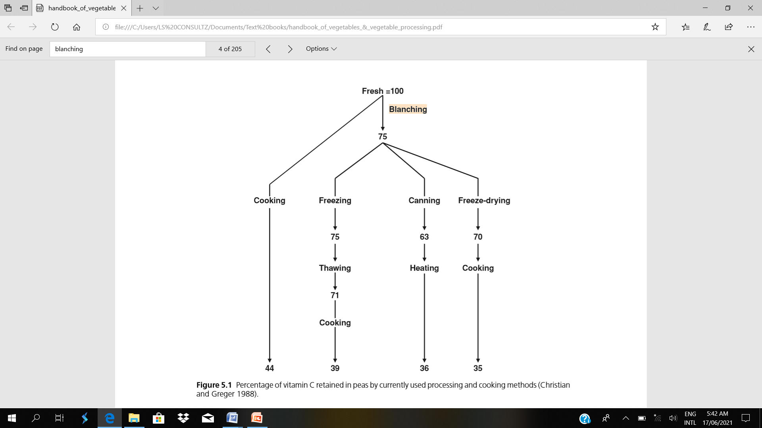
Figure 1. Percentage of Vitamin C retained in peas by currently used processing and cooking methods (Christian and Greger, 1988).

Slide 7
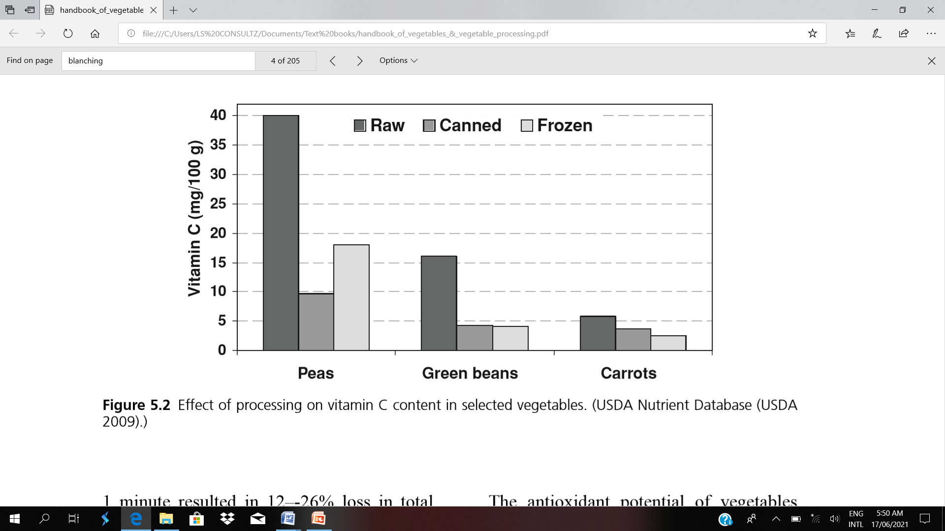
2009)

Slide 8
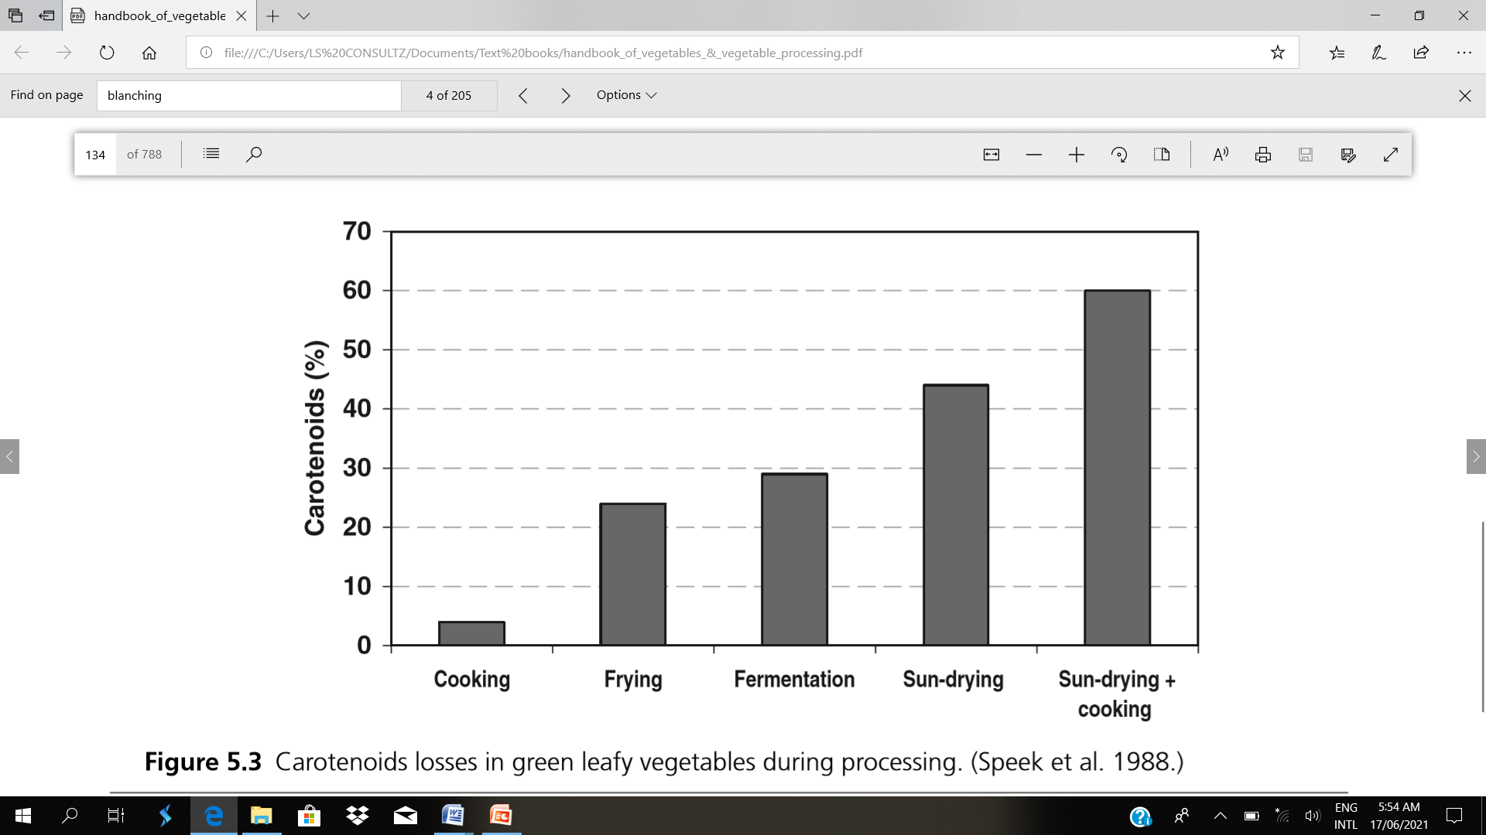

Slide 9
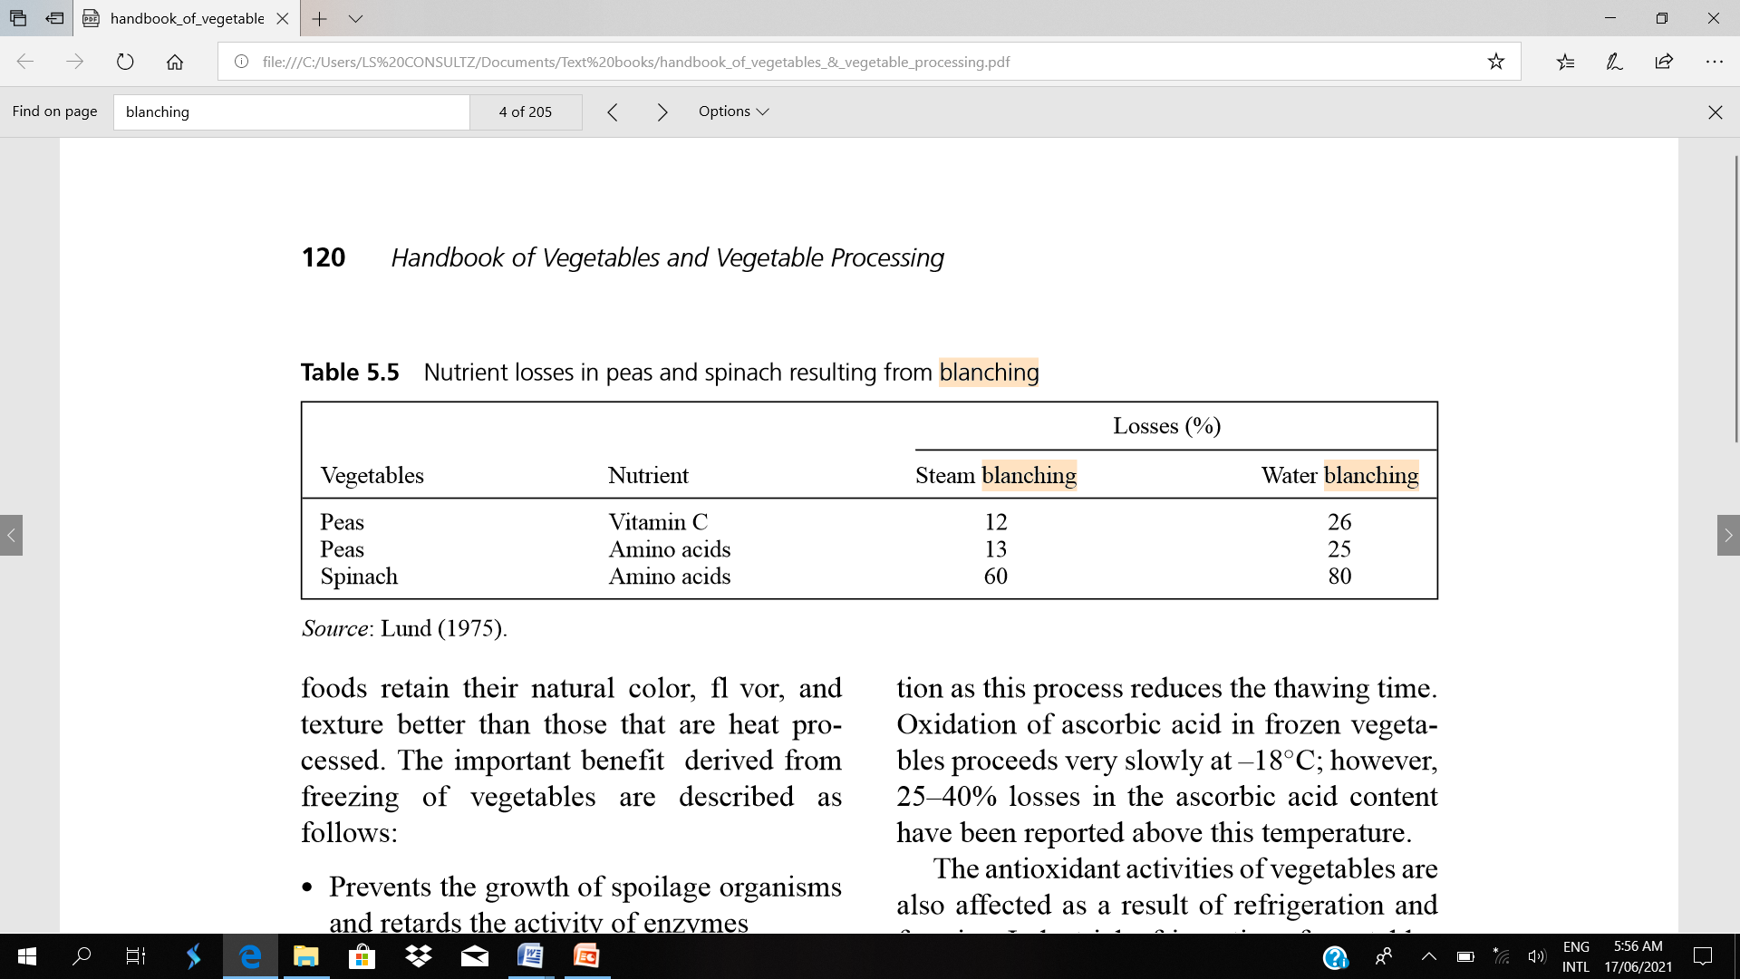
Nutrient losses in peas and spinach resulting from blanching

Slide 10
Canning
Vegetables such as peas, beans, and green leafy vegetables are canned after preparatory operations like washing, sorting, peeling, trimming, chopping, filling exhausting, and sealing, following which heat treatment is applied to safeguard the food from the hazardous effects of microorganisms and enzymes.
Heat treatment is also responsible for nutritional and quality losses. There are slight changes in colour, flavour, texture, and overall acceptability of the produce.
The water soluble vitamins and phytochemicals are lost during excessive heating.
Broadly, thermal degradation and leaching are the two main causes of nutritional losses. However, it is not possible to generalize the losses during processing as these vary with conditions and method applied.

Slide 11
These losses are further dependent on the following factors:
Improper preparation of foods; temperature of blanching and/or heat treatment; contamination and decomposition during heating; and exposure to air and high temperature for a longtime.
During heat treatment, vitamin C losses range from 15 to 40%. Such losses even continue during storage of canned items. Similarly, thiamin tends to decrease by about 50% during processing and further 15–40% after 12 months of storage. Canned vegetables have 12–15% less riboflavin as compared to fresh produce, and during subsequent storage, the losses may extend up to 50%.
However, niacin and other vitamins are heat stable. Like vitamins, losses in carotenoids ranged from 15–50% during heat treatment. Blanching of vegetables for a period of 1 minute resulted in 12–-26% loss in total phenolics.

Slide 12
The nutritional losses during canning can be minimized by the following guidelines: Optimized conditions during canning and storage of vegetables are accomplished, avoiding extremely high or low temperatures and relative humidity.
Use of tin containers instead of glass should be preferred due to ease of handling and heat exchange abilities.
Aseptic filling is more useful for vegetable juices or puree. Continuous agitation can reduce the processing time. Proper exhausting of the air from the cans reduces the nutrient losses. Storage should be done at a suitable temperature.

Slide 13
Drying/Dehydration
Drying is as old as human history, and early man dried the vegetables for their intended use during off-season. The promising drying methods employed are sun drying, still air, forced air, and spray drying.
During the drying/dehydration process, extra heat is applied to evaporate the moisture and in such cases, interaction between amino acids and reducing sugars(Maillard reaction) may occur, resulting in quality and hedonic loss.
Drying also induces significant losses in water soluble vitamins and phytochemicals like carotenoids and anthocyanins. Nonetheless, vitamin retention of dehydrated vegetables depends on the nature of the crop and sensitivity of the particular vitamin against heat, oxygen,and light.

Slide 14
These losses may be curtailed by the guidelines given below:
Sulphiting can be introduced to inhibit enzymatic browning and Maillard reaction.
Reducing the moisture content below 1–3% retards the process of browning; however, the time/temperature relationship should be properly managed.
Storing dried products at cool temperature also minimizes the quality deterioration.
Modified atmosphere packaging and controlled atmosphere storage are modern techniques to retard the deteriorative process during storage.

Slide 15
Freezing
Freezing ensures the shelf life of the produce with maximum nutrient retention. Frozen foods retain their natural colour, flavour, and texture better than those that are heat processed.
The important benefit derived from freezing of vegetables are described as follows:
Prevents the growth of spoilage organisms and retards the activity of enzymes
Minimizes the deteriorative changes in nutritive value
Enhances the shelf life of the produce

Slide 16
The process of thawing is a contributory factor in nutrient loss. As the temperature of food rises during thawing, growth of spoilage organisms begins.
It is advisable to thaw food in slightly warm water with agitation as this process reduces the thawing time.
Oxidation of ascorbic acid in frozen vegetables proceeds very slowly at–18◦C; however, 25–40% losses in the ascorbic acid content have been reported above this temperature.
The antioxidant activities of vegetables are also affected as a result of refrigeration and freezing. Industrial refrigeration of vegetables for7daysresultedinreducedantioxidantactivitiesofbroccoli,asparagus,garlic,spinach, green beans,Brussels sprouts,and peas. However, industrial freezing of vegetables maintained the antioxidant capacities.
On the contrary, antioxidant activities of garlic and onion were reduced as a function of freezing and subsequent storage, while antioxidant potential remained unaffected due to refrigeration.

Slide 17
The nutritional losses during freezing are mainly due to some preparatory operations, especially blanching prior to freezing.
Although there are some benefit of blanching as it inactivates the growth of microorganisms and retards the activities of the enzymes, some nutrient losses, for example, 9–60% in thiamin and up to 20% in riboflavin, are reported in green peas and beans as a result
Blanching vegetables in hot water incurs significantly higher nutrient losses as a result of leaching.
Changes in proteins and amino acids occur in stored processed foods.
Freeze-dried mushroom storedat30◦C for 9months showed decrease in asparticacid, threonine,asparagines, serine, valine, phenylalanine, ornithine, lysine, and histidine, and increase in glutamic acid, proline, alanine, methionine, and argenine as compared to those at 0◦C.

Slide 18
IRRADIATION

Slide 19
Classification of Doses
Radiation doses are classified into low, medium and high.
For fruits and vegetables, low doses of up to 1 kGy are used: to inhibit sprouting of certain crops such as potatoes and onions; to disinfect fruits and vegetables from insects and parasites and to delay physiological processes (e.g., ripening) of fruits.
A delay in postharvest ripening can occur only in a climacteric fruit, which ripens normally after harvest.

Slide 20
To eliminate spoilage microorganisms and to extend the shelflife of fruits and vegetables, medium doses of 1 to 10 kGy are necessary.
Fungi and bacteria are known to have serious pathological effects on fruits.
Senescence and physiological breakdown occur both for climacteric and nonclimacteric fruits as they age in postharvest storage.

Slide 21
High doses of 10 to 50 kGy are used to decontaminate herbs, spices and food ingredients.
At dose levels where the growth of spoilage microorganisms such as fungi on a fruit can be controlled, a number of problems may be encountered because the dose levels used are always higher than those used for delaying ripening of fruits.
The problems usually are related to the physiological response of the commodity being irradiated.

Slide 22
Thus, an effective treatment is dependent on the relative sensitivity of the host Internationally accepted symbols for irradiated foods. 263 (e.g. fruit) and the spoilage microorganism (e.g., fungi).
The host must be able to tolerate the treatment without any apparent injury or other undesirable side effects.
It is clear that ionizing energy has potential applications to fruit commodities, but it has limitations as well. In most cases for fruits, doses will be determined by the fruit species rather than by the pathogen.

Slide 23
Dosimetry
Measuring a dose is known as dosimetry. The three main purposes of dosimetry in food irradiation are:
(1) to develop the proper dose re quirement for the food commodity under research;
(2) to assemble data for commissioning the food product through the regulatory agency; and
(3) to establish the quality control procedure in the food production plant.
It also is used to determine the configuration of the irradiation field after the installation of the irradiator or any changes that would occur in the irradiation facility.

Slide 24
In general, experimental dosimetry is preferred over calculation methods.
Dosimeters are placed within the food product being irradiated to measure the distribution of the absorbed energy and to determine the maximum and the minimum dose absorbed by the food.
The measurement of the absorbed dose must be accomplished as accurately as possible to establish correct procedures for food preservation and quality control in irradiation processing.

Slide 25
The choice of a dosimeter is mainly dependent upon:
(1) its reliability for calibration and standardization;
(2) its reproducibility at all specified dose levels;
(3) its limited dependence on process conditions (i.e., radiation spectra, dose rate, etc.);
(4) its possibility for correction of systematic errors caused by environmental factors (i.e., humidity, temperature, light effects, etc.);
(5) its degree of equivalence to the food product;
(6) its commercial availability at low cost and its ease of handling.

Slide 26
Primary or reference dosimeters (e.g., calorimeter) are used to calculate the amount of energy absorbed or the dose directly from the measurements.
Secondary or routine dosimeters give measurements that vary with the amount of energy absorbed.
The dose is estimated from a calibration curve in which measurements obtained from a secondary dosimeter are plotted against the measurements made under similar conditions by the primary dosimeter.
Once secondary dosimeters are properly calibrated, they can be used to estimate the dose absorbed by the food.

Slide 27
Ceric-cerous is an aqueous chemical dosimeter. Ceric-cerous dosimeters are used mainly for research purposes.
Upon irradiation, ceric ions are reduced to cerous ions. The readout system is simple and comprises an electrochemical cell and a digital multimeter.
It is relatively inexpensive. The range of the dosimeter covers most food requirements (low dose: 0.6 to 10 kGy, high dose: 5 to 50 kGy). It usually is used in the development of the technology.

Slide 28
Fricke is a dosimeter generally prepared in-house. The Fricke dosimeter is widely used for calibration and for comparison between laboratories.
It is one of the most useful reference dosimeters for intercomparisons by national laboratories. Aqueous so lutions of Fe+2 ions are converted into Fe+3 ions.
An ultraviolet spectrophotometer is used as a readout system to determine the concentration of Fe+3 at 305nm. The range is 0.02 to 0.4kGy

Slide 29
For routine dosimetry during processing of fruits, FWT 60 radiochromic film (Far West Technology) is the most commonly used dosimeter.
Its ruggedness is excellent. Its size is small and it is relatively inexpensive. The dosimeter is usable throughout the anticipated dose range (0.1–100kGy) in food processing.
Other commercial dosimeters available for routine measurement of the absorbed dose are the Harwell YR (Didcot, UK) and Farwest Optichromic (Goleta, CA).

Slide 30
DETECTION OF RADIATION
Several attempts have been made to detect irradiation on an experimental basis that has proven to be most difficult because the changes induced by irradiation are small and are not radiation specific.
It is not likely that a universal method will be developed for all foods, but methods can be devised for specific groups.
At present, the most promising irradiation detection methods are electron spin resonance (ESR) and thermoluminescence.

Slide 31
Mechanisms of Action of Irradiation
The mechanism of action for irradiation has been attributed to free radical formation and a direct-hit target theory.
The radiation energy (ionising radiation) penetrates the food and produces free radicals from the material through which it passes.
Free radicals are highly reactive and very short-lived—so short-lived that they cannot even be detected in food almost immediately after it has been irradiated.
The target theory is based on the fact that gamma rays can hit and denature sensitive cell material, importantly DNA (deoxyribonucleic acid), the largest molecule in the nucleus and also RNA (ribonucleic acid).

Slide 32
DNA consists of a very long ladder twisted into a double helix.
The backbone is composed of sugar and phosphate molecules while the rings of the ladder are comprised of four nucleotide bases (cytosine, thymine, adenine and guanine), which are joined weakly in the middle by hydrogen bonds.
Disruption of these weak hydrogen bonds prevents replication and causes cell death while exerting minimal effects on non-living tissue.
Living organisms deprived of intact DNA or RNA will cease to function.
Hence ionising radiation can slow down cell-based processes, such as early ripening in fruit. Likewise, it is effective against insects and molds.

Slide 33
Irradiation Application Areas
A number of applications for irradiation have been identified as improving safety and reducing food spoilage. The following are a few:
Low-dose (less than 1 kGy) irradiation is adequate for insect control.
Medium-dose irradiation (up to 3–7 kGy) for salmonella, E. coli and other food poisoning/pathogenic bacteria.
High-dose irradiation (10–30 kGy) for spices and herbs for disinfestation and for containing food poisoning and pathogenic microorganisms.
Low-dose irradiation (~1–2 kGy) for shelf-life extension and spoilage control.
Low-dose irradiation (~1 kGy) for sprout inhibition.
Low-dose irradiation for quarantine treatment for insect decontamination.
High-dose irradiation (20–45 kGy) for commercial sterilization.

Slide 34
Advantages of Irradiation Processing
The following advantages have been ascribed to the irradiation process:
• Low energy consumption
• Environmental cleanliness
• Noise control
• Potential to reduce the use of chemical agents like fungicides, pesticides, fumigants, etc.
• Control of pathogenic and food poisoning microorganisms and reduce outbreaks
• High reliability
• Low overall cost

Slide 35
Radiation’s Potential Disadvantages
1. Nutritional quality loss: Irradiation is very effective against living organisms that contain DNA and/or RNA, but does not cause any significant loss of macronutrients.
Proteins, fats and carbohydrates undergo only small change in nutritional value during irradiation even with doses over 10 kGy, though there may be sensory changes. Similarly, the essential amino acids, essential fatty acids, minerals and trace elements also are unaffected.
There can be decreases in certain vitamins (particularly thiamine) but these are of the same order of magnitude as occurs in other manufacturing processes, such as drying or canning (thermal sterilization).

Slide 36
2. Mask spoilage in food: There has been some concern that irradiation could be used as a means to mask spoiled foods.
Although food irradiation kills microorganisms in foods that already are spoiled, it cannot suppress odors or other signs of spoilage, and thus cannot be used as a means to “hide” or “cover up” spoiled food.
Many bacteria and other microorganisms that produce bad odors or discoloration will remain as a warning sign to consumers that food is spoiled, even after the food has been irradiated.

Slide 37
3. Discourage strict adherence to good manufacturing practices: As with any other food processing, food irradiation is not a substitute for safe food handling by processors, retailers and consumers.
In addition, food irradiation should go hand-in-hand with modern Hazard Analysis and Critical Control Points (HACCP), a preventive food safety management system that is mandated in meat, poultry and seafood processing plants in many countries.
Consumers must also practice safe food handling techniques, whether a food is irradiated or not.
It remains possible for bacteria to multiply in irradiated food if it has not been refrigerated properly or if care was not taken to avoid cross contamination with harmful bacteria from other sources.

Slide 38
4. Radiological safety: The safety of irradiation facilities is regulated by government bodies in every country. Nuclear regulatory boards oversee the safety of irradiation facilities and regulate their application.
The incidents that have occurred in the past are documented by these agencies and thoroughly analyzed to determine root cause and improvement potential.
Such improvements are then mandated to retrofit existing facilities and future design. Utmost care is taken not to expose the operators and the environment to radiation or radioactive contamination.
Interlocks and safeguards are mandated to minimize this risk. Nevertheless there have been radiation-related deaths and injury among workers in such facilities, and these cause alarm. Nothing is 100% safe, and processes must be judged based on risk and benefit analysis

Slide 39
5. Induced radioactivity: Induced radioactivity occurs when a previously stable material has been made radioactive by exposure to specific radiation. Mostly, radioactivity does not induce other material to become radioactive.
Neutron activation is the main form of induced radioactivity, which happens when free neutrons are captured by nuclei.
This happens during the process of creating radioactive materials and requires long-time exposure to high-intensity radiation. Irradiation of foods does not make them radioactive.
The extent of induced radioactivity depends on the type and intensity of applied radiation, dose and the abundance of minerals. Generally, it has been accepted that cobalt-60 and electron beams below 10 MeV level do not have energy levels to induce radioactivity in irradiated foods.

Slide 40
A less common form involves removing a neutron via photodisintegration. In this reaction, a high energy photon (γ-ray) strikes a nucleus with energy greater than the binding energy of the atom, releasing a neutron.
This reaction has a minimum cutoff of around 10 MeV for most heavy nuclei. Many radionuclides do not produce gamma rays with energy high enough to induce this reaction.
The isotopes used in food irradiation (cobalt-60, cesium-137) both have energy peaks below this cutoff and thus will not induce radioactivity in the food. There may be some background radiation produced, which is small and disappears with time.

Slide 41
6. The conditions inside nuclear reactors can cause induced radioactivity. The components in those reactors may become highly radioactive from the radiation to which they are exposed. Induced radioactivity in such cases increases the amount of nuclear waste that must be properly disposed.
7. Multiple irradiations can be a problem and proper regulation should be in place to prevent it so that an overall applied dose does not exceed the specified limits.

