Slide 1
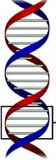
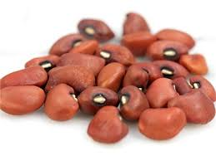
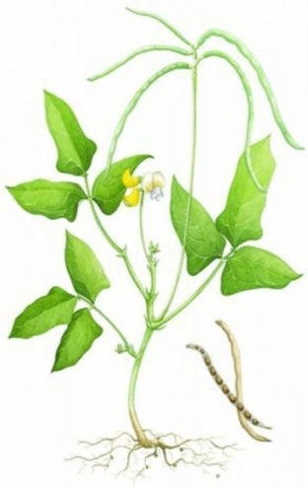
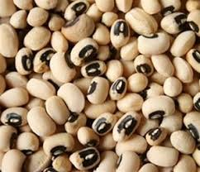
Harnessing Stress Tolerance for Sustainable Agriculture: Focus on African Cowpea
Moses Abiala^{1, 2,} Sanjeev Kumar², Richa Srivastava² and Lingaraj Sahoo²
^{1, 2} Mountain Top University, Prayer City, Ogun State, Nigeria
² Indian Institute of Technology, Guwahati, Assam, India
Inter. Conference on Plant Science by Botanical Society of Assam.
February 4-6, 2019 at Guwahati, India
DR. ABIALA MOSES
TWAS-DBT POSTDOC FELLOW , IIT, GUWAHATI
HOST: Prof. Lingaraj Sahoo
IIT, GUWAHATI, ASSAM
INDIA

Slide 2
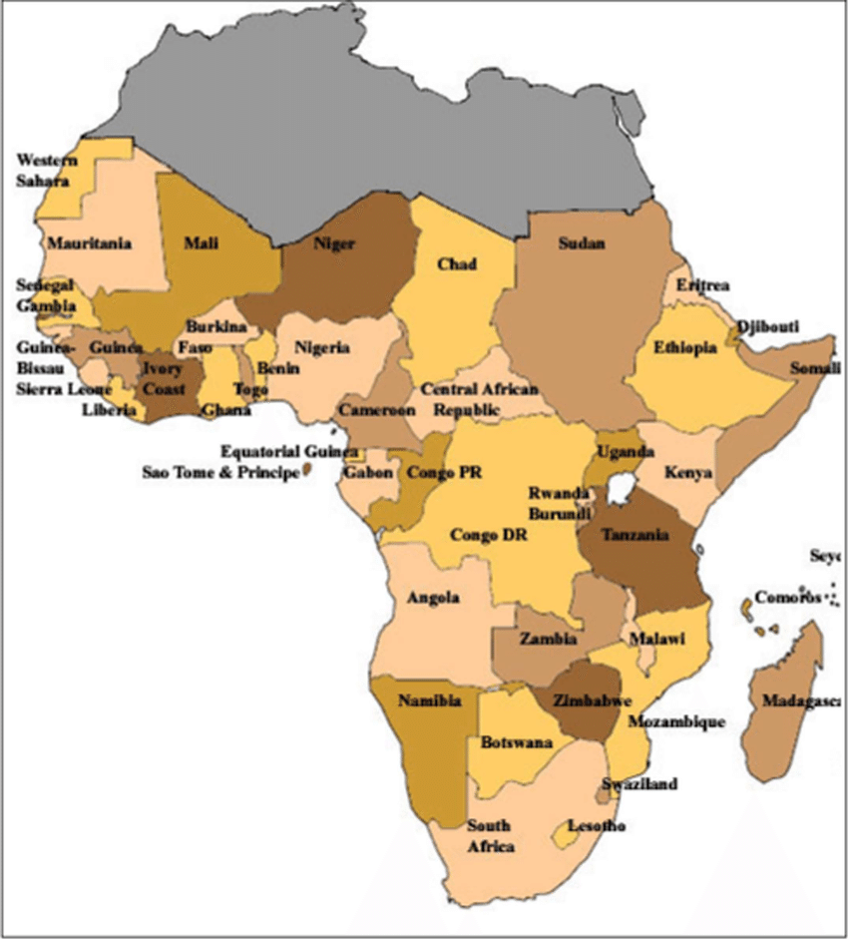
AFRICA
Africa
What we cherished
  Our Culture…Our heritage
  Love / Happiness
  Natural Resources
  Education
  Agriculture***
  Staple crops
  Maize
  Rice
  Cassava
  Cowpea
Map of Africa

Slide 3
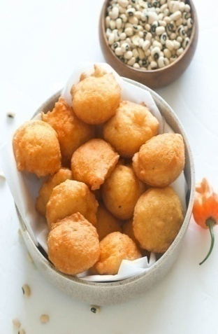
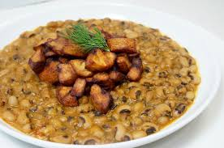
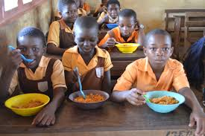
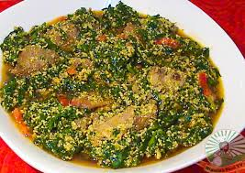
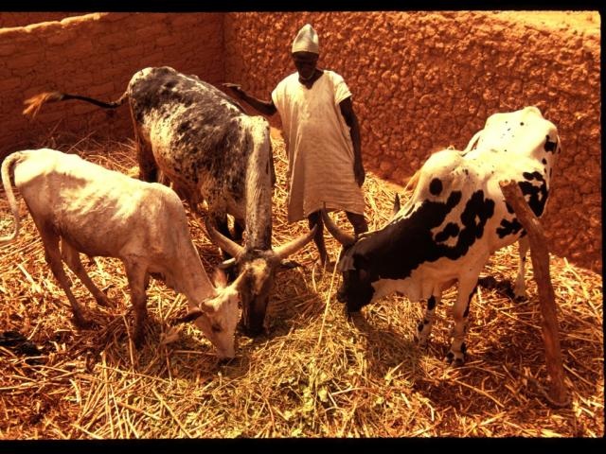
Cowpea, Our Heritage, Our Culture and Our Life in Africa
Cowpea production globally
Uses and consumption of cowpea
Cowpea production in Africa
Major threats on cowpea production
Biotic stress
Abiotic stress***
Source: http://www.iita.org/crops/cowpea/

Slide 4
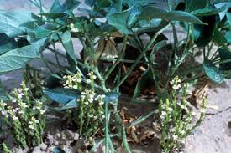
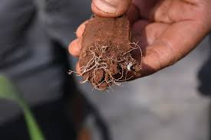
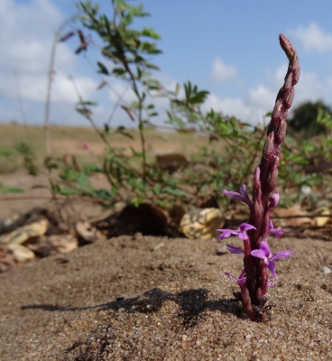
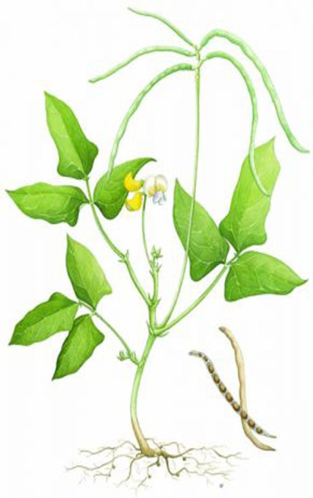
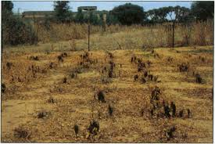
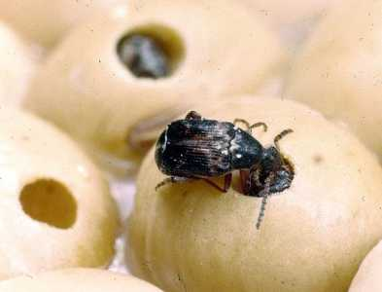
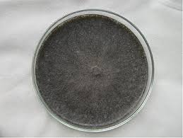
Biotic Factors Threatening Cowpea Production in Africa
Striga gesnerioides
Flower thrips
Aphids
Pod borers
Storage pests
Viruses
Root-knot nematodes
M. phaseolina

Slide 5
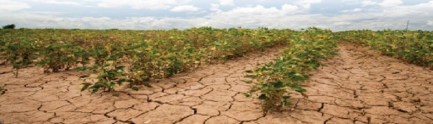

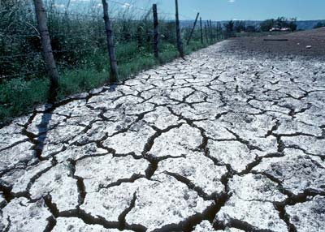
Abiotic factors threatening cowpea production in Africa
Effects of Abiotic Stress on Cowpea
Reduction in yield (farmers interest)
Inhibition of seed germination,
Seedling growth,
vegetative growth,
flowering
and pod formation
Oxidative stress
Alternation in photosynthesis
Alternation in dry matter
Alternation in phenology
    Drought***
    Heat**
    Salinity*
    Cold*

Slide 6
R4D (Quick Intervention)…..So Far in Nigeria
Inter. Inst. of Trop. Agric – R4D of cowpea cultivars
Breeding technology…. (IT98K-1111-1, IT93K-452-1)
University of California, Riverside, USA
Nigeria Federal Govt.
Nigeria States Govt.
Others (e.g USDA, Australia)
Improved cowpea varieties …IITA
High nutritional contents
Easier processing
Biotic stress tolerance
Abiotic stress tolerance
 | Comparative Effect of Biotic and Abiotic Stresses on Major Crops
Crop | % of record yield | % of record yield Biotic | % of record yield Abiotic
Wheat | 13.0 | 5.0 | 82.1
Corn | 23.8 | 10.1 | 65.8
Potato | 30.1 | 18.9 | 54.1
Cowpea | ? | ? | ?
Bray et al., 2000

Slide 7
Biotech - Improvement of Cowpea
Challenges
      Research facilities/Equipments
      Funding
      Capacity building
      Supervision capability
      Collaborative research for cowpea improvement ?
      Professor Lingaraj Sahoo: Department of Biosciences and Bioengineering, Indian Institute of Technology, Guwahati, Assam, India
      &
      Dr. Moses Abiala: Department of Biological Sciences, Mountain Top University, Prayer City, Ogun State, Nigeria

Slide 8
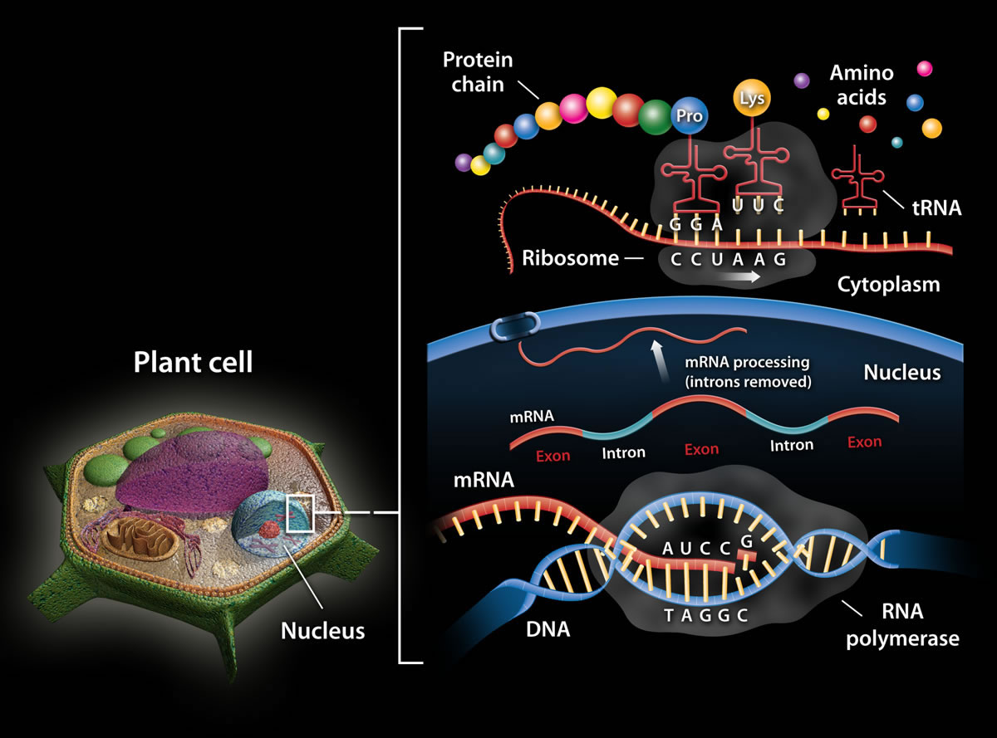
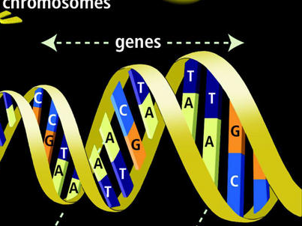
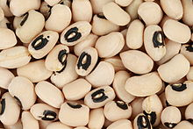
HARNESSING STRESS TOLERANCE GENE (S) FOR SUSTAINBLE GROWTH AND YIELD OF COWPEA
Expression of stress tolerance genes
Cellular level
System level
Re-evaluation of stress tolerance genes

Slide 9
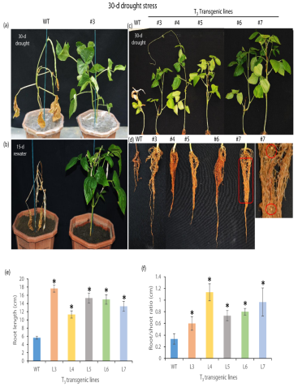
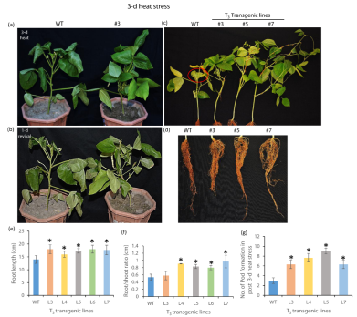

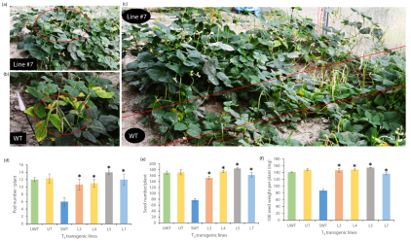
R4D of Cowpea in India…..Prof. L. Sahoo, IIT, Guwahati
Response of the cowpea VuDREB2A lines to Drought & Heat stress
Elevated photosynthetic rate in cowpea transgenic lines
The yield enhancement of transgenic lines under drought and heat stress

Slide 10
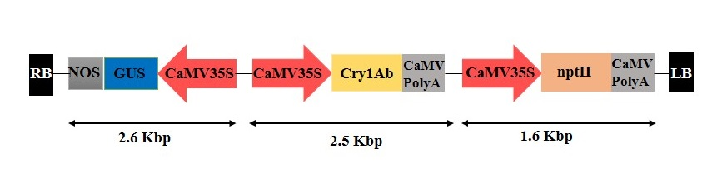
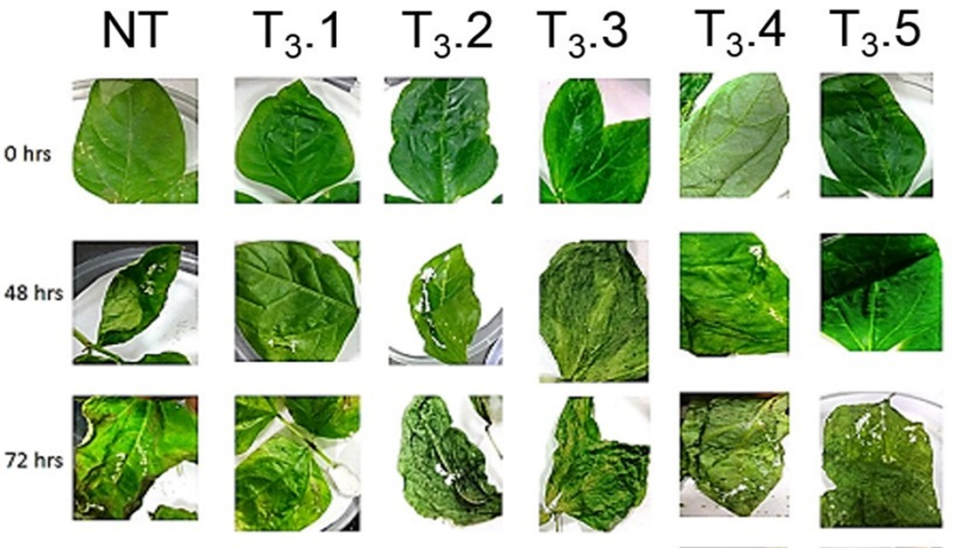
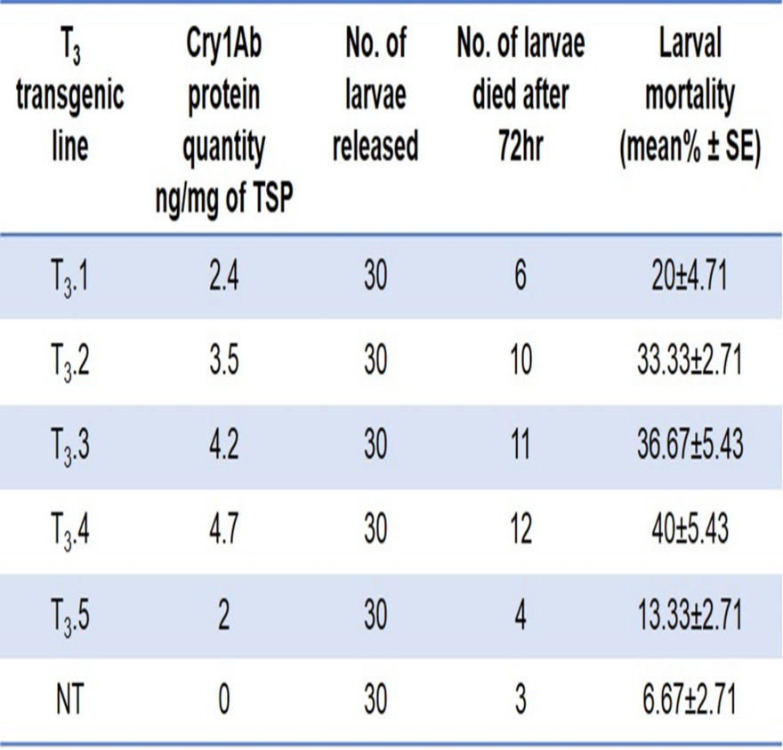
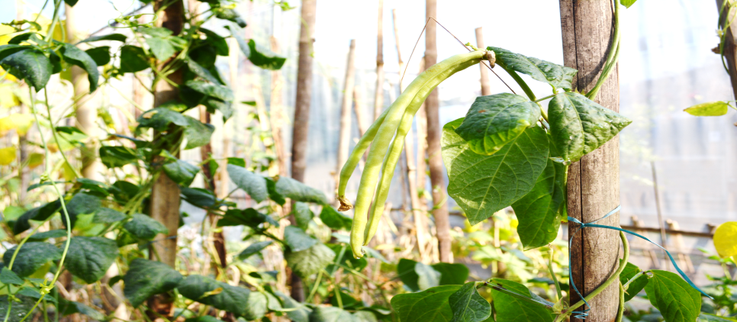
Cntd…….
Generation of transgenic cowpea with Btcry1Ab gene (cowpea resistance to insect)
Detached leaf insect bioassay

Slide 11
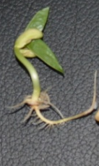
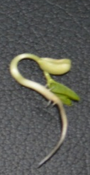



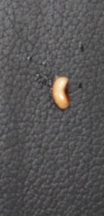


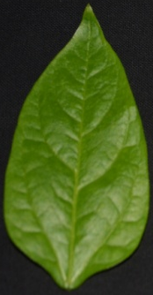
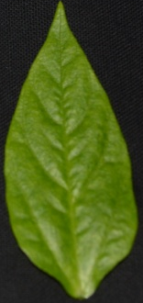
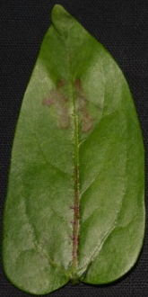

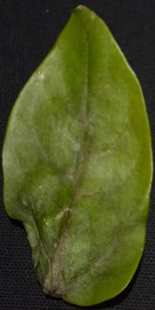
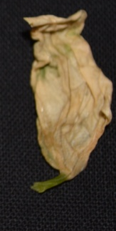
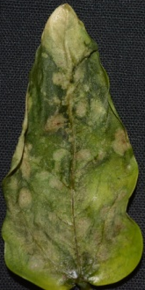

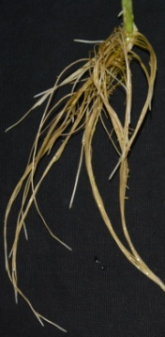
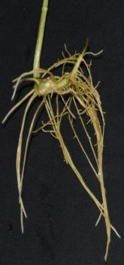
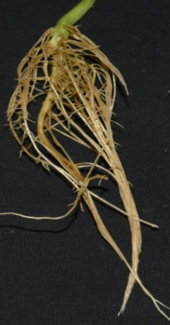





Harnessing salinity tolerance of cowpea…
Variety 1
Variety 2
Variety 1
Variety 2
Variety 1
Variety 2
Variety 1
Variety 2
Control
100mM
150mM
200mM
(NaCl)
(NaCl)
(NaCl)
Seed Germination
Leaf from Seedling
Root from Seedling

Slide 12
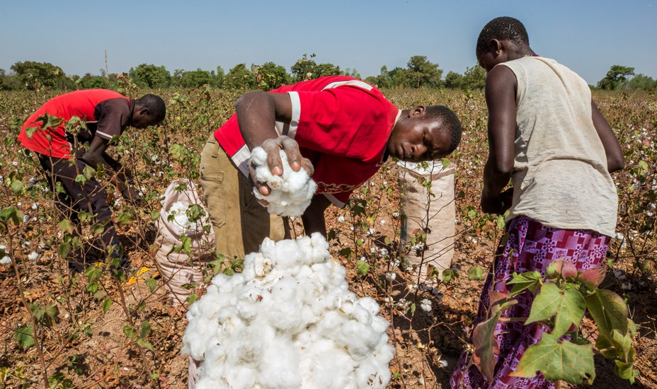
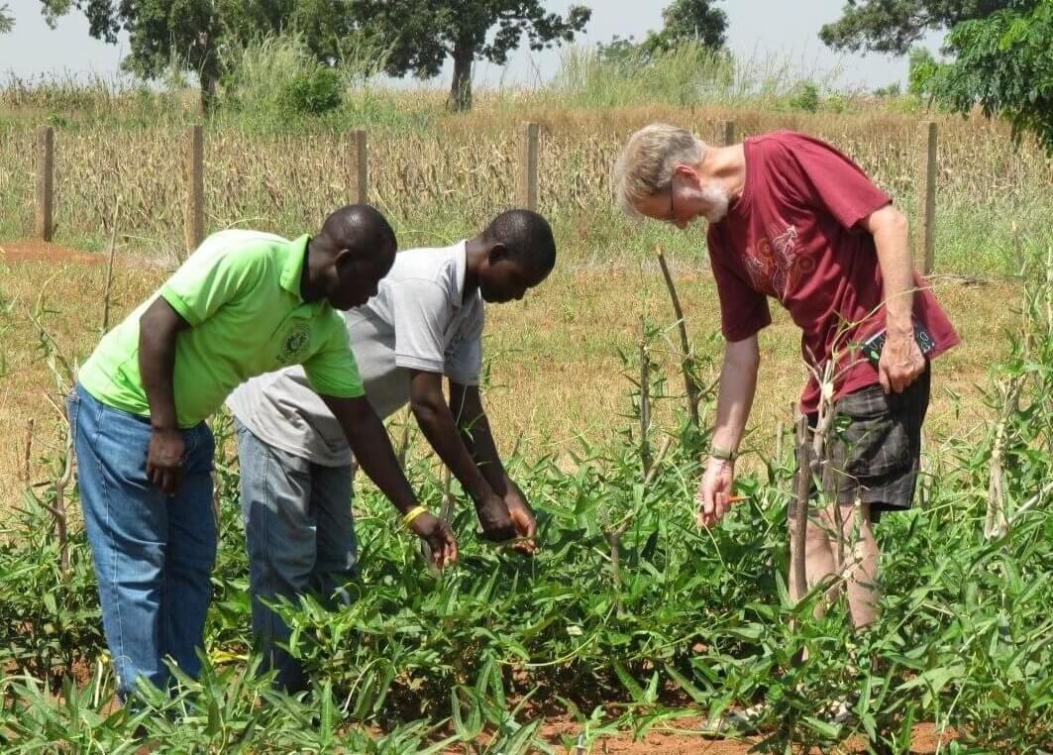
ACCEPTANCE OF TRANSGENIC COWPEA IN NIGERIA
GMO-Bt Cotton
Other GMOs …..:
3. VIRCA Plus project
Cassava - Virus
4. salt-tolerant, nitrogen- and water-use efficient NEWEST rice
Bt Cowpea
https://aatfnews.aatf-africa.org/?p=62
https://leadership.ng/2018/12/09/nigeria-gears-up-for-bt-cowpea-cotton-commercialisation/
5. African bio-fortified sorghum
https://allianceforscience.cornell.edu/blog/2019/01/nigerias-gmo-crop-research-advance-2019/
6. Bt maize
7. Improved GM cassava to prolong the shelf life of root starch

Slide 13
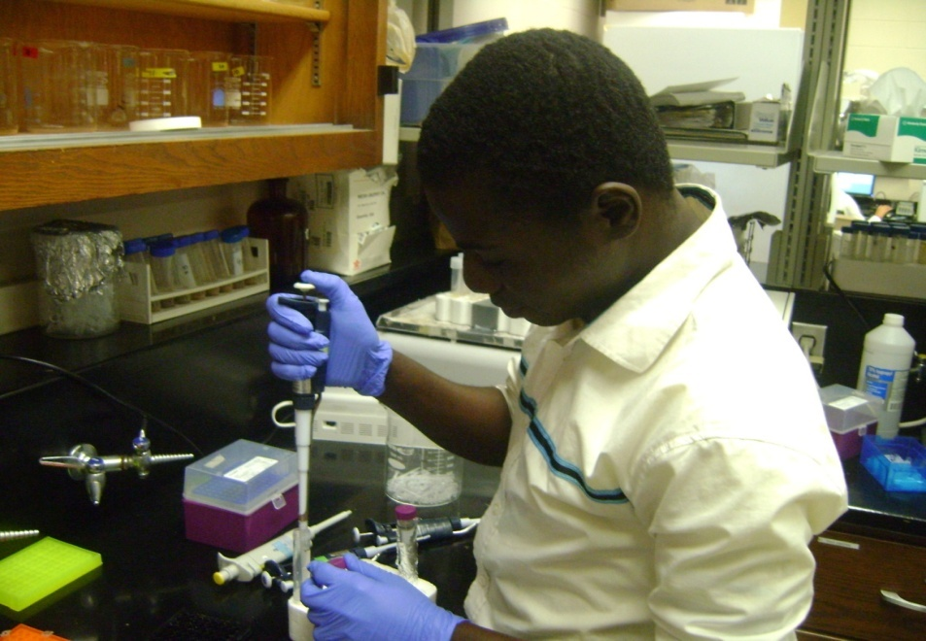
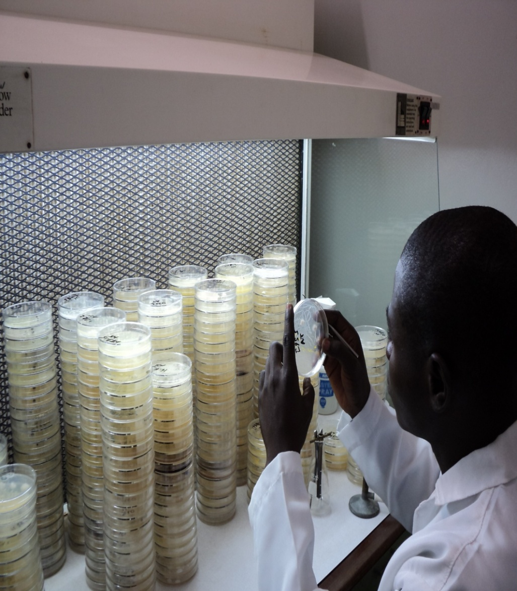
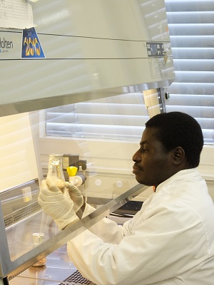
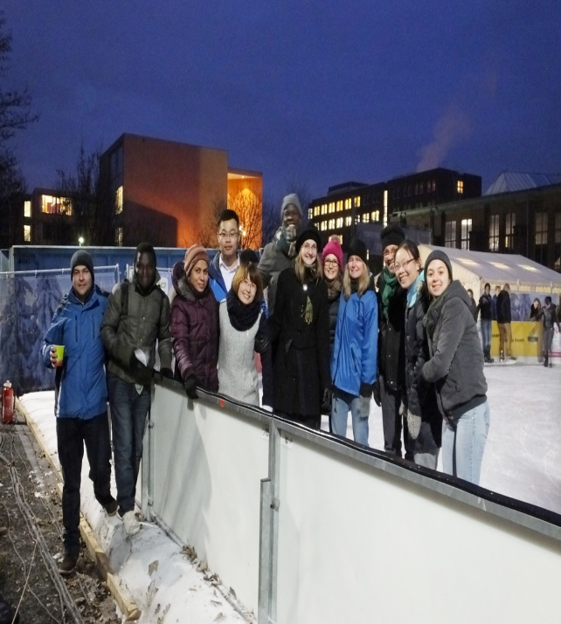
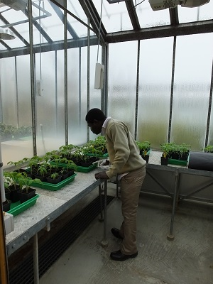
Dr. Moses Abiala’s Research Profiles
Kent State University, Ohio, USA
Dr. Abiala Moses at IITA, Ibadan, Nigeria
…….. for capacity building in Africa
Univ. Goettingen, Germany

Slide 14
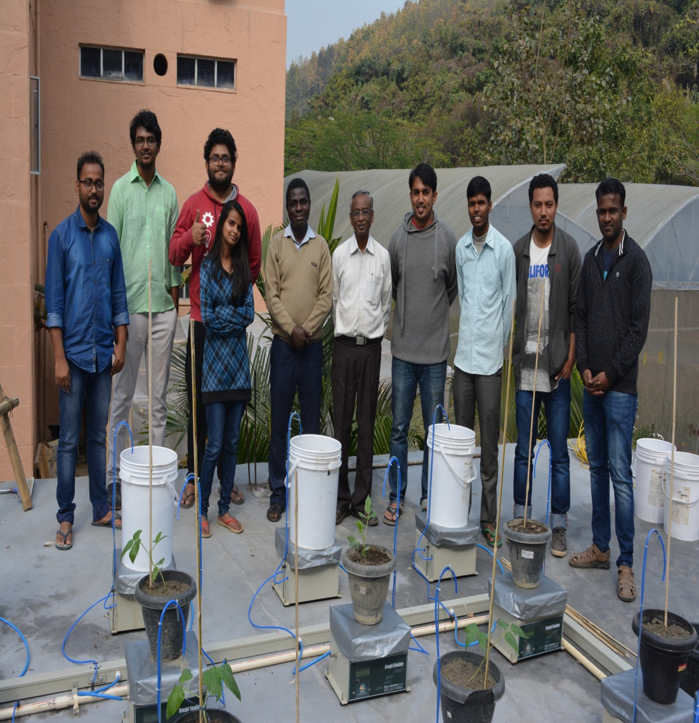
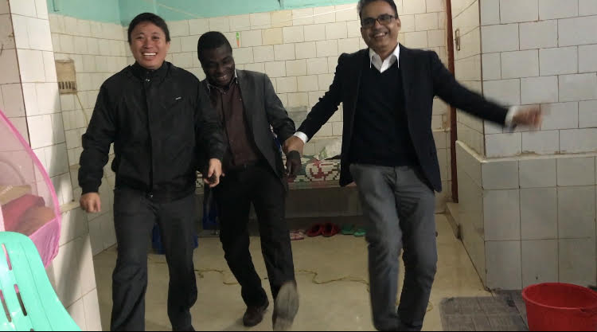

INDIANIZATION: COURTESY OF PROF. LINGARAJ SAHOO
Lovely Lab. Members
Dr. Abiala at Manipur University
…at Manipur

Slide 15
Appreciation and Acknowledgements
Department of Biotechnology (DBT), India
The World Academic of Science (TWAS), ITALY
Indian Institute of Technology (IIT), Guwahati, ASSAM
PROFESSOR LINGARAJ SAHOO (My Host in India), Department of Bioscience and Bioengineering, IIT, Guwahati
Mountain Top University, Prayer City, Nigeria
Guwahati University, Cotton University, Guwahati, Assam Science Technology and Environmental Council
Organizing Committee - Inter. Conference of Plant Science
Thank you

