Slide 1

Helminth-induced changes in cytokine profile of
pregnant women with co-infections of
helminthes and Plasmodium or HIV
OR Rabiu^{1, 6}, AM Kosoko^{2,6}, H Dada-Adegbola³, CO Falade^{4,6}, OG Arinola⁵, AB Odaibo¹, OG Ademowo^{4,6}
¹Department of Zoology
²Department of Biochemistry
³Department of Medical Microbiology and Parasitology
⁴Department of Pharmacology and Therapeutics
⁵Immunology Unit, Department of Chemical Pathology
⁶Institute for Advanced Medical Research and Training, College of Medicine, University of Ibadan

Slide 2
Background
UNAIDS, 2014; WHO, 2014, Pullan et al., 2014

Slide 3

Background
Cytokines (Th 2 cytokines) are involved in initiation and maintenance of pregnancy (Desai et al., 2007).
Pregnancy-induced immune responses affected by inflammation or infectious diseases (Marzi et al., 1996).
Dominance of Th 1 cytokines is associated with IUGR, spontaneous abortion and PTD (Moormann et al, 1999; Sykes et al, 2012).
Plasmodium infection caused a Th 1 biased response associated with increased parasite density (Achidi et al 2007; Nmorsi et al 2010).
Helminth infections display a strong polarization towards a Th 2 response (Anthony
et al 2007, Abdoli and Pirestani 2014).

Slide 4
Background
Helminthic infection influenced susceptibility and severity of Plasmodium and HIV infections in pregnancy (Egwunyenga et al., 2001; Ndibazza et al., 2013).
Some studies evaluated the systemic cytokine concentrations in co-infection of these diseases among pregnant women (Adeoti et al, 2015; Nmorsi et al, 2010).
However, there is still a dearth of information on the immunological interplay of these infectious diseases.
We investigated the modulatory effect of helminth in co-infections of the infective agents among pregnant women.

Slide 5
Research questions
What changes occur in the immune responses to single and co- infections?
Is helminth playing a modulatory role in co-infection with either malaria or HIV?

Slide 6
Study sites and population
Antenatal clinics of two healthcare facilities in Ibadan metropolis and PEPFAR clinic.
Pregnant women 18-45 years old.
  Inclusion criteria - Screening for both malaria and helminth parasites.
  Exclusion criteria - Subjects with obvious complications in pregnancy.
    Confirmed HIV infected pregnant women were excluded in ANCs.

Slide 7
Study procedures
Baseline screening
Malaria parasites
Ethical approval
Helminthes ova
Questionnaire
administration
Venous blood
collection
Serum stored at -20°C for cytokine analysis
Th 1 cytokines - TNF-α, IFN-γ, IL-1α, IL-2, IL-12p70, IL-17 Th 2 cytokines - IL-4, IL-6, IL-10, IL-13

Slide 8
RECRUITMENT CHART
1075 screened at baseline
368 excluded
707 recruited
ANC
490
199
217
PEPFAR

Slide 9

Data analysis
Frequencies were analysed using descriptive statistics.
Mann-Whitney U test was used to determine significant differences in median values at p<0.05.
All statistical test was done using SPSS software
22.0 while Graph Pad Prism software 6.0 was used in plotting graphs.

Slide 10
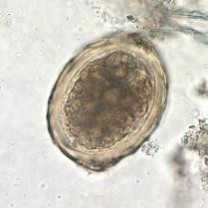
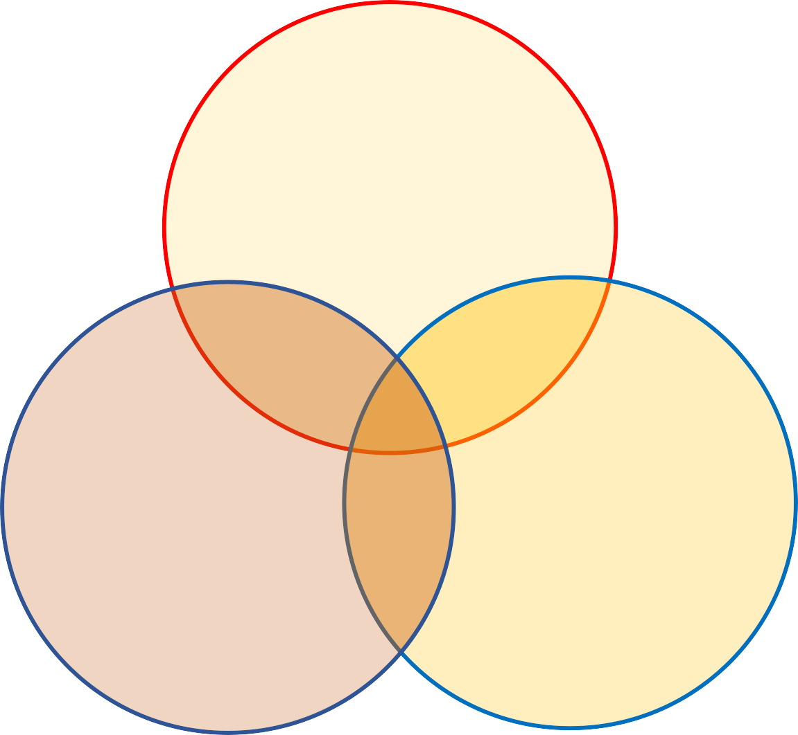
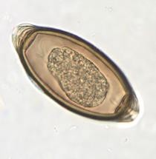
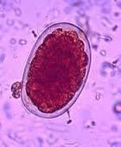
Results and Discussion
- 19.6%
No infection 59 (29.6%)
Malaria
36 (18.1%)
- 2.5%
- 0.5%
6 (3.0%)
25 (12.6%)
Helminth
30 (15.1%)
HIV
4
^{(2.0%)} 39 (19.6%)

Slide 11
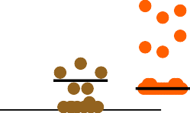
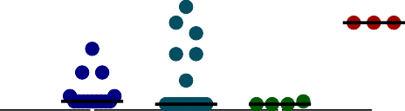

Helminth in Plasmodium infection
The cytokine profile of those infected with
Plasmodium only was not significantly altered rela⁰t^{.0}i⁵v⁰e
* *
* *
* *
to those uninfected.
0 .0 4 5
* *
M e d ia n c o n c . o f IF N - γ in n g /m l
0 .0 4 0
0 .0 3 5
Increase in IFN-γ, IL-2 etc. associated with increase in
malaria severity (Prakash et al., 2006; Nmorsi et al.,
0 .0 3 0
2010; Nasr et al., 2014;).
0 .0 2 5
0 .0 2 0
0 .0 1 5
Co-infection with helminthes increased IL-2 and decreased IFN-γ relative to those infected with Plasmodium only.
0 .0 1 0
0 .0 0 5
0 .0 0 0
P F
H
H IV
N
P F + H
H + H IV
P F + H IV
Acute malaria cases in Brazil found no difference (Sánchez-arcila et al, 2014).
Figure 1: Median concentrations of IFN-γ among the infected and uninfected groups
Key: PF – P. falciparum, H – Helminth, N – Uninfected
**p<0.05

Slide 12
Helminth in HIV infection
Increase in TNF-α, IL-4, IL-6 and IL-17 and decrease in IL-1α, IL-10 and IL-12p70.
TNF-α and IL-6 increased among HIV infected individuals (Tudela et al., 2014), HIV infected pregnant women (Sachdeva et al., 2008, Richardson & Weinberg, 2011).
Increased TNF-α suppressed HIV-1 replication in peripheral blood monocytes and alveolar macrophages (Lane et al, 1999, Breen, 2002).
IL-10 production was higher in cells derived from HIV-uninfected pregnant women similar to the IL-10 production in peripheral blood obtained in this study (Hygino et al, 2012).

Slide 13



Helminth in HIV infection
Increased concentrations of IFN-γ and IL-10
relative to those infected with HIV only.
0 .0 5 0
* *
* *
* *
0 .0 4 5
* *
in n g /m l
0 .0 4 0
0 .0 3 5
Increased IFN-γ inhibit HIV-1 replication
(Alfano & Poli, 2005).
IF N - γ
0 .0 3 0
M e d ia n c o n c . o f
0 .0 2 5
0 .0 2 0
0 .0 1 5
0 .0 1 0
0 .0 0 5
0 .0 0 0
P F
H
H IV
P F + H
H + H IV
P F + H IV
N
Figure 1: Median concentrations of IFN-γ among the infected and uninfected groups
Key: PF – P. falciparum, H – Helminth, N – Uninfected
**p<0.05

Slide 14
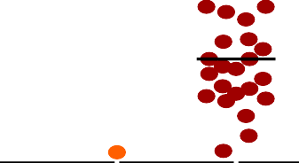


Helminth in HIV infection
* *
* *
Increased IL-10 involved in impaired innate immune responses in AIDS patients (Ma and Montaner, 2000).
* *
* *
0 . 8
* *
M e d ia n c o n c . o f IL -1 0 in n g /m l
0 . 6
Impairment of HIV immune profile by helminth infection occurs particularly in those who excrete worm eggs (Mkhize-Kwitshana et al., 2011).
0 . 4
0 . 2
0 . 0
PF
H
HIV
N
PF+H
H+HIV
PF+HIV
Figure 2: Median concentrations of IL-10 among the infected and uninfected groups
Key: PF – P. falciparum, H – Helminth, N – Uninfected
**p<0.05

Slide 15
Th 1:Th 2 Ratio
 | PF | HIV | PF + H | HIV + H | N
IFN-γ:IL-4 | 0.0002 | 0.000019 | 0.00004 | 0.00047
IFN-γ:IL-10 | 0.0226 | 0.1333 | 0.0042 | 0.1571
TNF-α:IL-4 |  | 0.009 |  |  | 0.0008
TNF-α:IL-10 |  | 62.87 |  |  | 0.0571
IL-17:IL-10 |  | 20111.33 |  |  | 154.96
Plasmodium - Helminth reduced Th 1:Th 2 ratio Protective role in asymptomatic cases.
HIV - Helminth increased Th 1: Th 2 ratio Inhibit HIV replication.

Slide 16


Acknowledgement
Supervisors:
Prof. George Ademowo
Prof. Alexander Odaibo
Study participants Field support workers Lab. technologists

Slide 17
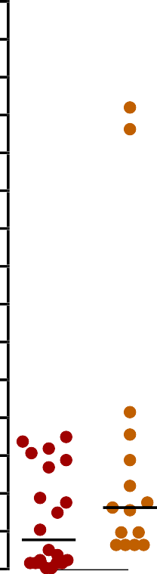



* *
* *
* *
0 .4 5
* *
0 .4 2
0 .3 9
0 .3 6
0 .3 3
0 .3 0
0 .2 7
0 .2 4
0 .2 1
0 .1 8
0 .1 5
0 .1 2
0 .0 9
0 .0 6
0 .0 3
0 .0 0
T N F - α c o n c . in n g /m l
P F
H
H IV
P F + H
H + H IV
P F + H IV
N

Slide 18



1 .0
* *
0 .9
* *
in p g /m l
0 .8
* *
* *
0 .7
IL - 1 α
0 .6
0 .5
0 .4
0 .3
0 .2
0 .1
0 .0
M e d ia n c o n c . o f
P F
H
H IV
P F + H
H + H IV
P F + H IV
N

Slide 19


* *
* *
3 0 0 0
* *
2 8 0 0
2 6 0 0
2 4 0 0
2 2 0 0
2 0 0 0
1 8 0 0
1 6 0 0
1 4 0 0
1 2 0 0
1 0 0 0
8 0 0
6 0 0
4 0 0
2 0 0
0
M e d ia n c o n c . o f IL - 2 in p g /m l
PF
H
HIV
PF+H
H+HIV
PF+HIV
N

Slide 20
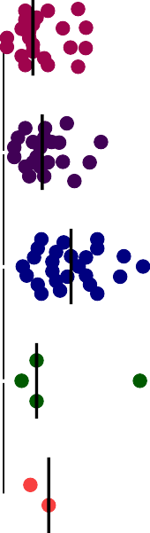

M e d ia n c o n c . o f IL - 4 in p g /m l
0
1 0 0
2 0 0
P F
H
H IV
P F + H
H + H IV
* *
* *
P F + H IV
N

Slide 21





0 .1 2
* *
0 .1 1
* *
0 .1 0
0 .0 9
0 .0 8
0 .0 7
0 .0 6
0 .0 5
0 .0 4
0 .0 3
0 .0 2
0 .0 1
0 .0 0
M e d ia n c o n c . o f IL - 6 in n g /m l
P F
H
H IV
P F + H
H + H IV
P F + H IV
N

Slide 22


M e d ia n c o n c . o f IL - 1 2 p 7 0 in p g /m l
0
1 0 0
2 0 0
3 0 0
4 0 0
5 0 0
6 0 0
7 0 0
P F
H
H IV
P F + H
H + H IV
* *
P F + H IV
N

Slide 23
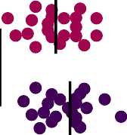

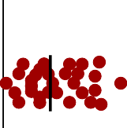
M e d ia n c o n c . o f IL - 1 7 in p g /m l
0
5 0
1 0 0
1 5 0
2 0 0
2 5 0
P F
H
H IV
* *
* *
P F + H
H + H IV
* *
* *
P F + H IV
N

Slide 24
Limitation
Few cases of co-infection of Plasmodium and helminthes
Few cases of co-infection of HIV and helminthes.
Reduced capacity to make strong statistical inferences is reduced.
More studies with larger number of co-infection cases will further increase the body of existing knowledge on impact of co-infection on immunological profile.

Slide 25
Background
The sub-Saharan region of Africa is the most endemic for P. falciparum and HIV infections (UNAIDS, 2014; WHO, 2014).
The burden of helminthes is also relatively high (Pullan et al., 2014).
Helminthic infection influenced susceptibility and severity of Plasmodium and HIV infections in pregnancy (Egwunyenga et al., 2001; Ndibazza et al., 2013).
Pregnancy-induced immune responses also affected by inflammation or infectious diseases (Marzi et al., 1996).

