Slide 1
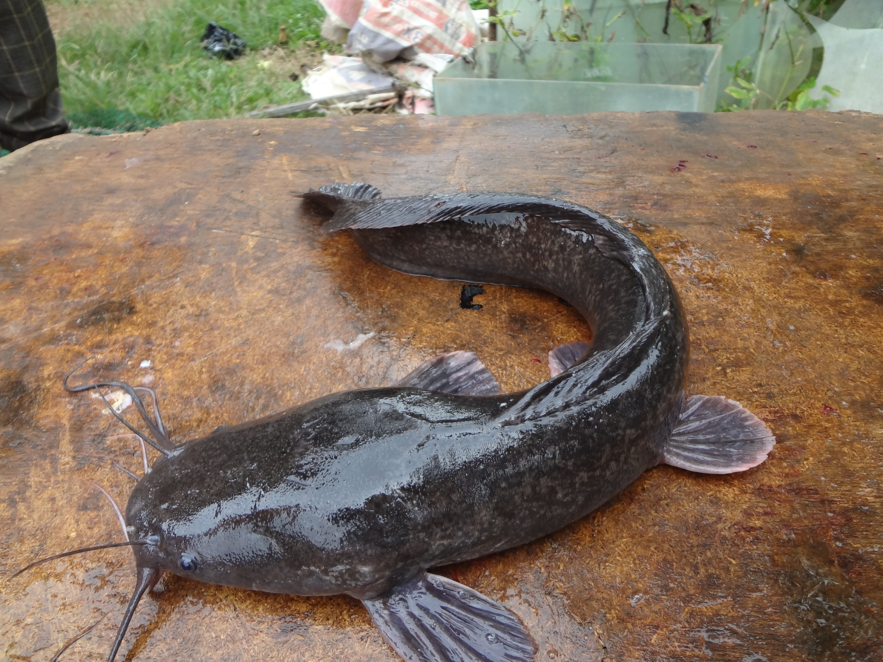
Influence of treatments and packaging materials on microbial Quality of Stored Dehydrated
Catfish (Clarias gariepinus)
By
Dupe Temilade Otolowo and Stephen Abiola Akinola

Slide 2
Introduction
Catfish is of good nutritive and economic value and widely sought in many parts of the world including Nigeria because of its palatability (Adeparusi et al., 2010).
Fish is an extremely perishable food item due to high water content thus, required preservation for future use (Balachandra, 2011).
The removal of most of the water present in fish muscles by dehydration, extends the shelf-life without the need for refrigeration (Olayemi, 2012).

Slide 3
Introduction (Contd)
Modern dehydration techniques, have been largely stimulated by the advantages dehydration gives in compactness (Balachandran, 2011), which will in turn aids easy storage and distribution.
Appropriate dehydration technique with effective packaging as an integral part of preservation processes is expected to maintain the quality of dried catfish, on shelf and during storage (Aworh et al., 2002; Oluwamukomi et al., 2008).
The quality of dehydrated catfish can be assessed using a range of physical, physicochemical, biological and organoleptic tests (Adam and Sidahmed, 2012).

Slide 4
Statements of Problem
Limitation of values
Limited affordable modern dehydration techniques / expensive and sophisticated equipment/operations in some other fish preservation methods like freezing, freeze drying, canning, etc (George, 2010).
Despite the numerous food and economic values imbedded in catfish (Clarias gariepinus), accessing these values is limited.
Product instability during storage leading to dried fish losses, majorly due to insufficient drying and inadequate packaging (Aworh et al., 2002; Ward, 2003).
Rejection of exported smoked-dried catfish from Nigeria to UK as a result of inadequate packaging that led to mould growth and insect infestation (Ward, 2003).

Slide 5
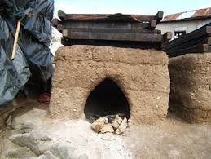
A traditional fish smoking kiln

Slide 6
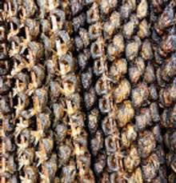
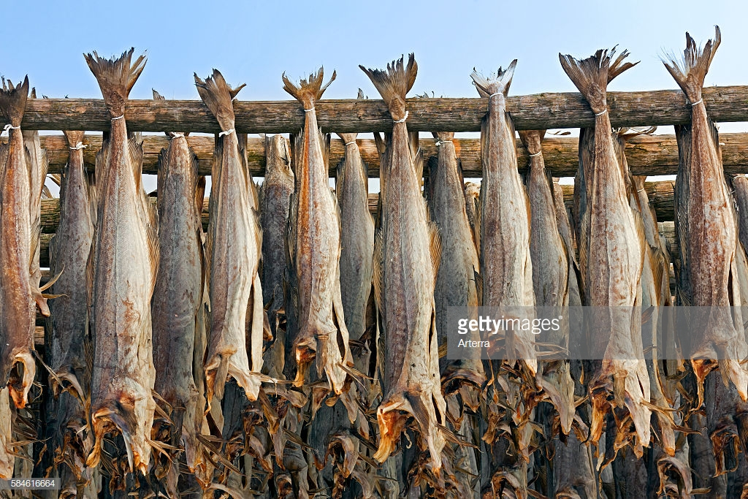
Traditional methods of dehydrated fish storage

Slide 7
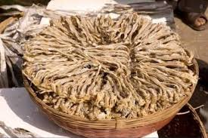
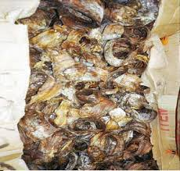
An inefficient dried fish packaging

Slide 8
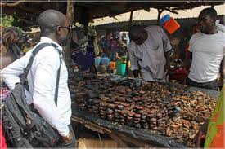
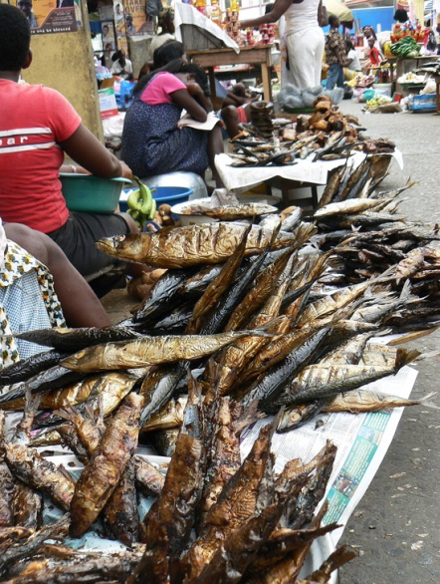
Men and women involved in dried fish business

Slide 9
Justification for the research
Simple dehydration technique with effective process parameters for catfish preservation could serve as an improvement over the traditional and alternative to the sophisticated modern methods.
Adequate packaging could improve the stability and reduce dehydrated catfish losses during storage; and as well aids proper presentation, easy and wider distribution of the product with a positive impact on the economic development of the society.

Slide 10
Objectives
The specific objectives of this research are to:
establish effective processing parameters (treatments) for dehydration of catfish,
evaluate storage stability of dehydrated catfish and recommend adequate packaging material for the product, and finally,
provide information on the microbial safety of stored dehydrated catfish with simple processing and packaging techniques.

Slide 11
Materials and Methods

Slide 12
Materials
Catfish (Clarias gariepinus) was used for the experiment.
Common salt (Mr Chef brand) was used to make brine solution.
The convective electric dryer was used for the drying of catfish.
Packaging materials used for the storage experiment include; high density (HD) and low density (LD) polyethylene, rigid plastic container (PL), paper board carton (CT), and nylon jute bag (BG).
Chemicals used for the analyses were of analytical grade.

Slide 13
METHODS

Slide 14
Methods
Design
A three-factor face centered central composite design (CCD) of Response Surface Methodology (RSM) was used.
Independent variables / factors
Brine concentration (3, 6, 9%) , brining time (30, 60, 90 min) and drying temperature (90, 110, 130ºC).

Slide 15
Table 1: Response surface Methodology (RSM) design runs
Run | A: Brine Concentration (%) | B: Brining Time (min) | C: Drying Temperature (oC)
1 | 6 | 60 | 110
2 | 6 | 90 | 110
3 | 3 | 60 | 110
4 | 3 | 30 | 90
5 | 6 | 30 | 110
6 | 9 | 90 | 130
7 | 9 | 60 | 110
8 | 6 | 60 | 110
9 | 9 | 90 | 90
10 | 6 | 60 | 130
11 | 3 | 90 | 130
12 | 6 | 60 | 110
13 | 6 | 60 | 90
14 | 3 | 90 | 90
15 | 3 | 30 | 130
16 | 9 | 30 | 130
17 | 9 | 30 | 90

Slide 16
Live-catfish
Slaughtering (beheaded)
Degutting
Washing
Brining
Hanging
Drying (90, 110 and 130ºC)
Cooling
Dehydrated Catfish
Packaging/Storage
Figure 1: Processing of dehydrated catfish (Eyo, 2001).

Slide 17
Sensory evaluation
General appearance, aroma, texture, taste and overall acceptability of the hydrated, slightly seasoned and simmered samples of dehydrated catfish were evaluated by 18-man sensory panelists using 5-points Hedonic scale, where 5=Like very much; 3=Neither like nor dislike; and 1=Dislike very much as described by Aworh et al. (2002).

Slide 18
Packaging and storage
Dehydrated catfish produced with the selected treatments were packaged in moderate sizes of the chosen materials in numbers corresponding to the expected intervals that the analyses were performed.
The nylon jute bag (BG) was used only for the unbrined samples to simulate the packaging of the existing unbrined dehydrated fish as obtained in Nigerian fish markets.
The storage was done under ambient conditions for six months.

Slide 19
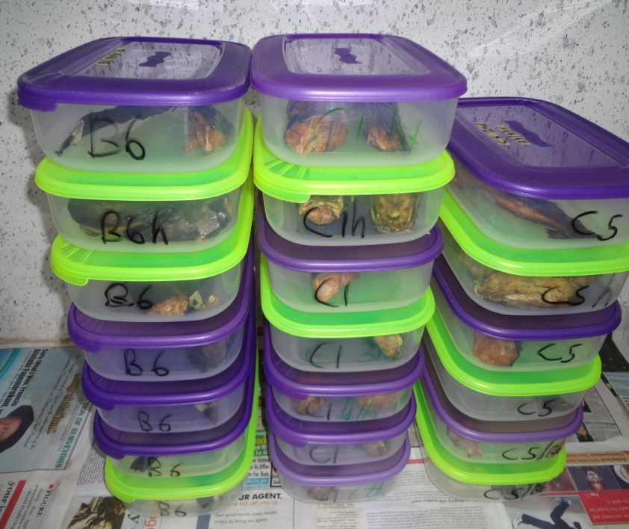
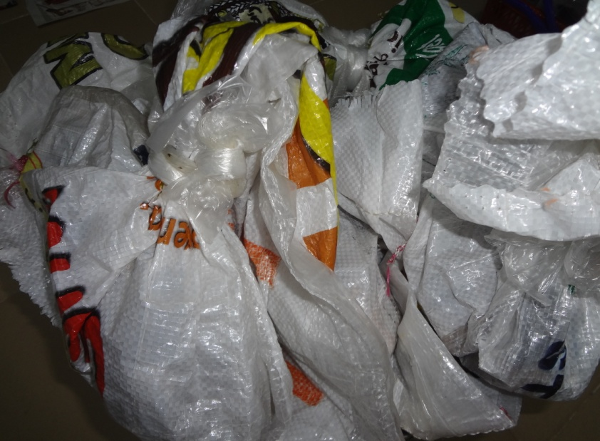
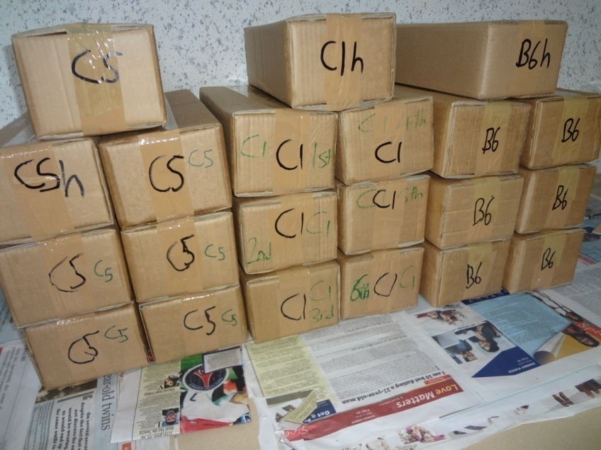
I: Rigid plastic (PL) packaging
II: Nylon jute bag (BG) packaging
Packaged dehydrated catfish
III: Carton (CT) packaging

Slide 20
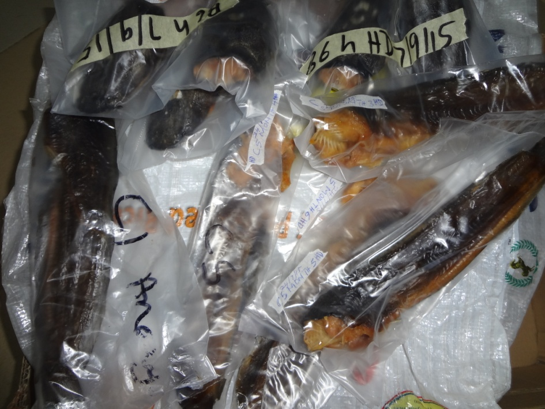
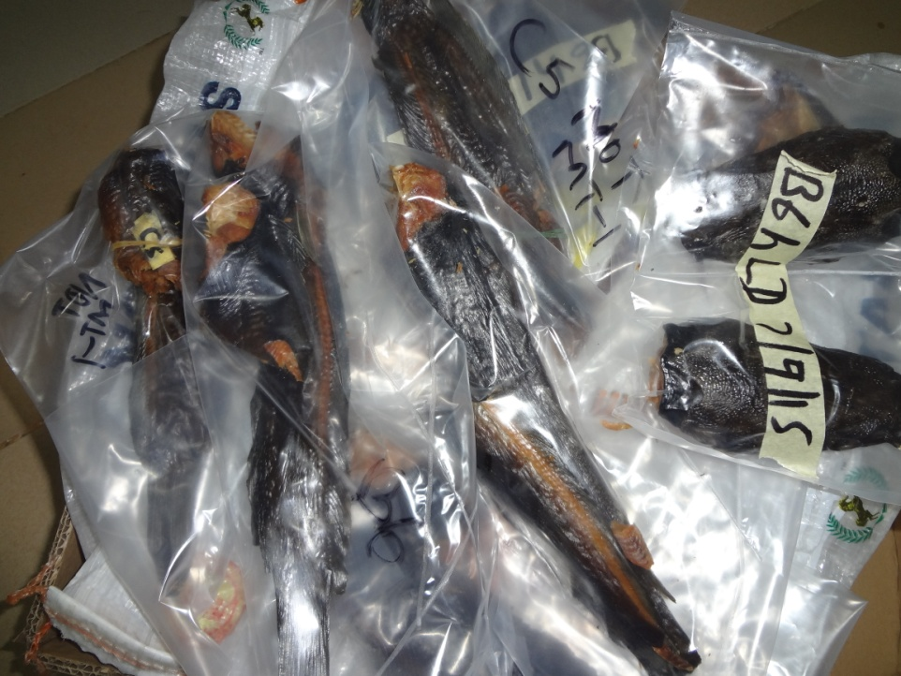
IV: High density polyethylene (HD) packaging
Packaged dehydrated catfish
V: Low density polyethylene (LD) packaging

Slide 21
Microbial analyses
Microbial analysis was done by pour plating technique as described by Harrigan and McCance (1976).

Slide 22
Table 2: The microbial quality parameters of dehydrated catfish determined
MICROBIAL LOAD : | Unit
Total viable count | cfu/g
Coliform | cfu/g
Salmonella E. coli | cfu/g cfu/g
Fungi (Mould / Yeast) | cfu/g

Slide 23
Software
Design expert (DX 8.0.3.1) was used for the RSM design of the experimental treatments.

Slide 24
RESULTS

Slide 25
Table 3: Microbial load of the fresh-raw and freshly processed samples of dehydrated catfish (cfu/g)
Code | Process variables | Total viable count (TVC) | Coliforms | Salmonella | E. coli | Fungi (Mould/ Yeast)
 | A B C
C5 (Tr1) | 6 60 90 | ND | ND | ND | ND | ND
C1 (Tr2) | 9 90 90 | 2. 0x 10³ | ND | ND | ND | ND
U2 (Tr3) | - - 90 | 6.0x10³ | ND | ND | ND | ND
B6 (Tr4) | 6 90 110 | ND | ND | ND | ND | 1.0 x 10³
U1 (Tr5) | - - 110 | 3.0x10³ | ND | ND | ND | 2.0x10³
FRF | No treatment | ND | ND | ND | ND | ND
STD |  | 5.0x10⁵ | - | - | - | 1.0x10⁶
Values are means of duplicate microbial counts.
Key: A = Brine concentration (%); B = Brining time (min); C = Drying temperature (ºC); Tr Treatment;
- = No brining; ND = Not detected ; FRF = Fresh raw fish; STD = Standard (ICMSF, 2002).

Slide 26
Table 4: Summary of the sensory evaluation mean scores from ANOVA single factor for the overall acceptability
Run | A B C | Average | Variance | Ranking
1 | 6 60 110 | 4.025 | 0.242361 | 4
2 (B6) | 6 90 110 | 4.325 | 0.111806 | 1
3 | 3 60 110 | 3.935 | 0.272806 | 7
4 | 3 30 90 | 3.825 | 0.292361 | 10
5 | 6 30 110 | 3.925 | 0.667361 | 8
6 | 9 90 130 | 3.850 | 0.336111 | 9
7 | 9 60 110 | 4.025 | 0.145139 | 4
8 | 6 60 110 | 3.775 | 0.700694 | 12
9 (C1) | 9 90 90 | 4.225 | 0.186806 | 2
10 | 6 60 130 | 3.425 | 0.861806 | 13
11 | 3 90 130 | 4.025 | 0.422917 | 4
12 | 6 60 110 | 3.400 | 0.419444 | 14
13 (C5) | 6 60 90 | 4.100 | 0.308333 | 3
14 | 3 90 90 | 3.200 | 0.525000 | 17
15 | 3 30 130 | 3.275 | 0.867361 | 16
16 | 9 30 130 | 3.825 | 0.153472 | 10
17 | 9 30 90 | 3.325 | 0.542361 | 15
RAW | FRESH FSH | 3.425 | 0.861806 | 13
Key: A = Brine Concentration (%); B = Brining Time (min); C = Drying Temperature (ºC)

Slide 27
Table 5: Treatments used for the storage study based on the sensory evaluation result
Tr Code | Brine conc. (%) | Brining time (min) | Drying temp. (º C)
Tr1 C1 | 9 | 90 | 90
Tr2 C5 | 6 | 60 | 90
Tr3 U2 | - | - | 90
Tr5 B6 | 6 | 90 | 110
Tr6 U1 | - | - | 110
Tr = Treatment; Conc. = Concentration; Temp. = Temperature; - = No brining.

Slide 28
RESULTS OF PACKING AND STORAGE OF DEHYDRATED CATFISH

Slide 29
Table 6: Microbial load of dehydrated catfish samples at one-month of storage
Treatment A B C | Sample code | Package | Total viable count (cfu/g) | Coliform (cfu/g) | Salmonella (cfu/g) | Escherichial coli (cfu/g) | Fungi (cfu/g)
Body Part 6 60 90 | C5 (Tr1) | PL | 3.0x10³ | ND | ND | ND | ND
 |  | HD | ND | ND | ND | ND | ND
 |  | LD | ND | ND | ND | ND | 1.0x10⁴
 |  | CT | ND | ND | ND | ND | 1.4x10⁴
9 90 90 | C1 (Tr2) | PL | ND | ND | ND | ND | ND
 |  | HD | ND | ND | ND | ND | ND
 |  | LD | ND | ND | ND | ND | ND
 |  | CT | ND | ND | ND | ND | 1.0x10³
- - 90 | U2 (Tr3) | BG | ND | ND | ND | ND | ND
 | B6 (Tr4) | PL | ND | ND | ND | ND | 1.0x10³
6 90 110 |  | HD | ND | ND | ND | ND | 2.0x10³
 |  | LD | ND | ND | ND | ND | ND
 |  | CT | ND | ND | ND | ND | 6.0x10³
- - 110 | U1 (Tr5) | BG | 1.0x10³ | ND | ND | ND | 6.0x10³
Head Part 6 60 90 | C5h | PL | ND | ND | ND | ND | ND
 |  | HD | ND | ND | ND | ND | ND
 |  | LD | ND | ND | ND | ND | ND
 |  | CT | ND | ND | ND | ND | ND
9 90 90 | C1h | PL | 1.0x10³ | ND | ND | ND | ND
 |  | HD | 1.0x10³ | ND | ND | ND | ND
 |  | LD | ND | ND | ND | ND | ND
 |  | CT | 1.0x10³ | ND | ND | ND | ND
- - 90 | U2h | BG | ND | ND | ND | ND | ND
6 90 110 | B6h | PL | ND | ND | ND | ND | 4.0x10³
 |  | HD | ND | ND | ND | ND | ND
 |  | LD | ND | ND | ND | ND | 1.0x10³
 |  | CT | ND | ND | ND | ND | 9.0x10³
- - 110 | U1h | BG | 1.0x10³ | ND | ND | ND | 2.0x10³
Values are means of duplicate microbial counts.
Key: A = Brine concentration (%); B = Brining time (min); C = Drying temperature (ºC); Tr = Treatment; PL = Rigid plastic container; HD = High density polyethylene; LD = Low density polyethylene; CT = Paper board carton; BG = Nylon jute bag; ND = Not detected.

Slide 30
Table 7: Microbial load of the Dehydrated Catfish Samples at two-month of Storage.
Treatment A B C | Sample Code | Package | Total viable count (cfu/g) | Coliform (cfu/g) | Salmonella (cfu/g) | Escherichial coli (cfu/g) | Fungi (cfu/g)
Body Part 6 60 90 | C5 (Tr1) | PL | 1.0x10³ | ND | ND | ND | 1.0x10³
 |  | HD | ND | ND | ND | ND | ND
 |  | LD | 1.0x10³ | ND | ND | ND | ND
9 90 90 |  | PL | ND | ND | ND | ND | ND
 | C1 (Tr2) | HD | ND | ND | ND | ND | 2.0x10³
 |  | LD | ND | ND | ND | ND | 8.0x10³
6 90 110 |  | PL | ND | ND | ND | ND | ND
 | B6 (Tr4) | HD | 2.0x10³ | ND | ND | ND | ND
 |  | LD | ND | ND | ND | ND | ND
Head Part 6 60 90 |  | PL | ND | ND | ND | ND | ND
 |  | HD | 1.0x10³ | ND | ND | ND | ND
 | C5h | LD | 3.0x10³ | ND | ND | ND | ND
9 90 90 |  | PL | 1.0x10⁴ | ND | ND | ND | 1.7x10⁴
 | C1h | HD | 1.0x10³ | ND | ND | ND | 8.0x10³
 |  | LD | 5.0x10³ | ND | ND | ND | 6.0x10³
6 90 110 |  | PL | 6.0x10³ | ND | ND | ND | ND
 | B6h | HD | ND | ND | ND | ND | ND
 |  | LD | ND | ND | ND | ND | 1.0x10³
Values are means of duplicate microbial counts.
Key: A = Brine concentration (%); B = Brining time (min); C = Drying temperature (ºC); Tr = Treatment; PL = Rigid plastic container; HD = High density polyethylene; LD = Low density polyethylene; ND =Not detected.

Slide 31
Table 8: Microbial load of the dehydrated catfish samples at three-month of storage
Treatment A B C | Sample Code | Package | Total viable count (cfu/g) | Coliform (cfu/g) | Salmonella (cfu/g) | Escherichial coli (cfu/g) | Fungi (cfu/g)
Body Part 6 60 90 |  | PL | 4.0x10³ | ND | ND | 1.0x10³ | 2.0x10³
 | C5 (Tr1) | HD | ND | ND | ND | ND | ND
 |  | LD | 1.0x10³ | ND | ND | ND | ND
9 90 90 | C1 (Tr2) | PL | 1.0x10³ | ND | ND | ND | 1.0x10³
 |  | HD | ND | ND | ND | ND | 6.0x10³
 |  | LD | 4.0x10³ | ND | ND | ND | 6.0x10³
6 90 110 | B6 (Tr4) | PL | ND | ND | ND | ND | ND
 |  | HD | 1.0x10³ | ND | ND | ND | ND
 |  | LD | 2.0x10³ | ND | ND | ND | ND
Head Part 6 60 90 | C5h | PL | 1.0x10³ | ND | 1.0x10³ | ND | 1.0x10³
 |  | HD | 1.0x10³ | ND | 2.0x10³ | ND | 1.0x10³
 |  | LD | 1.0x10³ | 1.0x10³ | 1.0x10³ | ND | ND
9 90 90 | C1h | PL | 9.0x10³ | ND | ND | ND | 2.0x10³
 |  | HD | ND | ND | ND | ND | 1.0x10³
 |  | LD | ND | ND | ND | ND | 5.0x10³
 |  | PL | 2.0x10³ | ND | ND | ND | ND
6 90 110 | B6h | HD | ND | ND | ND | ND | ND
 |  | LD | 1.0x10³ | ND | ND | ND | ND
Values are duplicate microbial counts;
Key: A = Brine concentration (%); B = Brining time (min); C = Drying temperature (ºC); Tr = Treatment; PL = Rigid plastic container; HD = High density polyethylene; LD = Low density polyethylene; ND = Not detected.

Slide 32
Table 9: Microbial load of the dehydrated catfish samples at four-month of storage
Treatment A B C | Sample Code | Package | Total viable count (cfu/g) | Coliform (cfu/g) | Salmonella (cfu/g) | Escherichial coli (cfu/g) | Fungi (cfu/g)
Body Part 6 60 90 |  | PL | ND | ND | ND | ND | ND
 | C5 (Tr1) | HD | 1.0x10³ | ND | ND | ND | ND
 |  | LD | 1.0x10³ | ND | ND | ND | 5.0x10³
9 90 90 |  | PL | 1.0x10³ | ND | ND | ND | 3.0x10³
 | C1 (Tr2) | HD | 6.0x10³ | ND | ND | ND | 3.0x10³
 |  | LD | 4.0x10³ | ND | ND | ND | 7.0x10³
6 90 110 |  | PL | 2.0x10³ | ND | ND | ND | 1.0x10³
 | B6 (Tr4) | HD | 1.0x10⁴ | ND | ND | ND | ND
 |  | LD | 1.0x10³ | ND | ND | ND | ND
Head Part 6 60 90 |  | PL | 1.0x10³ | ND | 1.0x10³ | ND | 5.0x10³
 | C5h | HD | ND | ND | 2.0x10³ | ND | 1.0x10³
 |  | LD | 1.6x10⁴ | ND | ND | ND | 1.0x10³
9 90 90 |  | PL | 4.0x10³ | ND | ND | ND | 2.0x10³
 | C1h | HD | 1.1x10⁴ | ND | ND | ND | 4.0x10³
 |  | LD | 1.5x10⁴ | ND | ND | ND | 3.0x10³
6 90 110 | B6h | PL | 1.0x10³ | ND | ND | ND | ND
 |  | HD | 7.0x10³ | ND | ND | ND | ND
 |  | LD | 3.0x10³ | ND | ND | ND | ND
Values are means of duplicate microbial counts.
Key: A = Brine concentration (%); B = Brining time (min); C = Drying temperature (ºC); Tr = Treatment; PL = Rigid plastic container; HD = High density polyethylene; LD = Low density polyethylene; ND =Not detected.

Slide 33
Table 10: Microbial load of the dehydrated catfish samples at five-month of storage
Treatment A B C | Sample Code | Package | Total viable count (cfu/g) | Coliform (cfu/g) | Salmonella (cfu/g) | Escherichial coli (cfu/g) | Fungi (cfu/g)
Body Part 6 60 90 | C5 (Tr1) | PL | 5.0x10⁴ | ND | ND | ND | 3.3x10⁴
 |  | HD | 5.0x10³ | ND | ND | ND | 9.0x10³
 |  | LD | 3.7x10⁴ | ND | ND | ND | 1.4x10⁴
9 90 90 | C1 (Tr2) | PL | ND | ND | ND | ND | ND
 |  | HD | ND | ND | ND | ND | ND
 |  | LD | 1.0x10³ | ND | ND | ND | ND
6 90 110 | B6 (Tr4) | PL | 1.3x10⁴ | ND | ND | ND | 2.4x10⁴
 |  | HD | 9.0x10³ | ND | ND | ND | 1.9x10⁴
 |  | LD | 8.0x10³ | 1.0x10³ | 5.0x10³ | ND | 2.0x10³
Head Part 6 60 90 | C5h | PL | 8.3x10⁴ | ND | ND | ND | 1.6x10⁴
 |  | HD | 1.1x10⁴ | ND | ND | ND | 2.3x10⁴
 |  | LD | 2.4x10⁴ | ND | ND | ND | 1.8x10⁴
9 90 90 | C1h | PL | 5.0x10³ | ND | ND | ND | 2.9x10⁴
 |  | HD | 1.2x10⁴ | ND | ND | ND | ND
 |  | LD | 6.0x10³ | ND | ND | ND | ND
6 90 110 | B6h | PL | 9.0x10³ | 1.0x10³ | ND | ND | 4.0x10³
 |  | HD | 6.0x10³ | ND | ND | ND | 3.2x10⁴
 |  | LD | 1.3x10⁴ | ND | ND | 1.0x10³ | 2.5x10⁴
Values are means of duplicate microbial counts.
Key: A = Brine concentration (%); B = Brining time (min); C = Drying temperature (ºC); Tr = Treatment; PL = Rigid plastic container; HD = High density polyethylene; LD = Low density polyethylene; ND =Not detected.

Slide 34
Table 11: Microbial load of dehydrated catfish samples at six-month of storage
Treatment A B C | Sample code | Package | Total viable count (cfu/g) | Coliform (cfu/g) | Salmonella (cfu/g) | Escherichial coli (cfu/g) | Fungi (Mould / Yeast) (cfu/g)
Body Part 6 60 90 | C5 (Tr1) | PL | 3.9x10⁴ | ND | ND | ND | 1.0x10³
 |  | HD | 4.8x10⁴ | ND | ND | ND | 2.0x10³
 |  | LD | 3.7x10⁴ | ND | ND | ND | 6.0x10⁴
9 90 90 | C1 (Tr2) | PL | 5.0x10³ | ND | ND | ND | 1.0x10³
 |  | HD | 1.0x10³ | ND | ND | ND | ND
 |  | LD | 9.0x10³ | ND | ND | ND | ND
6 90 110 | B6 (Tr4) | PL | 4.1x10⁴ | ND | ND | ND | ND
 |  | HD | 3.2x10⁴ | ND | ND | ND | 2.0x10³
 |  | LD | 4.2x10⁴ | ND | ND | ND | 5.0x10³
Head Part 6 60 90 | C5h | PL | 1.0x10³ | ND | ND | 1.0x10³ | ND
 |  | HD | ND | ND | ND | ND | 1.0x10³
 |  | LD | 2.0x10³ | ND | ND | ND | 1.0x10³
9 90 90 | C1h | PL | 6.0x10³ | ND | ND | ND | ND
 |  | HD | ND | ND | ND | ND | ND
 |  | LD | 7.0x10³ | ND | ND | ND | ND
6 90 110 | B6h | PL | 4.3x10⁵ | 4.3x10⁴ | 5.6x10⁵ | 5.0x10³ | 3.2x10⁵
 |  | HD | 2.0x10⁴ | ND | 1.0x10³ | ND | 5.0x10³
 |  | LD | ND | ND | ND | ND | 4.0x10³
STD |  |  | 5.0x10⁵ |  |  |  | 1.0x10⁶
Values are means of duplicate microbial counts; Tr = Treatment
Key: A = Brine concentration (%); B = Brining time (min); C = Drying temperature (ºC); PL = Rigid plastic container; HD = High density polyethylene; LD = Low density polyethylene; ND = Not detected; STD = Standard (ICMSF, 2002)..

Slide 35
Conclusions
Effective dehydration conditions (9% brine, 90 min, 90 ºC) and high density polyethylene (HD) packaging material maintained the quality of dehydrated catfish (body part) for storage period of six months (at 30ºC; RH≤75%).
Head part constitutes the intrinsic spoilage factor occurring in the whole dehydrated catfish.
The unbrined dehydrated catfish stored in BG package could not match the expected simulation.
Separating the head from the body during processing and storage prevented cross contamination which might result in consequent quality losses in the whole dehydrated catfish, and in this regard the nutritive value of catfish is preserving to aid food security.

Slide 36
Recommendations
Paper board carton and nylon jute bag should not be used as primary packaging for the storage of dehydrated catfish.
Head of dehydrated catfish should neither be processed nor packaged together with body part to avoid cross contamination.
The storage period for the head part of dehydrated catfish should not exceed two months.
Further study geared towards commercialisation of the product is suggested so as to encourage men and women in profitable entrepreneurship for the economic development of the society.

Slide 37
Contribution to knowledge
This work has been able to:
establish a simple and effective treatment that could preserved the quality of dehydrated catfish for adequate storage under ambient conditions,
provide effective packaging material to aid the stability and distribution of dehydrated catfish.

Slide 38
References
Adam Sulieman, H. M. and Sidahmed, M.A. (2012). Effect of drying system on chemical and
physical attributes of dried catfish meat (Clarias Sp.). World's Vetinery Journal 2(1):01
Adeparusi, E.O., Dada, A. A, and Alele, O.V. (2010). Effects of medicinal plant (Kigelia Africana) on sperm quality of African catfish (Clarias gariepinus) (Burchell, 1822) brood stock. Journal of Agricultural Science. 2:1.
Aworh, O. C., Okparanta, R. N. and Oyedokun ,E. O. (2002). Effect of irradiation on quality, shelf life and consumer acceptance of traditional Nigerian meat and fish products. In: Study of the impact of food irradiation on preventing losses: Experience in Africa. IAEA-TEC-DOC-1291. International Atomic Energy Agency, Vienna, pp 39-45.
Balachandran, K. K. (2011). Post-Harvest Technology of Fish and Fish Products.
Bangladesh Fisheries Information Share Home-Fish Drying and Dehydration. Views: 7, 839: 77-103.
Eyo, A. A. (2001). Fish processing technology in the tropics. National institute for fresh
water fisheries (NIFER), New Bussa Nigeria: 405.
George, W. L. (2010). Channel Catfish Production in Pond. Bulletin. University of Geor-
gia, School of Forest Resources Extension: 948/0
Harrigan, W. F., McCance, M. E. (1976). Laboratory Methods in Food and Dairy Microbiology. Academic Press, London, New York San Francisco.
ICMSF (International Commission on Microbiology Safety for Foods). (2002). In: Microorganisms in foods 7. Microbiological testing in food safety management. Kluwer Academic/Plenum Publishers, New York. 199.

Slide 39
References
Olayemi, F. F. (2012). Shelf-life and quality characteristics of smoked Catfish (Clarias gariepinus) stored in composite packaging materials. PhD Thesis. Department of Agricultural and Environmental Engineering. University of Ibadan, Ibadan. xii +191pp.
Oluwamokomi, M. O., Adeyemi, I. A. and Odeyemi, O. O. (2008). Adsorption isotherm modelling of soy-melon-enriched “gari” using Guggenhem-Anderson de Boer (GAB) equation. Applied Tropical Agriculture 13(1 and 2): 1-7.
Özogul, F., Polat, A. and Özogul, Y. (2004). The effect of modified atmosphere packaging and vacuum packaging on chemical, sensory and microbiological changes of sardines (Sardina pilchardus). Journal of Food Chemistry 85: 49-57.
Ward, A. (2003). A study of the trade in smoked-dried fish from West Africa to the United Kingdom. FAO Fisheries Circular. No. 981. Rome, FAO. 2003. 17p.
Woyewoda, A. D. (1986). Microbiology of Marine Food Products. Ed. Ward, D. R. and Hackney, C. Springer Science + Business Media; LLC. An Avi Book (1991).

Slide 40
APPENDICES

Slide 41
Description and dimensions of the packaging materials used
Packaging material | Description | Length (cm) | Width (cm) | Height (cm) | Thickness (mm) | Density (g/dm³)
High density polyethylene (HD) | Translucent | 40.9 | 12.95 | - | 0.09 | 0.9798
Low density polyethylene (LD) | Transparent | 41.38 | 15 | - | 0.165 | 0.9492
Paper board carton (CT) | Opaque | 38 | 24.5 | 10 | 5 | -
Rigid plastic container (PL) | Transparent | 28 | 27.7 | 6 | 4.9 | -

Slide 42
Recorded prevailing environmental condition during storage of dehydrated catfish
Period of storage | Prevailing conditions
 | Temperature (º C) | Relative humidity (%)
First month | 27 - 29 | 61 – 75
Second month | 27 – 30 | 55 – 75
Third month | 27 – 30 | Lo – 52 (Hammattan set inn)
Fourth month | 24 - 31 | Lo – 62 (Hammattan effect)
Fifth month | 27 – 32 | Lo – 65 (Hammattan effect)
Sixth month | 27 - 29 | 66–75 (With the first rain after the hammattan)
Measured, using an indoor/out door hygro-thermometer (Model; HH 439, China)
Key: Lo = Below 20 %.

Slide 43
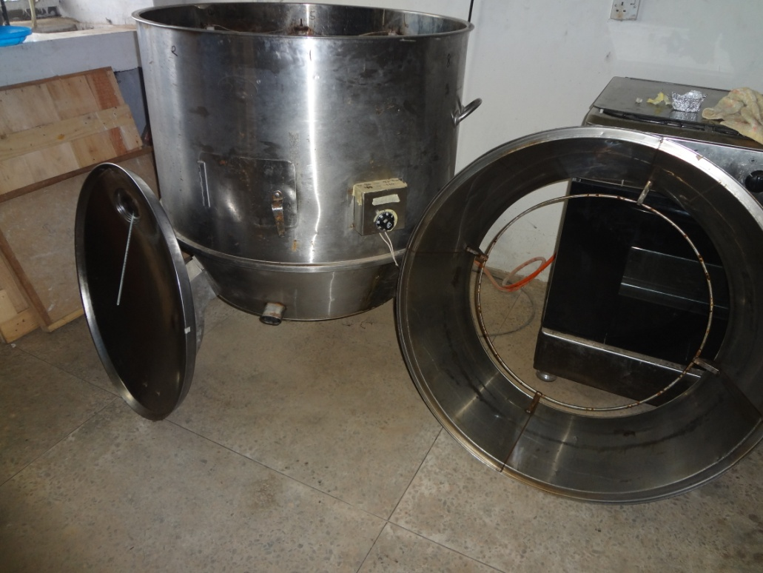
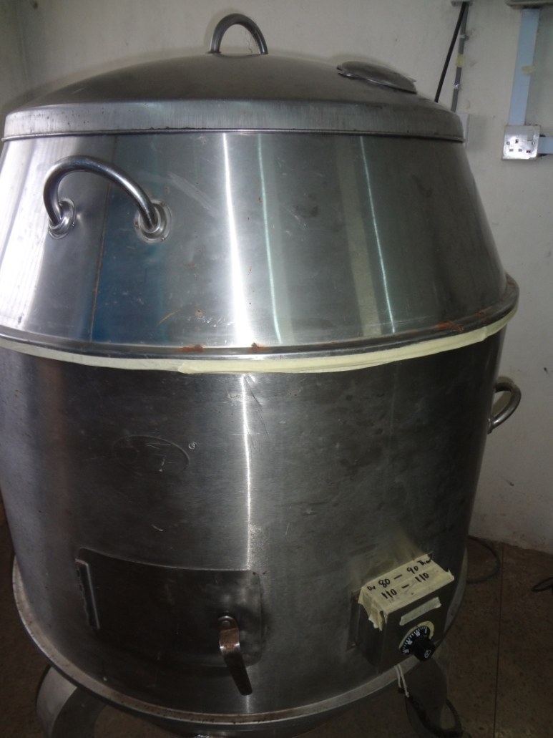
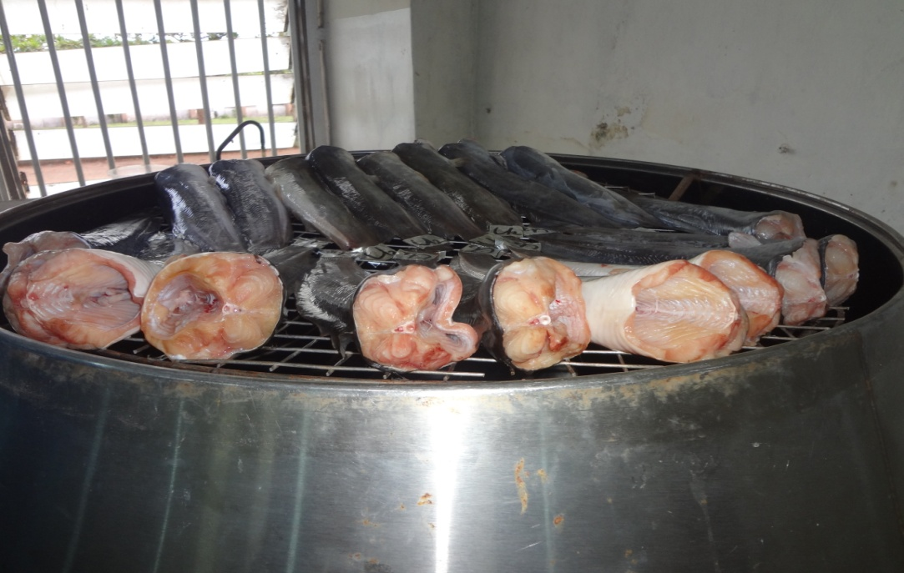
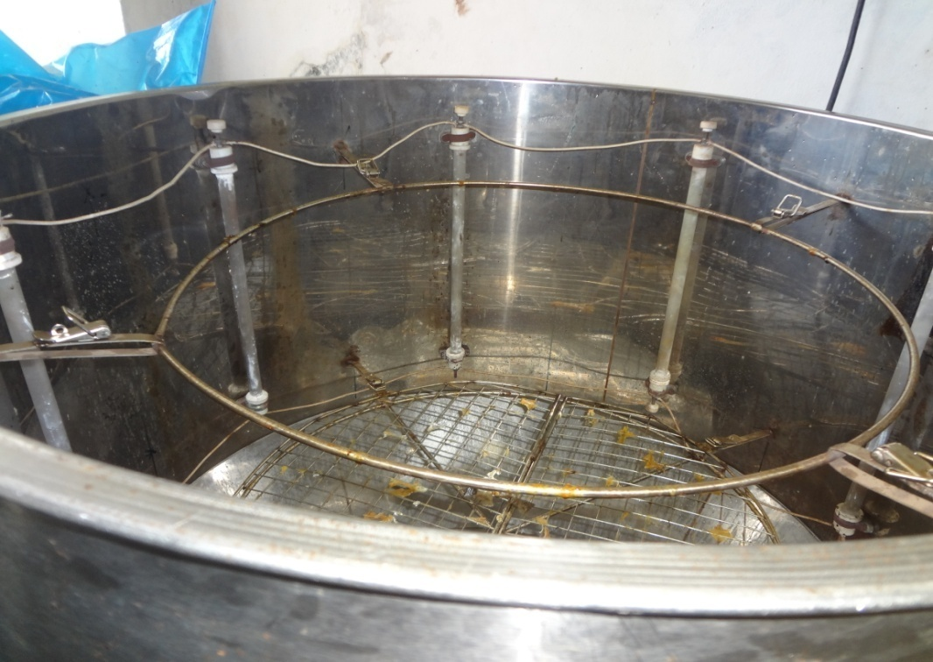
Outer and inner view of the electric dryer used

Slide 44
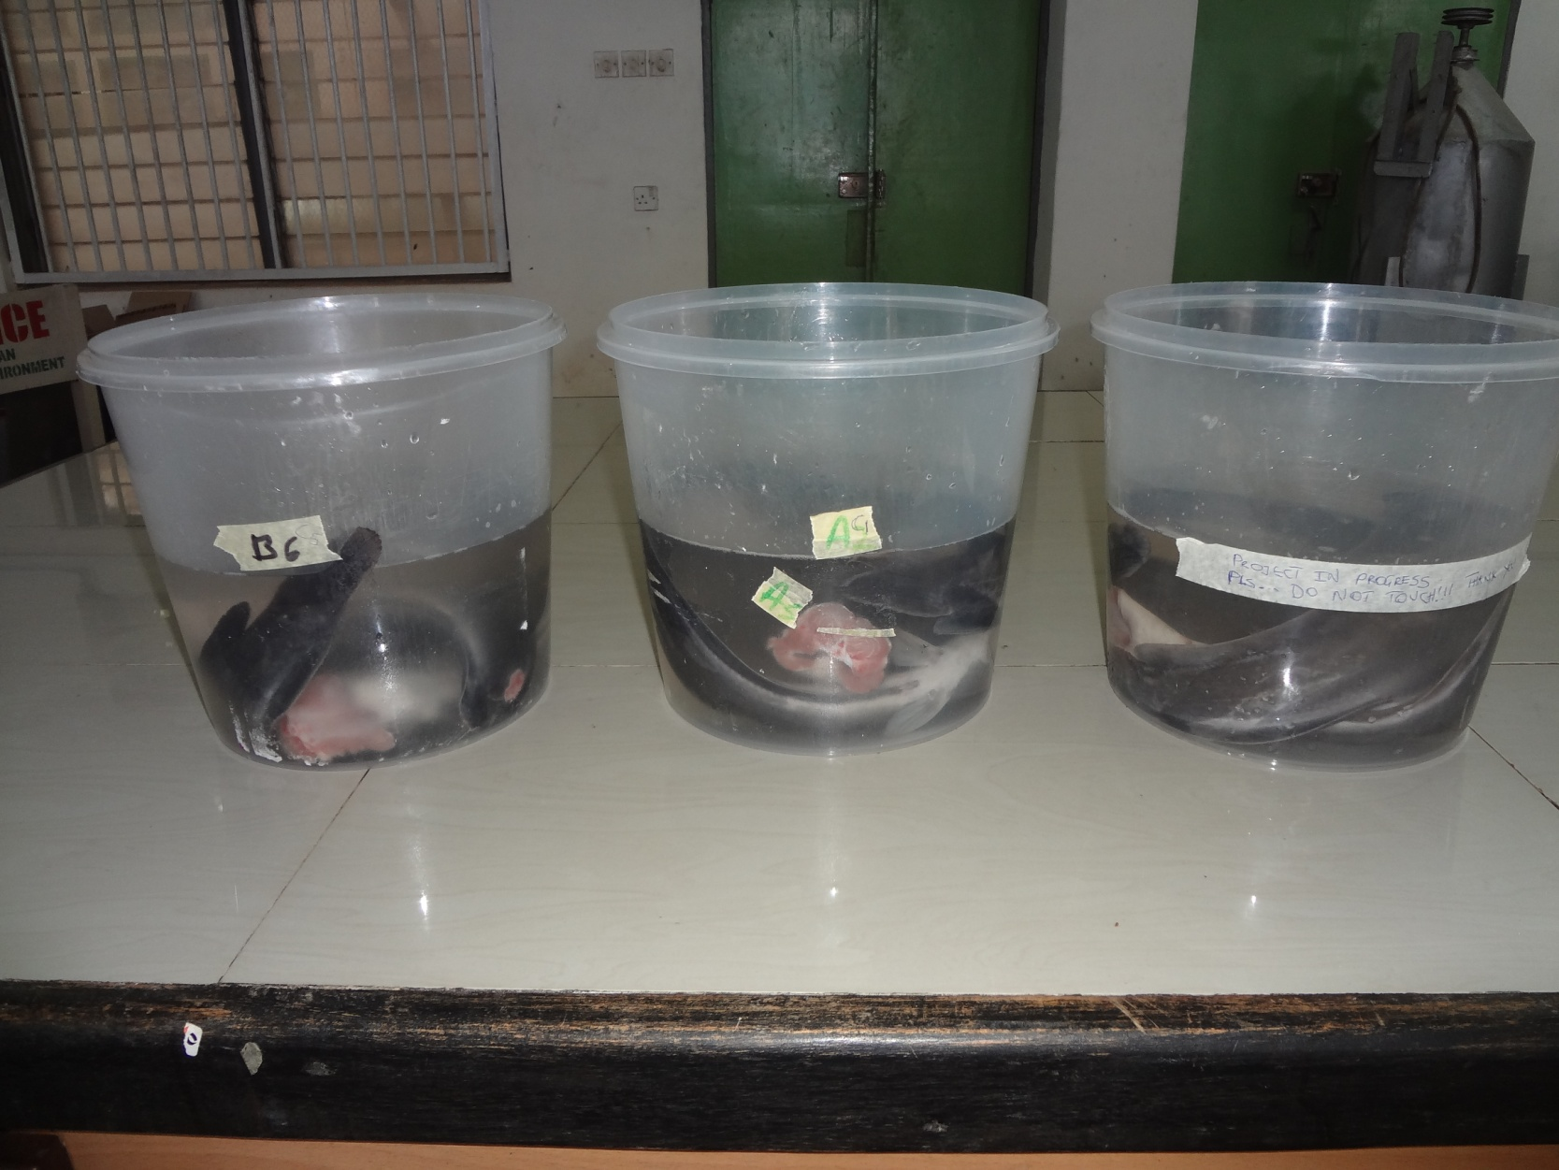
Brining of catfish

Slide 45
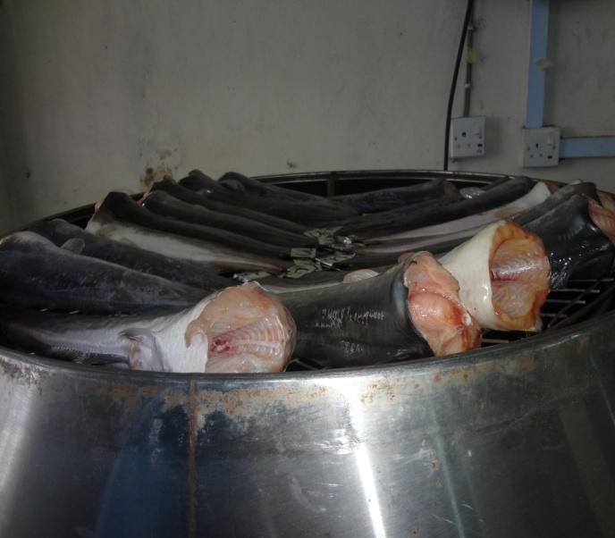

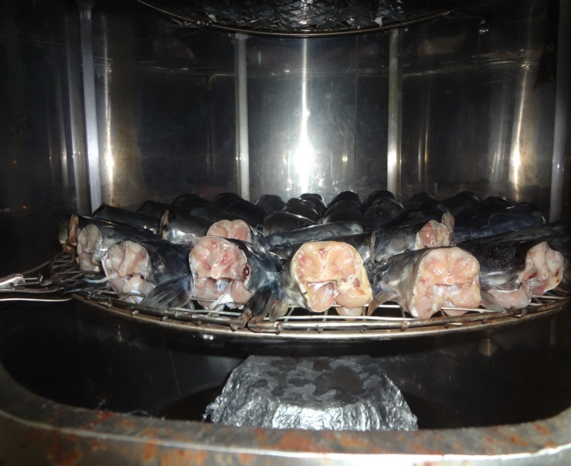
Drying operation of catfish in progress

Slide 46
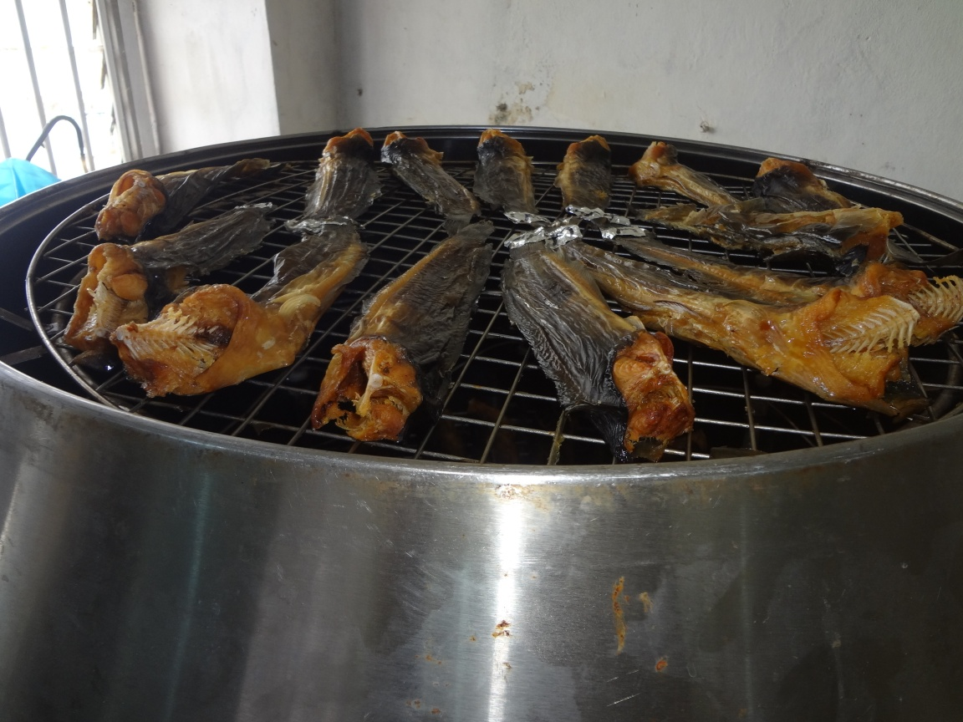
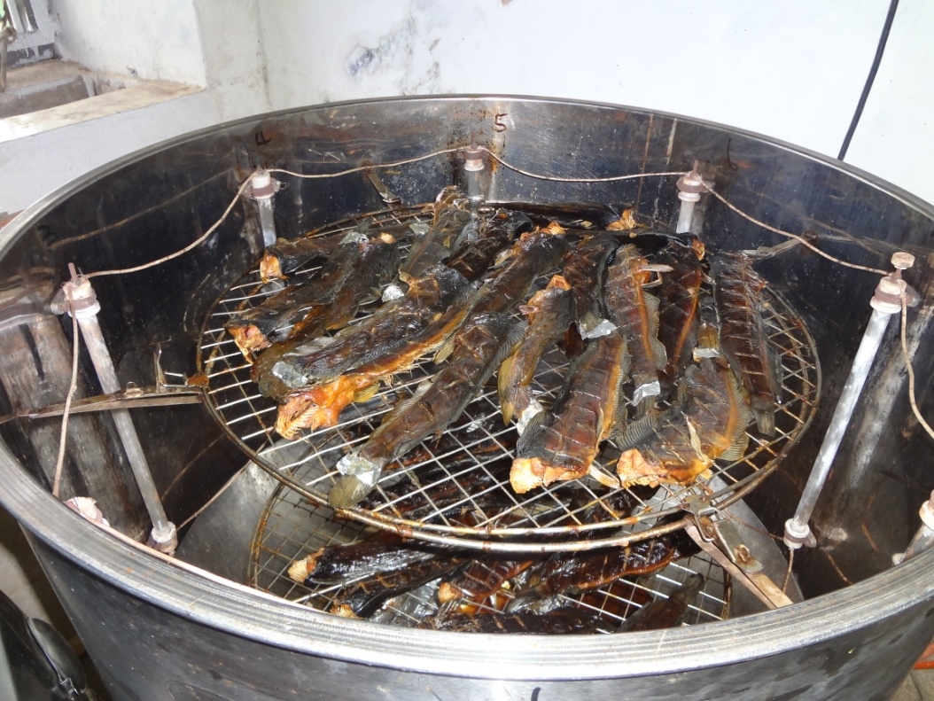
A batch of dehydrated catfish

Slide 47
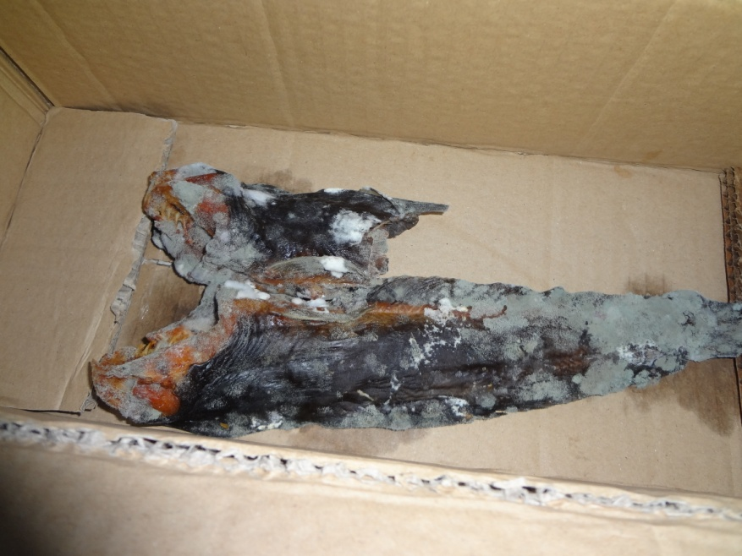
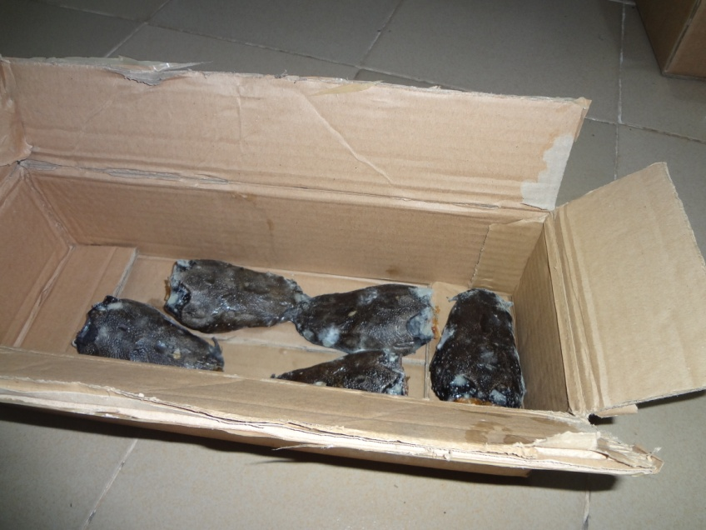
Mouldy dehydrated catfish in paper board carton package at two-month storage
Mouldy body part
Mouldy head part

Slide 48
THANK YOU FOR LISTENING

