Slide 1
MCB 305 – Soil Microbiology
Scope and Importance of Soil Microbiology by Dr. Francis Ibadin

Slide 2
Living organisms both plant and animal types constitute an important component of soil. Though these organisms form only a fraction (less than one percent) of the total soil mass, but they play important role in supporting plant communities on the earth surface.
Therefore, the scope and importance of soil microbiology, can be understood in better way by studying aspects like
Soil as a living system
Soil microbes and plant growth
Soil microorganisms and soil structure
Organic matter decomposition
Humus formation
Biogeochemical cycling of elements
Soil microorganisms as bio-control agents
Soil microbes and seed germination
Biological N₂ fixation
Degradation of pesticides in soil.

Slide 3
Soil as a living system:
Soil is a home to diverse group of living organisms, both micro flora (fungi, bacteria, algae and actinomycetes) and micro-fauna (protozoa, nematodes, earthworms, moles, ants).
The density of living organisms in soil is very high i.e. as much as billions / gm of soil, usually density of organisms is less in cultivated soil than uncultivated / virgin land and population decreases with soil acidity.
Top soil, the surface layer contains greater number of microorganisms because it is well supplied with Oxygen and nutrients. Lower layer / subsoil is depleted with Oxygen and nutrients hence it contains fewer organisms. Soil ecosystem comprises of organisms which are both, autotrophs (Algae) and heterotrophs (fungi, bacteria).
Autotrophs use inorganic carbon from CO₂ and are "primary producers" of organic matter, whereas heterotrophs use organic carbon and are decomposers/consumers.
2. Soil microbes and plant growth: Microorganisms play an important role in the decomposition of organic matter. Different types of microbes are specialised to different types of organic matter, between them covering just about everything.
Microorganisms being minute and microscopic, they are universally present in soil, water and air. Besides supporting the growth of various biological systems, soil and soil microbes serve as a best medium for plant growth.

Slide 4
Soil fauna & flora convert complex organic nutrients into simpler inorganic forms which are readily absorbed by the plant for growth. Further, they produce variety of substances like IAA (indoleacetic acid - a plant hormone promoting elongation of stems and roots), gibberellins (any of a group of plant hormones that stimulate stem elongation, germination, and flowering), antibiotics etc. which directly or indirectly promote the plant growth.
3. Soil microbes and soil structure: Constituents of soil are viz. organic matter, polysaccharides, lignins and gums, synthesized by soil microbes plays important role in cementing / binding of soil particles. Further, cells and mycelial strands of fungi and actinomycetes, Vormicasts (the end-product of the breakdown of organic matter by earthworms) from earthworm is also found to play important role in soil aggregation. Different soil microorganisms, having soil aggregation / soil binding properties are graded in the order as fungi > actinomycetes > gum producing bacteria > yeasts. Examples are: Fungi like Rhizopus, Mucor, Chaetomium, Fusarium, Rhizoctonia, Aspergillus and Bacteria like Azofobacler, Rhizobium Bacillus and Xanlhomonas.
4. Soil microbes and organic matter decomposition: The organic matter serves not only as a source of food for microorganisms but also supplies energy for the vital processes of metabolism that are characteristics of living beings.

Slide 5
Microorganisms such as fungi, actinomycetes, bacteria, protozoa etc. and macro organisms such as earthworms, termites, insects etc. plays important role in the process of decomposition of organic matter and release of plant nutrients in soil.
Thus, organic matter added to the soil is converted by oxidative decomposition to simpler nutrients / substances for plant growth and the residue is transformed into humus.
Organic matter / substances include cellulose, lignins and proteins (in cell wall of plants), glycogen (animal tissues), proteins and fats (plants, animals).
Cellulose is degraded by bacteria, especially those of genus Cytophaga and other genera (Bacillus, Pseudomonas, Cellulomonas, and Vibrio Achromobacter) and fungal genera (Aspergillus, Penicilliun, Trichoderma, Chactomium, Curvularia).
Lignins and proteins are partially digested by fungi, protozoa and nematodes. Proteins are degraded to individual amino acids mainly by fungi, actinomycetes and Clostridium.
Under anaerobic conditions of waterlogged soils, methane are main carbon containing product which is produced by the bacterial genera (strict anaerobes) Methanococcus, Methanobacterium and Methanosardna.

Slide 6
5. Soil microbes and humus formation: Humus is the organic residue in the soil resulting from decomposition of plant and animal remains in soil, or it is the highly complex organic residual matter in soil which is not readily degraded by microorganism, or it is the soft brown/dark coloured amorphous substance composed of residual organic matter along with dead microorganisms.
6. Soil microbes and cycling of elements: Life on earth is dependent on cycling of elements from their organic / elemental state to inorganic compounds, then to organic compounds and back to their elemental states. The biogeochemical process through which organic compounds are broken down to inorganic compounds or their constituent elements is known “Mineralization”, or microbial conversion of complex organic compounds into simple inorganic compounds and their constituent elements is known as mineralization.
Soil microbes plays important role in the biochemical cycling of elements in the biosphere where the essential elements (C, P, S, N and Fe etc.) undergo chemical transformations. Through the process of mineralization organic carbon, nitrogen, phosphorus, Sulphur, Iron etc. are made available for reuse by plants.

Slide 7
7. Soil microbes and biological N₂ fixation: Agriculture depends heavily on the ability of certain microbes (mainly bacteria) to convert atmospheric nitrogen (N₂ gas) to ammonia (NH₃). Some live freely in the soil, while others live in association with plant roots – the classic example is Rhizobiumbacteria in the roots of legumes. The process of conversion is known as nitrogen fixation.
Fixation of atmospheric nitrogen is essential because of the reasons:
i. Fixed nitrogen is lost through the process of nitrogen cycle through denitrification.
ii Demand for fixed nitrogen by the biosphere always exceeds its availability.
iii. The amount of nitrogen fixed chemically and lightning process is very less (i.e. 0.5%) as compared to biologically fixed nitrogen
iv. Nitrogenous fertilizers contribute only 25% of the total world requirement while biological nitrogen fixation contributes about 60% of the earth's fixed nitrogen
v. Manufacture of nitrogenous fertilizers by "Haber" process is costly and time consuming.
Two groups of microorganisms are involved in the process of BNF (Biological nitrogen fixation).
A. Non-symbiotic (free living) and B. Symbiotic (Associative)

Slide 8
Non-symbiotic (free living): Depending upon the presence or absence of oxygen, non symbiotic N₂ fixation prokaryotic organisms may be aerobic heterotrophs (Azotobacter, Pseudomonas, Achromobacter) or aerobic autotrophs (Nostoc, Anabena, Calothrix, BGA – Blue green algae) and anaerobic heterotrophs (Clostridium, Kelbsiella. Desulfovibrio) or anaerobic Autotrophs (Chlorobium, Chromnatium, Rhodospirillum, Meihanobacterium etc)
Symbiotic (Associative): The organisms involved are Rhizobium, Bratfyrhizobium in legumes (aerobic): Azospirillum (grasses), Actinonycetes (with Casuarinas, Alder).
8. Soil microbes as biocontrol agents: Several ecofriendly bioformulations of microbial origin are used in agriculture for the effective management of plant diseases, insect pests, weeds etc. eg: Trichoderma sp and Gleocladium sp are used for biological control of seed and soil borne diseases. Fungal genera Entomophthora, Beauveria, Metarrhizium and protozoa Maltesia grandis. Malameba locustiae etc are used in the management of insect pests. Nuclear polyhydrosis virus (NPV) is used for the control of Heliothis / American boll worm.
Bacteria like Bacillus thuringiensis, Pseudomonas are used in cotton against Angular leaf spot and boll worms.

Slide 9
9. Degradation of pesticides in soil by microorganisms: Soil receives different toxic chemicals in various forms and causes adverse effects on beneficial soil micro flora / micro fauna, plants, animals and human beings.
Various microbes present in soil act as the scavengers of these harmful chemicals in soil.
The pesticides/chemicals reaching the soil are acted upon by several physical, chemical and biological forces exerted by microbes in the soil and they are degraded into non-toxic substances and thereby minimize the damage caused by the pesticides to the ecosystem.
For example, bacterial genera like Pseudomonas, Clostridium, Bacillus, Thiobacillus, Achromobacter etc. and fungal genera like Trichoderma, Penicillium, Aspergillus, Rhizopus, and Fusarium are playing important role in the degradation of the toxic chemicals / pesticides in soil.
10. Biodegradation of hydrocarbons: Natural hydrocarbons in soil like waxes, paraffin’s, oils etc are degraded by fungi, bacteria and actinomycetes. E.g. ethane (C₂ H₆) a paraffin hydrocarbon is metabolized and degraded by Mycobacteria, Nocardia, Streptomyces Pseudomonas, Flavobacterium and several fungi.

Slide 10
Microbial activities in soil: Carbon cycle
The carbon cycle is the series of processes by which carbon from the environment is incorporated into living organisms and returned to the atmosphere as carbon dioxide. Atmospheric CO₂ is fixed into organic compounds by plants, together with phototrophic and chemoautotrophic microorganisms.
Carbon is a constituent of all organic compounds, many of which are essential to life on Earth. The source of the carbon found in living matter is carbon dioxide (CO₂) in the air or dissolved in water.
Algae and terrestrial green plants (producers) are the chief agents of carbon dioxide fixation through the process of photosynthesis, through which carbon dioxide and water are converted into simple carbohydrates.

Slide 11
These compounds are used by the producers to carry on metabolism, the excess being stored as fats and polysaccharides.
The stored products are then eaten by consumer organisms, from protozoans to man, which convert them into other forms.
The organic compounds thus synthesised undergo cellular respiration and CO₂ is returned to the atmosphere.
The carbon may have been passed along a food chain to consumers before this occurs.
Carbon dioxide is also produced by the decomposition of dead plant, animal and microbial material by heterotrophic bacteria and fungi.
Methanogenic bacteria produce methane from organic carbon or CO₂.
This in turn is oxidised by methanotrophic bacteria; carbon may be incorporated into organic material or lost as CO₂

Slide 12
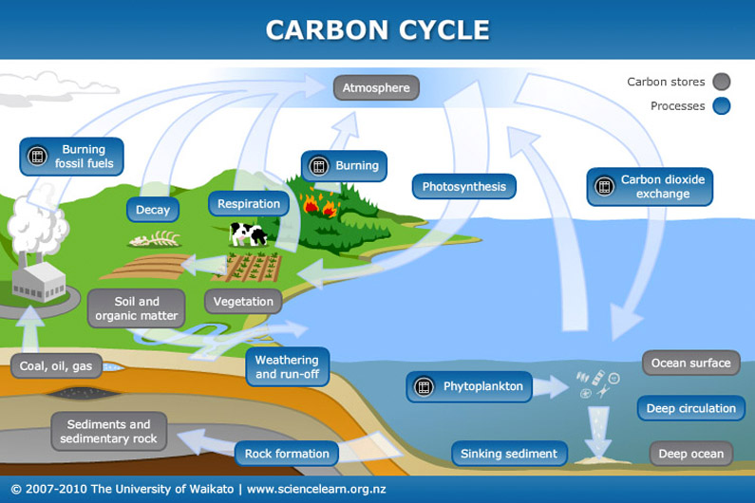

Slide 13
The Nitrogen Cycle
Nitrogen is essential to all living things as a component of proteins and nucleic acids.
Although elemental nitrogen makes up three quarters of the Earth’s atmosphere, only a handful of life forms are able to utilize it for metabolic purposes.
These are termed nitrogen-fixing bacteria, and incorporate the nitrogen into ammonia
N₂ + 8e⁻ + 8H⁺ + 16ATP −−−−−−−−→ 2NH₄⁺ + 16ADP + 16Pi
The nitrogenase enzyme complex responsible for the reaction is very sensitive to oxygen, and is thought to have evolved early in the Earth’s history, when the atmosphere was still largely oxygen-free. Many nitrogen-fixing bacteria are anaerobes; those that are not have devised ways of keeping the cell interior anoxic. Azotobacter species, for example, utilise oxygen at a high rate, so that it never accumulates in the cell, inactivating the nitrogenase. Many cyanophytes (blue-greens) carry out nitrogen fixation in thick-walled heterocyst which help maintain anoxic conditions.
Some nitrogen-fixing bacteria such as Rhizobium infect the roots of leguminous plants such as peas, beans and clover, where they form nodules and form a mutually beneficial.
(The process by which microorganisms convert organic matter to an inorganic form is termed mineralization)

Slide 14
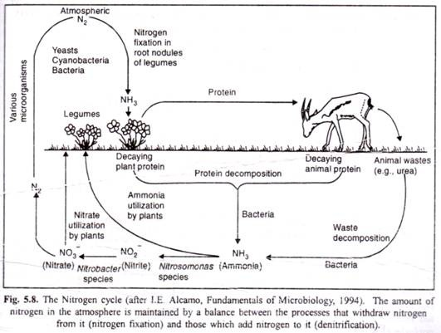
(Amino acids released during proteolysis undergo deamination in which nitrogen containing amino (-NH₂) group is removed. Thus, process of deamination which leads to the production of ammonia is termed as "ammonification". The process of ammonification is mediated by several soil microorganisms)

Slide 15
The process of nitrification, by which ammonia is oxidized stepwise firstly to nitrite and then to nitrate, involves two different groups of bacteria.
NH₄⁺ −----→ NO₂⁻
NO₂⁻ −----→ NO₃⁻
(Denitrification is the reduction, under anaerobic conditions, of nitrite and nitrate to nitrogen gas).
The nitrate thus formed may suffer a number of fates. It may act as an electron acceptor in anaerobic respiration, becoming reduced to nitrogen via a series of intermediates including nitrite. This process of denitrification occurs in anaerobic conditions such as waterlogged soils. Alternatively, it can be reduced once again to ammonia and thence converted to organic nitrogen.
(Anammox is the formation of nitrogen gas by the anaerobic oxidation of ammonia and nitrite).
A final pathway of nitrogen cycling has only been discovered in recent years. It is known as anammox (anaerobic ammonia oxidation), and is carried out by members of a group of Gram-negative bacteria called the Planctomycetes. The reaction, which can be represented thus:
NH₄⁺ + NO₂⁻ = N₂ + 2H₂O
has considerable potential in the removal of nitrogen from wastewater.

Slide 16
The Sulphur Cycle
Sulphur is found in living organisms in the form of compounds such as amino acids, coenzymes and vitamins. It can be utilized by different types of organisms in several forms.
In its elemental form, sulphur is unavailable to most organisms; however, certain bacteria such as Acidithiobacillus are able to oxidize it to sulphate, a form that can be utilized by a much broader range of organisms:
2S + 3O₂ + 2H₂O−−−−−−−→H₂SO₄
Powdered sulphur is often added to alkaline soils in order to encourage this reaction and thereby reduce the pH. Sulphate-reducing bacteria convert the sulphate to hydrogen sulphide gas using either an organic compound or hydrogen gas as electron donor:
8H⁺ + SO₄²⁻−−−−−−−→H₂S + 2H₂O + 2OH⁻

Slide 17
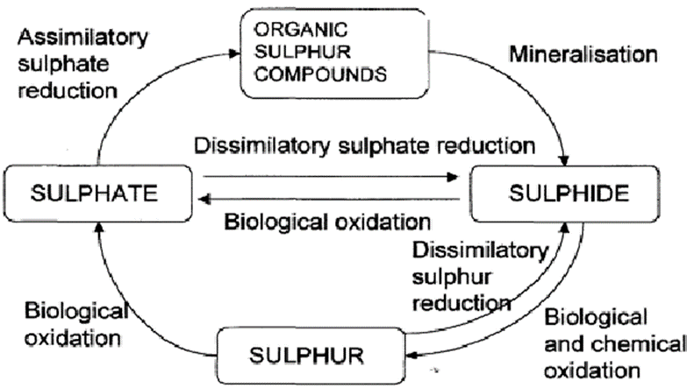
These bacteria are obligate anaerobes, and the process is termed dissimilatory sulphate reduction. Plants are also able to utilize sulphate, incorporating it into cellular constituents such
as the amino acids methionine and cysteine (assimilatory sulphate reduction). When the plants die, these compounds are broken down, again with the release of hydrogen sulphide.
Green and purple photosynthetic bacteria and some chemoautotrophs use hydrogen sulphide as an electron donor in the reduction of carbon dioxide, producing elemental sulphur and thus completing the cycle:
H₂S + CO₂⁻−−−−−−→ (CH₂O)_{n} + S⁰

Slide 18
Phosphorus
Minerals become available to organisms when they are released from rocks. Two mineral cycles of particular significance to organisms are the phosphorus and sulphur cycle. At the cellular level energy rich, phosphorus containing compounds are primary participants in energy transfer reactions.
The amount of available phosphorus in an environment can, therefore, have a dramatic effect on productivity. Abundant phosphorus stimulates lush plant and algal growth, making it a major contributor of water pollution.
The phosphorus cycle begins when phosphorus compounds are leached from rocks and mineral over long periods of time. Because phosphorus has no atmospheric form, it is usually transported in aqueous form.
Inorganic phosphorus is taken in by producer organisms, incorporated into organic molecules, and then passed on to consumers. It is returned to the environment by decomposition. An important aspect of phosphorus cycle is the very long time it takes for phosphorus atom to pass through it.
Deep sediments of the ocean are significant phosphorus sinks of extreme longevity. Phosphate ores that are mined to make detergents and inorganic fertilizers represent exposed ocean sediments that are millennia old.

Slide 19
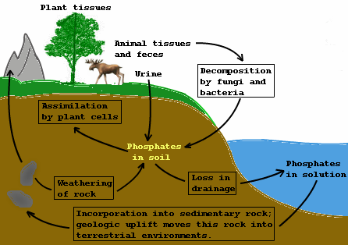
Aquatic ecosystems are often dramatically affected in the process because excess phosphates can stimulate explosive algal growth and photosynthetic bacteria populations, upsetting ecosystems stability.

