Slide 1

COLLEGE OF BASIC AND APPLIED SCIENCES
DEPARTMENT OF BIOLOGICAL SCIENCES
METABOLISM OF AMINO ACIDS AND PROTEINS (BCH 311)
Ayodele o.o (mrs.)

Slide 2
Introduction and course overview

Slide 3
Course outline
Amino acids which are the building blocks of proteins
Biological functions of proteins
Oxidative degradation of amino acids and metabolism of one carbon unit
Biosynthesis of amino acids and some derivatives
The Urea cycle,
Metabolism of inorganic nitrogen and
Disorders of amino acid metabolism.

Slide 4
introduction
Amino acids, in addition to their role as protein monomeric units, are energy metabolites and precursors of many biologically important nitrogen-containing compounds:
Examples include: heme, physiologically active amines, glutathione, nucleotides, and nucleotide coenzymes.
Amino acids are classified into two groups: essential and nonessential.
Mammals synthesize the nonessential amino acids from metabolic precursors but must obtain the essential amino acids from their diet.

Slide 5
introduction CONTD.
Excess dietary amino acids are neither stored for future use nor excreted.
Rather, they are converted to common metabolic intermediates such as pyruvate, oxaloacetate, acetyl-CoA, and α-keto-glutarate.
Consequently, amino acids are also precursors of glucose, fatty acids, and ketone bodies and are therefore metabolic fuels.
The course will consider the pathways of amino acid breakdown, synthesis, and utilization.

Slide 6
introduction CONTD.
We will examine the three common stages of amino acid breakdown:
Deamination (amino group removal), whereby amino groups are converted either to ammonia or to the amino group of Aspartate.
Incorporation of ammonia and aspartate nitrogen atoms into urea for excretion.
Conversion of amino acid carbon skeletons (the α-keto acids produced by deamination) to common metabolic intermediates.

Slide 7
Introduction contd.
After examining amino acid breakdown, the pathways by which amino acids are utilized in the biosynthesis of heme, physiologically active amines, and glutathione (which are derivatives) will be examined;
This will be followed by amino acid biosynthesis pathways.
Many of these reactions are similar to those considered in other pathways.

Slide 8
OVERVIEW OF AMINO ACIDS METABOLISM
CONDITIONS FOR AMINO ACIDS DEGRADATION
In animals, amino acids undergo oxidative degradation in three different metabolic circumstances:
During the normal synthesis and degradation of cellular proteins, some amino acids that are released from protein breakdown and are not needed for new protein synthesis undergo oxidative degradation.
When a diet is rich in protein and the ingested amino acids exceed the body’s needs for protein synthesis, the surplus is catabolized; amino acids cannot be stored.

Slide 9
Overview contd.
3. During starvation or in uncontrolled diabetes mellitus, when carbohydrates are either unavailable or not properly utilized, cellular proteins are used as fuel.
Under all these metabolic conditions, amino acids lose their amino groups to form α-keto acids, the “carbon skeletons” of amino acids.
The α-keto acids undergo oxidation to CO₂ and H₂O or, often more importantly, provide three- and four-carbon units that can be converted by gluconeogenesis into glucose.
The pathways of amino acid catabolism are quite similar in most organisms.

Slide 10
Overview contd.
As in carbohydrate and fatty acid catabolism, the processes of amino acid degradation converge on the central catabolic pathways, with the carbon skeletons of most amino acids finding their way to the citric acid cycle.
In some cases, the reaction pathways of amino acid breakdown closely parallel steps in the catabolism of fatty acids.

Slide 11
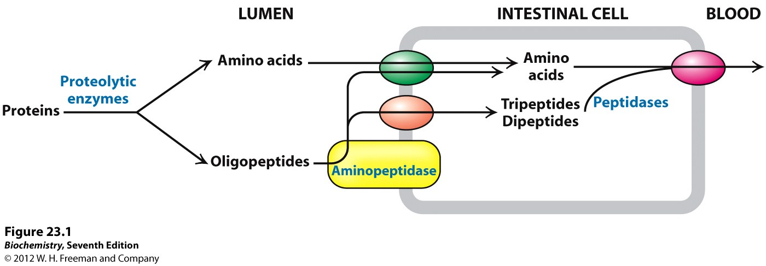
Fig: Breakdown of dietary Proteins.
Amino acids in excess cannot be stored or excreted. Surplus amino acids are used as metabolic fuel.

Slide 12
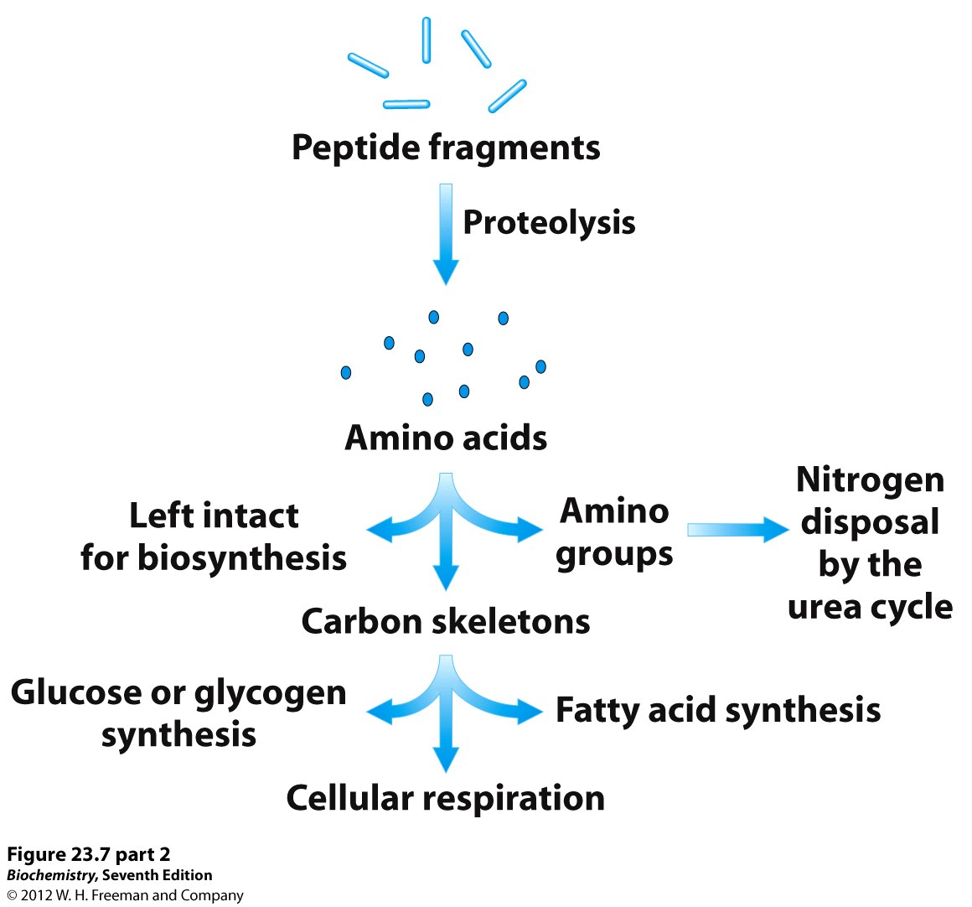
The major site of amino acid degradation in mammals is the liver, although muscles readily degrade the branched-chain amino acids.
Fig: Overview of amino acid metabolism

Slide 13
AMINO ACIDS CATABOLISM AND UREA CYCLE

Slide 14
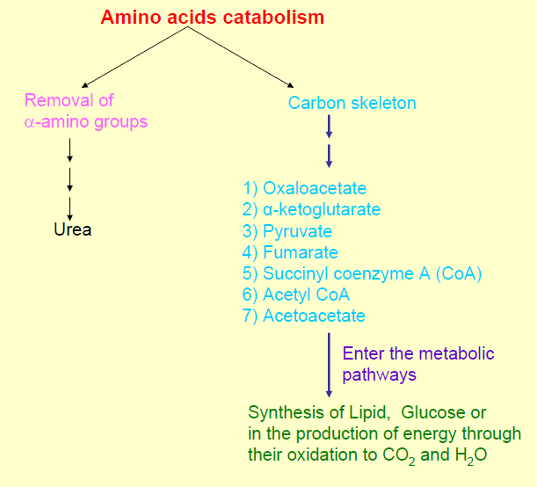

Slide 15
Amino Acid Degradation
The α-amino group is transferred to α-ketoglutarate to form glutamate.
The remaining C skeletons are transformed into major metabolic intermediates.
The major site of amino acid degradation in mammals is the liver, although muscles readily degrade the branched-chain amino acids.
The α-Amino group
The α-amino group is transferred to α-ketoglutarate to form glutamate.
  -Aminotransferases (also called transaminases) catalyze the tranfer of an α-amino group from an α-amino acid to an α-ketoacid.
  -This is then oxidatively deaminated to yield ammonium ion (NH₄⁺).

Slide 16
  Most of the ammonium ions are converted into urea (by the urea cycle) and then excreted, while some are used in the biosynthesis of nitrogen compounds.
The Carbon skeletons
The C skeletons are transformed into major metabolic intermediates:
    Acetyl CoA
    Acetoacetyl CoA
    Pyruvate
    α-ketoglutarate
    Succinyl CoA
    Fumarate
    Oxaloacetate
These intermediates are either converted into glucose or oxidized by the citric acid cycle. Thus, fatty acids, Ketone bodies, and glucose can be formed from amino acids.

Slide 17
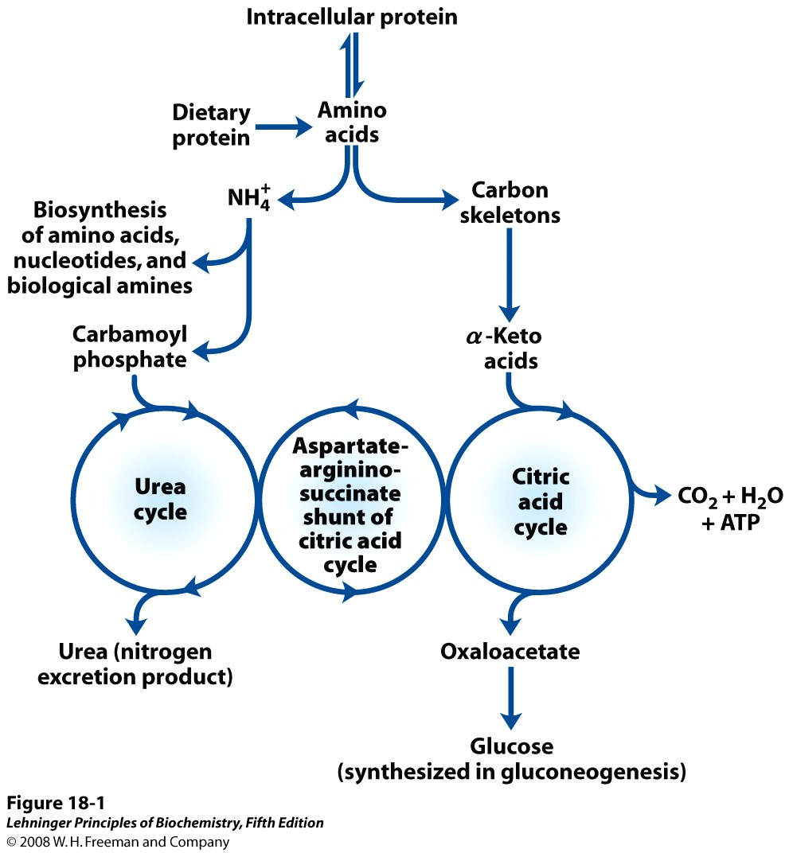

Slide 18
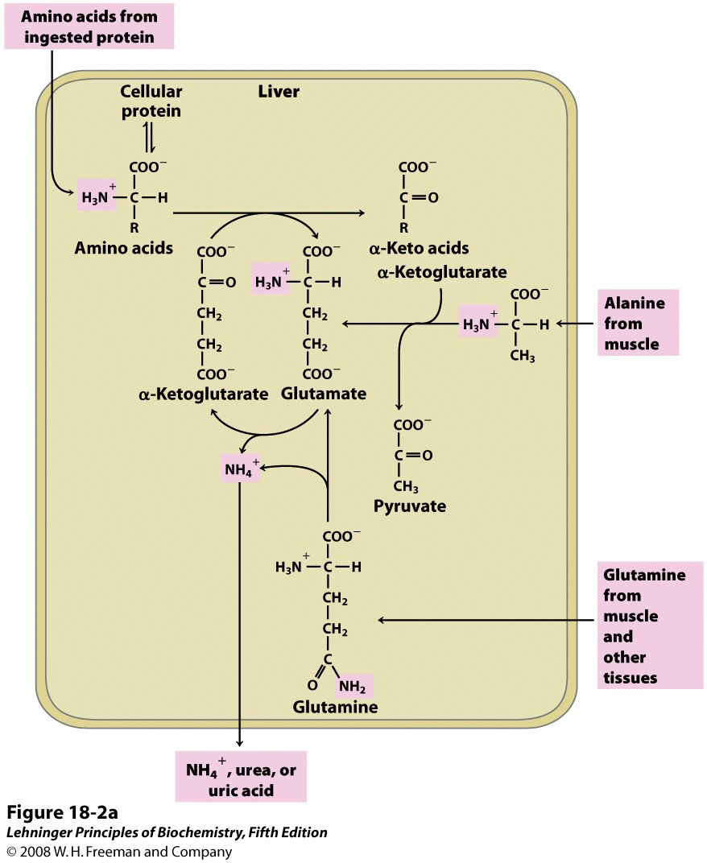
METABOLIC FATES OF AMINO GROUPS

Slide 19
The first step in the catabolism of most L-amino acids, once they have reached the liver, is removal of α -amino groups, promoted by enzymes called aminotransferases or transaminases.
In these transamination reactions, the α-amino group is transferred to the α carbon atom of α-ketoglutarate, leaving behind the corresponding α-keto acid analog of the amino acid.
There is no net deamination (loss of amino groups) in these reactions, because the α-ketoglutarate becomes aminated as the α-amino acid is deaminated.
The effect of transamination reactions is to collect the amino groups from many different amino acids in the form of L-glutamate.

Slide 20
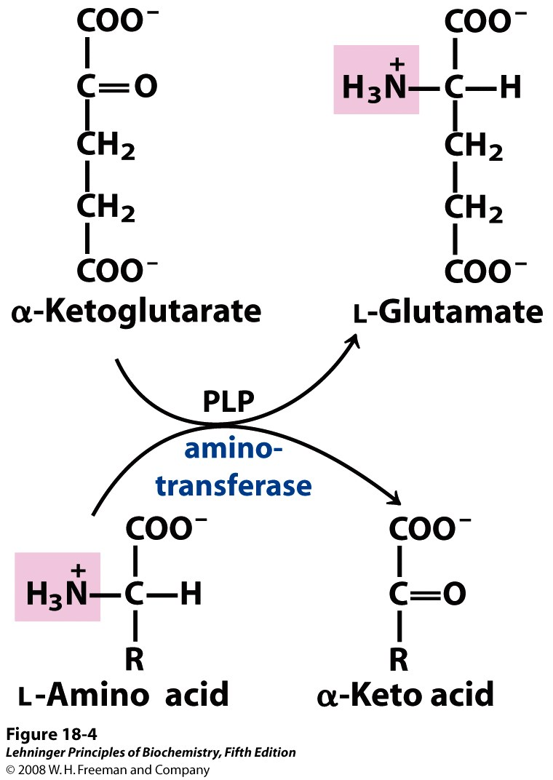
The glutamate then functions as an amino group donor for biosynthetic pathways or for excretion pathways that lead to the elimination of nitrogenous waste products.

Slide 21
Cells contain different types of aminotransferases. Many are specific for α-ketoglutarate as the amino group acceptor but differ in their specificity for the L-amino acid. The enzymes are named for the amino group donor (e.g. alanine aminotransferase, aspartate aminotransferase).
All aminotransferases have the same prosthetic group and the same reaction mechanism. The prosthetic group is pyridoxal phosphate (PLP), the coenzyme form of pyridoxine, or vitamin B6.
Diagnostic values of transaminases:
Transaminases are normally intracellular enzymes. Thus, the presence of elevated levels of transaminase in the serum indicated damage to cells rich in the enzyme. e.g.
  -Serum glutamate-oxaloacetate transaminase (SGOT), also called Aspartate aminotransferase (AST).

Slide 22
  -Serum glutamate-pyruvate transaminase (SGPT), also called Alanine aminotransferase (ALT).
Oxidative Deamination; Release of ammonia
The amino groups from many of the α-amino acids are collected in the liver in the form of the amino group of L-glutamate molecules.
These amino groups must next be removed from glutamate to prepare them for excretion.
In hepatocytes, glutamate is transported from the cytosol into mitochondria, where it undergoes oxidative deamination catalyzed by glutamate dehydrogenase.

Slide 23
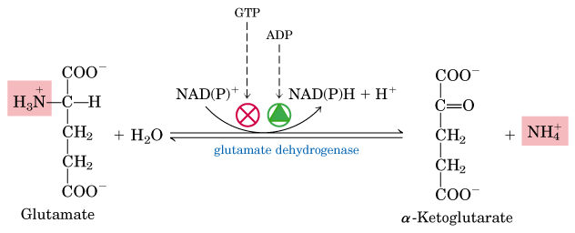
In mammals, this enzyme is present in the mitochondrial matrix. It is the only enzyme that can use either NAD⁺ or NADP⁺ as the acceptor of reducing equivalents.
The combined action of an aminotransferase and glutamate dehydrogenase is referred to as trans deamination.

Slide 24
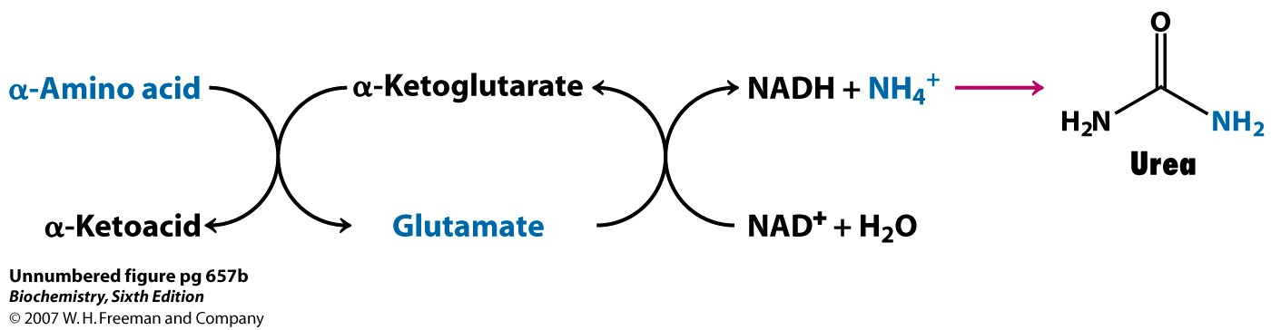
The sum of the reactions catalyzed by aminotransferases and glutamate dehydrogenase; Transdeamination.
NOTE: A few amino acids bypass the trans-deamination pathway and undergo direct oxidative deamination. For example, Serine and Threonine can be directly deaminated.

Slide 25
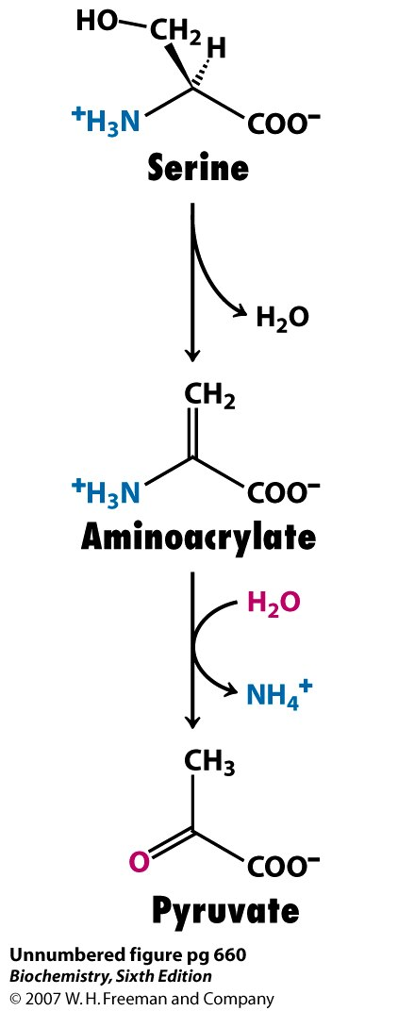
Their deamination is catalyzed by Serine dehydratase and Threonine dehydratase respectively.
*The α-ketoglutarate formed from glutamate deamination can be used in the citric acid cycle and for glucose synthesis.

Slide 26
RECALL:
α-amino groups are converted into ammonium ions by the oxidative deamination of glutamate.
NH₄⁺ is very toxic.
The liver, where most of the amino acid degradation takes place, uses the urea cycle to convert NH₄⁺ into urea which is then excreted from the body.
How is NH₄⁺ carried to liver?
Glutamine carries ammonia to the liver.
Alanine carries ammonia from muscles to the liver by Alanine (glucose-alanine) cycle.

Slide 27
Glutamine and Ammonia Transport in the Bloodstream
Ammonia is quite toxic to animal tissues, and the levels present in blood are regulated.
In many tissues, including the brain, some processes such as nucleotide degradation generate free ammonia. In most animals much of the free ammonia is converted to a nontoxic compound before export from the extrahepatic tissues into the blood and transport to the liver or kidneys.
For this transport function, glutamate, critical to intracellular amino group metabolism, is supplanted by L-glutamine. The free ammonia produced in tissues is combined with glutamate to yield glutamine by the action of glutamine synthetase.
This reaction requires ATP and occurs in two steps:

Slide 28
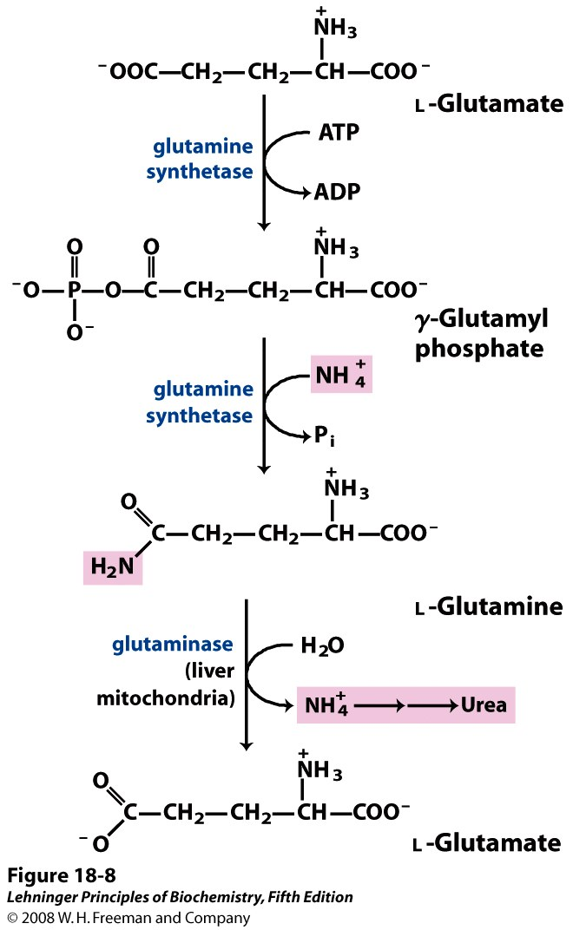
Glutamate and ATP react to form ADP and a Ƴ-glutamyl phosphate intermediate,
this then reacts with ammonia to produce glutamine and inorganic phosphate.

Slide 29
Glutamine is a nontoxic transport form of ammonia; it is normally present in blood in much higher concentrations than other amino acids.
It also serves as a source of amino groups in a variety of biosynthetic reactions. Glutamine synthetase is found in all organisms, always playing a central metabolic role. In microorganisms, the enzyme serves as an essential portal for the entry of fixed nitrogen into biological systems.
In most terrestrial animals, excess glutamine (than required for biosynthesis) is transported in the blood to the intestine, liver, and kidneys for processing.
In these tissues, the amide nitrogen is released as ammonium ion in the mitochondria, where the enzyme glutaminase converts glutamine to glutamate and NH₄⁺.

Slide 30
The NH₄⁺ from intestine and kidney is transported in the blood to the liver. In the liver, the ammonia from all sources is disposed of by urea synthesis.
Some of the glutamate produced in the glutaminase reaction may be further processed in the liver by glutamate dehydrogenase, releasing more ammonia and producing carbon skeletons for metabolic fuel.
However, most glutamate enters the transamination reactions required for amino acid biosynthesis and other processes.
In metabolic acidosis, there is an increase in glutamine processing by the kidneys.
Not all the excess NH₄⁺ thus produced is released into the bloodstream or converted to urea; some is excreted directly into the urine.

Slide 31
In the kidney, the NH₄⁺ forms salts with metabolic acids, facilitating their removal in the urine.
Bicarbonate produced by the decarboxylation of α-ketoglutarate in the citric acid cycle can also serve as a buffer in blood plasma.
Taken together, these effects of glutamine metabolism in the kidney tend to counteract acidosis.

Slide 32
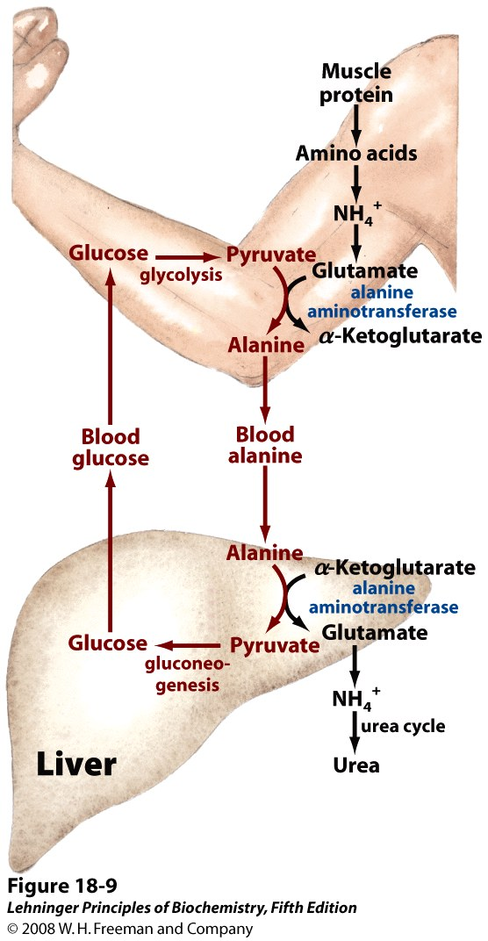
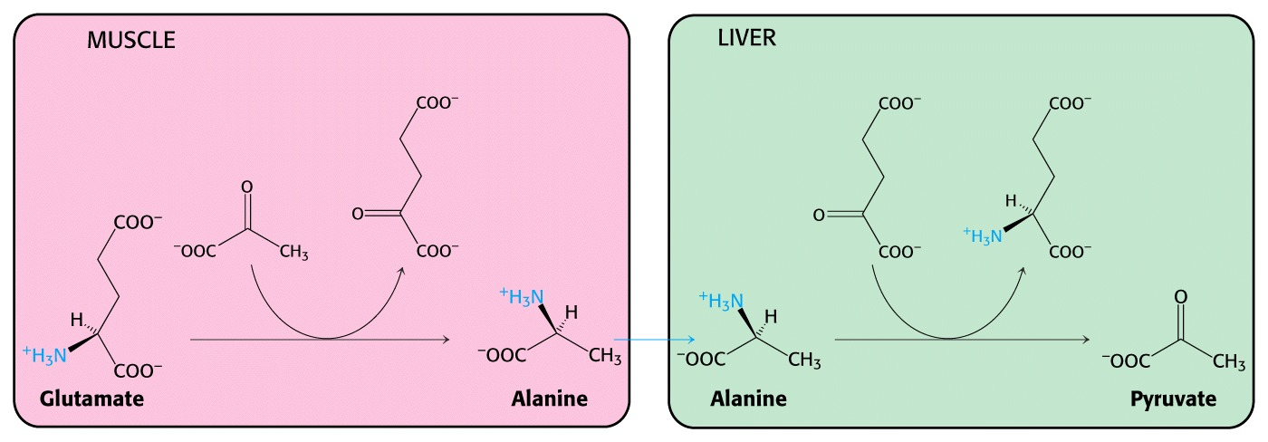
Glucose-Alanine Cycle (alanine cycle)

Slide 33
NITROGEN EXCRETION AND UREA CYCLE

Slide 34
NITROGEN EXCRETION
If not reused for the synthesis of new amino acids or other nitrogenous products, amino groups are channeled into a single excretory end product which is urea.
Most aquatic species, such as the bony fishes, are ammonotelic, excreting amino nitrogen as ammonia. The toxic ammonia is simply diluted in the surrounding water.
Terrestrial animals require pathways for nitrogen excretion that minimize toxicity and water loss. Most terrestrial animals are ureotelic, excreting amino nitrogen in the form of urea.
Birds and reptiles are uricotelic, excreting amino nitrogen as uric acid.

Slide 35
Plants recycle virtually all amino groups, and nitrogen excretion occurs only under very unusual circumstances.
In ureotelic organisms, the ammonia deposited in the mitochondria of hepatocytes is converted to urea in the urea cycle.
This pathway was discovered in 1932 by Hans Krebs (who later also discovered the citric acid cycle) and a medical student associate, Kurt Henseleit.
Urea production occurs almost exclusively in the liver and it is the fate of most of the ammonia channeled there.
The urea passes into the bloodstream and thus to the kidneys and is excreted into the urine.

Slide 36
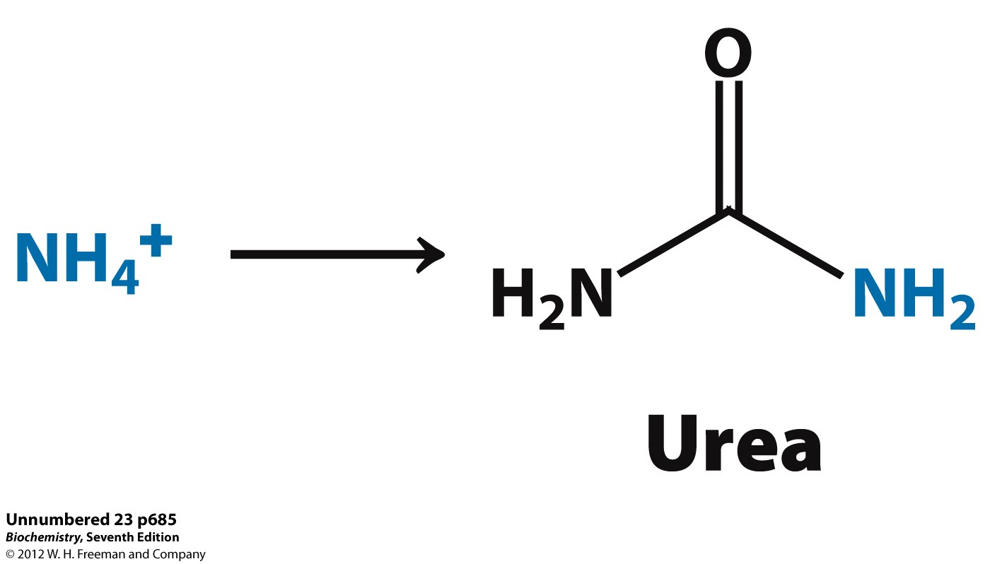
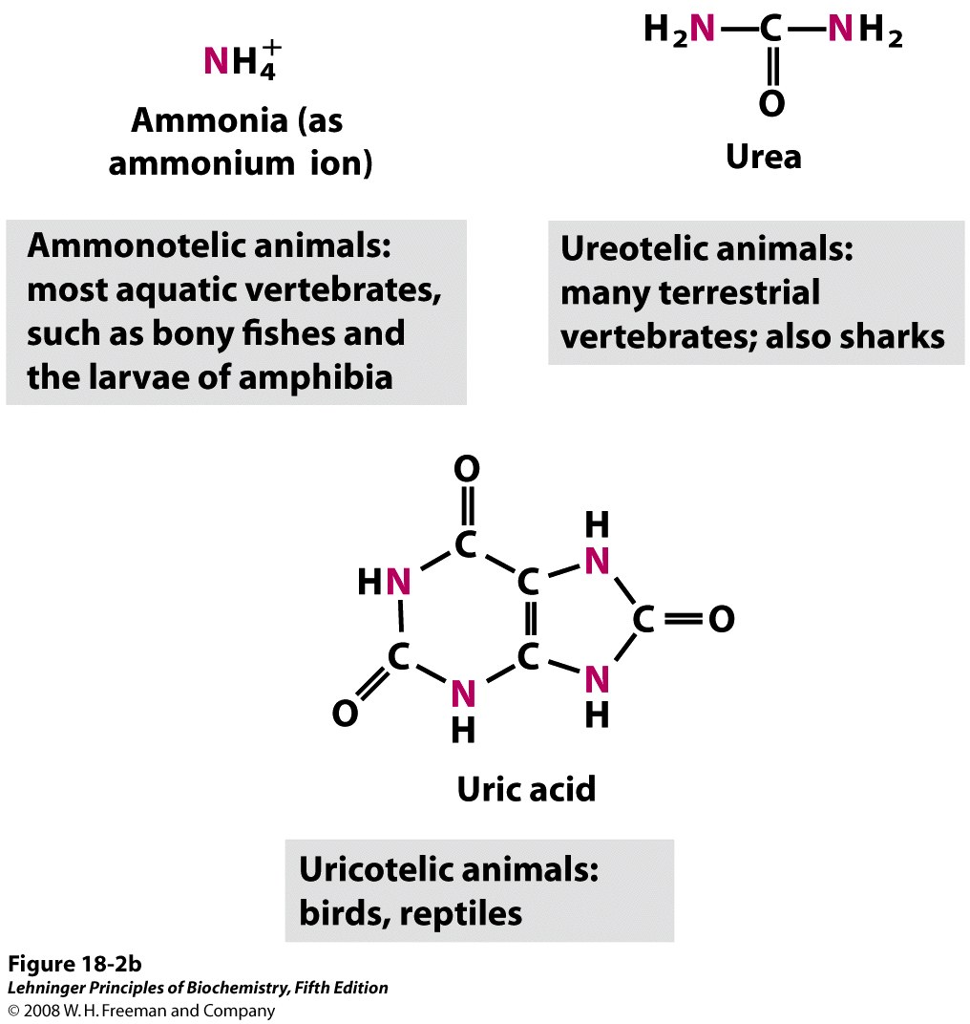

Slide 37
BIOSYNTHESIS OF UREA
Urea is the major end product in Nitrogen metabolism in humans and mammals.
NH3, the product of oxidative deamination reaction, is toxic in even small amount and must be removed from the body.
Urea cycle a.k.a Ornithine cycle is the conversion reactions of NH3 into urea.
Urea is produced from Ammonia in five enzymatic steps:
The urea cycle begins inside liver mitochondria, but three of the subsequent steps take place in the cytosol; the cycle thus spans two cellular compartments.
The first amino group to enter the urea cycle is derived from ammonia in the mitochondrial matrix.

Slide 38
The NH₄⁺ generated in liver mitochondria is immediately used, together with CO₂ (as HCO₃⁻ ) produced by mitochondrial respiration, to form carbamoyl phosphate in the matrix.
This ATP-dependent reaction is catalyzed by carbamoyl phosphate synthetase I, a regulatory enzyme.
The mitochondrial form of the enzyme is distinct from the cytosolic (II) form, which has a separate function in pyrimidine biosynthesis.
The carbamoyl phosphate, which functions as an activated carbamoyl group donor, now enters the urea cycle. The cycle has four enzymatic steps.

Slide 39
Steps In Urea Cycle
Synthesis of carbamoyl phosphate :
Carbamoyl phosphate synthase I (CPS l) of mitochondria catalyzes the condensation of NH4 + ions with CO2 to form carbamoyl phosphate. This step consumes 2 ATP and is irreversible, and rate-limiting.
CPS I requires N-acetylglutamate for its activity.
Another enzyme, carbamoyl phosphate synthase ll (CPS ll)- involved in pyrimidine synthesis-is present in cytosol. lt accepts amino group from glutamine and does not require N-acetylglutamate for its activity.

Slide 40
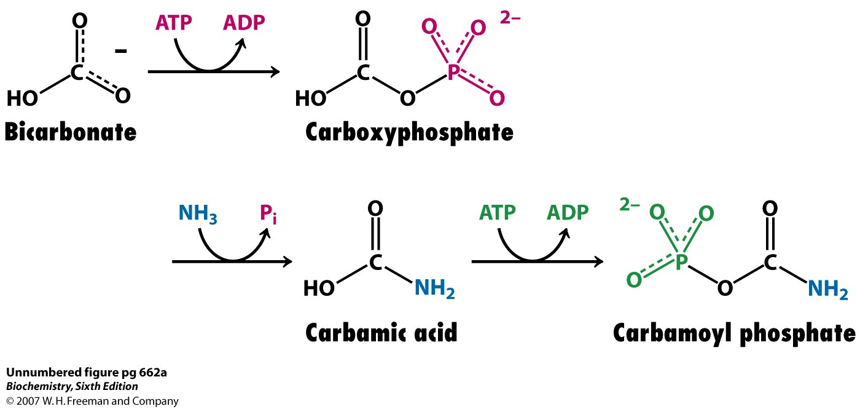
Formation of carbamoyl phosphate:
Enzyme: carbamoyl phosphate synthetase
Place: mitochondria
2 ATP are used.

Slide 41
2. Formation of citrulline:
Carbamoyl phosphate donates its carbamoyl group to ornithine to form citrulline, with the release of Pi.
Ornithine plays a role resembling that of oxaloacetate in the citric acid cycle, accepting material at each turn of the cycle. The reaction is catalyzed by ornithine Transcarbamoylase.
Ornithine and citrulline are basic amino acids (but they are never found in protein structure due to lack of codons).
Citrulline produced in this reaction is transported to cytosol by a transporter system.

Slide 42
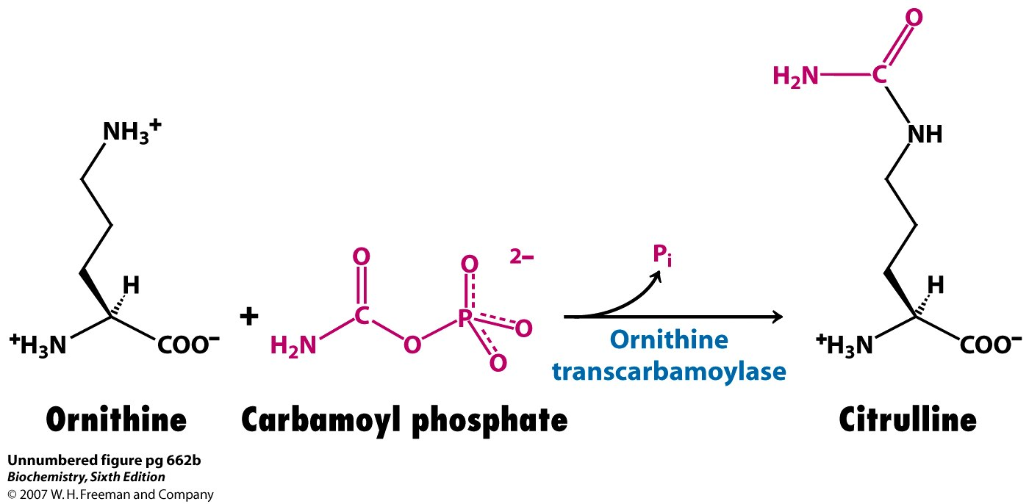
Formation of citrulline :
Enzyme: ornithine transcarbamoylase
Place: mitochondria
No ATP is used.

Slide 43
3. Synthesis of arginosuccinate :
Arginosuccinate synthase condenses citrulline with aspartate to produce
arginosuccinate.
The second amino group of urea is incorporated in this reaction.
This step requires ATP which is cleaved to AMP and pyrophosphate (PPi).
The latter is immediately broken down to inorganic phosphate (Pi).

Slide 44
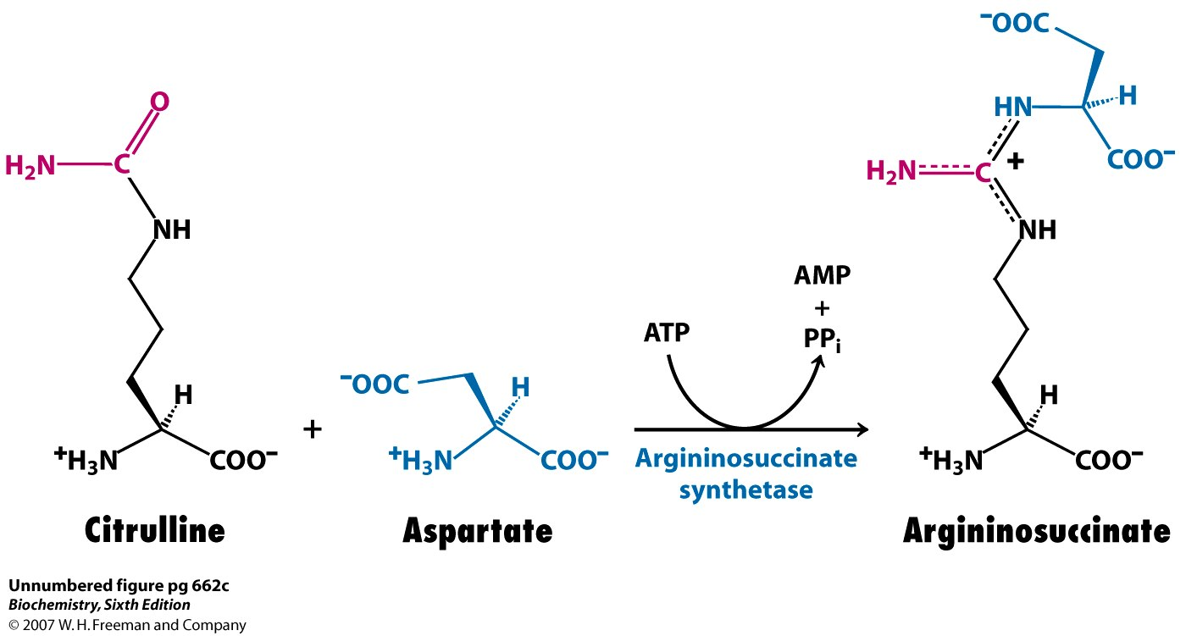
Synthesis of argininosuccinate :
Enzyme: argininosuccinate synthetase
Place: Cytosol
1 ATP is used.

Slide 45
4. Cleavage of arginosuccinate :
Arginosuccinase cleaves arginosuccinate to give arginine and fumarate. Arginine is the immediate precursor for urea.
Fumarate enters the mitochondria to join the pool of citric acid cycle intermediates.
Thus providing a connecting link with TCA cycle, gluconeogenesis etc.
This is the only reversible step in the urea cycle.

Slide 46
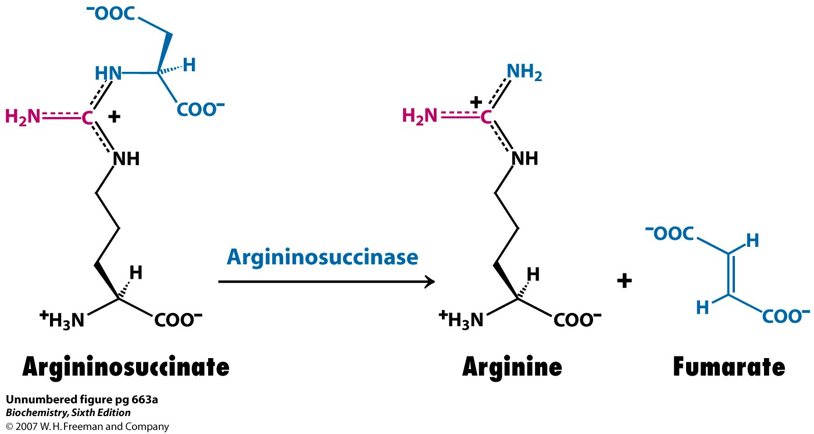
Cleavage of argininosuccinate:
Enzyme: argininosuccinase
Place: cytosol
No ATP is used.

Slide 47
5. Formation of urea :
In the last reaction of the urea cycle, the cytosolic enzyme arginase cleaves arginine to yield urea and ornithine. Ornithine is transported into the mitochondrion to initiate another round of the urea cycle.
Arginase is activated by Co2+ and Mn2+. Ornithine and lysine compete with arginine (competitive inhibition).
Note: Five enzymes took part in the formation of urea. Out of these the first four are found in all cells. But the last enzyme arginase is found only in the liver cells. For this reason, Arginine synthesis may occur to varying degrees in many tissues. But only the liver can ultimately produce urea.

Slide 48
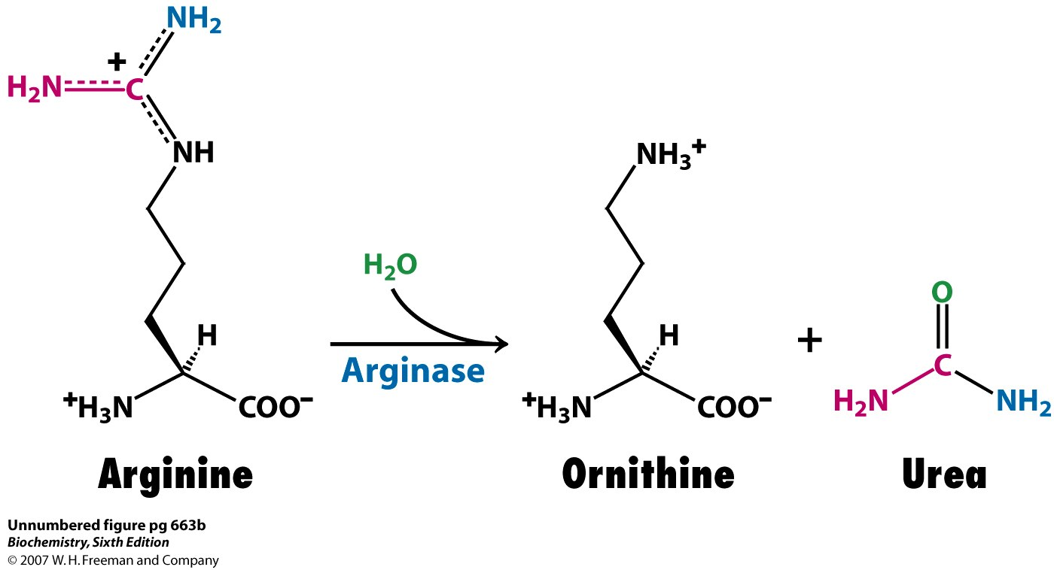
Cleavage of arginine to ornithine and urea
Enzyme: arginase
Place: cytosol
No ATP is used

Slide 49
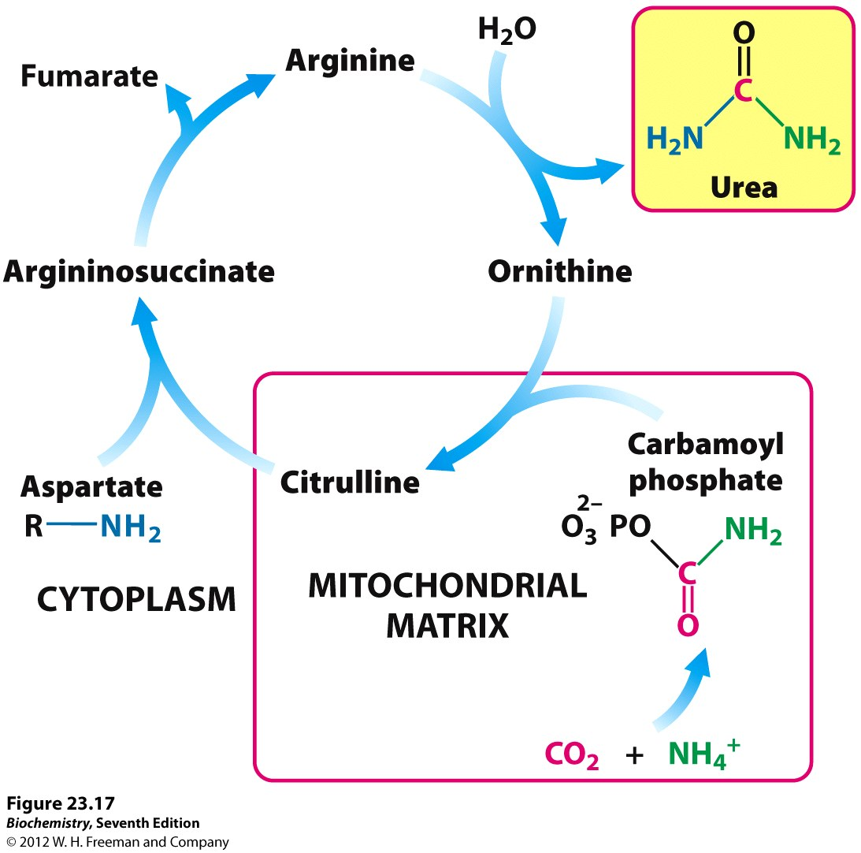
Fig.: Urea cycle

Slide 50
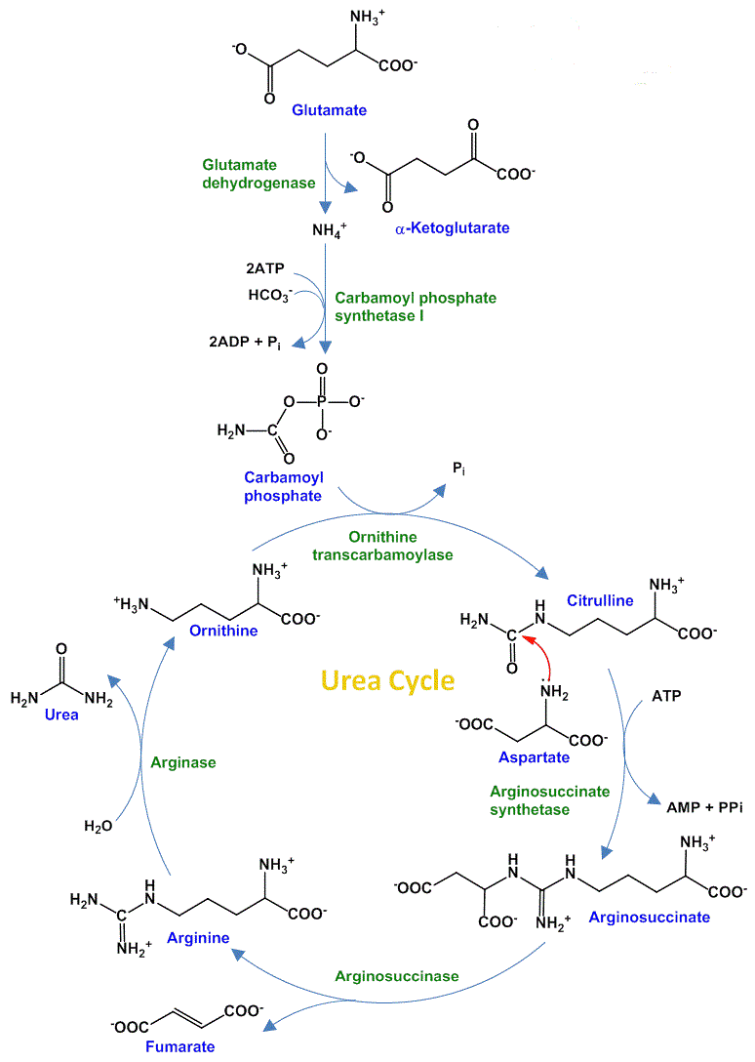
Source: Pharma change info

Slide 51
NOTE:
The enzymes of many metabolic pathways are usually clustered, with the product of one enzyme reaction being channeled directly to the next enzyme in the pathway.
In the urea cycle, the mitochondrial and cytosolic enzymes appear to be clustered in this way. The citrulline transported out of the mitochondrion is not diluted into the general pool of metabolites in the cytosol but is passed directly to the active site of argininosuccinate synthetase.
This channeling between enzymes continues for argininosuccinate, arginine, and ornithine. Only urea is released into the general cytosolic pool of metabolites.

Slide 52
Interconnectivity between Urea Cycle and Citric Acid Cycle
Because the fumarate produced in the Arginosuccinase reaction is also an intermediate of the citric acid cycle, the cycles are, in principle, interconnected.
However, each cycle can operate independently and communication between them depends on the transport of key intermediates between the mitochondrion and cytosol.
Several enzymes of the citric acid cycle, including fumarase (fumarate hydratase) and malate dehydrogenase, are also present as isozymes in the cytosol.
The fumarate generated in cytosolic arginine synthesis can therefore be converted to malate in the cytosol, and these intermediates can be further metabolized in the cytosol or transported into mitochondria for use in the citric acid cycle.

Slide 53
Aspartate formed in mitochondria by transamination between oxaloacetate and glutamate can be transported to the cytosol, where it serves as nitrogen donor in the urea cycle reaction catalyzed by argininosuccinate synthetase.
These reactions, making up the aspartate-argininosuccinate shunt, provide metabolic links between the separate pathways by which the amino groups and carbon skeletons of amino acids are processed.

Slide 54
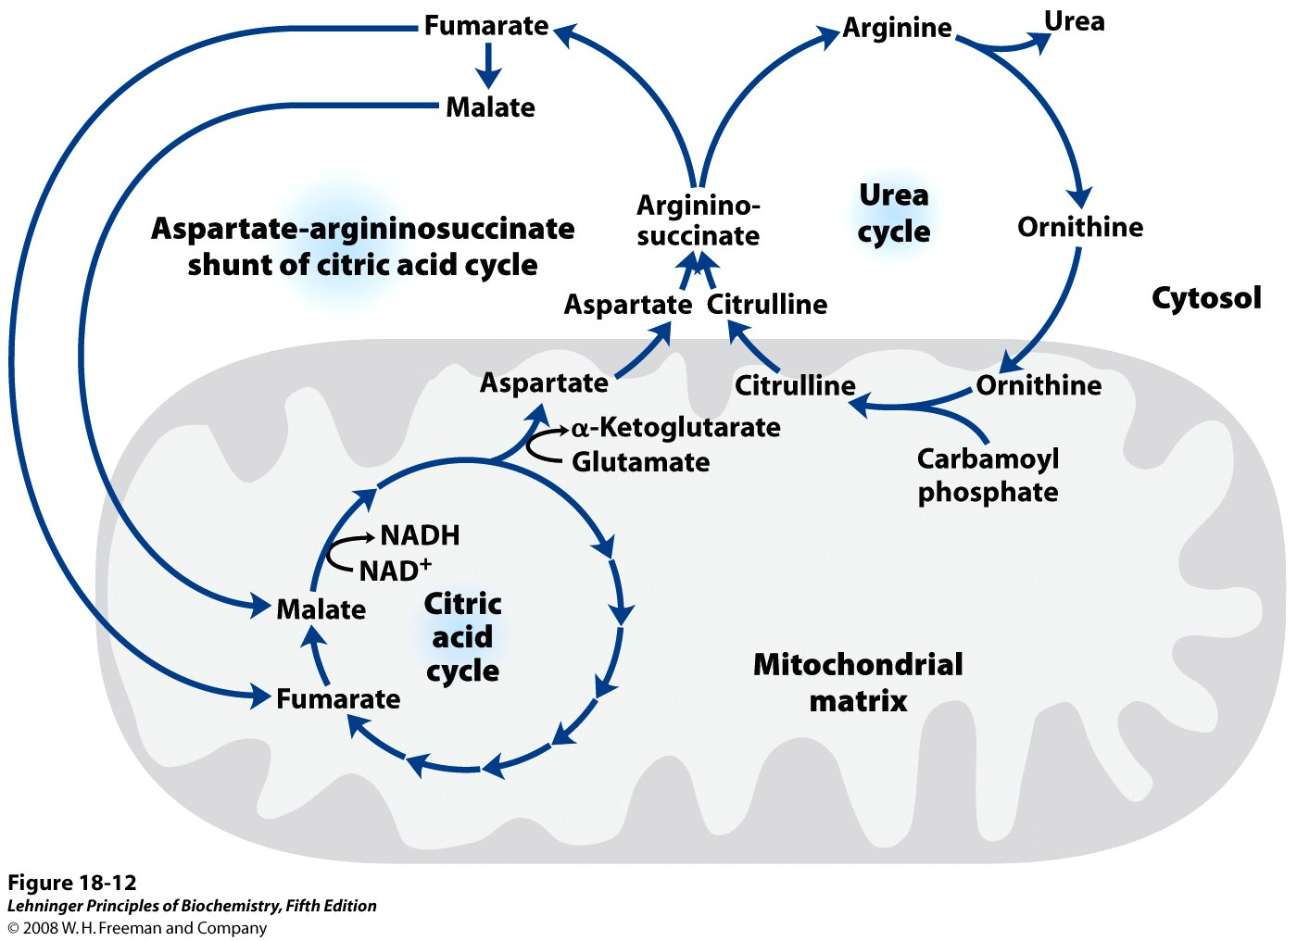

Slide 55
Pathway Interconnections Reduce the Energetic Cost of Urea Synthesis
If the urea cycle is considered in isolation, the synthesis of one molecule of urea requires four high energy phosphate groups.
Two ATP molecules are required to make carbamoyl phosphate, and one ATP to make arginosuccinate—the latter ATP undergoing a pyrophosphate cleavage to AMP and PPi, which is hydrolyzed to two Pi.
The overall equation of the urea cycle is:
2NH4⁺ + HCO₃ ⁻ + 3ATP⁴⁻ + H₂O Urea + 2ADP + 4Pi + AMP+ 2H⁺

Slide 56
However, the urea cycle also causes a net conversion of oxaloacetate to fumarate (via aspartate), and the regeneration of oxaloacetate produces NADH in the malate dehydrogenase reaction.
Each NADH molecule can generate 3 ATP during mitochondrial respiration, greatly reducing the overall energetic cost of urea synthesis.
Rate Limiting Steps of Urea cycle
The conversion of ammonium ions to carbamoyl phosphate catalyzed by carbamoyl synthetase I is a rate limiting step.
This enzyme (carbamoyl synthetase I) gets activated by N-acetylglutamate (NAG) which is formed by reaction between acetyl CoA and glutamate catalyzed by the enzyme N-acetylglutamate synthase (activated by arginine).

Slide 57
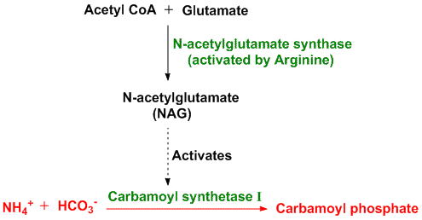
Thus, concentrations of glutamate and acetyl CoA as well as levels of arginine determine the steady state levels of N-acetylglutamate (NAG) which in turn regulates the concentration of urea.
When a high protein diet is consumed, levels of NAG increases and in turn urea levels increase. Also during starvation, when muscle proteins start breaking down to source out energy, urea levels increase in response. Other enzymes participating in the urea cycle are mostly regulated by the concentrations of their respective substrates.

Slide 58
*All the five enzymes are synthesized at higher rates in starving animals and in animals on very-high-protein diets than in well-fed animals eating primarily carbohydrates and fats.
Animals on protein-free diets produce lower levels of urea cycle enzymes.

Slide 59
METABOLIC FATES OF CARBON SKELETON
The carbon skeletons of amino acids are broken down into metabolites that can either be oxidized into CO₂ and H₂O to generate ATP, or can be used for gluconeogenesis.
The catabolism of amino acids accounts for 10 to 15% of the human body’s energy production.
Each of the 20 amino acids has a separate catabolic pathway, yet all 20 pathways converge into 5 intermediates, all of which can enter the citric acid cycle. From the citric acid cycle the carbon skeletons can be completely oxidized into CO₂ or diverted into gluconeogenesis or ketogenesis.

Slide 60
Glucogenic amino acids are broken down into one of the following metabolites: pyruvate, α-ketoglutarate, succinyl CoA, fumarate or oxaloacetate.
Ketogenic amino acids are broken down into acetoacetate or acetyl-CoA.
Larger amino acids, tryptophan, phenylalanine, tyrosine, isoleucine and threonine are both glucogenic and ketogenic.
Only 2 amino acids are purely ketogenic: lysine and leucine.
If 2 of the amino acids are purely ketogenic and 5 amino acids are both ketogenic and glucogenic, this implies that 13 amino acids are purely glucogenic: Arg, Glu, Gln, His, Pro, Val, Met, Asp, Asn,Ala, Ser, Cys, and Gly.

Slide 61
