Slide 1

COLLEGE OF BASIC AND APPLIED SCIENCES
DEPARTMENT OF BIOLOGICAL SCIENCES
METABOLISM OF LIPIDS (BCH 303)
AYODELE O.O (Mrs.)

Slide 2
INTRODUCTION AND COURSE OVERVIEW/CLASSIFICATION OF LIPIDS

Slide 3
COURSE OUTLINE
Classification of lipids - fatty acids, triglycerides, gycosylglyceroles, phospholipids, waxes, prostaglandins.
Lipid micelles, monolayers, bilayers Lipoprotein systems.
Oxidation and synthesis of fatty acids; cholesterol synthesis.
Formation of ketone bodies.
Integration of lipid metabolism.
Acetic acid as a central precursor for biosynthesis of lipids.

Slide 4
OVERVIEW OF LIPID METABOLISM
The major aspects of lipid metabolism include:
Fatty Acid Oxidation to produce energy, and
The synthesis of lipids which is called Lipogenesis.
The oxidation of long-chain fatty acids to acetyl-CoA is a central energy-yielding pathway in many organisms and tissues.
In mammalian heart and liver, for example, it provides as much as 80% of the energetic needs under all physiological circumstances.

Slide 5
OVERVIEW CONTD.
The electrons removed from fatty acids during oxidation pass through the respiratory chain, driving ATP synthesis.
the acetyl-CoA produced from the fatty acids oxidation may be completely oxidized to CO₂ in the citric acid cycle, resulting in further energy conservation.
In some species and in some tissues, the acetyl-CoA has alternative fates:
i. In liver, acetyl-CoA may be converted to ketone bodies (water-soluble fuels exported to the brain and other tissues when glucose is not available) through Ketogenesis.

Slide 6
OVERVIEW CONTD.
ii. In higher plants, acetyl-CoA serves primarily as a biosynthetic precursor, only secondarily as fuel.
Although the biological role of fatty acid oxidation differs from organism to organism, the mechanism is essentially the same.
The repetitive four-step process by which fatty acids are converted into acetyl-CoA is called β-oxidation.
Lipid metabolism is closely connected to the metabolism of carbohydrates which may be converted to fats, and the metabolism of both is upset by diabetes mellitus.

Slide 7
OVERVIEW CONTD.
The first step in lipid metabolism is the hydrolysis of the lipid in the cytoplasm to produce glycerol and fatty acids.
Since glycerol is a three-carbon alcohol, it is metabolized quite readily into an intermediate in glycolysis, dihydroxyacetone phosphate.
The dihydroxyacetone, obtained from glycerol is metabolized into one of two possible compounds:
It may be converted into pyruvic acid through the glycolysis pathway to make energy.

Slide 8
OVERVIEW CONTD.
ii. It may be used in gluconeogenesis to make glucose-6-phosphate for glucose to the blood or glycogen depending upon what is required at that time.
Fatty acids are oxidized to acetyl CoA in the mitochondria using the fatty acid spiral.
The acetyl CoA is then ultimately converted into ATP, CO₂, and H₂O using the citric acid cycle and the electron transport chain.
Fatty acids are synthesized from carbohydrates and occasionally from proteins;

Slide 9
OVERVIEW CONTD.
The carbohydrates and proteins would have been catabolized into acetyl CoA.
Depending upon the energy requirements, the acetyl CoA enters the citric acid cycle or is used to synthesize fatty acids in a process known as LIPOGENESIS.

Slide 10
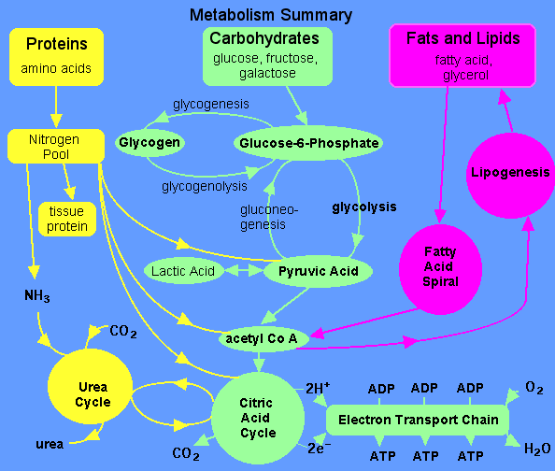

Slide 11
CLASSIFICATION OF LIPIDS

Slide 12
DESCRIPTION
Lipids are class of biological molecules defined by low solubility in water and high solubility in non-polar solvents.
They are largely hydrocarbon in nature, and represents highly reduced forms of carbon.
Upon oxidation in metabolism, they yield large amounts of energy, and are thus the molecules of choice for metabolic energy source or storage.

Slide 13
CLASSIFICATION
Lipids can be classified based on the following criteria:
A. Based on structure:
1. Simple lipids: these include fats, oils, waxes and steroids.
2. Complex/Compound lipids:
a. Phospholipids: glycerophospholipids, sphingolipids.
b. Glycolipids: glycosylglycerols, glycosphingolipids
3. Derived lipids: Hormones and fat-soluble vitamins.
B. Based on hydrolysis in alkaline solution:
1. Saponifiable lipids: these can be hydrolyzed under alkaline conditions to yield salt and fatty acids.

Slide 14
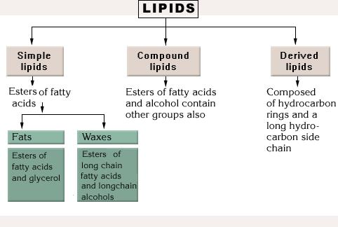
CLASSIFICATION CONTD.
2. Non-saponifiable lipids: they do not undergo hydrolysis reactions in alkaline solution.

Slide 15
BIOLOGICAL FUNCTIONS OF LIPIDS
The most important role is as source of fuel. Thus, fat is the most concentration form in which potential energy can be stored.
Insulation to the body: this is because fat is a bad conductor of heat.
Fats provide padding to the internal organs against shock.
Some compounds derived from lipids are important building blocks of biological active materials.

Slide 16
Biological functions Contd.
5. Lipoproteins are constituents of cell membranes.
6. Supplying of essential fatty acids.
7. They are important components of the membrane.
They give flavor to food.
They help the body to utilize carbohydrates and proteins efficiently.

Slide 17
FATTY ACIDS
These are saponifiable lipids building blocks.
They are naturally occurring carboxylic acids with an unbranched carbon chain and an even number of carbon atoms.
Fatty acids are structural components of many lipid molecules; they give the lipids their hydrophobic (non-polar) properties.
They are hydrocarbon chains that contain a carboxylic acid group at one end of the chain.

Slide 18
Fatty Acids Contd.
The hydrocarbon chains can range from fourteen-carbon to twenty-four carbon (14C-26C) chains.
However, sixteen-carbon and eighteen-carbon chains predominate in humans and animals.
All animal fatty acids are unbranched along the carbon backbone.
Fatty acids generally differ in their length and degree of unsaturation:
Long chain fatty acids: these consists of 12-26 carbon atoms. They are found in meat and fish.

Slide 19
Fatty Acids Contd.
ii. Medium-chain fatty acids: 6-10 carbon atoms.
iii. Short-chain FAs: <6 carbon atoms.
Both medium and short-chain fatty acids are primarily found in dairy products.
Based on the number of double bonds:
Saturated fats: consist of only carbon-carbon (-C-C-) single bonds.
Unsaturated fats: contains one or more double bonds.

Slide 20
Fatty Acids Contd.
Unsaturated FAs can be:
Monounsaturated e.g. oleic acid
Polyunsaturated e.g. Linoleic acid (18:2), Linolenic acid (18:3), Arachidonic acid (20:4), Eicosapentanoic acid (EPA) (20:5).
The physical properties of the fatty acids, and of compounds that contain them, are largely determined by the length and degree of unsaturation of the hydrocarbon chain.

Slide 21
Fatty Acids Contd.
A. The nonpolar hydrocarbon chain accounts for the poor solubility of fatty acids in water.
For example, Lauric acid (12:0, Mr 200) has a solubility in water of 0.063 mg/g—much less than that of glucose (Mr 180), which is 1,100 mg/g.
The longer the fatty acyl chain and the fewer the double bonds, the lower is the solubility in water.
The carboxylic acid group is polar (and ionized at neutral pH) and accounts for the slight solubility of short-chain fatty acids in water.

Slide 22
Fatty Acids Contd.
B. Decrease in chain length or increase in the degree of unsaturation will lower the melting point of fatty acids and increase the fluidity.
At room temperature (25ºC), the saturated fatty acids from 12:0 to 24:0 have a waxy consistency, whereas unsaturated fatty acids of these lengths are oily liquids.
This difference in melting points is due to different degrees of packing of the fatty acid molecules.
In the fully saturated compounds, free rotation around each C-C bond gives the hydrocarbon chain great flexibility.

Slide 23
Fatty Acids Contd.
This is the most stable conformation is the fully extended form, in which the steric hindrance of neighboring atoms is minimized.
These molecules can pack together tightly in nearly crystalline arrays.
In unsaturated fatty acids, a cis double bond forces a kink in the hydrocarbon chain.
Fatty acids with one or several such kinks cannot pack together as tightly as fully saturated fatty acids, and their interactions with each other are therefore weaker.

Slide 24
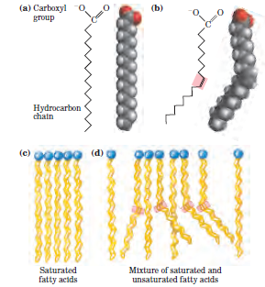
Fig. The packing of fatty acids into stable aggregates. The extent of packing depends on the degree of saturation;
Representations of the fully saturated acid stearic acid (stearate at pH 7) in its usual extended conformation.
The cis double bond (shaded) in oleic acid (oleate) does not permit rotation and introduces a rigid bend in the hydrocarbon tail. All other bonds in the chain are free to rotate.
Fully saturated fatty acids in the extended form pack into nearly crystalline arrays, stabilized by many hydrophobic interactions.
The presence of one or more cis double bonds interferes with this tight packing and results in less stable aggregates.

Slide 25
Naming of Fatty acids
Fatty acids are hydrocarbon chains of various lengths and degrees of unsaturation that terminate with carboxylic acid groups.
The systematic name for a fatty acid is derived from the name of its parent hydrocarbon by the substitution of oic for the final e.
For example, the C18 saturated fatty acid is called octadecanoic acid because the parent hydrocarbon is octadecane.

Slide 26
Naming of Fatty acids Contd.
A C18 fatty acid with one double bond is called octadecenoic acid; with two double bonds, octadecadienoic acid; and with three double bonds, octadecatrienoic acid.
A simplified nomenclature for these compounds specifies the chain length and number of double bonds, separated by a colon;
For example, the 16-carbon saturated palmitic acid is abbreviated 16:0, and the 18-carbon oleic acid, with one double bond, is 18:1.

Slide 27
Naming of Fatty acids Contd.
The positions of any double bonds are specified by superscript numbers following Δ (delta); a 20-carbon fatty acid with one double bond between C-9 and C-10 (C-1 being the carboxyl carbon) and another between C-12 and C-13 is designated 20:2(Δ ^{9,12}).
The most commonly occurring fatty acids have even numbers of carbon atoms in an unbranched chain of 12 to 24 carbons.
The even number of carbons results from the mode of synthesis of these compounds, which involves condensation of two-carbon (acetate) units.

Slide 28
Naming of Fatty acids Contd.
There is also a common pattern in the location of double bonds;
In most monounsaturated fatty acids the double bond is between C-9 and C-10 (Δ⁹), and
The other double bonds of polyunsaturated fatty acids are generally Δ¹² and Δ¹⁵.
Arachidonic acid is an exception to this generalization
The double bonds of polyunsaturated fatty acids are almost never conjugated (alternating single and double bonds, as in -CH=CH-CH=CH-), but are separated by a methylene group: -CH=CH-CH₂-CH=CH-.

Slide 29
Some naturally occurring Fatty acids
Symbol | Structure | Systemic name | Common name
Saturated fatty acid
С_{12:0} | СН₃(СН₂)₁₀СООН | n-Dodecanoic | Lauric
С_{14:0} | СН₃(СН₂)₁₂СООН | n-Tetradecanoic | Myristic
С_{16:0} | СН₃(СН₂)₁₄СООН | n-Hexadecanoic | Palmitic
С_{18:0} | СН₃(СН₂)₁₆СООН | n-Octadecanoic | Stearic
С_{20:0} | СН₃(СН₂)₁₈СООН | n-Eicosanoic | Arachidic
С_{22:0} | СН₃(СН₂)₂₀СООН | n-Docosanoic | Begenic
С_{24:0} | СН₃(СН₂)₂₂СООН | n-Tetracosanoic | Lignoceric
Unsaturated monoenic fatty acid
С_{16:1} | СН₃(СН₂)₅СН=СН(СН₂)₇СООН |  | Palmitoleic
С_{18:1} | СН₃(СН₂)₇СН=СН(СН₂)₇СООН |  | Oleic
Unsaturated polienic fatty acid
С_{18:2} | СН₃(СН₂)₄(СН=СНСН₂)₂(СН₂)₆СООН |  | Linoleic
С_{18:3} | СН₃СН₂(СН=СНСН₂)₃(СН₂)₆СООН |  | Linolenic
С_{20:4} | СН₃(СН₂)₄(СН=СНСН₂)₄(СН₂)₂СООН |  | Arachidonic

Slide 30
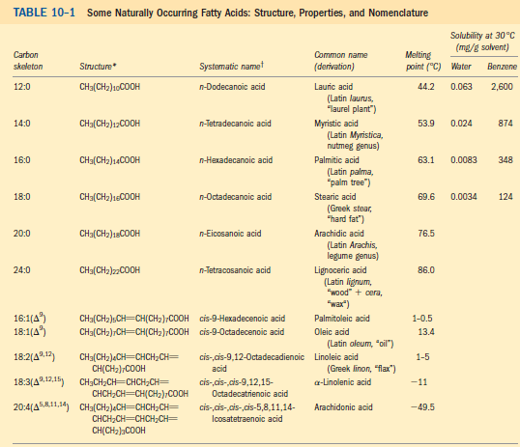

Slide 31
Numbering of the carbon atoms of fatty acids
Fatty acid carbon atoms are numbered starting at the carboxyl terminus.
Carbon atoms 2 and 3 are often referred to as α and β, respectively.
The methyl carbon atom at the distal end of the chain is called the ω-carbon atom.
The position of a double bond is represented by the symbol Δ followed by a superscript number.

Slide 32
Numbering of the carbon atoms of fatty acids
For example, cis-Δ 9 means that there is a cis double bond between carbon atoms 9 and 10;
trans-Δ 2 means that there is a trans double bond between carbon atoms 2 and 3.
Alternatively, the position of a double bond can be denoted by counting from the distal end, with the ω-carbon atom (the methyl carbon) as number 1.

Slide 33
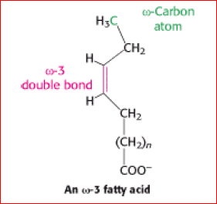
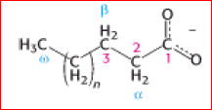
An ω-3 fatty acid, for example, has the structure shown below:

Slide 34
Cis and Trans fatty acids
Most naturally occurring unsaturated Fatty Acids have cis double bonds.
Trans fatty acids are present in certain foods, arising as a by-product of the saturation of fatty acids during hydrogenation, or "hardening," of natural oils in the manufacture of margarine.
An additional small contribution comes from the ingestion of ruminant fat that contains trans fatty acids arising from the action of microorganisms in the rumen.

Slide 35
Cis and Trans fatty acids Contd.
Consumption of trans fatty acids is known to be detrimental to health and is associated with increased risk of diseases including cardiovascular disease and diabetes mellitus.
This is because diets high in trans fatty acids correlate with increased blood levels of LDL (bad cholesterol) and decreased HDL (good cholesterol).
Unfortunately, French fries, doughnuts, and cookies tend to be high in trans fatty acids.
There is now an improved technology to produce soft margarine low in trans fatty acids or containing none.

Slide 36
Unsaturated Fatty Acids of Physiologic and Nutritional Significance
Monoenoic acids (one double bond)
Palmitoleic: 16:1;9 ω7 cis -9-Hexadecenoic
In nearly all fats.
Oleic: 18:1;9 ω9 cis -9-Octadecenoic
Possibly the most common fatty acid in natural fats; particularly high in olive oil.
Elaidic: 18:1;9 ω9 trans -9-Octadecenoic
Hydrogenated and ruminant fats.

Slide 37
Dienoic acids (two double bonds)
Linoleic: 18:2;9,12 ω6 all-cis -9,12-Octadecadienoic
Corn, peanut, cottonseed, soy bean, and many plant oils.
Trienoic acids (three double bonds)
γ-Linolenic: 18:3;6,9,12 ω6 all-cis -6,9,12-Octadecatrienoic
Some plants, eg, oil of evening primrose, borage oil; minor fatty acid in animals.
α-Linolenic: 18:3;9,12,15 ω3 all-cis -9,12,15-Octadecatrienoic
Frequently found with linoleic acid but particularly in linseed oil.
Tetraenoic acids (four double bonds)
Arachidonic: 20:4;5,8,11,14. ω6, all-cis -5,8,11,14 Eicosatetraenoic
Found in animal fats; important component of phospholipids in animals.

Slide 38
Pentaenoic acids (five double bonds)
Timnodonic: 20:5;5,8,11,14,17 ω3 all-cis -5,8,11,14,17-Eicosapentaenoic
Important component of fish oils, eg, cod liver, mackerel, menhaden, salmon oils.
Hexaenoic acids (six double bonds)
Cervonic: 22:6;4,7,10,13,16,19 all-cis -4,7,10,13,16,19-Docosahexaenoic
Fish oils, phospholipids in brain.
Omega-3 fatty acids are precursors of Eicosanoids including Prostaglandins, Prostacyclins, Thromboxanes, and Leukotrienes.

Slide 39
Essential Fatty acids
Mammals lack the enzymes to introduce double bonds at carbon atoms beyond C-9 in the fatty acid Chain, therefore they cannot synthesize Linoleic acid (18:2 cis Δ⁹, Δ¹²) and α-Linolenic acid (18:3 cisΔ⁹, Δ¹², Δ¹⁵).
Thus, Linoleic, and α-Linolenic acids (PUFAs) are called essential fatty acids.

Slide 40
Storage Lipids
The fats and oils used almost universally as stored forms of energy in living organisms are derivatives of fatty acids.
The fatty acids are hydrocarbon derivatives, at about the same low oxidation state (that is, as highly reduced) as the hydrocarbons in fossil fuels.
The cellular oxidation of fatty acids (to CO₂ and H₂O), like the controlled, rapid burning of fossil fuels in internal combustion engines, is highly exergonic.
There are two types of fatty acid–containing compounds; triacylglycerols and waxes.

