Slide 1
CSC 417
MOBILE DESIGN AND DEVELOPMENT
(DR KASALI F. A.)

Slide 2
Android Overview
What is Android
Android is an open source and Linux-based Operating System for mobile devices such as smartphones and tablet computers. Android was developed by the Open Handset Alliance, led by Google, and other companies.
Android offers a unified approach to application development for mobile devices which means developers need to develop only for Android, and their applications should be able to run on different devices powered by Android.
The first beta version of the Android Software Development Kit (SDK) was released by Google in 2007, whereas the first commercial version, Android 1.0, was released in September 23, 2008.
On June 27, 2012, at the Google I/O conference, Google announced the next Android version, 4.1 Jelly Bean. Jelly Bean is an incremental update, with the primary aim of improving the user interface, both in terms of functionality and performance.
The source code for Android is available under free and open source software licenses. Google publishes most of the code under the Apache License version 2.0 and the rest, Linux kernel changes, under the GNU General Public License version 2.
Notes:
DESIGNED PRIMARILY FOR TOUCHSCRREN MOBILE DEVICES SUCH AS SMARTPHONES AND TABLETS, google has also developed android tv, auto, wear OS for wristwatches, each with a specialized interface. Written in java, C, C++

Slide 3
Features of Android
Feature | Description
Beautiful UI | Android OS basic screen provides a beautiful and intuitive user interface
Connectivity | GSM/EDGE, IDEN, CDMA, EV-DO, UMTS, Bluetooth, Wi-Fi, LTE, NFC and WiMAX
Storage | SQLite, a lightweight relational database, is used for data storage purposes.
Media support | H.263, H.264, MPEG-4 SP, AMR, AMR-WB, AAC, HE-AAC, AAC 5.1, MP3, MIDI, Ogg Vorbis, WAV, JPEG, PNG, GIF, and BMP
Messaging | SMS and MMS
Web browser | Based on the open-source WebKit layout engine, coupled with Chrome's V8 JavaScript engine supporting HTML5 and CSS3

Slide 4
Web browser | Based on the open-source WebKit layout engine, coupled with Chrome's V8 JavaScript engine supporting HTML5 and CSS3.
Multi-touch | Android has native support for multi-touch which was initially made available in handsets such as the HTC Hero.
Multi-tasking | User can jump from one task to another and same time various application can run simultaneously
Resizable widgets | Widgets are resizable, so users can expand them to show more content or shrink them to save space
Multi-Language | Support single direction and bi-directional text.
GCM | Google Cloud Messaging (GCM) is a service that let developers send short message data to their users on Android devices, without needing a proprietary sync solution.
Wi-Fi Direct | A technology that let apps discover and pair directly, over a high bandwidth peer-to-peer connection.
Android Beam | A popular NFC-based technology that let users instantly share, just by touching two NFC-enabled phones together.

Slide 5
Android Applications
Android applications are usually developed in the Java language using the Android Software Development Kit. Once developed, Android applications can be packaged easily and sold out either through a store such as Google Play or the Amazon Appstore.
Android powers hundreds of millions of mobile devices in more than 190 countries around the world. It's the largest installed base of any mobile platform and is growing fast. Every day more than 1 million new Android devices are activated worldwide.
This lecture has been written with an aim to teach you how to develop and package Android application.
We will start from environment setup for Android application programming and
then drill down to look into various aspects of Android applications.

Slide 6
ANDROID – Environment Setup
You will be glad to know that you can start your Android application development on either of the following operating systems:
Microsoft Windows XP or later version.
Mac OS X 10.5.8 or later version with Intel chip.
Linux including GNU C Library 2.7 or later.
Second point is that all the required tools to develop Android applications are freely available and can be downloaded from the Web. Following is the list of software's you will need before you start your Android application programming.
Java JDK5 or JDK6
Android SDK
Eclipse IDE for Java Developers (optional)
Android Development Tools (ADT) Eclipse Plugin (optional)
The last two components are optional and if you are working on Windows machine then these components make your life easy while doing Java based application development. So let us have a look at how to proceed to set the required environment.

Slide 7
Step 1- Setup Java Development Kit (JDK)
You can download the latest version of Java JDK from Oracle's Java site: Java SE Downloads.
You will find instructions for installing JDK in downloaded files, follow the given instructions to install and configure the setup. Finally, set PATH and JAVA_HOME environment variables to refer to the directory that contains java and javac, typically java_install_dir/bin and
java_install_dir respectively.
If you are running Windows and have installed the JDK in C:\jdk1.6.0_15, you would have to put the following line in your C:\autoexec.bat file.
set PATH=C:\jdk1.6.0_15\bin;%PATH%
set JAVA_HOME=C:\jdk1.6.0_15
Alternatively, you could also right-click on My Computer, select Properties, then Advanced,
then Environment Variables. Then, you would update the PATH value and press the OK button

Slide 8
On Linux, if the SDK is installed in /usr/local/jdk1.6.0_15 and you use the C shell, you would put the following code into your .cshrc file
setenv PATH /usr/local/jdk1.6.0_15/bin:$PATH
setenv JAVA_HOME /usr/local/jdk1.6.0_15
Alternatively, if you use an Integrated Development Environment (IDE) Eclipse, then it will know automatically where you have installed your Java.

Slide 9
Step 2- Setup Android SDK
You can download the latest version of Android SDK from Android’s official website: http://developer.android.com/sdk/index.html.
If you are installing SDK on Windows machine, then you will find ainstaller_rXX-windows.exe, so just download and run this exe which will launch Android SDK Tool Setup wizard to guide you throughout the installation, so just follow the instructions carefully.
Finally, you will have Android SDK Tools installed on your machine.
If you are installing SDK either on Mac OS or Linux, check the instructions provided along with the downloaded android-sdk_rXX-macosx.zip file for Mac OS and
android-sdk_rXXlinux.tgz file for Linux.
This lecture will consider that you are going to setup your environment on Windows machine having at least Windows 7 operating system.
So let's launch Android SDK Manager using the option All Programs > Android SDK Tools
> SDK Manager, this will give you following window:

Slide 10
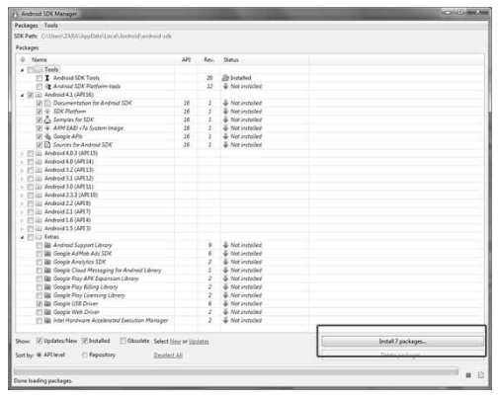

Slide 11
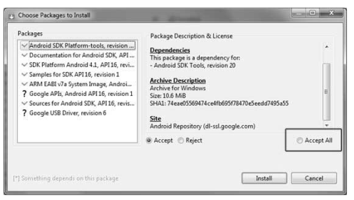
Once you launched SDK manager, it is time to install other required packages. By default it will list down total 7 packages to be installed, but we will suggest to de-select Documentation for Android SDK and Samples for SDK packages to reduce installation time.
Next click the Install 7 Packages button to proceed, which will display following dialogue box:

Slide 12
If you agree to install all the packages, select Accept All radio button and proceed by clicking Install button. Now let SDK manager do its. It may take some time depending on your internet connection.
Once all the packages are installed, you can close SDK manager using top-right
cross button.

Slide 13
Step 3- Setup Eclipse IDE
All the examples in this lecture have been written using Eclipse IDE. So it is suggested you should have latest version of Eclipse installed on your machine.
To install Eclipse IDE, download the latest Eclipse binaries from
http://www.eclipse.org/downloads/. Once you have downloaded the installation, unpack the binary distribution into a convenient location. For example in C:\eclipse on windows, or /usr/local/eclipse on Linux and finally set PATH variable appropriately.
Eclipse can be started by executing the following commands on windows machine, or you can simply double click on eclipse.exe
%C:\eclipse\eclipse.exe
Eclipse can be started by executing the following command on Linux machine:
$/usr/local/eclipse/eclipse
After a successful startup, if everything is fine then it should display the following result:

Slide 14
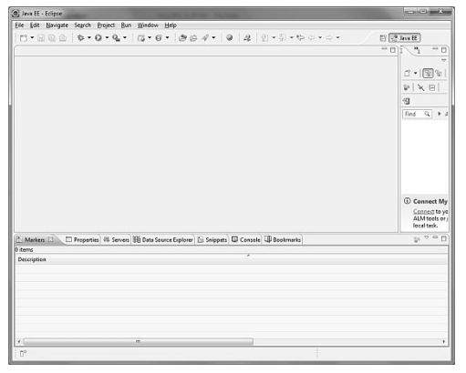

Slide 15
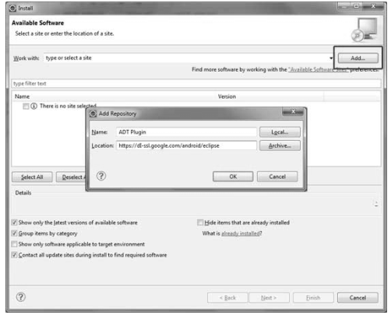
Step 4- Setup Android Development Tools (ADT) Plugin
This step will help you in setting Android Development Tool plugin for Eclipse. Let's start with launching Eclipse and then, choose Help > Software Updates > Install New Software.
This will display the following dialogue box.

Slide 16
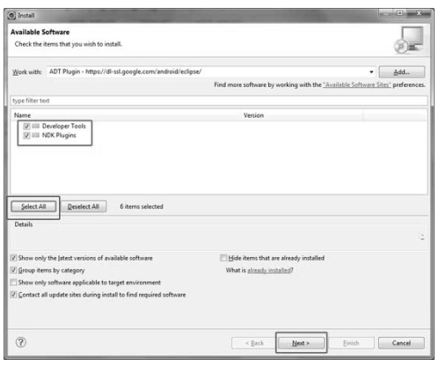
Now use Add button to add ADT Plugin as name and https://dlssl.google.com/android/eclipse/ as the location. Then click OK to add this location. As soon as you will click OK button to add this location, Eclipse starts searching for the plug-in available in the given location and finally lists down the found plugins.

Slide 17
Now select all the listed plug-ins using Select All button and click Next button which will guide you ahead to install Android Development Tools and other required plugins.
Step 5- Create Android Virtual Device
To test your Android applications you will need a virtual Android device. So before we start writing our code, let us create an Android virtual device.
Launch Android AVD Manager using Eclipse menu options Window > AVD Manager> which will launch Android AVD Manager.
Use New button to create a new Android Virtual Device and enter the following information, before clicking Create AVD button.

Slide 18
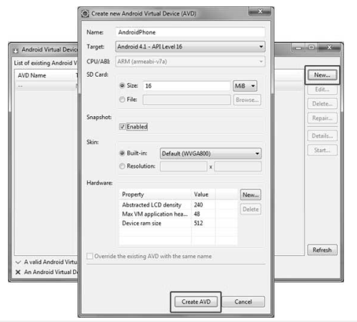

Slide 19
If your AVD is created successfully it means your environment is ready for Android application development.
If you like, you can close this window using top-right cross button. Better you re-start your machine and once you are done with this last step, you are ready to proceed for your first Android example.

Slide 20
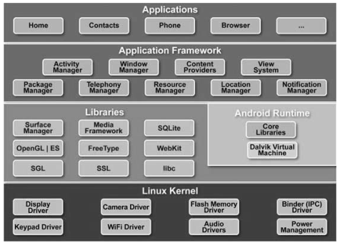
ANDROID – Architecture
Android operating system is a stack of software components which is roughly divided into five sections and four main layers as shown below in the architecture diagram.

Slide 21
Linux kernel
At the bottom of the layers is Linux - Linux 2.6 with approximately 115 patches. This provides basic system functionality like process management, memory management, device management like camera, keypad, display etc. Also, the kernel handles all the things that Linux is really good at, such as networking and a vast array of device drivers, which take the pain out of interfacing to peripheral hardware
Libraries
On top of Linux kernel there is a set of libraries including open-source Web browser engine WebKit, well known library libc, SQLite database which is a useful repository for storage and sharing of application data, libraries to play and record audio and video, SSL libraries responsible for Internet security etc.

Slide 22
Android Runtime
This is the third section of the architecture and available on the second layer from the bottom.
This section provides a key component called Dalvik Virtual Machine which is a kind of Java Virtual Machine specially designed and optimized for Android.
The Dalvik VM makes use of Linux core features like memory management and multithreading, which is intrinsic in the Java language. The Dalvik VM enables every Android application to run in its own process, with its own instance of the Dalvik virtual machine.
The Android runtime also provides a set of core libraries which enable Android application developers to write Android applications using standard Java programming language.

Slide 23
Application Framework
The Application Framework layer provides many higher-level services to applications in the form of Java classes. Application developers are allowed to make use of these services in their applications.
Applications
You will find all the Android application at the top layer. You will write your application to be installed on this layer only. Examples of such applications are Contacts Books, Browser, Games, etc.

Slide 24
ANDROID – Applications Component
Application components are the essential building blocks of an Android application. These components are loosely coupled by the application manifest file AndroidManifest.xml that describes each component of the application and how they interact.
These are the following four main components that can be used within an Android application:
Components | Description
Activities | They dictate the UI and handle the user interaction to the smartphone screen
Services | They handle background processing associated with an application.
Broadcast Receivers | They handle communication between Android OS and applications
Content Providers | They handle data and database management issues.

Slide 25
Activities
An activity represents a single screen with a user interface. For example, an email application might have one activity that shows a list of new emails, another activity to compose an email, and one for reading emails.
If an application has more than one activity, then one of them should be marked as the activity that is presented when the application is launched.
An activity is implemented as a subclass of Activity class as follows:
public class MainActivity extends Activity
{
}

Slide 26
Services
A service is a component that runs in the background to perform long-running operations. For
example, a service might play music in the background while the user is in a different application, or it might fetch data over the network without blocking user interaction with an
activity.
A service is implemented as a subclass of Service class as follows:
public class MyService extends Service
{
}

Slide 27
Broadcast Receivers
Broadcast Receivers simply respond to broadcast messages from other applications or from the system. For example, applications can also initiate broadcasts to let other applications know that some data has been downloaded to the device and is available for them to use, so this is broadcast receiver who will intercept this communication and will initiate appropriate action.
A broadcast receiver is implemented as a subclass of BroadcastReceiver class and each
message is broadcasted as an Intent object.
public class MyReceiver extends BroadcastReceiver
{
}

Slide 28
Content Providers
A content provider component supplies data from one application to others on request.
Such requests are handled by the methods of the ContentResolver class. The data may be stored
in the file system, the database or somewhere else entirely.
A content provider is implemented as a subclass of ContentProvider class and must
implement a standard set of APIs that enable other applications to perform transactions.
public class MyContentProvider extends ContentProvider
{
}

Slide 29
Additional Components
There are additional components which will be used in the construction of above mentioned entities, their logic, and wiring between them. These components are:
Components | Description
Fragments | Represent a behavior or a portion of user interface in an Activity.
Views | UI elements that are drawn onscreen including buttons, lists forms etc.
Layouts | View hierarchies that control screen format and appearance of the views
Intents | Messages wiring components together.
Resources | External elements, such as strings, constants and drawable pictures.
Manifest | Configuration file for the application

Slide 30
ANDROID – Hello World Example
Let us start actual programming with Android Framework. Before you start writing your first example using Android SDK, you have to make sure that you have setup your Android development environment properly as explained in Android - Environment Setup above.
It is also assumed, that you have a little bit working knowledge with Eclipse IDE.
So let us proceed to write a simple Android Application which will print "Hello World!".

Slide 31
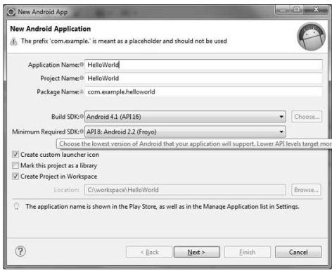
Create Android Application
The first step is to create a simple Android Application using Eclipse IDE. Follow the option File -> New -> Project and finally select Android New Application wizard from the wizard list.
Now name your application as HelloWorld using the wizard window as follows

Slide 32
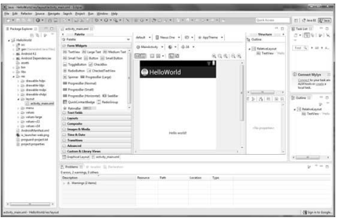
Next, follow the instructions provided and keep all other entries as default till the final step.
Once your project is created successfully, you will have the following project screen:

Slide 33
Anatomy of Android Application
Before you run your app, you should be aware of a few directories and files in the Android project:

Slide 34
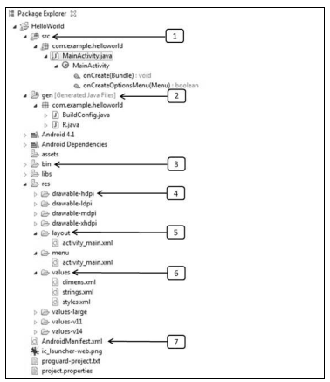

Slide 35
src: This contains the .java source files for your project. By default, it includes anMainActivity.java source file having an activity class that runs when your app is launched using the app icon.
gen:This contains the .R file, a compiler-generated file that references all the resources found in your project. You should not modify this file
bin: This folder contains the Android package files .apk built by the ADT during the build process and everything else needed to run an Android application.
res/drawable-hdpi: This is a directory for drawable objects that are designed for high-density screens
res/layout: This is a directory for files that define your app's user interface.
res/values: This is a directory for other various XML files that contain a collection of resources, such as strings and colors definitions
AndroidManifest.xml: This is the manifest file which describes the fundamental characteristics of the app and defines each of its components.

Slide 36
The Main Activity File
The main activity code is a Java file MainActivity.java. This is the actual application file which ultimately gets converted to a Dalvik executable and runs your application.
Following is the default code generated by the application wizard for Hello World! application:
package com.example.helloworld;
import android.os.Bundle;
import android.app.Activity;
import android.view.Menu;
import android.view.MenuItem;
import android.support.v4.app.NavUtils;
public class MainActivity extends Activity {
@Override

Slide 37
public void onCreate(Bundle savedInstanceState) {
super.onCreate(savedInstanceState);
setContentView(R.layout.activity_main);
}
@Override
public boolean onCreateOptionsMenu(Menu menu) {
getMenuInflater().inflate(R.menu.activity_main, menu);
return true;
}
}
Here, R.layout.activity_main refers to the activity_main.xml file located in the res/layout folder. The onCreate() method is one of many methods that are fired when an activity is loaded.

Slide 38
The Manifest File
Whatever component you develop as a part of your application, you must declare all its components in a manifest file called AndroidManifest.xml which resides at the root of the application project directory.
This file works as an interface between Android OS and your application, so if you do not declare your component in this file, then it will not be considered by the OS.
For example, a default manifest file will look like as following file:
<manifest xmlns:android="http://schemas.android.com/apk/res/android"
package="com.example.helloworld"
android:versionCode="1"
android:versionName="1.0" >

Slide 39
<uses-sdk
android:minSdkVersion="8"
android:targetSdkVersion="15" />
<application
android:icon="@drawable/ic_launcher"
android:label="@string/app_name"
android:theme="@style/AppTheme" >
<activity
android:name=".MainActivity"
android:label="@string/title_activity_main" >
<intent-filter>
<action android:name="android.intent.action.MAIN" />
<category
android:name="android.intent.category.LAUNCHER"/>
</intent-filter>
</activity>
</application>
</manifest>

Slide 40
Here <application>...</application> tags enclosed the components related to the application.
Attribute android:icon will point to the application icon available underres/drawable-hdpi.
The application uses the image named ic_launcher.png located in the drawable folders.
The <activity> tag is used to specify an activity and android:name attribute specifies the fully
qualified class name of the Activity subclass and the android:label attributes specifies a string
to use as the label for the activity.
You can specify multiple activities using <activity> tags.
The action for the intent filter is named android.intent.action.MAIN to indicate that this
activity serves as the entry point for the application.
The category for the intent-filter is named android.intent.category.LAUNCHER to indicate that the application can be launched from the device's launcher icon.
The @string refers to the strings.xml file explained below.
Hence, @string/app_name refers to the app_name string defined in the strings.xml file, which is "HelloWorld".
Similar way, other strings get populated in the application.
Following is the list of tags which you will use in your manifest file to specify different Android
application components:

Slide 41
<activity>elements for activities
<service> elements for services
<receiver> elements for broadcast receivers
<provider> elements for content providers

Slide 42
The Strings File
The strings.xml file is located in the res/values folder and it contains all the text that your
application uses.
For example, the names of buttons, labels, default text, and similar types of strings go into this file.
This file is responsible for their textual content. For example, a default string file will look like as following file:
<resources>
<string name="app_name">HelloWorld</string>
<string name="hello_world">Hello world!</string>
<string name="menu_settings">Settings</string>
<string name="title_activity_main">MainActivity</string>
</resources>

Slide 43
The R File
The gen/com.example.helloworld/R.java file is the glue between the activity Java files likeMainActivity.java and the resources like strings.xml.
It is an automatically generated file and you should not modify the content of the R.java file.
Following is a sample of R.java file:
/* AUTO-GENERATED FILE. DO NOT MODIFY.
*
* This class was automatically generated by the
* aapt tool from the resource data it found. It
* should not be modified by hand.
*/
package com.example.helloworld;
public final class R {

Slide 44
public static final class attr {
}
public static final class dimen {
public static final int padding_large=0x7f040002;
public static final int padding_medium=0x7f040001;
public static final int padding_small=0x7f040000;
}
public static final class drawable {
public static final int ic_action_search=0x7f020000;
public static final int ic_launcher=0x7f020001;
}
public static final class id {
public static final int menu_settings=0x7f080000;
}
public static final class layout {
public static final int activity_main=0x7f030000;
}
public static final class menu {

Slide 45
public static final int activity_main=0x7f070000;
}
public static final class string {
public static final int app_name=0x7f050000;
public static final int hello_world=0x7f050001;
public static final int menu_settings=0x7f050002;
public static final int title_activity_main=0x7f050003;
}
public static final class style {
public static final int AppTheme=0x7f060000;
}
}

Slide 46
The Layout File
The activity_main.xml is a layout file available in res/layout directory that is referenced by your application when building its interface.
You will modify this file very frequently to change the layout of your application.
For your "Hello World!" application, this file will have following content related to default layout:
<RelativeLayout xmlns:android="http://schemas.android.com/apk/res/android"
xmlns:tools="http://schemas.android.com/tools"
android:layout_width="match_parent"
android:layout_height="match_parent" >
<TextView
android:layout_width="wrap_content"
android:layout_height="wrap_content"
android:layout_centerHorizontal="true"
android:layout_centerVertical="true"
android:padding="@dimen/padding_medium"
android:text="@string/hello_world"
tools:context=".MainActivity" />
</RelativeLayout>

Slide 47
This is an example of simple RelativeLayout.
TheTextView is an Android control used to build the GUI and it has various attributes like
android:layout_width, android:layout_height, etc., which are being used to set its width and
height etc.
The @string refers to the strings.xml file located in the res/values folder.
Hence, @string/hello_world refers to the hello string defined in the strings.xml file, which is "Hello World!".

Slide 48
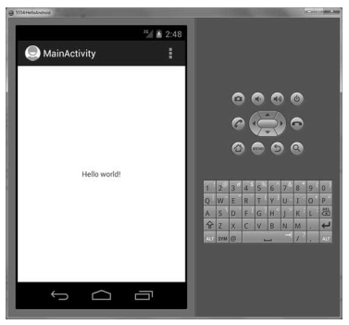
Running the Application
Let's try to run our Hello World! application we just created. We assume, you had created your AVD while doing environment setup.
To run the app from Eclipse, open one of your project's activity files and click Run icon from the toolbar.
Eclipse installs the app on your AVD and starts it and if everything is fine with your setup and application, it will display
following Emulator window:

Slide 49
Congratulations! You have developed your first Android Application and now just keep following rest of the lectures, study android development processes online and in books to become a great Android Developer. All the very best!

Slide 50
Review Question
Explain in details the concept of Memory Management in Android devices and the main hardware platform for Android.
Notes:
Next class, we will talk about anatomy of android applications, user interface design principles generally.

Slide 51
THANK YOU

