Slide 1


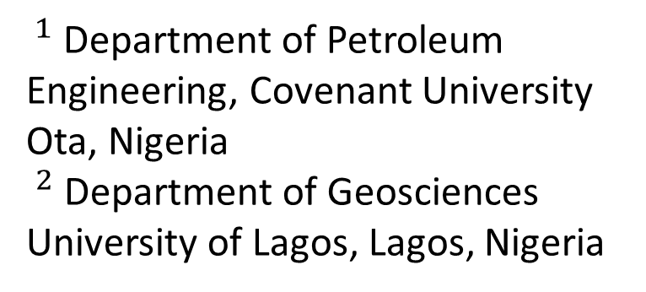
MODELING TOTAL DISSOLVED SOLID USING MULTIPLE LINEAR REGRESSION MODEL DEVELOPED FROM EM-34 DATA AROUND OLUSHOSUN DUMPSITE IN LAGOS, SOUTH-WEST, NIGERIA
Ameloko A. $A^{1}$ and Ayolabi E. $A^{2}$
$^{1}$ Department of Petroleum Engineering, Covenant University Ota, Nigeria
$^{2}$ Department of Geosciences
University of Lagos, Lagos, Nigeria

Slide 2
Presentation Outline
Introduction
  Background to the study
  Aim and Objectives of the study
  Literature review
Materials and method
Results and Discussion
Conclusions
References

Slide 3
Background to the study
The management of solid waste landfills has been a major problem of our urban centers in Nigeria and other developing economies worldwide.
In these urban centres, wastes are generated daily and disposed indiscriminately in rivers and landfills without recourse to the subsurface environment, geology and their proximity to the living quarters (Ehirim et; al, 2009, Adeoti et; al, 2011).

Slide 4
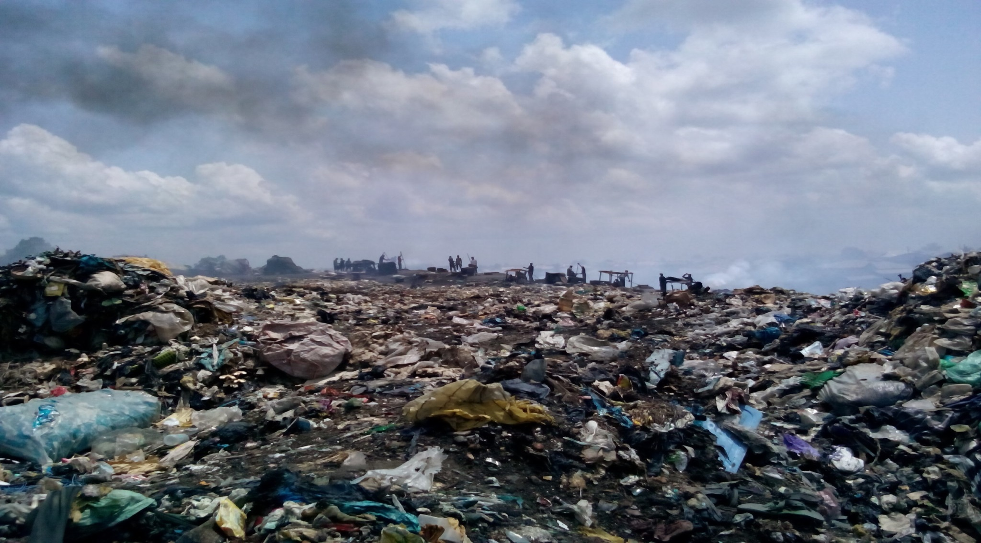
Background to the study Cont’d
Fig 1.0: Pictorial view of part the Olushosun dumpsite

Slide 5
Aim and objectives of the study
The aim of the this research work is to assess the impact of leachates from the dumpsite on the soil and groundwater system around the study area.
The specific objectives are to:
Carry out Frequency Domain Electromagnetic [FDEM] surveys to investigate the vertical and lateral distribution of contaminants around the dumpsite.
Analyze the hydrophysical properties of water samples obtained from boreholes near the sites.
Develop predictive TDS model for the study area

Slide 6
Literature review
Electrical and electromagnetic geophysical methods are becoming increasingly accepted tools for the initial characterization of contaminant plumes from municipal and hazardous waste landfills (Greenhouse and Harris 1983; Sweeney 1984; Greenhouse and Monier-Williams 1985 Ayolabi et.al, 2015).
Many other workers have investigated the contamination of groundwater by heavy metal around landfill site [Lee, et al., 1986, Christensen, et al., 1998, Ogundiran, and Afolabi, 2008, Ayolabi and Peters, 2004, Ayolabi and Oyelayo, 2005, Ayolabi et al., 2013, Ayolabi et.al, 2015]

Slide 7
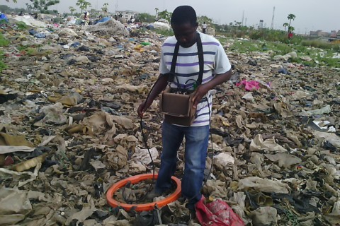
Materials and methods
Data Acquisition
EM data
Figure 1.2: EM-34 instrument

Slide 8
Materials and methods cont’d
Water sample analysis
The physical properties of water tested for are their total dissolved solid (TDS), pH values, temperatures, hardness and electrical conductivity (EC).

Slide 9
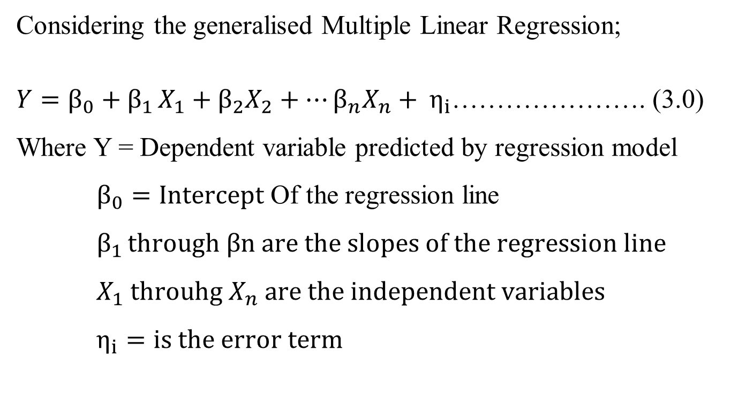
Materials and methods cont’d
Statistical analysis of data
Considering the generalised Multiple Linear Regression;
$Y=β_{0}+β_{1 }X_{1}+β_{2}X_{2}+…β_{n}X_{n}+ η_{i}$…………………. (3.0)
Where Y = Dependent variable predicted by regression model
$β_{0}=Intercept$ Of the regression line
$β_{1 }through βn are the slopes of the regression line$
$X_{1} throuhg X_{n} are the independent variables$
$η_{i}=is the error term$

Slide 10
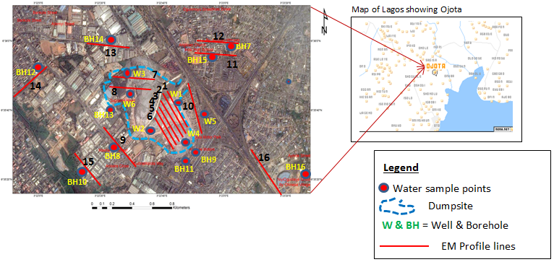
Results and discussion
Figure 1.3: Satellite image of Olushosun dumpsite and surrounding areas showing water sample points and EM-34 data profiles

Slide 11
Results and discussion Cont’d
Table 1.1: Observed mean Terrain Conductivity and TDS Parameters around the Vicinity of Olushosun Dumpsite

Slide 12
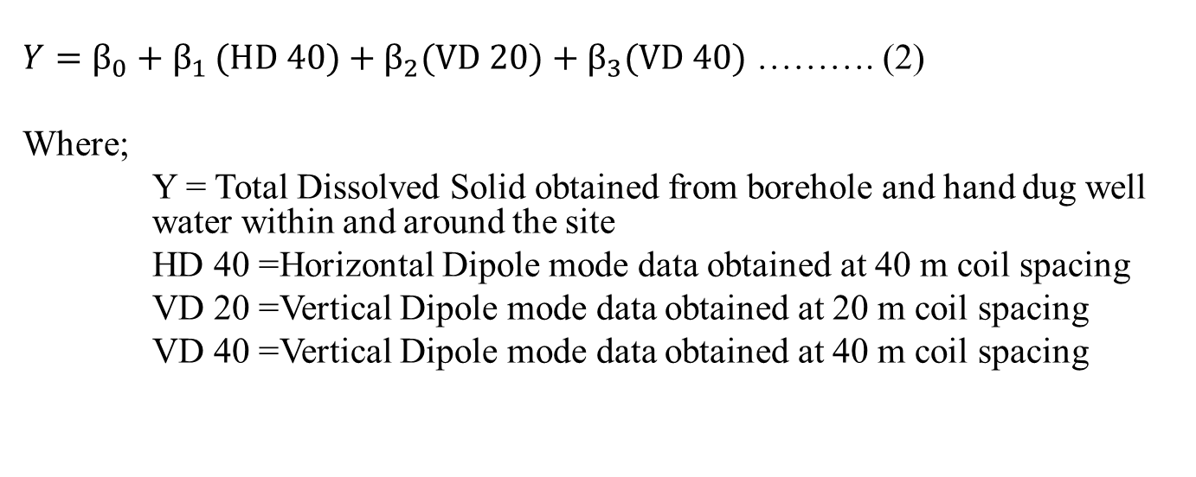
Results and discussion Cont’d
Table 1.2: Summary statistics for regression model using all data variables
 | Coefficients | Stand. Error | tStat | P-value | Lower 95% | Upper 95% | Lower 95% | Upper 95%
Intercept | 60.42368 | 27.2158 | 2.22016 | 0.04642 | 1.12539043 | 119.721995 | 1.1253904 | 119.721995
HD 40 | 9.579794 | 0.32902 | 29.1156 | 1.69E-12 | 8.86291053 | 10.2966793 | 8.8629105 | 10.2966793
VD 20 | 3.533745 | 0.79573 | 4.44088 | 0.00081 | 1.79999782 | 5.26749358 | 1.7999978 | 5.26754935
VD 40 | -12.7011 | 0.87967 | -14.438 | 6.008E-9 | -14.617793 | -10.784481 | -14.61779 | -10.784482
$Y=β_{0}+β_{1 }(HD 40)+β_{2}(VD 20)+β_{3}(VD 40)$ ………. (2)
Where;
Y = Total Dissolved Solid obtained from borehole and hand dug well water within and around the site
HD 40 =Horizontal Dipole mode data obtained at 40 m coil spacing
VD 20 =Vertical Dipole mode data obtained at 20 m coil spacing
VD 40 =Vertical Dipole mode data obtained at 40 m coil spacing

Slide 13
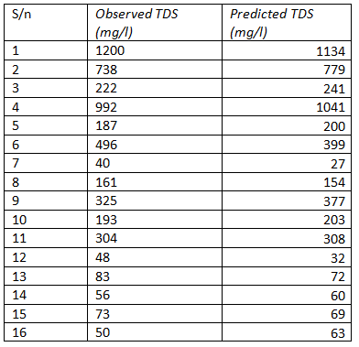
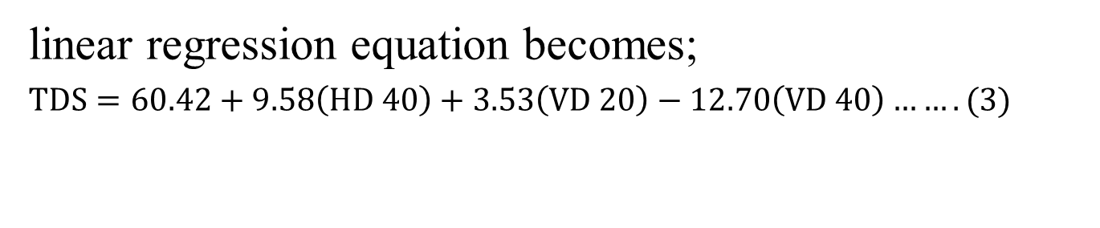
Results and discussion Cont’d
linear regression equation becomes;
$TDS=60.42+9.58\left(HD 40\right)+3.53\left(VD 20\right)−12.70\left(VD 40\right)…….(3)$
Table 1.3: Record of the Observed and Predicted TDS

Slide 14
Results and discussion Cont’d
Model Validation
Table 1.4: Observed mean Terrain Conductivity and TDS Parameters around Olushosun dumpsite obtained from Ayolabi et.al 2015
Profile locations | Coordinates | VD20(mS/m) | HD40(mS/m) | VD40(mS/m) | Observed TDS from water samples (Ayolabi et.al 2015) | Predicted TDS using proposed model
P11 | 6⁰35¹20.26¹¹N 3⁰22¹31.20¹¹E | 27.3 | 17.3 | 18 | 81 | 93.9
P1 | 6⁰35¹45.00¹¹N 3⁰22¹42.36¹¹E | 110.0 | 80.0 | 85 | 112 | 135.62
P9 | 6⁰35¹40.05¹¹N 3⁰22¹38.85¹¹E | 143.5 | 140.0 | 69 | 896 | 1037.63
P10 | 6⁰35¹30.86¹¹N 3⁰22¹29.78¹¹E | 21.3 | 22.0 | 21.5 | 81 | 73.0

Slide 15
Results and discussion Cont’d
Figure 1.4: Plot of comparism between the observed TDS by Ayolabi et.al 2015b and predicted TDS using proposed model

Slide 16
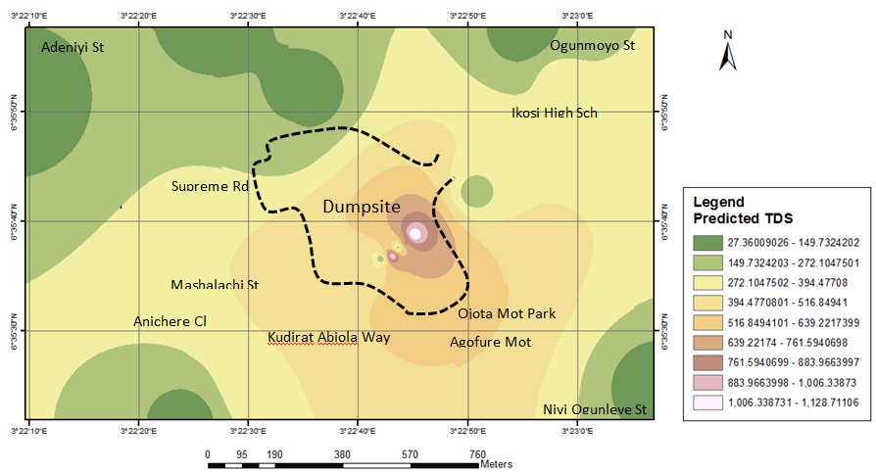
Results and discussion Cont’d
Figure 1.5: Spatial distribution of interpolated estimated TDS around Olushosun dumpsite

Slide 17
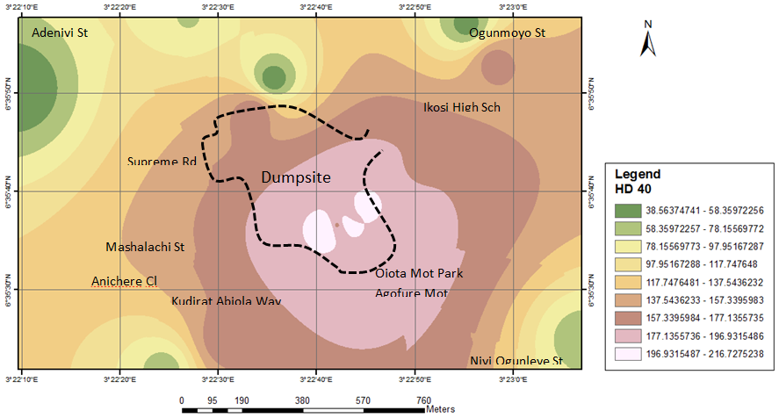
Results and discussion Cont’d
Figure 1.6: Spatial distribution plot of apparent soil electrical conductivity (σa − mS∕m) measured using EM34 in horizontal dipole mode: 40 m (EM34-HD 40)

Slide 18
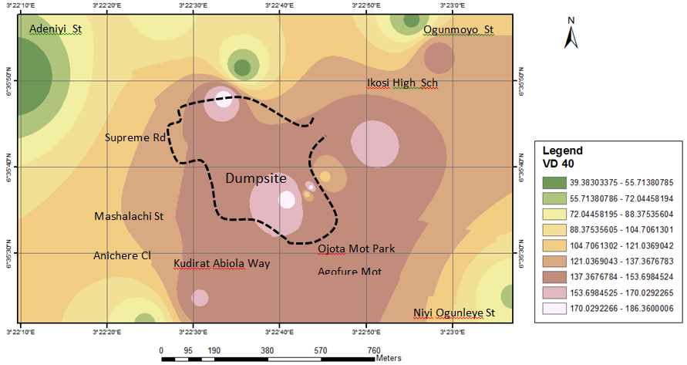
Results and discussion Cont’d
Figure 1.7: Spatial distribution plot of apparent soil electrical conductivity (σa − mS∕m) measured using EM34 in Vertical dipole mode: 40 m (EM34-VD 40)

Slide 19
Conclusion
The developed TDS models can easily be deployed to determine TDS concentration in groundwater around the study areas where the terrain conductivity data is available, thus reducing the time and cost of determining and monitoring both parameters separately
The outcome of this research work will assist policy makers and environmental managers to take quality decisions required to preserve and sustain a healthy environment for mankind and the ecosystems in general, and to effectively and safely manage our natural resources

Slide 20
References
Abu-Zeid, N., G. Bianchini, G., Santarato, and C. Vaccaro, 2004. Geochemical characterisation and geophysical mapping of landfill leachates: The Marozzo Canal case study NE Italy: Environmental Geology, 45, 439–447.
Ademola, J. A., 2008. Exposure to high background radiation level in the tin minning area of Jos Plateau, Nigeria. J. Radiol. Prot, 28: 93-99.
AGI, 2003. Earth Imager 2D Resistivity Inversion Software, version1.5.10. Advanced Geosciences, Inc. Austin, TX
Adeoti, L.., Oladele, S., Ogunlana, F. O., 2011. Geo-electrical investigation of leachate impact on groundwater: A case study of Ile-Epo Dumpsite, Lagos, Nigeria, Journal of Applied Sciences and Environmental Management, 15(2), pp 361-364.
Akinloye, M. K. and Olomo J. B., 2005. The radioactivity in some grasses in the environment of nuclear research facilities located within the OAU, Ile-Ife, Nigeria. Nig. J. Phys., 17S: 219-225.
Akoteyon I. S., Mbata U. A., Olalude G. A., 2011. Investigation of Heavy Metal Contamination in Groundwater around Land-fill Site in a Typical Sub-Urban Settlement in Alimosho, Lagos State. “J. App. Sci. in Environ. Sanitation 6(2) 155-163.
Aldecy de Almeida, S., and Shozo, S., 2008. "Evaluation on surface water quality of the influence area of the sanitary landfill." Engenharia Ambiental : Pesquisa e Tecnologia 5(2): 139-151.

Slide 21
References
Ayolabi, E. A., 2005. Geoelectric evaluation of Olushosun landfill site, southwest Nigeria and its implications on groundwater. J Geol Soc India 66:318–322
Ayolabi, Elijah A., Ebenezer, Epelle S., Oluwatosin, Lucas B., and Adedayo Ojo, 2014a. "Geophysical and geochemical site investigation of eastern part of Lagos metropolis, southwestern Nigeria", Arabian Journal of Geosciences. DOI 10.1007/s12517-014-1688-0 8:7445–7453
Ayolabi, Elijah A., Lucas, Oluwatosin B., and Chidinma, Ifekwuna D., 2014b. "Integrated geophysical and physicochemical assessment of Olushosun sanitary landfill site, southwest Nigeria", Arabian Journal of Geosciences. DOI 10.1007/s12517-014-1486-8
Baedecker, M. J., Back, W., 1979. Hydrogeological processes and chemical reactions at a landfill: Ground Wat., 17, 429-437.
Bagchi, A., 1989. Design, construction and monitoring of sanitary landfill. John Wiley & Sons, New York.
Ball, J. M., and Stove, J. G., 2002. Pollution plume migration: Coastal Park landfill. Proc. WasteCon-2002. International water management biennial, Durban, South Africa.

Slide 22
Thank you for listening!!!

