Slide 1
Paper Presented At the Symposium In Honour Of Professor Akin Euba
Held at The University Of Lagos Nigeria
16-18 the January, 2019

Slide 2
Performance Style, Rhythmic Organization in Yoruba Dùndún drumming: A Study of Dùndún performance in Òkèmèsí Èkìtì
‘Báyò Ògúnyemí
Mountain Top University,
Lagos-Ìbàdàn Expressway,
Prayer City,
Ògùn State Nigeria
aoogunyemi@mtu.edu.ng
08171353575 08023018515

Slide 3
Assumption
There are some towns outside the areas classified as strong in Dùndún tradition that are well endowed in the drumming of dùndún.

Slide 4
Statement to Interrogate
To this extent, Euba (1990) writes ‘Dùndún tradition is at its strongest in the central and Northern parts of Yoruba land, an area roughly coincident with that of the Oyo-Yoruba. (29)
By this submission, towns like Ìkòròdú, Iléşà, Ijebu, Lagos Ekiti and others in the eastern axis of the Yoruba are adjudged to be weak in the practice of dùndún tradition. (Euba 1990, 20)

Slide 5
ABSTRACT
Dùndún is a prominent drum ensemble and a form of dance in Yorùbá land.
It is one of the Yorùbá ensembles that caught the ingenious attention of Akin Euba.
Professor Euba did an extensive research work on this drums and its essential features.
Other scholars
Oláníyan, Adégbìte Samuel, et al

Slide 6
Issues this paper Interrogate
Area of strong and weak Dùndún tradition Euba, 1990; 30
a) Dùndún is an active element of cultural life
b) Dùndún is practiced in its most classical idiom
c) there is proliferations of Dùndún drummers
4) Dùndún is used in secular as well as religious Ceremonies
2. Area of Weak Dùndún tradition
a) Tendency to import Dùndún drummers from outside
b) There is preference for local instrument types for kingship and fro religious purposes
c) Modern Popularised idioms of Dùndún are more predominant

Slide 7
OBJECTIVES
Examine the suitability of the segmentation of Yoruba towns as either weak or strong in Dùndún tradition
Present an overview of Dùndún tradition in Yoruba land
Elucidate on those factors that are responsible for the spread of musical traditions in Yoruba land
Examine the performance and practice of Dùndún music in Okemesi Ekiti

Slide 8
Introduction
Dùndún drumming and the Yoruba people
Okemesi Ekiti, the place and the people
Dùndún in Okemesi Ekiti
The practice/The ensemble
The usages
The Philosophy/Taboos
The instrument
The Knowledge transfer

Slide 9
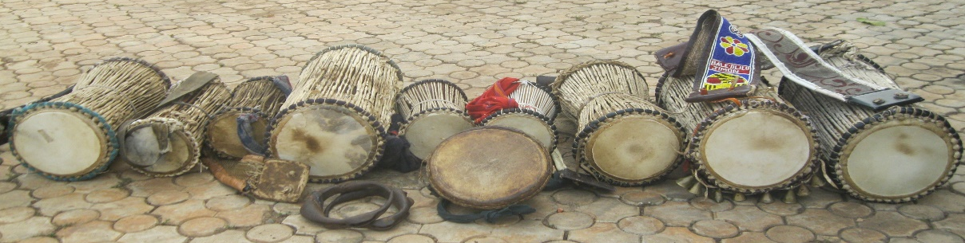
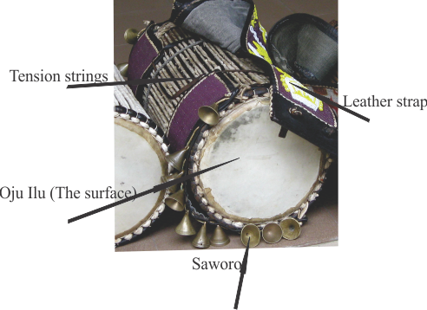
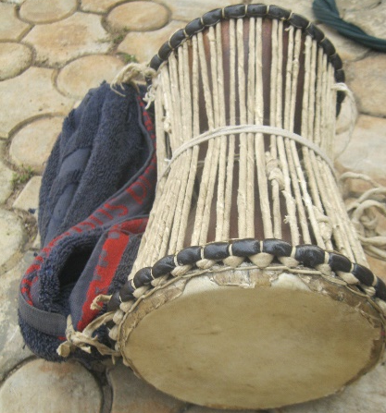
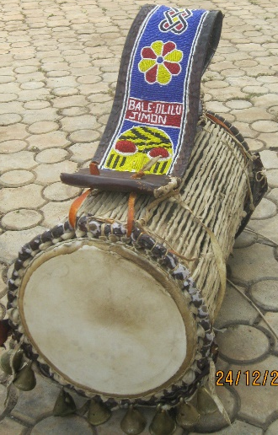
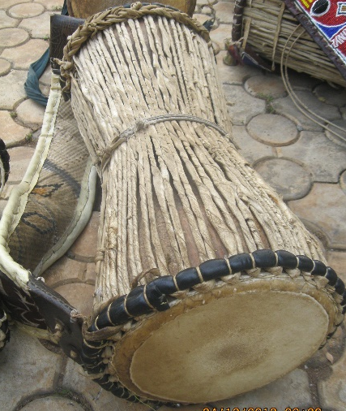
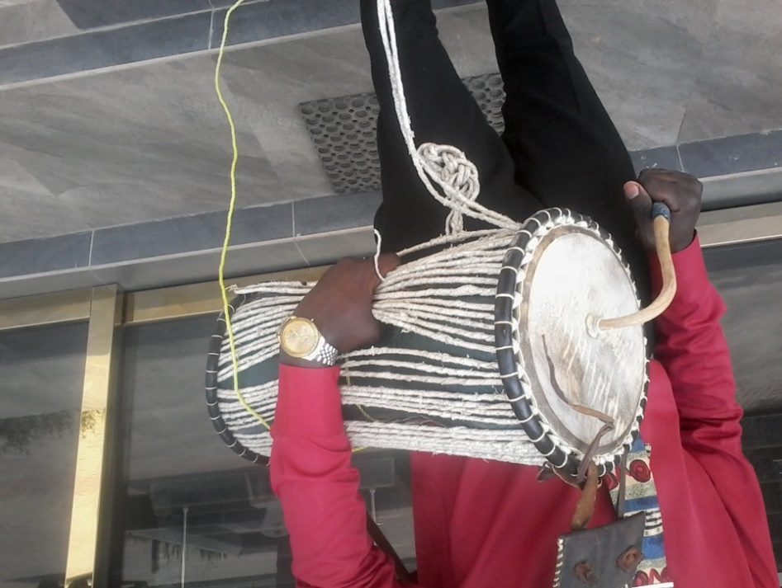
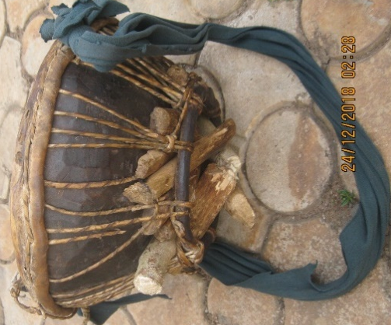
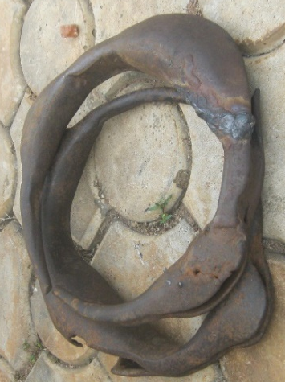
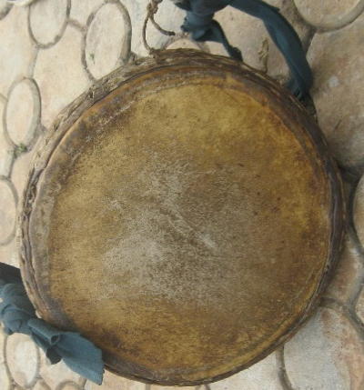
The Practice/The Ensemble
Iya Ilu
Atele
Isaaju
Iya Ilu showing the features
Aro
Gudugudu Front view
Gudugudu Side view
Dundun Performance Position

Slide 10
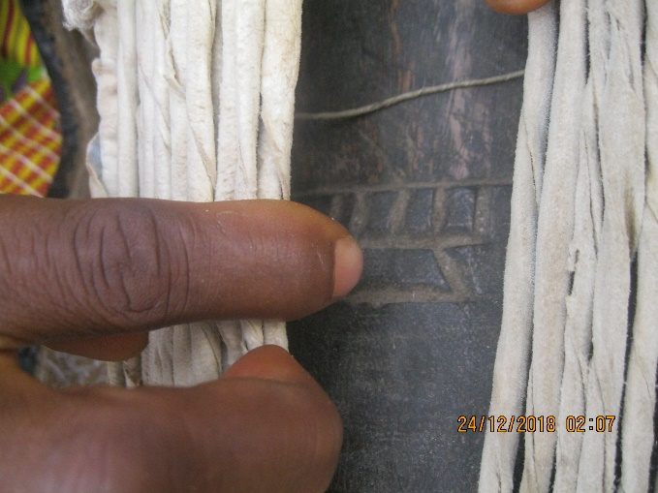
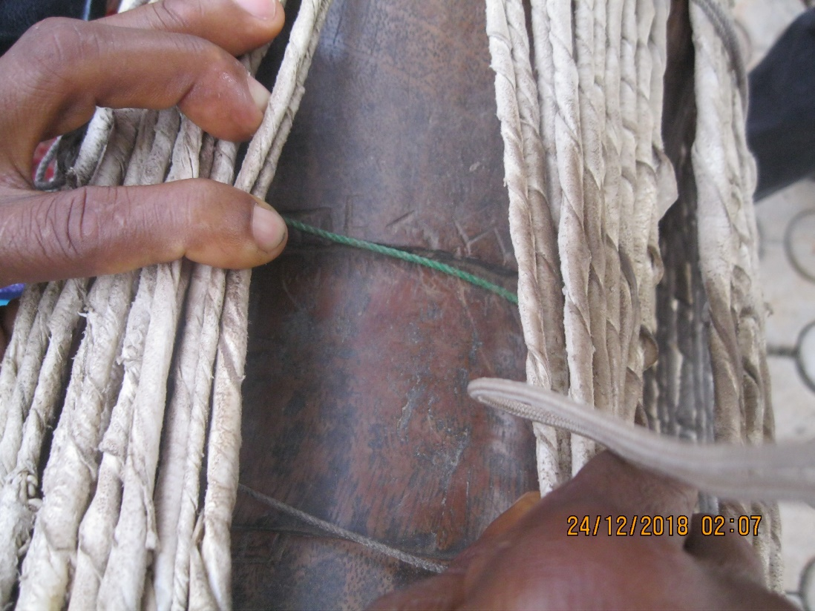
Drum Making and Symbolism in drums

Slide 11
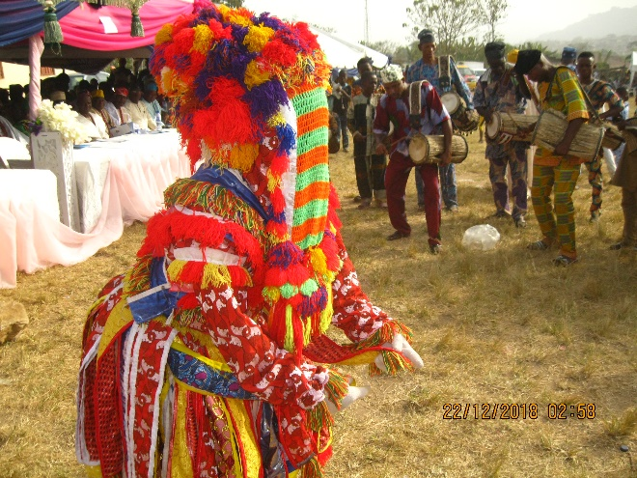
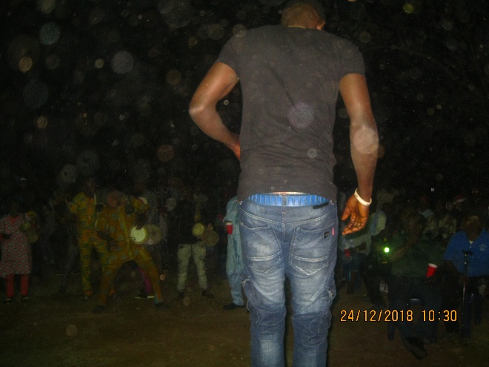
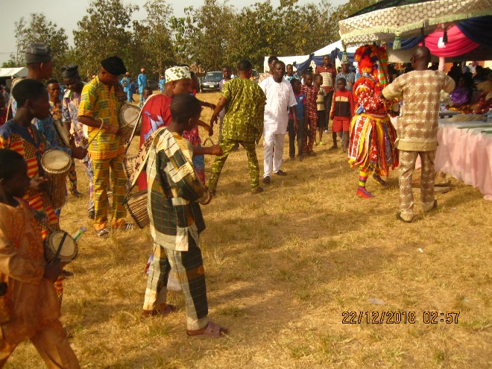
The usages
Concert
Educative
Ceremonial
War
Games
Religious

Slide 12
Rhythm Organization
Ègbò
Àlùbánsí
Àárín (Àlùbánsí)
)
Èle (Àlùbánsí
)

Slide 13
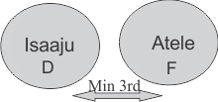
Agere
NOTES
. Talking drum is Melo Rhythmic, Basically improvisational, and instant CRETAIVITY (extemporizational)
Ìyá Ilu 2 is
I have decided not to notate Ìyá Ilu because the notes of Ìyá Ilu are not fixed
In interval, (Aurally taken) between Ìsáájú and Àtèlé is approximately a min 3rd
Aro is not categorized as a generic instrument in the ensemble but always brought in occasionally

Slide 14
Philosophy and Taboos
Making of the drums
Maintenance of the drums
Birth in a drummer’s family
Life of a drummer
Burial of a drummer

Slide 15
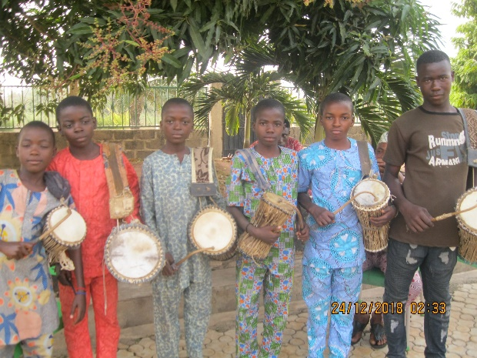
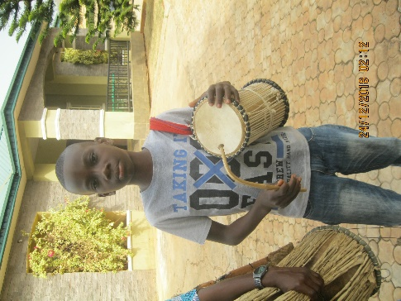
Training and Transfer of Knowledge
Training of drummer is orally conducted by experienced drummer to the younger ones.
Knowledge is also transferred by observation and imitation from one generation of drummer to the other.

Slide 16
,
Findings
Dùndún is in an Ekiti town, having a history and tradition.
The tradition of Dùndún in the town under reviewed is of a strong presence
Internecine wars has been a major factor in the spread and distribution of Music Musical instruments and musicians.

Slide 17
Conclusion
Having examined the characteristics of Dùndùn performance tradition in an area that falls into the ones termed ‘weak’ based on the yardsticks Prof Euba (and so many other scholars have implied) for such submission to capture the intention, I opined that exceptions must be created.
There are some isolated cases which must be so recognized in other to properly situate history. the influence of war in the spread of music, musical instruments
3. Because of some factors, herein analyzed as long years of inter, it is practically difficult to categorize Yoruba music using geographical spread as the basis

Slide 18
Recommendation
I have instigated discussion on this topic and recommend a further research in this respect. I also recommend comparative study to determine.

Slide 19
Thank You

