Slide 1
Presented
By
FAYEMI, OLANREWAJU EMMANUEL (Ph.D)
(Guest Lecturer)
at
University of Lagos, Faculty of Science Seminar Series (January 19th, 2017). University of Lagos, Akoka, Lagos State, Nigeria

Slide 2
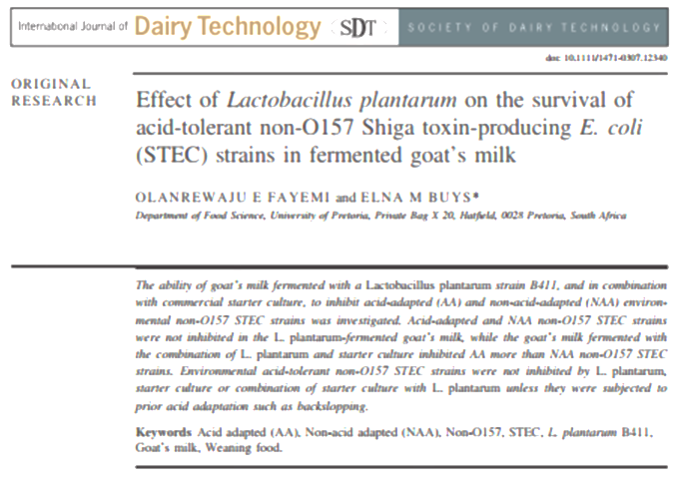
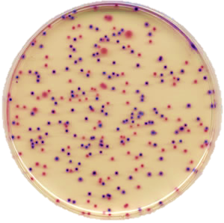
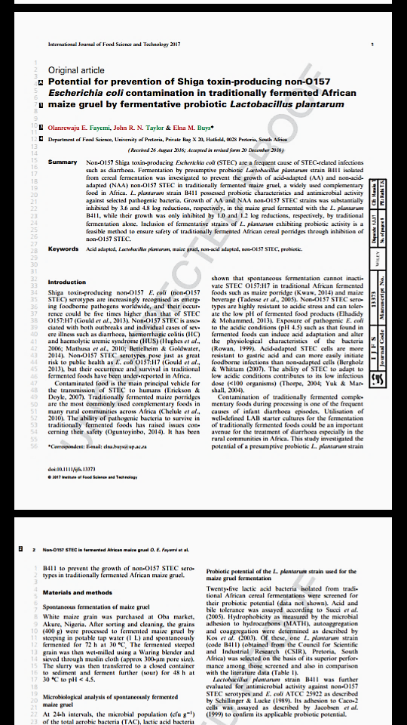


Prevention of Non-O157 Shiga Toxin Producing Escherichia coli in Traditionally Fermented African Complementary Foods. by
Fayemi Olanrewaju (Ph.D)
UNIVERSITY OF LAGOS
FACULTY OF SCIENCE
SEMINAR SERIES, JANUARY, 2017

Slide 3
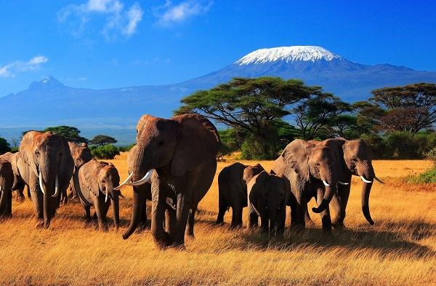
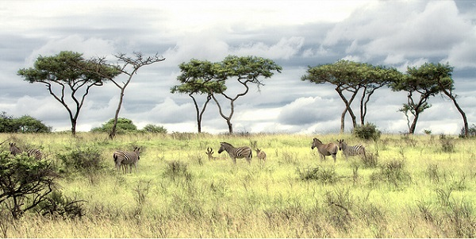
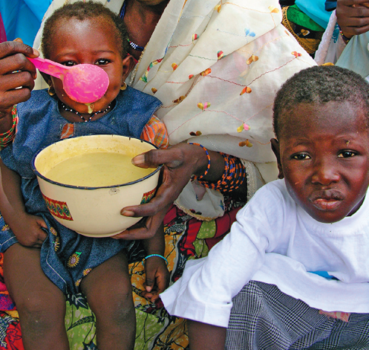
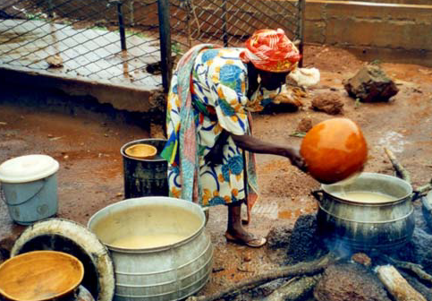



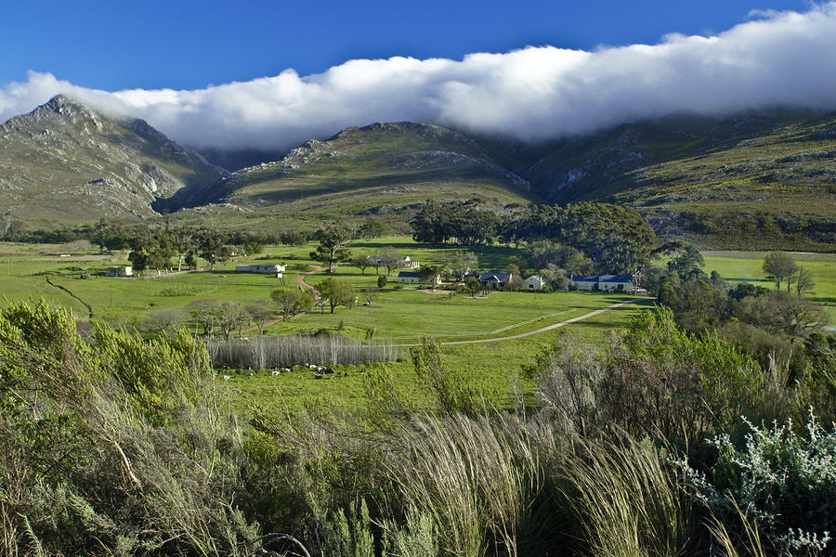

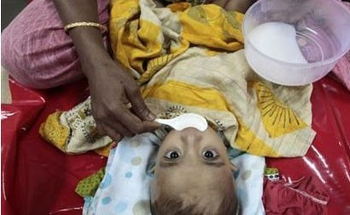
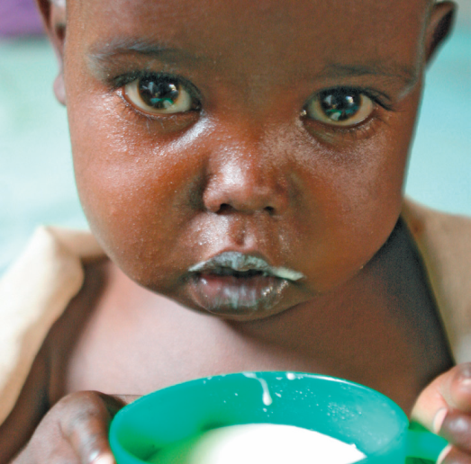
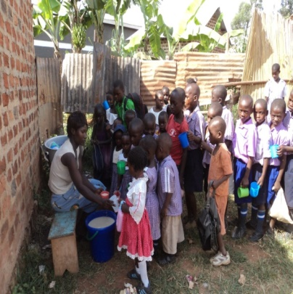
Unicef, 2009 & www.googleimages.com

Slide 4
OUTLINE:
Background Objective Experimental Results Conclusions
Background
Significance of cereal-based weaning foods in African
Safety challenges associated with the fermentation and preparation of tradition African fermented foods
Prevalence of diarrhoea and infant mortality in Africa
Emergence and occurrence of non-O157 STEC across the world
Research
Probiotic characterisation of LAB associated with traditional fermented maize gruel
Isolation and characterisation of non-O157 STEC from environmental sources
Inhibition of non-O157 STEC in traditionally fermented complementary foods by presumptive probiotic bacteria.

Slide 5
Background Objective Experimental Results Conclusions
Significance of cereal-based weaning foods in African
Goat milk plays an important role in nutrition and wellbeing of developing countries, where it provides basic nutrition and subsistence to rural people. _{Park and Haenlein 2007}
Traditional lactic acid fermented foods are an important part of the diet in Africa
Fermented foods of various types serve as complementary foods for infants and children, and the major meal of adults. _{Galati et al., 2014}

Slide 6
Background Objective Experimental Results Conclusions
Fermented foods, particularly those produced under controlled fermentation, have a good record of safety and are rarely implicated in outbreaks of diseases. _{Omemu and Adeosun, 2010}
Natural fermentation processes practised in Africa are based largely on experience and knowledge gained through trial and error, which routinely allowed participation of diverse microorganisms. _{Galati et al., 2014}
Therefore, involvement of pathogenic microorganisms during production cannot be totally ruled out

Slide 7
Background Objective Experimental Results Conclusions
Emergence and occurrence of non-O157 STEC serotypes
Identification of a heterogeneous group of STEC that express an O surface antigen other than 157 as foodborne pathogens is on the increase worldwide Gould et al., 2013; Wang et al., 2013; Bettelheim and Goldwater, 2014.
Non-O157 STEC with outbreaks of foodborne infections and illness. Rund et al., 2013; Preubel et al., 2013; Bettelheim and Goldwater, 2014
Non-O157 STEC serotypes are increasingly being associated with both outbreaks and individual cases of severe illness such as diarrhoea, haemorrhagic colitis (HC) and haemolytic-uremic syndrome (HUS).Hughes et al., 2006; Mathusa et al., 2010; _{Gould et al., 2013}

Slide 8
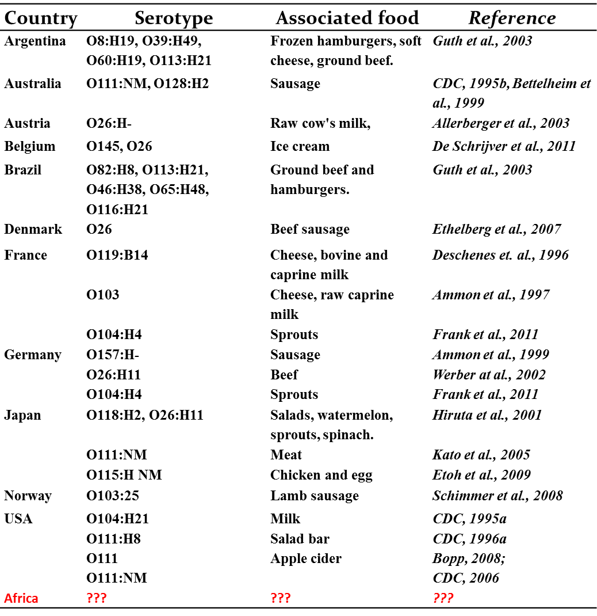
Background Objective Experimental Results Conclusions
Reported outbreaks of non-O157 STEC

Slide 9
Background Objective Experimental Results Conclusions
Non-O157 STEC serotypes pose just as great risk to public health as E. coli O157:H7_{Gould et al., 2013}but their occurrence and survival in traditional fermented foods have been under-reported in Africa.
Currently, there is no effective treatment available for STEC infections in people and the use of antibiotics is not generally recommended due to the concern that they will induce Stx production, thus worsening the symptoms. Rund et al., 2013; Mohsin et al., 2015
Probiotic bacteria have been recommended as the only possible treatment for the STEC infections in people. Rund et al., 2013; Mohsin et al., 2015.

Slide 10
Probiotic characterisation of the LAB strains isolated from traditional African fermented maize gruel

Slide 11
Objective
Background Objective Experimental Results Conclusions
To determine the probiotic characteristics of LAB that are associated with the traditional African fermented maize gruel in order to predict their usefulness as potential probiotic starter culture for the fermentation of traditional fermented complementary foods.

Slide 12
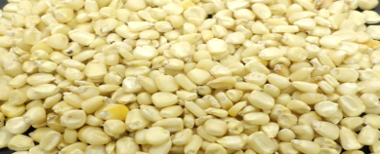
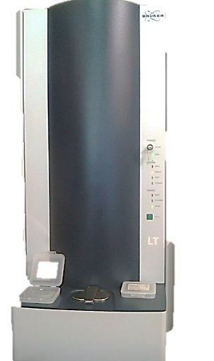
Background Objective Experimental Results Conclusions
Experimental
Maize grains
Isolation and identification of LAB strains in ogi
(MALDI-TOF MS)
24 h interval
Sorting and Cleaning and steeping in potable tap water for 72 h
Determination of probiotic characteristics of the isolated LAB strains
Acid and bile tolerance
Hydrophobicity (MATH)
Coaggregation
Autoaggregation
Antimicrobial activity
Adhesion to erythrocyte-like Caco-2 cells
Wet milling, sieving and souring for 48 h
16S rDNA Sequencing of the strain with probiotic attributes
Determination of amylolytic properties

Slide 13
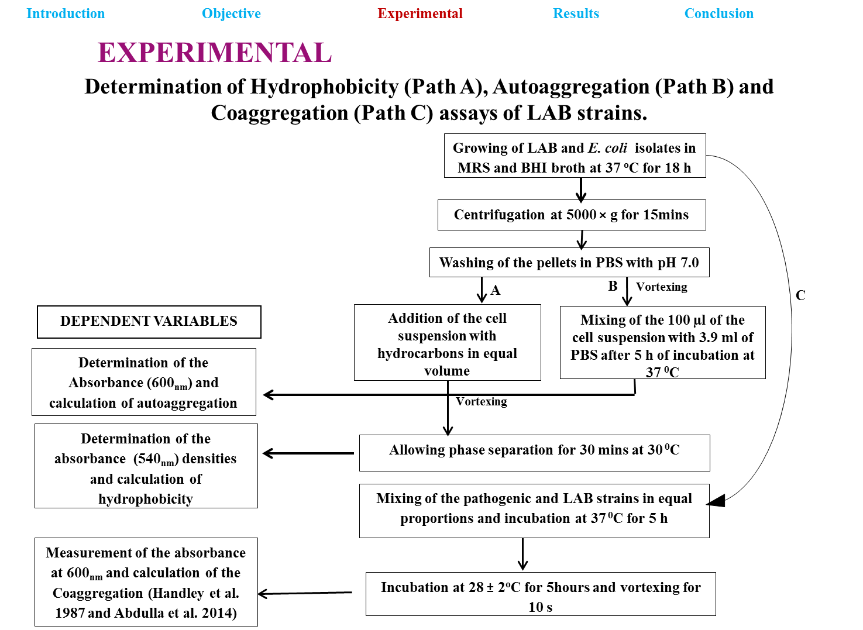
Background Objective Experimental Results Conclusions

Slide 14
Background Objective Experimental Results Conclusions
RESULTS
Survival of LAB strains during incubation for for 2 h at pH 2.5 (acidified with 1.0 N HCl) followed by incubation for 5 h at pH 6.5 in presence of 0.3% bile salts
LAB strain | LAB count (log₁₀ CFU/mL ) |  |  |  |  |  | * Survival after exposure to low pH and bile salt (%)
 | at pH 2.5 |  |  | Growth in 0.3 % bile salt at pH 6.5
 | 0 h | 1 h | 2 h | 3 h | 5 h | 7 h
L. plantarum FS1 | 8.69ª ± 0.08 | 7.45^{bc} ± 1.04 | 7.25^{ef} ± 1.00 | 7.88^{g} ± 0.61 | 7.41^{k} ± 0.12 | 6.14^{f} ± 0.35 | 71
L. plantarum D31 | 8.74ª ± 0.18 | 7.45^{bc} ± 0. 97 | 5.71^{bcde} ± 1.00 | 5.44de ± 0.95 | 5.41^{h} ± 0.01 | 6.38^{f} ± 0.10 | 73
L. plantarum FS2 | 8.86ª ± 0.06 | 8.37^{c} ± 0.94 | 7.53^{f} ± 0.98 | 8.42^{g} ± 0.80 | 8.32^{l} ± 0.05 | 8.28^{h} ± 0.62 | 93
L. plantarum FS11 | 8.54ª ± 0.12 | 5. 31^{abc} ± 1.10 | 4.85^{abcd} ± 1.00 | 4.36^{bcd} ± 0.64 | 4.22e ± 0.05 | 4.01de ± 0.48 | 47
L. plantarum D35 | 8.89ª ± 0.10 | 6.44^{abc} ± 1.03 | 4.57^{ab} ± 0.98 | 4.26^{bcd} ± 0.97 | 3.97^{d} ± 0.03 | 3.34^{c} ± 0.10 | 38
L. plantarum B411 | 8.86ª ± 0.06 | 8.37^{c} ± 0.94 | 7.53^{f} ± 0.98 | 8.42^{g} ± 0.80 | 8.32^{l} ± 0.05 | 8.28^{h} ± 0.62 | 94
L. plantarum D33 | 8.88ª ± 0.04 | 6.63^{abc} ± 1.00 | 6.44^{def} ± 1.02 | 4.80^{bcd} ± 0.40 | 5.22^{g} ± 0.02 | 6.41^{f} ± 0.06 | 72
L. plantarum FS0 | 8.70ª ± 0.04 | 7.59^{bc} ± 0.79 | 5.83^{bcde} ± 0.97 | 5.66^{def} ± 0.96 | 4.76^{f} ± 0.12 | 4.20e ± 0.14 | 48
L. plantarum D30 | 8.68ª ± 0.08 | 4.78^{ab} ± 0.98 | 4.33^{ab} ± 1.05 | 2.83ª ± 0.65 | 2.53ª ± 0.03 | 2.43^{ab} ± 0.13 | 28
L. plantarum FS12 | 8.74ª ± 0.02 | 6.22^{abc} ± 0.99 | 6.22^{cdef} ± 1.02 | 5.47de ± 0.96 | 5.64^{i} ± 0.02 | 6.41^{f} ± 0.12 | 73
P. pentosaceus D39 | 8.62ª ± 0.22 | 7.06^{abc} ± 0.85 | 6.51^{ef} ± 1.00 | 6.84^{efg} ± 0.96 | 7.10^{j} ± 0.10 | 7.39^{g} ± 0.21 | 86
P. pentosaceus FS7 | 8.98ª ± 0.14 | 5.45^{abc} ± 0.97 | 3.80ª ± 0.70 | 3.46^{ab} ± 0.64 | 3.43^{b} ± 0.06 | 3.58^{cd} ± 0.26 | 40
L. rhamnosus GG | 8.72ª ± 0.26 | 6.41^{abc} ± 1.00 | 4.61^{abc} ± 0.50 | 5.25^{cde} ± 0.91 | 5.36^{h} ± 0.05 | 6.30^{f} ± 0.20 | 72
P. pentosaceus FS5 | 8.80ª ± 0.07 | 4.21ª ± 1.00 | 3.25ª ± 0.48 | 3.84^{abc} ± 0.63 | 3.68^{c} ± 0.10 | 2.17ª ± 0.33 | 25
P. pentosaceus FS27 | 8.78ª ± 0.04 | 6.30^{abc} ± 1.11 | 4.43^{ab} ± 0.50 | 5.30^{cde} ± 0.95 | 5.40^{h} ± 0.05 | 6.55^{f} ± 0.12 | 75
Values are the means and standard deviations (n =3).
Means with different superscript in the same column are significantly different at p ˂ 0.05.

Slide 15
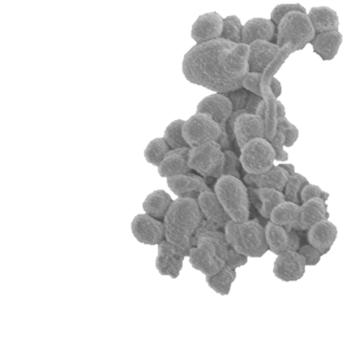
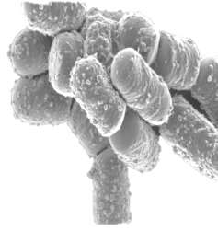


Background Objective Experimental Results Conclusions
Acid and bile tolerance of the LAB strains
Fifteen LAB strains ( 10 Lactobacillus plantarum and 4 Pediococcus pentosaceus) were examined for acid and bile tolerance
0.3 % bile salt at pH 6.5
(5 h)
pH 4.5 (18 h )
pH 2.5
(2 h)
Six L. plantarum and two P. pentosaceus strains showed acid and bile tolerance of ˃ 6 log₁₀ cfu/mL

Slide 16
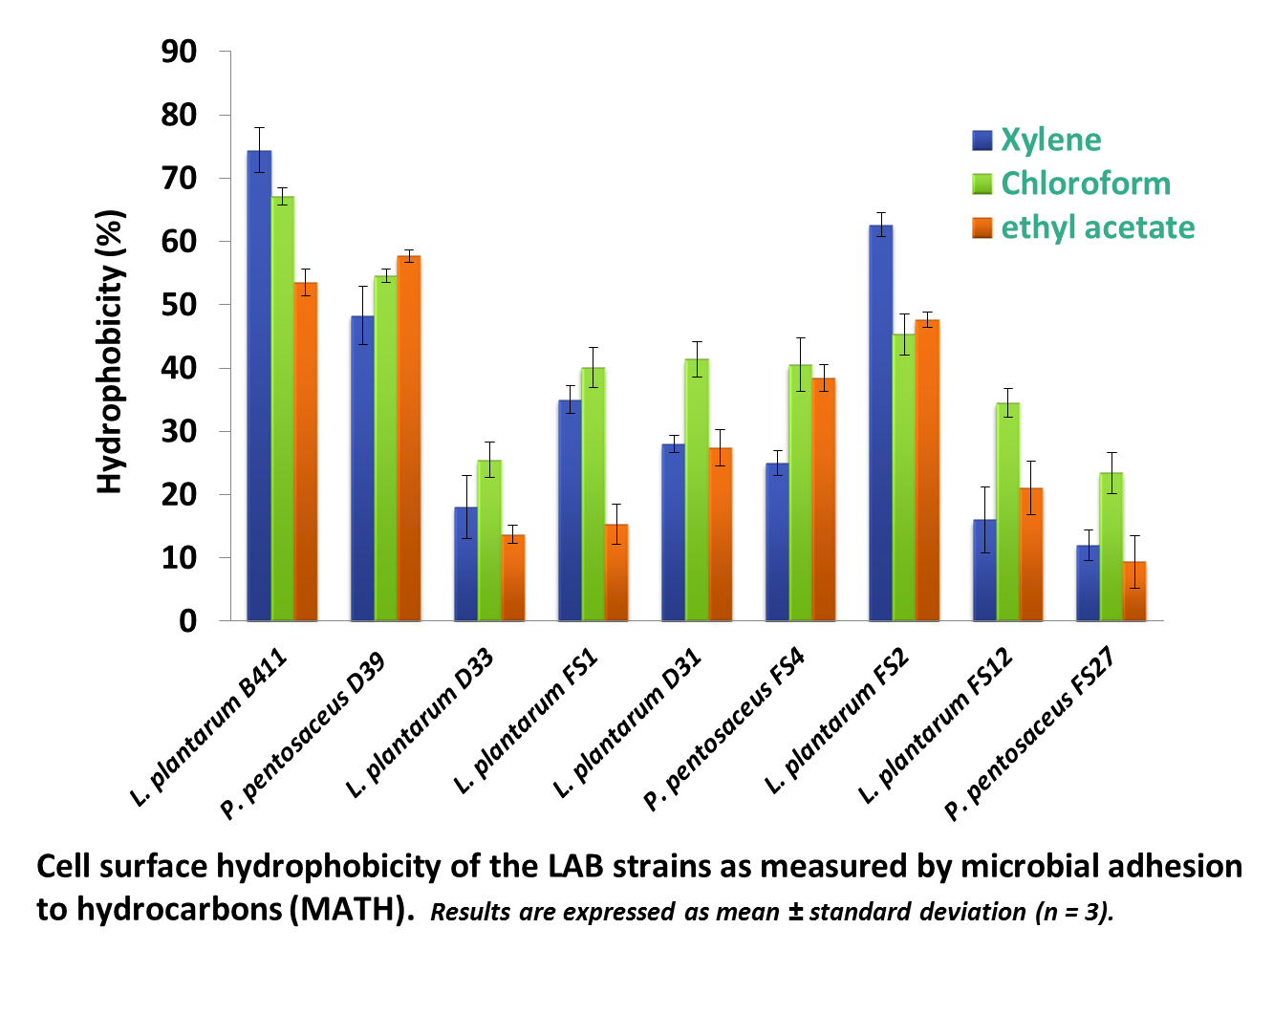
Background Objective Experimental Results Conclusions
Strains with hydrophobic cell surface
L. rhamnosus GG
Cell surface hydrophobicity of the LAB strains as measured by microbial adhesion to hydrocarbons (MATH). Results are expressed as mean ± standard deviation (n = 3).
Calculated using :
Hydrophobicity, (%) = {(A₀ – A)/A} × 100

Slide 17
Background Objective Experimental Results Conclusions
Coaggregation of the LAB strains with selected pathogenic E. coli strains in phosphate buffered saline (PBS) after incubation for 5 h at 37 ºC.
Results are expressed as mean ± standard deviation (n = 3)
Calculated using:
Coaggregation, (%) = { (Ax + A_{y})/2 – A(x +y)/ (Ax + A_{y})/2 } × 100
Where: A_{t} represents absorbance at time t and A₀ is the absorbance at time 0 (Del Re et al., 2000; Kos et al., 2003; Orlowski and Bielecka, 2006; Abdulla et al., 2014)

Slide 18
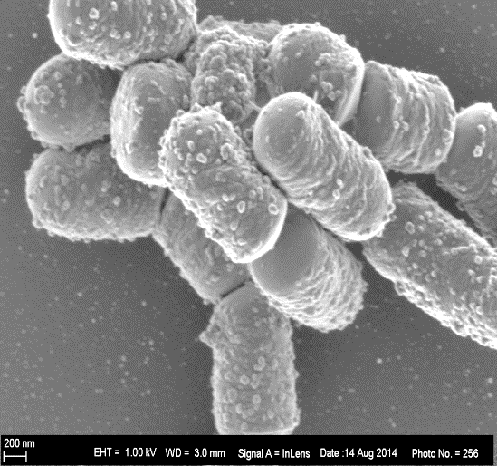
Autoaggregation of the LAB strains with hydrophobic cell surface
Background Objective Experimental Results Conclusions
LAB strains | Autoaggregation (%)
 | PBS | MRS broth
Lactobacillus plantarum B411 | 62.0^{b} (3.0) * | 93.0^{b} (4.0)
Lactobacillus plantarum FS2 | 54.5^{ab} (4.0) | 85.0^{ab} (4.0)
Pediococcus pentosaceus D39 | 43.0ª (2.0) | 76.5ª (4.0)
SEM showing auto-aggregation of L. plantarum B411
* Means and standard deviation (n = 3). Values in the same column with different letters are significantly different at p ≤ 0.05
Calculated using :
Autoaggregation , (%) = 1 – (A_{t} /A₀) × 100
Where: A_{t} represents absorbance at time t and A₀ is the absorbance at time 0 (Del Re et al., 2000; Kos et al., 2003; Orlowski and Bielecka, 2006; Abdulla et al., 2014)

Slide 19
Background Objective Experimental Results Conclusions
Antimicrobial activity of the LAB strains against pathogenic E. coli indicator strains
E. Coli indication Strain | Inhibition zone (mm)
 | Lactobacillus Plantarum B411 | Lactobacillus plantarum FS2 | Pediococcus pentosaceus D39
Non-O157 STEC (UPE1) | 26.0^{b} (2.0) * | 27.5^{c} (2.0) | 21.0^{b} (2.0)
Non-O157 STEC (UPE6) | 28.0^{b} (3.0) | 19.0^{b} (2.0) | 21.5^{b} (2.0)
Non-O157 STEC (UPE8) | 28.0^{b} (2.0) | 20.0^{b} (3.0) | 25.5^{c} (2.0)
ATCC 25922 | 17.0ª (2.0) | 13.0ª (2.0) | 15.0ª (1.0)
*Means and standard deviation (n = 3).
Mean values in the same column with different superscript are significantly different at p ≤ 0.05

Slide 20
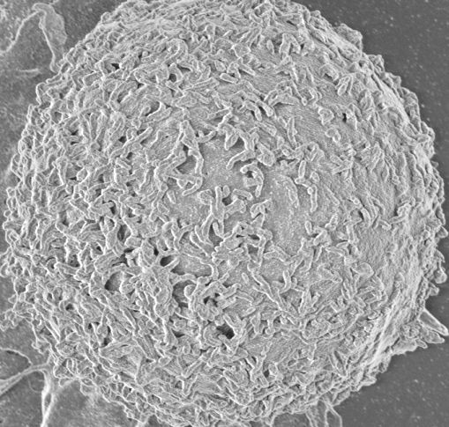
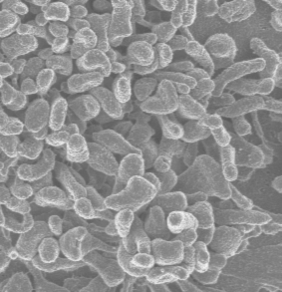
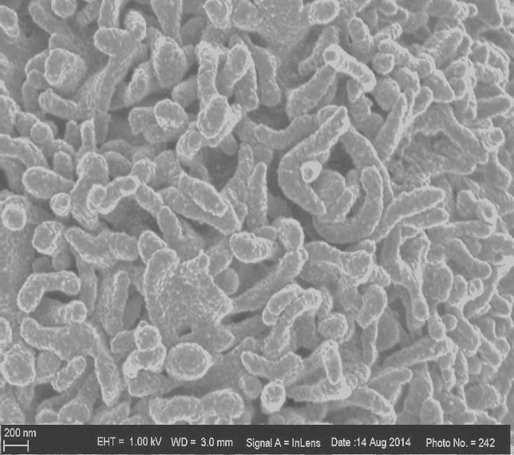
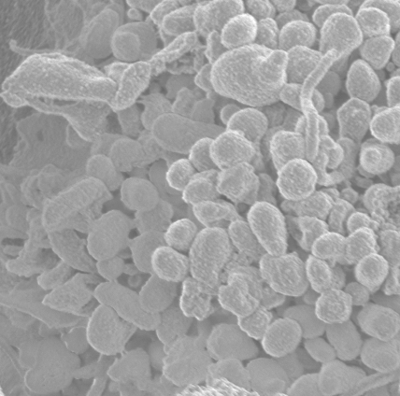
Background Objective Experimental Results Conclusions
Bacterial adhesion to Caco-2 cells
a
2µm 1KV
b
c
d
2µm 1KV
2µm 1KV
2µm 1KV
SEM showing (a) Caco-2 cell, adherence of (b) L. plantarum B411, (c) L. plantarum FS2 and (d) P. pentosaceus D39 to Caco-2 cells.

Slide 21
Background Objective Experimental Results Conclusions
Adhesion of L. plantarum B411, P. pentosaceus D39 and L. plantarum FS2 to Caco-2 cells.
Each adhesion assay was expressed as mean ± standard deviation (n = 3). Bar graphs with different superscript are significantly different at p ˂ 0.05

Slide 22
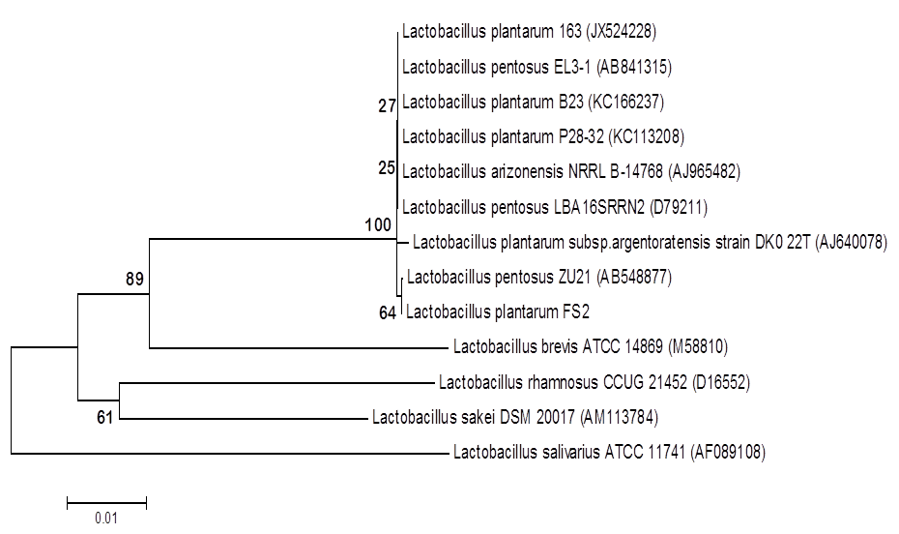
Background Objective Experimental Results Conclusions
plantarum B411
Phylogenetic tree highlighting the position of characterised L. plantarum (B411 & FS2) relative to the representative potential probiotic strains in the GenBank (NCBI).
The tree was constructed by the neighbor-joining method based on alignments of 16S rDNA gene sequences. Corresponding NCBI accession numbers are shown in parentheses. Numbers at the nodes indicate support values obtained from 1,000 bootstrap replications.

Slide 23
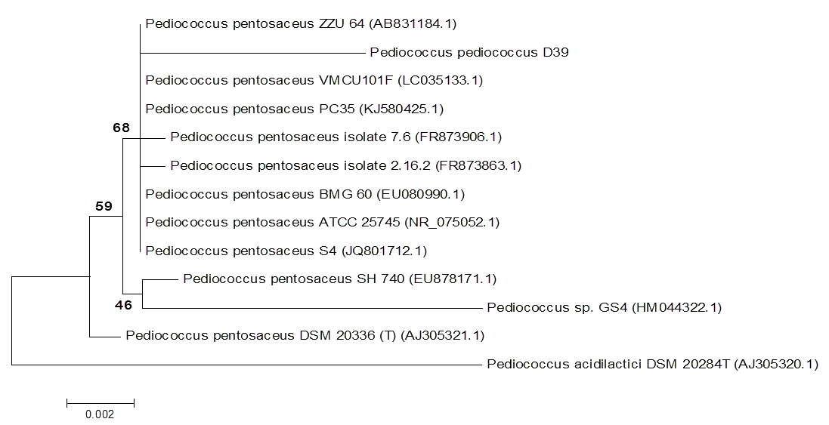
Background Objective Experimental Results Conclusions
Phylogenetic tree highlighting the position of characterised P. pentosaceus D39 relative to the representative potential probiotic strains in the GenBank (NCBI).
The tree was constructed by the neighbor-joining method based on alignments of 16S rDNA gene sequences. Corresponding NCBI accession numbers are shown in parentheses. Numbers at the nodes indicate support values obtained from 1,000 bootstrap replications.

Slide 24
Effect of LAB with probiotic attributes on the survival of non-O157 STEC strains in traditionally fermented dairy and cereal-based complementary foods

Slide 25
Objective 2
Background Objective Experimental Results Conclusions
To determine the ability of presumptive probiotic bacteria to inhibit acid tolerant non-O157 STEC strains in traditional African fermented complementary foods

Slide 26
Experimental-2
Background Objective Experimental-2 Results Conclusions
Raw goat’s milk
Maize grains
Sorghum flour
Isolation and identification of LAB strains in ogi
Sorting and Cleaning
Reconstitution in water and cooking for 30 mins
Determination of probiotic potential of the LAB strains in ogi & L. plantarum (CSIR, SA)
Acid and bile tolerance
Hydrophobicity (MATH)
Coaggregation
Autoaggregation
Antimicrobial activity
Adhesion to erythrocyte-like Caco-2 cells
Pasteurization
&
inoculation with yoghurt starter culture
Stepping in potable tap water
Cooling to 30 ºC
Selected potential Probiotic strains
Inoculation with potential probiotic bacteria and acid adapted and non-acid adapted non-O157 STEC strains
Fermentation for 6 h
Fermentation for 72 h
Fermentation for
24 h
Enumeration on selective agar
24 h interval
Wet milling, sieving and souring for 48 h

Slide 27
Acid adaptation of the non-O157 STEC strains
Background Objective Experimental Results Conclusions
RESULTS
The acid tolerance of acid adapted non-O157 STEC strains in brain heart infusion (BHI) broth at pH 2.5 and the percentage of survival after 2 h of exposure at 37 ºC adapted from Fayemi et al., 2016
Non-O157 STEC Strain | Microbial count (log₁₀ cfu/mL) |  |  |  | % survival after 120 min
 | 0 min | 60 min | 90 min | 120 min
MPU(W)8(3) | 6.60 ± 0.08ª | 5.42 ± 0.01^{ab} | 4.19 ± 0.01^{b} | 3.28 ± 0.04^{d} | 50.0 ± 3.0
MPU(W)9(3) | 6.66 ± 0.01ª | 5.64 ± 0.06^{ab} | 3.11 ± 0.04ª | 2.26 ± 0.03^{b} | 34.0 ± 2.0
MPU(W)8(4) | 6.73 ± 0.08ª | 4.05 ± 0.07^{c} | nd | nd | nd
MPU(W)5(3) | 6.12 ± 0.01ª | 5.60 ± 0.08^{ab} | 3.31 ± 0.10ª | 1.80 ± 0.03ª | 29.0 ± 3.0
NW(W)5(1) | 6.67 ± 0.02ª | 4.31 ± 0.03^{cd} | nd | nd | nd
MPU(W)9(1) | 6.80 ± 0.06ª | 5.30 ± 0.10ª | 4.68 ± 0.10^{b} | 3.89 ± 0.07^{c} | 57.0 ± 3.0
MPU(W)5(7) | 6.75 ± 0.02ª | 6.04 ± 0.10^{b} | 3.12 ± 0.10ª | nd | nd
MPU(W)5(2) | 6.84 ± 0.04ª | 5.00 ± 0.03ª | 4.49 ± 0.05^{b} | 3.70 ± 0.10^{c} | 54.0 ± 2.5
Means and standard deviation (n = 3).
Mean values in the same column with different superscript are significantly different at p ≤ 0.05
nd = not detected

Slide 28
Background Objective Experimental Results Conclusions
Eight non-O157 STEC strains from environmental sources were evaluated for acid adaptation and acid tolerance
Three strains which exhibited acid tolerance potential were selected for the survival studies in fermented goat’s milk and two cereal-based fermented complementary foods.
The 3 non-O157 STEC serotypes were then serotyped (O138 : K81 and O83 : K-)

Slide 29
Background Objective Experimental Results Conclusions
Inhibition of non-O157 STEC in the goat’s milk fermented with potential probiotic L. plantarum B411 in comparison with those fermented with commercial yoghurt starter culture and combination of starter culture with L. plantarum B411. _{Fayemi et al., 2016}
Results are expressed as mean ± standard deviation (n = 3).

Slide 30
Background Objective Experimental Results Conclusions
Changes in the pH during the fermentation of goat’s milk with starter culture, L. plantarum B411 and combination of starter culture and L. plantarum B411 inoculated with acid adapted (A) or non-acid adapted (B) non-O157 STEC strains. _{Fayemi et al., 2016}

Slide 31
Background Objective Experimental Results Conclusions
0.3 & 1.0 log reductions
2.5 & 3.0 log reductions
Survival of acid adapted and non-acid adapted non-O157 STEC strains during the fermentation of maize gruel by spontaneous fermentation alone and in combination with L. plantarum. _{Fayemi et al., 2017}
Results are means ± standard deviation (n = 3).

Slide 32
Background Objective Experimental Results Conclusions
Effects of fermenting sorghum spontaneously and with potential probiotic bacteria (L. plantarum FS2 & P. pentosaceus D39) on the survival of acid adapted (AA) and non-acid adapted (NAA) non-O157 Shiga toxin producing E. coli (STEC) in the motoho product
Stage of motoho processing | Inoculated non-O157 STEC | Spontaneously fermented sorghum motoho | L. plantarum FS2 fermented sorghum motoho (Log₁₀ cfu/mL) | P. pentosaceus D39 fermented sorghum motoho (Log₁₀ cfu/mL) | L. plantarum FS2 and P. pentosaceus D39 fermented sorghum motoho (Log₁₀ cfu/mL)
Before incubation | AA | 4.52^{g} ± 0.02 | 4.42^{g} ± 0.06 | 4.49^{g} ± 0.02 | 4.58^{g} ± 0.02
 | NAA | 4.48^{g} ± 0.04 | 4.40^{g} ± 0.07 | 4.46^{g} ± 0.01 | 4.57^{g} ± 0.05
After 24 h incubation | AA | 2.70^{d} ± 0.01 | 2.16^{b} ± 0.09 | 2.43^{c} ± 0.26 | 1.67ª ± 0.39
 | NAA | 3.78^{f} ± 0.04 | 3.95^{f} ± 0.02 | 3.98^{f} ± 0.02 | 3.22e ± 0.05
2.9 log reductions
Means and standard deviation (n = 3).
Values in the same column with different superscript are significantly different at p ≤ 0.05

Slide 33
Background Objective Experimental Results Conclusions
Conclusions
This study shows that:
certain LAB that are associated with the traditional non-alcoholic African fermented maize gruel possess desirable in vitro probiotic attributes.
non-O157 STEC strains from environmental sources vary in their acid tolerance ability and natural fermentation brings about some inhibition of non-O157 STEC but not enough to ensure the safety of such traditionally fermented complementary foods from this emerging pathogen.
utilization of fermentative strains of LAB exhibiting probiotic activity is a feasible method to prevent the growth of this important emerging pathogen and ensure the safety of traditional African fermented complementary foods.

Slide 34

What next??
What is the risk level ?
Risk analysis modelling of the survival of non-O157 STEC in the cereal-based fermented complementary foods.
Assayed for the antibiotic resistance of the presumptive probiotic bacteria to prevent the undesirable transfer of resistance genes to other endogenous bacteria.
identifying the presence of genes encoding for putative probiotic functions for deeper knowledge of the probiotic characteristics of these strains
in vivo studies such as clinical trials and intervention studies as well as ability to modulate immune response should be carried out as guided by the FAO/WHO guidelines for evaluation of probiotic bacteria.
The contribution of the outer membrane fatty acids to acid adaptation and subsequent acid tolerance in non-O157 STEC strains should also be determined

Slide 35

Thank you
Merci
Asanteni
Shukrah
E seun
Dankie
Oh yeh rah don
Ngiyabonga
Kea leboha

