Slide 1
PRESENTATION AT MOUNTAIN TOP UNIVERSITY-INTERNATIONAL
CONFERENCE ON ENTREPRENEURSHIP, 2020
TITLE OF PAPER: RANKING THE factors affecting ICT usage among
youth-led agribusiness in different agricultural
value chains IN NIGERIA (AHP APPROACH)
AUTHORS: Kasali, F. A., Akinyemi, I. O., Balogun, J. A.
PRESENTED BY: Kasali, F. A.
Date: 13th of October, 2020

Slide 2
Outline
1.0 Introduction
2.0 Problem Statement
3.0 Literature Review
What is Information and Communication Technology (ICT)
Factors hindering agricultural development in Nigeria
Role of ICT in agri-business sector
Application of ICT Tools in Agriculture
3.0 Research Methodology
4.0 Analysis of Results and Discussion
5.0 Conclusion and Recommendations
6.0 References

Slide 3
Introduction
Impact of COVID 19 on the Economy
Oil Sector
Impact on Economic Activities: Economic Recession, Reduced family income
Increment in Prices of goods and services
High rate of Unemployment
Way Out
Digitization of Agricultural Businesses

Slide 4
Problem Statement
Information and Communication Technology (ICT) has become an essential source of innovation and economic improvement. In the agricultural sector, the application of ICT has become a critical part of the whole agri-business. In Nigeria, the agribusiness has been discovered as a potential that can be harnessed by its teeming youth population to curb the current high rate of unemployment in the country, reduce poverty and for economic development and sustainability. Despite the numerous positive impacts of the use of ICT in agribusiness, their usage are still being marred by numerous factors Hence, the main focus of this paper is to rank and prioritize some of these identified factors based on their level of importance towards the success of agribusiness among youths in Nigeria for effective decision making by governments and other agribusiness stakeholders.
Research Questions
What are the factors affecting ICT usage among youth agropreneurs in different Agricultural Value Chains (AVC) in Nigeria
From the factors identified, which one has the highest priority among youths in different AVCs in Nigeria.
Out of three popularly used ICT tools for agribusiness, which one has the highest priority among youths in different AVCs in Nigeria

Slide 5
2.0 Literature Review
What is Information and Communication Technology (ICT)
Eguavon (2016) defined ICT as an umbrella term which involves the use of any communication device or application encompassing radio, television, cellular phones, hardware, software, satellite systems amongst others as well as the various services and applications associated with them, such as video-conferencing and distance learning”
ICT tools are used for information processing, data monitoring, analysis, management and visualization
They are also used to convey information to a target audience in a particular and participative way.
The growth in ICT sector has brought tremendous development in many facets of life and the agricultural sector is not an exception.
The agriculture sector is a panacea for poverty eradication, economic growth and prosperity especially in low and middle-income countries (Sertoglu, Ugural, & Bekun, 2017).

Slide 6
Factors hindering agricultural development in Nigeria
Marketing, storage and processing, lack of good infrastructure, instability in prices of raw materials and other related products which inadvertently affects agricultural produce, unpredictable climatic conditions, inconsistency and non-inclusive government policies, lack of basic and adequate infrastructure, lack of education, oil boom and too much dependence on white collar jobs amongst many other critical issues.
Despite all these issues, agriculture still remains the highest employer of labour especially in a country that is plagued by political instability, economic recession as a result of the COVID 19 pandemic and high rates of youth unemployment.
Role of ICT in agri-business sector
ICT tools inherent attributes such as accuracy, high speed performance, reliability and capability to store very large amount of data as outlined by Yusuf, Afolabi & Loto (2013) have made it possible for their applicability to all human endeavours including agribusiness sector.
ICT tools helps in the analysis of
Soil
Crop
Climate
Market
Inputs
Infrastructures
Demographic and Socio-economic data

Slide 7
Use of ICT tools in agriculture improves:
Efficiency in resource management
Data collection for predictive and diagnostic purposes
Sharing of knowledge and technology transfer
Improved productivity which means more income
Bridges the gap between rural farmers and urban markets
Improves the quality and spread of extension services to rural areas
Use of ICT in Agri-business
Easily link producers (farmers) to buyers
Reduce the issue of market accessibility and transportation,
Instant sending and receiving of money,
Access to knowledge,
More customer base and so on.
Some of the areas in agri-business in which the use of ICTs are of immense benefits also include farm/business recordings for proper data management, communication as easy dissemination of information is critical to the success of any business, measurement f farm produce, soil analysis, obtaining geodetic data by using Geographic Information Systems (GIS) for proper land management and more recently in the use of diagnostic tools for diagnosing both plant and animal diseases especially in areas where human experts are not readily available (Igwe, Onu & Agwu, 2019).

Slide 8
Identification of factors affecting ICT usage among youth led agribusiness in Nigeria
Most of the factors identified in this work were based on the Thory of Reasoned Action (TRA) model proposed by Ajzen, I. & Fishbein (1980) and also found in Ali, Jabeen and Nikhitta (2016); Jin, Seong ans Khin (2020); Nizar, (2016); Tata & McNamara (2016)
Bahavioural Intention to Use: Sub attributes of this include Perceived Ease of use, Perceived trust and perceived usefulness
Socio Demographic Facors: These include age, level of education, income level, gender etc.
Business Orientation: These include Farm characteristics, knowledge of social networking technologies, number of Agricultural Value Chainc (AVC) involved in
ICT Context: Fcators under this include information quality, system reliability, accessibility and service care quality

Slide 9
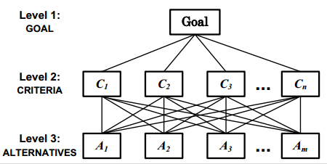
3.0 Research Methodology
Analytic Hierarchy Process (AHP) Model for Ranking Attributes
AHP is a useful mathematical technique that is used to solve MCDM problems where a choice has to be made from a number of alternatives based on their relative importance (Asuquo, & Onuodu, 2016; Srichetta, & Thurachon, 2012).
It was developed by Saaty in the 70’s from mathematical and psychological principles.
It relies on the judgments of experts to derive priority scales through pairwise comparison of decision elements at each level as shown in Figure 1.
Fig. 1: Bacudio, L., Esmeria, G. J., & Promentilla, M. A (2016

Slide 10
Steps in AHP Model
Define the unstructured problem based on the criteria and alternatives.
Construct a set of pair-wise comparison matrices among decision elements 𝑖 and 𝑗 by establishing priorities among them based on a pre ference scale.
Compute the consistency ratio to determine the acceptability or otherwise of the chosen criteria or alternative. This is given in equation 2
If CR is less than 10%, then the matrix can be considered as having an acceptable consistency
Estimate the relative weights of the decision elements using eigenvector method
Aggregate the relative weights
Perform Sensitivity analysis
Make a final decision

Slide 11
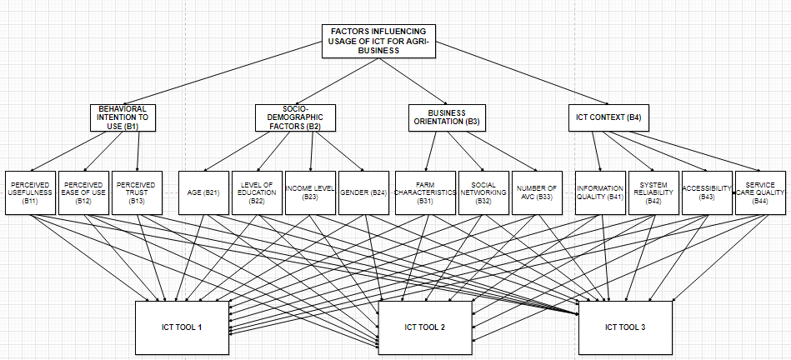
Hierarchical Model Used for Ranking Purposes
Fig 2: AHP Hierarchical Model

Slide 12
Problem Identification and Formulation
A general multi-criteria decision problem with m alternatives A_{i} (i=1, 2, …., m) and n criteria C_{j} (j=1, 2,……, n) can be briefly expressed as:
D = [x_{ij}]_{m x n} and W = [w_{j}]_{n}, where i= 1,2,……,m and j=1,2,…..,n. Equation (1)
In equation (1), D is the decision matrix (where x_{ij} denotes the rating or performance of i-th alternative A_{i} with respect to j-th criterion C_{j}), and W is the the weight vector (where w_{j} denotes the weight of j- th criterion C_{j}, m is the number of compared alternatives and n is the number of the criteria).
From the hierarchy in Figure 2, the main goal is to get a crisp value after evaluation. Priority weights were given to each criteria and sub-criteria for optimized decision making.

Slide 13
The study was carried out in Mokoloki Local Community Development Area (LCDA) in
Obafemi Owode Local Government (LG), Ogun State, Nigeria.
The major food crops of the area includes cassava, rice, cocoyam, plantain, maize and vegetable, while palm produced and cocoa form the major cash crops.
Primary data was obtained purposively and randomly both from youths with ages ranging between 18 and 35 years according to the Nigerian national youth policy (2019-2023). The data was obtained through the use of the specially prepared AHP questionnaire and administered by the researchers themselves.
As a result of the sensitive and complex nature of the measuring tool, it was required that respondents understand some basic ICT tools and the meaning of each criteria and sub-criteria specified in the hierarchical model.
In the selection of respondents, the AVCs considered include agricultural input, agro-processing, agro- production, agro-marketing and agro-distribution/agro-transportation. Decisions of participants were analyzed with the web based AHP tool developed by Goepel (2018).

Slide 14
4.0 Analysis of Results and Discussion
Factors affecting usage of ICT among youth-led agri-business in different AVCs Ranking Group Consensus Results
The data in Table 1 shows the percentage and level of consensus of all judgements made by the participation
Table 1: Group Consensus Results
Node | Group CR (%) | AHP Group Consensus (%) | AHP-OS Scale
Influencing factors of ICTs usage | 0.8 | 54.0 | Low
Behavioral Intention to use (B1) | 0 | 54.5 | Low
Socio Demographic Attributes (B2) | 1.9 | 88.4 | Very High
Business Orientation (B3) | 1.7 | 61.9 | Low
ICT Context (B4) | 0.9 | 61.7 | Low

Slide 15
Table 2: Decision Hierarchy with Consolidated Priorities.
Level 0 | Level 1 | Level 2 | Global Priorities (%)
 | B1 = 0.252 | B11 = 0.292 | 7.3
 |  | B12 = 0.558 | 14.0
 |  | B13 = 0.150 | 3.8
 | B2 = 0.090 | B21 = 0.094 | 0.8
 |  | B22 = 0.254 | 2.3
 |  | B23= 0.595 | 5.4
 |  | B24 = 0.057 | 0.5
 | B3 = 0.408 | B31 = 0.201 | 8.2
 |  | B32 = 0.161 | 6.6
 |  | B33 = 0.639 | 26.1
Influencing factors of ICT Usage | B4 = 0.250 | B41 = 0.362 | 9.0
 |  | B42 = 0.198 | 4.9
 |  | B43 = 0.357 | 8.9
 |  | B44 = 0.083 | 2.1
 |  |  | Overall Total = 100.0

Slide 16
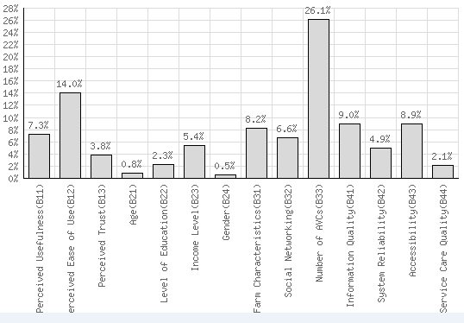
Figure 3 shows Consolidated Global Priority Bar Chart

Slide 17
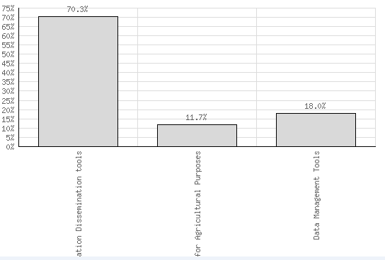
Evaluation of Existing Popularly used ICT tools with the AHP Model
Table 3 and figure 4 show the Alternatives Evaluation Result by Participants
ICT Tools | Tool 1 | Tool 2 | Tool 3 | CR_{max} (%)
Weights of Alternatives | 70.3% | 11.7% | 18.0% | 8.3%

Slide 18
Table 4: Alternatives Analysis Results based on the AHP Model
Criterion | Global Priority (%) | ICT Tool 1 (%) | ICT Tool 2 (%) | ICT Tool 3 (%) | CR (%) | Group Consensus (%)
B11 | 7.3 | 0.536 | 0.323 | 0.141 | 0.2 | 64.5
B12 | 14.0 | 0.730 | 0.079 | 0.191 | 6.9 | 98.4
B13 | 3.8 | 0.614 | 0.074 | 0.312 | 0.8 | 72.4
B21 | 0.8 | 0.548 | 0.082 | 0.370 | 0.5 | 65.4
B22 | 2.3 | 0.746 | 0.068 | 0.186 | 8.3 | 99.8
B23 | 5.4 | 0.723 | 0.078 | 0.200 | 6.5 | 99.6
B24 | 0.5 | 0.736 | 0.089 | 0.175 | 0.8 | 95.1
B31 | 8.2 | 0.615 | 0.177 | 0.208 | 8.3 | 47.4
B32 | 6.6 | 0.758 | 0.068 | 0.174 | 6.7 | 99.6
B33 | 26.1 | 0.727 | 0.114 | 0.159 | 1.2 | 94.0
B41 | 9.0 | 0.762 | 0.142 | 0.097 | 0.7 | 94.7
B42 | 4.9 | 0.729 | 0.068 | 0.204 | 7.1 | 99.6
B43 | 8.9 | 0.714 | 0.066 | 0.220 | 7.1 | 99.1
B44 | 2.1 | 0.750 | 0.077 | 0.173 | 6.3 | 98.7
 | Total=100.0 | AER=70.3 | AER = 11.7 | AER = 18.0

Slide 19
5.0 CONCLUSION AND RECOMMENDATIONS
The study identified 14 factors affecting the usage of ICT among youth-led agri-business in different AVC in Nigeria based on existing literatures.
As a result, a hierarchical model which had three levels was developed for the identified factors. Level 1 was the goal of the study, level 2 consisted of four criteria which included Behavioural to use (B1), Socio-demographic factors (B2), Business Orientation (B3) and ICT Context (B4) while Level 3 consisted of 14 sub-criteria respectively.
All these factors were ranked using the Analytic Hierarchy Process (AHP), a technique based on mathematical and psychological principles. This approach was used as a result of the complex nature involved in evaluating both the quantitative and qualitative factors identified simultaneously.

Slide 20
Relevant weights for all identified factors were determined using Saaty’s eigenvalue and eigenvector approach.
Opinions were elicited from decision makers which comprised of youths between the ages of 18-35 years old. Consistency ratio for all participants were computed to get reliable and valid opinions.
Based on results of analysis, Business Orientation had the highest priority weight with 40.8%, Behavioural Intention to Use had 25.2% followed very closely by ICT Context with 25% while Socio-demographic factors had the lowest weight with 9%.
This result shows that factors like age, income level, level of education and gender has low impact when it comes to the usage of ICT tools among youth-led agri-business in different AVC based on the participants response and there was high consensus among them.
From the socio-demographic factors, gender ranked the least with 5.7% which indicates that making decisions as to using ICT by youths in different agri-business is not affected by gender issue. Three ICT tools which include Agricultural information dissemination tools (Tool 1), diagnostic tools (Tool 2) and Data management tools (Tool 3) were all compared and evaluated using the model and results showed that Tool 1 ranked the highest with a weight of 70.3% followed by Tool 3 with 18% while Tool 2 had the lowest rank with a weight of 11.7%.
There was a high consensus amongst the participants based on the ICT factors except for decisions taken on perceived usefulness and farm characteristics.

Slide 21
Generally, the agricultural sector in Nigeria is not without its challenges coupled with the high cost of raw materials, transportation amongst others.
ICT usage comes with its own unique challenges because in a country where there is persistent high cost of electricity, high cost of ICT devices and gadgets, poor connectivity and unreliable internet of mobile network services, absence of or limited ICT literacy, weak awareness of the potentials and applications of ICT in agribusiness, the implication is that government agencies and other stakeholders have a lot to do.
The COVID-19 pandemic has further dealt a huge blow to world economies and Nigeria is not an exception. There is a general increment in prices of foodstuffs and common household items, unemployment and reduction rate in family income is at its highest but the pandemic also presents a big chance for African nations, especially Nigeria, to invest heavily in highly innovative tools and technologies to improve agricultural businesses which has the chance to reduce unemployment rate, ensure food security and economic sustainability in a post COVID-19 era.

Slide 22
It is recommended based on the result of this study to ensure that youths who are involved in different agricultural businesses have access to affordable ICT tools, governments and policy makers should make policies that support or encourage the use of ICT for agriculture extension services, research, youth entrepreneurship and sustainability.
They should educate youths in agri-business on the numerous benefits that comes with the usage of ICT tools for agri-business.
The use of ICT in agriculture should be incorporated in school curriculums and more so, there is urgent need for youths in agri-business to be educated on how to use some of the more popular trending ICT tools for information dissemination and diagnostic purposes especially those who are in the rural areas and women as gender has been identified to have a low influence on the usage of ICT among youths in agri-business in different AVCs.
This study can be extended by considering other factors not mentioned in existing literature but still have a huge influence on ICT usage by youths. Furthermore, it is suggested that identified factors can also be ranked using other Multi-criteria Decision Making (MCDM) approaches and for the results obtained to be compared so as to be able to determine the differences or relationships between other MCDM techniques.

Slide 23
6.0 List of References
Adams D. A., Nelson, R. R, & Todd, P. A. (1992). Perceived Usefulness, Ease of Use, and Usage of Information Technology: A Replication. MIS Quarterly, 16(2):227–47
Adebayo, M. (2017, April 25). AFDB releases $280 million to support Nigerian youths in agriculture Retrieved from http://dailypost.ng/2017/04/25/afdb-releases-280-million-support-nigerian-youths-agriculture/
Ajzen, I. & Fishbein, M. (1980). Understanding Attributes and Predicting Social Behaviour. Englewood Cliffs, New Jersey: Prentice-Hall Publishers.
Ajzen, I. (1991). The Theory of Planned Behaviour. Organizational Behaviour and Human Processes 50(1): 179-211.
Ali, J. (2012). Factors Affecting the Adoption of Information and Communication Technologies (ICTs) for Farming Decisions. Journal of Agricultural & Food Information 13(1), 78-96
Ali, S., Jabeen, U. A. & Nikhitta, M. (2016). Impact of ICT on agricultural productivity. European Journal of Business, Economics and Accountancy, 4(5), 82-92
Asuquo, D. E., & Onuodu, F. E. (2016). A fuzzy AHP Model for selection of university academic staff. International Journal of Computer Applications, 141(1), 19-26.
Bacudio, L., Esmeria, G. J., & Promentilla, M. A (2016). A fuzzy analytic process approach for optimal selection of manufacturing layout. Proceedings of the De La Salle University Research Congress (vol. 4). Manilla, Philippines.
Banwet, D. K., & Majumdar, A. (2014). Comparative analysis of AHP-TOPSIS and GA-TOPSIS methods for selection of raw materials in textile industries. Proceedings of the International Conference on Industrial Engineering and Operations Management. Bali, Indonesia
Burke, K. (2012). The Impact of Internet and ICT Use among SME Agribusiness Growers and Producers. Journal of Small Business & Entrepreneurship, 23(2), 173-194

Slide 24
THANK YOU ALL FOR YOUR RAPT ATTENTION
QUESTIONS?????????

