Slide 1
RENEWABLE AND NON-RENEWABLE RESOURCES: MAN AND HIS ENERGY
DR. FRANCIS H. IBADIN
COORDINATOR OF BIOLOGY PROGRAMME
DEPARTMENT OF BIOLOGICAL SCIENCES

Slide 2
A resource is a source or supply from which a benefit is produced and that has some utility.
Resources can be classified into renewable and non-renewable resources. Examples of non-renewable resources are coal, crude oil etc.
Examples of renewable resources are air, water, natural gas, wind, solar energy, etc.
Resources are useful raw materials that we get from nature.
Natural resources are structures and processes that humans can use for their own purposes but cannot create.

Slide 3
The agricultural productivity of the soil, rivers, minerals, forests, wildlife, and weather (wind, sunlight, rainfall) are all examples of natural resources.
The landscape is also a natural resources, as we see in countries with a combination of mountainous terrain and high rainfall that can be used to generate hydroelectric power or those that have beautiful scenery or biotic resources that foster tourism.

Slide 4
RENEWABLE RESOURCES
Renewable resources are those resources that can be replenished or renewed naturally over time.
Air, water, wind, solar energy etc. are all renewable resources. Renewable resources can be easily renewed by nature.
Just because some resources are renewable, however, does not mean that they are inexhaustible.
Overuse of some renewable resources can result in their irreversible degradation.

Slide 5
Solar Energy
The sun is often mentioned as the ultimate answer to the world's energy problems.
It provides a continuous supply of energy that far exceeds the world's demand.
The energy that we get from the Sun is called solar energy.
All the natural phenomenon like the flowing of wind, water cycle, photosynthesis etc. are due to solar energy.
solar energy is being used to cook food in solar cookers, heat water, light streets, pump water for irrigating fields etc.

Slide 6
Photovoltaic cells are devises capture solar energy and convert it to electrical current.
It offers an exciting way that will provide clean, versatile, renewable energy.
This simple devise has no moving parts, negligible maintenance costs, produces no pollution, and has a lifetime equal to that of a conventional fossil fuel or nuclear power plant.

Slide 7
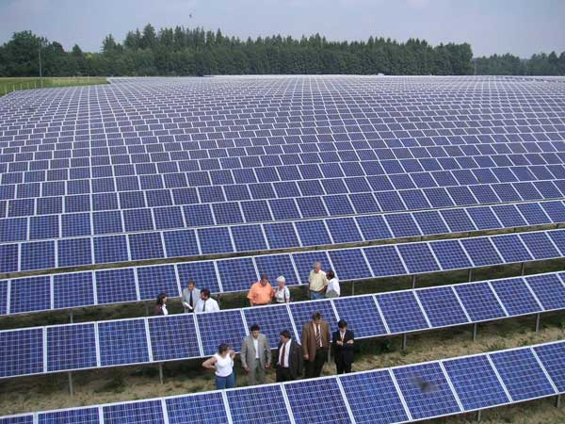
Photovoltaic cells are devises capture solar energy and convert it to electrical current.
It offers an exciting way that will provide clean, versatile, renewable energy.
This devise has no moving parts, negligible maintenance costs, produces no pollution, and has a lifetime equal to that of a conventional fossil fuel or nuclear power plant.

Slide 8
2. Hydro-Energy
Humans need water for many purposes such as drinking, cleaning, cooking and for growing crops.
Water flowing into the river or water stored in a dam is a source of hydro energy.
The Simple method to use hydro energy is to convert it into electrical energy.
The energy from falling water is used to drive turbines in a power station.

Slide 9
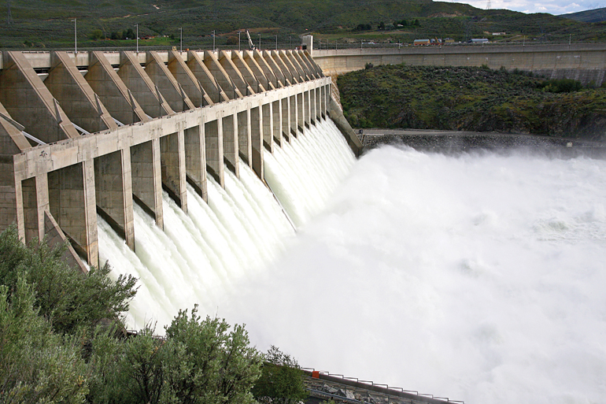
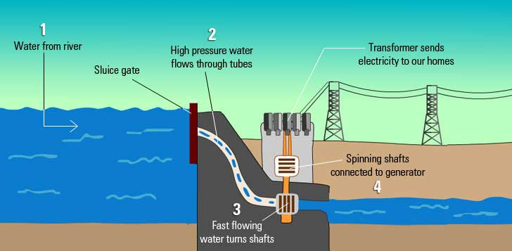
Unlike coal power stations, the water does not need to be heated and the water can be reused.
These power stations must be at waterfalls or dams because there needs to be a strong flow of water to harness the energy.

Slide 10
3. Wind Energy
Winds are constantly being created in nature.
The windmill is a source of electrical energy.
These windmills are generally established only at places where most of the days in a year experience strong winds.
The energy from this wind is used for grinding grain, pumping water and to produce electricity.
The energy from moving air particles is used to turn large turbines.
The turbines are connected to a generator which produces electrical energy.

Slide 11
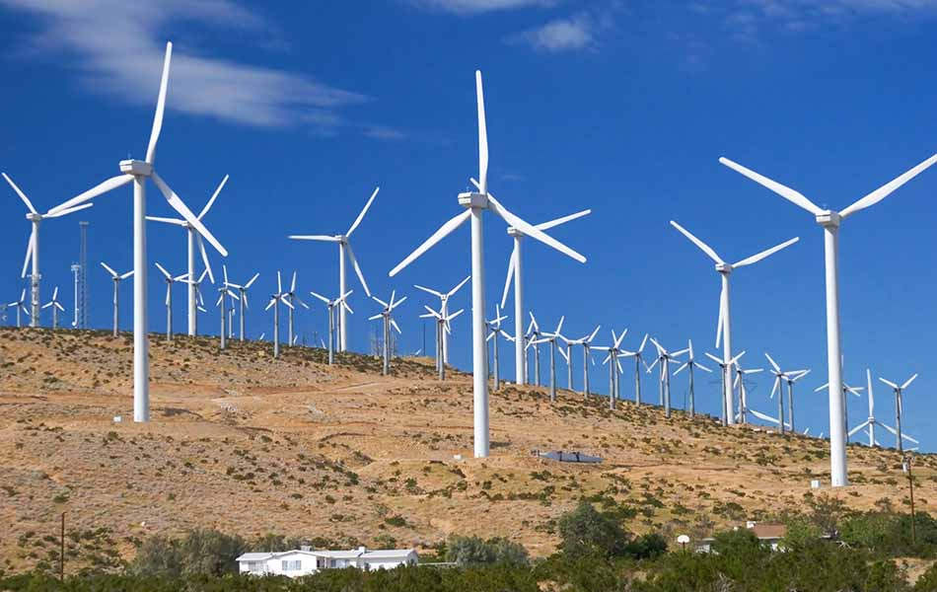
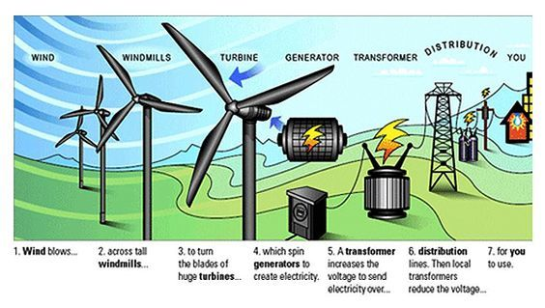
You need a steady, strong wind blowing in order to produce a large, consistent amount of electricity.
This means that wind farms cannot be put up in areas where there is not a lot of wind.

Slide 12
4. Biomass
Biomass resources used as fuel include wood, wood chip, bark, branches, leaves, starchy roots, and other plant and animal materials.
a) Burning Wood
Wood fires has been primarily used for heating and cooking for thousands of years. In many poor countries of the world, wood and other biomass fuels produce up to 95% of all energy used. Wood chips, sawdust, wood residue, and other plant materials are being used in some places as a substitute for coal and oil in industrial boilers

Slide 13
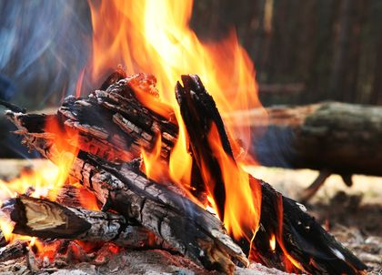
Burning Wood

Slide 14
b) Dung and Methane as Fuels
Where wood and other fuels are in short supply, people often dry and burn animal manure.
Biogas is a type of fuel which is a mixture of gases such as methane which is obtained by decomposition of animal and plant wastes like animal dung, with the help of micro-organisms in the presence of water.
It is used as fuel in gas stove especially in rural areas. Methane gas is the main component of natural gas.

Slide 15
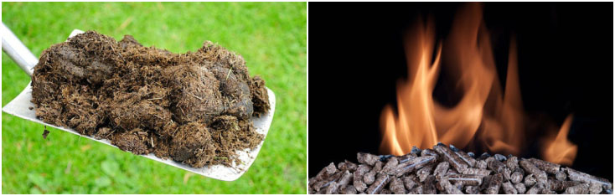
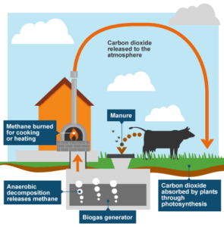
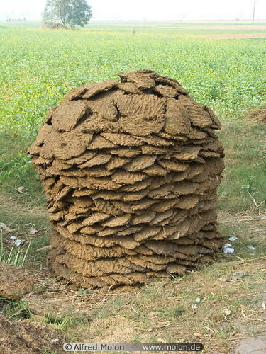
It is produced by anaerobic decomposition of any moist organic material thereby producing flammable gases instead of carbon dioxide.
Organic waste material can be used to generate gas e.g. livestock manure, kitchen and garden scraps, even municipal garbage and sewage.

Slide 16
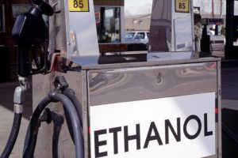
c) Alcohol from Biomass
Ethanol (grain alcohol) and methanol (wood alcohol) are produced by anaerobic digestion of plant materials with high sugar content, mainly grains and sugar cane. Ethanol can be burned directly in automobile engines adapted to use this fuel, or it can be mixed with gasoline (up to about 10%) to be used in any normal automobile engine.

Slide 17
5. Geothermal Energy
The earth's internal temperature can provide a useful source of energy in some places.
High-pressure, high temperature steam fields exist below the earth’s surface.
Around the edges of continental plates or where the earth's crust overlays magma (molten rock).
The United States, Iceland, Japan and New Zealand have high concentrations of geothermal springs and vents.

Slide 18
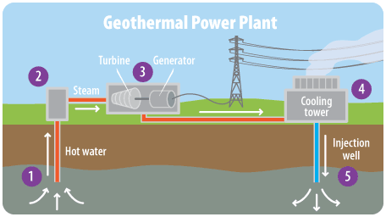
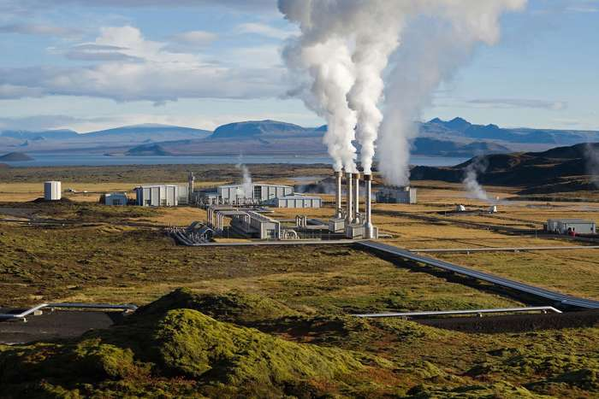
Geothermal energy has been used in electric power production, industrial processing, space heating, agriculture, and aquaculture.
In Iceland most building are heated with geothermal steam.

Slide 19
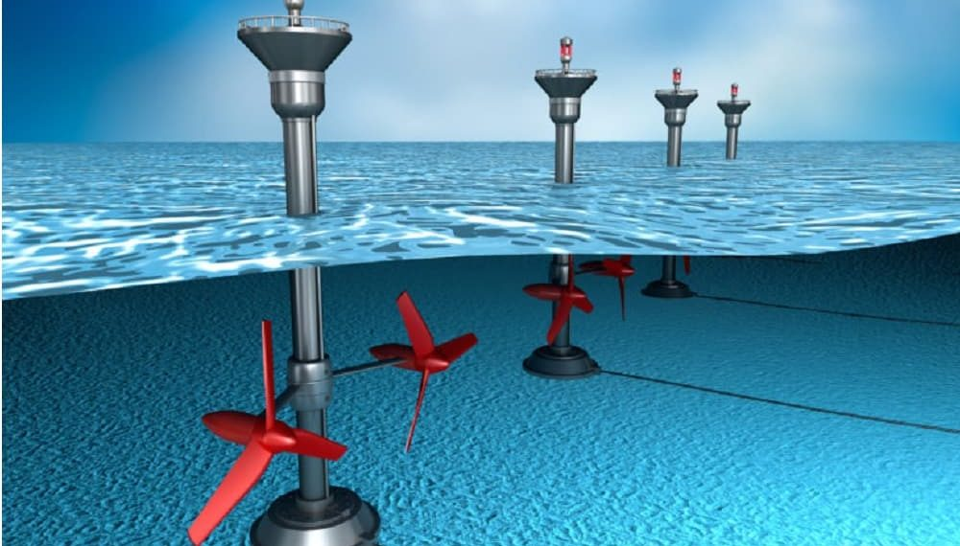
6. Tidal and Wave Energy
Ocean tides and waves contain enormous amounts of energy that can be harvested to do useful work.
The Rance River Power Station in France in operation since 1966, was the first large electric generation plant, producing 160MW.

Slide 20
A tidal station works like a hydropower dam, with its turbines spinning as the tide flows through them. It requires a high tide and a low tide differential to spin the turbine.
7. Ocean Thermal Electric Conversion
Temperature differentials between upper and lower layers of the ocean's water also are a potential source of renewable energy.
In a closed-cycle ocean thermal electric conversion (OTEC) system, heat from sun-warmed upper ocean layers is used to evaporate a working fluid, such as ammonia or Freon, which has a high boiling point.

Slide 21
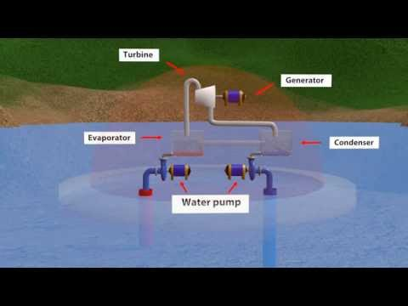
The pressure of the gas produced is high enough to spin turbines to generate electricity, cold water is pumped from the ocean depths to condense the gas.

Slide 22
NON RENEWABLE ENERGY
The non-renewable energy sources most commonly used in our world today are fossil fuels.
Non-renewable resources are those natural resources that are available in limited quantity.
These resources cannot be renewed or replenished in short duration.
Therefore they are also known as exhaustible resources. Examples are coal, natural gas, petroleum etc.

Slide 23
1. Fossil Fuels
Fossil fuels like coal and petroleum are non-renewable resources.
They are found deep inside the earth and are made by natural processes over many centuries.
Their quantity is limited and they take thousands of years to get renewed.
Example of fossil fuels is coal, petroleum, natural gas etc.

Slide 24
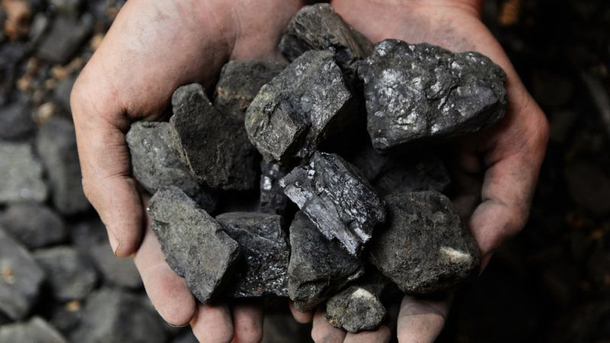
a) Coal: It is also known as black diamond.
Coal is most commonly used as a source of energy by power stations to generate electricity, and in factories and steam engines.
Coal can also be burned in fires to keep warm or in coal stoves to cook our food.

Slide 25
b) Natural Gas: Natural gas is used as a fuel called Compressed Natural Gas or CNG.
Some wells dug into the earth produce only natural gas.
Natural gases are a good alternative to petrol and diesel and it is used as Compressed Natural Gas.
Natural gas is found in deep underground rock formations and usually with other fossil fuels, such as oil and coal.
The biggest part of the gas mixture is a gas called methane.

Slide 26
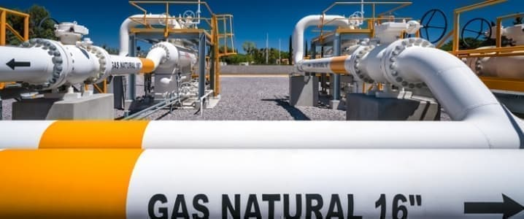
Methane is a gas which burns easily and releases a lot of energy when it is burnt.
Natural gas is used for cooking, heating and producing electricity.

Slide 27
c) Petroleum: Petroleum is also known as mineral oil or crude oil.
This liquid mineral is refined to make fuels such as petrol, diesel, cooking gas and kerosene.
Plastic, cosmetics, and lubricants are also products of petroleum.
It is found deep inside the Earth or under the sea floor.
It is taken out by drilling wells deep into the Earth or under the seabed.
Crude oil contains a lot of energy which can be used.

Slide 28
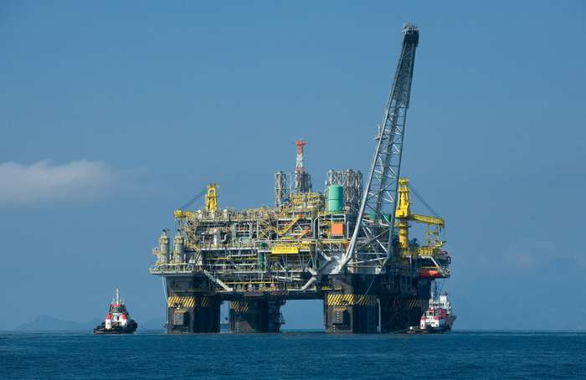
Crude oil is a non-renewable energy source because it takes millions of years to produce crude oil and so we cannot produce more when the existing reserves are finished.

Slide 29
2. Nuclear Energy
In the classification of resources, nuclear energy is classified as non-renewable.
The fuel used for nuclear energy is generally uranium, which is in a limited supply.
Production of electricity from nuclear energy does not release carbon dioxide.
Within the atom, the nucleus is held together by very strong forces.
When the nucleus is broken apart, a huge amount of energy is released.

Slide 30
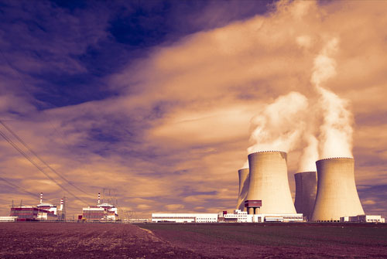
This energy can be used in nuclear power plants to generate electricity. Two different nuclei can also collide at very high speeds to form a new atomic nucleus. The energy released is also used in nuclear power plants, however on a smaller scale than when nuclei are broken apart. Thus, use of nuclear energy is safe for the environment.

