Slide 1
Self-Efficacy influence and Students' intentions on social Entrepreneurship Education in Nigerian Universities
Saidi Adedeji Adelekan
University of KwaZulu-Natal, Durban, South Africa.
Dr. Mervywn Williamson
University of KwaZulu-Natal, Durban, South Africa.

Slide 2
Introduction
Most universities in Nigeria churn out graduates that are suitable for formal employment placement without much appreciation of vocational skills required for entrepreneurship (Olorundare & Kayode, 2014).
Obviously, such occasion will lead to high rate of unemployment specifically amongst university graduates (Ejere, 2012).
It is easy to assess how much social entrepreneurs contribute to the nations’ development when they are employers and innovators.

Slide 3
Introduction Contd.
Thus, the policy of fostering social entrepreneurship education is therefore the general support and training of social entrepreneurs (Olorundare & Kayode, 2014).
Therefore, there exists a debate with regard to whether the training of social entrepreneurs is best conducted within the classroom or not.
The dominant view is that entrepreneurs are best trained in school (Solomon & Fernald Jr, 1991).

Slide 4
Background of the Study
Over a few decades, the Nigeria economy has been challenged by high rates of youth unemployment (Awogbenle & Iwuamadi, 2010).
Government needed to partner with Non-governmental organizations to surmount the intractable problems of unemployment and social venture creation.
In 2000, the Nigeria Government introduced entrepreneurial education module in the University curriculums as part of its initiatives in promoting self-employment.
The main purpose of the initiative was to provide graduates with adequate entrepreneurial skills to improve the employability in the labor market, ultimately contribute to ameliorating associated social problems in the society.

Slide 5
Background of the Study Contd.
This study investigates the role of social entrepreneurship education to the development of students’ social entrepreneurial self-efficacy and intentions in Nigerian universities. Additionally, the study examined the relationship that exists between students’ self-efficacy and intentions to create social venture.
However, it recognizes the development and the teaching of social entrepreneurship modules in most Nigerian universities with the purpose of equipping students to become job creators and originators.
Therefore, the main aim of this research is to explore the dimensions of pedagogical techniques and contents of social entrepreneurial in the selected Nigerian Universities and its influence on self-efficacy and students’ intentions to create social venture.

Slide 6
Literature Review
This research study put forward the explanations on social entrepreneurship education and social ventures creation in Nigerian Universities.
This literature will be reviewed in this section and the different perspectives on social entrepreneurship education will be discussed.
Social entrepreneurship may be understood broadly in terms of economy, education, research, and in social terms (Leadbeater, 1997).
This has made researchers to attempt at conceptualizing social entrepreneurship with the contexts of public sector, community enterprises, and relief organisations, among others.
Dees & Anderson (2006) in their study indicated three challenges faced in social entrepreneurship education.
The first problem concerns how to teach and learn social entrepreneurship education against a background of non-existing laid down approach to guide relevant faculties.
Secondly, social entrepreneurship is still considered as a venture by most Universities or colleges instead of being considered as a field of study.

Slide 7
Literature Review Contd.
The last problem relates to student motivation.
Social entrepreneurship education should not be learning the art of generating income.
Rather, students are interested in educational institutions that assist and equip them with innovation and creativity skills that are oriented towards problem-solving.
As argued by (Austin et al., 2006), the primary concern should be on ensuring that students appreciate social entrepreneurship in a manner which creates value for the society.
Furthermore, it is incumbent upon students to understand that in order to realize organizational mandate, materials can be obtained from a variety of sources such as charity organizations, support from the state, generous contributions from individuals or companies and revenue generated from business ventures.

Slide 8
Research Objectives & Questions
Research objectives
To investigate the role of social entrepreneurship education in the development of students’ social entrepreneurial self-efficacy and intentions in Nigerian universities.
To examine the relationship that exists between self-efficacy and students’ intentions to create social venture.
Research Questions
What are the roles of social entrepreneurship education in the development of students’ social entrepreneurial self-efficacy and intentions in Nigerian universities?
What is the relationship that exist between self-efficacy and students’ intentions to create social venture?

Slide 9
Theoretical/Conceptual Framework
The theory of planned behavior was developed by Ajzen, (1991) and it was used to predict individual’s behavior, attitude and intentions. Hence, The theory will explain the attitude, intentions and behavior of students in this study.
Instructor Inputs Psychological State Student Outputs
Pedagogical Techniques
Seminar
Internship
Case study
Networking
Discussion
Pedagogical Contents
Practical/Application
Explore Prototypes
Introducing Tools
Self-Efficacy
Intentions
Source: Adapted from Smith & Woodworth, (2012)

Slide 10
Methodology
This study employed quantitative method.
The collected data established the effect of social entrepreneurship education on self-efficacy, and as well its relationship.
Furthermore, the study also examined the extent to which self-efficacy mediate the relationship between social entrepreneurship education and students’ social entrepreneurial intentions.
Data were collected through the use of a structured questionnaire.
The population was built on students from three universities in Nigeria.

Slide 11
Methodology Contd.
The respondents were restricted to the final year student (400) in the faculty of management in Lagos State University, Babcock University and University of Lagos in Nigeria.
The population of the study is 3,777. A sample size of 367 was drawn based on the population of the study using Bartlett et al (2001).
Presently, the three (3) Nigerian universities randomly selected for the study, offer Business creation and growth; issues of business growth; sources of funds; and entrepreneurial marketing modules in social entrepreneurship education within their respective Faculties of Management.

Slide 12
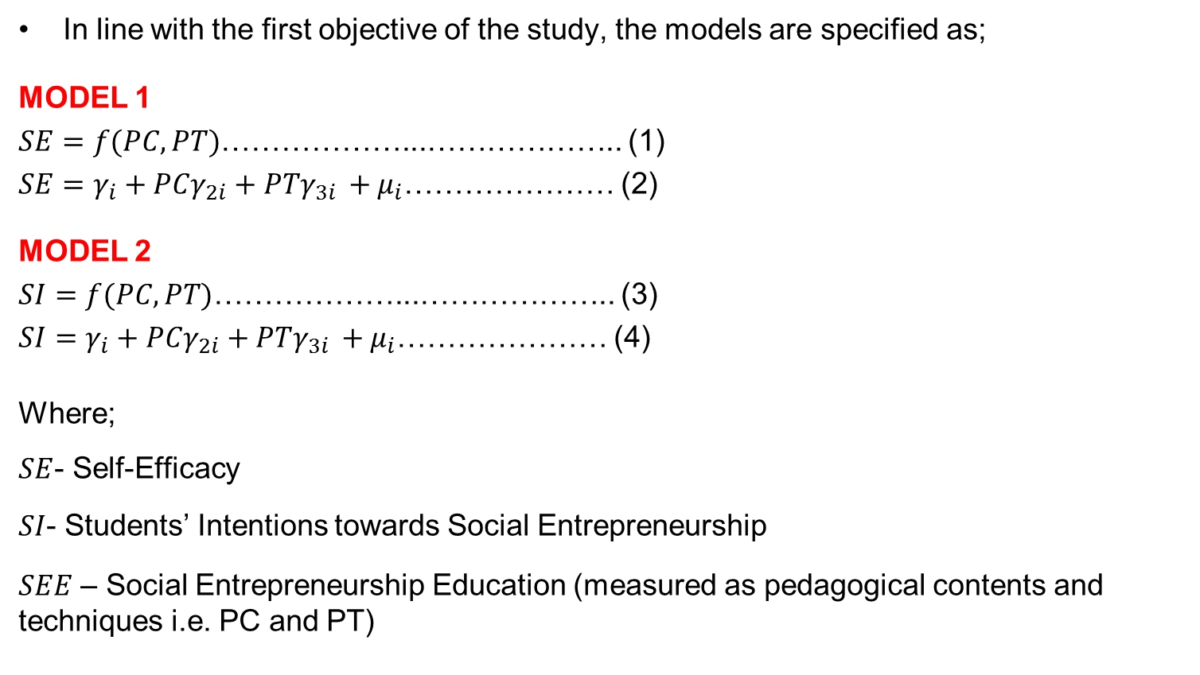
Model Specification
In line with the first objective of the study, the models are specified as;
MODEL 1
$SE=f(PC,PT)$………………...……………….. (1)
$SE=γ_{i}+PCγ_{2i}+PTγ_{3i }+μ_{i}$………………… (2)
MODEL 2
$SI=f(PC,PT)$………………...……………….. (3)
$SI=γ_{i}+PCγ_{2i}+PTγ_{3i }+μ_{i}$………………… (4)
Where;
$SE$- Self-Efficacy
$SI$- Students’ Intentions towards Social Entrepreneurship
$SEE$ – Social Entrepreneurship Education (measured as pedagogical contents and techniques i.e. PC and PT)

Slide 13
Analysis and Interpretation of Results
Table 1. Reliability and Validity Test.
Social Entrepreneurship Education scale |  |  | Students’ Self-Efficacy scale |  |  | Students Intentions scale
Factor Name | Nos. | Cronbach α | Factor Name | Nos. | Cronbach α | Factor Name | Nos. | Cronbach α
Pedagogical contents | 10 | .839 | Self-Efficacy | 10 | .885 | Intentions | 8 | .887
Pedagogical Techniques | 7 | .754
Total reliability Cronbach α | 17 | .861
All questionnaire items |  |  |  | Cronbach α
 |  |  |  | .763
Source: SPSS version 22

Slide 14
Table 1 shows the Cronbach Alpha coefficient for 1-5 Likert-type scale to assess internal consistency reliability of the social entrepreneurship education, students’ self-efficacy and intentions.
All questionnaire items yielded a high reliability Cronbach Alpha coefficient of 0.763 which suggests that the questions comprising the social entrepreneurship education, students’ self-efficacy and intentions are internally consistent.
The inter-item reliability Alpha Cronbach coefficient scored 0.861 for social entrepreneurship education, 0.885 for students’ self-efficacy, and 0.887 for students’ intentions.
Content validity was constructed by adhering to the three social entrepreneurship constructs: social entrepreneurship education, students’ self-efficacy and intentions.

Slide 15
Regression Analysis
Table 2
Variable(s) | Coefficient(s) | p-value
C | 18.261 | 0.000
PC | 0.306 | 0.000
PT | 0.391 | 0.000
R-Squared |  | 0.265
F-test |  | 65.563 (0.000)
Source: SPSS version 22

Slide 16
From table 2 above, there exist a positive and statistical relationship between pedagogical content and techniques on students’ self-efficacy, this posit that a one unit increase in pedagogical content and techniques, self-efficacy increases by 0.30 and 0.39 units respectively.
However, the coefficient of determination (R-squared) suggest 26.5% variation in Students’ Self-efficacy can be explained by Pedagogical contents and Pedagogical Techniques.
Therefore, this leaves 73.5% unexplained in this study. In other words, there are other variables that are important in explaining Students’ self-efficacy which were not accounted for in the model.
Lastly, the F-test suggests that the model is reliable for prediction or policy making.

Slide 17
Regression Analysis
Table 3
Variable(s) |  | Coefficient(s) | p-value
C |  | 28.654 | 0.000
PC |  | 0.45 | 0.000
PT |  | 0.60 | 0.000
 | R-Squared |  | 0.296
 | F-test |  | 76.519 (0.000)
Source: SPSS version 22

Slide 18
Table 3 also revealed that, there exist a positive and statistical relationship between pedagogical content and techniques on students’ intention towards social venture-creation.
This implies that a one unit increase in pedagogical content and techniques, the intention of students’ increases by 0.45 and 0.60 units respectively.
However, the coefficient of determination (R-squared) suggest 29.6% variation in Students’ intention, this can be explained by Pedagogical contents and Pedagogical Techniques.
It postulates that 70.4% were not accounted for in this study. Lastly, the F-test suggests that the model is reliable for prediction or policy making.

Slide 19
Re-Statement of Hypothesis
The research hypothesis captured the second objective.
H₀: there is no significant relationship between social entrepreneurial self-efficacy and students’ intentions to start a new social venture.
Table 4
Correlations Test
 |  | SE | SI
SE | Pearson Correlation | 1 | .573**
 | Sig. (2-tailed) |  | .000
 | N | 367 | 367
SI | Pearson Correlation | .573** | 1
 | Sig. (2-tailed) | .000
 | N | 367 | 367
**. Correlation is significant at the 0.01 level (2-tailed).
Table 4 above affirmed that there is moderate positive and statistically significant relationship between social entrepreneurial self-efficacy and students’ intentions to start a new social venture. Therefore, the null hypothesis was rejected.

Slide 20
Discussion, Conclusion and Recommendation
This present study fills the glaring lacuna on how social entrepreneurship education contributes to the development of students’ social entrepreneurial self-efficacy and intentions using Nigerian universities as case study and rallying points of departure.
However, Social entrepreneurship education has a positive and statistically significant effect on students’ self-efficacy and intentions toward social venture creation.
Empirical data of “Social entrepreneurship education” and “social entrepreneurial self-efficacy” on “social entrepreneurial intention” has a good fit. This shows that fourth year students of the selected Nigerian Universities, exhibits potentials of venturing into social entrepreneurial endeavors based on the pedagogical contents and techniques acquired during schooling.
The finding is in tandem with the study of Wilson et al 2007; Dyer et al 2008; Mars & Garrison, 2009; and Kristiansen & Indarti, 2004, which postulated that the influence of social entrepreneurship education enhances the ability of the students.

Slide 21
Additionally, it was discovered that there exist positive and significant relationship between social entrepreneurial self-efficacy and students’ intentions to start a new social venture.
This finding is in line with the study of Malebana and Swanepoel (2014); Edgar and Marc (2008) and Aslam, Awan & Khan (2012) who noted that there is a positive and statistically significant relationship between social entrepreneurial self-efficacy and students’ intentions to start a new social venture
It is crystal clear at this juncture that social entrepreneurship education is imperative for the sustainability of an economy that wants to compete amongst states, that intends to reduce social vices and unemployment, must utilized the social entrepreneurial ability and intentions of students via its ministries, department and agencies.
It is not a misnomer or a fallacy to assert that social entrepreneurship education helps in the achievement of national development as noted in the BRICS (Brazil, Russian, Indian, China and South Africa) and the Asian Tigers.

Slide 22
      Thank you

