Slide 1
SIGNIFICANCE OF
SCIENTIFIC RESEARCH: FROM LAB TO LAND
BY
DR. ABIALA MOSES
DBT-TWAS BIOTECHNOLOGY POSTDOCTORAL RESEARCH FELLOW ,
TO
IIT, GUWAHATI
HOST: Prof. Lingaraj Sahoo
IIT, GUWAHATI.

Slide 2
State of scientific research
      Past
      Present
      Future
        Implications on upcoming generations
        Threat to sustainability of life

Slide 3
Scientific and Technological Capacities of Developed and Developing Countries
CaCa
Parameter | Developed | Developing | Africa
Scientists and Technology | 3.8 | 0.4 | 0.4
Percentage of GDP spent on Research and development | 2 | 0.5 | 0.1-0.7
Scientific Publications (Per capita) | 84 | 16 | 0.8
Patents and Inventions (Per capita) | 97 | 3 | Negligible
Source: Cameroon Ministry of External Relations, 2001S

Slide 4
Effects of Scientific research challenges in WA Universities on National Development
Fluctuate
Stagnant
Science
National development
Time
Science
National development
Science
Decline
Normal
Science
Time

Slide 5
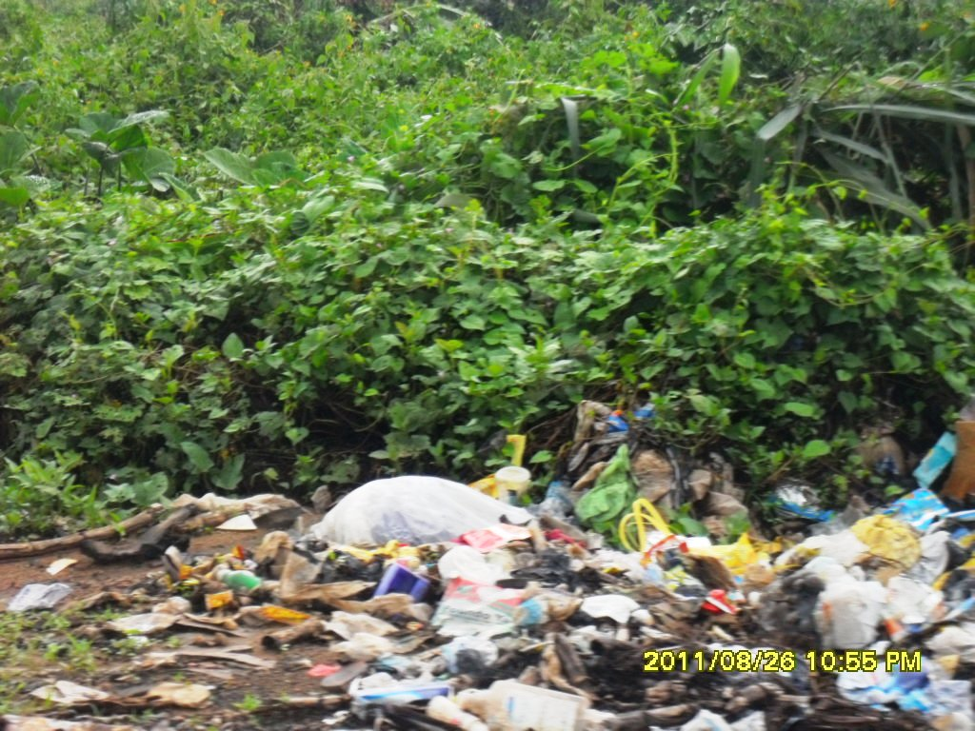
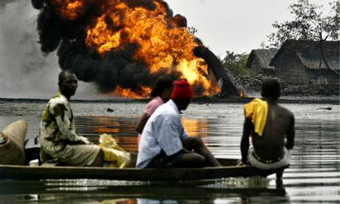
Current Scientific Research
Protecting
  Our environments and

Slide 6
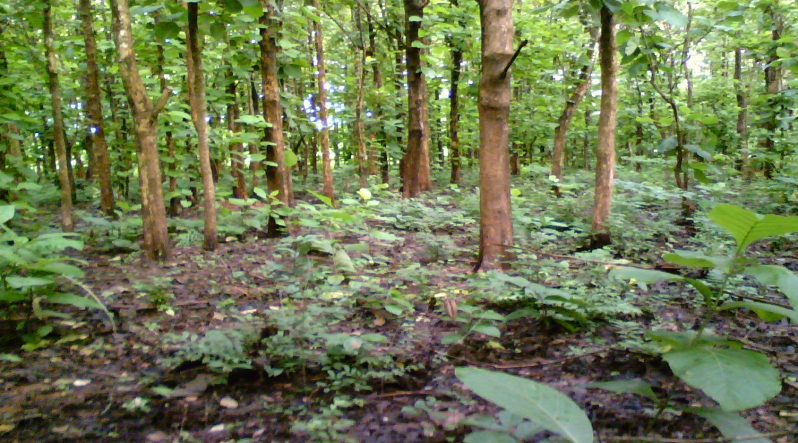
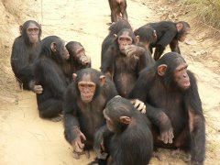
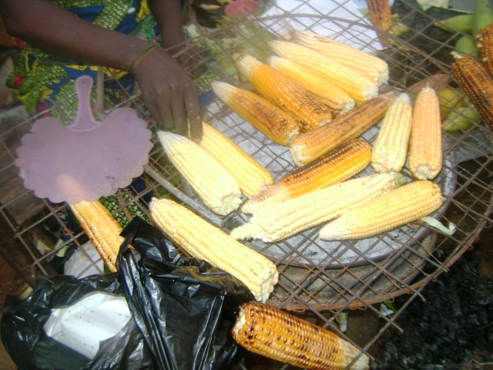
Current Scientific Research……..Cntd
Conservation of natural resources
  Forest
  Aquatic
  Animals
  Food Security
  Biotic
  Abiotic stress
West Africa River (Source: New England Aquarium, 1998).
Source: African Conservation Foundation (ACF)

Slide 7
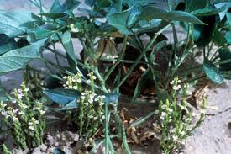
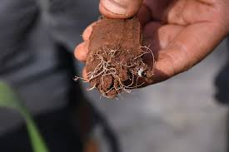
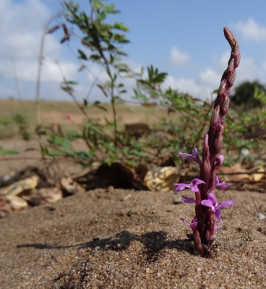
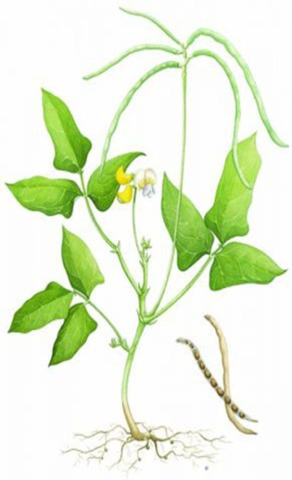
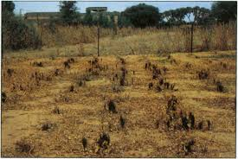
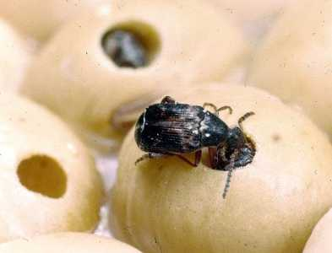
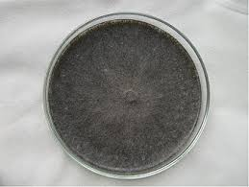
Why I am in India?: From Lab to Land
Flower thrips
Aphids
Pod borers
Storage pests
Viruses
Root-knot nematodes
M. phaseolina

Slide 8
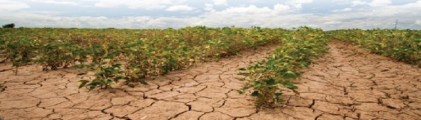

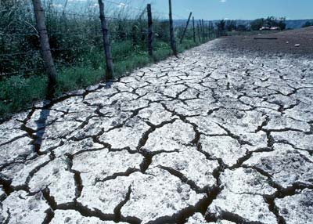
    Drought***
    Heat**
    Salinity*

Slide 9
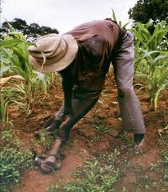
Who will help us?.....farmers
This is our CRY……..FARMERS
University of Ibadan
Inter. Inst. Trop. Agric
Kent State University
University of Goettingen
IIT, Guwahati
Manipur University
Tezpur University
You or Me

Slide 10
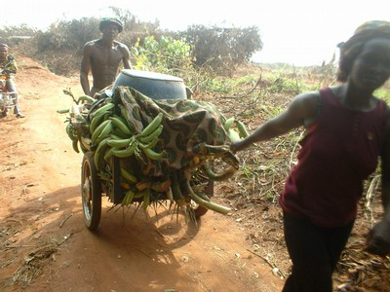
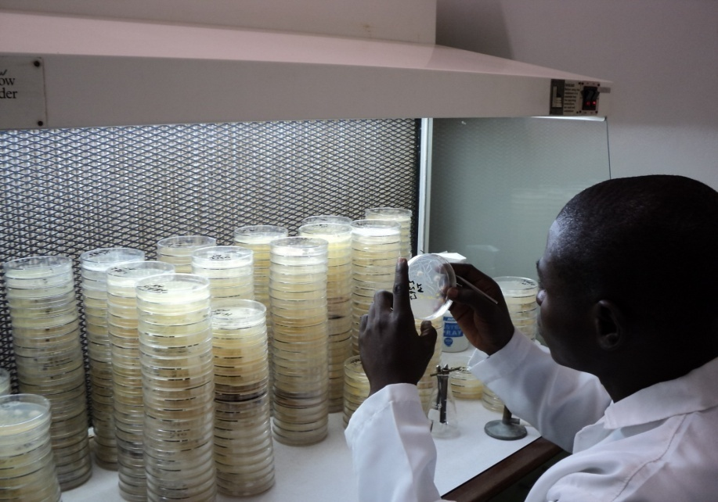
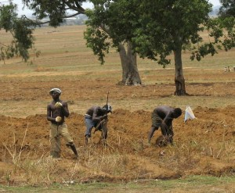
From Lab to Land
Dr. Abiala at IITA, NIgeria

Slide 11
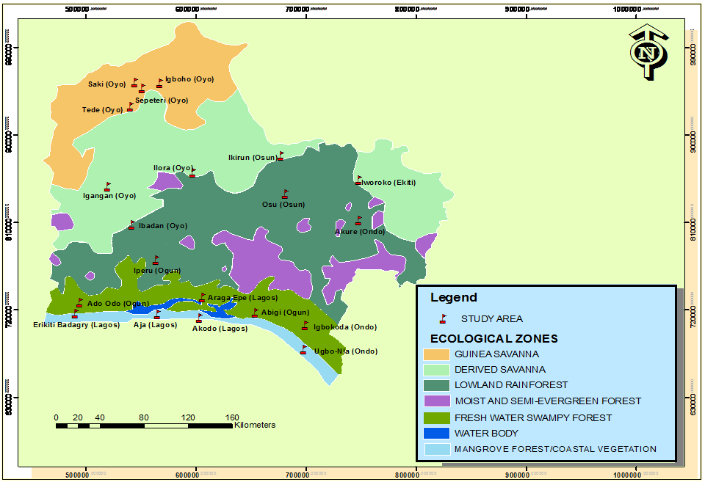
Map of Southwestern Nigeria showing Ecological zones and Study areas.

Slide 12
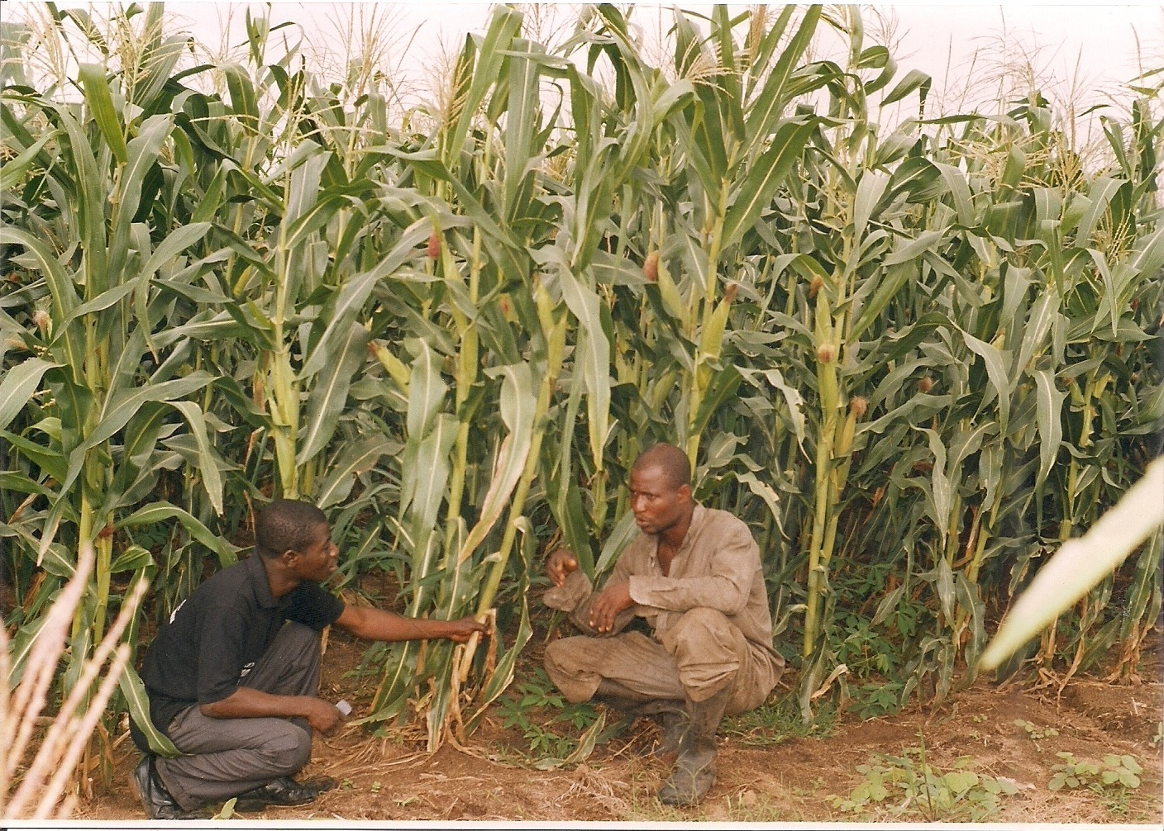

From the field to the Laboratory
Dr. Abiala Moses at IITA, Ibadan, Nigeria
Field and Research Security

Slide 13
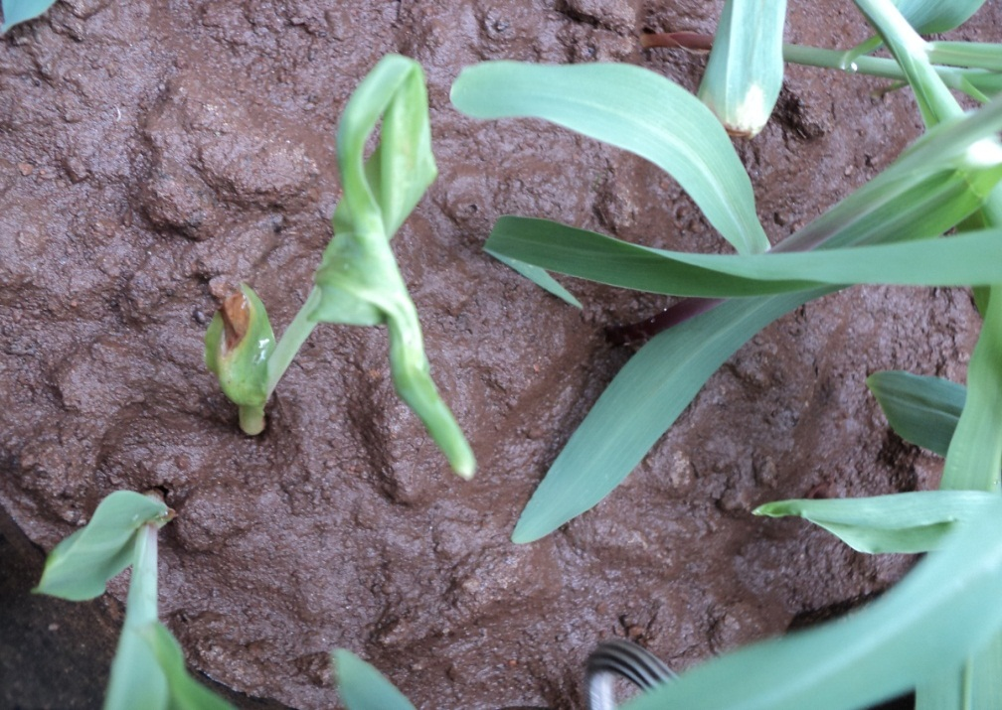
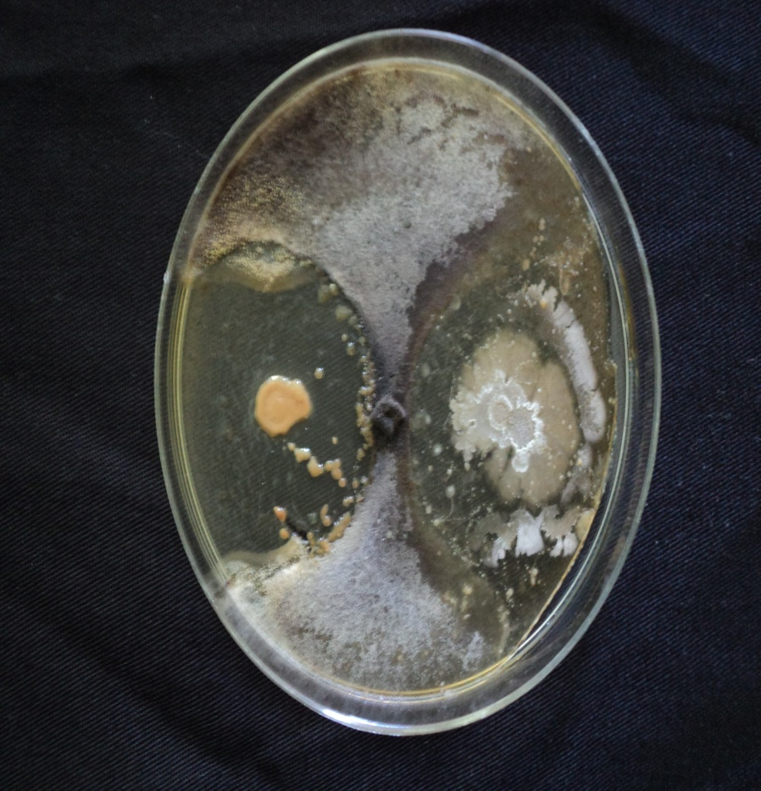
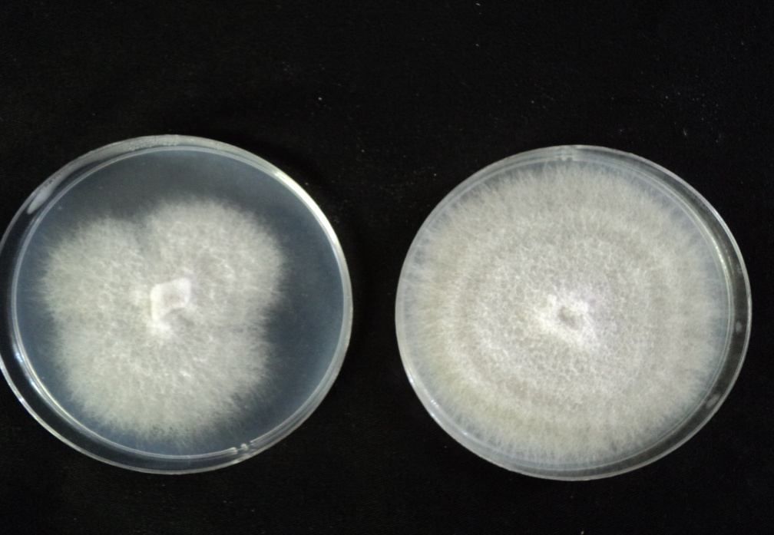
Research on food security in progress.......
Useful soil bacteria
Deadly plant pathogen to majority of WA food crops

Slide 14
Fusarium verticillioides
Antagonistic bacteria (EPR2)
Antagonistic bacteria (AT-IKS)

Slide 15
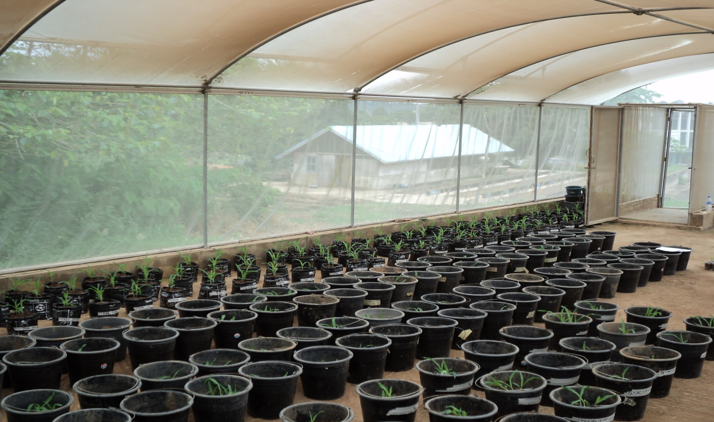
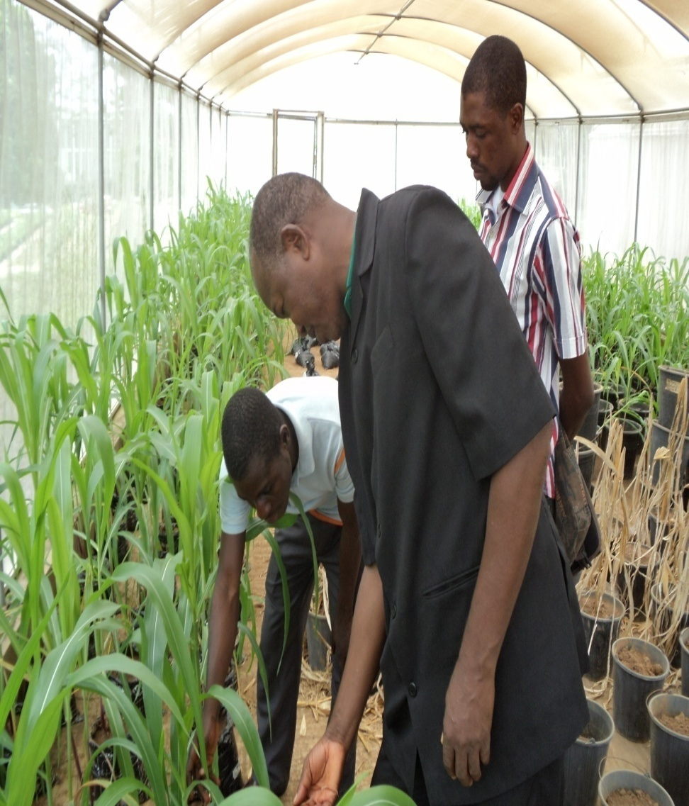
Research in progress……

Slide 16
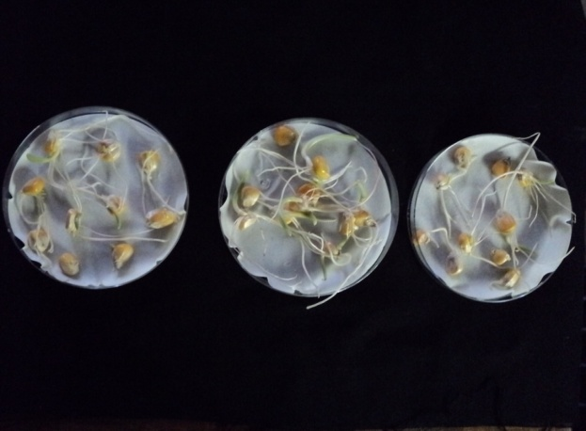
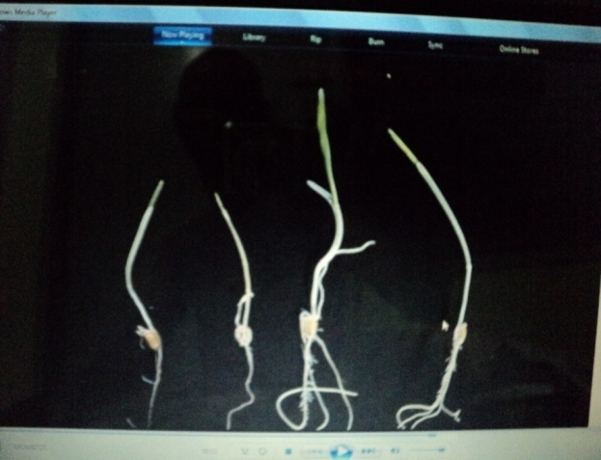
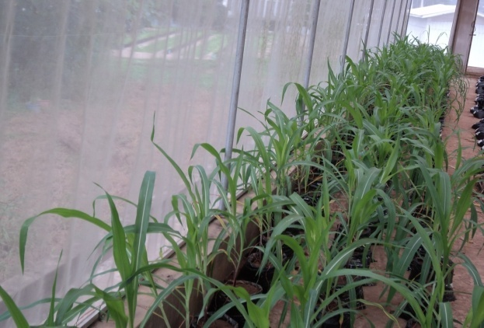
West Africa Universities Scientific Research Impacts
Food security
Nutrients Uptake (82% Carbohydrate, 18% Protein)
Environments
PLANT/SOIL NUTRIENT INTERACTION
Treatment | % Nitrogen | %Phos | % Potassium
MZ | 9.27 | 0.87 | 10.05
MZ + PF | 0.00 | 0.00 | 0.00
MZ + NPK | 19.19 | 1.52 | 23.28
MZ+NPK+PF | 0.00 | 0.00 | 0.00
MZ+PF+ACT | 16.06 | 1.39 | 18.00
MZ+PF+ATA | 16.5 | 1.24 | 18.18
MZ+PF+NPK+ACT | 9.39 | 0.74 | 9.14
MZ+PF+NPK+ATA | 18.46 | 2.04 | 26.42
MZ+ACT | 19.8 | 1.8 | 23.5
MZ+ATA | 18.5 | 2.31 | 28.5

Slide 17
Application of biotechnology to food security
??????????????????????????????????????
Challenges
      Research facilities/Equipments
      Funding
      Capacity building
      Supervision capability

Slide 18
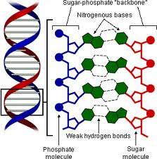
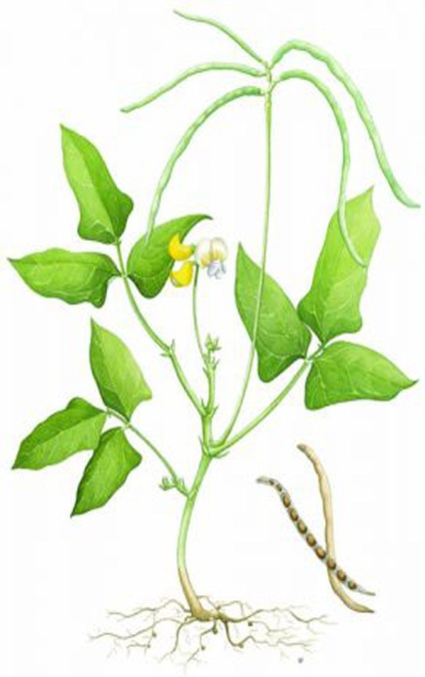
Collaborative Research
    Professor Lingaraj Sahoo and Dr. Abiala Moses
    Laboratory of Professor L. Sahoo, IIT, Guwahati
      Application of molecular techniques to legumes, cereals and vegetables
    Advantages
        Sustainability of life
        Biodiversity
        Improve nutrition
        Conservation
        Support MDG in

Slide 19
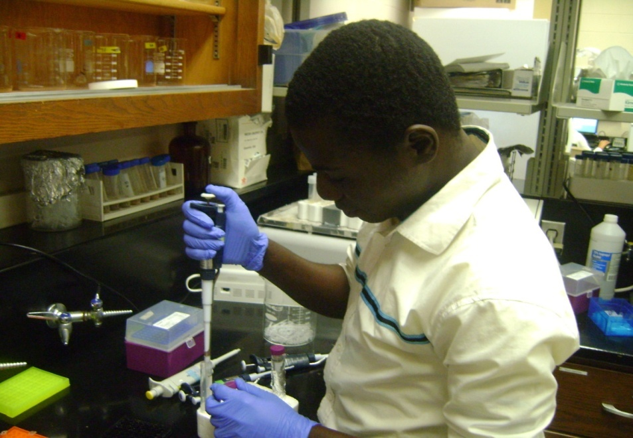
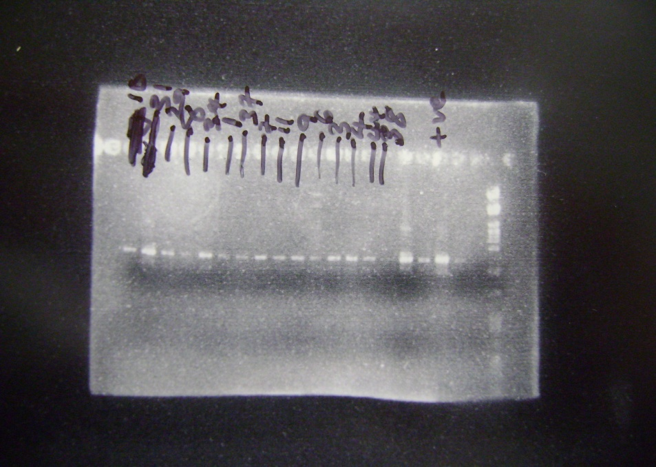
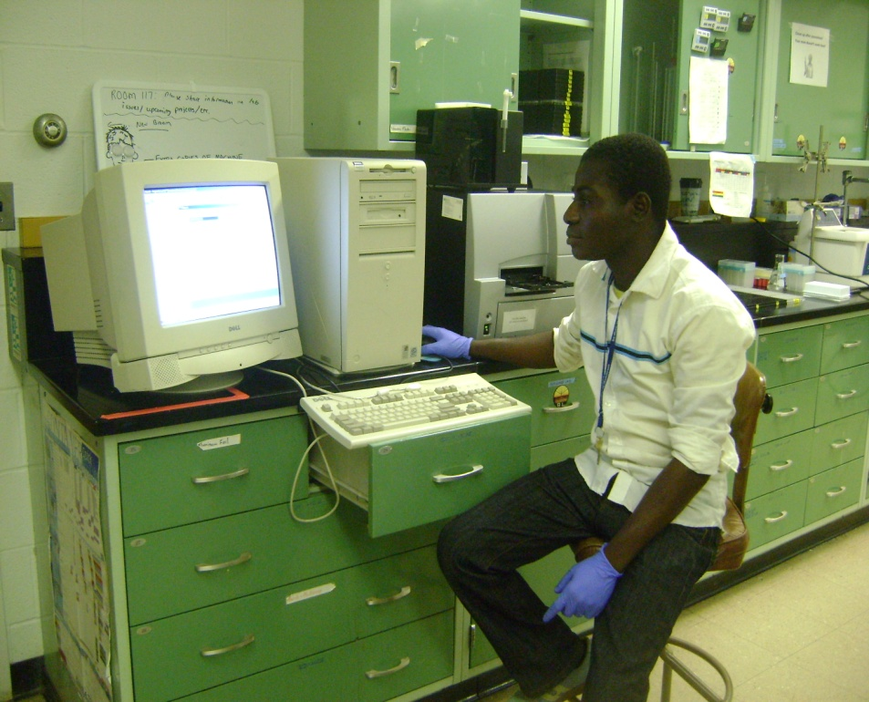
Collaborative research in progress……..
When I was rounding up my PhD in United States of America (USA)
Molecular bands of WA soil Bacteria DNA

Slide 20
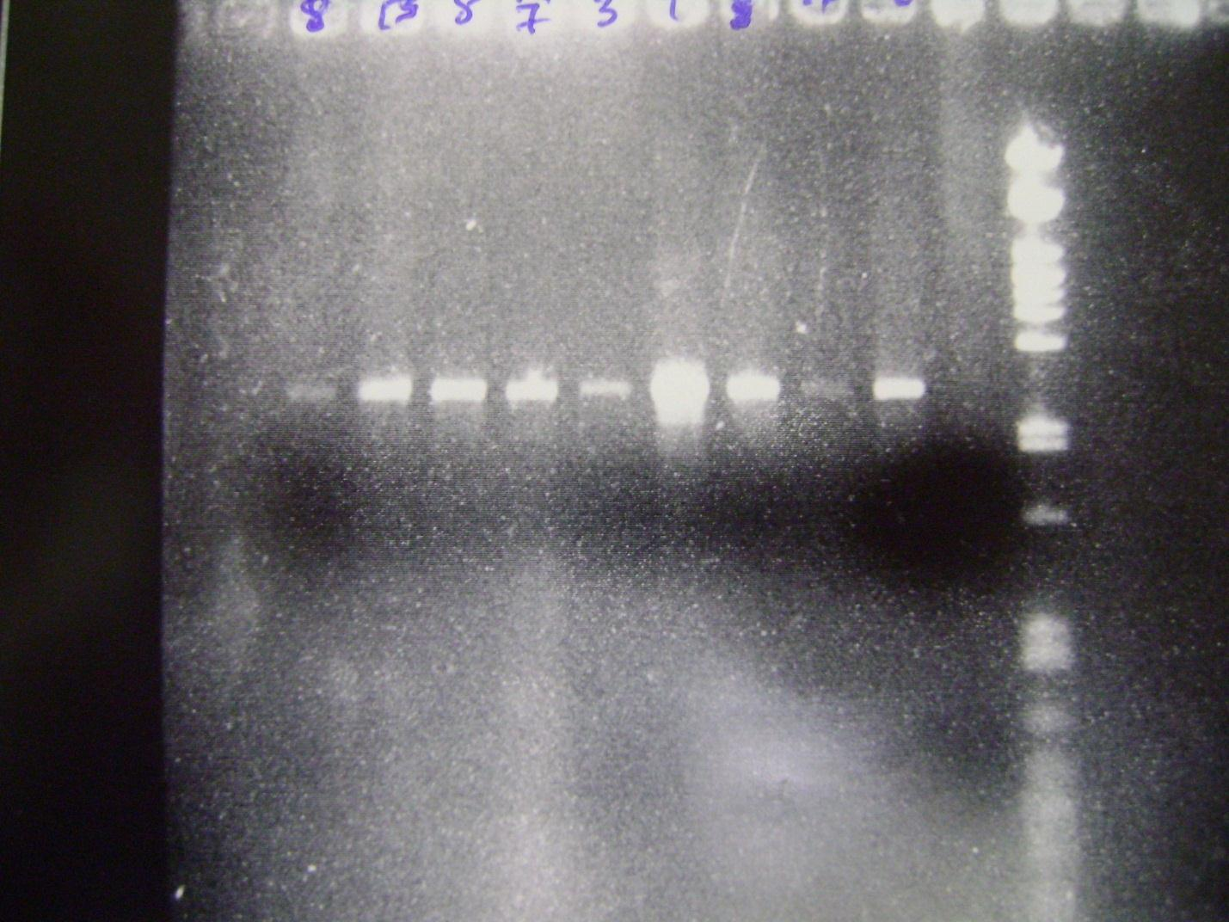
Positive control
Negative control
+
-
DNA ladder
1986 bp
1700bp
1159bp
DNA band

Slide 21
Overcoming scientific research challenges
Capacity building
Research policies
Science
I
ND
I
A
A
F
R
I
C
A
LIFE
(Food Security)
Science
Leadership
Funding
Collaborative research

Slide 22
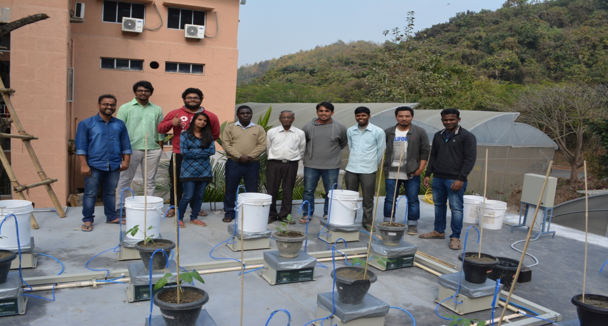
Acknowledgement
Department of Biotechnology (DBT)
The World Academic of Science (TWAS)
Indian Institute of Technology (IIT), Guwahati
Translation Crop Research Laboratory, Department of Bioscience and Bioengineering, IIT, Guwahati
PROFESSOR LINGARAJ SAHOO
Lovely Lab Members

Slide 23
INDIA (My Second Home)
MY SOCIO-CULTURAL
&
RESEARCH EXPERIENCE
I LOVE INDIA…..Courtesy of Prof. L. Sahoo
?

