Slide 1

MOUNTAIN TOP UNIVERSITY
Presents A Webinar On
TECHNOLOGY ENHANCED PEDAGOGY:
Deploying Google Classroom for Pedagogy
BALOGUN JEREMIAH ADEMOLA
Department of Computer Science and Mathematics
Mountain Top University
Date: Thursday August 13, 2020
Time: 5:00PM

Slide 2
GOOGLE APPS
A wide range of cloud-based application platforms provided by Google for improving productivity.
  Google Drive: cloud-based storage platform
  Google Classroom: cloud-based online assessment system
  Google Docs: Word, Sheets and Slides
  Google Forms: cloud-based online form-creation platform
  Google Meet: cloud-based real-time interactive platform (strictly for Gmail users)
  Google Colaboratory: cloud-based machine learning simulation platform.
Access to these applications are freely accessible to Gmail users.
There are two ways to have access to these applications:
  The public Google platform, such as: username@gmail.com
  The private Organizational Google platform, such as: username@mtu.edu.ng

Slide 3
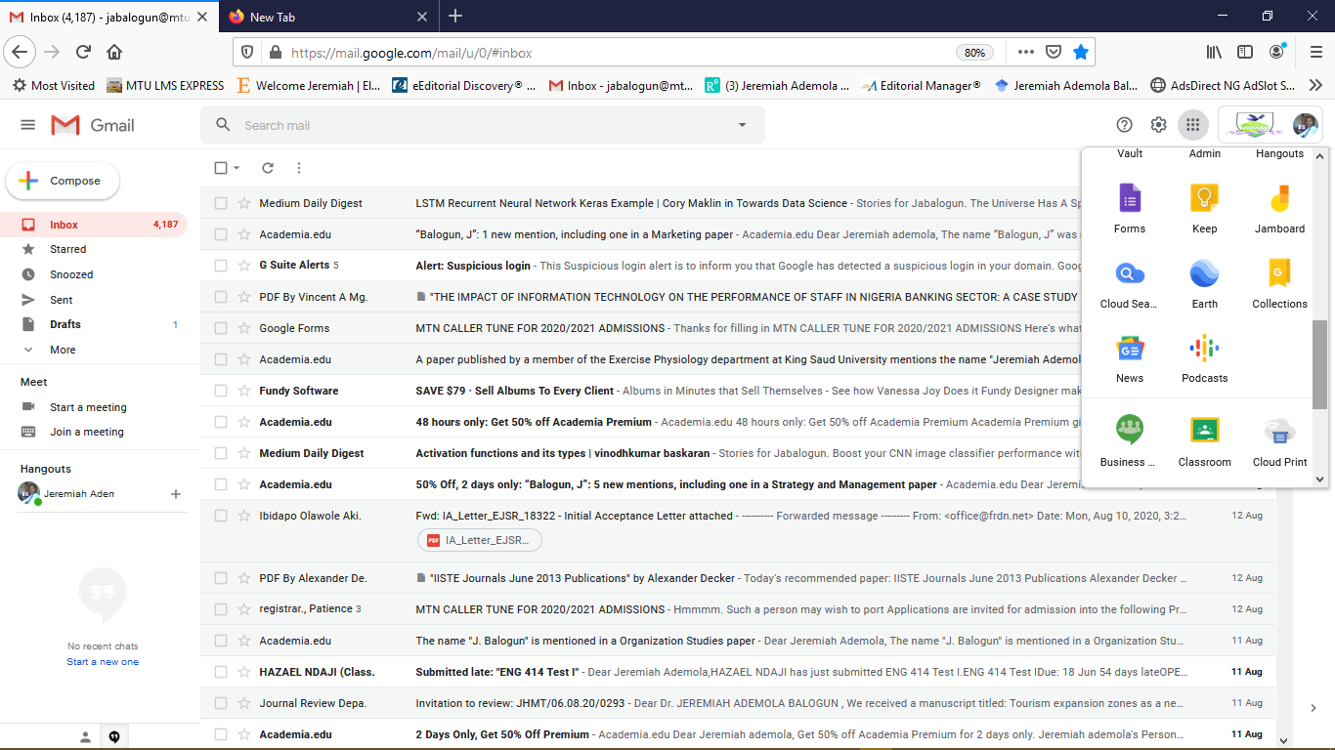
ACCESSING GOOGLE APPS
All Google Apps can be assessed by clicking on this icon
Google Classroom can be accessed by clicking this link

Slide 4
GOOGLE CLASSROOM

Slide 5
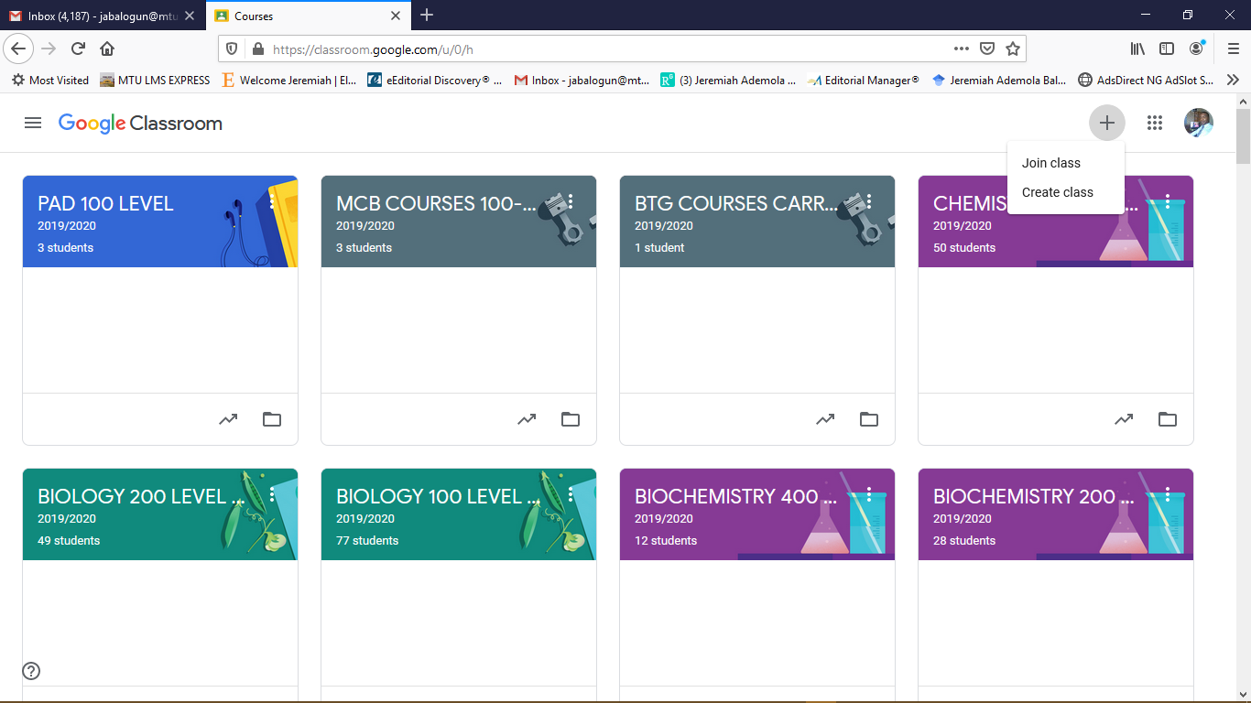
ACCESSING GOOGLE CLASSROOM
Classes can be created by clicking this link

Slide 6
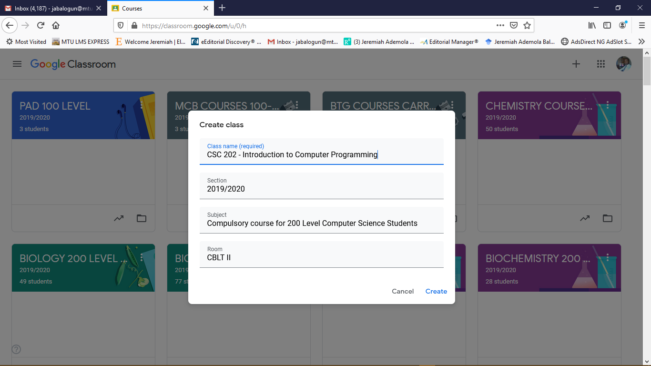
CREATING CLASSROOM

Slide 7
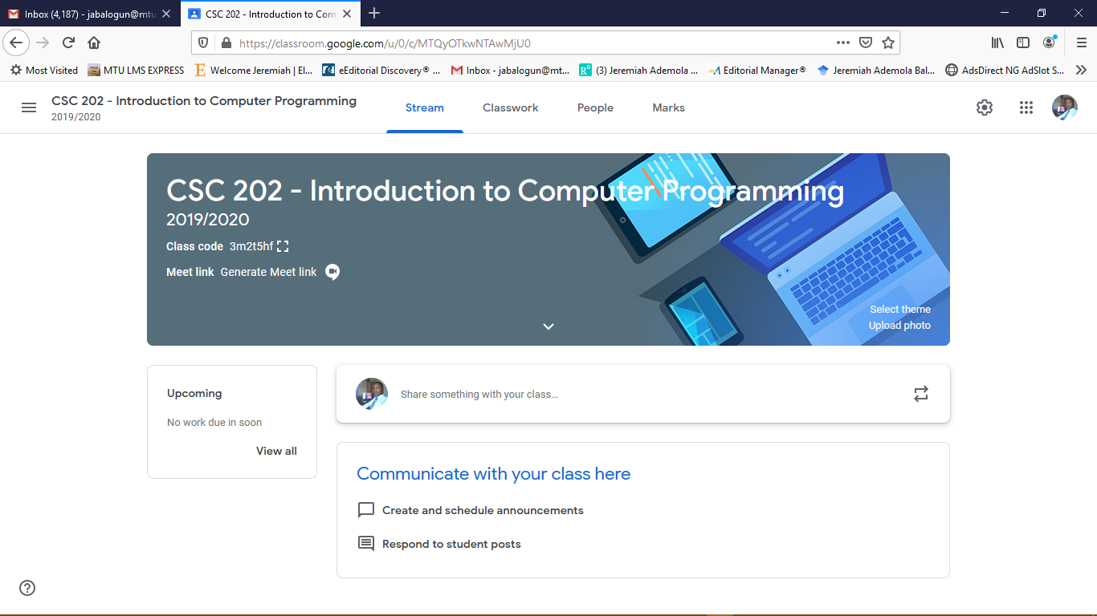
ACCESSING CLASSROOM

Slide 8
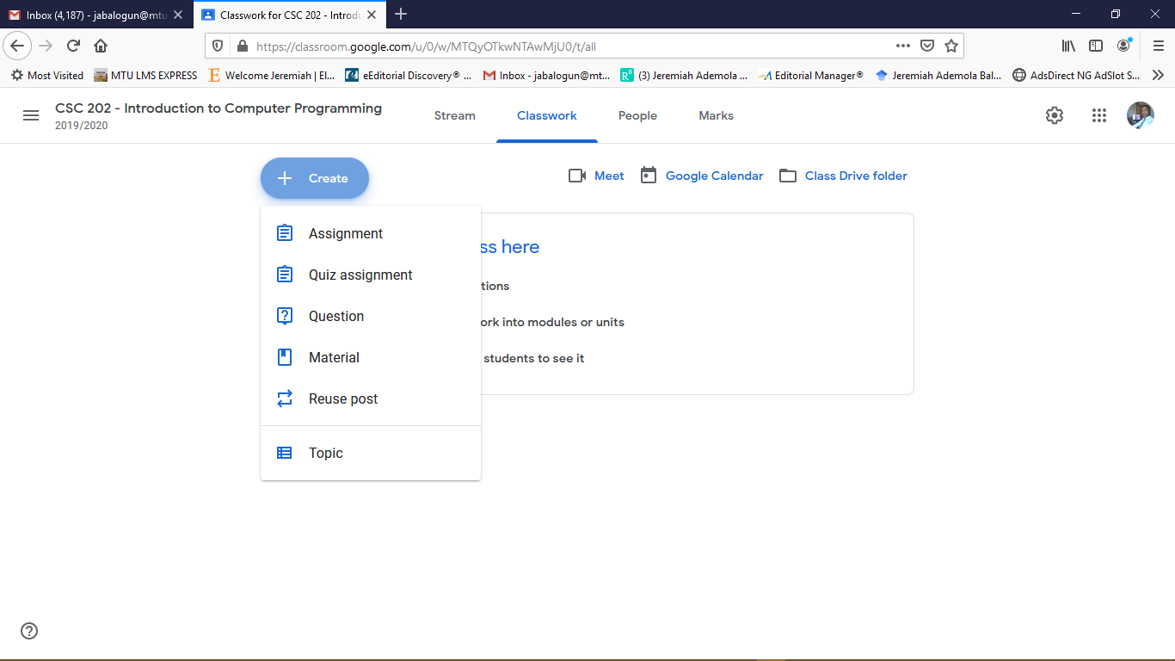
CREATING CLASSWORK

Slide 9
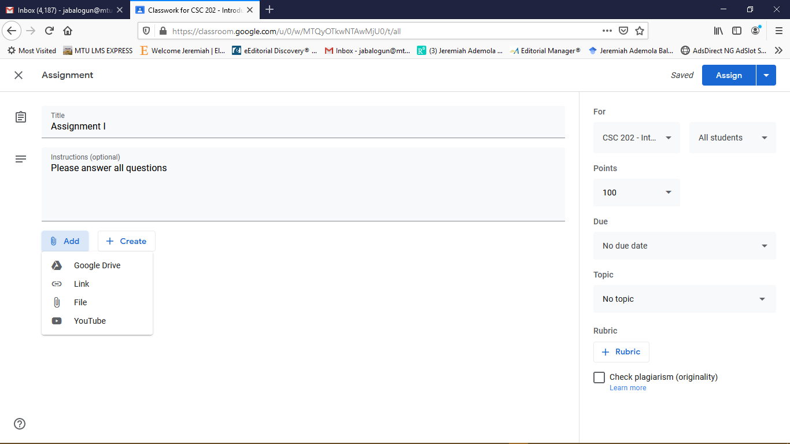
CREATING CLASSWORK….

Slide 10
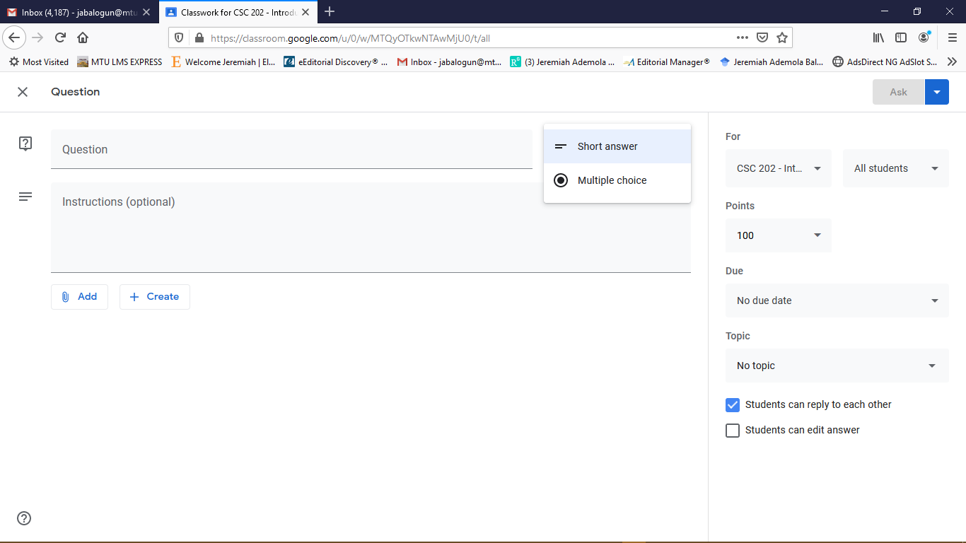
CREATING CLASSWORK….

Slide 11
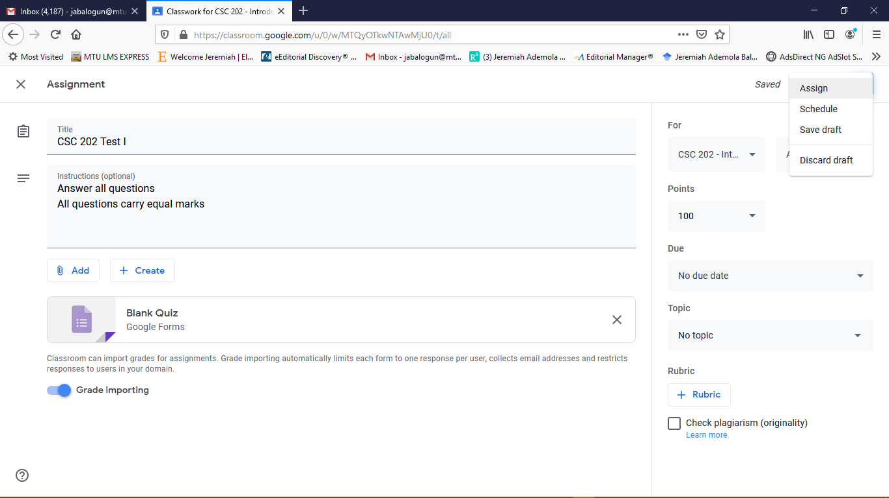
CREATING CLASSWORK….

Slide 12
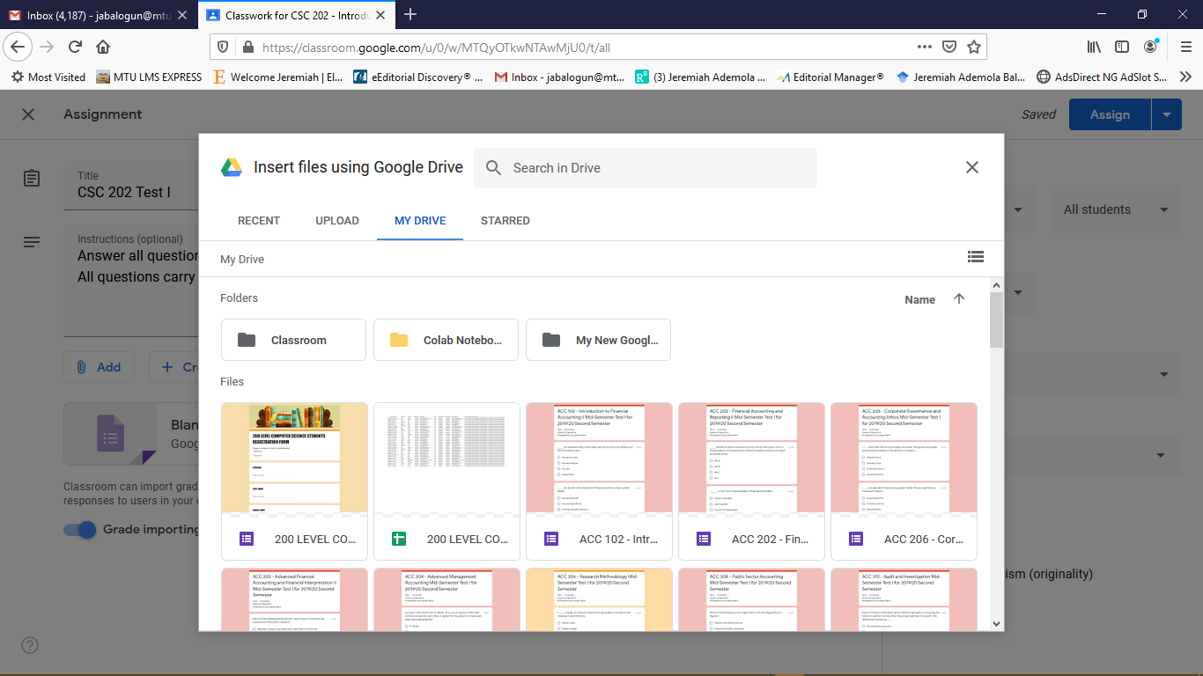
CREATING CLASSWORK….

Slide 13
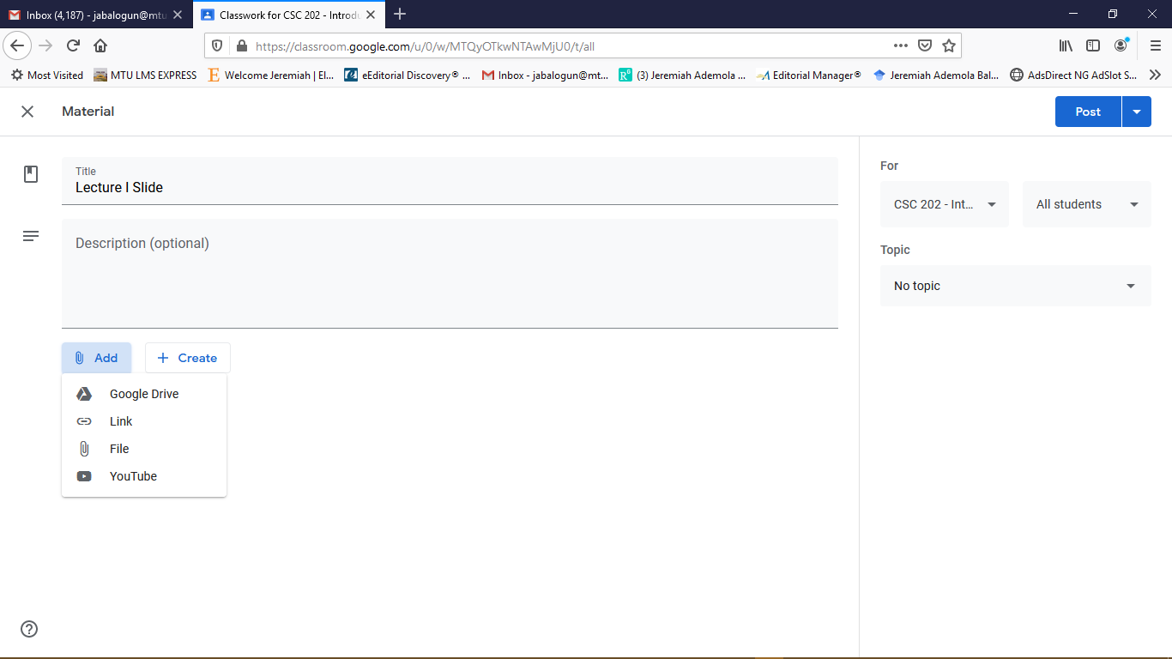
ADDING COURSE MATERIALS

Slide 14
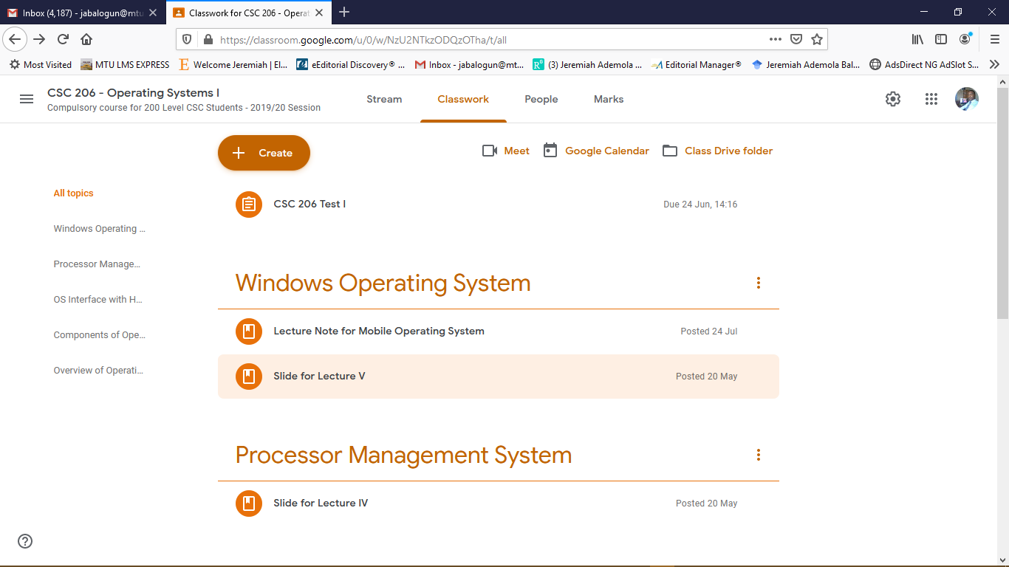
VIEWING CLASSWORK ACTIVITIES

Slide 15
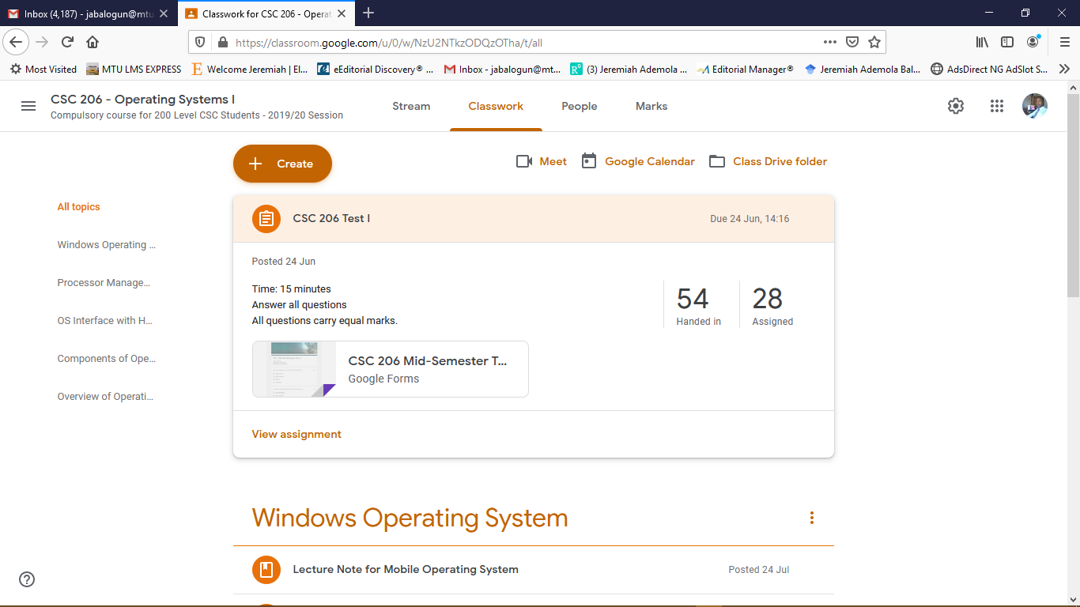
VIEWING ATTEMPTED ASSESSMENTS

Slide 16
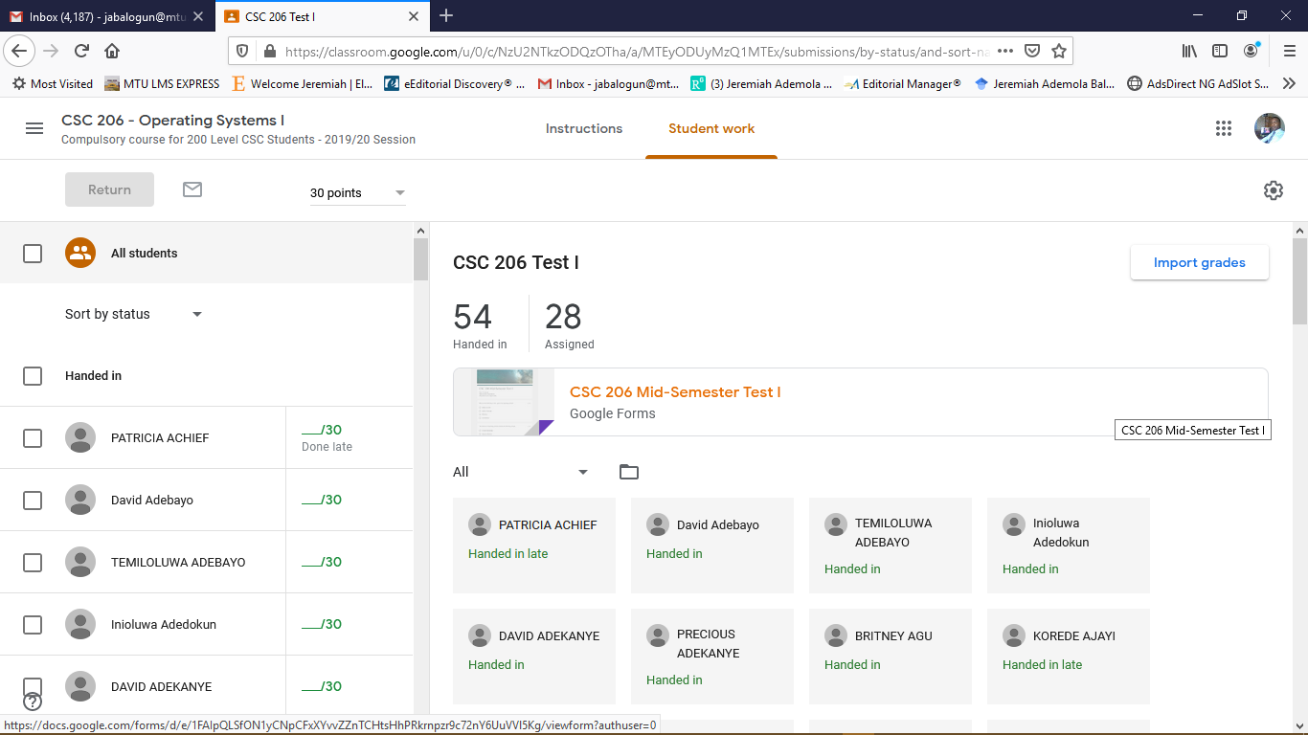
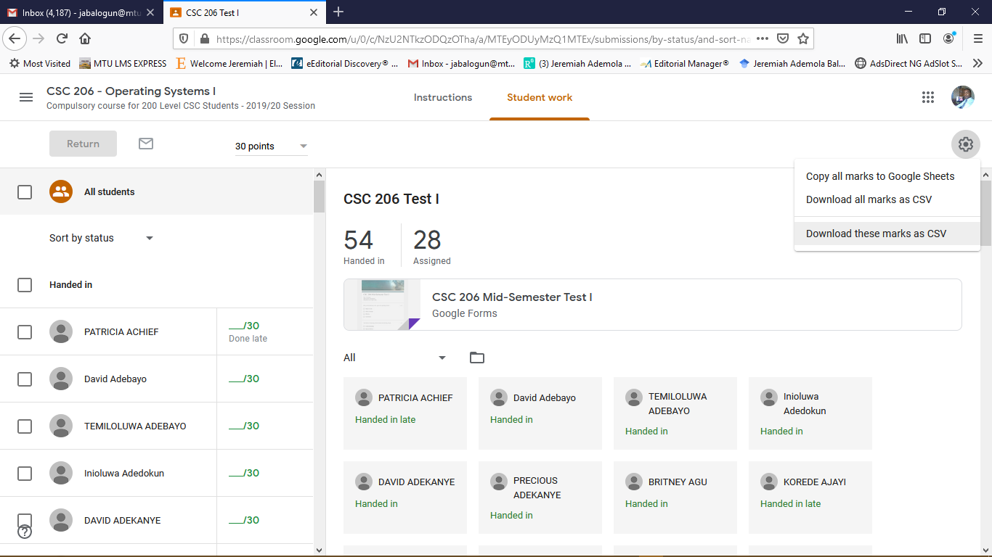
VIEWING ATTEMPTED ASSESSMENTS..

Slide 17
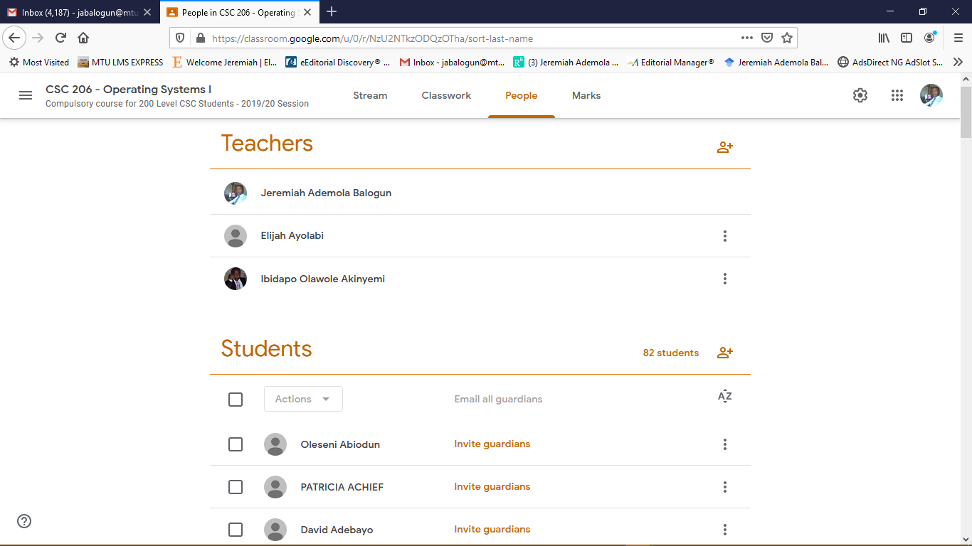
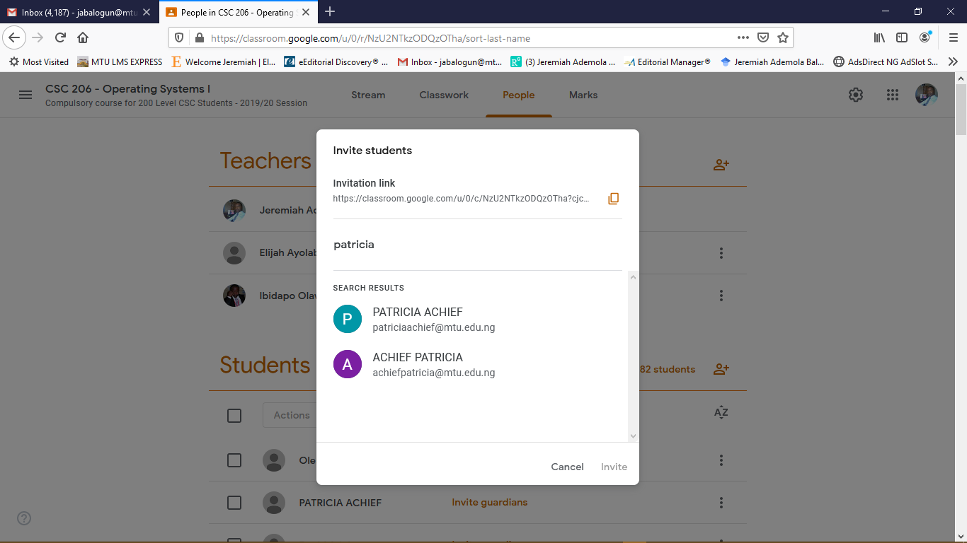
ADDING AND VIEWING PARTICIPANTS

Slide 18
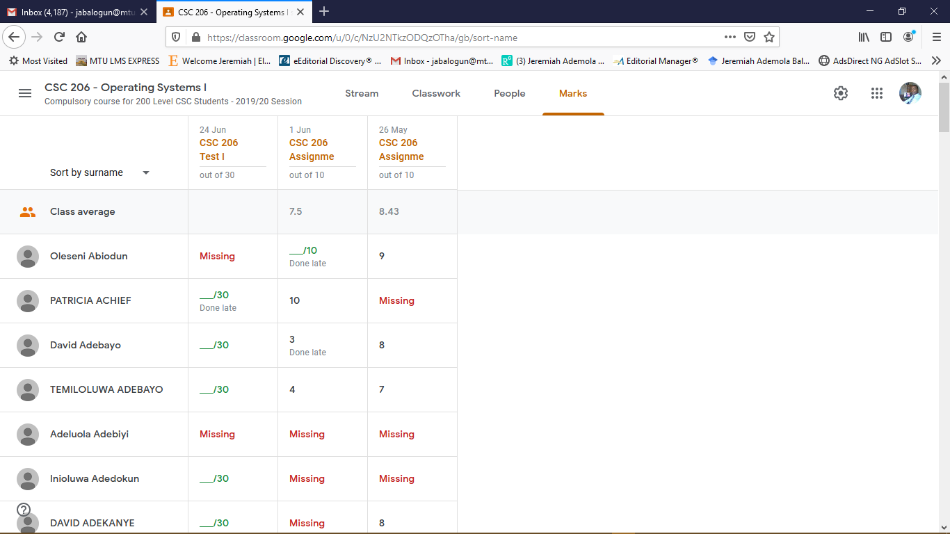
ACCESSING STUDENT PERFORMANCE

Slide 19
GOOGLE FORM

Slide 20
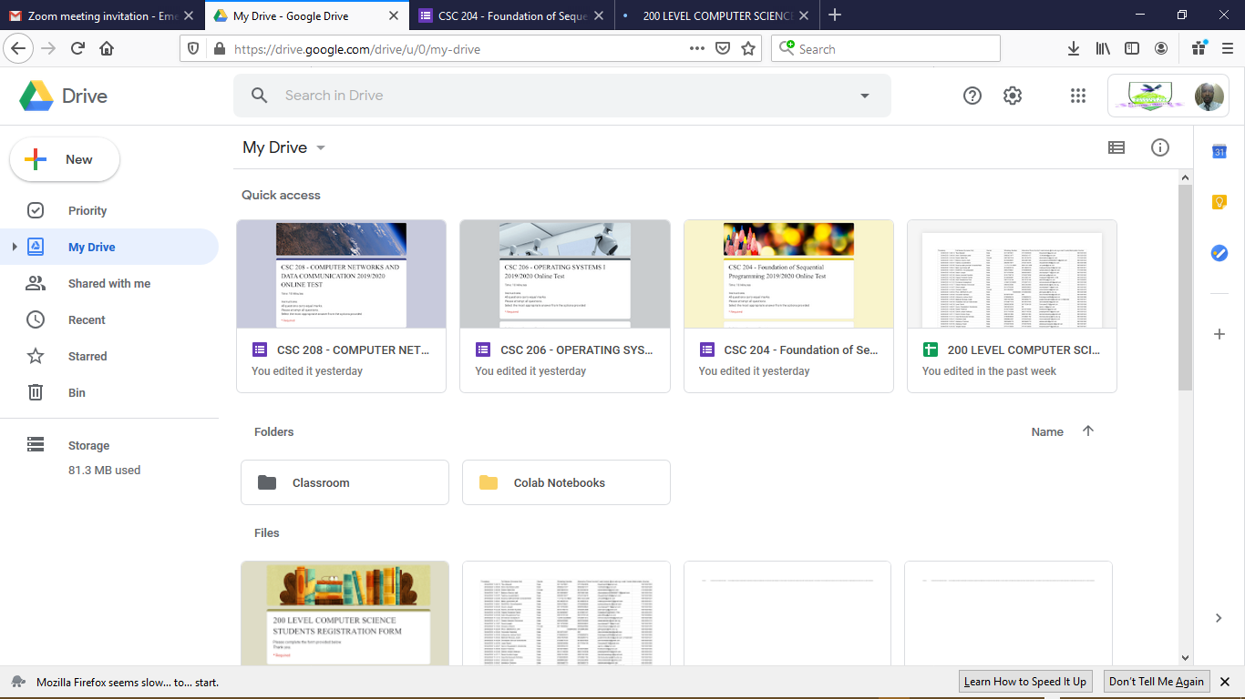
ACCESSING USER’S GOOGLE DRIVE ACCOUNT
Upon successful connection to the URL drive.google.com the Google Drive homepage is displayed as shown below.
If the user is signed into his/her Google (or MTU) account on the browser then they will not be required to sign in.
Quick access shows recently created documents stored on the drive which includes docs, forms, sheets and files.
All files in the drive can be viewed under Files.
By clicking on the NEW button located on the top-right corner one can select the new document to be created.

Slide 21
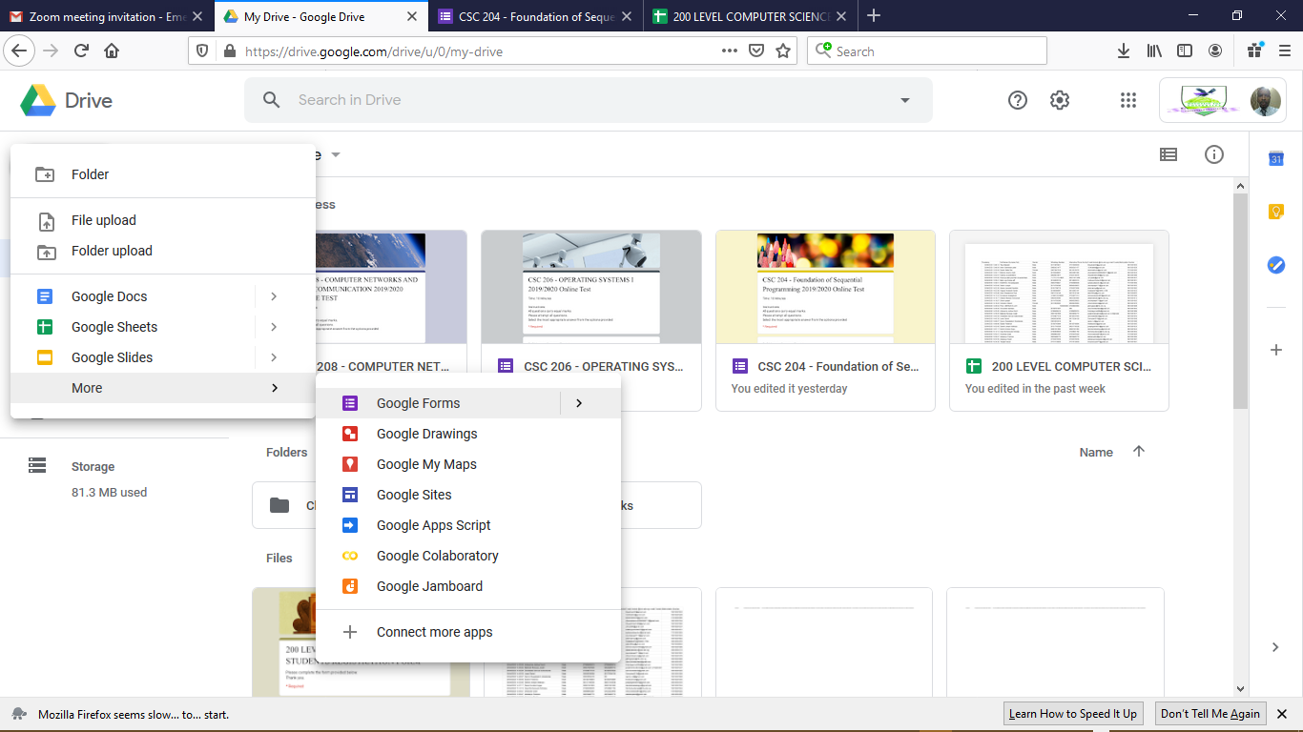
CREATING A NEW GOOGLE FORM
By selecting the more option at the bottom, one can access additional new documents to be created.
Upon selecting More, then one should select the option showing Google Forms to create new Google Form.

Slide 22
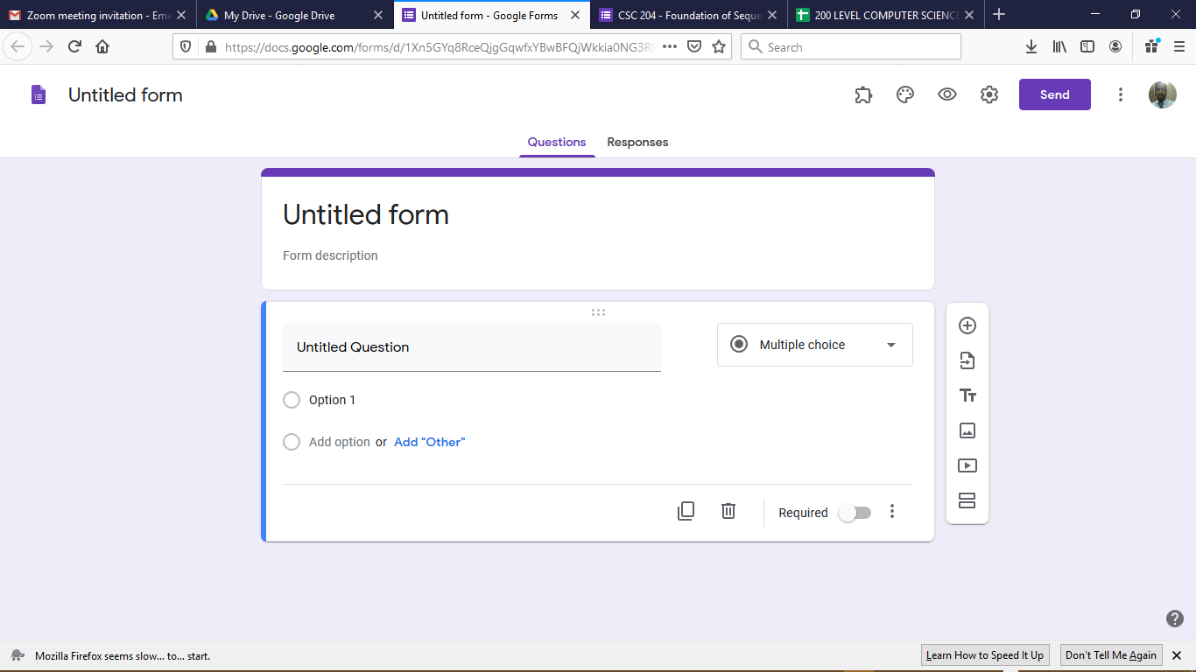
CREATING A NEW GOOGLE FORM….
Upon selecting Google Forms, a new browser tab is created as shown in the Figure below.
The form is very user friendly as it contains a user-interface which requires a user to select, drag and drop contents.
All new Google Forms are labelled untitled until a new Title is provided to the Google Form.

Slide 23
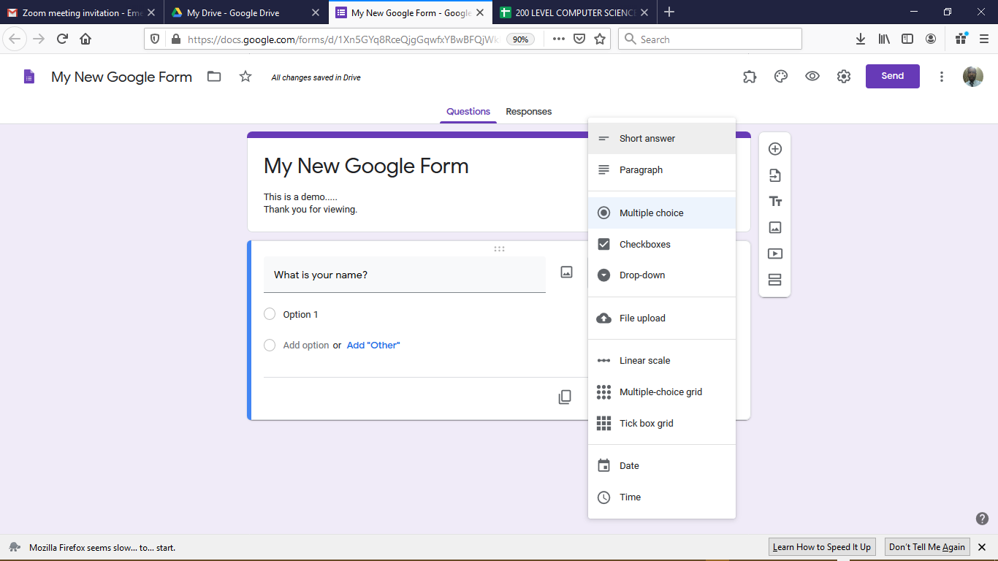
ADDING QUESTIONS TO A NEW GOOGLE FORM
For each question provided, there are various categories of options available depending on the type of questions asked.
  Short answer or paragraph are required for providing typed responses (e.g. theory-based response).
  Multiple choice (drop down or checkboxes) allows the respondent to select (e.g. for MCQ-based response).
  Linear scale allows respondents to select from a rated-scale of option (e.g. Likert scale of 1 to 5).
  Date and Time option allows respondents to provide date (or time) related information.

Slide 24
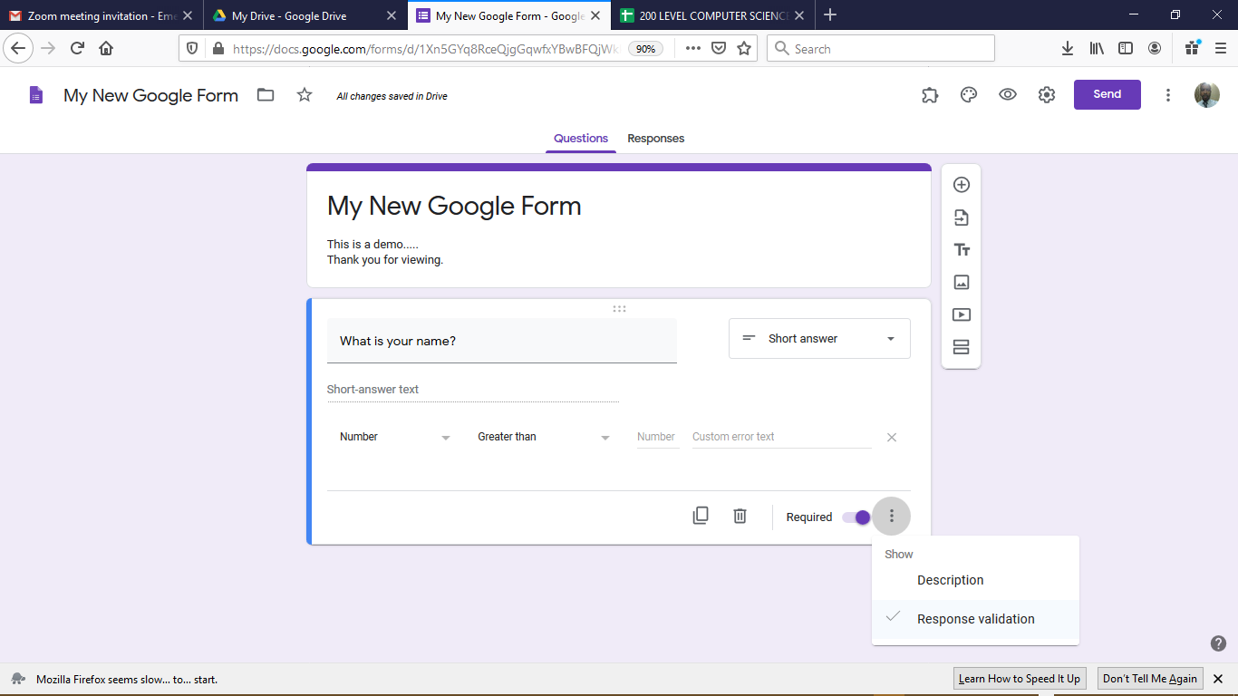
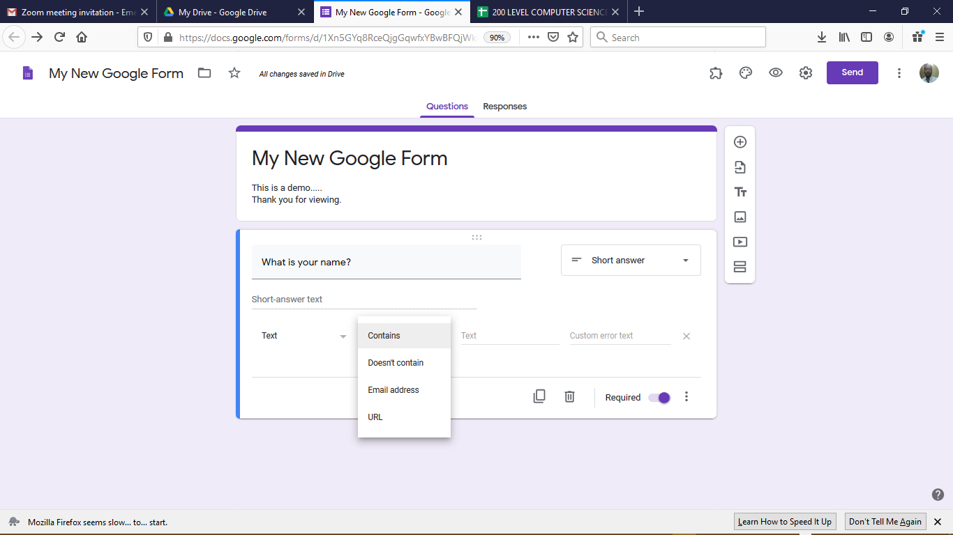
EDITING QUESTIONS ON A NEW GOOGLE FORM
Responses to questions can be validated as a way of ensuring that responses provided are valid.
  Descriptions can also be provided to questions (if required).
Once a questions is marked as Required, the Google Form will not be submitted without a selected response.
Questions can be copied for another question with the same format or deleted completely if more than required.

Slide 25
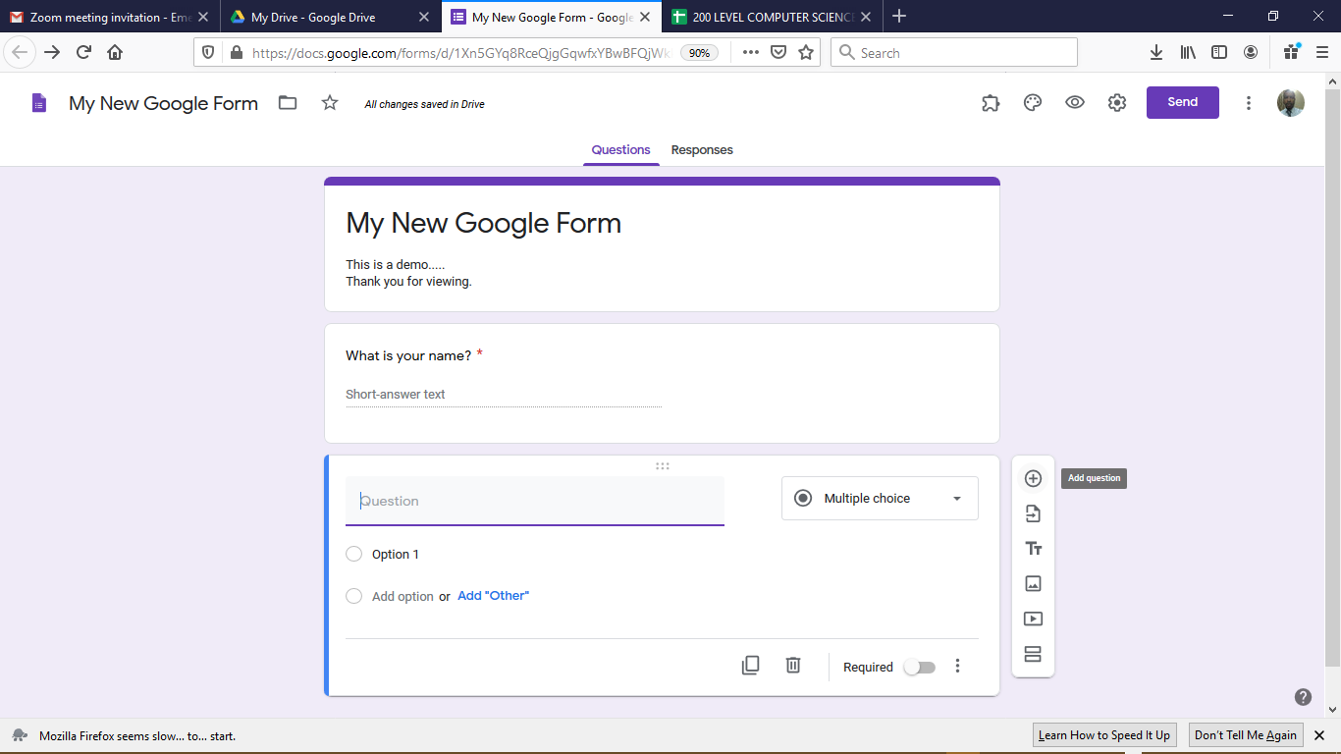
EDITING QUESTIONS ON A NEW GOOGLE FORM…..
For every question marked as required, an asterisk is attached to the question.
On the right-hand side of each question created lies the formatting menu for questions.
  The + symbol is used to add a new question as shown in the diagram with the new question entry.
  The second menu is used to import question from an existing Google Form.
  The third menu is used to input a text based information into the form
  The fourth and fifth menu are used to import pictures and videos respectively into the form.
  The sixth menu option is used to create a new section of questions.

Slide 26
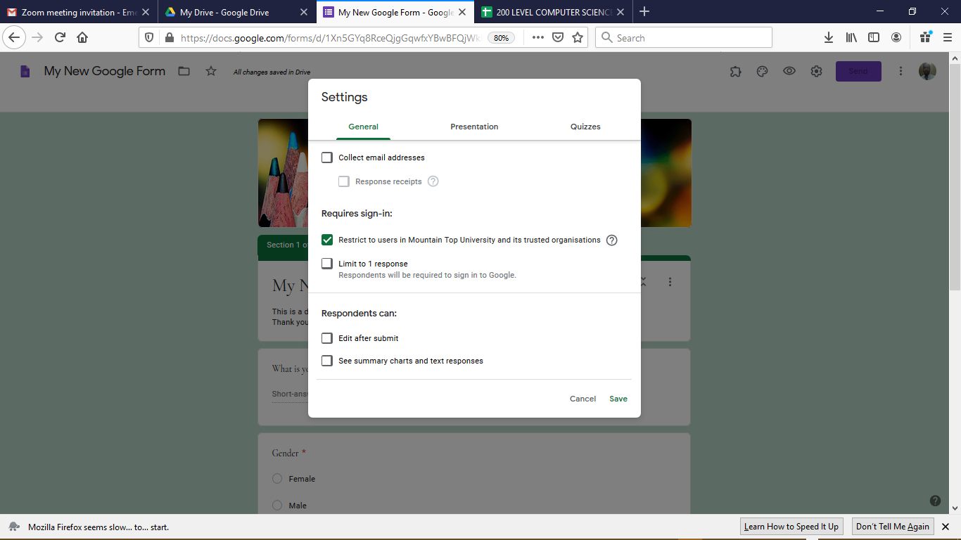
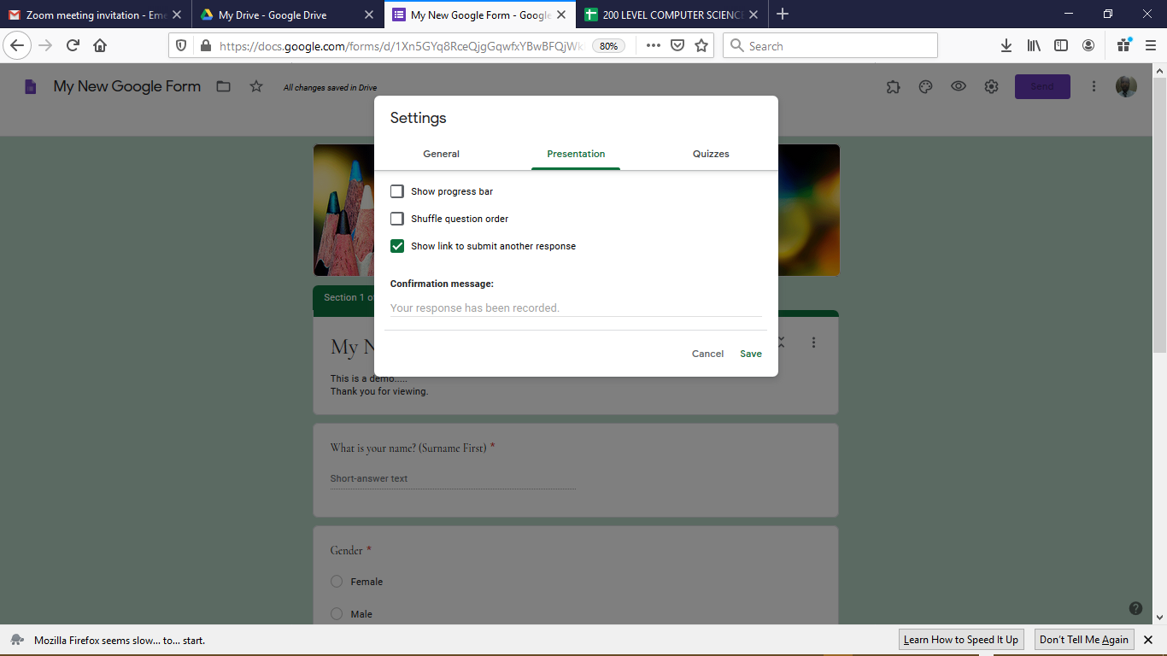
SETTING UP A GOOGLE FORM
By selecting the setting menu button, additional configuration required for controlling access is provided.
  Including, collecting e-mail addresses, sign-in requirements for response limitation and respondents’ actions.
Also, the view of the presentation can also be edited.
  Including progress bar, shuffling questions and link for new sections.

Slide 27
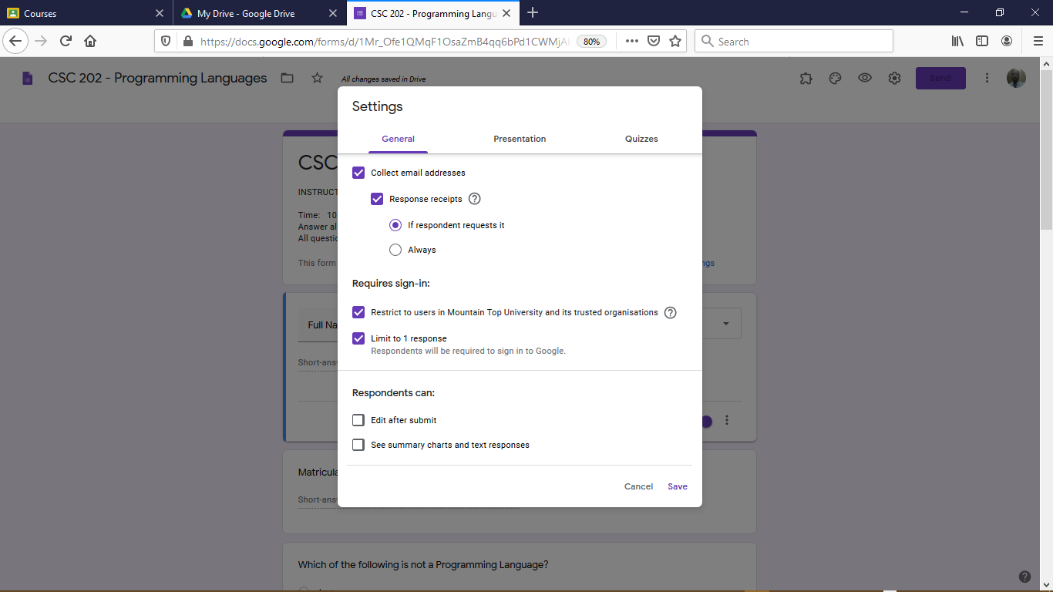
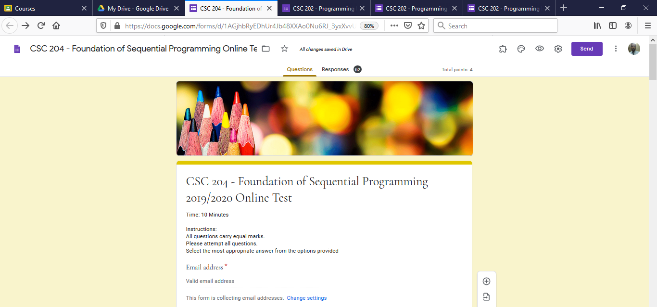
ENABLING ACTIONS ON GOOGLE FORMS
Following the completion of the design of the Google Forms, certain actions can be initiated by clicking the setting button (left image)
General – For placing restrictions on the users that are authorized to access this forms (mtu.edu.ng users), collection of respondents’ e-mail alongside the limitation to responses (right image)

Slide 28
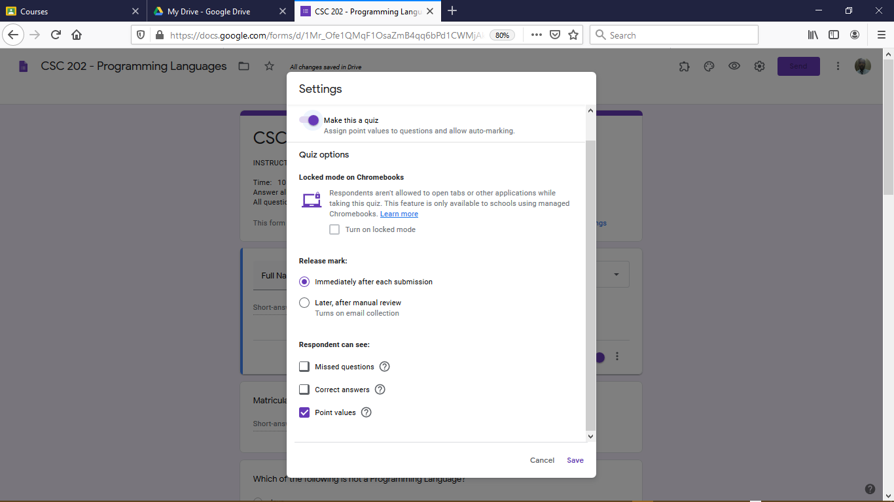
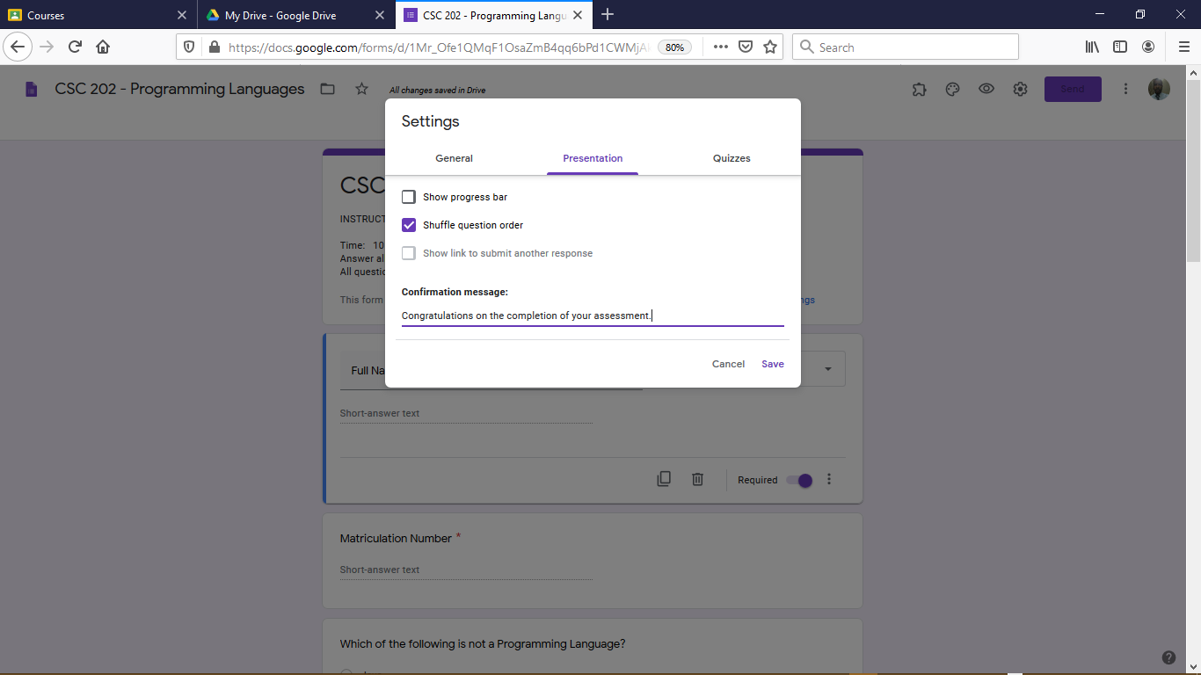
ENABLING ACTIONS ON GOOGLE FORMS….
Presentations – For enabling the shuffling of question order alongside a form delivery confirmation message (left image).
Quizzes – For enabling the assigning of point values to questions, mark release mode and auto-marking (right image).

Slide 29
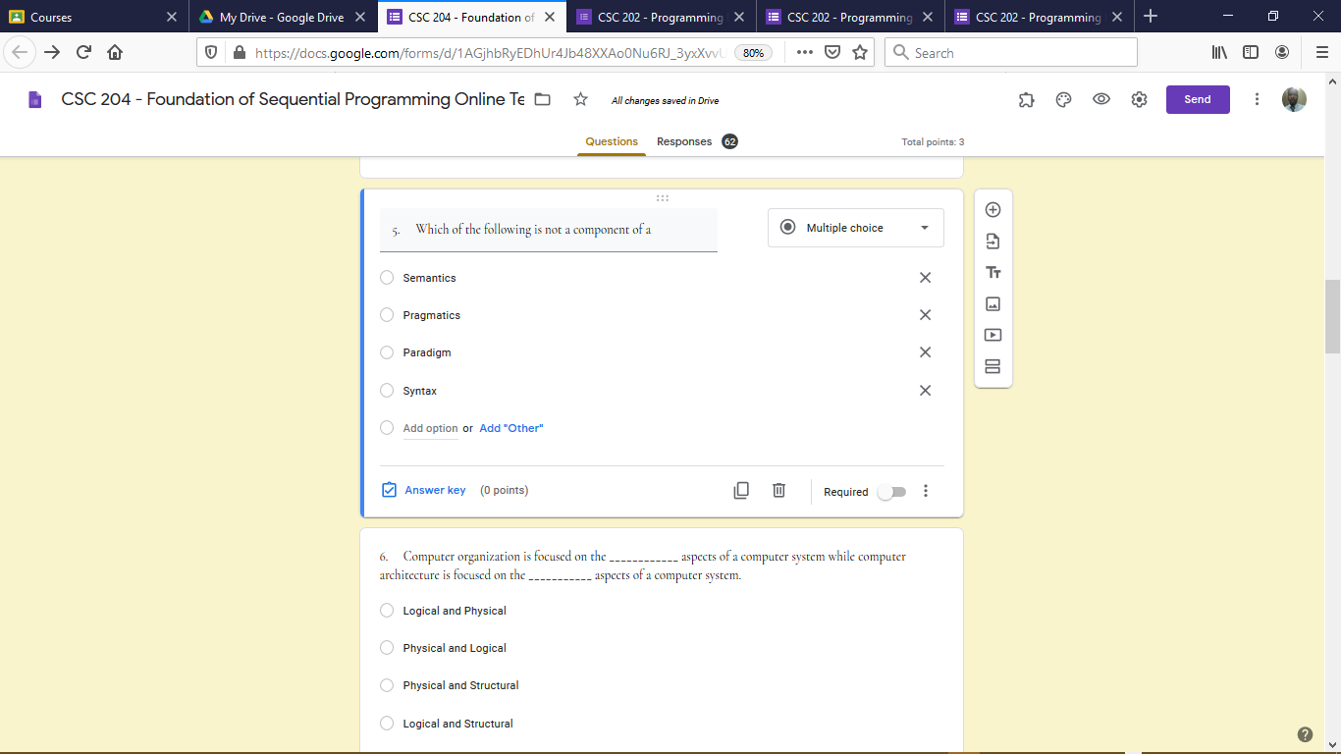
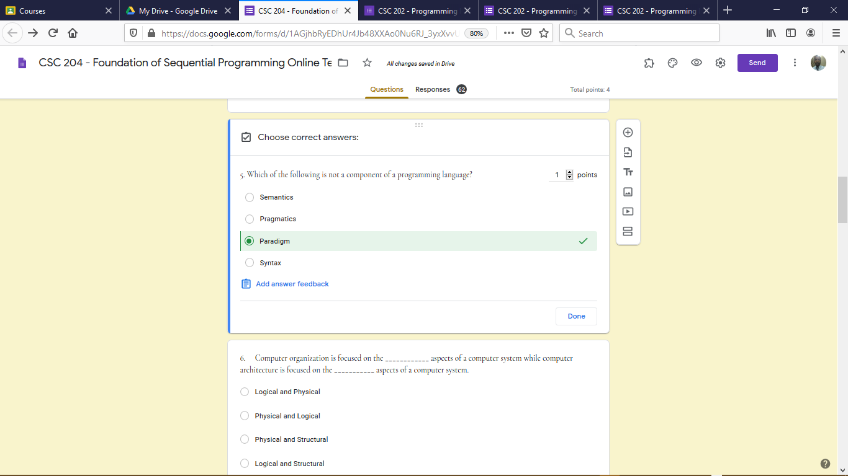
ASSIGNING CORRECT OPTION AND POINT VALUES TO GOOGLE FORM QUESTION
Upon clicking DONE following completion of the Settings, one can assign correct options alongside the assigning of grades to each questions.
First Click on the Question, thus assessing the question editing environment
  To identify answer click on Answer Key and this will activate the selection of correct option (left image).
  After selecting the correct option, then one can specify the marks assigned for that question (right image).
  Then click Done

Slide 30
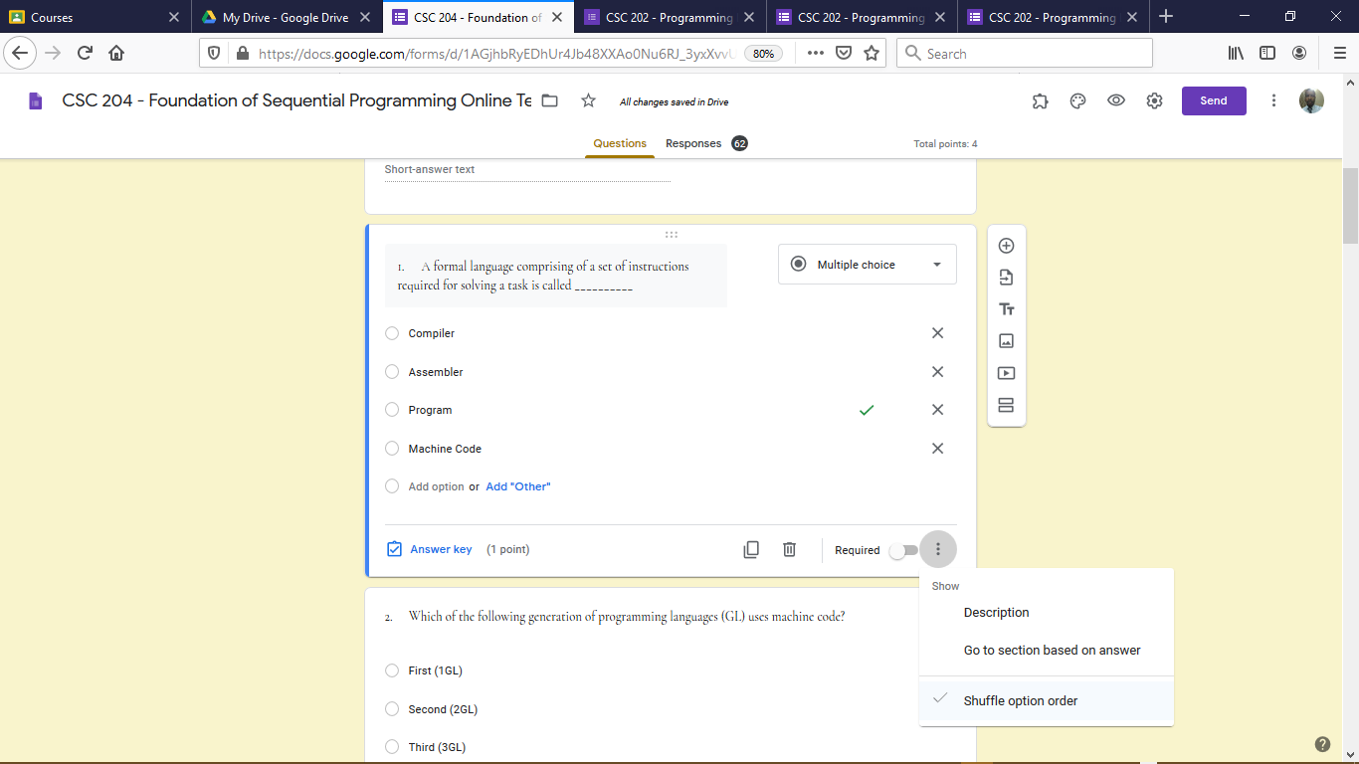
ACTIVATING SHUFFLING OF GOOGLE FORM QUESTION OPTION ORDER
First Click on the Question, thus assessing the question editing environment
  Click on the 3 vertical dots on the bottom right part of the Question editing environment
  Tick the option stated as Shuffle option order.

Slide 31
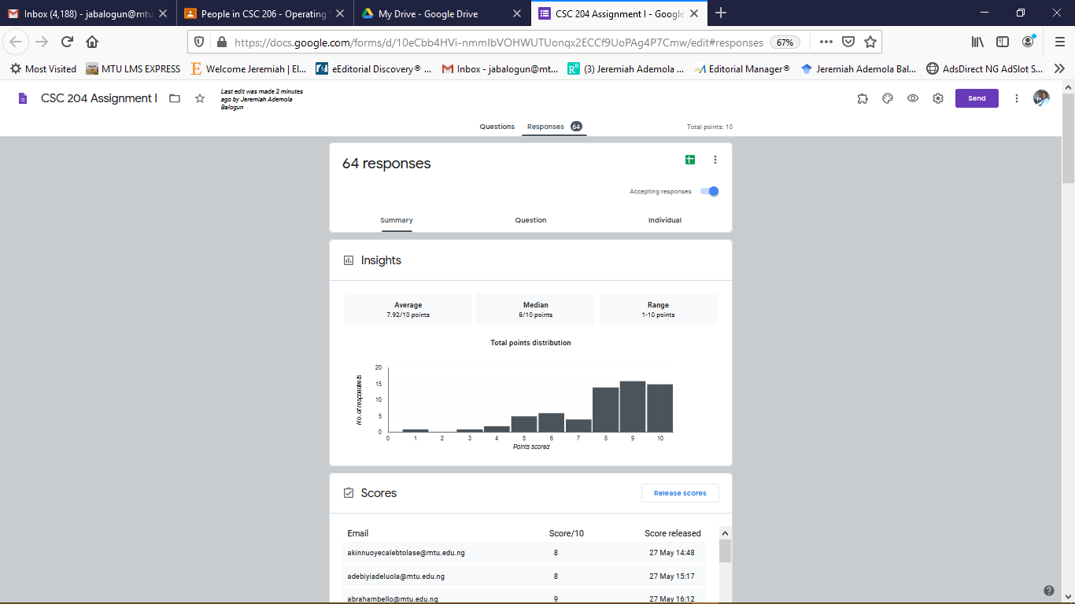
ACCESSING RESPONSES TO GOOGLE FORMS
By clicking Responses, one is able to view the responses made by the users to the information requested.
The responses can be viewed either as a general summary, by question or by individual response.
If there is need to view the Responses on a spreadsheet then the user clicks + to link data to Google Sheets.

Slide 32
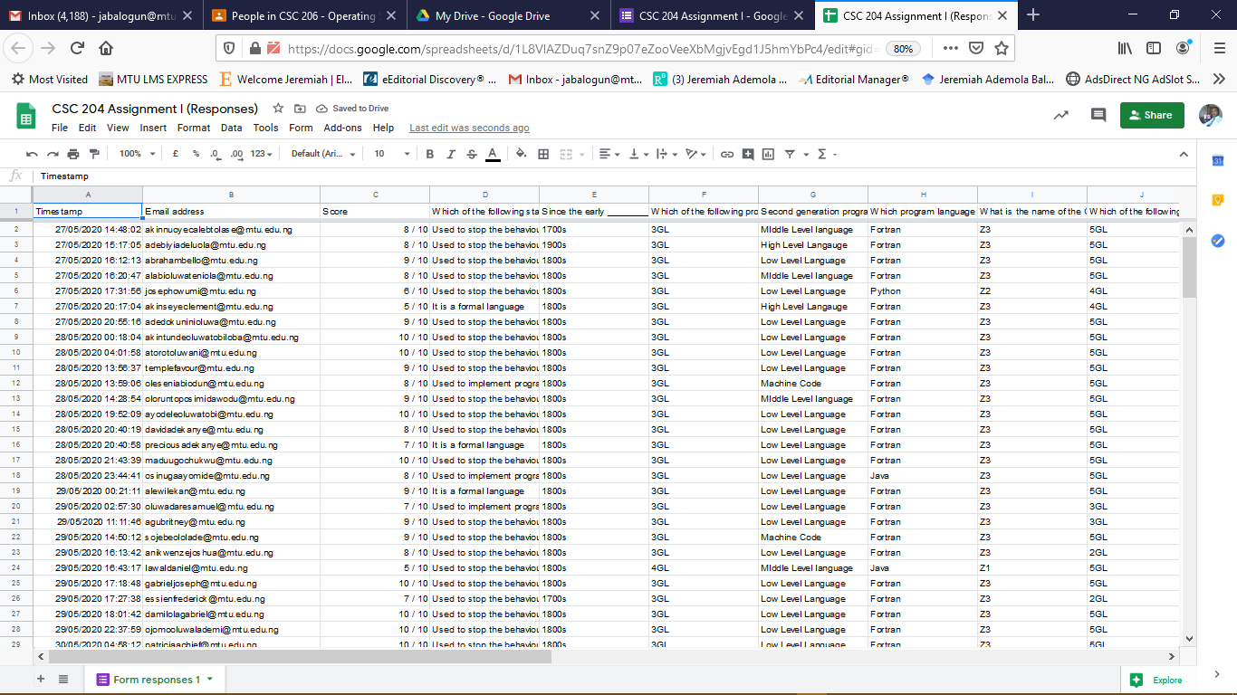
ACCESSING RESPONSES TO GOOGLE FORMS
By clicking the + symbol under Responses, one can access the responses on Google Sheet after linking.
The Google Sheet generated can be Downloaded locally to disk or Shared with other Gmail or MTU users.

Slide 33
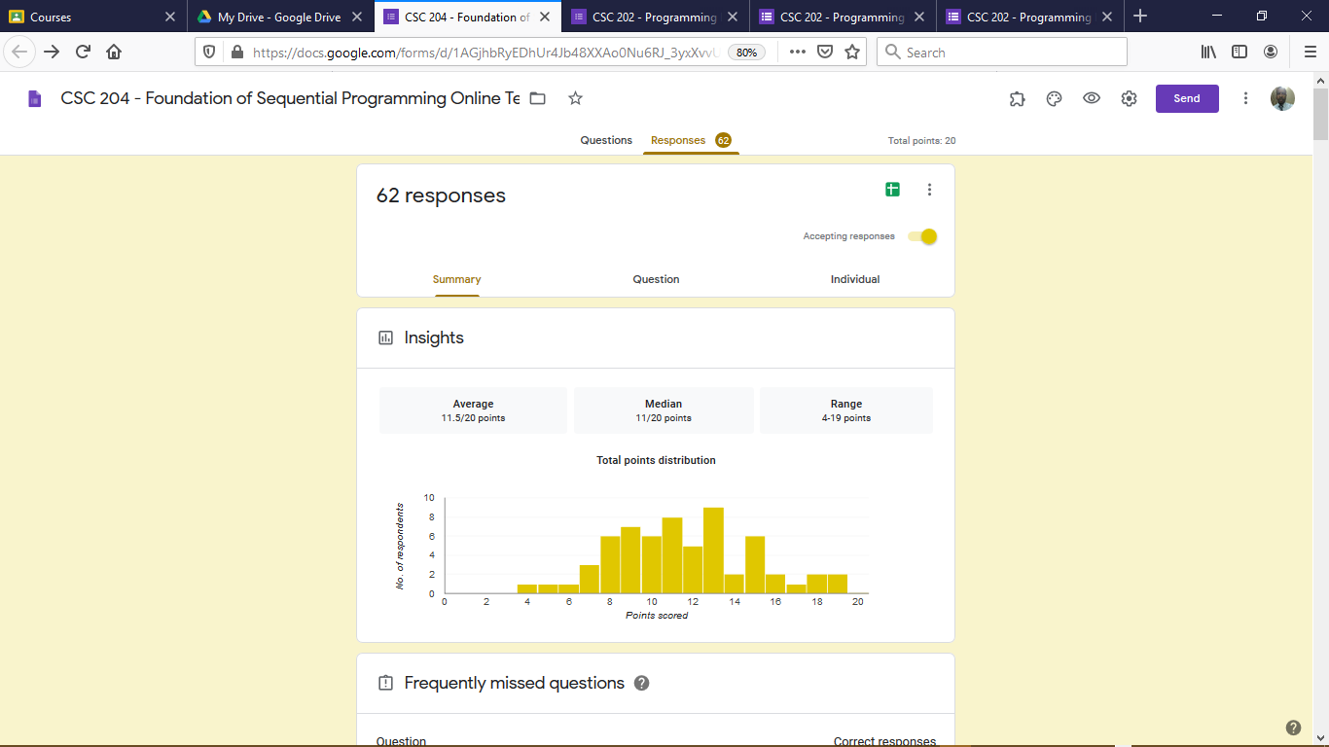
VIEWING THE TOTAL POINT PERFORMANCE OF STUDENTS
  Under the Insights Section:
    The distribution of the average score (11.5), median score (11) and the range of scores of Students is shown.
      The range shows the minimum and maximum score of Students (minimum of 4 and maximum of 9).
    Also, a frequency distribution of the total number of Students whom made each score is shown.

Slide 34
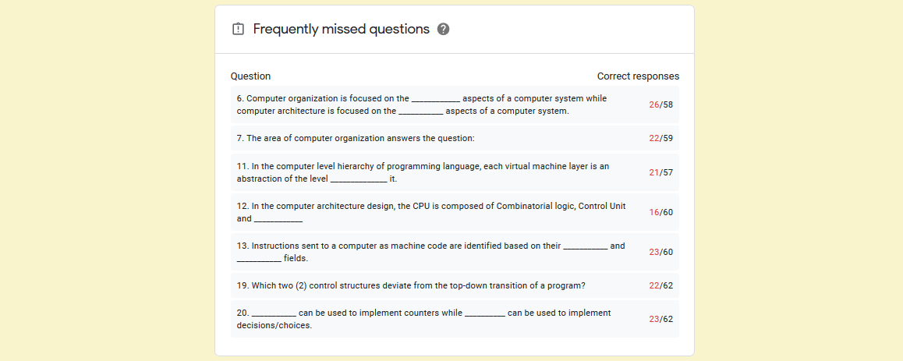
VIEWING THE TOTAL POINT PERFORMANCE OF STUDENTS….
  Under the Frequently Missed Questions
    The various questions which were missed by majority of students are presented in this section.
    For example, in question 6, the values 26/58 means that out of the 58 students who attempted the question only 26 got it right while 32 missed the question.

Slide 35
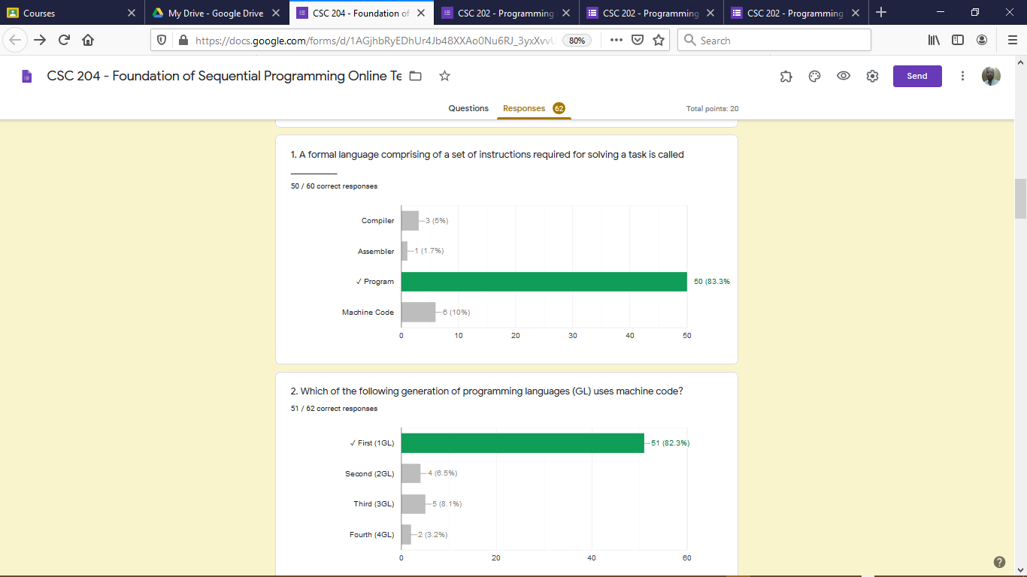
VIEWING THE TOTAL POINT PERFORMANCE OF STUDENTS….
  For each Question asked the Students
    The first part of the question response shows the total number of correct out of total attempted response (e.g. 50/60 shows that there were 50 correct responses out of 60 attempts)
    A bar chart shows the frequency distribution for each option while the correct option is indicated green.

Slide 36
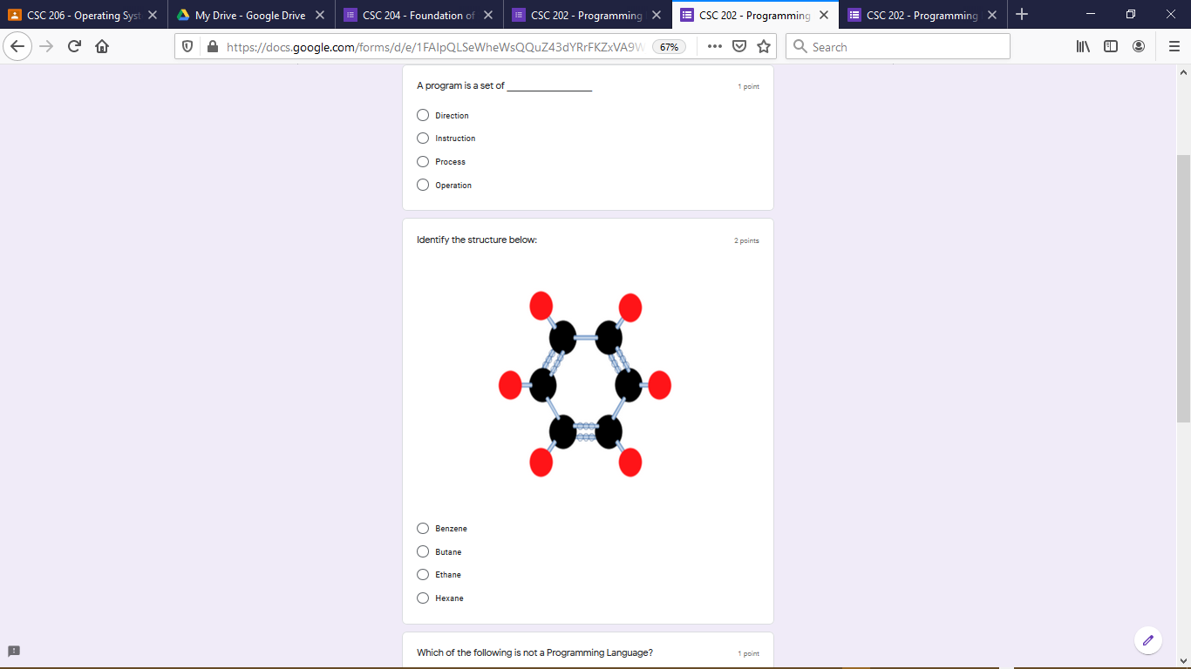
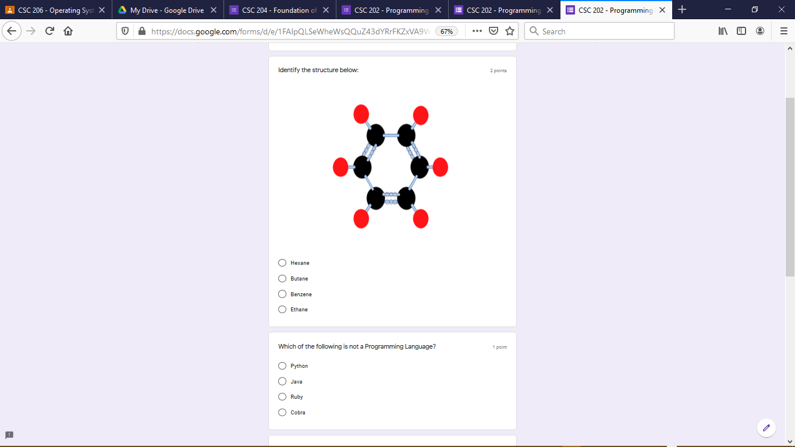
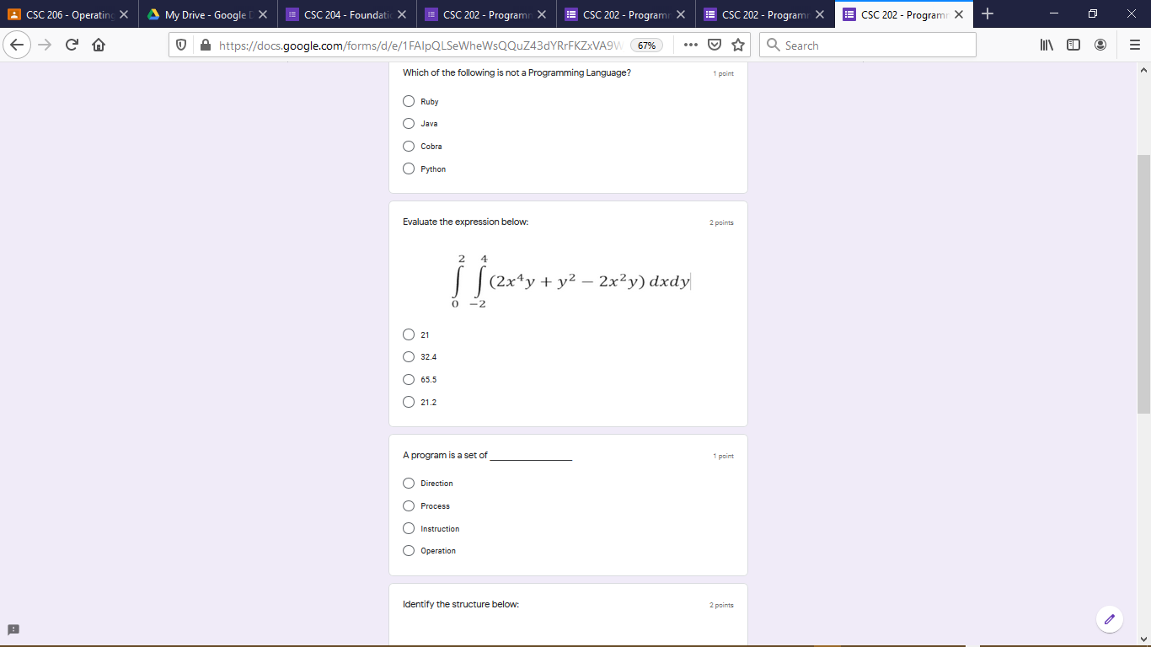
VIEWING QUESTION AND OPTION SHUFFLING ORDER
By clicking on the preview icon of the Google Form
  The view of the Google Form from a Student’s end can be viewed.
  For as many Students who access the Goggle Form using this link, there will be various combination of question order.
  Also, similar questions will also have various distribution of option order.
  There is no need to create a question that collects the names and matriculation of students since the Form will be linked to the Google Classroom (via MTU mail) else they will also be shuffled alongside test/examination questions.

Slide 37
LINKING
GOOGLE FORM
WITH
GOOGLE CLASSROOM

Slide 38
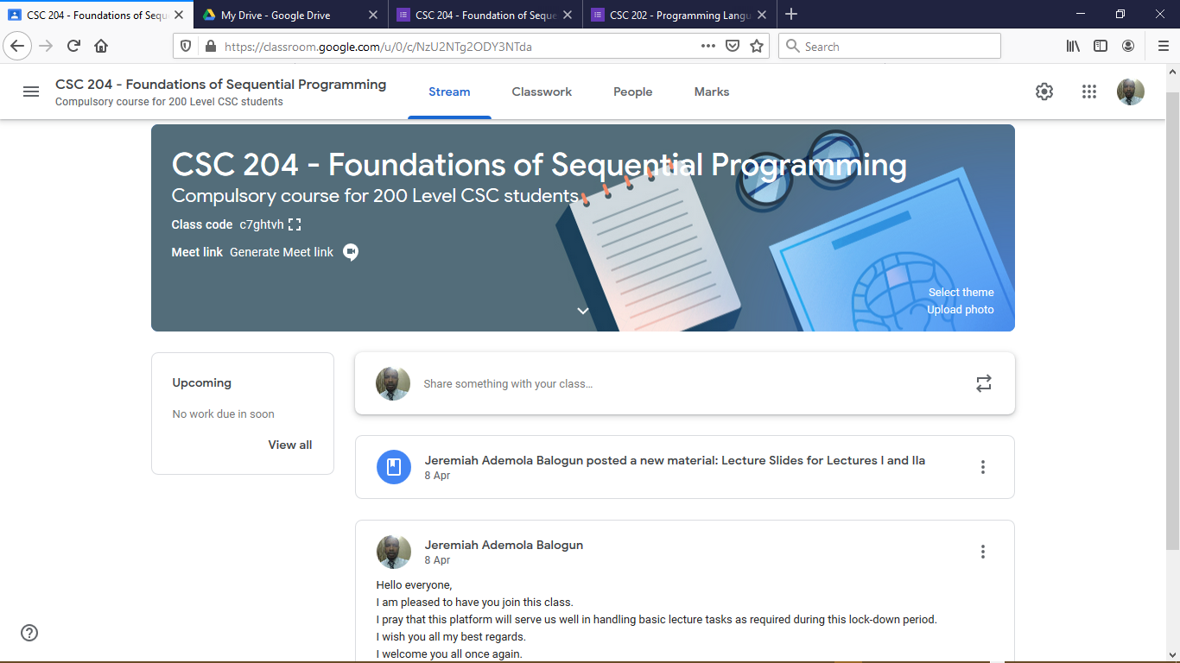
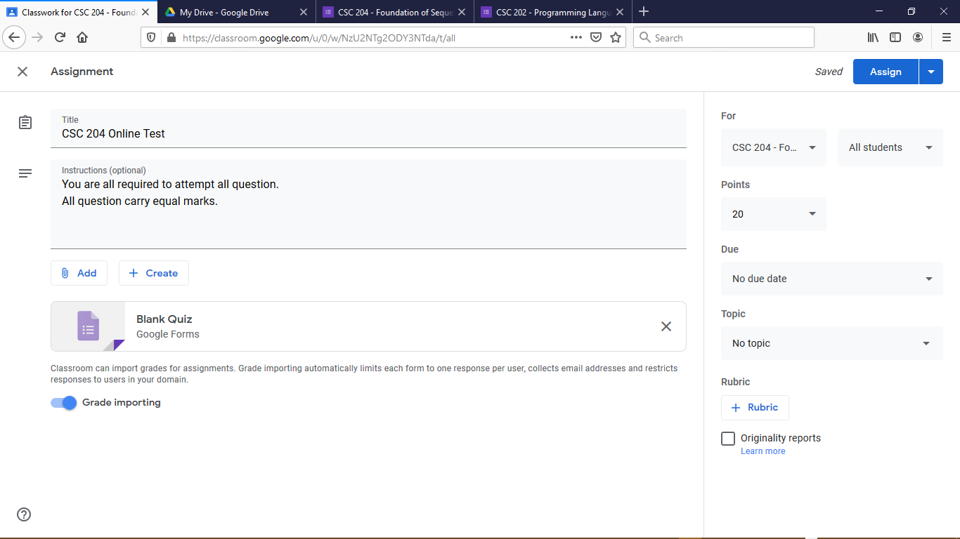
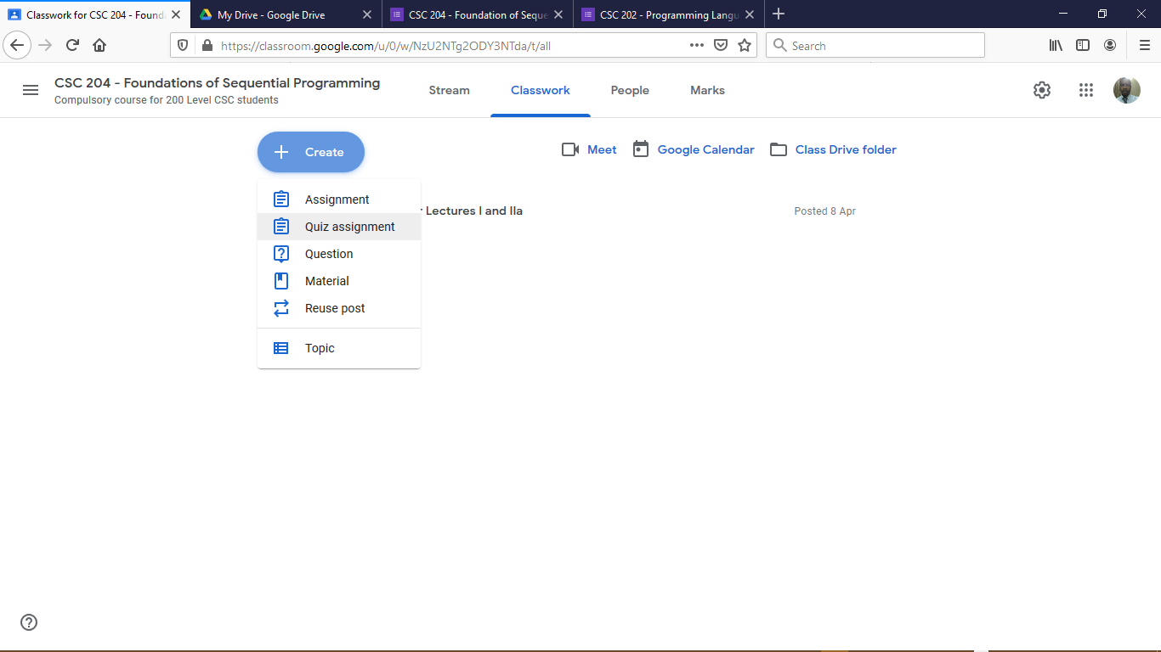
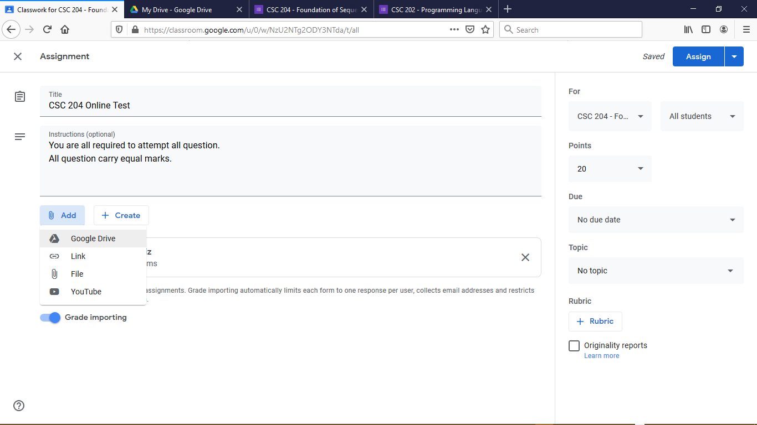
LINKING GOOGLE FORM TO RESPECTIVE COURSE IN GOOGLE CLASSROOM
Go to Google Classroom and access the required class then select Classwork (top left image)
Under Classwork select Create then select Quiz Assignment (bottom left image)
Identify the Assignment Title and provide optional instructions (top right image)
On the right-hand side, select All Students and specify total point which in this case is 20 points.
Link the Google Form by Clicking on Add and select Google Drive then pick the required Google Form (bottom-right image)

Slide 39
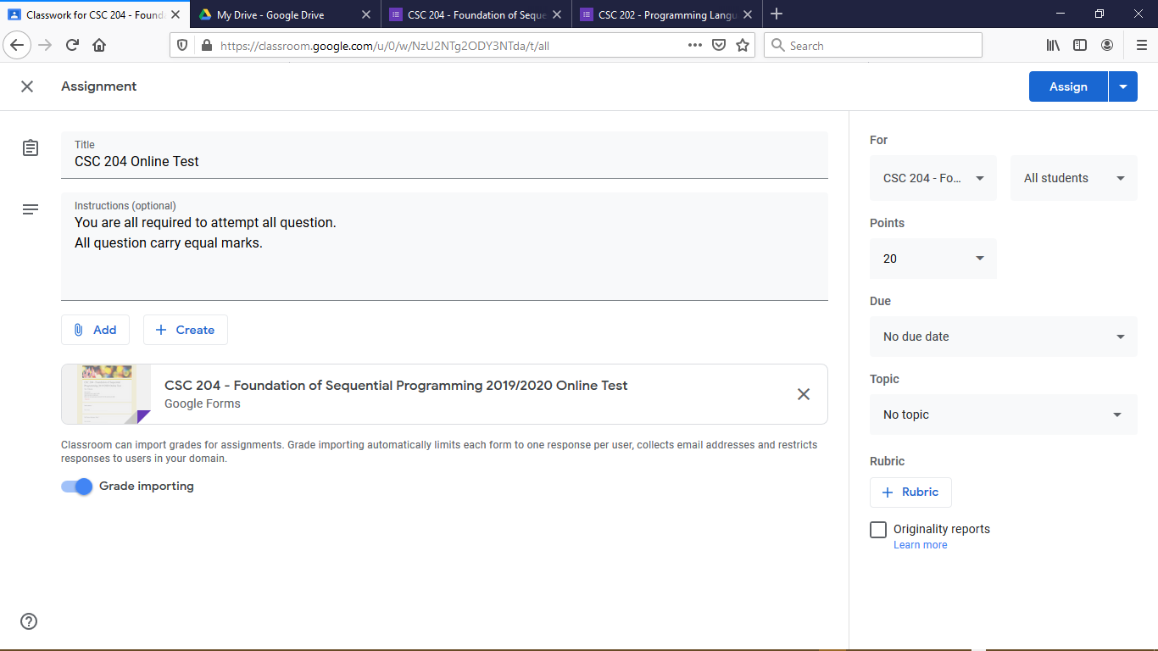
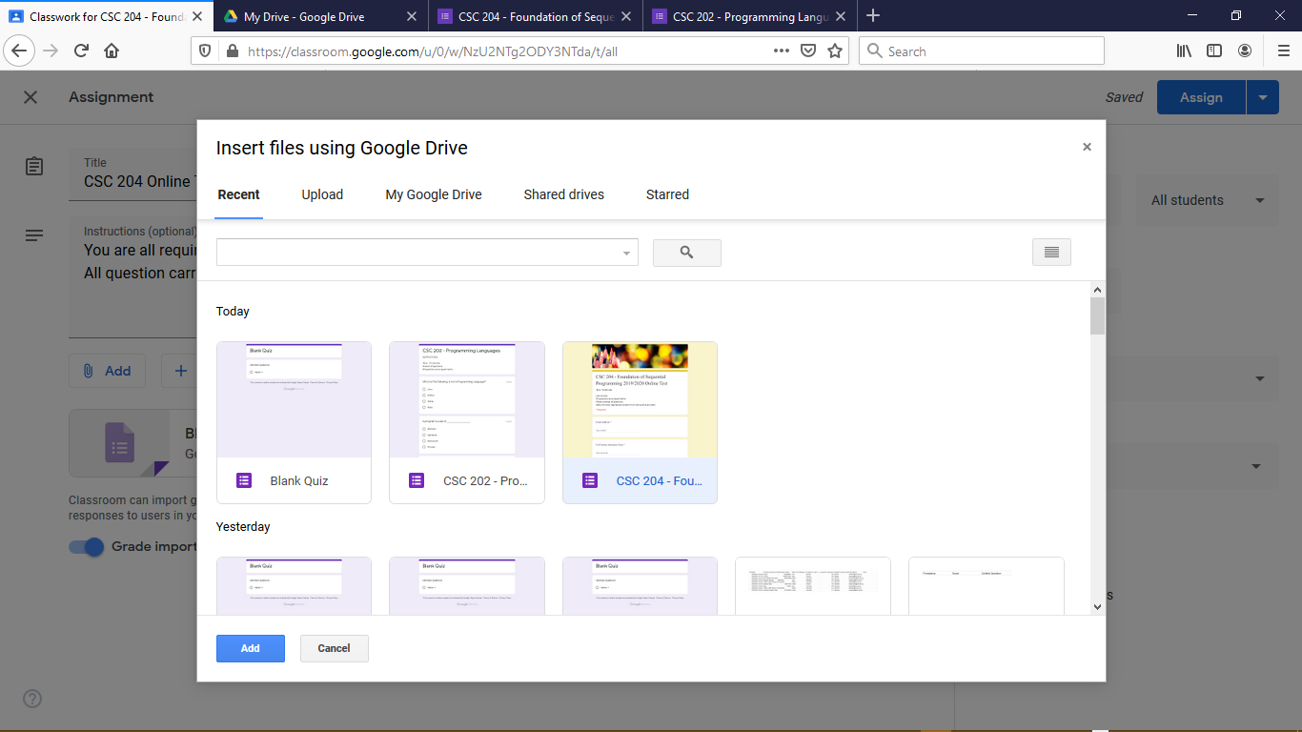
LINKING GOOGLE FORM TO RESPECTIVE COURSE IN GOOGLE CLASSROOM
After Clicking on Google Drive
  Select the Google Form which is required to be linked to Google Classroom Quiz Assessment then click Add(left image)
  At this point the Google Form has been successfully linked to the Google Classroom.
  Delete the Blank Quiz Google Form in the Quiz Assignment (right image).
  Leave the Grade Importing option on since this allows the grades to be imported to the Classroom from Form Responses

Slide 40
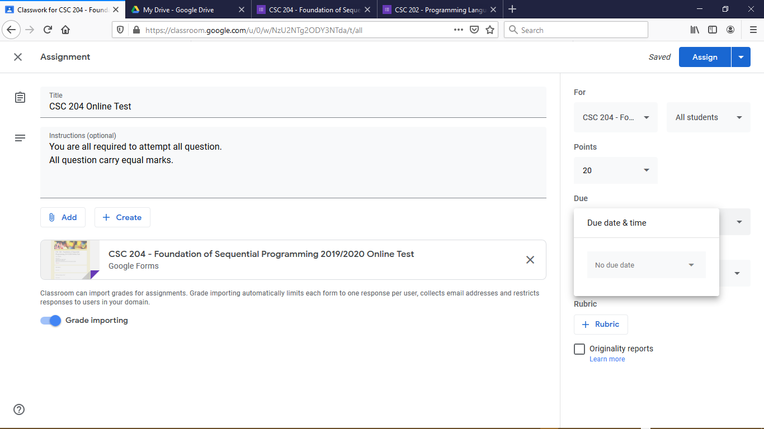
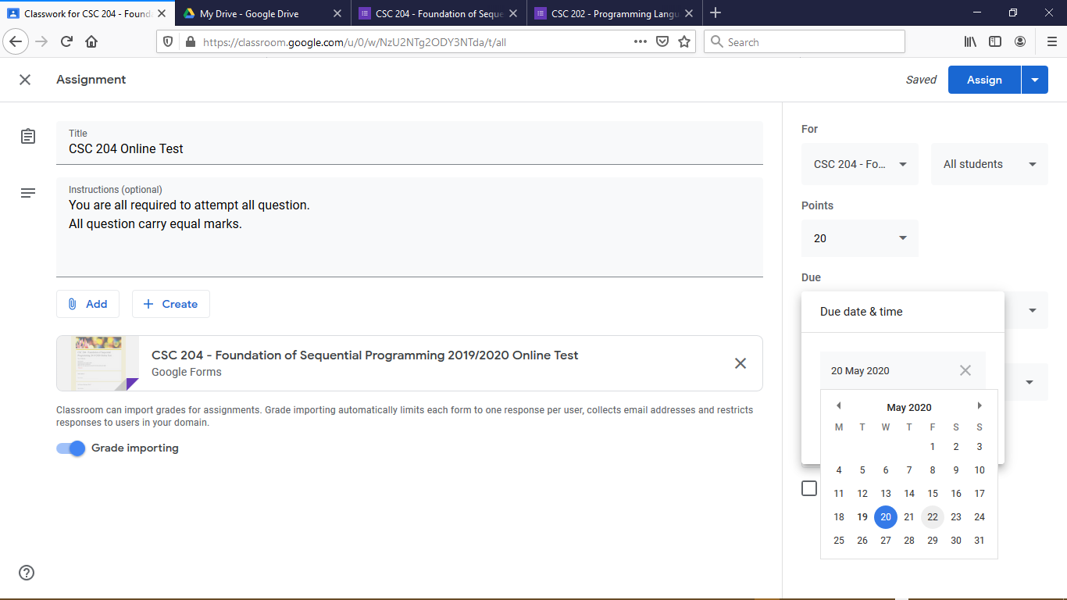
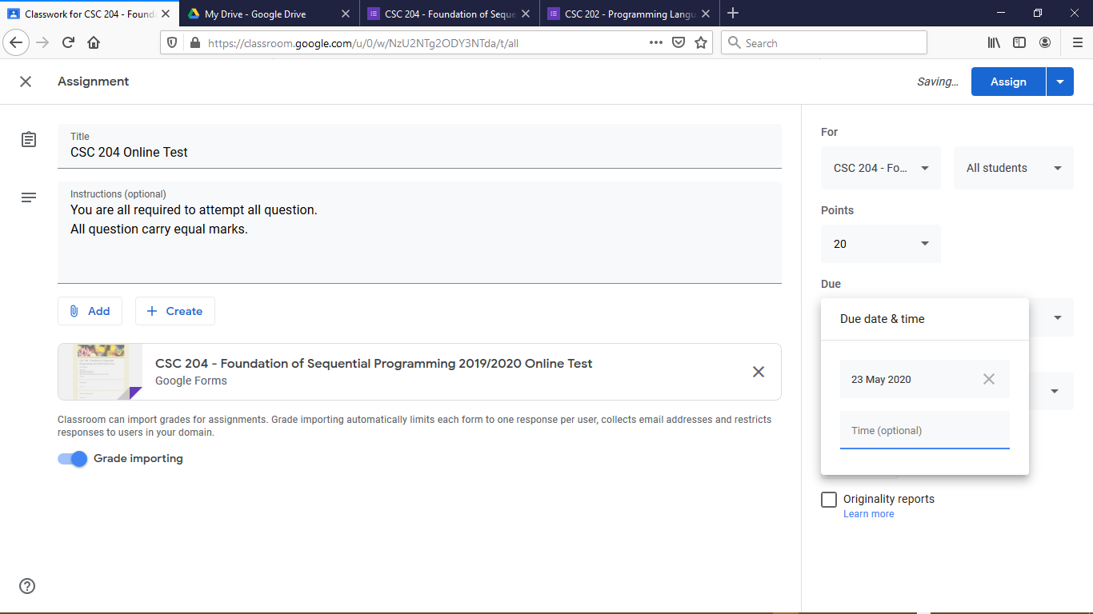

SETTING THE DUE DATE AND TIME OF GOOGLE CLASSROOM TEST/EXAM
At the right hand side of the Assignment section underneath the Points (No Due date)
  Click on No Due Date to select Due Date and Time by clicking the arrow (Image 1)
  Select Due Date from Calendar (Image 2)
  Click on Time (optional) as a 24 hours format (e.g. 8 am is 8:00 while 2 pm is 14:00 (Image 3)
  The Google Classroom Assignment Due Date and Time has been successfully set (Image 4).
  This is when the assignment is expected to be ended.

Slide 41


SCHEDULING THE GOOGLE CLASSROOM TEST/EXAM
  At the right hand side of the Assignment section, click the arrow beside Assign (Image 1)
  Click on Schedule (Image 2)
  Select Scheduled Date from Calendar and Time then click Schedule (Image 3).
  The Google Classroom Assignment Scheduled Date and Time has been successfully set.
  This is when the notification for the Start of the Test/Examination will be sent to he Students’ MTU mail box.

Slide 42

SCHEDULING THE GOOGLE CLASSROOM TEST/EXAM
  The Figure shown below presents the final presentation of the Scheduled Test on the Classwork section of the Google Classroom
  Once the Scheduled date has arrived the beginning of the Test/Exam is notified to all students.
  For every submission made by each student, an e-mail notification is sent to the lecturer’s mail.
  Student grades can be viewed by lecturer and handed in to the Students to view via Google Classroom or by E-mail.

Slide 43



RECEIVING NOTIFICATION OF GOOGLE CLASSROOM TEST/EXAM
  Notification about activities taken place on the Google Classroom will be received via MTU mail (Top Image).
  Once the scheduled time for the test/Examination has reached, a notification will be sent by mail to information the staff of the beginning of the test/Examination (Bottom Left Image).
  The Staff will also receive notification about tests/Examinations submitted late by students (Bottom Right Image).

Slide 44


RELEASING MARKS FROM GOOGLE FORM TO THE GOOGLE CLASSROOM
  Following completion of the Test/Examination, the staff should visit the Response section of the linked Google Form
  The Staff should scroll to the section indicating the Scores then Click Release Scores (Left Image)
  A dialog box will be prompted which will require the Staff to Select All Respondents at the top part (Right Image)
  Click SEND EMAIL AND RELEASE in order to release the grades to the Students via E-mail (Right Image).

Slide 45


ACCESSING GRADES ON GOOGLE CLASSROOM
  Upon returning to the Google Classroom, click on the required course and Select the Classwork menu tab (Right Image).
    This will allow us view the Test/Examination and by clicking the tab showing CSC 204 Online Test reveals the Summary.
  The Summary of the completed Test/Examination can now be viewed (Right Image)
    Handed In shows the number of Students who have submitted the Test/Examination but not yet graded.
    Assigned shows the number of students whom did not take part in the Test/Examination.
    Marked shows the number of Students who have been graded after handing in.
  By selecting View Assignment the Staff is able to view the overall information about the outcome of the Test/Examination.

Slide 46




IMPORTING AND RETURNING GRADES TO STUDENTS ON GOOGLE CLASSROOM
  Upon accessing complete information of the Classwork, it is important to Import and Return Grades to Students who handed In via the Student Work which is split into Left and Right Tabs (Left Image).
  The Left Tab shows the various students that have handed in without scores however upon Clicking Import Grades, the results of such Students can be seen as shown in the Right Image.
  Following the successful importation of grades, the results of the students can then be returned (allows students to see their scores when they visit the classroom) by selecting the Student and Clicking Return
  This process moves the name of a graded student from Handed In to the Marked List.
  Students who did not attempt the Test/Examination are placed on a Missing List (or Assigned List).

Slide 47



DOWNLOADING STUDENT GRADES FROM GOOGLE CLASSROOM
  Upon successfully returning the grades of all students who have completed the Tests/Examination, there is a need for the Staff to download the results.
  This is achieved by clicking the settings on the top-right corner then selecting Download all marks as CSV (Left Image).
  This will prompt the Staff to either Open or Save the File however the Staff should Save the File then click OK.
  Following the completion of the download, the Staff can open the Spreadsheet file in order to view the presentation of the results (Right Image) showing the Surname, First name, E-mail address and Score for each student who was graded but Nil for those who failed to take the Test/Examination.

Slide 48
THANK YOU ALL!!!!

