Slide 1
Presented
By
FAYEMI, OLANREWAJU EMMANUEL
at
South African Society of Dairy Technology 46th Annual General Meeting and Symposium on Food Safety and Security: A dairy perspective. (16th – 19th April, 2013), Khaya Ibhubesi, Parys Free State, South Africa

Slide 2
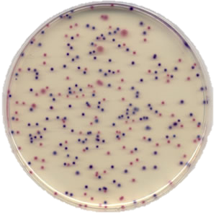

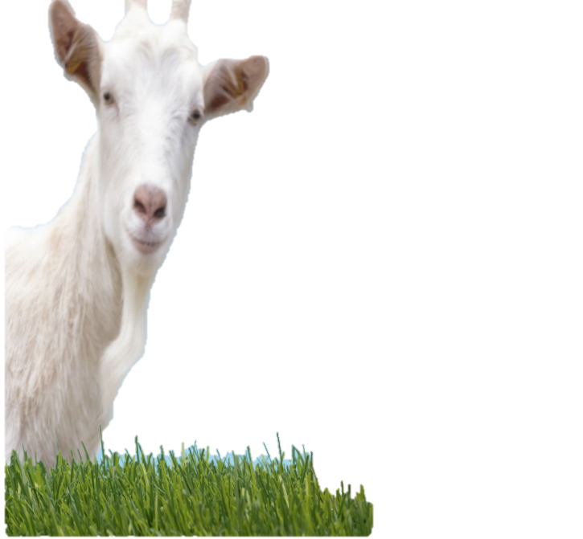
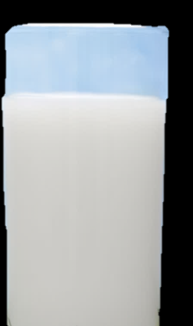
The effect of probiotic bacteria on environmental E. coli strains in fermented goat’s milk
- FAYEMI, O. E

Slide 3
Introduction
E. coli strains are non-pathogenic members of the intestinal microbiota of humans and other animals, but some acquired virulence factors that enable them to cause important intestinal and extra intestinal diseases, such as diarrhoea, hemorrhagic colitis (HC), and haemolytic uremic syndrome (HUS)
Diarrhoea disease is a major cause of morbidity and mortality in children aged five and below in most low-and-middle income countries (Olatunde et al. 2011)

Slide 4

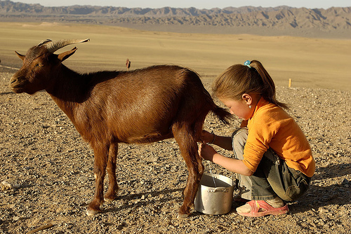
In 2009, UNICEF and WHO reported that one in five child deaths (about 1.5 million) each year is due to diarrhoea. It kills more young children than AIDS, malaria and measles combined
According to Carey et al. (2008), the majority of the outbreaks of diarrhoea are associated with water and food.
In many rural areas of South Africa, village communities depend on untreated water from wells, rivers, and other surface-water for drinking and food processing (Pascal, 2009)

Slide 5
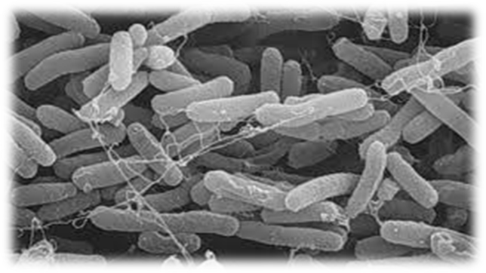
Acid Resistance in E. coli
Acidification is a treatment commonly used to control growth or kill pathogenic microorganisms in foods
Implication of fermented foods in food-borne outbreaks caused by E. coli.
Several studies have been done to determine the mechanism of acid–adaptation and acid resistance in E. coli systems (Dlamini and Buys, 2009)

Slide 6
Problem Statement
Eli Metchnikoff hypothesis
If the extended survival of E. coli in acidic foods cannot be dismissed, then What will be the effects of probiotic bacteria on the growth of E. coli in fermented goat’s milk product?

Slide 7
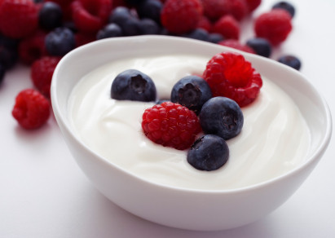

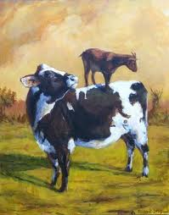
Why goat’s milk ?
The lower buffering capacity of goat’s milk when compared with that of cow milk may allow for a faster acidification of that media, thus avoiding contamination during fermentation during fermentation undertaken with species that grow slowly such as common probiotic.

Slide 8
Aim
This work was undertaken to study the survival of acid adapted and Non adapted E. coli strains in the goat’s milk fermented with starter cultures and probiotic bacteria.

Slide 9
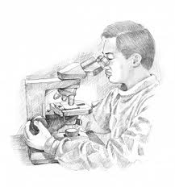
Methodology
Acid Adaptation procedure
Raw goat’s milk
Environmental E. coli strains
Addition of Skim milk (3%) and Gelatine (0.5%)
Induction of acid resistance in TS broth at pH 4.5
Pasteurization
Incubation at 37⁰C for 18h
  Inoculation with L. plantarum (B411) and starter culture ( L. bulgaricus and S. thermophilus)
Centrifugation
DEPENDENT VARIABLES
Acid adapted E. coli strains
Fermentation at 30⁰C for 6 hours
Viability on selective agar
  Analyses
  Microbial growth/counts
pH (pH meter)
TTA
  Inoculation with acid adapted and Non-adapted E. coli strains when the pH is at 4.5
  Analyses at 2h interval
Fermented goat’s milk

Slide 10
Results
Survival of environmental E .coli in TS Broth at pH 4.5

Slide 11
CHANGES IN THE PH DURING THE FERMENTATION OF GOAT’S MILK

Slide 12
CHANGES IN THE TITRATABLE ACIDITY DURING THE FERMENTATION OF GOAT’S MILK.

Slide 13
GROWTH OF STARTER CULTURES AND L. PLANTARUM (B411) DURING THE FERMENTATION OF GOAT’S MILK

Slide 14
SURVIVAL OF ACID ADAPTED (AA) AND NON ADAPTED E COLI DURING THE FERMENTATION OF GOAT’S MILK

Slide 15
Conclusions
The preliminary results from this study indicate that:
Fermentation of the goat’s milk with a single strain of L. plantarum does not ensure the safety of the product as it allows the survival of both acid adapted and non-adapted toxigenic E. coli strains;
Inhibition of acid adapted E. coli strains can be achieved in fermented goat’s milk through fermentation of the product with the combination of starter cultures (L. bulgaricus and S. thermophilus) and L. plantarum;

Slide 16

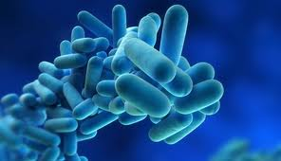

Slide 17
Thank you for listening

