Slide 1
Presented
By
FAYEMI, OLANREWAJU EMMANUEL
(Guest Speaker)
at
Dairy evening and award presentation of South African Society of Dairy Technology, 4th August, 2013, University of Pretoria, Hatfield Campus, South Africa.

Slide 2
The survival of pathogenic E. coli strains in fermented milk
- O. E. FAYEMI

Slide 3
Outline
Introduction
Origin and morphology of E. coli
Virotypes of E. coli
Mechanisms of inhibition of pathogenic bacteria
Mechanism of adaptation to stress in pathogenic E. coli
Experimental
Results
conclusion

Slide 4
Introduction
E. coli strains are non-pathogenic members of the intestinal microbiota of humans and other animals, but some acquired virulence factors that enable them to cause important intestinal and extra intestinal diseases, such as diarrhoea, hemorrhagic colitis (HC), and haemolytic uremic syndrome (HUS)
Diarrhoea disease is a major cause of morbidity and mortality in children aged five and below in most low-and-middle income countries (Olatunde et al. 2011)

Slide 5
In 2009, UNICEF and WHO reported that one in five child deaths (about 1.5 million) each year is due to diarrhoea. It kills more young children than AIDS, malaria and measles combined
According to Carey et al. (2008), the majority of the outbreaks of diarrhoea are associated with water and food.
In many rural areas of South Africa, village communities depend on untreated water from wells, rivers, and other surface-water for drinking and food processing (Pascal, 2009)

Slide 6
Origin and morphology of E. coli
German bacteriologist-paediatrician and Theodor Escherich first described E. coli in 1885, as Bacterium coli commune, which he isolated from the faeces of newborns. It was later renamed Escherichia coli.
It was not until 1935 that a strain of E. coli was shown to be the cause of an outbreak of diarrhoea among infants.
E. coli is in the bacterial family Enterobacteriaceae, which is made up of Gram-negative, non-sporeforming, rod-shaped bacteria that are often motile by means of flagella.

Slide 7
E coli is usually seen as a unicellular Gram-negative organism about 1 micrometer in width and 2-4 micrometers in length.
For most of the 20th century, E. coli has been used as the principal indicator of faecal pollution in both tropical and temperate countries.
E. coli comprises about 1% of the total faecal bacterial flora of humans and most warm-blooded animals.

Slide 8
The generation time for E. coli in the intestine is thought or believed to be about 12 hours
In its natural environment, as well as the laboratory, E. coli can respond to environmental signals such as chemicals, pH, temperature and osmolarity in a number of very remarkable ways considering it is a single cell organism

Slide 9
Physiology of E. coli
Physiologically, E. coli is versatile and well-adapted to its characteristic habitats.
In the laboratory it can grow in media with glucose as the sole organic constituent.
Wild-type E. coli has no growth factor requirements, and metabolically it can transform glucose into all of the molecular components that make up the cell.

Slide 10
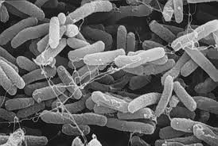
Virotypes of E. coli
Enterotoxigenic E. coli (ETEC)
Enteropathogenic E. coli (EPEC)
Enteroivasive E. coli (EIEC)
Enteroaggregative E. coli (EAggEC)
Enterohemorrhagic E. coli (EHEC)
Each class falls within a serological subgroup and manifests distinct features in pathogenesis.

Slide 11
Enterotoxigenic E. coli (ETEC)
ETEC is one of the largest pathotypes among DEC and is responsible for a majority of the episodes of infants diarrhoea and deaths in developing countries or regions of poor sanitation.
ETEC are acquired by ingestion of contaminated food and water.
Enterotoxins produced by ETEC include the LT (heat-labile) toxin and/or the ST (heat-stable) toxin, the genes for which may occur on the same or separate plasmids.
The LT enterotoxin is a large immunogenic oligotoxin which is very similar to cholera toxin of Vibrio cholerae in sequence, structure and mechanism of action.

Slide 12
Figure 1: Classification of heat labile enterotoxin in Enterotoxigenic E. coli (ETEC)
Heat Labile Enterotoxin (LT)
LT-I LT-II
LT-Ih (Human) LT-Ip (Pig) LT-IIa LT-IIb LT-IIc
Pathogenic for both human and animal Associated with ETEC of animal origin
Rarely with humans isolates

Slide 13
Heat Stable Enterotoxin (ST)
ST I or ST a (methanol-soluble) ST II or ST b (methanol-insoluble)
Four cysteine residues which forms disulphide STp (ST Porcine) STh (ST Human) bonds and has no homology with STa
Figure 2: Classification of heat stable enterotoxin in Enterotoxigenic E. coli (ETEC)

Slide 14
Enteropathogenic E. coli (EPEC)
EPEC induce a watery diarrhoea similar to ETEC, but they do not possess the same colonization factors and do not produce ST or LT toxins.
They produce a non-fimbrial adhesion designated intimin, an outer membrane protein, that mediates the final stages of adherence.
Although they do not produce LT or ST toxins, there are reports that they produce an enterotoxin similar to that of Shigella.

Slide 15
Enteroivasive E. coli (EIEC)
EIEC closely resemble Shigella in their pathogenic mechanisms and the kind of clinical illness they produce. EIEC penetrate and multiply within epithelial cells of the colon causing widespread cell destruction.

Slide 16
Enteroaggregative E. coli (EAggEC)
The distinguishing feature of EAggEC strains is their ability to attach to tissue culture cells in an aggregative manner.
These strains are associated with persistent diarrhoea in young children.
They resemble ETEC strains in that the bacteria adhere to the intestinal mucosa and cause non-bloody diarrhea without invading or causing inflammation.

Slide 17
Enterohemorrhagic E. coli (EHEC)
EHEC are represented by a single strain (serotype O157:H7), which causes a diarrheal syndrome distinct from EIEC (and Shigella) in that there is copious bloody discharge and no fever. A frequent life-threatening situation is its toxic effects on the kidneys (hemolyticuremia).

Slide 18
Mechanisms of inhibition of pathogenic bacteria
Eli Metchnikoff hypothesis
Organic acids
Phenolic compounds

Slide 19
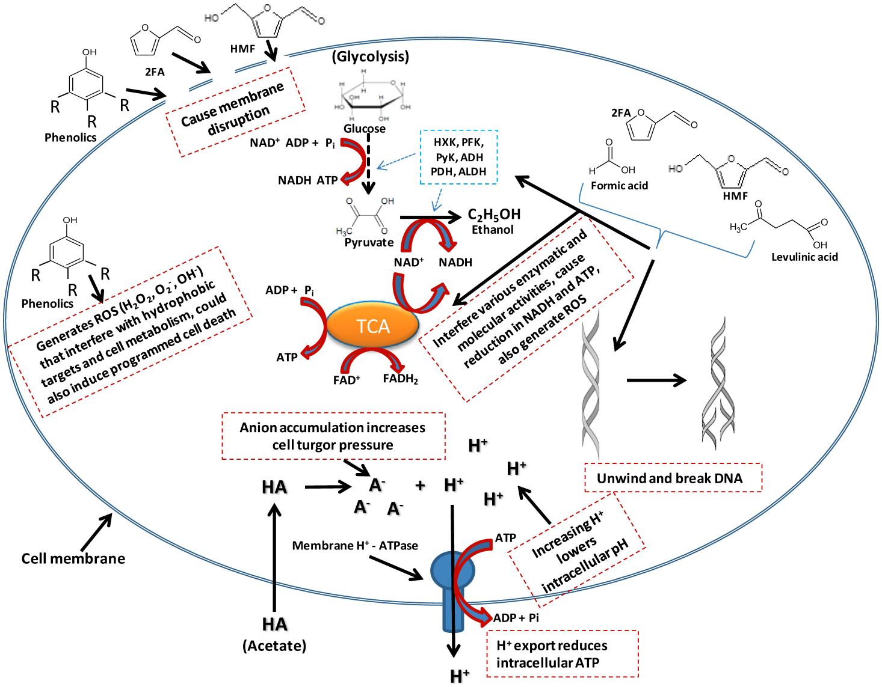
Figure 3: A model of effects of inhibitors presence in pathogenic bacteria cells. As depicted in the illustration, inhibitory effect could range from membrane disruption, lowering of intracellular pH to interference with lots of cell metabolic targets/pathways.
Source :Omodele and Bongani (2003)

Slide 20
Organic acids
The presence of organic acids during fermentation result in intracellular acidification to levels that damage or disrupt key biochemical processes.
Under severe acidic pH (that is, pH 3), proton leakage is faster than the cell’s ability to maintain homeostasis. Organic acids penetrate the cell membrane and after dissociation inside the cell, the released proton acidifies intracellular pH.
The lower the exterior pH, the greater the influx of organic acids. The membrane-impermeable ionized form of the organic acid accumulates and the constant influx of protons will eventually deplete cellular energy, causing cell death in enterobacteriaceae.

Slide 21
Phenolic compounds
Their high hydrophobicity allows furfural and HMF to compromise membrane integrity leading to extensive membrane disruption/leakage, which eventually will cause reduction in cell replication rate and ATP production.
This membrane disruption, allows the release of proteins, RNAs, ATP, Ions, out of the cytoplasm, consequently causing reduced ATP levels, diminished proton motive force and impaired protein function and nutrient transport.

Slide 22
They enhance the generation of reactive oxygen species (ROS) such as hydrogen peroxide (H2O2), super oxides (O2-) and super hydroxyl (OH-) that interact with proteins/ enzymes, which results in their denaturation causing DNA mutagenesis, and induce programmed cell death.

Slide 23
Acid Resistance in E. Coli
Acidification is a treatment commonly used to control growth or kill pathogenic microorganisms in foods
Acid stress is described as the combined biological effect of H+ ion (that is, pH) and weak acids (organic) in the environment as a result of fermentation
The three complex medium-dependent of acid resistance systems in E. coli included an oxidative system (AR1) and two fermentative acid resistance systems involving a glutamate decarboxylase (AR2) and an arginine decarboxylase (AR3)

Slide 24
Mechanism of adaptation to stress in pathogenic microorganisms
Activation and regulation of global stress responses
Maintenance of pH homeostasis
Maintenance of cell membrane integrity
Activation and regulation of global stress responses
Inhibitors degradation

Slide 25
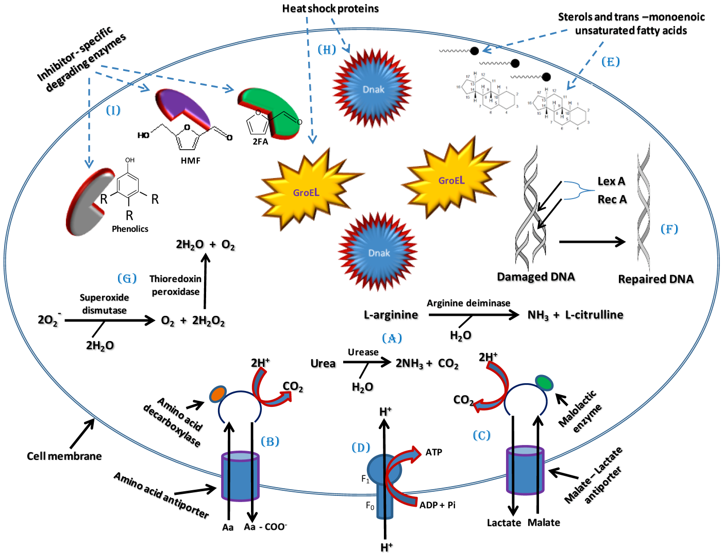
Figure 3: A model of tolerance and adaptation mechanisms which could be employed by pathogenic bacteria against the effects of inhibitors and which may involve maintenance of pH homeostasis and cell membrane integrity, activation and regulation of global cellular stress responses and degradation of Inhibitors.
Source :Omodele and Bongani (2003)

Slide 26
Maintenance of pH homeostasis
Increased production of ammonia (NH3). Ammonia will combine with the excess H+ ions present in the cell upon exposure to acids produced to form ammonium (NH4+) ions, consequently raising the intracellular pH.
This can be linked to the bacterial cells generating more ATP in order to maintain the intracellular pH, forcing the bacteria to switch to anaerobic respiration.

Slide 27
Maintenance of cell membrane integrity
Membrane cyclopropane fatty acid content is a major factor in the acid resistance of E. coli
The hydrophobicity of the inhibitors results in the interference with fluidity and rigidity and concomitant instability of the bacterial cell membrane.
One means to cope with this instability is by increasing sterol production and altering phospholipid fatty acids through synthesis of more trans-monoenoic than cis-monoenoic unsaturated fatty acids .
This enhances membrane restructuring, conferring higher rigidity and resistance to disruption by external factors such as LCM bioconversion inhibitors.

Slide 28
Activation and regulation of global stress responses
Another means by which bacteria can tolerate these inhibitors is through the activation of global stress responses. Sigma factors (σS and σB) that regulate the general stress responses in bacteria play a major role in initiating the transcription of vital stress response genes.
Activated response genes include those encoding SOS response proteins such as LexA and RecA which participate in various housekeeping functions.including DNA repair and correction of mutation errors

Slide 29
Inhibitors degradation
The synthesis and activation of proteins such as enzymes or co-enzymes in inhibitor-specific degradation pathways can contribute significantly towards alleviating the negative effects of the inhibitors on bacteria.

Slide 30
Problem Statement
If the extended survival of E. coli in acidic foods ( in the presence of organic acids) cannot be dismissed, then What will be the effects of probiotic bacteria on the growth of E. coli in fermented goat milk product?

Slide 31
Why goat milk ?
The lower buffering capacity of goat milk when compared with that of cow milk may allow for a faster acidification of that media, thus avoiding contamination during fermentation undertaken with species that grow slowly such as common probiotic.

Slide 32
Objective
This work was undertaken to study the survival of acid adapted and Non adapted E. coli strains in the goat milk fermented with starter cultures and Lactobacillus plantarum (B411) .

Slide 33
Figure 4: Experimental design for the fermentation of the goat milk and acid induction process in the Enterotoxigenic E. coli strains
Methodology
Acid Adaptation procedure
Raw goat milk
Environmental E. coli strains
Addition of Skim milk (3%) and Gelatine (0.5%)
Induction of acid resistance in TS broth at pH 4.5
Pasteurization
Incubation at 37⁰C for 18h
  Inoculation with L. plantarum (B411) and starter culture ( L. bulgaricus and S. thermophilus)
Centrifugation
DEPENDENT VARIABLES
Acid adapted E. coli strains
Fermentation at 30⁰C for 6 hours
Viability on selective agar
  Analyses
  Microbial growth/counts
pH (pH meter)
TTA
  Inoculation with acid adapted and Non-adapted E. coli strains when the pH is at 4.5
  Analyses at 2h interval
Fermented goat milk

Slide 34
Results
Figure 5: Survival of environmental E .coli in TS Broth at pH 4.5

Slide 35
Figure 6: Changes in the pH during the Fermentation of Goat Milk

Slide 36
Figure 7: Changes in the Titratable Acidity (TTA) during the Fermentation of Goat Milk

Slide 37
Figure 8: Growth of starter cultures and L. plantarum (B411) during the Fermentation of Goat milk

Slide 38
        Figure 9: Survival of Acid adapted (AA) and Non Adapted E Coli during the Fermentation of Goat milk with starter culture and L. Plantarum (B 411)

Slide 39
Conclusions
Fermentation of the goat milk with a single strain of L. plantarum does not ensure the safety of the product as it allows the survival of both acid adapted and non-adapted toxigenic E. coli strains;
Inhibition of acid adapted E. coli strains can be achieved in fermented goat milk through fermentation of the product with the combination of starter cultures (L. bulgaricus and S. thermophilus) and L. plantarum;

Slide 40
Thank you

