Slide 1
CSC 307
COMPUTER ARCHITECTURE AND ORGANISATION
(DR KASALI F. A.)

Slide 2
Objectives of this Lesson
At the end of this class, students should be able to:
Discuss the top level view of a computer
List the steps involved in the Fetch, Execute and Interrupt cycle of an Instruction Cycle
Draw the Instruction cycle state diagram with Interrupts
Discuss the concept of Interrupts and differentiate between the 4 classes of Interrupts
Discuss the concept of scheduling, scheduling types and scheduling algorithms
Define the Operating System and explain its functions
Compare and contrast between time sharing and batch programming
Calculate the wait time for processes
Notes:
Although seemingly simple in concept, computer memory exhibits perhaps the widest
range of type, technology, organization, performance, and cost of any feature
of a computer system. No single technology is optimal in satisfying the memory
requirements for a computer system. As a consequence, the typical computer
system is equipped with a hierarchy of memory subsystems, some internal to the
system (directly accessible by the processor) and some external (accessible by the
processor via an I/O module). We examine first an essential element
of all modern computer systems: cache memory.

Slide 3
Top Level View of the Computer
At a top level, a computer consists of CPU, memory, and I/O components, with one or more modules of each type. These components are interconnected in some fashion to achieve the basic function of the computer, which is to execute programs.
Thus, at a top level, we can describe a computer system by
Describing the external behavior of each component—that is, the data and control signals that it exchanges with other components; and
describing the interconnection structure
and the controls required to manage the use of the interconnection structure
Notes:
Top level view helps us to understand the nature of a computer

Slide 4
What is a Program?
A sequence of steps
For each step, an arithmetic or logical operation is done
For each operation, a different set of control signals is needed
For each operation a unique code is provided
  e.g. ADD, MOVE
A hardware segment accepts the code and issues the control signals
We have a computer whose basic function is to execute instructions.

Slide 5
Components of the computer
The Control Unit and the Arithmetic and Logic Unit (ALU) constitute the Central Processing Unit
Data and instructions need to get into the system and generate desired results
  Input/output
Temporary storage of code and results is needed
  Main memory
Notes:
Figure 3.2 illustrates these top-level components and suggests the interactions
among them. The CPU exchanges data with memory. For this purpose, it typically
makes use of two internal (to the CPU) registers: a memory address register
(MAR), which specifies the address in memory for the next read or write, and a
memory buffer register (MBR), which contains the data to be written into memory
or receives the data read from memory. Similarly, an I/O address register (I/OAR)
specifies a particular I/O device. An I/O buffer (I/OBR) register is used for the exchange of data between an I/O module and the CPU.
A memory module consists of a set of locations, defined by sequentially numbered addresses. Each location contains a binary number that can be interpreted as
either an instruction or data. An I/O module transfers data from external devices to
CPU and memory, and vice versa. It contains internal buffers for temporarily holding these data until they can be sent on.

Slide 6
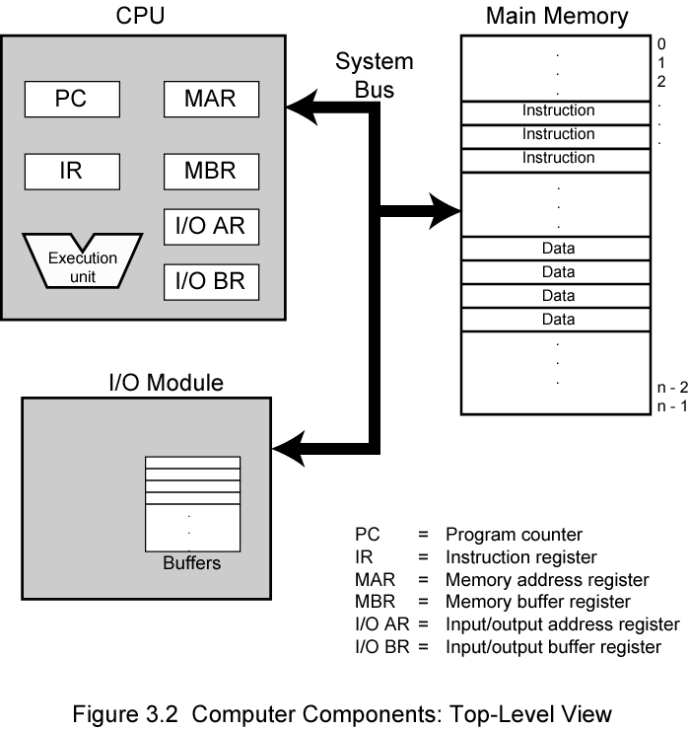
Figure 1: Computer Components (Top Level View)
Notes:
Figure 3.2 illustrates these top-level components and suggests the interactions
among them. The CPU exchanges data with memory. For this purpose, it typically
makes use of two internal (to the CPU) registers: a memory address register
(MAR), which specifies the address in memory for the next read or write, and a
memory buffer register (MBR), which contains the data to be written into memory
or receives the data read from memory. Similarly, an I/O address register (I/OAR)
specifies a particular I/O device. An I/O buffer (I/OBR) register is used for the exchange of data between an I/O module and the CPU.
A memory module consists of a set of locations, defined by sequentially numbered addresses. Each location contains a binary number that can be interpreted as
either an instruction or data. An I/O module transfers data from external devices to
CPU and memory, and vice versa. It contains internal buffers for temporarily holding these data until they can be sent on.
MAR: This specifies the address in memory for the next read or write
MBR: This contains the data to be written into memory or receives the data read from memory.
I/OAR: This specifies a particular I/O device.
I/OBR: This is used for the exchange of data between an I/O module and the CPU.
PC: This holds the address of the instruction to be fetched next
IR: This is used to hold a fetched instruction
A memory module consists of a set of locations, defined by sequentially numbered addresses. Each location contains a binary number that can be interpreted as either an instruction or data. An I/O module transfers data from external devices to CPU and memory, and vice versa.
It contains internal buffers for temporarily holding these data until they can be sent on.

Slide 7
The figure above illustrates these top-level components and suggests the interactions among them.
The CPU exchanges data with memory. For this purpose, it typically makes use of two internal (to the CPU) registers: MAR and MBR
MAR: This specifies the address in memory for the next read or write
MBR: This contains the data to be written into memory or receives the data read from memory.
I/OAR: This specifies a particular I/O device.
I/OBR: This is used for the exchange of data between an I/O module and the CPU.
PC: This holds the address of the instruction to be fetched next
IR: This is used to hold a fetched instruction
A memory module consists of a set of locations, defined by sequentially numbered addresses. Each location contains a binary number that can be interpreted as either an instruction or data. An I/O module transfers data from external devices to CPU and memory, and vice versa.
It contains internal buffers for temporarily holding these data until they can be sent on.
Notes:
How do the components function together to execute programs. This brings us to Instruction Cycle

Slide 8
Instruction Cycle
At the beginning of each instruction cycle, the processor fetches an instruction from memory.
In a typical processor, a register called the program counter (PC) holds the address of the instruction to be fetched next.
Unless told otherwise, the processor always increments the PC after each instruction fetch so that it will fetch the next instruction in sequence. F
For example, consider a computer in which each instruction occupies one 16-bit word of memory. Assume that the program counter is set to location 300. The processor will next fetch the instruction at location 300. On succeeding instruction cycles, it will fetch instructions from locations 301, 302, 303, and so on.
This sequence may be altered. The fetched instruction is loaded into a register in the processor known as the instruction register (IR). This is called the Fetch Cycle.
The instruction contains bits that specify the action the processor is to take. The processor interprets the instruction and performs the required action. In general, these actions fall into four categories:
Notes:
In its simplest form, instruction processing
consists of two steps:The processor reads ( fetches) instructions from memory one at
a time and executes each instruction. Program execution consists of repeating the
process of instruction fetch and instruction execution. The instruction execution
may involve several operations and depends on the nature of the instruction. The processing required for a single instruction is called an instruction cycle
The two steps are referred to as the fetch cycle and the execute
cycle. Program execution halts only if the machine is turned off, some sort of unrecoverable error occurs, or a program instruction that halts the computer is encountered

Slide 9
Processor-memory: Data may be transferred from processor to memory or from memory to processor.
Processor-I/O: Data may be transferred to or from a peripheral device by transferring between the processor and an I/O module.
Data processing: The processor may perform some arithmetic or logic operation on data.
Control: An instruction may specify that the sequence of execution be altered.
Combination of these actions.
This is known as the Execute Cycle
Notes:
For example, the processor may fetch an instruction from location 149, which specifies that the next instruction be from location 182. The processor will remember this fact by setting the program counter to 182.Thus, on the next fetch cycle, the instruction will be fetched from location 182 rather than 150. An instruction’s execution may involve a combination of these actions.

Slide 10
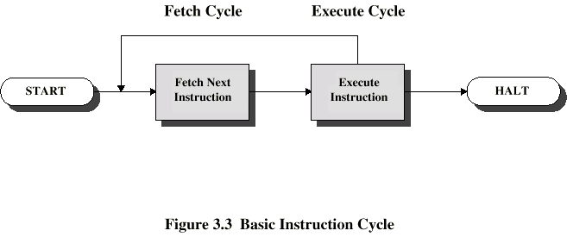
Figure 2: Simple Instruction Cycle
Notes:
For example, the PDP-11 processor includes an instruction, expressed symbolically as ADD B,A, that stores the sum of the contents of memory locations B and A
into memory location A. A single instruction cycle with the following steps occurs:
• Fetch the ADD instruction.
• Read the contents of memory location A into the processor.
• Read the contents of memory location B into the processor. In order that the
contents of A are not lost, the processor must have at least two registers for
storing memory values, rather than a single accumulator.
• Add the two values.
• Write the result from the processor to memory location A.
Thus, the execution cycle for a particular instruction may involve more than one
reference to memory. Also, instead of memory references, an instruction may specify
an I/O operation. With these additional considerations in mind, Figure 3 provides
a more detailed look at the basic instruction cycle of Figure 2

Slide 11
Instruction Cycle State Diagram
The execution cycle for a particular instruction may involve more than one reference to memory.
Also, instead of memory references, an instruction may specify an I/O operation. With these additional considerations, Figure 3 provides a more detailed look at the basic instruction cycle of Figure 2.
The figure is in the form of a state diagram. For any given instruction cycle, some states may be null and others may be visited more than once.

Slide 12
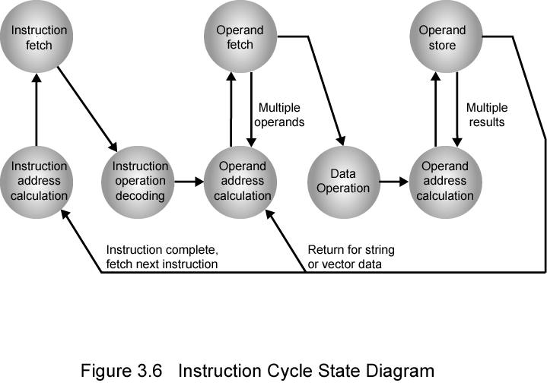
Figure 3: Instruction Cycle State Diagram
Notes:
Instruction address calculation (iac): Determine the address of the next instruction to be executed
Instruction fetch (if): Read instruction from its memory location into the processor.
Instruction operation decoding (iod): Analyze instruction to determine type of operation to be performed and operand(s) to be used.
Operand address calculation (oac): If the operation involves reference to an operand in memory or available via I/O, then determine the address of the operand.
Operand fetch (of): Fetch the operand from memory or read it in from I/O.
Data operation (do): Perform the operation indicated in the instruction.
Operand store (os): Write the result into memory or out to I/O.

Slide 13
Instruction address calculation (iac): Determine the address of the next instruction to be executed
Instruction fetch (if): Read instruction from its memory location into the processor.
Instruction operation decoding (iod): Analyze instruction to determine type of operation to be performed and operand(s) to be used.
Operand address calculation (oac): If the operation involves reference to an operand in memory or available via I/O, then determine the address of the operand.
Operand fetch (of): Fetch the operand from memory or read it in from I/O.
Data operation (do): Perform the operation indicated in the instruction.
Operand store (os): Write the result into memory or out to I/O.
Notes:
For example, most external devices are much slower than the processor. Suppose
that the processor is transferring data to a printer using the instruction cycle scheme
of Figure 3.3. After each write operation, the processor must pause and remain idle
until the printer catches up. The length of this pause may be on the order of many
hundreds or even thousands of instruction cycles that do not involve memory.
Clearly, this is a very wasteful use of the processor.

Slide 14
Interrupts
Virtually all computers provide a mechanism by which other modules (I/O, memory) may interrupt the normal processing of the processor.
Interrupts are provided primarily as a way to improve processing efficiency.
Classes of Interrupts
Program: Generated by some condition that occurs as a result of an instruction execution, such as arithmetic overflow, division by zero, attempt to execute an illegal machine instruction, or reference outside a user’s allowed memory space.
Timer: Generated by a timer within the processor. This allows the operating system to perform certain functions on a regular basis.
I/O: Generated by an I/O controller, to signal normal completion of an operation or to signal a variety of error conditions.
Hardware failure: Generated by a failure such as power failure or memory parity error

Slide 15
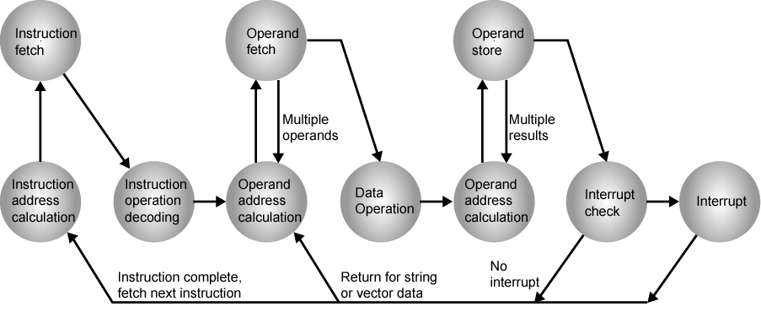
Figure 4: Instruction Cycle (with Interrupts) State Diagram

Slide 16
Interrupt Cycle
Added to instruction cycle
Processor checks for interrupt
  Indicated by an interrupt signal
If no interrupt, fetch next instruction
If interrupt pending:
  Suspend execution of current program
  Save context
  Set PC to start address of interrupt handler routine
  Process interrupt
  Restore context and continue interrupted program

Slide 17
Assignment 2
Briefly Discuss how the different components in the computer are connected (Illustrate with diagram(s))
Discuss memory, CPU and Input/output connections
Briefly discuss the concept of Bus in computer systems
Notes:
A computer consists of a set of components or modules of three basic types
(processor, memory, I/O) that communicate with each other. There must be paths for connecting the modules.

Slide 18
Interconnection Structures
This is the collection of paths connecting the various modules of the computer. The design of this structure will depend on the exchanges that must be made among modules
The interconnection structure must support the following types of transfers:
Memory to processor: The processor reads an instruction or a unit of data from memory.
Processor to memory: The processor writes a unit of data to memory.
I/O to processor: The processor reads data from an I/O device via an I/O module.
Processor to I/O: The processor sends data to the I/O device.
I/O to or from memory: For these two cases, an I/O module is allowed to exchange data directly with memory, without going through the processor, using direct memory

Slide 19

Operating Systems
The most important system program
Masks the details of the hardware from the programmer and provides the programmer with a convenient interface for using the system
Most important function lies in scheduling, resource and memory management.
The OS typically provides services in the following areas:
  Program creation
  Program execution
  Access to I/O devices
  Controlled access to files
  System access
  Error detection and response
  Accounting
Notes:
The most important system program is the OS.
The OS masks the details of the hardware from the programmer and provides the
programmer with a convenient interface for using the system. It acts as mediator,
making it easier for the programmer and for application programs to access and use
those facilities and services.
Briefly, the OS typically provides services in the following areas:
• Program creation: The OS provides a variety of facilities and services, such
as editors and debuggers, to assist the programmer in creating programs.
Typically, these services are in the form of utility programs that are not actually
part of the OS but are accessible through the OS.
• Program execution: A number of steps need to be performed to execute a
program. Instructions and data must be loaded into main memory, I/O devices
and files must be initialized, and other resources must be prepared. The OS
handles all of this for the user.
• Access to I/O devices: Each I/O device requires its own specific set of instructions
or control signals for operation. The OS takes care of the details so that
the programmer can think in terms of simple reads and writes.
• Controlled access to files: In the case of files, control must include an understanding
of not only the nature of the I/O device (disk drive, tape drive) but
also the file format on the storage medium. Again, the OS worries about the
details. Further, in the case of a system with multiple simultaneous users, the
OS can provide protection mechanisms to control access to the files.
• System access: In the case of a shared or public system, the OS controls access
to the system as a whole and to specific system resources. The access function
must provide protection of resources and data from unauthorized users and
must resolve conflicts for resource contention.
• Error detection and response: A variety of errors can occur while a computer
system is running. These include internal and external hardware errors, such as
a memory error, or a device failure or malfunction; and various software errors,
such as arithmetic overflow, attempt to access forbidden memory location, and
inability of the OS to grant the request of an application. In each case, the OS must
make the response that clears the error condition with the least impact on running
applications. The response may range from ending the program that caused the
error, to retrying the operation, to simply reporting the error to the application.
• Accounting: A good OS collects usage statistics for various resources and
monitor performance parameters such as response time. On any system, this
information is useful in anticipating the need for future enhancements and in
tuning the system to improve performance. On a multiuser system, the information
can be used for billing purposes.

Slide 20
Operating System as a Manager
A computer is a set of resources for the movement, storage, and processing of data and for the control of these functions
  The OS is responsible for managing these resources
The OS as a control mechanism is unusual in two respects:
  The OS functions in the same way as ordinary computer software – it is a program executed by the processor
  The OS frequently relinquishes control and must depend on the processor to allow it to regain control
Notes:
A computer is a set of resources for the movement, storage, and processing of data and for the control of
these functions. The OS is responsible for managing these resources.
Can we say that the OS controls the movement, storage, and processing of
data? From one point of view, the answer is yes: By managing the computer’s
resources, the OS is in control of the computer’s basic functions. But this control is
exercised in a curious way. Normally, we think of a control mechanism as something
external to that which is controlled, or at least as something that is a distinct and
separate part of that which is controlled. (For example, a residential heating system
is controlled by a thermostat, which is completely distinct from the heat-generation
and heat-distribution apparatus.) This is not the case with the OS, which as a control
mechanism is unusual in two respects:
• The OS functions in the same way as ordinary computer software; that is, it is
a program executed by the processor.
• The OS frequently relinquishes control and must depend on the processor to
allow it to regain control.
Like other computer programs, the OS provides instructions for the processor.
The key difference is in the intent of the program. The OS directs the processor
in the use of the other system resources and in the timing of its execution of other
programs. But in order for the processor to do any of these things, it must cease
executing the OS program and execute other programs. Thus, the OS relinquishes
control for the processor to do some “useful” work and then resumes control long
enough to prepare the processor to do the next piece of work. The mechanisms
involved in all this should become clear as the chapter proceeds.

Slide 21
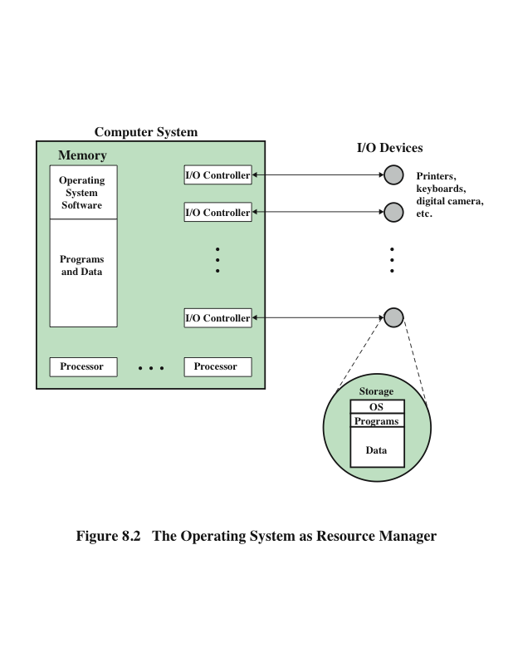
Notes:
Figure 8.2 suggests the main resources that are managed by the OS. A portion
of the OS is in main memory. This includes the kernel, or nucleus, which contains
the most frequently used functions in the OS and, at a given time, other portions of
the OS currently in use. The remainder of main memory contains user programs and
data. The allocation of this resource (main memory) is controlled jointly by the OS
and memory-management hardware in the processor, as we shall see. The OS decides
when an I/O device can be used by a program in execution, and controls access to and
use of files. The processor itself is a resource, and the OS must determine how much
processor time is to be devoted to the execution of a particular user program. In the
case of a multiple-processor system, this decision must span all of the processors.

Slide 22
Types of OS
Interactive system
  The user/programmer interacts directly with the computer to request the execution of a job or to perform a transaction
  User may, depending on the nature of the application, communicate with the computer during the execution of the job
Batch system
  Opposite of interactive
  The user’s program is batched together with programs from other users and submitted by a computer operator
  After the program is completed results are printed out for the user
Notes:
Certain key characteristics serve to differentiate various types of operating systems.
The characteristics fall along two independent dimensions. The first dimension
specifies whether the system is batch or interactive. In an interactive system, the
user/programmer interacts directly with the computer, usually through a keyboard/
display terminal, to request the execution of a job or to perform a transaction.
Furthermore, the user may, depending on the nature of the application, communicate
with the computer during the execution of the job. A batch system is the
opposite of interactive. The user’s program is batched together with programs from
other users and submitted by a computer operator. After the program is completed,
results are printed out for the user. Pure batch systems are rare today. However,
it will be useful to the description of contemporary operating systems to examine
batch systems briefly.
An independent dimension specifies whether the system employs multiprogramming
or not. With multiprogramming, the attempt is made to keep the processor
as busy as possible, by having it work on more than one program at a time. Several
programs are loaded into memory, and the processor switches rapidly among them.
The alternative is a uniprogramming system that works only one program at a time.

Slide 23
Early Systems
From the late 1940s to the mid-1950s the programmer interacted directly with the computer hardware – there was no OS
  Processors were ran from a console consisting of display lights, toggle switches, some form of input device and a printer
Problems:
  Scheduling
    Sign-up sheets were used to reserve processor time
      This could result in wasted computer idle time if the user finished early
      If problems occurred the user could be forced to stop before resolving the problem
  Setup time
    A single program could involve
      Loading the compiler plus the source program into memory
      Saving the compiled program
      Loading and linking together the object program and common functions
Notes:
With the earliest computers, from the late 1940s to the mid-1950s,
the programmer interacted directly with the computer hardware; there was no
OS. These processors were run from a console, consisting of display lights, toggle
switches, some form of input device, and a printer. Programs in processor code were
loaded via the input device (e.g., a card reader). If an error halted the program,
the error condition was indicated by the lights. The programmer could proceed
to examine registers and main memory to determine the cause of the error. If the
program proceeded to a normal completion, the output appeared on the printer.
These early systems presented two main problems:
• Scheduling: Most installations used a sign-up sheet to reserve processor time.
Typically, a user could sign up for a block of time in multiples of a half hour or
so. A user might sign up for an hour and finish in 45 minutes; this would result
in wasted computer idle time. On the other hand, the user might run into problems,
not finish in the allotted time, and be forced to stop before resolving
the problem.
• Setup time: A single program, called a job, could involve loading the compiler
plus the high-level language program (source program) into memory,
saving the compiled program (object program), and then loading and linking
together the object program and common functions. Each of these steps could
involve mounting or dismounting tapes, or setting up card decks. If an error
occurred, the hapless user typically had to go back to the beginning of the
setup sequence. Thus a considerable amount of time was spent just in setting
up the program to run.
This mode of operation could be termed serial processing, reflecting the fact
that users have access to the computer in series. Over time, various system software
tools were developed to attempt to make serial processing more efficient. These
include libraries of common functions, linkers, loaders, debuggers, and I/O driver
routines that were available as common software for all users.

Slide 24
Time Sharing Systems
Used when the user interacts directly with the computer
Processor’s time is shared among multiple users
Multiple users simultaneously access the system through terminals, with the OS interleaving the execution of each user program in a short burst or quantum of computation
Example:
  If there are n users actively requesting service at one time, each user will only see on the average 1/n of the effective computer speed
Notes:
With the use of multiprogramming, batch processing
can be quite efficient. However, for many jobs, it is desirable to provide a mode in
which the user interacts directly with the computer. Indeed, for some jobs, such as
transaction processing, an interactive mode is essential.
Today, the requirement for an interactive computing facility can be, and often
is, met by the use of a dedicated microcomputer. That option was not available in the
1960s, when most computers were big and costly. Instead, time sharing was developed.
Just as multiprogramming allows the processor to handle multiple batch jobs
at a time, multiprogramming can be used to handle multiple interactive jobs. In
this latter case, the technique is referred to as time sharing, because the processor’s
time is shared among multiple users. In a time-sharing system, multiple users
simultaneously access the system through terminals, with the OS interleaving the
execution of each user program in a short burst or quantum of computation. Thus,
if there are n users actively requesting service at one time, each user will only see
on the average 1/n of the effective computer speed, not counting OS overhead.
However, given the relatively slow human reaction time, the response time on a
properly designed system should be comparable to that on a dedicated computer.

Slide 25
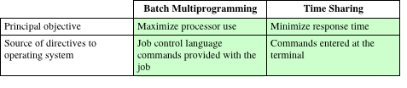
Batch Programming Versus Time Sharing
Notes:
Both batch multiprogramming and time sharing use multiprogramming. The
key differences are listed in Table 8.3.

Slide 26
Scheduling
This is the key to multiprogramming.
Process: This is a program in execution
Types of Scheduling
Long Term Scheduling: This determines which programs are admitted to the system for processing
It controls the degree of multiprogramming (number of processes
in memory).
Once admitted, a job or user program becomes a process and is added to the queue for the short-term schedule
Medium Term Scheduling: The decision to add to the number of processes that are partially or fully in main memory
Short-term scheduling The decision as to which available process will be executed
by the processor
I/O scheduling The decision as to which process’s pending I/O request shall
be handled by an available I/O device
Notes:
The key to multiprogramming is scheduling. In fact, four types of scheduling are
typically involved (Table 8.4). We will explore these presently. But first, we introduce
the concept of process. This term was first used by the designers of the Multics
OS in the 1960s. It is a somewhat more general term than job. Many definitions
have been given for the term process, including
• A program in execution
• The “animated spirit” of a program
• That entity to which a processor is assigned

Slide 27
OS Scheduling Algorithms
A Process Scheduler schedules different processes to be assigned to the CPU based on particular scheduling algorithms. There are six popular process scheduling algorithms which we are going to discuss in this chapter −
First-Come, First-Served (FCFS) Scheduling
Shortest-Job-Next (SJN) Scheduling
Priority Scheduling
Shortest Remaining Time
Round Robin(RR) Scheduling
Multiple-Level Queues Scheduling
These algorithms are either non-preemptive or preemptive.
Non-preemptive algorithms are designed so that once a process enters the running state, it cannot be preempted until it completes its allotted time, whereas the preemptive scheduling is based on priority where a scheduler may preempt a low priority running process anytime when a high priority process enters into a ready state.

Slide 28
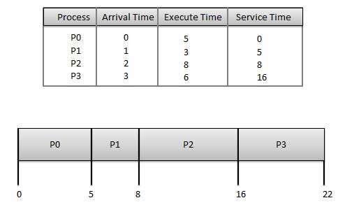
First Come First Serve (FCFS)
Jobs are executed on first come, first serve basis.
It is a non-preemptive, pre-emptive scheduling algorithm.
Easy to understand and implement.
Its implementation is based on FIFO queue.
Poor in performance as average wait time is high

Slide 29
Wait time of each process is as follows −
Process Wait Time : Service Time - Arrival Time
P0 0 - 0 = 0
P1 5 - 1 = 4
P2 8 - 2 = 6
P3 16 - 3 = 13
Average Wait Time: (0+4+6+13) / 4 = 5.75

Slide 30
Shortest Job Next (SJN)
This is also known as shortest job first, or SJF
This is a non-preemptive, pre-emptive scheduling algorithm.
Best approach to minimize waiting time.
Easy to implement in Batch systems where required CPU time is known in advance.
Impossible to implement in interactive systems where required CPU time is not known.
The processer should know in advance how much time process will take.

Slide 31
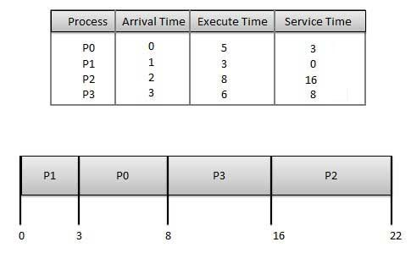

Slide 32
Wait time of each process is as follows −
Process Wait Time : Service Time - Arrival Time
P0 3 - 0 = 3
P1 0 - 0 = 0
P2 16 - 2 = 14
P3 8 - 3 = 5
Average Wait Time: (3+0+14+5) / 4 = 5.50

Slide 33
Priority Based Scheduling
Priority scheduling is a non-preemptive algorithm and one of the most common scheduling algorithms in batch systems.
Each process is assigned a priority. Process with highest priority is to be executed first and so on.
Processes with same priority are executed on first come first served basis.
Priority can be decided based on memory requirements, time requirements or any other resource requirement.

Slide 34
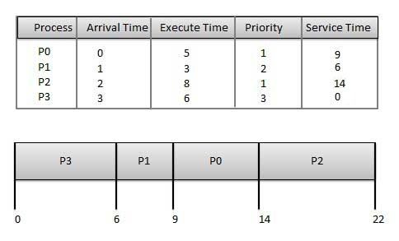

Slide 35
Wait time of each process is as follows −
Process Wait Time : Service Time - Arrival Time
P0 9 - 0 = 9
P1 6 - 1 = 5
P2 14 - 2 = 12
P3 0 - 0 = 0
Average Wait Time: (9+5+12+0) / 4 = 6.5

Slide 36
Shortest Remaining Time
Shortest remaining time (SRT) is the preemptive version of the SJN algorithm.
The processor is allocated to the job closest to completion but it can be preempted by a newer ready job with shorter time to completion.
Impossible to implement in interactive systems where required CPU time is not known.
It is often used in batch environments where short jobs need to give preference.

Slide 37
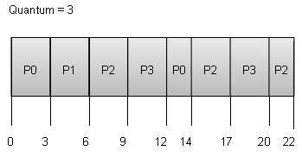

Slide 38
Wait time of each process is as follows −
Process Wait Time : Service Time - Arrival Time
P0 (0 - 0) + (12 - 3) = 9
P1 (3 - 1) = 2
P2 (6 - 2) + (14 - 9) + (20 - 17) = 12
P3 (9 - 3) + (17 - 12) = 11
Average Wait Time: (9+2+12+11) / 4 = 8.5

Slide 39
Multiple-Level Queues Scheduling
Multiple-level queues are not an independent scheduling algorithm. They make use of other existing algorithms to group and schedule jobs with common characteristics.
Multiple queues are maintained for processes with common characteristics.
Each queue can have its own scheduling algorithms.
Priorities are assigned to each queue.
For example, CPU-bound jobs can be scheduled in one queue and all I/O-bound jobs in another queue. The Process Scheduler then alternately selects jobs from each queue and assigns them to the CPU based on the algorithm assigned to the queue.

Slide 40
Review Questions/Quiz
Turn all the objectives of this lesson into questions and answer them.
On the IAS, describe in English the process that the CPU must undertake to read a value from memory and to write a value to memory in terms of what is put into the MAR, MBR, address bus, data bus, and control bus.
Notes:
Bus ia a communication pathway connecting two or more devices, we have data, address and control bus.

Slide 41
THANK YOU FOR LISTENING

