Slide 1
INTRODUCTORY ECOLOGY
BIO 202
BY DR. FRANCIS H. IBADIN

Slide 2
TOPIC: CONCEPTS AND DEFINITION OF ECOSYSTEMS

Slide 3
Ecosystems
Ecosystem definition: An ecosystem is a specific biological community and its physical environment interacting in an exchange of matter and energy. It can also be regarded as a natural unit of both living and non-living components whose interactions results in a self-perpetuating system. Central to the ecosystem concept is the idea that living organisms are continually engaged in a set of relationships with every other element constituting the environment in which they exist.

Slide 4
Components of the ecosystem
Two major components
(a) Biotic components which comprises of living organisms
(b) Abiotic components which comprises the non-living physical and chemical environment
Other essential abiotic components of an ecosystem include energy, water, nitrogen and soil minerals. The energy required to perpetuate an ecosystem is naturally obtained primarily from the sun, through photosynthesis, a process that also captures carbon from the atmosphere.

Slide 5
Animals feed on plants and on one another thereby playing an important role in the movement of matter and energy through the system.
When plants and animals die the nutrients stored in their bodies are eventually released back into nature. By breaking down dead organic matter, decomposers release carbon back to the atmosphere and facilitate nutrient cycling by converting nutrients stored in dead biomass back to a form that can be readily used by plants and other microbes, thereby completing the cycle of life.

Slide 6
The study of ecosystems helps us to understand two key processes, the flow of energy and the cycling of materials through biological channels. The largest ecosystem is the biosphere, the layer of land, water and atmosphere that envelope the great mass of the planet and that supports life on earth.
There are certain internal and external factors that control ecosystems. Some of the external factors include climate, the parent material that forms the soil, and topography. Other factors include time and biota.

Slide 7
Ecosystems are not as resilient as was once thought, and have been known to go through certain periods of disturbances and stress, sometimes due to natural or man-made activities. In some cases recovery from such activities have been swift, slow or even nearly impossible.
ECOLOGY AT COMMUNITY LEVEL
A community is an assemblage of populations of different species of organisms occupying and interacting in the same habitat, e.g. community of plants and animals in a pond or desert.

Slide 8
Variety of a community is measured as species diversity. The population of species in a community interact with each other in many ways, the most prevalent of which are predation, parasitism and competition.
Predators obtain energy and nutrient by killing and eating their prey. Parasites derive similar benefits from their hosts but usually do not kill the hosts.
Competition occurs when food, mates, space etc. are limited in supply and members of the same or different species interfere with each other’s use of their shared resources.

Slide 9
In biology, a population is all the organisms of the same group or species, which live in a particular geographical area, and have the capability of interbreeding.
Characteristics of Populations
1 Size – is the density or the number of individuals occupying a known area or volume of the habitat
2 Birth or reproductive rate (Natality) – leads to increase in population, which can also occur through immigration
3 Death rate (Mortality) – leads to decrease in population, which can also occur through emigration

Slide 10
4 Sex ratio – proportion of females and males
5 Age structure – The age groups in a population: Pre-reproductives; Reproductives; Post reproductive.
In many populations, individuals younger than reproductive age (pre-reproduction), of reproductive age or past reproductive age (post-reproductive) can be distinguished.

Slide 11
Based on the proportion of the three age groups, a population can be described as
Expanding – Reproductive > post-reproductive
Stable – Reproductive = post reproductive
Diminishing – Post and pre-reproductive > the reproductive

Slide 12
A stable population will show a gradual decline in percent of individuals in classes of increasing age. If most of its members in the post-reproductive age classes, the population is likely to decline.
If unusually large percentages of individuals are in the pre-reproductive age classes, the population will grow fast as these members reach reproductive age.

Slide 13
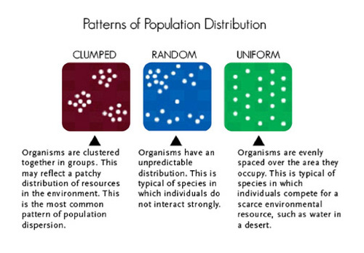
6 Distribution – There are three types, namely Random, Uniform and Clumped.

Slide 14
Growth rate of population is best described in terms of doubling time i.e. time required for the population to double in size. The size of human population has with minor irregularities increased exponentially. The density of the population with time represents growth pattern.
There are two growth patterns in population:

Slide 15
a) S shaped curve or sigma type characterized by low increase initially followed by a rapid increase, then decrease sets in due to environmental resistance
b) J shaped growth curve – density increase rapidly in an exponential form and then stops abruptly due to changes in the environment.

Slide 16
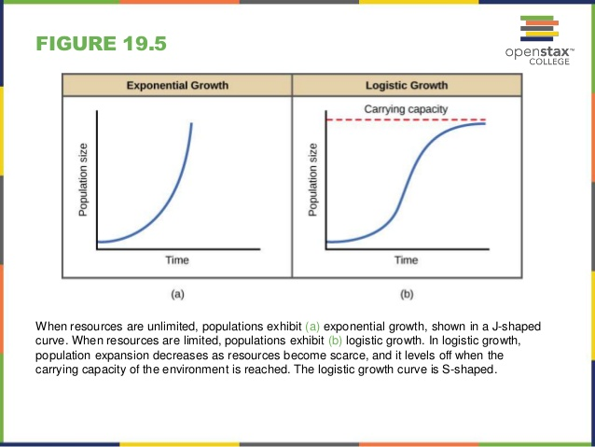

Slide 17
Impact of population growth on the biosphere
Population growth goes along with growth of towns and cities, which is referred to as urbanization. Urbanization is caused by the presence of social amenities like electricity, good roads, medical facilities, pipe borne water, availability of industries and high quality goods and employment opportunities.

Slide 18
Consequences of population growth and urbanization
Accommodation problem
Lack of planned cities resulting in the development of slums
Reduction in the number of people farming in rural areas
More mouths to feed, therefore more emphasis on large-scale agriculture leading to deforestation, soil erosion, desertification, loss of wild and game animals

Slide 19
5. Epidemics like cholera, influenza
6. Antisocial behavior in human beings
7. High cost of living
8. Environmental pollution
Pollution is the contamination of a medium (air, water, soil) with impurities to a level that is detrimental to organisms or the balance of nature. To make foul, unclean, dirty;

Slide 20
It can also be defined as any physical, chemical, or biological change that adversely affects the health, survival, or activities of living organisms or that alters the environment in undesirable ways.
Pollutants are contaminants that adversely alter the physical, chemical or biological properties of the environment.
The term includes nutrients, sediments, pathogens, toxic metals, carcinogens, oxygen-demanding materials and all other harmful substances.

Slide 21
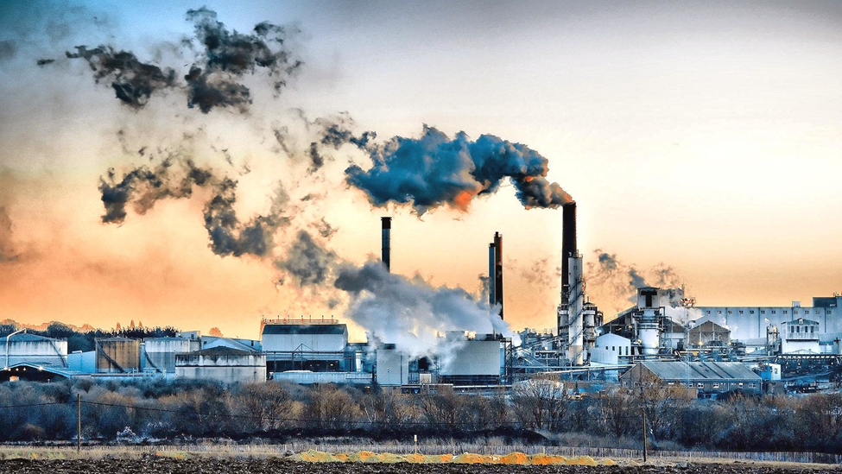
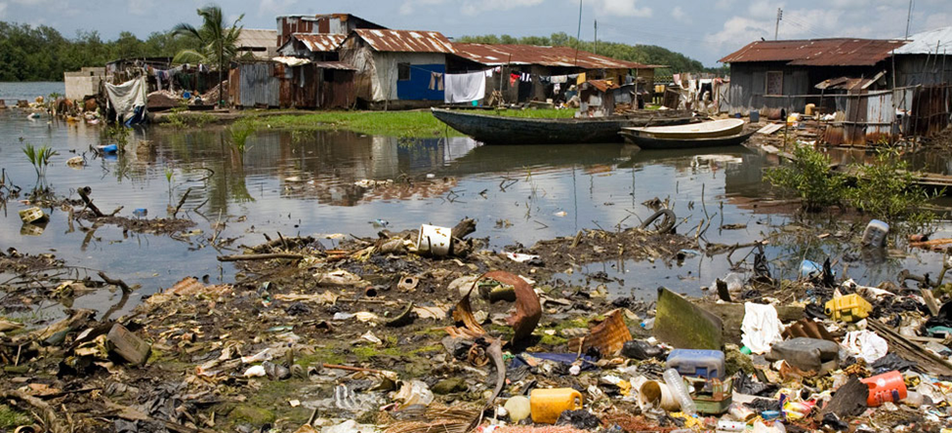
Air and Water Pollution

Slide 22
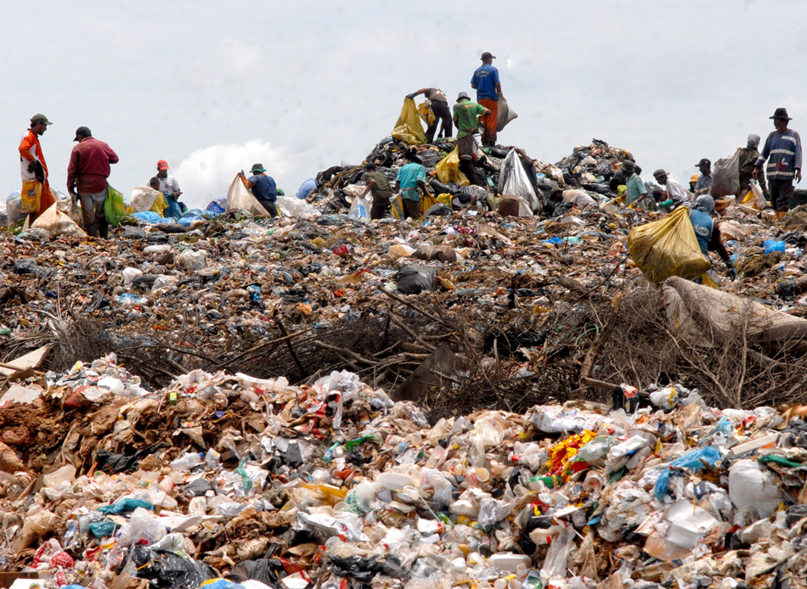
Land Pollution
Two types of pollutants are known; biodegradable and non-biodegradable pollutants. Biodegradable pollutants are those that can be decomposed by bacteria, hence could easily be removed from the environment e.g. sewage. Sewage is a water-carried waste, in solution that is intended to be removed from a community e.g. waste water from the kitchen sink and excrement from homes.

Slide 23
Non-biodegradable are chemicals substances which cannot be broken down by bacteria, hence persists and accumulate in the environment e.g. heavy metals from industries, plastic and other man-made synthetic materials.
There are two major sources of pollution, namely
Point Source Pollution and Non-point Source Pollution
Point source pollution results when the contaminants come from a single location.

Slide 24
Examples of point source pollution in the air, water and soil are given below.
Air – when factories release untreated, toxic chemicals are released directly into the air.
Water – when chemicals used in washing oil tankers are released directly into the stream water without being treated or decontaminated to make them safe.
Soil – waste oil released from a mechanic garage into soil without being treated.
Each of these examples illustrates point source pollution.

Slide 25
Non-point-source pollution results when contaminants are introduced into the environment over a large, widespread area. Some examples follow.
Air – vehicles producing gases and unburned hydrocarbons from gasoline.
Large trucks and buses with diesel engines contribute to smoke and hydrocarbons.
Burning of fuels with a high sulfur content also produces sulfur dioxide which enters the air.

Slide 26
Sulfur dioxide reacts with water in the air to produce sulfurous acid which is a major component of acid rain.
Water. Acid rain from the air can enter the water cycle. The result is that it enters the environment. The acid is harmful to fish and other creatures in fresh-water lakes and streams.
Soil. Harmful pollutants can enter the soil either from the air or from the water. Sometimes these pollutants are absorbed by plants so then the plants become toxic as well.

Slide 27
In the middle part of the 20th century they used to add lead to gasoline so that cars would run better. The lead passed out from the cars through the tailpipe and was deposited in the soil along roads and highways. The lead was absorbed by plants making the plants poisonous to any animals that ate them. By this means, the lead entered the food chain.

Slide 28
Summary.
If the origin of the pollution can be traced to a single point, it is called point source pollution. If the pollutants are entering the environment in a widespread fashion, or the pollution is of a general nature and cannot be traced to a single source, it is said to be non-point-source pollution.

Slide 29
ECOLOGICAL CLASSIFICATION OF HABITAT TYPES
Habitat and environment are two words commonly used in everyday speech to indicate the location of living organisms. The habitat of an animal of an animals, you often hear people say, is where it lives; and its environment is its surroundings.

Slide 30
The word Habitat, in ecological study, does not denote a particular place, rather it denotes areas which sustain life, and which have similar physical or chemical constituents. In other words, habitat is used here as a collective noun.
Hence, when we speak of marine habitat, we mean any water body with physical and chemical constituents of sea water.
In this way we can identify three main habitats, (a) Marine habitat, (b) Freshwater habitat, and (c) Terrestrial habitat.

Slide 31
The word biosphere is used to describe all these habitat collectively, as comprising all the available habitable areas of the earth, be it sea, freshwater or land.
In everyday speech environment means surrounding, but in ecology the environment of an organism is described more precisely, firstly in terms of the physical nature of its habitat, called its abiotic environment, and secondly in terms of all other living organisms associated with it in that habitat, which constitutes its biotic environment.

Slide 32
In short the environment is the sum total of all the external factors affecting an organism.
If we consider as fish in a lake therefore, its habitat is freshwater, its abiotic environment consists of the physical and chemical features of freshwater, and its biotic environment consists of the plants and animals in the lake. Given an even wider meaning, environment includes the internal environment of the organism, consisting primarily of its body fluids. When considering the surrounding of an organism, therefore, we have to bear in mind its abiotic, biotic, and internal environments.

Slide 33
The idea of niches can be further defined in terms of Fundamental Niche and Realized Niche.
A species’ fundamental niche is the full range of resources or habitat it could exploit if there were no competition with other species.
A species’ realized niche is the resources or habitat it actually uses, which may be much less than the fundamental niche.

Slide 35
There are three major types of habitats namely; Terrestrial, Freshwater and Marine Habitats, which are all located within the Biosphere.
The marine and freshwater habitats are mainly aquatic.
The terrestrial and aquatic ecosystems are located within the Biosphere.

Slide 36
The Biosphere – thin outer layer of the earth capable of supporting life. The non-living subdivisions of the biosphere include:
a. Lithosphere – is the rocky materials of the earth’s outer shell and is the ultimate source of all mineral elements required by living organisms.
b. Hydrosphere – is the water on or near the earth’s surface and it extends to the lithosphere and the atmosphere.

Slide 37
c. Atmosphere – gaseous components of the atmosphere. It extends to some 3500 km above the surface of the earth, but life is confined to the lowest 8 to 15 km (troposphere).
The oxygen-ozone screening layer in the atmosphere is concentrated mostly between 20 and 25 km. The main gases present in the atmosphere are by volume, nitrogen – 78%; oxygen, 21%; argon, 0.93%; carbon dioxide, 0.03% and variable amount of water vapour.

Slide 38
Terrestrial environment:
The terrestrial habitats are mainly land based biomes.
The geographical distribution (and productivity) of the various biomes is controlled primarily by the climatic variables like precipitation and temperature. Most of the classified biomes are identified by the dominant plants found in their communities.

Slide 39
Major Biomes
(i) Deserts
Desert is a temperate or tropical biome arid region commonly occurring where there is less than 10 inches (<25cm) of precipitation per year, and high evaporation. Their vegetation is sparse, but it can be surprisingly diverse, and a most desert plants and animals are highly adapted to survive long droughts, extreme heat, and often extreme cold.

Slide 40
(ii) Grasslands
Grasslands occur where there is enough rain to support grass but not enough for forests. There are two main divisions of grasslands, namely tropical grassland or savannas and the temperate grasslands.
Tropical grasslands (Savannas) - Tropical grasslands can occur in regions with as much as 47.2 in (120 cm) of rainfall per year, but under highly seasonal conditions with a pronounced dry season. Savannahs are dominated by grasses and other herbaceous plants.

Slide 41
Temperature grasslands - These grasslands occur under temperate climatic regimes that are intermediate to those that support forest and desert. In the temperate zones, grasslands typically occur where rainfall is 9.9-24 in (25-60 cm) per year. Grasslands in North America are called prairie.

Slide 42
(iii) Forests
It is a type of biome which is dominated by trees, and also where other plants and animals live. The plants in forests provide shade and protection to many different types of animals
Different types of forest are:
Deciduous forest - These are forest in cool rainy areas, they can be found in the eastern part of the United States and Canada, most of Europe and parts of China and Japan. Deciduous trees shed their leaves each autumn and winter and re-grow them in the springtime.

Slide 43
Coniferous forest (evergreen) - Coniferous forests are made up mainly of cone-bearing or coniferous trees. The leaves of these trees are either small and needle-like or scale-like and most stay green all year around (evergreen). It has fewer animals as comparison to the deciduous forest, as cold weather makes life very difficult in these forests. Common trees of this biome are species of pine, Douglas fir, hemlock, cedar, redwood, while animals include lynx, moose, squirrel, hawk, owl etc.

Slide 44
Rainforest - The reason it is called a "rainforest” is because of the high amount of rainfall it gets per year. The rain forest has a constant temperature with very high humidity. Rainforests support a very broad array of fauna, including mammals, reptiles, birds and invertebrates. Tropical rainforests are characterized by a warm and wet climate with no substantial dry season. Mean monthly temperatures exceed 18 °C (64 °F) during all months of the year. Average annual rainfall can be higher than 380 cm (150 in). Rainforests can be found in locations like Southeast Asia, Papua New Guinea, Sri Lanka, etc.

Slide 45
(iv) Tundra (Mountain Ecosystems)
Tundra, a treeless landscape occurs at high latitudes or on mountaintops, has growing season of only two to three months, and it may have frost any month of the year. Compared to other biomes, tundra has relatively low diversity.
mosses and lichens tend to dominate the vegetation. Migratory musk-ox, caribou, or alpine mountain sheep and mountain goats live on the vegetation.

Slide 46
The freshwater habitat:
Freshwater is defined as having a considerably low salt concentration. Freshwater can be divided into two main groups, namely the lentic (standing) and the lotic (running) water bodies.
The lentic water bodies are those that are relatively still, they are generally localized in a basin that is surrounded by land, although limited movement can occur as a result of wind action e.g. Lakes Ponds, Pot holes etc. Due to their lower velocity they have lower oxygen concentration.

Slide 47
The lotic water bodies are those in constant flow, some examples are Rivers, Streams, Mountain brooks, Waterfalls etc. They have high velocity water flow and a high oxygen concentration.
Some of the various types of freshwater under these two groups are described below:
(a) Ponds and lakes
Ponds are generally considered to be small temporary or permanent bodies of water shallow enough for rooted plants to grow over most of the bottom. Lakes are inland depressions that hold standing fresh water year-round.
Lakes and ponds are divided into three different “zones” which are usually determined by depth and distance from the shoreline.

Slide 48
The zones are:
(i) Littoral Zone: - The topmost zone near the shore of a lake or pond is the littoral zone
(ii) Limnetic Zone: - The near surface open water surrounded by the littoral zone is the limnetic zone.
(iii) The Profundal Zone: - This zone is much colder and denser than the other two. Little light penetrates all the way through the limnetic zone into the profundal zone
Temperature varies in ponds and lakes seasonally. Most lakes (deep ones) have what is referred to as thermal stratification, leading to the formation of three (3) temperature layers. There is the
epilimnion layer at the top with warmer temperatures, while the colder temperature hypolimnion layer is at the bottom, and the thermocline layer (mesolimnion) in between them.

Slide 49
(b) Streams and Rivers
These are bodies of water are always in constant motion. Precipitation that does not evaporate or infiltrate into the ground runs off over the surface, drawn by the force of gravity back to the sea. Rivulets accumulate to form streams, and streams join to form rivers. Streams are generally shallow when compared with rivers, and sometimes one can even walk across them if they are not so deep and there is no strong water current.
The River Nile is the longest river in the world, while the Amazon River is the largest river in the world. The largest river in Africa is River Congo.

Slide 50
(c) Wetlands
Wetlands are ecosystems of several types in which rooted vegetation is surrounded by standing water during part of the year. They are mostly found at the edges of ponds, lakes, rivers and streams.
Other terms for wetland include marsh (wetlands without trees), bog, flood plain, prairie pothole and swamp (wetlands with trees).
Some of the plants found in wetlands include water lilies, cattails, sedges and spruce. This habitat supports many animals like amphibians, exotic birds (such as ducks and waders), reptiles and some mammals and fish.
Mangroves are trees that grow in the coastal intertidal zone (salt water), with low oxygen soil.

Slide 51
Marine Habitat:
Together, the oceans contain more than 97% of all liquid water in the world. Oceans are too salty for most human uses, but they contain 90% of the world’s living biomass.
Their salt content is considerably higher than of freshwater habitats (higher than 35 parts per thousand).
The marine habitat can be studies in terms of horizontal and vertical zones, namely:
Horizontal zones
The horizontal zones of the ocean are:
(a) Coastal Zone: - It is made up of the littoral region which is where the sea meets the land; it is the richest of all marine environment but the harshest.

Slide 52
The animals that live there are subjected to pounding, surf, sun, wind, rain, extreme temperature fluctuations, erosion and sedimentation. This zone consists of three subzones called the supralittoral zone, the intertidal zone and the sublittoral zone.
The Supralittoral zone is only underwater during storms, and is located between the high-tide line and dry land.
The Intertidal zone is located between high and low tides.

Slide 53
The Sublittoral zone is always underwater and is below the low tide line. This zone extends all the way to where the continental shelf drops off into the abyssal plane.
(b) Pelagic Zone: - located seaward of the coastal zone’s low-tide mark, this contains the vast open waters of the ocean. Everything except areas near the coast and the sea floor is called the pelagic zone. Two subdivisions are recognized:
i. Neretic Zone: the water overlying the continental shelf. With the exception of Antarctica, these waters usually extend to a depth of 600 ft. Light penetrates the entire water column.
ii. Oceanic Zone: It extends from the edge of the continental shelf, over the continental slope, and over ocean floor. It is characterized by darkness and tremendous pressure.

Slide 54
Ii. Vertical zones.
(a) Neustic Zone: the thin film formed by surface tension at the surface of the water
(b) Euphotic Zone (epipelagic zone): It is home to the greatest biodiversity in the sea, largely because of the availability of sunlight that allows photosynthesis. Depending upon water clarity, the bottom of the euphotic zone is about 500 ft. below sea level.
(c) Aphotic Zone: this is the remainder of the water column, and is below the euphotic zone. Food chains usually begin with detritus or living algae and bacteria sinking from above. This zone is further subdivided by depth as follows:
i. Mesopelagic zone: It ranges from a depth of about 500 to 3,280 ft. below the sea surface. This zone is a twilight zone where some light filters through but does not reach a level of brightness enough for photosynthesis to occur.
ii. Bathypelagic zone: this zone ranges from a distance of 3,280 to 13,000 ft., and is completely dark. Bioluminescent organisms, some of the strangest marine creatures of the deep live here.

Slide 55
Plants are non-existent in the bathypelagic zone. The giant squid is a resident of the bathypelagic zone and serve as a food source for deep-diving sperm whales.
iii. Abyssopelagic zone: Ranges from about 13,000 to 20,000 ft. below the sea surface. Most animals in the abyssopelagic zone are blind and colourless due to the complete lack of light. The name, “abyssopelagic” comes from the Greek meaning "bottomless abyss".
iv. Hadal zone: 20,000 to 35,000 ft. below the sea surface. The name is from the Greek “Hades”, or the Greek underworld.
III. Benthic Zone: This zone contains all the habitats of the sea bottom, whether in coastal, continental shelf, or deep sea environments. Organisms may live within the bottom material or on its surface.

Slide 57
Brackish water:
This environment is actually a meeting point between the fresh water and the marine water habitat. It occurs in places like estuaries, where rivers drain into the ocean, where there is therefore a mixture of fresh and marine water. The salt content of the water is normally higher than that of fresh water and lower than that of marine water due to mixing of both waters (between 0.5 to 35 parts per thousand). The plant and animal species found in this environment are adapted to tolerate a wider range of salinity. Some of the animals include some species of prawns, oyster, mud crabs, birds etc.

Slide 58
TERRESTRIAL AND AQUATIC HABITAT BIOMASS
Food Chains, Food Webs, and Trophic Levels
Photosynthetic organisms, mainly green plants and algae, are known as producers; with photosynthesis (and rarely chemosynthesis, being the base of all ecosystems).
One important properties of an ecosystem is its productivity, the amount of biomass (biological material) produced in a given area during a given period of time. Photosynthesis is described as primary productivity because it is the basis for almost all other growth in an ecosystem.
Manufacture of biomass by organisms that eat plants is termed secondary productivity. A given ecosystem may have very high total productivity, but if decomposers decompose organic material as rapidly as it is formed, the net primary productivity will be low.

Slide 59
Biomass is the total mass or weight of living organisms in a given population or area at a given time. Biomass can refer to species biomass, which is the mass of one or more species, or to community biomass, which is the mass of all the species in the community. It can include microorganisms, plants or animals.
The mass can be expressed as the average mass per unit area, or as the total mass in the community. Sometimes, the biomass is regarded as the natural mass or organisms, in situ, just as they are. For example, in salmon fishery, the salmon biomass might be regarded as the total wet weight the salmon would have if they were taken out of the water. In order contexts, biomass can be measured in terms of the dried organic mass, so perhaps only 30% of the total weight might count, the rest being water. For other purpose, only biological tissues count, teeth, bones and shell are excluded.

Slide 61
In the study of biomass is relevant for us to always trace whatever have eaten to its very photosynthetic source. If you have eaten an egg, it can be traced to a chicken which in turn ate a corn. This is an example of a food chain; a linked feeding series. There is however a more complex food chain involving man, a chicken, a corn plant, and a grasshopper. The chicken could eat grasshoppers that had eaten the corn leaves. Man can also eat the grasshopper directly, or also eat corn directly (a short food chain).
Humans have several options of fitting into the food web).
Some consumers are known to feed on a single species, while most consumers have multiple sources of food. Similarly some species are prey to a single predator while others are beset by man predators and parasites. In this way individual food chains gets interconnected to form a food web.

Slide 62
An organisms feeding status in an ecosystem can be expressed as its trophic level (from the Greek word trophe, food). In our first example, the corn plant is at the producer level; it transforms solar energy into chemical energy, producing food molecules. Other organisms in the ecosystem are consumers of the chemical energy harnessed by the producers. An organism that eats producers is a primary consumer.

Slide 63
An organism that eats primary consumers is a secondary consumer, which may in turn be eaten by a tertiary consumer, and so on. Most terrestrial food chains are relatively short (seeds → mouse → owl), but aquatic food chains may be quite long
(microscopic algae → copepod → minnow → crayfish → bass → osprey). The length of a food chain also may reflect the physical characteristics of a particular ecosystem. A harsh arctic landscape has a much shorter food chain than a temperate or tropical one.

Slide 64
Organisms can be identified both by the trophic level at which they feed and by the kinds of food they eat.
Trophic Levels

Slide 66
Herbivores are plant eaters, carnivores and flesh eaters, and omnivores eat both plant and animal matter. Man is a natural omnivore, by history and by habit. Tooth structure is an important clue to understanding animal food preferences, and humans are no exception. Our teeth are suited for an omnivorous diet, with a combination of cutting and crushing surfaces that are not highly adapted for one specific kind of food, as are the teeth of a wolf (carnivore) or a horse (herbivore).
One of the important trophic levels is that occupied by many kinds of organisms that remove and recycle the dead bodies and waste products of others. Scavengers such as crows, jackals and vultures clean up dead carcasses of larger animals. Detritivores such as ants and beetles consume litter, debris, and dung, while decomposer organisms such as fungi and bacteria complete the final breakdown and recycling of organic materials. It could be argued that these microorganisms are second in importance only to producers, because without their activity nutrients would remain locked up in the organic compounds of dead organisms and discarded body wastes, rather than being made available to successive generations of organisms.

Slide 67
Ecological Pyramids
If we arrange the organisms in a food chain according to trophic levels, they often forma pyramid with a broad base representing primary producers and only a few individuals in the highest trophic levels. This pyramid arrangement is especially true if we look at the energy content of an ecosystem

Slide 68
True to the second principle of thermodynamics, less food is available to the top trophic levels than is available to preceding levels. For example, it takes a huge number of plants to support a modest colony of grazers such as prairie dogs. Several colonies of prairie dogs, in turn might be required to feed a single Wolfe. And a very large top carnivore like a tiger may need a home range of hundreds of square kilometers to survive.
Why is there so much less energy in each successive level? In the first place, some of the food that organisms eat is undigested and does not provide usable energy. Much of the energy that is absorbed is used in the daily processes of living or lost as heat when it is transformed from one form to another and thus is not stored as biomass that can be eaten.
Furthermore predators do not operate at 100% efficiency. If there were enough foxes to catch all the rabbits available in the summer when supply is abundant, there would be too many foxes in the middle of the winter when rabbits are scarce.

Slide 69
A general rule of thumb is that only about 10% of the energy in one consumer level is represented in the next higher level. The amount of energy available is often expressed in biomass. For example, it generally takes about 100 kg of clover to make 10 kg of rabbit and 10 kg of rabbit to make 1 kg of fox.
Energy Pyramid

Slide 70
The total number of organism and the total amount of biomass in each successive trophic level of an ecosystem also may form pyramids similar to those describing energy content.
The relationship between biomass and numbers in not as dependable as energy, however.
The biomass pyramid, for instance, can be inverted by periodic fluctuations in producer populations (for example, low plant and algal biomass present during winter in temperate aquatic ecosystems).
The numbers pyramid also can be inverted. One pig can support numerous tapeworms, for example.
Numbers inversion also occurs at lower trophic levels (for example, one large tree can support thousands of caterpillars).

Slide 71
SPECIFIC FEATURES OF AQUATIC AND TERRESTRIAL HABITAT
Ecological Factors
Any factor which are liable to cause changes in a habitat are called ecological factors. For each of the different habitats, the important factors differ, but there are a number of ecological factors which are common to all. They will be considered first.
Ecological factors common to all habitats
Rainfall
The direct effect of rainfall is that it soaks the soil, after the soil has become saturated, the excess water flows into streams, rivers, lakes, lagoons, and thence into the sea. In West Africa, the rivers are drained into three main basins; the Chad basin, the Niger basin, and the coastal lagoons and the sea. For life in freshwater habitat, rainfall is of utmost importance. Without rain the body of water gradually dries up, and only the lung fish and some small invertebrates have developed means of survival when this happens.

Slide 72
The former builds a mud cocoon round itself, and is able to make use of atmospheric air; whilst the latter have resting eggs which can survive dryness, and may in fact be blown about by wind.
Nevertheless, the period through which they are able to survive in this way is limited; and furthermore, these animals are only a very small fraction of the total of aquatic animals.
It is interesting to know the way water level do not rise at the start of the rains, due no doubt to the fact that the early rains saturate the soil first before draining into rivers; and how the highest water level lags behind the pick in rainfall. With marine habitats there is no danger of drying up as in freshwater.
The salt content of the water, however, may be greatly reduced locally because of the freshwater flowing into the sea.
On the other hand, lack of rainfall may also lead to increase in the percentage salt content of enclosed marine waters.

Slide 73
Terrestrial habitats too are greatly affected by rain, and although water in the soil is usually primarily associated with plants, it is also important for most animals. It should be remembered that certain animals, including almost all amphibian, are tied to water for their reproduction.
Many forest and grassland animals must go to streams, rivers and water holes to drink; and certain insects like termite require a rain-soaked soil before they can start their new colonies.
Measurement of rainfall is with a rain gauge, while measurement of water level in a standing or running water is with a depth gauge.
Temperature
Temperatures of 30oC in summer and below freezing point in winter are commonplace in temperate regions. The temperature range is even wider in far inland than in coastal areas. Although temperature variation in tropical waters is not so pronounced, it would be wrong to suppose that there is no seasonal variation worth considering.

Slide 74
We also have seasonal and diurnal variation in air and water temperature during dry and rainy seasons.
Another important temperature variation in aquatic habitats is a vertical one, temperatures tending to fall with depth.
At a depth of 1500 meters in tropical marine waters, temperature is about 4oC compared with 30oC at the surface.
Also in lakes, it is quite clear that there is a marked difference between
the temperature at the surface and at the bottom.
More important is that the fall is not uniform, but there is a sharp fall at a depth of about 2 meters in shallow lakes, so that there are two bodies of water, the one above of higher temperature and the one below.

Slide 75
The upper water is called the epilimnion and the lower one the hypolimnion; the narrow zone between them is the thermocline. This is a very important phenomenon in aquatic biology, occurring both in marine and freshwater habitat, not only in tropical water but also in temperate waters during the warm summer months. Mixing usually occurs; and this can be caused by winds and storms, and could also be due to convection currents. For mixing of this type to occur, the surface water has to be at a lower temperature and therefore of higher density. During the night, atmospheric temperature usually falls, and this affects the surface waters so that the epilimnion becomes lower in temperature, tending to sink to the bottom. This hypolimnion does the opposite. The result is that a current is set up and an overturn occurs, particularly in shallow lakes.

Slide 76
In oceans, convection currents are very common. The cold Benguella currents from the south and the Guinea currents from the west to the east are the important currents in the West African coast; but these are only two of several to be found in the oceans of the world. For the terrestrial habitat, both atmospheric and soil temperature are important. We also know that temperature falls with altitude, hence there are snow-capped mountains even in the tropics. Soil temperature is less variable that atmospheric temperature; and subsoil temperature less variable that surface soil temperature.
Winds
For both aquatic and terrestrial habitats, winds are an important climatic factor. Apart from the effects of wind on stratified water in lakes, they also play a part in the creation of water currents and waves, which are in turn important ecological factors in aquatic habitats. In terrestrial habitats such as mountain zones, winds are also important. For example areas on the windward side of a mountain may differ from those on the leeward side in flora and fauna.

Slide 77
Lights
This is a factor of prime importance in plant ecology; because without light the fundamental process of photosynthesis cannot take place. Since animals eventually depends on plants for all their food, light is equally important to them. Some animals feed and are more active in daylight and rest at night, whilst others, particularly many carnivorous ones, especially mammals, do the reverse.
Pressure
This is a climatic factor great importance in aquatic habitats, but operates in terrestrial habitats as well. The pressure of the atmosphere is reduced as we ascend from sea level, so that in mountain areas pressure is relatively less than in lowlands. In oceans and deep freshwater habitats, the pressure increases at a rate of one atmosphere (1.03 kg/m3) for every 10 meters or so increase in depth.

Slide 78
Animals that are dwell in the abyssal and hadal zone and have adjusted their lives to the very high pressures of these zones are usually dead by the time they are brought to the water surface. Conversely, surface dwelling animals die as they are exposed to high pressures of deep water. The measurement of atmospheric pressure by a barometer. Below water surface, special pressure gauges are used.
Hydrogen ion concentration (pH)
A measure of the hydrogen ion concentration affords a measure of the acidity or alkalinity of the water in aquatic habitats, or the soil in terrestrial habitats, pH is closely related to the amount of carbonate present, because the carbonate act as a buffer tending to neutralize any acidity. When enough carbonates are available, the pH tends to be neutral, with a value of approximately pH 7.0; and when no carbonates are available as buffering material the medium tends to be acid, with values less that pH 7.0. In aquatic habitats, pH varies with salinity and oxygen content, sea water tending to be alkaline, with values of pH 8.0 – 8.5 in surface water.

Slide 79
Aquatic Ecological factors
In additional to the physical factors listed above, there are a number of ecological factors which apply only to aquatic habitats, and these will be considered
Salinity
Salinity is the measure of the amount of dissolved salts in the water. The importance of salinity is in its relation to the maintenance of osmotic balance by aquatic animals. Salinity influences the type of organisms that live in a water body. As well, salinity has an influence of the kind of fauna that grow either in a body of water or on land fed by water In general, the range of salinity in the oceans does not raise problems for most marine forms; but the sudden changes in the brackish water zone and lagoons create particular problems.
A plant adapted to saline conditions is called a halophyte. A halophyte which is tolerant to residual sodium carbonate salinity are called glasswort or saltwort or barilla plants. Organism (mostly bacteria) that can live in very salty conditions are classified as extremophiles, or halophiles specifically. An organism that can withstand a wide range of salinities is euryhaline.

Slide 80
Density
The density and viscosity of a medium are factors of great biological significance in relation to the movement of organisms in it. The density of pure freshwater is 1.00 and the density of sea water of salinity 35o/oo at atmospheric pressure and 0oC is about 1.028. The specific gravity of most soft tissues is close to this, and in the open ocean it is doubtful whether the distribution of any organisms are limited by this factor. Forms which are modified for floating on the surface, such as planktonic organisms may be particularly sensitive to small changes in the density and viscosity of the water. Measurement of density is done with the aid of a hydrometer.
Transparency and turbidity
The transparency of water is another important factor, since it determines the depth to which light, essential for photosynthesis, can penetrate. It varies directly with rainfall in the freshwater habitat, transparency falling in the freshwater habitat, transparency falling in the rainy season when a lot of salt and debris are washed from the soil by rainwater.

Slide 81
The measurement of transparency is carried out using a weighted disc about 10 to 15 cm in diameter, called a Secchi disc. It is painted white and carefully observed as it is lowered through the water. The point at which it just disappears from sight when lowered, and reappears when hauled in, can be measured on a graduated cord, and this gives a comparative measure of transparency. Turbidity is the presence of suspended and dissolved solids in a water body. An increase in transparency leads to a decrease in turbidity and vice versa.
Currents
Water currents which are a feature of aquatic habitats may originate in a number of ways. In lotic freshwater, rainfall plays an important part, causing fast currents during the rainy season when the river is flooding, compared with the trickle of slowly moving water during the dry season. Currents in lentic freshwater and the sea, however, are not due to rainfall but mainly due to temperature difference between parts of the water body in question, thus setting up convection currents.

Slide 82
Currents may reduce transparency (and increase turbidity) by agitating the sediments. Currents may also cause constant shifting of the bottom if it is soft, causing a reduction in the number of fauna and flora. Currents play an important part in distribution of animals, the ocean currents in particular being important for this. For example, the Gulf Stream carries warm water up the eastern coast of North America, and the cold Benguella currents from the south spread several organisms beyond their normal limits of distribution along the coast of Southern Africa.
Dissolved gases
All aquatic animals require oxygen in solution and the amount available is an important ecological factor. Unlike the atmosphere where the amount of the different gases are constant under normal conditions, there is a great deal of variation in the amount of gases dissolved in water. Oxygen, for example is present in much smaller quantity in solution than in the atmosphere.
100 cm3 of air would contain 20 cm3 of oxygen, but 100 cm3 of water at the most would contain only 1-2 cm3 of oxygen.

Slide 83
The amount also varies at different depths, and the oxygen content of the epilimnion and hypolimnion is usually different. Some other factors that affect the amount of oxygen in solution include temperature, the presence of dissolved salts, and the abundance of organic matter. The higher the temperature or salinity of the water, for example, the less its oxygen content. Biological activities affect oxygen content.
Tides and waves
Although waves and tides may be associated, they are two different things. If you go to a coastal city like Lagos and mark the water level against a jetty (a place where boats come together) or concrete pillar, and you return in about 6 hours, you will find that the level has either increased or decreased, as regards your initial marking. The level of water in the sea or lagoon is changing all the time; and it is this continuous diurnal variation in water level that is referred to as tide. If you take a particular day, the highest point which the water level reaches is called high water level (high tide), and the lowest, low water level (low tide).

Slide 84
The explanation for this changing water level is based on the gravitational pull of the sun and moon on the earth. An instrument which continuously records the variation in tide level is a tide gauge.
Unlike the tide, wave action is difficult to define or measure as an ecological factor. Nevertheless, it is known that waves are produced by winds, and their height and period depends on the velocity of the wind, its duration, and the distance over which it is operating. Waves are an important factor in the intertidal zone and the splash zone just above it. In the open waters they influence aeration and light penetration at the surface and considerable mixing of water to varying depths.
Terrestrial Ecological Factors
There are a number of ecological factors which operate only on land. These factors, most of which are associated with the soil, are called edaphic factors and are of great significance in plant ecology, since plants are the only sessile land organisms. Soil varies greatly in chemical composition, its physical composition, its moisture content, and its thickness; and these constitute edaphic factors. Thus variability is reflected in the type and richness of plant life which it supports.

Slide 85
Then nature of plant life in turn affects the animal life.
The composition of soil may be affected directly by animals which burrow into it, such as ants, earth worms, and beetles, and by micro-organisms which hasten the decay process. In this respect, the activity of animals constitute and edaphic factor. One other important ecological factor which operates only on terrestrial habitat is relative humidity. Which is the measure of the amount of water in the atmosphere.
The distribution and life of many living organisms is influenced by the relative humidity of atmosphere or, as with termites, the relative humidity within their nests. Relative humidity varies with temperature and wind, and its measurement is by the use of a variety of hygrometers. The simplest method for estimating relative humidity is by the use of the wet and dry bulb hygrometers.
Finally, a variety of topographic factors may affect the life of animals in a terrestrial habitat; for example an area may be hilly or flat, it may be poorly drained or well drained, it may include a ravine or highly eroded areas.

Slide 86
BIOTIC COMPONENTS OF HABITAT
Biotic component
Biotic components are the living things that shape an ecosystem.
Biotic components usually include:
• Producers, i.e. autotrophs: e.g. plants, convert the energy [from photosynthesis (the transfer of sunlight, water, and carbon dioxide into energy), or other sources such as hydrothermal vents] into food.
• Consumers, i.e. heterotrophs: e.g. animals, depend upon producers (occasionally other consumers) for food.
• Detritivores such as ants and beetles consume litter, debris, and dung.
• Decomposers, e.g. fungi and bacteria, break down chemicals from producers and consumers (usually dead) into simpler form which can be reused.

Slide 87
A biotic factor is any living component that affects the population of another organism, or the environment. This includes animals that consume the organism, and the living food that the organism consumes. Biotic factors also include human influence, pathogens, and disease outbreaks. Each biotic factor needs energy to do work and food for proper growth.
All species are influenced by biotic factors in one way or another. For example, if the number of predators will increase, the whole food web will be affected as the population number of organisms that are lower in the food web will decrease due to predation. Similarly, when organisms have more food to eat, they will grow quicker and will be more likely to reproduce, so the population size will increase. Pathogens and disease outbreaks, however, are most likely to cause a decrease in population size. Humans make the most sudden changes in an environment (e.g. building cities and factories, disposing of waste into the water). These changes are most likely to cause a decrease in the population of any species, due to the sudden appearance of pollutants.

Slide 88
Biotic components are contrasted to abiotic components, which are non-living components that influence population size and the environment. Examples of abiotic factors are: temperature, light intensity, moisture and water levels, air currents, carbon dioxide levels and the pH of water and soil. An additional abiotic factor include minerals as they are nonliving and make up the composition of the soil.
The factors mentioned above may either cause an increase or a decrease in population size, depending on the organism. For example, rainfall may encourage the growth of new plants, but too much of it may cause flooding, which may drastically decrease the population size.

