Slide 1

YOUTH PARTICIPATION – KEY TO ACCELERATING GROWTH AND DEVELOPMENT AMONG YOUTHS IN
NIGER-DELTA REGION
Delivered by:
Dr. Ologundudu, Mojeed M.
Associate Professor of Economics
Mountain Top University,
Prayer City, Ogun State.
On university of port Harcourt
5th national conference on youth development and Nigeria economy national development
April, 23rd, 2021

Slide 2
1.0. Highlights
Introduction
Youth Population Contextualization
Growth and Development Contextualization
Niger-Delta Region Economic profile
Youth participation in Growth and Development of Niger Delta Region
Approach to Youth Participations
Obstacles to Youth Participation
Conclusion

Slide 3
1.1. Introduction
It is axiomatic to posit that there is a linkage between youth and National integration.
The links is not only symbiotically connected but also one depends on the other for its sustenance.
The youth in any society are engine of growth and development because:
    They provide the highest labour force.
    Their action and inaction can make or mar the hegemonies of the society.
The role of youths in the Niger-Delta region development can not be over-emphasized.

Slide 4
According to the 2006 National census, the youth population constituted over 70% of the total population of Nigeria.
Any society that prepare their youth for the sake of future aspiration will:
    Secure her future development
    Prepare her next set of leaders with challenges of national reconciliation and development.

Slide 5
1.2. Youth Population Contextualized
There is no universally definition of youth population.
Youths “is traditionally” defined as a period of transition from childhood to adulthood.
In the African Youth Report (AYR-UNECA 2009), youths are defined as people between 15-39 years of age.
Several African countries defined youth differently:
    Ghana, Tanzania & South Africa (15-35 years)
    Nigeria & Swaziland (19-30 years)
    Botswana & Mauritania (14-25 years)
For statistical purposes, the United Nations (2011) defined youths as that aged 15-25 years.

Slide 6
The youth population according to 2006 census is almost a hundred million.
87% of the youth population are facing different challenges (UNO, 2007).
45 million people live in the Niger-Delta (25% of 180m).
62% of 45 million living and residing in the Niger-Delta are below 30 years.
Niger-Delta region is an economic centre of Nigeria in terms of oil and gas resource endowment:
    95% export revenues
    80% government revenues
    32% GDP

Slide 7
There should be a good plan to tap the energy and resourcefulness of youth population to fast track economic growth and development in the region (Aiyede, 2010).
Youth are a heterogeneous group:
    Life experiences
    Cultural background
    Education
    Gender
    Social group
    Economic status.

Slide 8
Why Work with Youth?
Understanding the dynamics of youth in every local content is, therefore, essential.
The demographic imperative: the youth bulge
    62% of 45 million Niger-Delta population are youth
    Each generation challenges
Young people are assets: preventing and reducing vulnerabilities and risks.
Aid effectiveness: engage with democracy, development and peace building .

Slide 9
Human rights: young people are frequently in the position of needing to express their rights the most, but enjoy them the least.
Critical rights issues for young people
    Governance and accountability
    Managerial decision making process
    Capacity building in civil society
    Sexual and reproductive health's and rights.

Slide 10
1.3. National Development
National Development according to Steward (1981) is the ability of a country to improve and sustain social welfare of the people.
This can be measured by the provision of;
        Basic social amenities (road, hospital, schools, water)
        Employment opportunities
        Uninterrupted power supply
        Effective communications

Slide 11
National Development usually translates to sustainable economic growth in which resources use aims at meeting human needs which preserving the environment so that these needs are not only in the present but also for generation to come.
It leads to meeting the needs of the present generation without compromising the need of future generation.
National Development is often broken down into three constituents:
    Environmental sustainability
    Economic sustainability
    Socio-political sustainability

Slide 12
1.4. Niger-Delta Region Economy at a Glance
General
9 States 185 LGAs | South-South Zone: Akwa Ibom, Bayelsa, Cross River, Delta, Edo, Rivers Extended Niger Delta includes: Abia, Imo, and Ondo—all oil producing states
Population | 32 million (22% of total Nigerian population), 2/3 under 30 years of age
Population density | 265 people per km²; 13, 329 settlements, 94% with < 5,000 population
Ethnic groups/languages | 40 main ethnic groups; around 120 mutually unintelligible languages
 | and dialects
Land area | 112,000 km² of land area is oil affected; core delta is 75,000 km²
Ecological zones | Coastal barrier sandy ridge; mangrove swamp; freshwater swamp; lowland rainforest
Natural Resources | Petroleum, natural gas, tin, lead, coal, zinc, arable land
Livelihoods | Agriculture and fishing (48%); trading (17%); services (10%); Education/health (7%)
Social/Economic Indicators
Infant mortality rate | 120 per thousand (Nigeria: 100 per thousand)
Unemployment | Estimated youth unemployment (ages 15–24): 40% Official average for the South-South: 24% (2006)
Poverty | 43% in relative poverty (2004); 75% perceive themselves as “poor”
Water | 76 to 80% in rural areas and 50 to 55% in urban areas do not have
 | access to safe drinking water
Energy | Firewood is the primary energy source for 73% 34% of population has access to electric power, when available

Slide 13
Oil and Gas Production
Crude oil production, mid-2011 | About 2.3 mbpd (including condensate); 3.2 mbpd installed capacity; supplies 95% of Nigeria’s export earnings and 80% of federal government revenue On average, 25% of production was shut in due to violence or sabotage (2006–2009), at times up to 65%. Production fell from 2.6 mbpd in February 2006 to 1.3 mbpd in May 2009, during a major clash between combatants and the military before the Amnesty.
Main international operators and principal Nigerian companies; all have onshore operations except ExxonMobil | Shell (Shell Petroleum Development Company, Nigeria, Ltd); Chevron (Chevron Nigeria, Ltd.); ExxonMobil (Mobil Producing Unlimited); Eni (Nigerian Agip Oil Company); Total (Elf) (Total E&P Nigeria Limited, formerly EPNL)
Main terminals/offshore platforms | Bonny Island (Shell), Brass River (Eni/Agip), Escravos (Chevron), Forcados (Shell), Kwa Iboe platform (Mobil), Odudu platform (Total), Pennington (Chevron), etc.
Oil reserves | 36 billion barrels—11th in the world, 2nd in Africa; estimated reserve life of 41 years
Natural gas reserves | 187 trillion cubic feet—7th largest gas reserves in the world
Oil/gas pipelines & fields | Over 7,000 km of pipelines; 606 oil fields
Gas plants/LNG | 30; NLNG Plant with 6 trains; 2 LNG plants in construction in Brass and Olokola
Environment | 1958–2010: est. 546 million gallons spilled; av. 300 spills or nearly 10.8 million/year 1986—2003: 50,000 acres of mangrove forest disappeared Q1 2010: 32% of associated gas flared (127 bcf)
Source: Presenter Investigation (2020)

Slide 14
1.5. Youth Participation in Niger-Delta Region
Defining participation
  World Bank has defined participatory development as: “a process through which stakeholders influence and share control over development initiatives and the decisions and resources which affect them” (World Bank 2014).
Definition of participation is linked to a rights perspective as follows: “enabling people to realize their rights -

Slide 15
-to participate in, and access information relating to, the decision-making processes which affect their lives (DFID, 2014).
  There is increasing interest in Youth participations, driven to some extent by the discourse on children’s rights.
  This rights has been limited and is often discussed only at a superficial level, in the sense that young people are often included in one-off discussion where there contributions of ‘voice’, do not actually affect our structural policy decision.

Slide 16
Youth should be seen as assets.
  Which is an active approach that would make them to recognize their potentials.
  A shift in working with young people, and valuing them as assets: as advisors, colleagues and stakeholders is crucial if development policies are to be truly representative and effective.

Slide 17
  In ascended order of responsibility, young people can participate in development as beneficiaries, partners and leaders (DFID-CSO three-lens approach) as depicted in fig. below:
  Participation means work with young people, and not merely work for them.

Slide 18
ROLES OF YOUTH IN NIGER-DELTA REGION
At an operational level, participation is about:
  Information sharing: people are informed in order to facilitate collective and individual action.
  Consultation: people are consulted and interacting with an organization which can take account of their feedback.
  Decision-making: people have this role, which may be theirs or joint with others, on specific issues of a policy or project.
  Initiating action: people are proactive and able to take the initiative.

Slide 19
1.6. Approach to Youth Participation
Youth participation in more than gathering their views in surveys representative (fig. 3).
It is a formal consultation and dialogue that guide decision and opinion.
The 3-lens approach to youth participation advocated that government work for the benefit of youth (as target beneficiary) with youth (as partners) and be shaped by youth as leaders (fig 1 and 2).
This is an assets approach to youth participation in development.

Slide 20
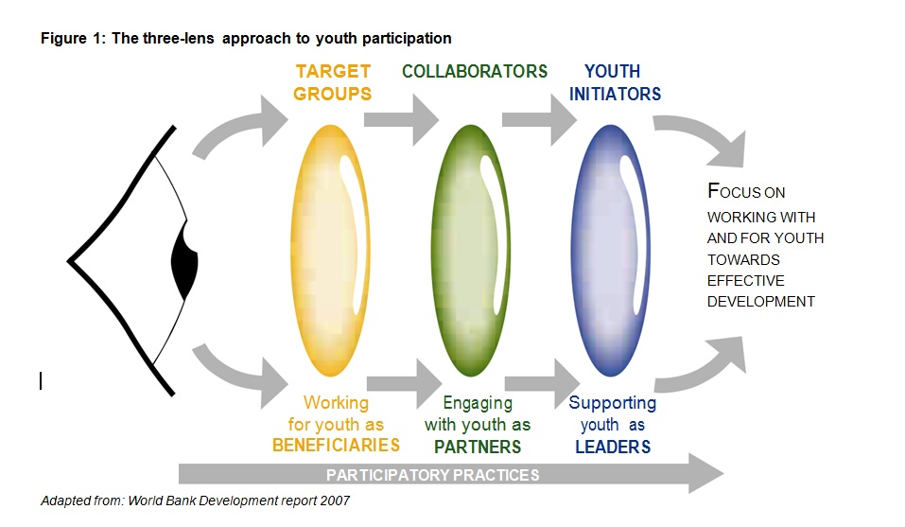

Slide 21
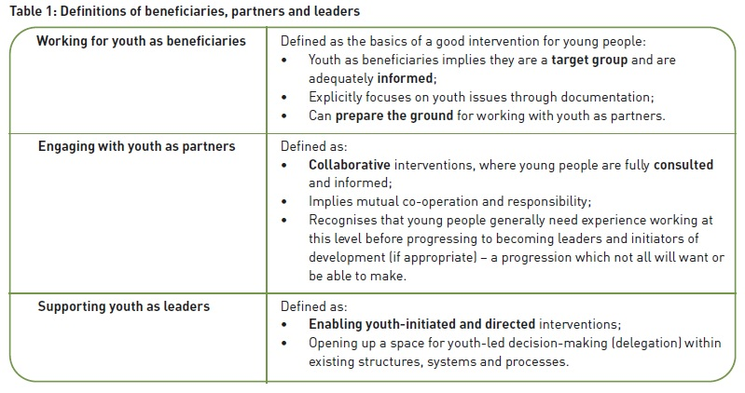

Slide 22
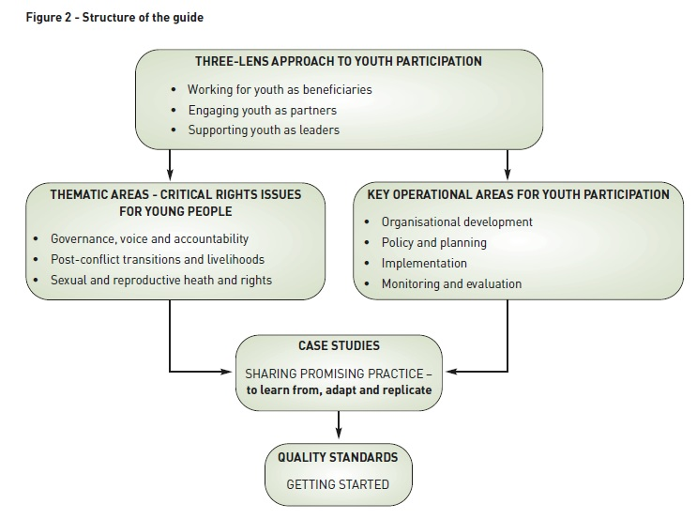
Managerial Decision process
Capacity building in civil society

Slide 23
1.7. Obstacles to Youth Participation
There are obstacles in developmental processes:
    Poor education an training – Analytical skills for critical thinking for decision making
    Weak infrastructure - Lacking direct access to institutional systems and structures within government
    Inequality and exclusion - Youths are socially excluded within the youth sector
    Cost effectiveness – Youth are more expensive to maintain than adult.

Slide 24
Overcoming Obstacles
As a starting point, government should always consider using international and national frameworks which ensure the rights of young people to participate in development as a mechanism to overcome the inherent obstacles (fig. 4).
Many of the obstacles can be overcome by challenging the perceptions and values of colleagues, key stakeholders, and gatekeepers for youth.

Slide 25
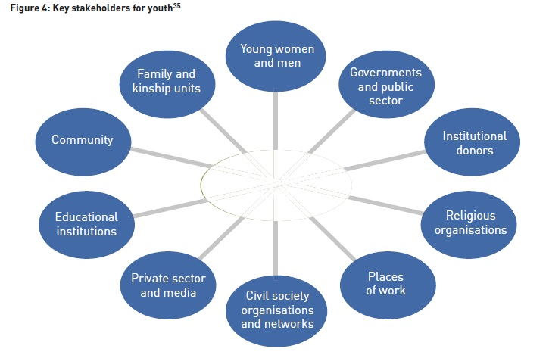
Perceptions and Values

Slide 26
1.8. Conclusion
It is crucial that we engage the young decision makers of tomorrow in the Developmental process of Niger-Delta region in order to effectively harness the potential of the region optimally.
The process of developing the relationship between the government and youths has stimulated considerable interest in the Niger-Delta regions.
We hope that the sharing and learning networks will continue until we get to the desires destination.
It makes them being the targets of outreach, to being actively engaged in the planning and implementation of development interventions.

Slide 27
THANK YOU FOR LISTENING!

